Slide 1
kathara lab
bgp: prefix-filtering with frr
Version | 2.1
Author(s) | G. Di Battista, M. Patrignani, M. Pizzonia, F. Ricci, M. Rimondini
E-mail | contact@kathara.org
Web | http://www.kathara.org/
Description | examples of filtering rules; kathara version of a netkit lab

Slide 2
copyright notice
All the pages/slides in this presentation, including but not limited to, images, photos, animations, videos, sounds, music, and text (hereby referred to as “material”) are protected by copyright.
This material, with the exception of some multimedia elements licensed by other organizations, is property of the authors and/or organizations appearing in the first slide.
This material, or its parts, can be reproduced and used for didactical purposes within universities and schools, provided that this happens for non-profit purposes.
Information contained in this material cannot be used within network design projects or other products of any kind.
Any other use is prohibited, unless explicitly authorized by the authors on the basis of an explicit agreement.
The authors assume no responsibility about this material and provide this material “as is”, with no implicit or explicit warranty about the correctness and completeness of its contents, which may be subject to changes.
This copyright notice must always be redistributed together with the material, or its portions.
kathara – [ lab: bgp-prefix-filtering_frr ]
last update: Oct 2021

Slide 3
preconditions
for this lab we assume you have chosen “kathara/frr” as the default image of your Kathará installation
  execute “kathara settings”
    select “choose default image”
    select “kathara/frr”
    exit from the settings procedure
kathara – [ lab: bgp-prefix-filtering_frr ]
last update: Oct 2021

Slide 4
applying policies
1 announcement filtering
  send/accept an announcement only if some condition is verified
  commands:
    prefix-list used to filter prefixes
    filter-list used to filter as numbers
2 announcement tuning
  attach to your announcement some information (attributes) that should be considered by the receiver
  commands:
    route-map
    access-list used to match prefixes or as-paths in a route-map
kathara – [ lab: bgp-prefix-filtering_frr ]
last update: Oct 2021

Slide 5
bgp prefix filtering
kathara – [ lab: bgp-prefix-filtering_frr ]
last update: Oct 2021

Slide 6
prefix filtering commands
command syntax
neighbor <neighbor-ip> prefix-list <p-list-name> in
command syntax
neighbor <neighbor-ip> prefix-list <p-list-name> out
command syntax
ip prefix-list <p-list-name> permit <network/mask>
command syntax
ip prefix-list <p-list-name> deny <network/mask>
kathara – [ lab: bgp-prefix-filtering_frr ]
last update: Oct 2021

Slide 7
prefix filtering: example
frr configuration file
router bgp 1
! no bgp ebgp-requires-policy (not needed anymore)
neighbor 193.10.11.2 remote-as 2
neighbor 193.10.11.2 description Router 2 of AS2
!
network 195.11.14.0/24
network 195.11.15.0/24
neighbor 193.10.11.2 prefix-list partialIn in
neighbor 193.10.11.2 prefix-list partialOut out
!
ip prefix-list partialOut seq 5 permit 195.11.14.0/24
ip prefix-list partialIn seq 5 deny 200.1.1.0/24
ip prefix-list partialIn seq 10 permit any
only 195.11.14.0/24 is announced to neighbor 193.10.11.2
all with the exception of 200.1.1.0/24 is accepted from 193.10.11.2
kathara – [ lab: bgp-prefix-filtering_frr ]
last update: Oct 2021

Slide 8

about prefix-lists
prefix-list entries are ordered according to a sequence number
  explicitly assigned by the user; example:
    ip prefix-list myPfxList seq 5 permit 10.0.0.0/8
  implicitly assigned by frr; example:
    ip prefix-list myPfxList permit 10.0.0.0/8
    ip prefix-list myPfxList permit 20.0.0.0/8
    is automatically turned to:
    ip prefix-list myPfxList seq 5 permit 10.0.0.0/8
    ip prefix-list myPfxList seq 10 permit 20.0.0.0/8
kathara – [ lab: bgp-prefix-filtering_frr ]
last update: Oct 2021

Slide 9
about prefix-lists
the first matching entry is applied; example:
  ip prefix-list letThru permit 10.0.0.0/8
  ip prefix-list letThru deny any
  accepts 10.0.0.0/8 only
  ip prefix-list throwAway deny any
  ip prefix-list throwAway permit 10.0.0.0/8
  rejects everything
kathara – [ lab: bgp-prefix-filtering_frr ]
last update: Oct 2021

Slide 10
prefix-list defaults
in frr, prefix-lists default to deny; for example:
  ip prefix-list myPrefixList permit 10.0.0.0/8
  filters out everything but 10.0.0.0/8
  ip prefix-list myPrefixList deny 10.0.0.0/8
  filters out everything
referencing an undefined prefix-list in a neighbor statement is equivalent to denying anything; for example:
  neighbor 10.0.0.1 prefix-list undefinedPrefixList in
  filters out everything if undefinedPrefixList is not defined
kathara – [ lab: bgp-prefix-filtering_frr ]
last update: Oct 2021

Slide 11
prefix filtering
AS1
195.11.14.0/24
B
1
eth1
1
eth2
router 1
1
200.1.2.0/24
195.11.15.0/24
C
eth0
A
AS2
2
193.10.11.0/24
eth0
router 2
1
eth2
1
eth1
E
200.1.1.0/24
D
kathara – [ lab: bgp-prefix-filtering_frr ]
last update: Oct 2021

Slide 12
prefix filtering
start the lab
check the frr configuration file
check the frr log file
host machine
user@localhost:~$ cd kathara-lab_bgp-prefix-filtering_frr
user@localhost:~/kathara-lab_bgp-prefix-filtering_frr$ kathara lstart
router1
router1:~# less /etc/frr/frr.conf
router1
router1:~# less /var/log/frr/frr.log
kathara – [ lab: bgp-prefix-filtering_frr ]
last update: Oct 2021

Slide 13
prefix filtering
© Computer Networks Research Group Roma Tre
check the routing table
router1
root@router1:/# route
Kernel IP routing table
Destination Gateway Genmask Flags Metric Ref Use Iface
193.10.11.0 0.0.0.0 255.255.255.0 U 0 0 0 eth0
195.11.14.0 0.0.0.0 255.255.255.0 U 0 0 0 eth1
195.11.15.0 0.0.0.0 255.255.255.0 U 0 0 0 eth2
200.1.2.0 193.10.11.2 255.255.255.0 UG 20 0 0 eth0
root@router1:/# vtysh
Hello, this is FRRouting (version 7.5.1).
Copyright 1996-2005 Kunihiro Ishiguro, et al.
router1-frr# show ip route
Codes: K - kernel route, C - connected, S - static, R - RIP,
O - OSPF, I - IS-IS, B - BGP, E - EIGRP, N - NHRP,
T - Table, v - VNC, V - VNC-Direct, A - Babel, D - SHARP,
F - PBR, f - OpenFabric,
> - selected route, * - FIB route, q - queued, r - rejected, b - backup
C>* 193.10.11.0/24 is directly connected, eth0, 00:08:56
C>* 195.11.14.0/24 is directly connected, eth1, 00:08:56
C>* 195.11.15.0/24 is directly connected, eth2, 00:08:56
B>* 200.1.2.0/24 [20/0] via 193.10.11.2, eth0, weight 1, 00:08:54
router1-frr#
kathara – [ lab: bgp-prefix-filtering_frr ]
kathara – [ lab: bgp-prefix-filtering ]
last update: Oct 2021
last update: Nov 2018

Slide 14
prefix filtering
check the frr cli (command line interface)
router1
router1-frr# show ip bgp neighbors
BGP neighbor is 193.10.11.2, remote AS 2, local AS 1, external link
Description: Router 2 of AS2
Hostname: router2
BGP version 4, remote router ID 200.1.2.1,
local router ID 195.11.15.1
BGP state = Established, up for 00:11:36
Last read 00:00:36, Last write 00:00:36
Hold time is 180, keepalive interval is 60 seconds
Neighbor capabilities:
4 Byte AS: advertised and received
AddPath:
IPv4 Unicast: RX advertised IPv4 Unicast and received
Route refresh: advertised and received(old & new)
Address Family IPv4 Unicast: advertised and received
...
...
router1-frr# show ip bgp 200.1.1.0
% Network not in table
router1-frr#
kathara – [ lab: bgp-prefix-filtering_frr ]
last update: Oct 2021

Slide 15
prefix filtering
terminate the lab
host machine
user@localhost:~/kathara-lab_bgp-prefix-filtering_frr$ kathara lclean
kathara – [ lab: bgp-prefix-filtering_frr ]
last update: Oct 2021

Slide 16
bgp attributes

Slide 17
attributes
a bgp announcement is a “bag” of attributes
attributes may be
  “well-known” or optional
    well-known attributes are understood by any bgp4 speaker
  mandatory or discretionary
    mandatory attributes must be present in updates
  transitive or nontransitive
    transitive attributes are passed when received
    nontransitive attributes traverse a single peering
kathara – [ lab: bgp-prefix-filtering_frr ]
last update: Oct 2021

Slide 18
attribute list
prefix
  the section of ip space announced
as-path
  the sequence of traversed ases
origin
  igp (route is interior to the originating as)
  egp (route learned via the egp protocol)
  incomplete (route learned in some other way)
next-hop
  to be inserted in the routing table
metric (multi-exit-discriminator)
  asking another as to prefer lower values of it
local-pref
  prefer higher values
atomic aggregate
aggregator
weight
  cisco proprietary
kathara – [ lab: bgp-prefix-filtering_frr ]
last update: Oct 2021

Slide 19
well-known attributes
mandatory well-known
  as-path: the sequence of traversed ASes
  next-hop: to be inserted in the routing table; in i-bgp stays unchanged
  origin
discretionary well-known
  local preference: asking i-bgp peers to prefer higher values of it
  atomic aggregate
kathara – [ lab: bgp-prefix-filtering_frr ]
last update: Oct 2021

Slide 20
optional attributes
non transitive optional
  multi-exit discriminator: asking other ASes to prefer lower values of it
transitive optional
  aggregator
  community
kathara – [ lab: bgp-prefix-filtering_frr ]
last update: Oct 2021

Slide 21

attributes: prefix & as-path
as40
as31
193.204.161.0/24
193.204.161.0/24
40 100
193.204.161.0/24
193.204.161.0/24
100
31 40 100
as100
as60
193.204.161.0/24
193.204.161.0/24
212 60 31 40 100
60 31 40 100
193.204.161.0/24
100
as212
legenda:
prefix
as-path
kathara – [ lab: bgp-prefix-filtering_frr ]
last update: Oct 2021

Slide 22
attributes: as-path
the as-path is empty when a local route is inserted into the BGP table
when the announcement goes to a different as (e-BGP) the as number is inserted at the end of the as-path (prepending)
  a router knows which and how many ases should be traversed to reach the destination
  loops are avoided
  policies can be applied
in i-BGP the as-path does not change
kathara – [ lab: bgp-prefix-filtering_frr ]
last update: Oct 2021

Slide 23
attributes: nexthop
where to send packets for a specific ip network
usually, the nexthop is the router that sends the announcements
  exceptions:
    “shared media” (ethernet, etc..)
    i-BGP announcements of networks learned using e-BGP
kathara – [ lab: bgp-prefix-filtering_frr ]
last update: Oct 2021

Slide 24
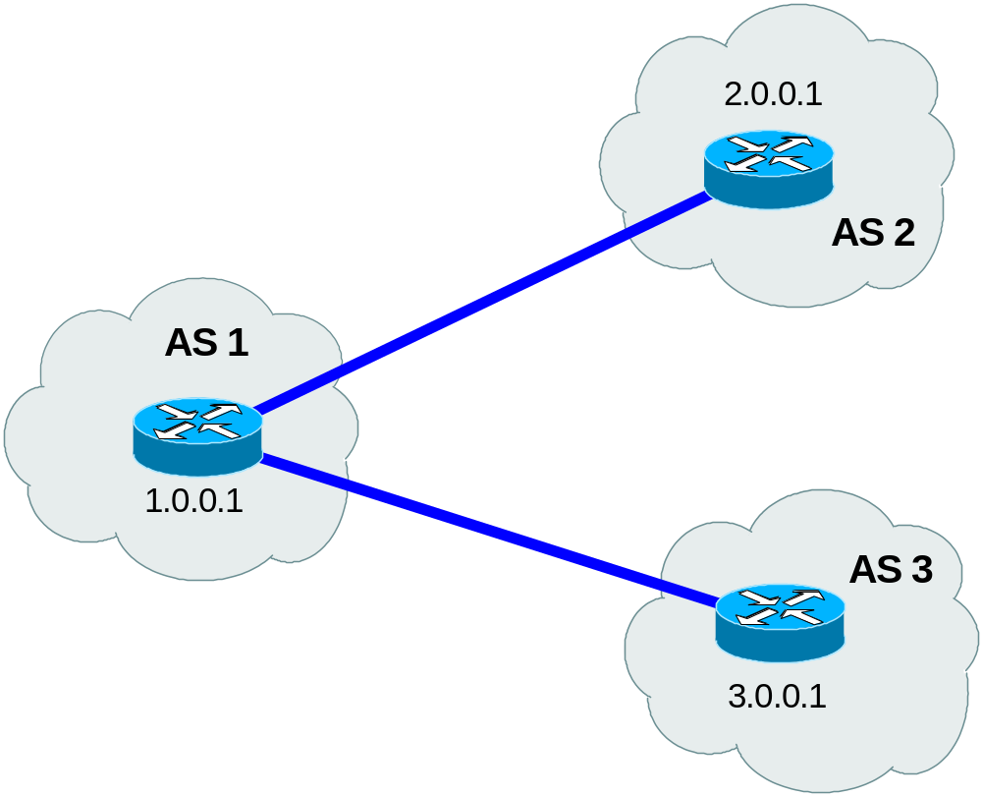
attributes: nexthop
as 2 router sends an announcement to as 1 specifying 2.0.0.1 as the nexthop
Network=10.0.0.0/8
AS-path=2
Nexthop=2.0.0.1
kathara – [ lab: bgp-prefix-filtering_frr ]
last update: Oct 2021

Slide 25
attributes: nexthop
as 1 router changes the nexthop
Network=10.0.0.0/8
AS-path=1 2
Nexthop=1.0.0.1
kathara – [ lab: bgp-prefix-filtering_frr ]
last update: Oct 2021

Slide 26
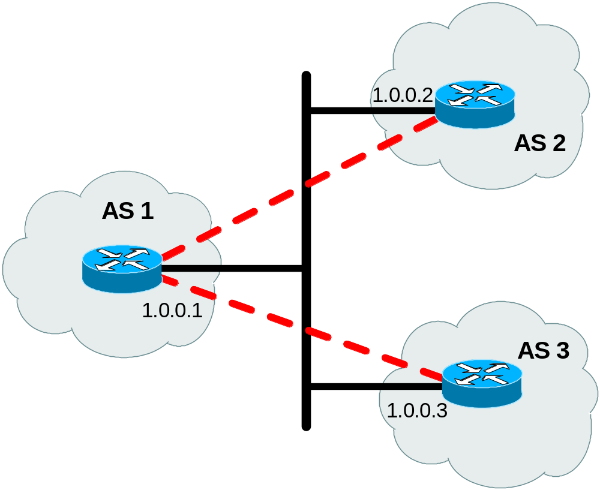
attributes: nexthop
shared segment: nexthop stays unchanged
  routing optimization
Network=10.0.0.0/8
AS-path=2
Nexthop=1.0.0.2
Network=10.0.0.0/8
AS-path=1 2
Nexthop=1.0.0.2
kathara – [ lab: bgp-prefix-filtering_frr ]
last update: Oct 2021
Notes:
400-impianti-bgp-protocollo-lab-19
In questo caso ovvero quando il router verso il quale si deve propagare un annuncio, si trova sulla stessa rete del nexthop dell’annuncio, si preferisce non modificare il nexthop.
In questo modo si ottimizza il routing in quanto i pacchetti destinati alla rete 10.0.0.0 vengono subito indirizzati verso l’AS 2 invece di essere indirizzati all’AS 1 e poi da li essere rimbalzati verso l’AS 2

Slide 27
attributes: nexthop
if a route learned from e-BGP is propagated using i-BGP, then the nexthop remains the same
  nexthop equal to the address of the remote peer
internal routers perform a “recursive lookup” for understanding how to reach the nexthop
  the routers should know, via igp, how to reach the nexthop
kathara – [ lab: bgp-prefix-filtering_frr ]
last update: Oct 2021
Notes:
400-impianti-bgp-protocollo-lab-19
Il nexthop rimane invariato quando si tratta di peering interni mentre viene modificato con l’indirizzo dell’interfaccia di uscita quando viene propagato verso altri AS.
Questo vuol dire che tutti i router interni all’AS per poter raggiungere la network specificata nell’annuncio devono effettuare un recursive lookup per capire come raggiungere il nexthop (visto che non gli è direttamente connesso). E’ quindi importante che le informazioni di raggiungibilità dei nexthop siano presenti in tabella di routing e per poter soddisfare questa condizione è necessario annunciare in IGP le rotte statiche.
Per evitare di mantenere l’indirizzo del nexthop originario possiamo specificare per i peering interni la direttiva next-hop self. In questo modo il router modificherà il nexthop specificando il proprio indirizzo IP.

Slide 28
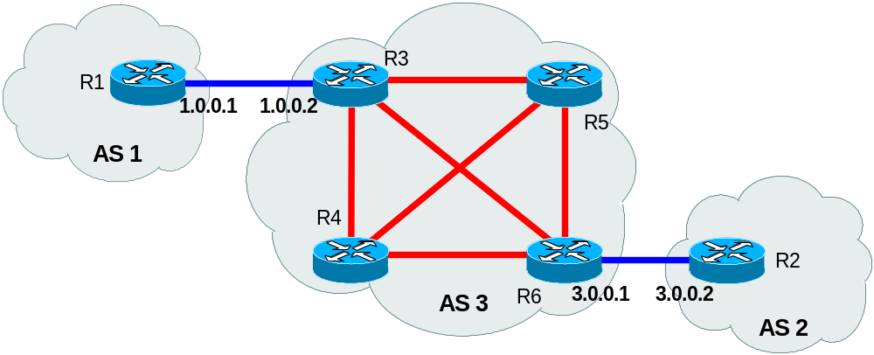
attributes: nexthop
R1 announces network X with nexthop 1.0.0.1
X (1.0.0.1)
kathara – [ lab: bgp-prefix-filtering_frr ]
last update: Oct 2021

Slide 29
attributes: nexthop
the announcement is propagated with i-BGP to R4, R5, and R6
  the nexthop is unchanged
X (1.0.0.1)
X (1.0.0.1)
X (1.0.0.1)
kathara – [ lab: bgp-prefix-filtering_frr ]
last update: Oct 2021
Notes:
400-impianti-bgp-protocollo-lab-19
R4, R5 e R6 sanno che per raggiungere la rete X devono utilizzare come nexthop l’indirizzo IP 1.0.0.1 e quindi devono sapere come raggiungerlo. Per questo motivo fanno un recursive lookup nella tabella di routing per capire qual è il nexthop necessario per raggiungere l’1.0.0.1 e si accorgono che il nexthop è proprio il router R3. A questo punto le cose procedono normalmente con il normale ARP (se non si dispone dell’indirizzo fisico) e la successiva trasmissione del pacchetto verso R3

Slide 30
attributes: nexthop
the nexthop changes when the announcement goes to a different as
X (3.0.0.1)
kathara – [ lab: bgp-prefix-filtering_frr ]
last update: Oct 2021
Notes:
400-impianti-bgp-protocollo-lab-19
Il nexthop rimane invariato quando si tratta di peering interni mentre viene modificato con l’indirizzo dell’interfaccia di uscita quando viene propagato verso altri AS.
Questo vuol dire che tutti i router interni all’AS per poter raggiungere la network specificata nell’annuncio devono effettuare un recursive lookup per capire come raggiungere il nexthop (visto che non gli è direttamente connesso). E’ quindi importante che le informazioni di raggiungibilità dei nexthop siano presenti in tabella di routing e per poter soddisfare questa condizione è necessario annunciare in IGP le rotte statiche.
Per evitare di mantenere l’indirizzo del nexthop originario possiamo specificare per i peering interni la direttiva next-hop self. In questo modo il router modificherà il nexthop specificando il proprio indirizzo IP.

Slide 31
attributes: origin
igp
  declared as internal by the starting AS: “network” command
egp
  injected into BGP by EGP: backward compatibility
incomplete
  generated redistributing an igp protocol
kathara – [ lab: bgp-prefix-filtering_frr ]
last update: Oct 2021

Slide 32
attributes: aggregator
conveys the IP address of the router or BGP speaker generating the aggregate route
  useful for debugging purposes
kathara – [ lab: bgp-prefix-filtering_frr ]
last update: Oct 2021
Notes:
400-impianti-bgp-protocollo-lab-19

Slide 33
selection of the “best route” to a prefix
each router, for each prefix, chooses one of the received announcements as the “best”
the decision process is fully deterministic
  no random choice is applied
only the best routes are (possibly) announced to peers
selection criteria:
  more specific and less specific prefixes are considered different prefixes
    both are injected into the routing table
  if the next-hop is not reachable (it does not match a line of the routing table of the router) the announcement can not be selected
  the selection is based both on the values of the attributes and on the constraints imposed by the administrator (e.g. weight)
kathara – [ lab: bgp-prefix-filtering_frr ]
last update: Oct 2021

Slide 34
bgp decision process (at a router)
for each network prefix, select the route with:
highest
priority
1. largest weight (cisco proprietary)
2. largest local preference
3. locally originated (by the router itself)
4. shortest as-path length
5. lowest origin (igp<egp<incomplete)
6. lowest multi-exit-discriminator
(only comparable for the same neighboring as)
7. prefer ebgp over ibgp (hot potato routing)
8. lowest igp metric (to next-hop)
9. lowest router-id (of announcing peer)
lowest
priority
kathara – [ lab: bgp-prefix-filtering_frr ]
last update: Oct 2021

Slide 35
BGP decision process and architecture
AS1
AS1
AS4
Routing
Table
Input
Policy
Engine
Decision
Process
Output
Policy
Engine
AS2
AS5
kathara – [ lab: bgp-prefix-filtering_frr ]
last update: Oct 2021
Notes:
400-impianti-bgp-protocollo-lab-19

Slide 36
as-path filtering
kathara – [ lab: bgp-prefix-filtering_frr ]
last update: Oct 2021

Slide 37
as-path filtering commands
command syntax
neighbor <neighbor-ip> filter-list <acl-name> in
command syntax
neighbor <neighbor-ip> filter-list <acl-name> out
command syntax
bgp as-path access-list <acl-name> permit <regexp>
command syntax
bgp as-path access-list <acl-name> deny <regexp>
kathara – [ lab: bgp-prefix-filtering_frr ]
last update: Oct 2021

Slide 38
as-path filtering commands
regexp may contain the following characters:
. | matches any single character
\ | escapes special characters
[] | matches a range of characters
^ | matches the beginning of a string
$ | matches the end of a string
? | matches zero or one occurrence of a pattern
* | matches zero or more occurrences of a pattern
+ | matches one or more occurrences of a pattern
() | groups characters to form a pattern
| | matches one of the patterns on either side
_ | a shortcut for [,{} ]|^|$
kathara – [ lab: bgp-prefix-filtering_frr ]
last update: Oct 2021

Slide 39
as-path filtering example
frr configuration file
router bgp 100
network 100.1.1.0/24
neighbor 222.2.2.2 remote-as 200
neighbor 222.2.2.2 filter-list myACL in
!
bgp as-path access-list myACL permit ^200_300
accept from as 200 only the routes received via as 300
kathara – [ lab: bgp-prefix-filtering_frr ]
last update: Oct 2021

Slide 40
announcement tuning
kathara – [ lab: bgp-prefix-filtering_frr ]
last update: Oct 2021

Slide 41
attribute setting commands
command syntax
neighbor <neighbor-ip> route-map <r-map-name> in
command syntax
neighbor <neighbor-ip> route-map <r-map-name> out
command syntax
route-map <r-map-name> permit <seq-number>
match <announce-property>
set <attribute-setting>
...
command syntax
route-map <r-map-name> deny <seq-number>
match <announce-property>
set <attribute-setting>
...
kathara – [ lab: bgp-prefix-filtering_frr ]
last update: Oct 2021

Slide 42
about route-maps
route-maps may consist of multiple statements
  statements are processed in the order established by sequence numbers
  for each received/sent announcement, only one statement is applied
    the first one without a match condition
    the first one that matches the announcement attributes (prefix, as-path, etc.)
  announcements that are not matched by any statement, or that are matched by a deny statement are simply filtered out
    set commands in a route-map deny are useless
referencing an undefined route-map in a neighbor statement results in filtering out everything
kathara – [ lab: bgp-prefix-filtering_frr ]
last update: Oct 2021

Slide 43
all match commands
match as-path
match community
match extcommunity
match ip address
match ip next-hop
match ipv6 address
match metric
match origin
kathara – [ lab: bgp-prefix-filtering_frr ]
last update: Oct 2021

Slide 44
all set commands
set aggregator as
set as-path prepend
set atomic-aggregate
set comm-list
set community
set extcommunity
set ip next-hop
set ipv6 next-hop
set local-preference
set metric
set origin
set originator-id
set weight
kathara – [ lab: bgp-prefix-filtering_frr ]
last update: Oct 2021

Slide 45
address match conditions
match ip address can be used in conjunction with access-lists or prefix-lists
command syntax
match ip address <acl-name>
command syntax
match ip address prefix-list <prefix-list-name>
command syntax
access-list <acl-name> permit <network/mask>
command syntax
access-list <acl-name> deny <network/mask>
kathara – [ lab: bgp-prefix-filtering_frr ]
last update: Oct 2021

Slide 46
about access-lists
an alternative construction to filter prefixes
the as-path access-list variant allows to filter based on as-paths
access-lists are identified by a name or an integer
  the integer determines the type of filtering applied
    1-99: standard access list (filter from specific IPs)
    100-199: extended access list (filter by protocol and/or source/destination IP)
kathara – [ lab: bgp-prefix-filtering_frr ]
last update: Oct 2021

Slide 47
about access-lists
no sequence numbers, still the first matching entry applies; example:
  access-list permissiveAcl permit any
  access-list permissiveAcl deny any
  allows everything
  access-list restrictiveAcl deny any
  access-list restrictiveAcl permit any
  discards everything
same for as-path access-lists; example:
  ip as-path access-list noWay deny .*
  ip as-path access-list noWay permit ^100_200
  discards everything
kathara – [ lab: bgp-prefix-filtering_frr ]
last update: Oct 2021

Slide 48

access-list defaults
in frr, access-lists default to deny
by default, access-lists match a prefix as well as all its more specifics; for example:
  access-list myList permit 193.100.0.0/16
  also matches 193.100.5.0/24, 193.100.192.0/25, etc.
  access-list permissiveList permit 0.0.0.0/0
  matches everything(!)
this behavior can be changed by using
exact-match
referencing an undefined access-list (e.g., in a filter-list statement) results in filtering out everything
kathara – [ lab: bgp-prefix-filtering_frr ]
last update: Oct 2021

Slide 49
attribute setting example
frr configuration file
router bgp 100
network 100.1.1.0/24
neighbor 222.2.2.2 remote-as 200
neighbor 222.2.2.2 route-map myRouteMap in
!
route-map myRouteMap permit 10
match ip address myAccessList
set metric 5
set local-preference 25
!
route-map myRouteMap permit 20
set metric 2
!
access-list myAccessList permit 193.204.0.0/16
kathara – [ lab: bgp-prefix-filtering_frr ]
last update: Oct 2021

