Slide 1
Kathará
A container-based framework for experimenting computer networking
Version | 2.1
Author(s) | L. Ariemma, G. Bonofiglio, G. Di Battista, V. Iovinella, G. Lospoto, M. Patrignani, M. Pizzonia, M. Rimondini
E-mail | contact@kathara.org
Web | https://www.kathara.org/
Description | An introduction to the architecture, setup and usage of Kathará – based on a similar presentation of Netkit

Slide 2
Copyright notice
All the pages/slides in this presentation, including but not limited to, images, photos, animations, videos, sounds, music, and text (hereby referred to as “material”) are protected by copyright.
This material, with the exception of some multimedia elements licensed by other organizations, is property of the authors and/or organizations appearing in the first slide.
This material, or its parts, can be reproduced and used for didactical purposes within universities and schools, provided that this happens for non-profit purposes.
Information contained in this material cannot be used within network design projects or other products of any kind.
Any other use is prohibited, unless explicitly authorized by the authors on the basis of an explicit agreement.
The authors assume no responsibility about this material and provide this material “as is”, with no implicit or explicit warranty about the correctness and completeness of its contents, which may be subject to changes.
This copyright notice must always be redistributed together with the material, or its portions.

Slide 3
About computer networks
Computer networks are quite complex
Several devices (computers, routers, etc.)
Several interfaces
Several protocols running
Physical interconnections originate complex topologies

Slide 4
Example of a computer network
P2
D1
W1
A:2
.44
C:33
.33
C:55
.55
Internet
100.0.0.0/24
100.0.2.0/24
.1
0:1
.1
0:7
router-A
.1
.2
.1
.2
0:3
0:4
router-B
0:6
0:8
router-C
100.0.1.0/24
0:2
.1
10.10.10.0/30
0:5
.1
10.10.20.0/30
100.0.3.0/24
C:11
.11
C:22
.22
C:77
.77
P1
W2
D2

Slide 5
How to perform experiments?
Performing experiments may be unfeasible
A live network cannot be exploited for experiments
It hosts services that are critical for the company
It would be necessary to coordinate different departments of the company
Network equipment is expensive
Sometimes, even for performing simple experiments, several equipment should be available in the same test bed

Slide 6
Simulation vs. emulation
Emulation and simulation systems put at user’s disposal a virtual environment that can be exploited for tests, experiments, measures
Simulation systems aim at reproducing the performance of a real-life system (latency time, packet loss, etc.)
e.g.: ns, real, …
Emulation systems aim at accurately reproducing the functionalities of a real-life system (configurations, architectures, protocols), with limited attention to performance

Slide 7
Kathará
a system for emulating computer networks

Slide 8
Emulating a network
Basic idea:
several containers are created inside a single host machine
containers are connected to virtual collision domains and thus can communicate with each other
Each container can be configured as a device that plays the role of a regular host, of a router, of a switch, ….

Slide 9
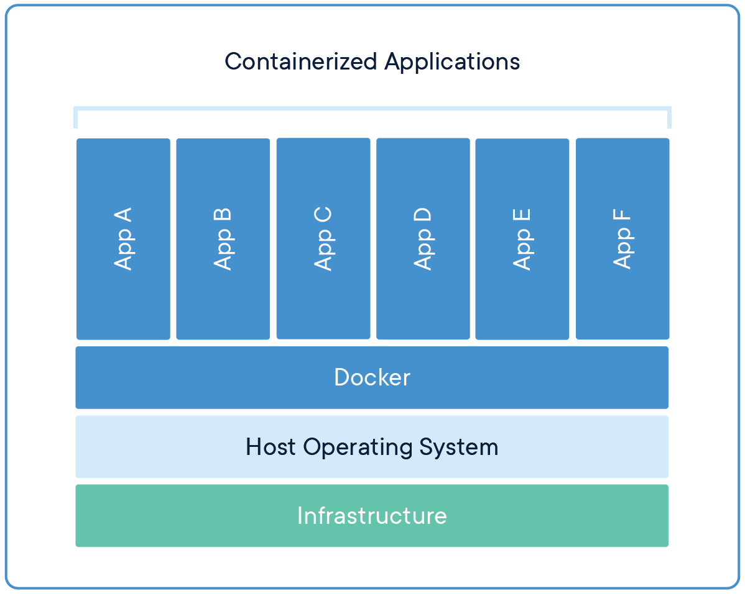
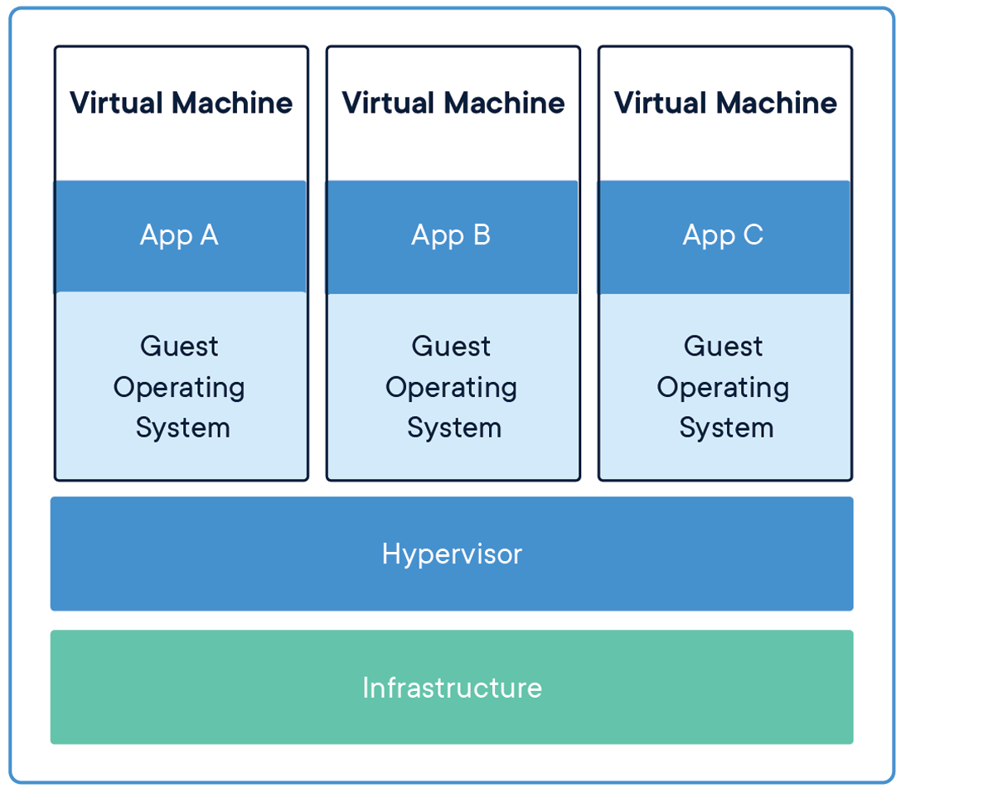
Docker and containers
A container is a standard unit of software that packages up code and all its dependencies, so the application runs quickly and reliably from one computing environment to another.
https://www.docker.com/resources/what-container

Slide 10
Kathará
Based on Docker
Each emulated network device (in what follows device) is a container
Note: several container images available, e.g.:
Base (DNS, Web Server, network utilities)
Quagga (standard routing protocols)
FRRouting (standard routing protocols + EVPN + MPLS)
Open vSwitch (Open Flow enabled switch)
Behavioral Model (software implementation of a P4 switch)

Slide 11
Emulated network devices
Each device has:
A console (a terminal window)
A memory
A filesystem
(zero, one or more) network interfaces
Each network interface is connected to a single (virtual) collision domain
Each virtual collision domain can be connected to several interfaces

Slide 12

host machine
pc1
user@host$ █
collision
domain A
root@pc1:~$ █
root@pc3:~$ █
pc3
collision
domain B
pc2
root@pc2:~$ █
host machine
console

Slide 13
Setting up Kathará
Setup manual

Slide 14
Installing Kathará
Available for:
Windows
Linux
MacOS
Download at https://www.kathara.org/
Follow the wiki

Slide 15
Changing the default Docker Image
Run kathara settings
Select Choose default image by pressing 2
Select kathara/frr by pressing 2
Confirm and exit

Slide 16
Using Kathará

Slide 17
Kathará commands
Kathará provides users with three sets of commands
v-prefixed commands (v-commands)
l-prefixed commands (l-commands)
Global commands
v-commands act as low-level tools for configuring and starting up a single device
l-commands provide an easier-to-use environment to set up complex labs consisting of several devices
Global commands are mainly management commands

Slide 18
Kathará v-commands
Allow to startup a single device with arbitrary configurations (network interfaces, etc.)
vstart: starts a new device
vconfig: attaches network interfaces to a running device
vclean: halts a device

Slide 19
Kathará l-commands
Ease setting up complex labs consisting of several virtual machines
lstart: starts a Kathará lab
lclean: halts all the devices of a lab
lconfig: manage the network interface of a running lab
lrestart: halts all the devices of a lab and start them again
linfo: provides information about a lab

Slide 20
Kathará global commands
Management commands
check: Check your system environment
connect: Connect to a running Kathará machine
list: Show all running Kathará machines of the current user
settings: Show and edit Kathará settings
wipe: Delete all Kathará machines and links, optionally also delete settings

Slide 21
Testing Kathará

Slide 22
Testing Kathará
To test if your setup works correctly run:
kathara check
This command will ran automatic tests to your environment
kathara vstart -n pc1 --eth 0:A
This command will start a new device called pc1 and connected to the virtual collision domain A
A terminal window will open allowing to run commands inside the device
kathara vclean -n pc1
This command will stop the previous started device

Slide 23
Preparing a Kathará lab

Slide 24
Kathará lab
a Kathará lab is a set of preconfigured devices that can be started and halted together
a basic Kathará lab is a directory tree containing:
a lab.conf file describing the network topology
a set of subdirectories that contain the configuration settings for each device
<device_name>.startup files that describe actions performed by devices when they are started

Slide 25
lab.conf
describes:
The topology of the network that interconnects the lab’s devices
The devices to be started
contain a list of machine[arg]=value lines where:
machine is the name of the device (e.g. pc1)
if arg is a number, then value is the name of a collision domain to which etharg should be attached
if arg is not a number, then it must be an option and value the argument

Slide 26
lab.conf
example
eth0
pc1
pc1[0]=A
pc2[0]=A
pc2[1]=B
pc3[0]=B
collision domain A
eth0
pc2
eth1
collision domain B
eth0
pc3

Slide 27
Share files between the host and the devices
There are two ways to share files between the host filesystem and the device filesystem:
Share files mirrored to the device
A change inside the device will reflect in the host filesystem
A change in the host filesystem will reflect in the device
Share files copied to the device
Two independent copies of the same files

Slide 28
Share files mirrored to the device
There are two ways to share mirrored files:
the /shared directory inside a device directly points to the shared directory inside the lab
by default it is ENABLED, you can disable it in the settings
the /hosthome directory inside a device directly points to the home directory of the current user of the host
by default it is DISABLED, you can enable it in the settings

Slide 29
Share files copied to the device
Can be done through the subdirectories of a lab
The contents of subdirectory device are copied into the root (/) of the device named device filesystem
for example, pc1/foo/file.txt is copied to /foo/file.txt inside the device pc1

Slide 30
.startup files
Shell scripts that are executed inside a device right after its startup
Typical usage of a .startup file is to configure network interfaces and/or start network services
For example:
ip address add 10.0.0.1/24 dev eth0
systemctl start frr

Slide 31
Launching/halting a lab
Open a terminal
Enter the lab directory (cd lab_directory)
Launch a Kathará l-command
Where l-command could be one of the following
kathara lstart, to start the lab
kathara lclean, to stop the lab
kathara lrestart, to restart the lab

Slide 32
More information
Further information can be found:
On GitHub’s Kathará wiki
On the official website https://www.kathara.org
Inside Kathará man pages
On Linux and MacOS accessible by the terminal man kathara
Available online at https://www.kathara.org/man-pages/kathara.1.html

