Slide 1
IoT
PREPARED BY,
S.BABITHA,AP,
IT,HITS

Slide 2
IOT
The Internet of Things (IoT) refers to a vast network of physical objects, or "things," that are embedded with sensors, software, and other technologies, enabling them to connect and exchange data with other devices and systems over the internet.
Essentially, it's the concept of connecting everyday objects to the internet and to each other, allowing them to collect and share data.

Slide 3
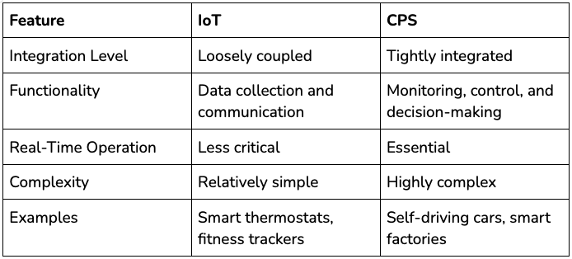
COMPARISON BETWEEN IoT AND CPS

Slide 4
KEY CONCEPTS
Interconnected Devices:
IoT involves a wide range of devices, from simple sensors to complex machines, that are connected to the internet.
Data Collection and Exchange:
These devices are equipped with sensors that collect data about their surroundings or their own status, and they can then transmit this data to other devices or systems.
Automation and Control:
The data collected by IoT devices can be used to automate tasks, control processes, and provide valuable insights for decision-making.

Slide 5
HOW IT WORKS
1. Sensors and Devices:
IoT devices have sensors that gather data about their environment or their own state.
2.Connectivity:
This data is transmitted over the internet or other networks using various communication protocols.
3. Data Processing:
The data is then processed and analyzed, often in the cloud, to extract meaningful information.
4. User Interface:
The processed data is presented to users through interfaces, such as dashboards or mobile apps, allowing them to monitor and control the devices.

Slide 6
EXAMPLES OF IoT IN ACTION:
Smart Homes:
Smart thermostats, lighting systems, and security systems that can be controlled remotely.
Industrial IoT (IIoT):
Connecting machinery and equipment in factories to monitor performance, predict maintenance needs, and optimize production processes.
Wearable Technology:
Smartwatches and fitness trackers that monitor health metrics and activity levels.
Smart Cities:
Utilizing sensors to monitor traffic flow, manage energy consumption, and improve public safety.
Agriculture:
Using sensors to monitor soil conditions, weather patterns, and crop growth.

Slide 7
BENEFITS OF IOT
Increased Efficiency:
Automating tasks and optimizing processes can lead to significant efficiency gains.
Improved Decision-Making:
Access to real-time data provides valuable insights for informed decision-making.
Enhanced Productivity:
By automating tasks and streamlining workflows, IoT can boost productivity.
New Business Models:
IoT enables businesses to create innovative products and services and develop new revenue streams.

Slide 8


