Slide 1
MEDICAL CPS
PREPARED BY,
S.BABITHA,AP,
IT,HITS.

Slide 2
DEFN
Medical Cyber-Physical Systems (Medical CPS) are integrated systems that combine medical devices, sensors, actuators, communication networks, software, and computing platforms to monitor, diagnose, and treat patients in real time. ➡ They bridge the physical (biological) world and the cyber (computing + network) world for advanced healthcare delivery.

Slide 3
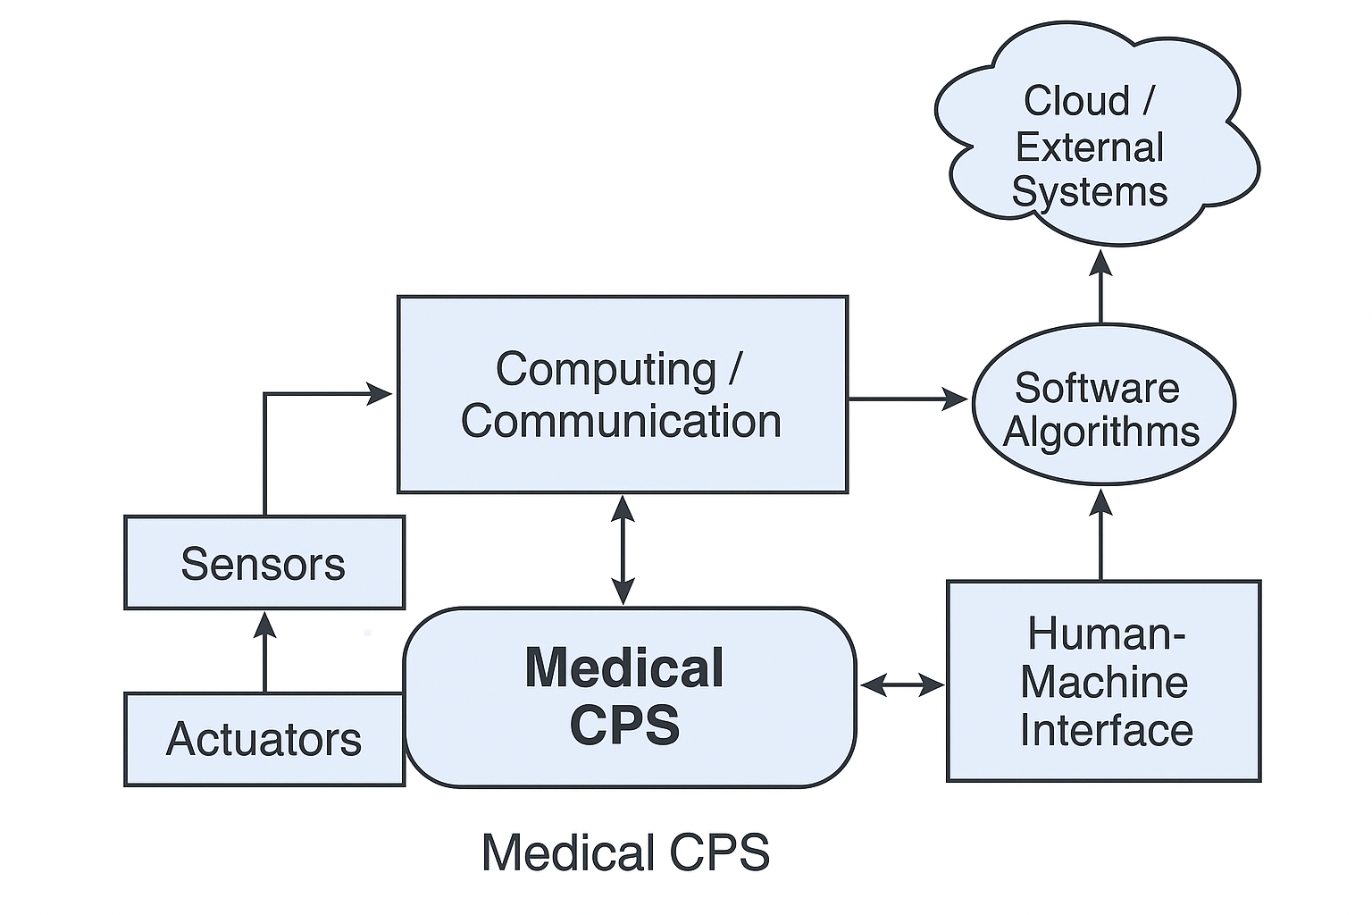

Slide 4
Key Components
Sensors: Measure physiological parameters (e.g., ECG, blood pressure, glucose levels, oxygen saturation).
Actuators: Administer treatment (e.g., insulin pumps, ventilators, drug delivery systems).
Communication networks: Enable data exchange (e.g., wired, wireless, Bluetooth, Wi-Fi, 5G).
Embedded computing: Process sensor data and make decisions (e.g., microcontrollers, edge computing devices).
Software algorithms: Analyze data for diagnostics, predictive alerts, and control.

Slide 5
Applications
Implantable and wearable medical devices — pacemakers, insulin pumps, smart prosthetics. ✅ Remote patient monitoring — continuous tracking of vital signs at home. ✅ Surgical robots — assist or perform precise procedures under doctor supervision. ✅ Smart hospital rooms — integrated monitoring, alarms, and environment control for patient safety. ✅ Emergency response systems — real-time data from ambulances to hospitals for rapid intervention.

Slide 6
Benefits
Improved patient safety and outcomes — real-time monitoring and timely interventions.
Personalized treatment — therapy adjusted based on individual patient data.
Reduced hospital visits — via remote monitoring and telemedicine.
Efficient use of resources — smarter allocation of healthcare staff and equipment.

Slide 7
Challenges
Cybersecurity risks — medical CPS devices are vulnerable to hacking, which can endanger patients.
Interoperability issues — integration of devices from different manufacturers can be complex.
Real-time reliability — systems must function with high precision and minimal delay to ensure safety.
Regulatory compliance — strict standards for safety, data privacy (e.g., HIPAA, GDPR).

Slide 8
Examples
Artificial pancreas systems for diabetes management.
Smart inhalers for asthma patients with usage tracking.
Robotic surgical assistants like da Vinci Surgical System.
Wireless vital signs monitors in ICUs.

Slide 9


