Slide 1
Fielding a public opinion survey on Prolific in the UK
Ana, Dominik, Judah, Katharina

Slide 2
Our approach
Qualtrics survey (3-4min)
Fielded on Prolific UK
Exclusions: UK-based, UK nationals, over the age of 18
Payment: £0.5, in line with Prolific recommendations on fair payment
Budget: £35
Target N: 50
Qualtrics

Slide 3
Questionnaire
Benchmark: BES 2019 Face to Face Random Probability Survey
Demographic questions:
Gender, age, ethnicity, UK country, education
Outcome questions:
Political knowledge battery
Turnout, Vote choice in 2019 election
Partisanship

Slide 4
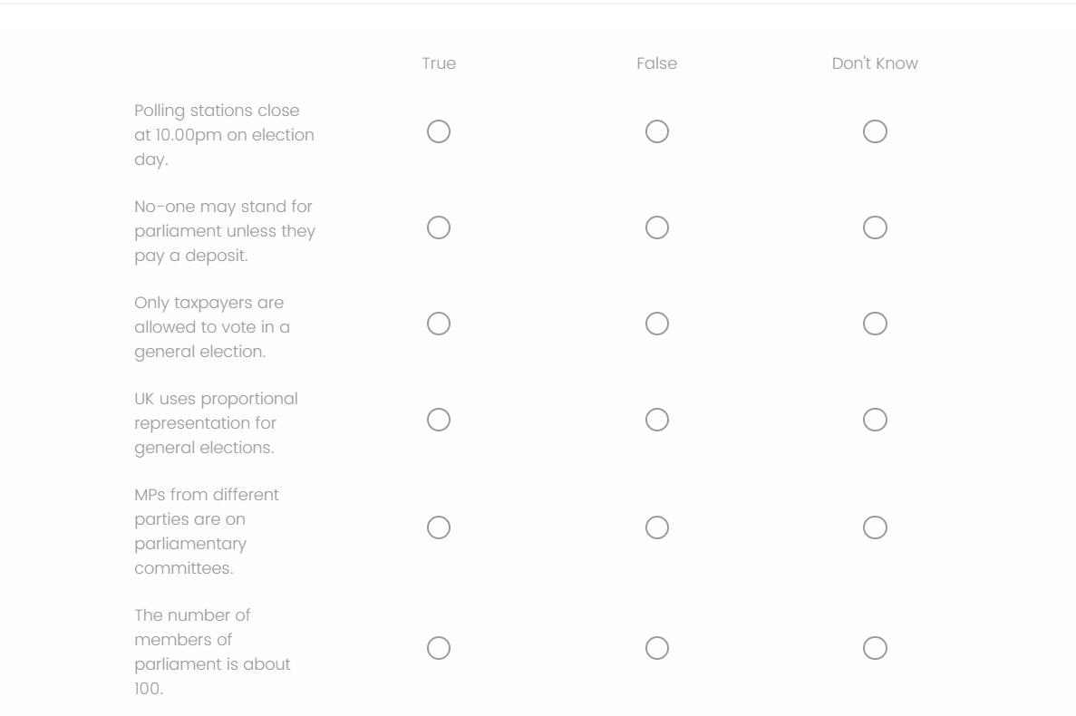

Slide 5
Unadjusted Political knowledge (Prolific)

Slide 6
Unadjusted Political knowledge (Prolific vs BES)

Slide 7
Unadjusted Turnout (Prolific)

Slide 8
Unadjusted Turnout (Prolific vs BES)

Slide 9
Political knowledge: Calculate group means, group weights, and weighted means

