Slide 1
WEEK 4 MEETUP
RAG with PostgreSQL
+ pgvector
From news articles to evidence-backed answers
Concepts → vectors → retrieval → generation
Notes:
Opening question: What can an LLM answer about an article published five minutes ago?

Slide 2
Introduction
AI News API • Week 4
4
Notes:
Connect this to the project rule: the API queries stored data; it never scrapes during requests.

Slide 3
The problem: generic AI model does not know YOU
Static knowledge
Plausible ≠ true
RAG adds evidence
Training knowledge has a cutoff and does not include your private news database.
A fluent answer can still be unsupported, stale, or invented.
Retrieve current passages first, then ask the model to answer from them.
AI News API • Week 4
2
Notes:
Think of RAG as giving your AI system access to an "open-book exam." While traditional language models are limited to the knowledge they were trained on, RAG systems can access external information sources to provide more accurate, up-to-date, and contextually relevant responses.
RAG solves a fundamental problem with Large Language Models (LLMs): they have static knowledge that becomes outdated and may not include your organization's specific information. Instead of trying to cram all possible knowledge into the model's parameters during training, RAG acknowledges that certain information is better stored externally and retrieved when needed.
RAG offers several critical benefits over standalone LLMs:
Knowledge Extensibility: You can continuously update your knowledge sources without retraining the model
Transparency: Responses can be traced back to specific sources, creating accountability
Reduced Hallucinations: By grounding responses in retrieved facts, RAG significantly reduces the LLM's tendency to generate plausible-sounding but incorrect information
Cost Efficiency: Storing knowledge externally is more cost-effective than increasing model size

Slide 4
RAG is two systems joined at the prompt
1 RETRIEVAL
2 GENERATION
Question → embedding → similarity search → top chunks
Instructions + evidence + question → LLM → grounded answer
Output: evidence
Output: language
AI News API • Week 4
3
Notes:
RAG systems operate in two distinct phases that work together seamlessly:
1. Retrieval Phase
The retrieval phase is like having an intelligent research assistant that finds relevant information based on your question. This involves:
Converting your query into a format the system can search with
Finding semantically similar content in the knowledge base
Selecting the most relevant documents or passages
Preparing this information for the LLM to use
2. Generation Phase
The generation phase is where the LLM synthesizes the retrieved information with your question to create a coherent, contextually appropriate response. The LLM uses its reasoning capabilities to:
Analyze the retrieved information
Apply it to your specific question
Generate a response that incorporates the external knowledge
Cite sources when appropriate

Slide 5
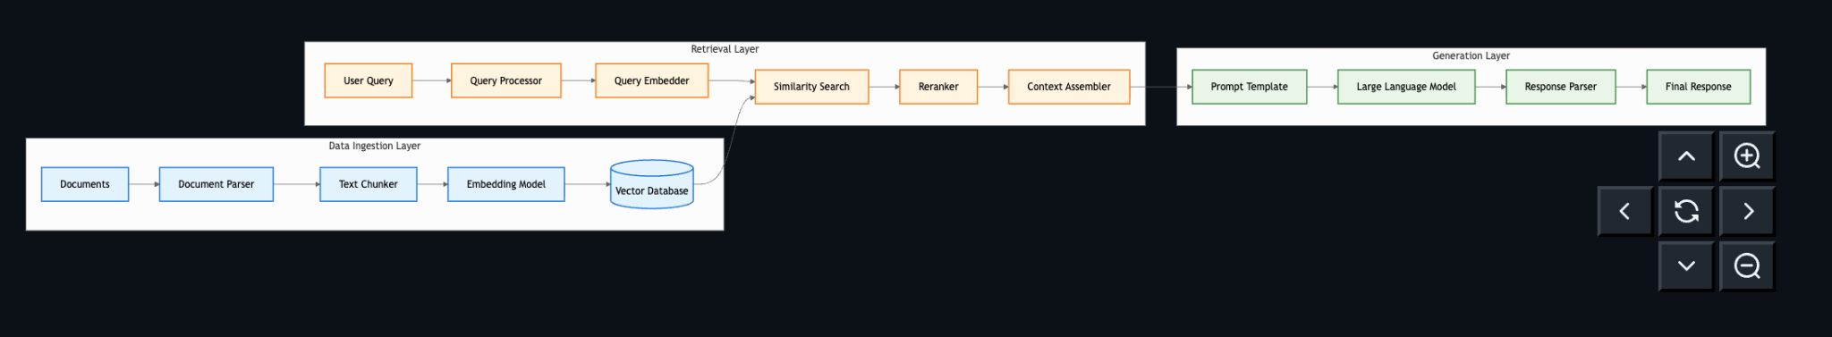
How RAG Works: The Complete Pipeline
ONLINE / REQUEST
Read many times
OFFLINE / BATCH
Write once
AI News API • Week 4
4
Notes:
Understanding the Data Flow
The diagram above shows three distinct layers that work together:
Data Ingestion Layer (Blue): This happens offline, before any user queries. Your documents are parsed, split into manageable chunks, converted into mathematical representations called embeddings, and stored in a specialized vector database.
Query Processing Layer (Orange): This happens in real-time when you ask a question. Your query gets processed and converted into the same mathematical format as the stored documents, allowing the system to find semantically similar content.
Generation Layer (Green): The retrieved context gets formatted into a prompt template and sent to the LLM, which generates a response based on both your question and the relevant retrieved information.

Slide 6
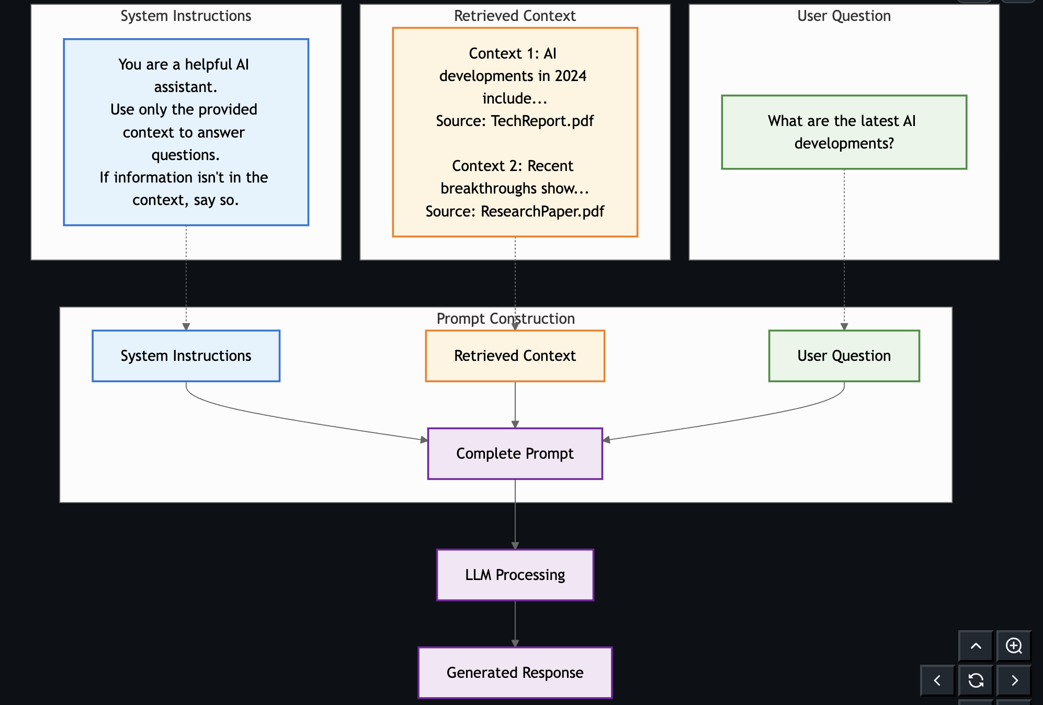
Context Injection: How Retrieved Information Reaches the LLM
AI News API • Week 4
5
Notes:
The magic of RAG happens when retrieved information gets combined with your original question. This process, called context injection, follows a structured pattern:
A well-constructed RAG prompt contains three essential components:
System Instructions: Clear guidelines that define the assistant's role and constraints
Retrieved Context: Formatted chunks of relevant information with source attribution
User Question: The original query, clearly marked and preserved

Slide 7
Offline Phase:
1. Extraction
2. Chunking
3. Embed
AI News API • Week 4
4
Notes:
Connect this to the project rule: the API queries stored data; it never scrapes during requests.

Slide 8
1.Extraction
Ideal Preprocessing:
Unified Interface: Handles multiple document types (PDF, DOCX, HTML, etc.)
Standardized Output: Converts all documents to a consistent format
Advanced Features: Handles complex layouts, tables, and OCR
Type Safety: Uses Pydantic models for strict type checking
Types of Data
Research papers (PDF)
Company documentation (Word/PDF)
Web content (HTML)
Structured data (CSV/Excel)
Scanned documents (Images with OCR)
You can load Docling(library) for this. For this project I already had text from json so I can skip this part for now
AI News API • Week 4
5

Slide 9
2. Chunking - defines the unit of retrieval
One article
Small chunks
Medium chunks
Large chunks
1
2
3
Precise
less context
Balanced
default start
More context
more noise
Overlap protects boundary facts — but duplicates tokens and storage.
DEMO 02_chunking_lab.py
AI News API • Week 4
6
Notes:
Chunking is crucial for RAG performance using 2-chunking.py. We use Docling's HybridChunker because it:
Preserves Context: Maintains document structure and hierarchy
Token-Aware: Respects model token limits
Semantic Boundaries: Splits at logical points (sections, paragraphs)
Overlap Control: Manages chunk overlap for context continuity
Key considerations:
Chunk size affects retrieval quality
Too small: Loses context
Too large: Dilutes relevance
Overlap helps maintain context between chunks

Slide 10
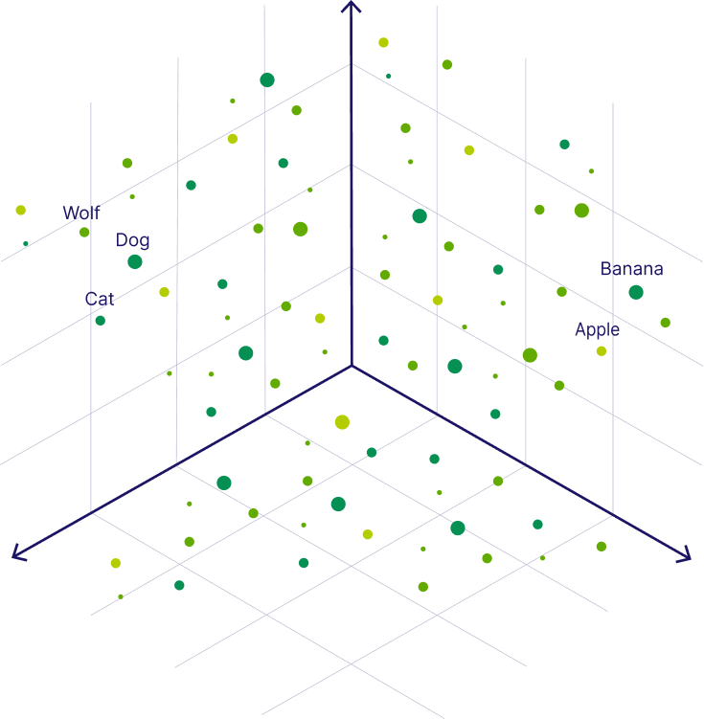
3. Embeddings
AI News API • Week 4
5
Notes:
Vector embeddings are the foundation of semantic search in RAG systems. They convert text into numerical vectors that capture meaning, allowing computers to understand relationships between words and phrases.
Think of vector embeddings as a way to translate human language into a mathematical space where similar concepts are positioned close together. Each word or phrase becomes a point in this high-dimensional space, and the distance between points represents their semantic similarity.

Slide 11
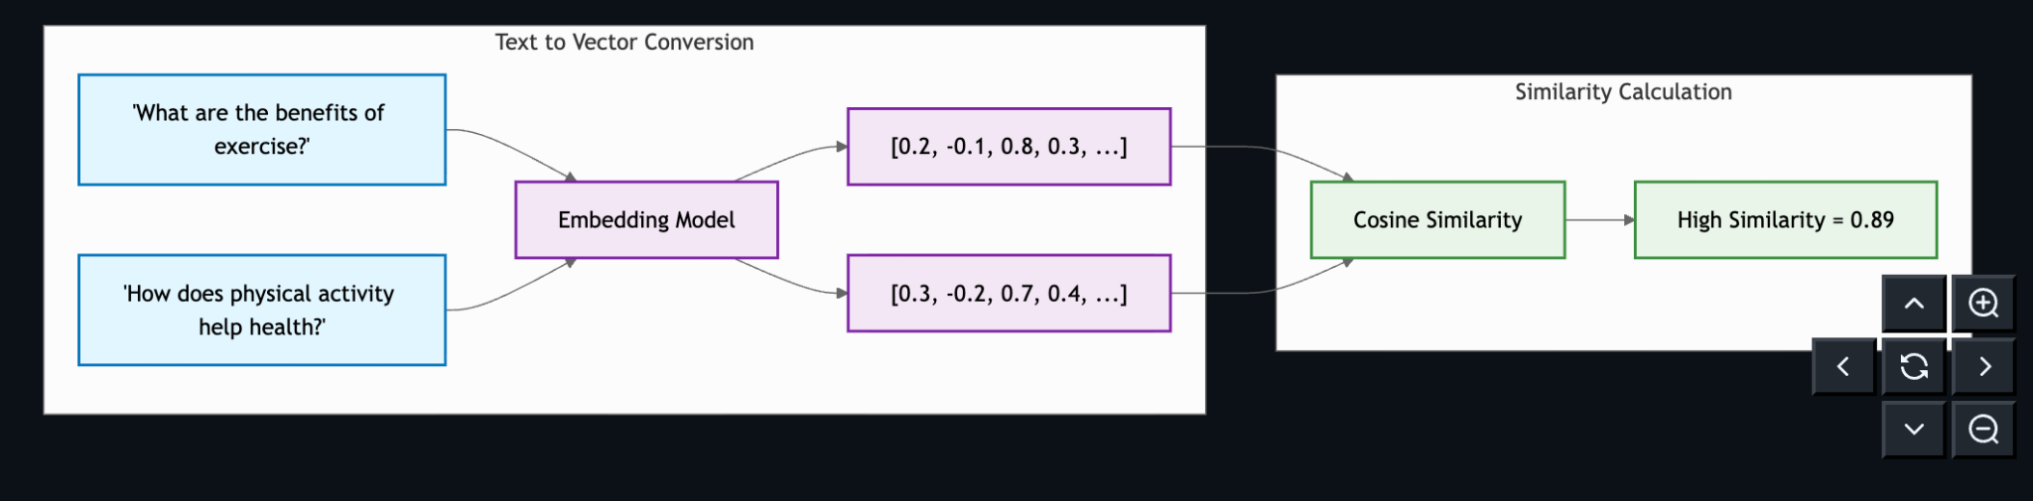
How Embeddings Make Meaning Searchable
AI News API • Week 4
5
Notes:
Traditional keyword search would struggle to connect "benefits of exercise" with "physical activity helps health" because they don't share common words. Vector embeddings capture semantic meaning, allowing the system to understand that these phrases are related conceptually, even with different vocabulary.
Popular Embedding Models
Several embedding models are commonly used in production RAG systems:
OpenAI Embeddings
text-embedding-3-small: 1536 dimensions, fast and efficient
text-embedding-3-large: 3072 dimensions, higher accuracy
Best for: General-purpose applications, English text
Open Source Alternatives
all-MiniLM-L6-v2: 384 dimensions, lightweight
BAAI/bge-small-en: 384 dimensions, good performance
Best for: Cost-sensitive applications, non-English text
Specialized Models
intfloat/e5-large: Optimized for retrieval
BAAI/bge-large-en: Strong performance on benchmarks
Best for: High-accuracy requirements, multilingual support

Slide 12
Choosing Embedding Model
Dimension Size: Higher dimensions can capture more nuance but require more storage
Model Size: Larger models are more accurate but slower and more expensive
Language Support: Some models work better with specific languages
Domain Specialization: Consider models trained on domain-specific data
Cost: Balance between API costs and self-hosted infrastructure
AI News API • Week 4
5
Notes:
Traditional keyword search would struggle to connect "benefits of exercise" with "physical activity helps health" because they don't share common words. Vector embeddings capture semantic meaning, allowing the system to understand that these phrases are related conceptually, even with different vocabulary.
Popular Embedding Models
Several embedding models are commonly used in production RAG systems:
OpenAI Embeddings
text-embedding-3-small: 1536 dimensions, fast and efficient
text-embedding-3-large: 3072 dimensions, higher accuracy
Best for: General-purpose applications, English text
Open Source Alternatives
all-MiniLM-L6-v2: 384 dimensions, lightweight
BAAI/bge-small-en: 384 dimensions, good performance
Best for: Cost-sensitive applications, non-English text
Specialized Models
intfloat/e5-large: Optimized for retrieval
BAAI/bge-large-en: Strong performance on benchmarks
Best for: High-accuracy requirements, multilingual support

Slide 13
Implementation Practice (with github tutorials)
AI News API • Week 4
4
Notes:
Connect this to the project rule: the API queries stored data; it never scrapes during requests.

Slide 14
Choose your vector DB
Integration & Simplicity: The most important factor is how easily the database fits into your existing software stack. Open-source solutions and those with mature integrations are generally easier to adopt and maintain, especially for teams already using relational databases like PostgreSQL
Open Source vs. Managed Services: Open-source options provide flexibility, transparency, and cost control, while managed services can offer convenience and operational support. Your choice depends on your team's expertise and operational requirements
Performance (Speed & Latency): While speed is important, it's often overemphasized. For most GenAI applications, the time spent on vector search is negligible compared to the latency of large language model (LLM) inference, which can be 10–20x longer. Unless you're working with tens or hundreds of millions of vectors, performance differences are unlikely to be the bottleneck
Scalability: True scalability only becomes critical at very large data volumes. For most use cases, starting with a simple solution is best, and you can always migrate to a more specialized system if you outgrow your initial setup
Community & Ecosystem: Strong community support and documentation can make a significant difference, especially for troubleshooting and upgrades
AI News API • Week 4
7
Notes:
Different Vector Databases
Pinecone: A fully managed, cloud-native vector database built for high-speed, low-latency similarity search and effortless scaling; its strong suit is production-grade reliability and seamless integration for enterprise AI applications, especially when you need robust hybrid (dense + sparse) search and hands-off infrastructure management
Milvus: An open-source, highly scalable vector database supporting both approximate and exact nearest neighbor search; excels at handling massive-scale vector data and is popular for multimodal data (text, image, audio)
Qdrant: An open-source vector search engine optimized for real-time, high-dimensional data processing; strong at precise search and real-time updates, suitable for both text and multimodal use cases
ChromaDB: An open-source embedding database focused on LLM and AI app development; integrates easily with Python and LangChain, ideal for rapid prototyping and small-to-medium scale retrieval-augmented generation (RAG) applications
Weaviate: An open-source, cloud-native vector database with built-in semantic search, graph features, and multi-modal support; excels at integrating structured data with vector search for complex AI-driven applications
PGVector (PostgreSQL with pgvector): An extension for PostgreSQL that adds vector search capabilities to the familiar SQL environment; best for teams seeking simplicity, integration with existing relational data, and moderate-scale vector workloads
LanceDB: An open-source vector database optimized for multimodal data (text, images, audio, video); known for its fast local development, efficient storage, and strong support for AI workflows involving multiple data types.
MongoDB (with Atlas Vector Search): A general-purpose document database with vector search capabilities integrated into its cloud offering; good for teams already using MongoDB and seeking to add basic vector search to their stack

Slide 15
Why PostgreSQL + pgvector?
One source of truth
SQL still works
Production basics
Relational fields, JSON metadata, article text, and embeddings live together.
Filter by source, tag, date, or tenant before or alongside vector search.
Transactions, backups, permissions, joins, and familiar operations remain available.
However it really varies: in our company we opted for Weaviate for multi-tenant easibility (important for europe countries)
AI News API • Week 4
7
Notes:
Why Many Start with PostgreSQL + pgvector
Many companies opt for PostgreSQL with the pgvector extension because it’s simple, familiar, and integrates seamlessly with existing infrastructure. For teams already using PostgreSQL, this approach allows you to add vector search capabilities without introducing new systems, reducing operational complexity and risk
Simplicity: No need to manage a separate database.
Integration: Leverages existing authentication, backup, and monitoring setups.
Good Enough Performance: For most small-to-medium workloads, pgvector is fast enough. If you ever need more, migration paths to specialized solutions are available

Slide 16
The pgvector schema is ordinary data + one new type
news_chunks
news_item_id
FK → news_items.id
HNSW index
chunk_index
integer
Fast approximate nearest-neighbor search with strong recall
content
text
embedding
vector(1536)
AI News API • Week 4
8
Notes:
Point out the foreign key: retrieval must preserve provenance back to the article.

Slide 17
Similarity search: sort by distance, return evidence
<#>
SELECT content,
-(embedding <#> :query) AS similarity
FROM news_chunks
ORDER BY embedding <#> :query
LIMIT 5;
Negative inner product
Why negate?
Display a familiar similarity score
Normalized vectors
Inner product and cosine rank alike
AI News API • Week 4
9
Notes:
The application uses SQLAlchemy max_inner_product(), which maps to the same pgvector behavior.

Slide 18
Pgvector Setup : Go through tutorial
GITHUB REPO : week4/pgvector-setup
Docker Setup: change the original postgres image to pgvector/pgvector:pg17 which includes PostgreSQL 17 with pgvector pre-installed.
Database Initialization: docker/init.sql script sets up the foundation table for vector operations. When you run docker compose up the first time, this script is automatically executed when the PostgreSQL container starts for the first time through Docker's initialization mechanism and will create the basic table schema with a vector column defined (this is where pgvector enable to have)
  Database Configuration like in week3, the postgres instance is initialized with host, port, username, password, etc. You can log into the postgres through GUI like TablePlus, refer back to week3 if you are unclear.
  Understanding Vector Index: Index is crucial for performance at scale and is CS research topic of its own. For now just know we use HNSW index for the vector column (read more in repo)
Basic Vector Operation: Run and interact with 1-basic-operations.py. Remember after every action, check GUI . 1.create table 2.search for similar document . Her we are interacting with pgvector directly.basic-ope1-basic-operations.pyrations.py
SQLAlchemy Integration: Optional, doing similar things but with SQLAlchemy (python ) layer on top of pgvector to interact with sql.
**READ THE TOP OF THE SCRIPT TO GET HIGH LEVEL OF WHAT YOU ARE DOING **
7
Notes:
Why Many Start with PostgreSQL + pgvector
Many companies opt for PostgreSQL with the pgvector extension because it’s simple, familiar, and integrates seamlessly with existing infrastructure. For teams already using PostgreSQL, this approach allows you to add vector search capabilities without introducing new systems, reducing operational complexity and risk
Simplicity: No need to manage a separate database.
Integration: Leverages existing authentication, backup, and monitoring setups.
Good Enough Performance: For most small-to-medium workloads, pgvector is fast enough. If you ever need more, migration paths to specialized solutions are available

Slide 19
End 2 End RAG Pipeline : Go through tutorial
GITHUB REPO : week4/rag-pipeline
Document Processing: Load and chunk local news article JSON files
Embedding Generation: Create embeddings using OpenAI's text-embedding-3-small
Vector Storage: Store embeddings in PGVector database
Similarity Search: Query the database to find relevant chunks
Response Generation: Use retrieved context to generate answers with OpenAI
DEMO
7
Notes:
Why Many Start with PostgreSQL + pgvector
Many companies opt for PostgreSQL with the pgvector extension because it’s simple, familiar, and integrates seamlessly with existing infrastructure. For teams already using PostgreSQL, this approach allows you to add vector search capabilities without introducing new systems, reducing operational complexity and risk
Simplicity: No need to manage a separate database.
Integration: Leverages existing authentication, backup, and monitoring setups.
Good Enough Performance: For most small-to-medium workloads, pgvector is fast enough. If you ever need more, migration paths to specialized solutions are available

Slide 20
Implementation for your application
AI News API • Week 4
4
Notes:
Connect this to the project rule: the API queries stored data; it never scrapes during requests.

Slide 21
Data Flow
Create
uv run python -m app.database.create_tables
1
Collect
uv run python -m app.services.ingestion
2
Enrich
uv run python -m app.services.enrichment
3
Index
uv run python -m app.services.indexing
4
Serve
uv run uvicorn app.main:app --port 8001
5
AI News API • Week 4
10
Notes:
If time is tight, prepare through indexing before the meetup and perform only search live.

Slide 22
What changed on my application
GITHUB REPO : ai-news-api
- docker-compose.yml — Postgres image changed from plain postgres:16 to pgvector/pgvector:pg17, needed to store embeddings.
- app/database/models.py — added NewsChunkModel (news_chunks table): one article's content, split into chunks, each with an embedding vector.
- app/database/create_tables.py — now enables the vector extension and creates news_chunks too.
- app/database/repository.py — added functions to find un-indexed articles, save chunks, and search by embedding similarity.
- app/agents/embedding_agent.py — new file: turns text into an embedding vector via OpenAI.
- app/services/indexing.py — new file:: chunks + embeds articles, stores them in news_chunks.
- app/schemas/news.py — added SearchResult, the shape returned by search.
- app/api/routes/search.py — new file: the GET /search endpoint.
- app/main.py — registers the new search router.
- app/pipelie.py — runs ingestion → enrichment → indexing in order, so the whole scrape/enrich/index flow can run as one command (or one cron job).
- pyproject.toml — added pgvector and tiktoken\
7
Notes:
Why Many Start with PostgreSQL + pgvector
Many companies opt for PostgreSQL with the pgvector extension because it’s simple, familiar, and integrates seamlessly with existing infrastructure. For teams already using PostgreSQL, this approach allows you to add vector search capabilities without introducing new systems, reducing operational complexity and risk
Simplicity: No need to manage a separate database.
Integration: Leverages existing authentication, backup, and monitoring setups.
Good Enough Performance: For most small-to-medium workloads, pgvector is fast enough. If you ever need more, migration paths to specialized solutions are available

Slide 23
Generation is controlled context injection
INSTRUCTIONS
Use only the supplied sources.
Cite [Source N].
Grounded
answer
+ citations
EVIDENCE
Top retrieved article chunks
with titles and URLs
LLM
QUESTION
What are the main
AI privacy concerns?
DEMO 03_grounded_answer.py
AI News API • Week 4
12
Notes:
Show retrieved evidence first. Then generate. This makes provenance and failure diagnosis tangible.

