Slide 1
LINUX COMMANDS
Created by : Katharine Christine Sheen
Uid : 166573

Slide 2

FILE CREATION AND EDITING

Slide 3
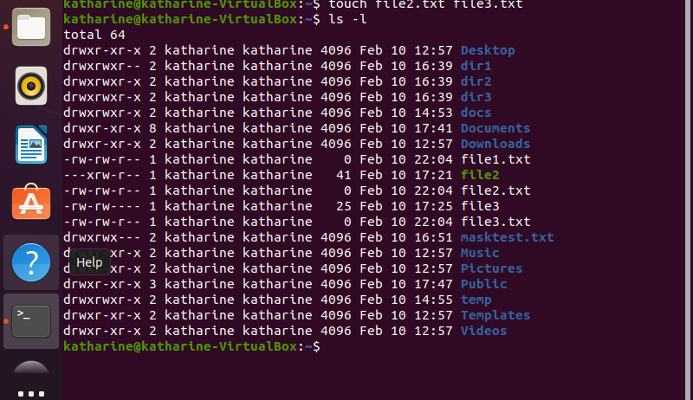
CREATING FILES
→touch file1.txt file2.txt file3.txt
→ls

Slide 4
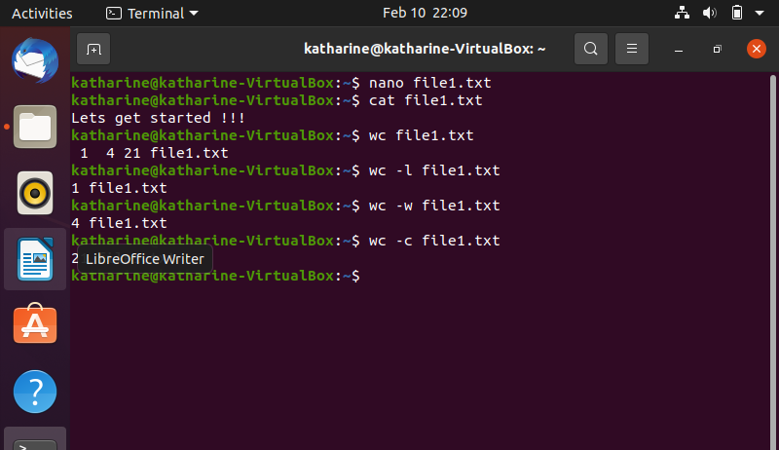
EDITING FILES
→nano file1.txt (& enter text (ctrl+s, ctrl+x))
→cat file1.txt (displays file1.txt)

Slide 5
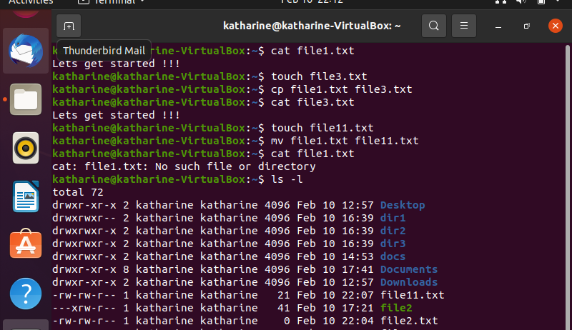
MOVING A FILE
→mv filename1 filename2 TO REMOVE A FILE : →rm filename TO COPY A FILE : →cp filename1 filename2

Slide 6
DEFINING PATHS

Slide 7
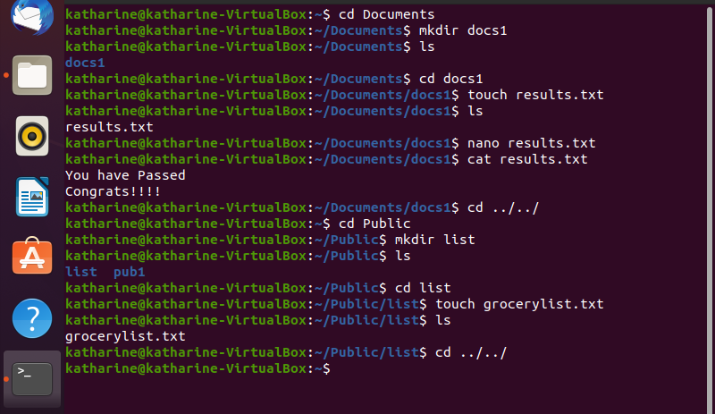
TWO KINDS OF PATHS
Absolute
2. Relative

Slide 8
PERMISSION GRANTS

Slide 9
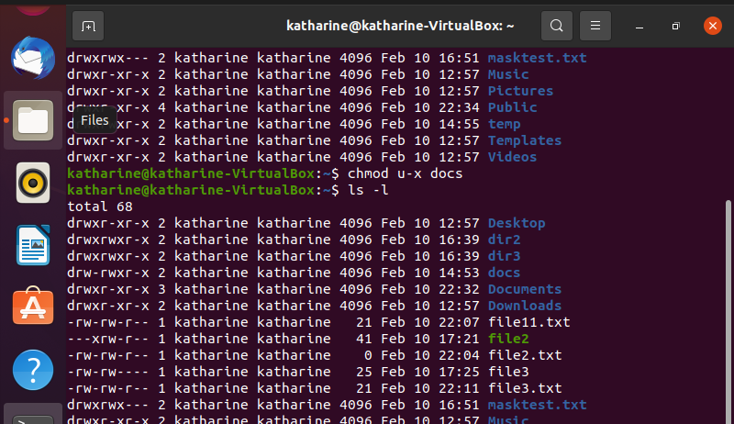
THE 3 LEVELS OF PERMISSIONS
1. Owner Permission
2. Group Permission
3. Other World Permission

Slide 10
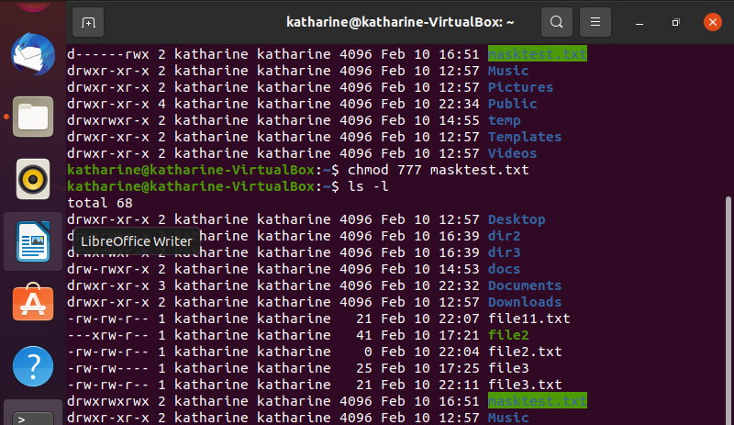
METHODS TO CHANGE THE MODE OF PERMISSION
Symbolic Method
2. Absolute Method

Slide 11
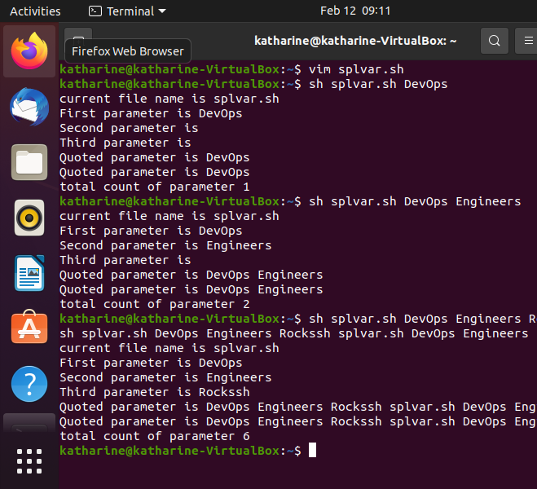
SPECIAL VARIABLES

Slide 12
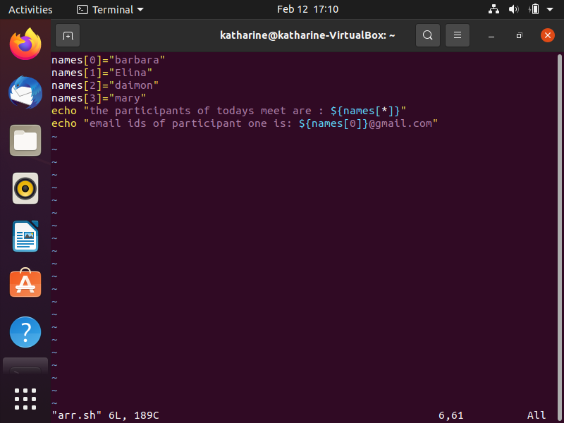
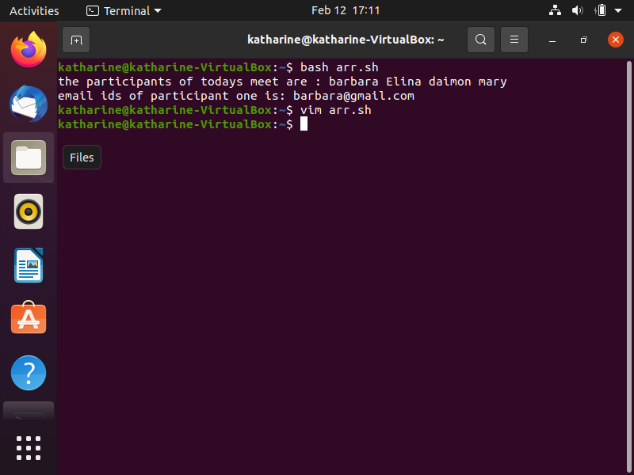
SHELL ARRAYS

Slide 13
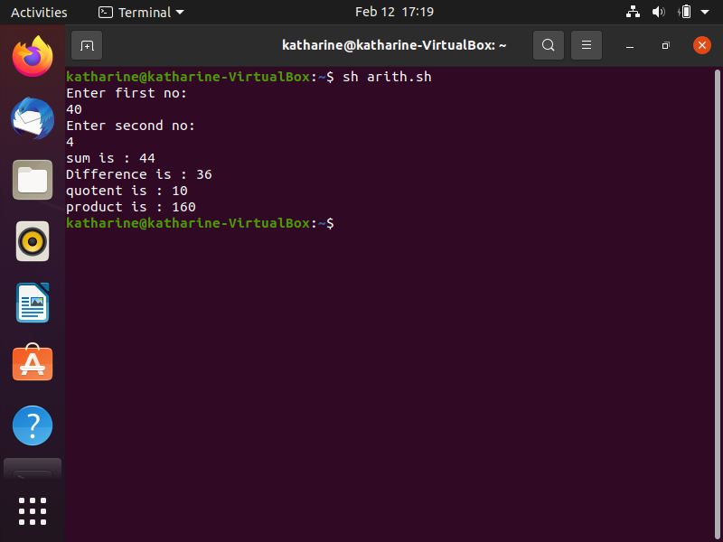
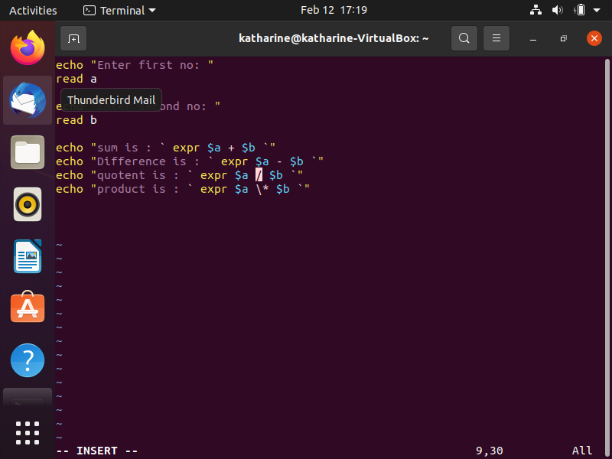
SHELL OPERATORS(ARITHMETIC)

Slide 14
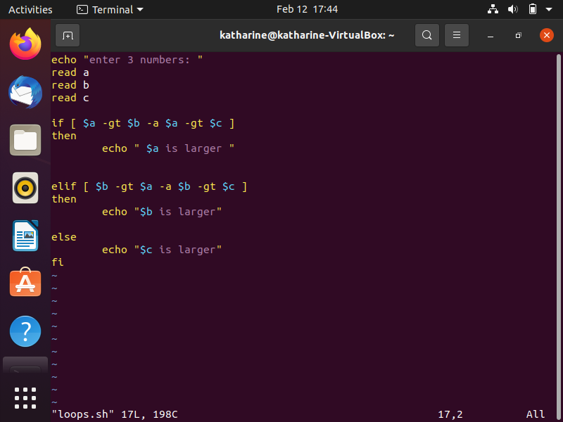
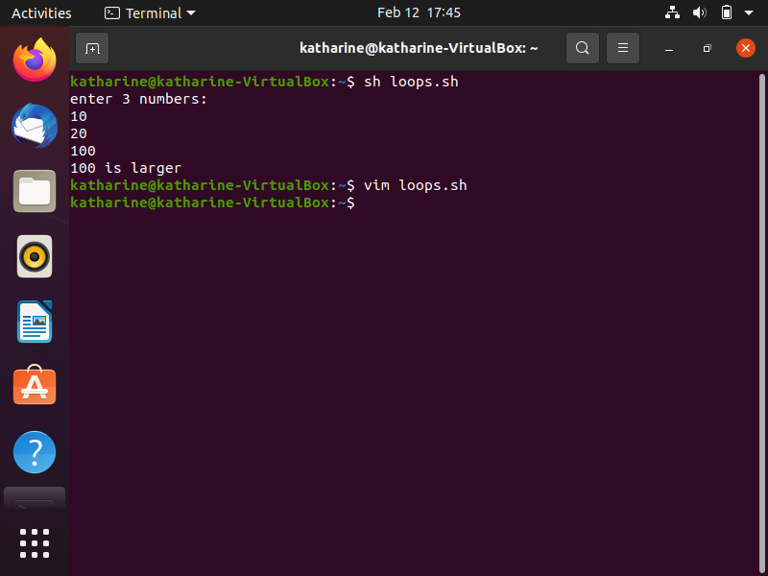
SHELL LOOPS(IF-ELIF-ELSE)

Slide 15
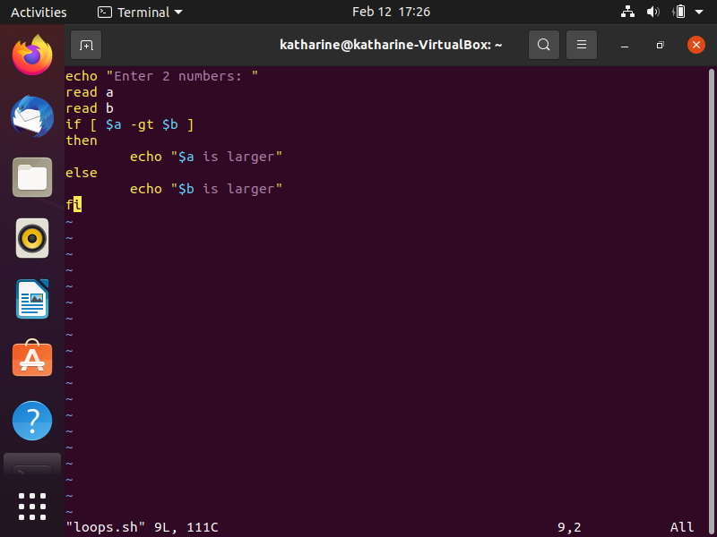
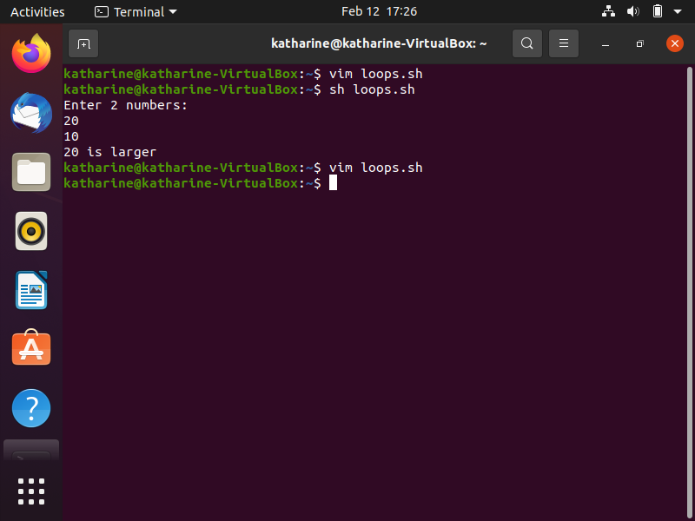
SHELL LOOPS(IF ELSE)

Slide 16
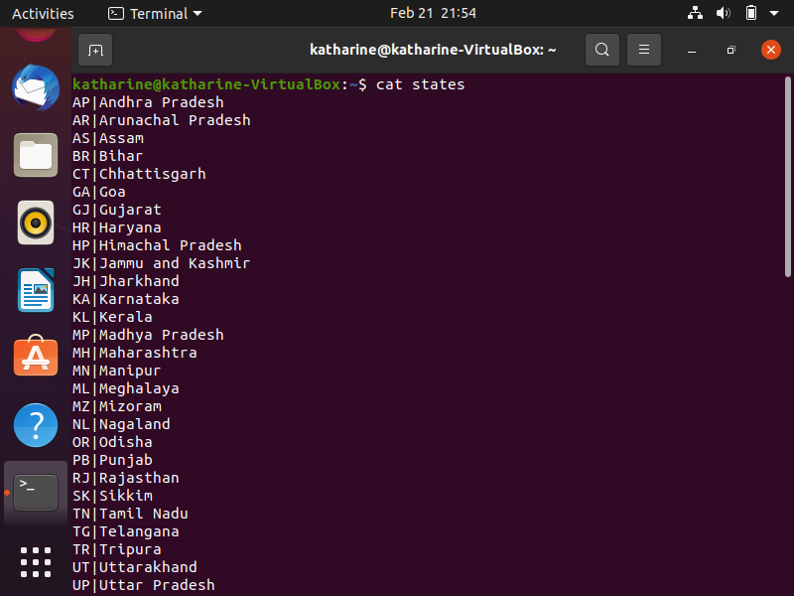
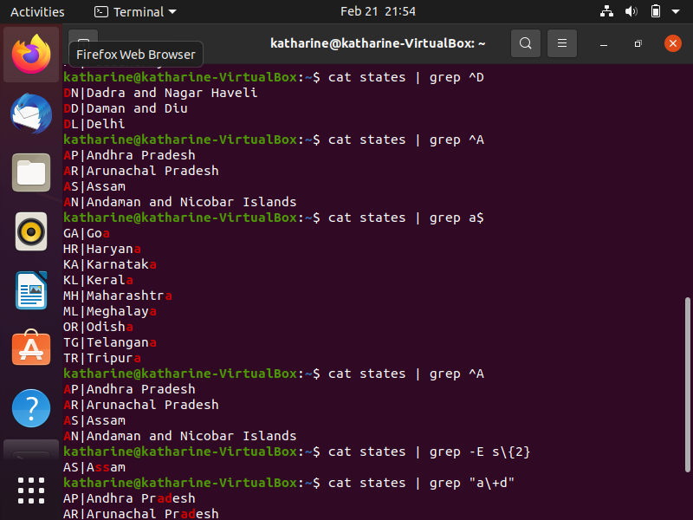
PIPES

Slide 17
ADDING HARD DISK(STEPS)
sudo fdisk /dev/sdb/
m for help
n for create new partition
e for extented
t selecting type
w write and quit
sudo mkdir /media/mydisk
sudo mkfs.ext4 /dev/sdb1
sudo mount /dev/sdb1 /media/mydisk

Slide 18
CREATING GROUPS AND ADDING USERS
useradd Adds account to the system
usermod Modifies account attributes
userdel Deletes account from the system
groupadd Add groups to the system
groupmod Modify group
groupdel Delete group

Slide 19
User and group commands
TO CREATE A GROUP
sudo groupadd group_name
TO CREATE A USER AND ADD TO GROUP
Sudo useradd –G new_group new_user
TO ADD USER TO GROUP
sudo useradd user_name group_name
ASSIGNING PASSWORD TO NEW USER
sudo passwd new_user
TO ADD EXISTING USER TO EXISTING GROUP
Sudo useradd user_name group_name
CHANGE USERS PRIMARY GROUP
Sudo usermod –g new_group user_name

Slide 20
Contd…..
TO REMOVE A USER FROM GROUP
Sudo gpasswd –d user_name group_name
TO LIST EXISTING GROUPS IN LINUX
Sudo nano /etc/groups

Slide 21
SOME MORE COMMANDS…
TO INSTALL SOFTWARE
sudo apt-get install bsd-mailx
TO SEND MAIL
mailx mailid@gmail.com
(subject
body)
^C

Slide 22
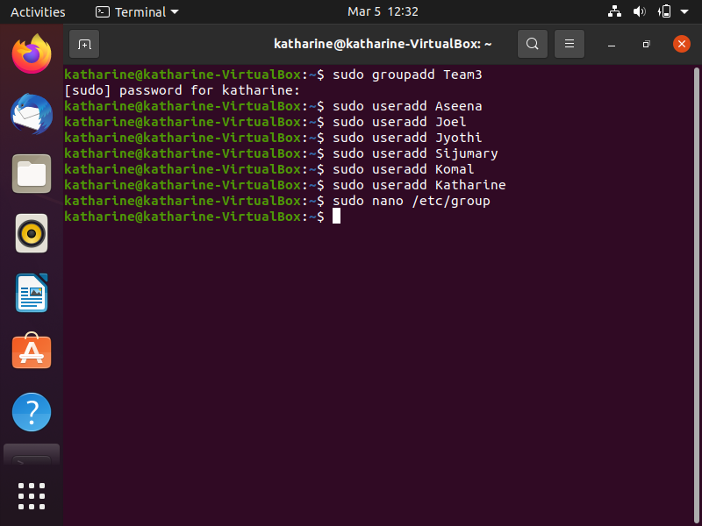
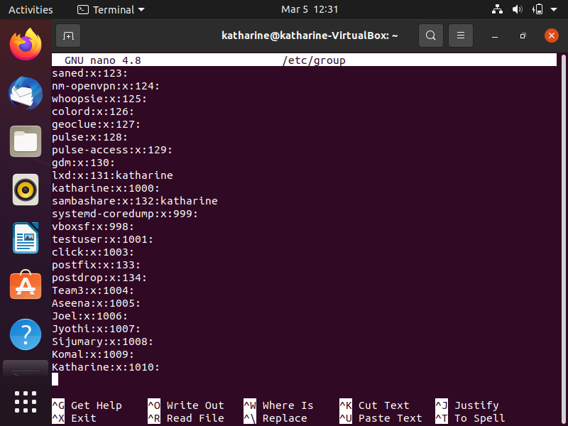
GROUP AND USER ADD

Slide 23
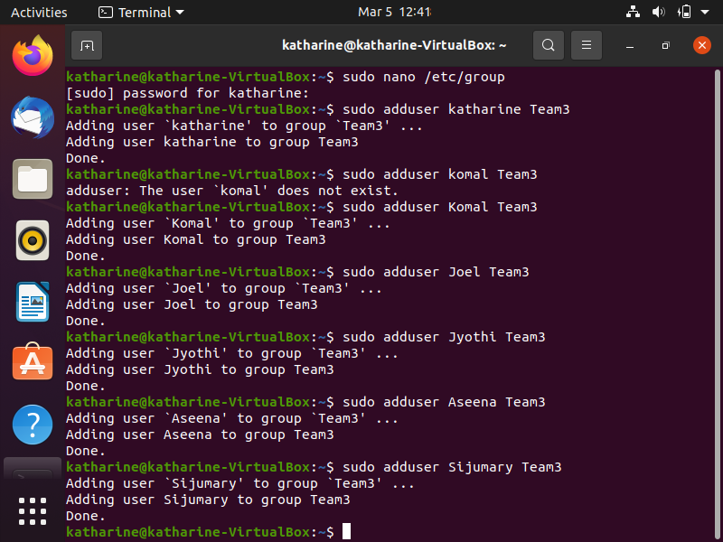
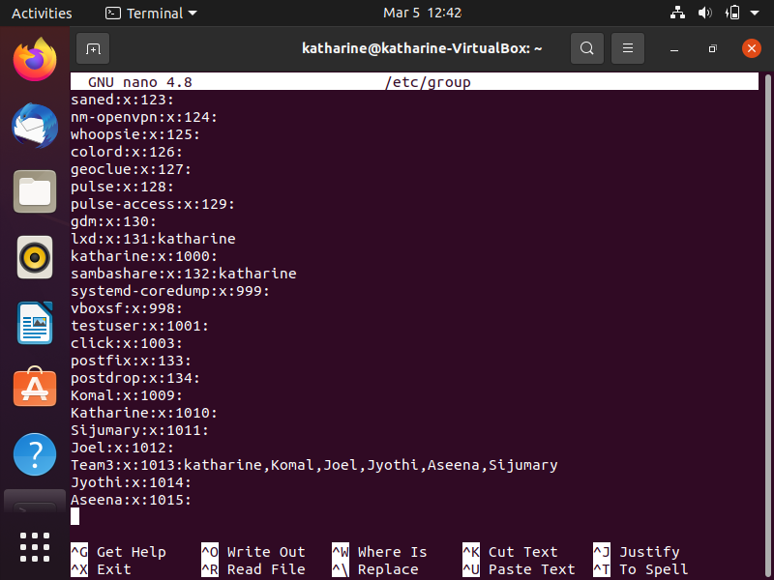
ADDING USER TO GROUP

Slide 24
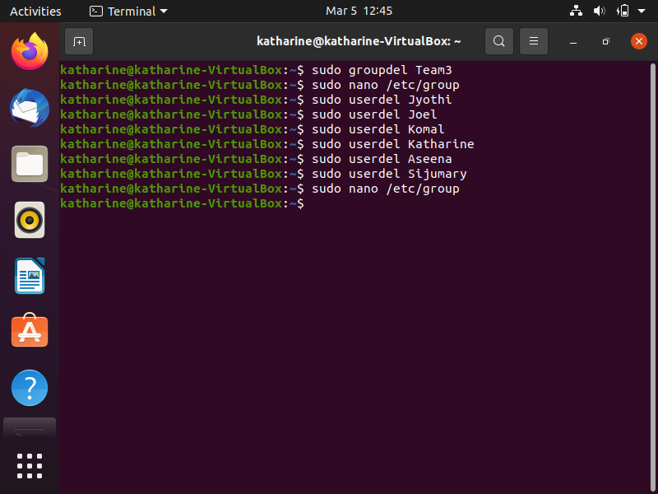
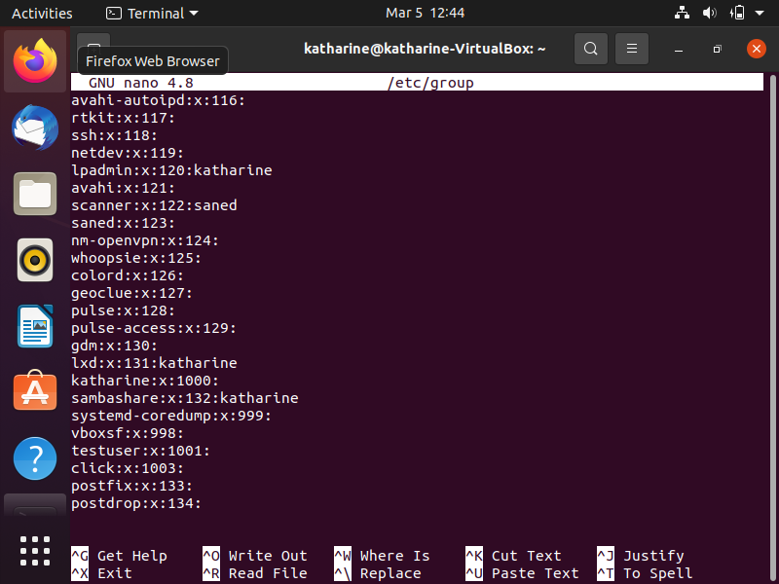
GROUP AND USER DELETE

Slide 25
THANKYOU

