Slide 1
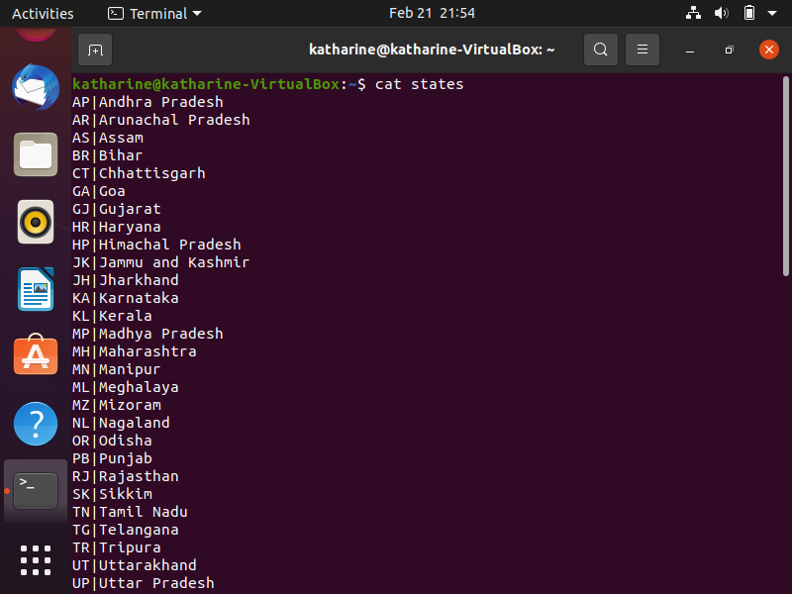
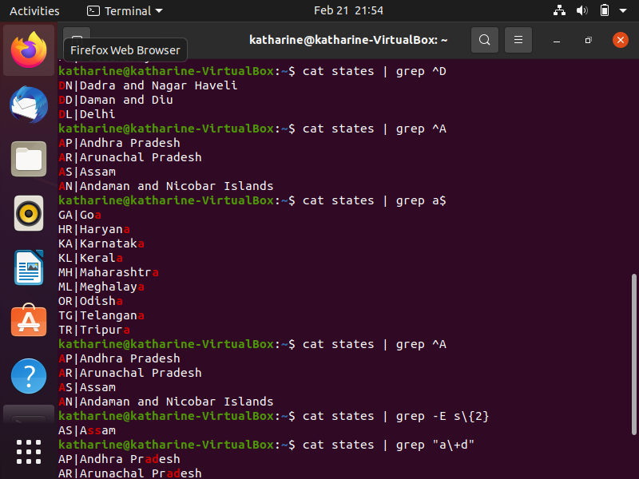
PIPES

Slide 2
ADDING HARD DISK(STEPS)
sudo fdisk /dev/sdb/
m for help
n for create new partition
e for extented
t selecting type
w write and quit
sudo mkdir /media/mydisk
sudo mkfs.ext4 /dev/sdb1
sudo mount /dev/sdb1 /media/mydisk

Slide 3
CREATING GROUPS AND ADDING USERS
useradd Adds account to the system
usermod Modifies account attributes
userdel Deletes account from the system
groupadd Add groups to the system
groupmod modify group
groupdel delete group

Slide 4
COMMANDS ….
TO CREATE A GROUP
sudo groupadd group_name
TO CREATE A USER AND ADD TO GROUP
Sudo useradd –G new_group new_user
TO ADD USER TO GROUP
sudo useradd user_name group_name
ASSIGNING PASSWORD TO NEW USER
sudo passwd new_user
TO ADD EXISTING USER TO EXISTING GROUP
Sudo useradd user_name group_name
CHANGE USERS PRIMARY GROUP
Sudo usermod –g new_group user_name

Slide 5
Contd…..
TO REMOVE A USER FROM GROUP
Sudo gpasswd –d user_name group_name
TO LIST EXISTING GROUPS IN LINUX
Sudo nano /etc/groups

Slide 6
SOME MORE COMMANDS…
TO INSTALL SOFTWARE
sudo apt-get install bsd-mailx
TO SEND MAIL
mailx mailid@gmail.com
(subject
body)
^C

