Slide 1
Predicting VEN/AZA Response in AML from Blast Morphology with AI
SFB 1709 · Project B01 • STAMP computational-pathology pipeline
Jiefu Zhu (PhD) • PIs: Prof. J. N. Kather, Dr. M. Janssen
Dept. of Medical Oncology (NCT-HD) & Dept. of Hematology, Heidelberg University Hospital

Slide 2
Clinical motivation
Goal: predict VEN/AZA response in AML directly from the appearance of blast cells.
• Acute myeloid leukemia (AML): aggressive blood cancer driven by immature blast cells.
• Venetoclax + azacitidine (VEN/AZA) is a key therapy — but response is variable and hard to predict up front.
• Blasts are the diagnostic read-out: counted and graded by hematopathologists on bone-marrow smears.
– We study paired primary samples at diagnosis and relapse.
• If blast morphology encodes who will respond, we can stratify patients earlier.
SFB 1709 · B01 · STAMP

Slide 3
Project B01 — the vision
B01: morphology (AI) + single-cell transcriptomics → response prediction & biomarker discovery.
• Analyze cytologic variability of AML blasts as a determinant of VEN/AZA response.
• Combine two modalities on the same patients:
– Generative-AI / deep-learning image analysis of blast morphology (this talk).
– Single-cell RNA sequencing (scRNA-seq) of the same samples.
• Integrate morphology + molecular profiles to predict outcome and discover novel response biomarkers.
SFB 1709 · B01 · STAMP

Slide 4
What is STAMP?
STAMP turns gigapixel slides into predictions with only slide-level labels.
• End-to-end, weakly-supervised deep-learning pipeline: whole-slide image → biomarker prediction.
• No pixel-level annotations needed — only one clinical label per sample.
• Peer-reviewed protocol (Nature Protocols 2024); used across many tumor types and centers.
• Supports 20+ pathology foundation models and classification, regression & survival in one framework.
– We use it as the image-analysis engine for B01.
SFB 1709 · B01 · STAMP

Slide 5
The STAMP pipeline (as we run it)
Preprocess → UNI2 tile features → ViT-MIL → 5-fold crossval → metrics + heatmaps.
• 1. Preprocess — tile each smear WSI into 224×224 patches; QC filters drop empty/blurred tiles.
• 2. Feature extraction — UNI2 pathology foundation model embeds every tile.
• 3. Aggregation — Vision-Transformer multiple-instance learning (MIL) pools tiles → one prediction per sample.
• 4. Cross-validation — 5-fold; every sample is predicted while held out of training.
• 5. Outputs — metrics with 95% CIs + explainability heatmaps + top-tile exports.
SFB 1709 · B01 · STAMP

Slide 6
Our cohort & labels
69 patients • 489 samples • 511 BM-smear WSIs • 4 prediction tasks.
• Bone-marrow smear whole-slide images from the AG Janssen AML cohort.
• 69 patients • 489 samples (diagnosis/relapse × smear parts A/B/C) • 511 slide images.
• Tile features: UNI2 (uni2-0242c340). Model: ViT-MIL (dim 512, 2 layers, 8 heads), 5-fold crossval.
• Four clinical labels per sample, defined with the hematology team:
– RESPONSE_CR, HIGH_BLAST, BLAST_SEVERITY, BLAST_PERCENT.
SFB 1709 · B01 · STAMP

Slide 7
The four prediction tasks
Label | Question | Type
RESPONSE_CR | Will the patient reach complete remission? | binary (yes/no)
HIGH_BLAST | Is this a high-blast-burden sample? | binary (yes/no)
BLAST_SEVERITY | Low / intermediate / high blast burden | 3-class
BLAST_PERCENT | What % of cells are blasts? | regression (0–100)
SFB 1709 · B01 · STAMP

Slide 8
Results at a glance (5-fold cross-validation)
Task | Type | Samples | Performance
RESPONSE_CR (complete remission) | binary | 489 (336 yes / 153 no) | AUROC 0.870 (95% CI 0.80–0.94)
HIGH_BLAST | binary | 489 (98 / 391) | AUROC 0.929 (0.88–0.98)
BLAST_SEVERITY | 3-class | 489 (98 / 55 / 336) | AUROC: high 0.91 · low 0.86 · interm. 0.78
BLAST_PERCENT | regression | n≈97 | Pearson r 0.68 · R²≈0 · MAE 12%
Classification reported as cross-validated AUROC with 95% CI. Regression: correlation is strong but absolute calibration is poor (see BLAST_PERCENT slide).
SFB 1709 · B01 · STAMP

Slide 9
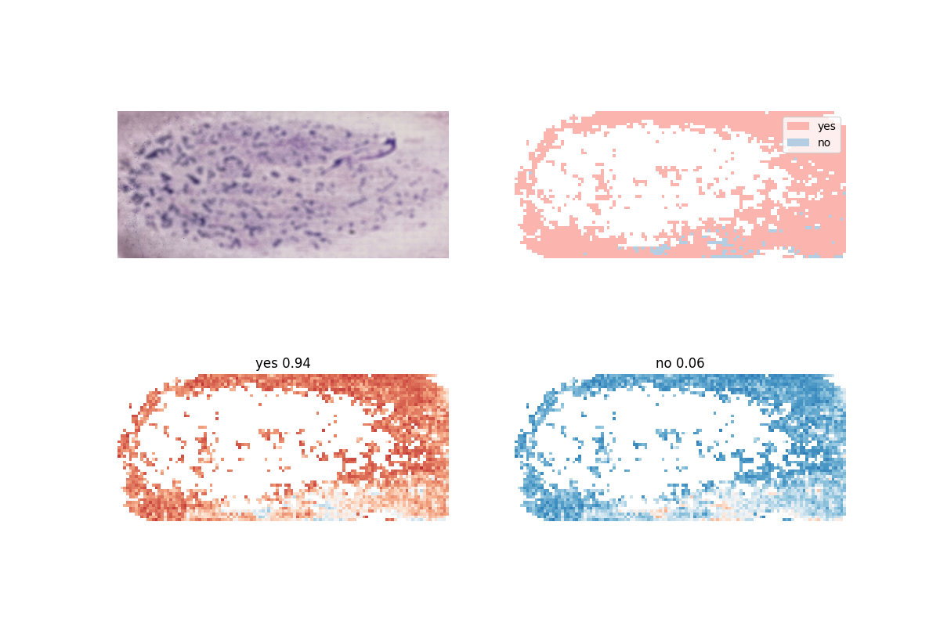
RESPONSE_CR — predicting complete remission
• AUROC 0.870 (95% CI 0.80–0.94).
• Best clinically actionable result: response is predictable from morphology alone.
• Heatmap shows the model concentrates on cell-rich smear regions.
– Confident mistakes are flagged for re-review (label-noise check).
Heatmap: sample 333 19 A (held-out). GT = responder (yes); model P(yes)=0.945. Red = tiles most relevant to the 'responder' prediction.
SFB 1709 · B01 · STAMP

Slide 10
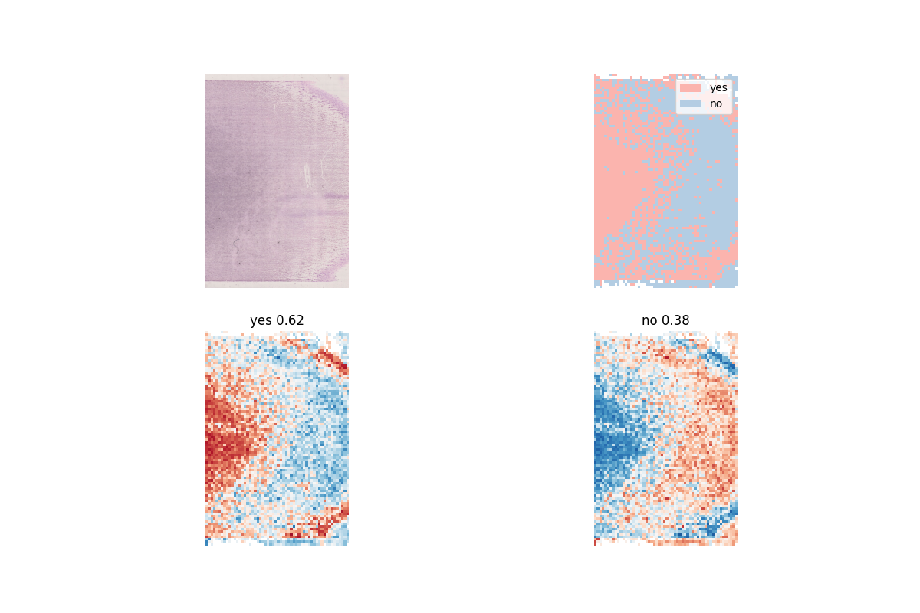
HIGH_BLAST — detecting high blast burden
• AUROC 0.929 (95% CI 0.88–0.98) — our strongest classifier.
• Attention lands on dense blast-rich areas.
• This is the signal we trust most for visual triage.
Heatmap: sample S_895 19 B (held-out). GT = high blast (yes); model P(yes)=0.618 → correct.
SFB 1709 · B01 · STAMP

Slide 11
BLAST_SEVERITY — low / intermediate / high
Severity grading works well at the extremes; the middle class is the hard one.
• 3-class severity grading.
• AUROC: high 0.912 • low 0.864 • intermediate 0.783.
– The 'intermediate' class is hardest — expected, it sits between two boundaries.
• High and low are separated reliably; intermediate is where extra annotation would help most.
SFB 1709 · B01 · STAMP

Slide 12
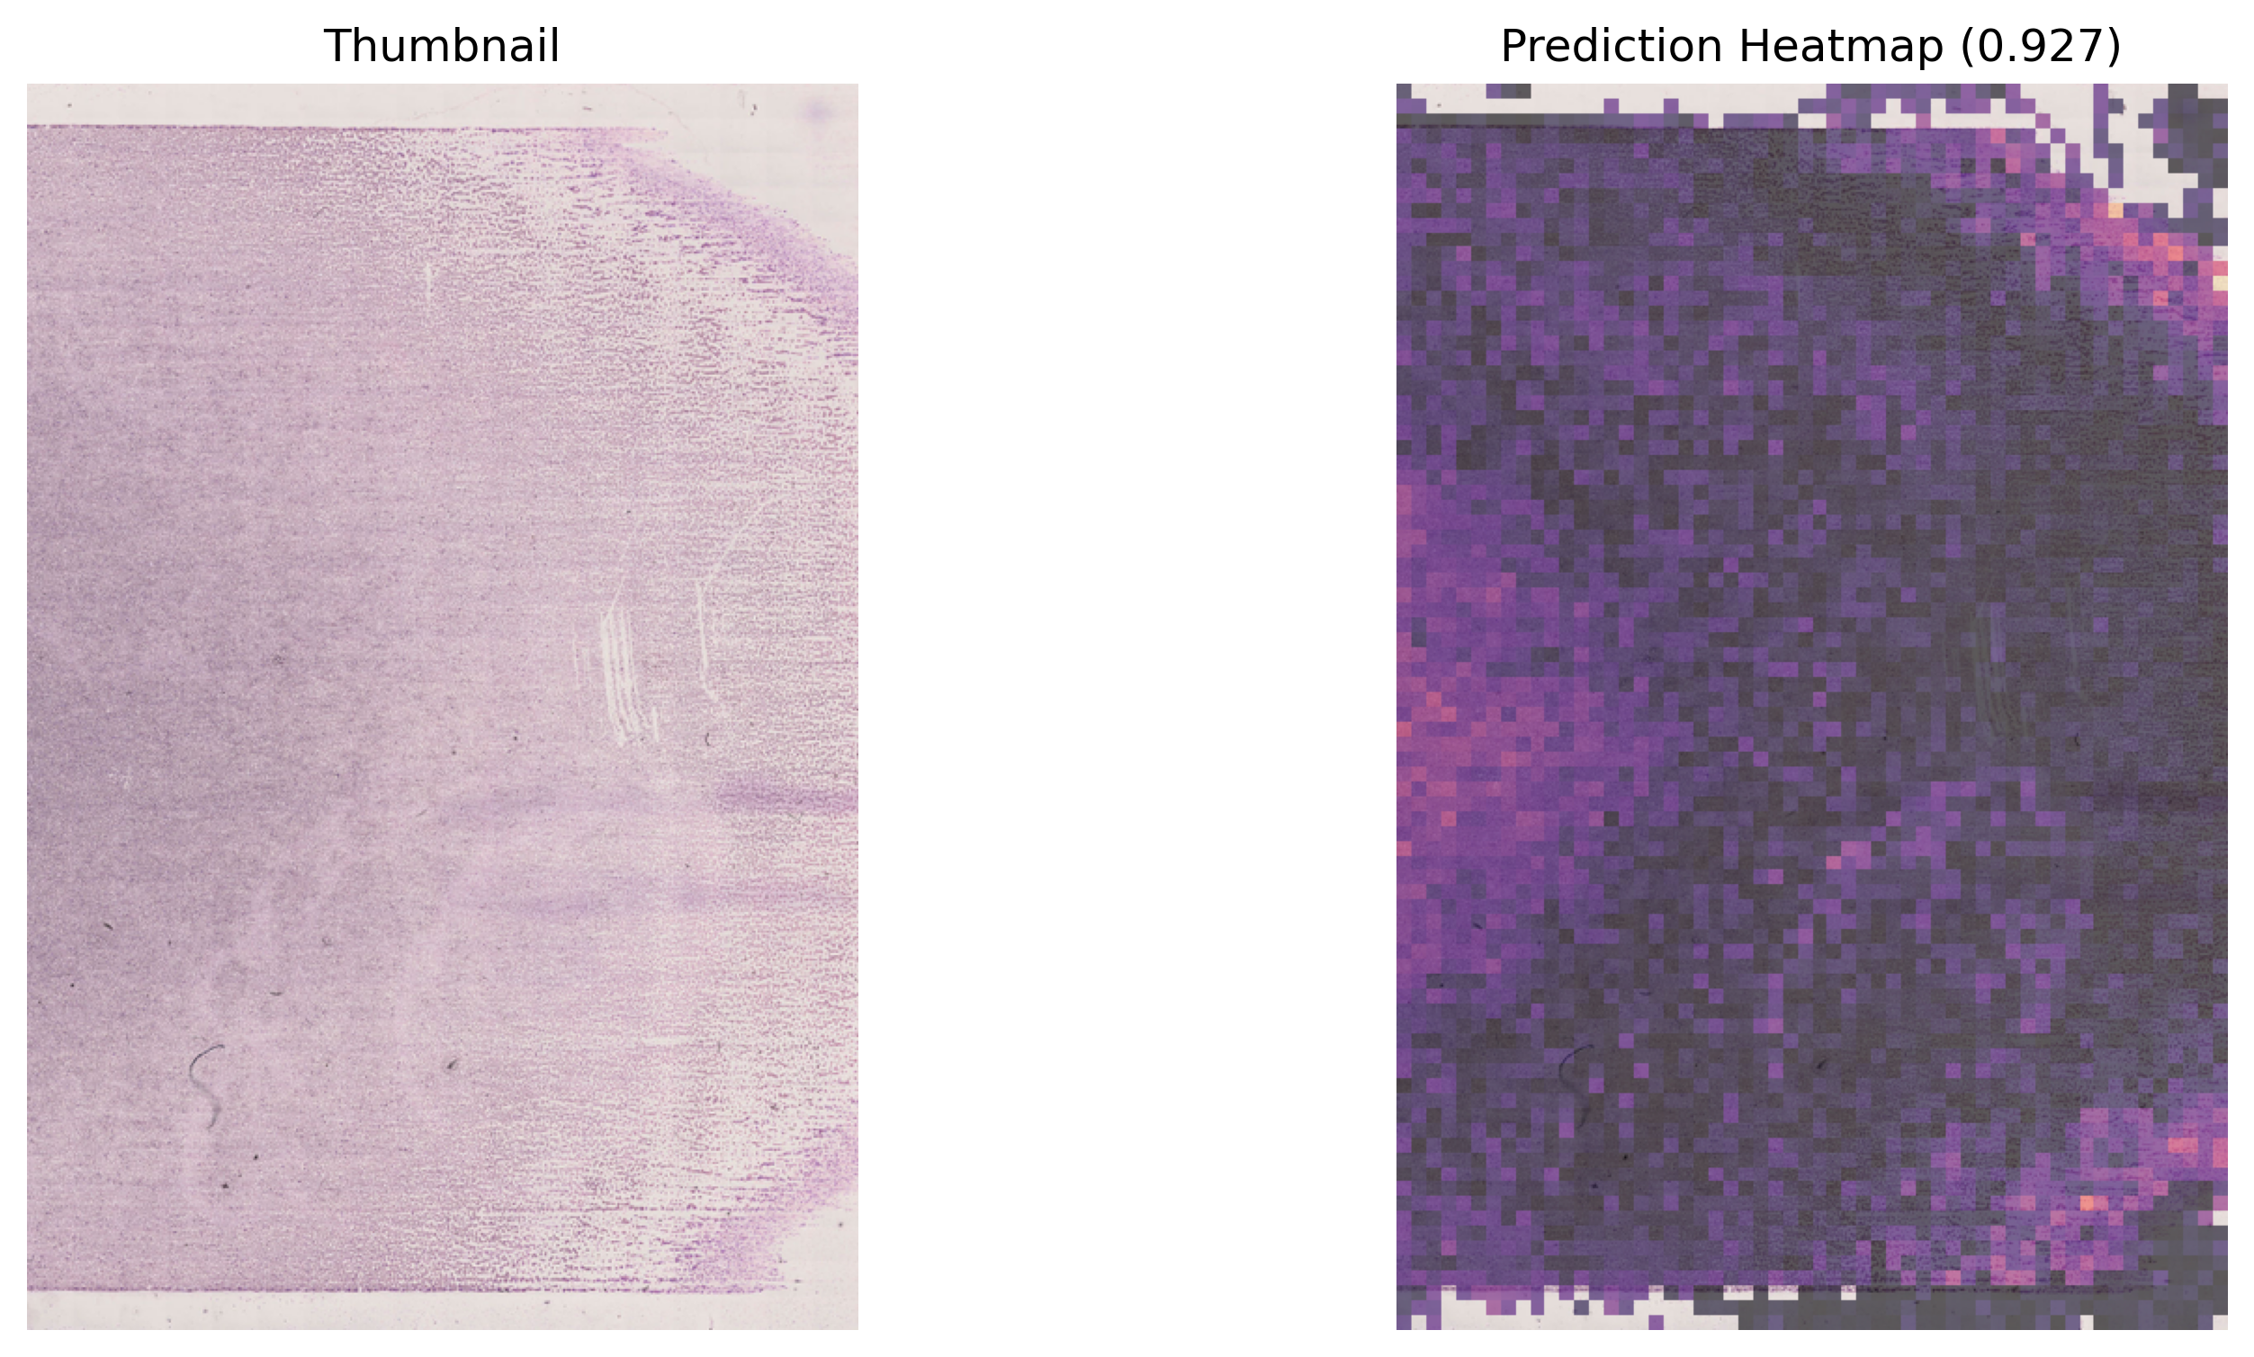
BLAST_PERCENT — a cautionary result
• Pearson r = 0.68 (p≈10⁻¹⁴): ranks samples well.
• But R²≈0 and MAE 12% — absolute values are mis-calibrated.
• Fails badly on the highest-blast slides.
– Lesson: trust the ordering, not the exact % (yet).
Regression relevance map: sample S_895 19 B. GT blast = 75%, but predicted 0.9% (|err| 74%).
SFB 1709 · B01 · STAMP

Slide 13
What the model looks at — and what to trust
Same slide, two heads: use HIGH_BLAST maps for visual blast triage — not the regression maps.
HIGH_BLAST attention — tracks clinical blast burden (proxy AUROC 0.86, ρ=0.35).
BLAST_PERCENT relevance — does NOT track blast burden (proxy AUROC 0.42, ρ=−0.04).
SFB 1709 · B01 · STAMP

Slide 14
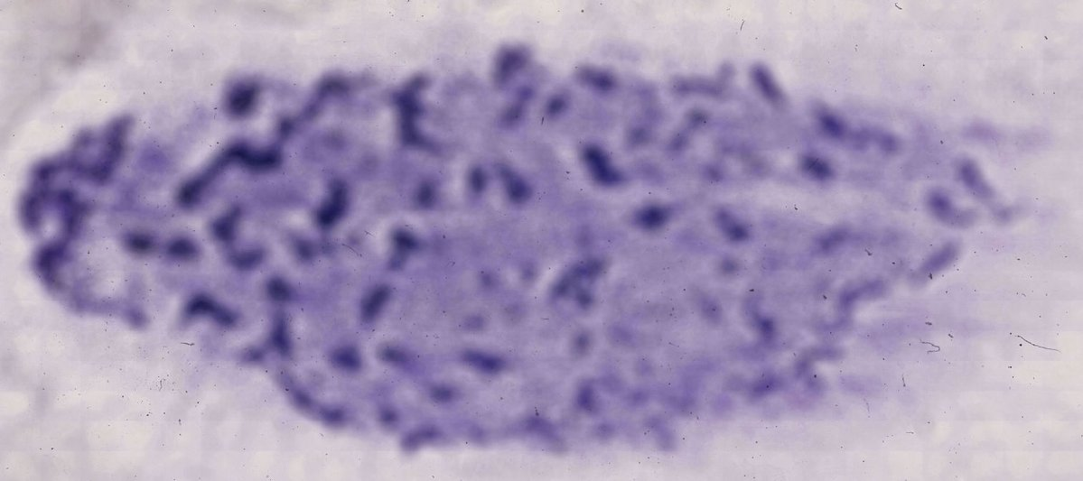
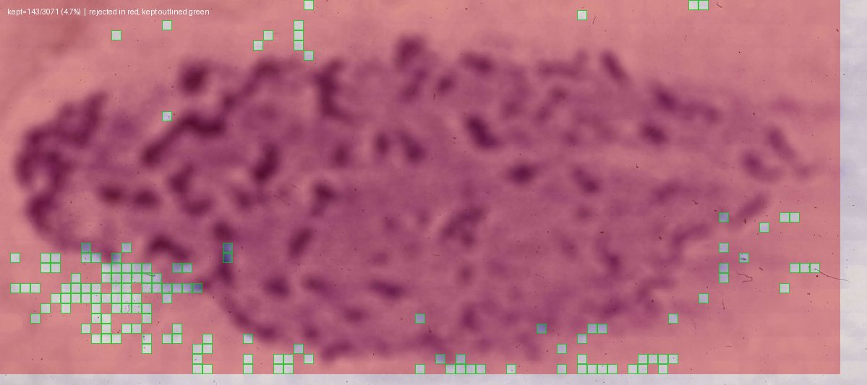
Preprocessing QC insight: a data-quality finding
Cause: out-of-focus tiles fail the Canny edge filter — a 5- vs 10-'Fokuspunkte' scan issue. Fix = re-scan.
Before — raw smear (sample 127 26 C).
After — only 4.7% of tiles kept (green); rest dropped (red).
SFB 1709 · B01 · STAMP

Slide 15
Toward hematopathologist annotation
A targeted annotation plan turns model uncertainty into the most informative labels.
• We rank slides by how much a human label would help, in three buckets:
– Confidently correct → validate the visual cues the model relies on.
– Confidently wrong → surface label noise or genuinely hard morphology (highest value).
– Near the decision boundary → add ground truth exactly where it moves AUROC.
• Output is a ready-to-review deck + overlay contact sheets for the hematology team.
SFB 1709 · B01 · STAMP

Slide 16
Limitations
• Labels are slide-level, not cell-level — no per-blast ground truth yet.
• BLAST_PERCENT regression is mis-calibrated on high-blast samples.
• Focus/staining artifacts (and the 5-Fokuspunkte scans) reduce usable tissue on some slides.
• Some confident errors look like label noise — needs pathologist adjudication.
• Single-center cohort; external validation still to come.
SFB 1709 · B01 · STAMP

Slide 17
Summary & next steps
• Response (AUROC 0.87) and blast burden (0.93) are predictable from smear morphology alone.
• Explainability heatmaps make the predictions auditable for clinicians.
• Next: pathologist annotation round, regression re-calibration, re-scan low-focus slides.
• Then: integrate with single-cell transcriptomics for VEN/AZA biomarker discovery.
• Thanks: AG Janssen, Kather Lab, SFB 1709 consortium.

