Slide 1
Predicting VEN/AZA Response in AML from Blast Morphology with AI
SFB 1709 · Project B01 • STAMP computational-pathology pipeline
Jiefu Zhu (PhD) • PIs: Prof. J. N. Kather, Dr. M. Janssen
Dept. of Medical Oncology (NCT-HD) & Dept. of Hematology, Heidelberg University Hospital

Slide 2
The question
Predict VEN/AZA response in AML from the appearance of blast cells.
• AML is treated with venetoclax + azacitidine — but who responds is hard to predict.
• Blasts (leukemic cells) are graded by eye on bone-marrow smears.
• Can we predict VEN/AZA response directly from blast morphology?
– Project B01: AI image analysis + single-cell transcriptomics on paired diagnosis/relapse samples.
SFB 1709 · B01 · STAMP

Slide 3
Our approach
Slide → UNI2 features → ViT-MIL → cross-validated prediction + heatmap.
• STAMP weakly-supervised pipeline on bone-marrow smear WSIs (only slide-level labels).
• UNI2 tile features → Vision-Transformer MIL → 5-fold cross-validation.
• 69 patients • 489 samples • 511 slides • 4 prediction tasks.
• Outputs metrics with 95% CIs and explainability heatmaps.
SFB 1709 · B01 · STAMP

Slide 4
Key results (5-fold cross-validation)
Task | Type | Samples | Performance
RESPONSE_CR (complete remission) | binary | 489 (336 yes / 153 no) | AUROC 0.870 (95% CI 0.80–0.94)
HIGH_BLAST | binary | 489 (98 / 391) | AUROC 0.929 (0.88–0.98)
BLAST_SEVERITY | 3-class | 489 (98 / 55 / 336) | AUROC: high 0.91 · low 0.86 · interm. 0.78
BLAST_PERCENT | regression | n≈97 | Pearson r 0.68 · R²≈0 · MAE 12%
Response and blast burden are strongly predictable. Blast-% regression ranks well (r=0.68) but is not yet calibrated (R²≈0, MAE 12%).
SFB 1709 · B01 · STAMP

Slide 5
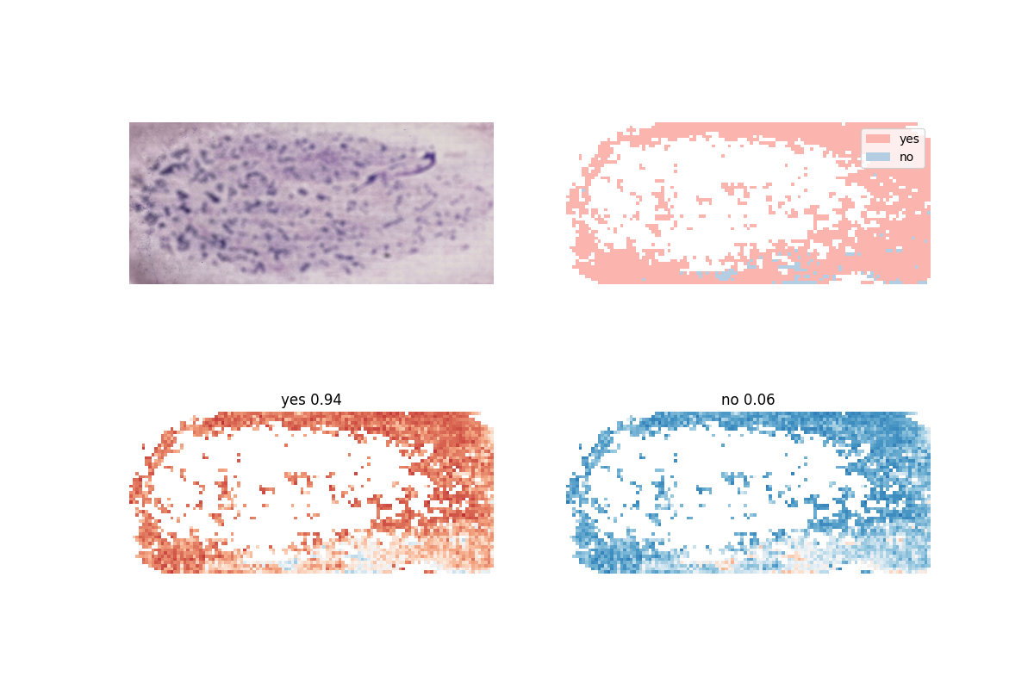
What the model looks at
• Heatmaps localize the morphology driving each call.
• HIGH_BLAST attention tracks clinical blast burden.
– Caveat: trust blast-% ordering, not the exact number.
RESPONSE_CR heatmap: sample 333 19 A (held-out). GT responder; P(yes)=0.945. Red = most relevant tiles — the prediction is auditable.
SFB 1709 · B01 · STAMP

Slide 6
Takeaways
• Response (AUROC 0.87) & high blast burden (0.93) predictable from smear morphology alone.
• Predictions are explainable via heatmaps — ready for clinician review.
• Next: pathologist annotation + integration with single-cell transcriptomics for biomarkers.

