Slide 1
Predicting VEN/AZA Response in AML from Blast Morphology with AI
SFB 1709 · Project B01 • STAMP computational-pathology pipeline
Jiefu Zhu (PhD) • PIs: Prof. J. N. Kather, Dr. M. Janssen
Dept. of Medical Oncology (NCT-HD) & Dept. of Hematology, Heidelberg University Hospital
Notes:
Good morning, and thank you for the time. I'll present our progress on Project B01 — predicting venetoclax–azacitidine response in AML from bone-marrow smear morphology with deep learning. I'll cover the clinical question, our data, the method, all the experiments, the honest cross-validated results, and where I'd like your input.

Slide 2
Clinical problem
Question: can treatment response be predicted from blast morphology?
• AML is an aggressive leukemia driven by immature blast cells.
• Venetoclax + azacitidine (VEN/AZA) is a standard therapy, but response is heterogeneous.
• Predicting response before treatment remains an unmet need.
• Blasts are assessed manually on bone-marrow smears — informative but subjective and slide-level.
SFB 1709 · B01 · STAMP
Notes:
AML is driven by immature cells called blasts. Venetoclax plus azacitidine is a standard therapy, but response varies a lot between patients and is hard to predict up front. Blasts are already read on smears, so there is rich morphological information — it is just subjective and summarised at the slide level. Our question: is that morphology enough to predict response?

Slide 3
Project B01: approach
Image morphology + single-cell transcriptomics, integrated on the same patients.
• Hypothesis: cytologic variability of blasts encodes treatment response.
• Two modalities on paired diagnosis/relapse samples:
– Computational image analysis of blast morphology (this work).
– Single-cell RNA sequencing of the same samples.
• Aim: predict response and identify candidate VEN/AZA biomarkers.
SFB 1709 · B01 · STAMP
Notes:
The hypothesis is that blast morphology carries response information. The project pairs two modalities on the same diagnosis and relapse samples — image analysis, which I'll show today, and single-cell RNA sequencing. The aim is prediction and, by linking the two, candidate biomarkers of VEN/AZA response.

Slide 4
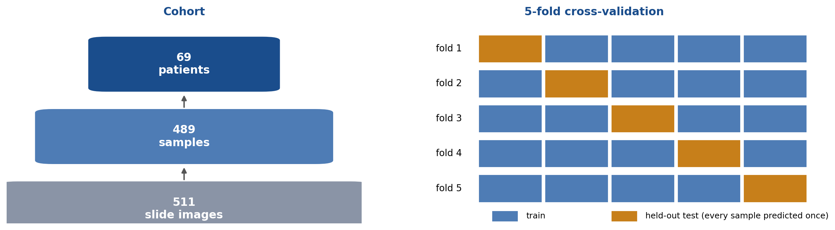
Cohort and cross-validation design
Weakly supervised — one clinical label per sample, no cell-level annotation.
69 patients · 489 bone-marrow samples · 511 slide images. Because there are ~7 smears per patient, folds must be grouped by patient (next slide).
SFB 1709 · B01 · STAMP
Notes:
The cohort is 69 patients, 489 samples across 511 slides. The crucial detail for evaluation is that there are about seven smears per patient — up to 24 for one patient. That shapes how we must cross-validate, which is the next slide.

Slide 5
Evaluation: avoiding data leakage
We re-ran every task with patient-grouped CV; the honest numbers follow.
• RESPONSE_CR is a patient-level outcome, copied onto all ~7 of a patient's smears.
• If folds split by sample, a patient's other smears can sit in training while one is tested — leakage.
• Fix: group folds by PATIENT (StratifiedGroupKFold) — no patient spans train and test.
• Effect is real: sample-split vs patient-grouped AUROC differs by +0.05 (RESPONSE_CR) and +0.03 (HIGH_BLAST).
• All results shown here are patient-grouped.
SFB 1709 · B01 · STAMP
Notes:
A methodological point I want to be transparent about. Response is a patient-level outcome, so it is the same label on all of a patient's smears. If we split folds by sample, the model can see other smears from the same patient during training and then be tested on a held-out smear of that same patient — that is leakage, and it inflates performance. So I re-ran all four tasks grouping the folds by patient, which guarantees no patient is in both train and test. Everything I show from here on is the honest, patient-grouped evaluation.

Slide 6
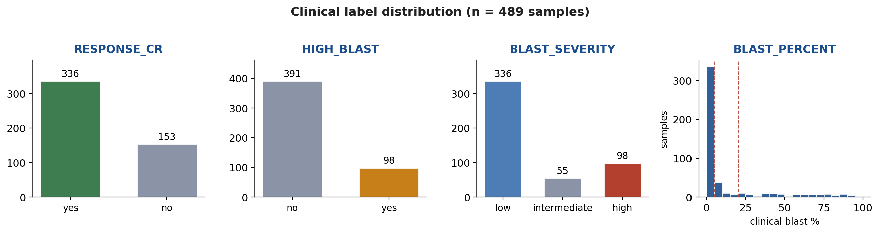
Clinical label distribution
Four prediction targets derived from the clinical table.
Classes are imbalanced (98/489 high-blast; most samples <5% blasts) — we report AUROC, AUPRC and calibration accordingly.
SFB 1709 · B01 · STAMP
Notes:
The four targets and their distributions. Two points: the classes are imbalanced — only about 98 of 489 samples are high-blast — and blast percentage is concentrated below 5% with a long high tail. That tail is where the regression struggles.

Slide 7
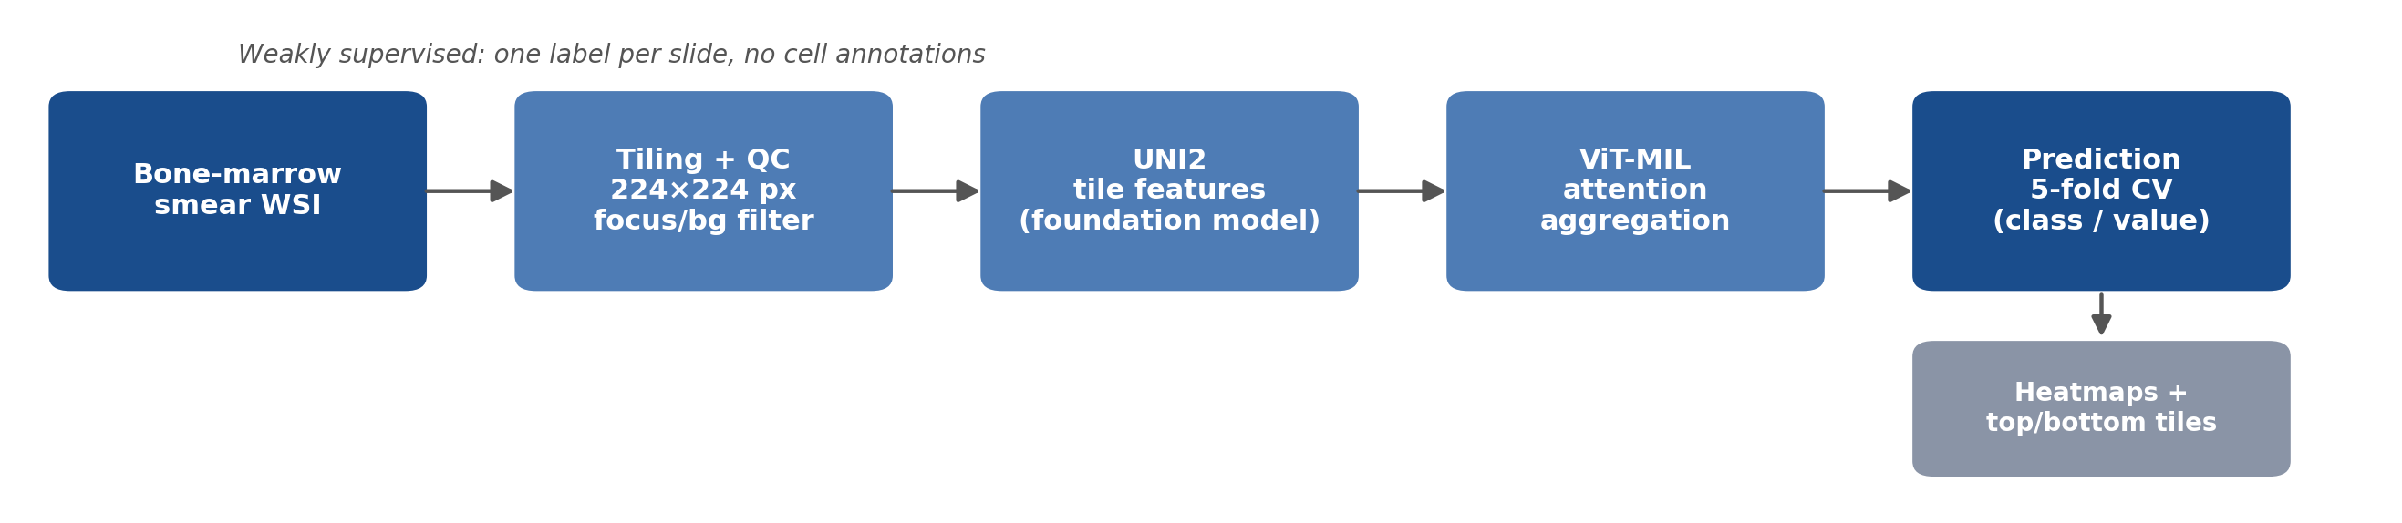
Method: the STAMP pipeline
WSI → tiling + QC → UNI2 tile features → ViT-MIL aggregation → patient-grouped CV.
Tile + QC each slide; embed tiles with the UNI2 foundation model; aggregate with an attention Transformer (MIL); heatmaps expose the evidence.
SFB 1709 · B01 · STAMP
Notes:
The method is the published STAMP pipeline. Slides are tiled and quality-filtered, every tile is embedded by the UNI2 foundation model, and an attention Transformer aggregates them into one prediction per sample. The attention gives us heatmaps, which matter for the interpretability experiment.

Slide 8
Experiments
# | Experiment | What we asked
1 | RESPONSE_CR | Predict complete remission from the smear
2 | HIGH_BLAST | Flag high blast burden
3 | BLAST_SEVERITY | Grade blast burden (low/interm./high)
4 | BLAST_PERCENT | Regress the exact % of blasts
5 | Explainability + triage | Do the heatmaps point at real blasts?
6 | Preprocessing / data QC | Why do some slides lose most tiles?
7 | Cell-resolution pilot | Can a human even see cells in our tiles?
SFB 1709 · B01 · STAMP
Notes:
Here is the full set of experiments — four predictive models, an interpretability test, a preprocessing-quality investigation, and a cell-level feasibility pilot. I'll take them in order.

Slide 9
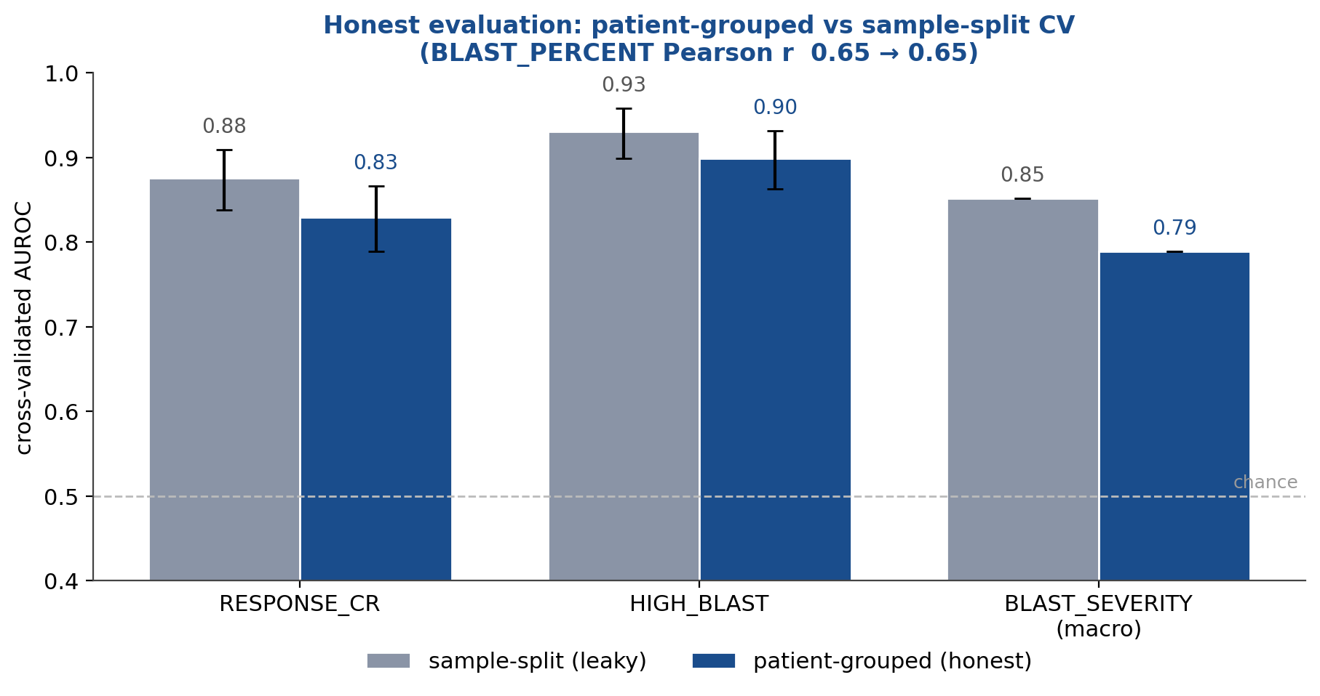
Results: honest (patient-grouped) evaluation
Fixing the leakage lowers the estimates but the ranking of tasks is preserved.
Grey = leaky sample-split; navy = patient-grouped. The patient-grouped bars are the numbers we stand behind.
SFB 1709 · B01 · STAMP
Notes:
This is the headline. The grey bars are the old sample-split numbers; the navy bars are the honest patient-grouped numbers. Performance comes down when we remove the leakage — as expected, most for response — but the picture is stable: high blast burden is easiest, response is predictable above chance, and blast percentage stays the weak spot. These navy numbers are what we stand behind.

Slide 10
Results at a glance (patient-grouped, 5-fold CV)
Task | Type | n | Patient-level result (5-fold CV)
RESPONSE_CR | binary | 489 | AUROC 0.83 (95% CI 0.79–0.87)
HIGH_BLAST | binary | 489 | AUROC 0.90 (95% CI 0.86–0.93)
BLAST_SEVERITY | 3-class | 489 | macro-AUROC 0.79
BLAST_PERCENT | regression | 489 | Pearson r 0.65 · R² 0.04 · MAE 11%
Classification: AUROC with 95% CI. Regression: correlates but is not calibrated.
SFB 1709 · B01 · STAMP
Notes:
The same numbers in a table. I'll now walk through each experiment with the supporting heatmaps.

Slide 11
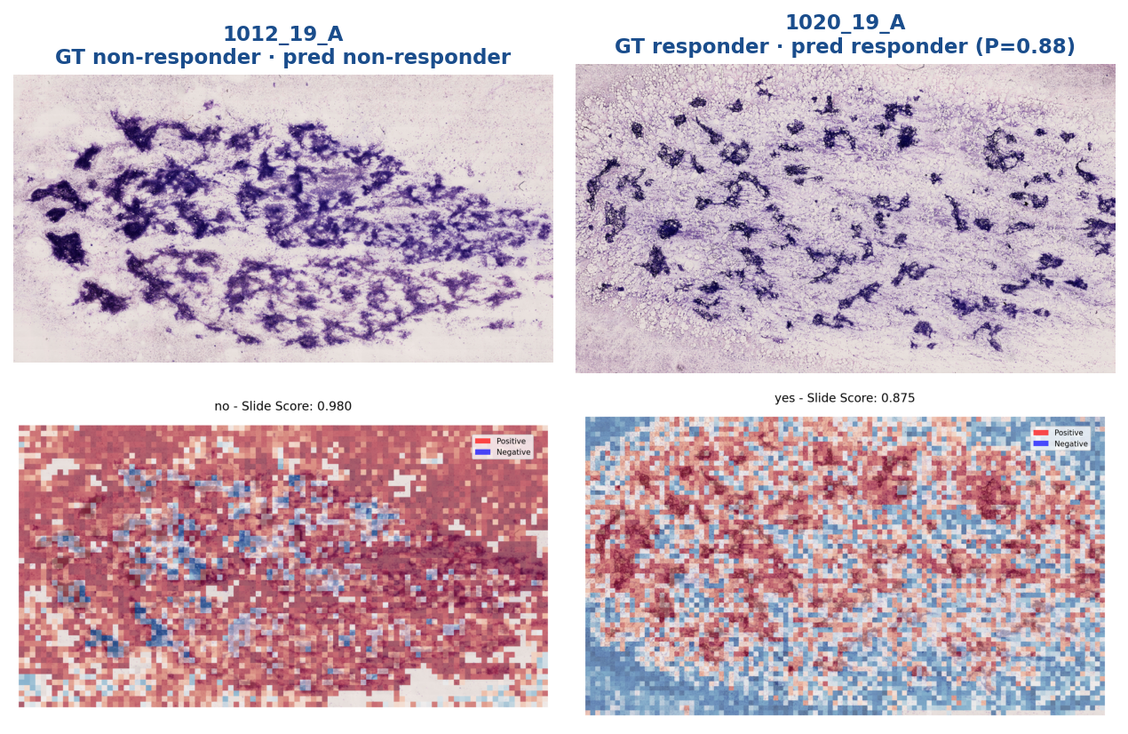
Experiment 1 — Complete-remission label (RESPONSE_CR)
Patient-grouped AUROC 0.83 (95% CI 0.79–0.87) — but note the caveat on the labels (slide 17).
Two held-out cases (left non-responder, right responder). Top: whole-slide image; bottom: attention on cellular smear regions. (Illustrative maps from the initial models.)
SFB 1709 · B01 · STAMP
Notes:
Experiment one is the complete-remission label. The honest patient-grouped AUROC is 0.83. I'll show it here, but with an important caveat I'll come back to in a few slides: in this dataset the RESPONSE_CR label turns out to be defined by the blast count, so this number is closely tied to blast burden rather than an independent outcome. The heatmaps, from the initial models, show attention on the cellular smear.

Slide 12
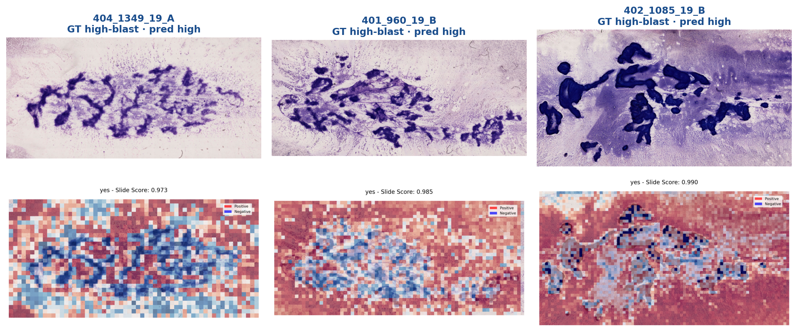
Experiment 2 — High blast burden (HIGH_BLAST)
Patient-grouped AUROC 0.90 (95% CI 0.86–0.93) — the strongest classifier.
Three held-out high-blast cases; attention overlaps the dense blast clusters in the WSIs above.
SFB 1709 · B01 · STAMP
Notes:
Experiment two, high blast burden — our strongest model at AUROC 0.90, and it barely moves under patient-grouped CV, which makes sense because blast burden is genuinely visible in the images. The attention lands on the dense blast clusters. This is the signal we trust most.

Slide 13
Experiment 3 — Blast-severity grading (3-class)
Reliable at the extremes; the intermediate class is the main source of error.
• Three-class grade: low / intermediate / high.
• Patient-grouped one-vs-rest AUROC: high 0.83 · low 0.82 · intermediate 0.71.
– Extremes separate reliably; the intermediate band is hardest.
• Indicates where additional expert annotation would help most.
SFB 1709 · B01 · STAMP
Notes:
Experiment three grades severity into three levels. High and low are recovered well; the intermediate band is hardest, which matches clinical experience — the middle is genuinely ambiguous. That tells us where extra annotation would pay off.

Slide 14
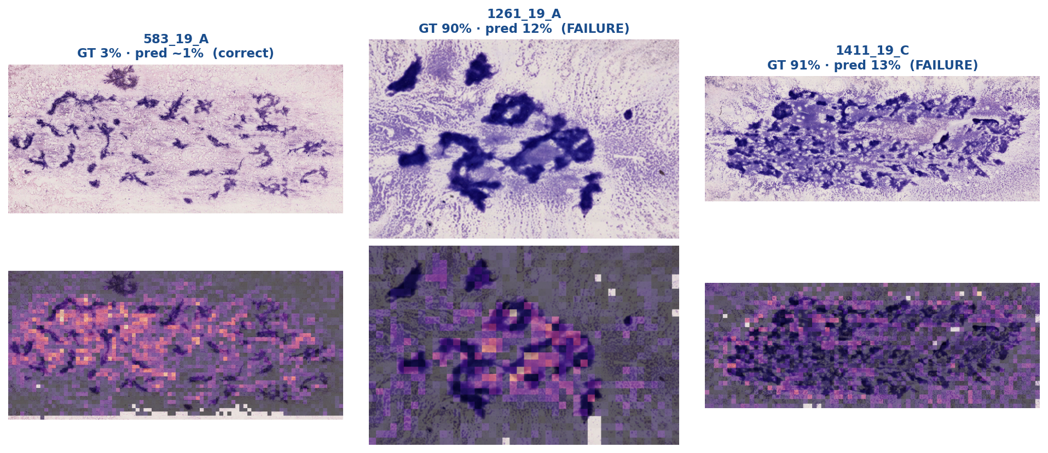
Experiment 4 — Blast-percentage regression
Pearson r 0.65, R² 0.04, MAE 11% — good ranking, poor calibration.
Prediction heatmaps: the model attends to blast-rich regions but under-predicts the count on high-blast slides (e.g. 90% → 12%).
SFB 1709 · B01 · STAMP
Notes:
Experiment four, the exact blast percentage. Correlation is moderate — Pearson 0.65 — so ordering is roughly right, but calibration is poor: it systematically under-predicts the highest-blast slides, as in these examples where the truth is 90% and the model says about 12%. Use the ranking, not the absolute number.

Slide 15
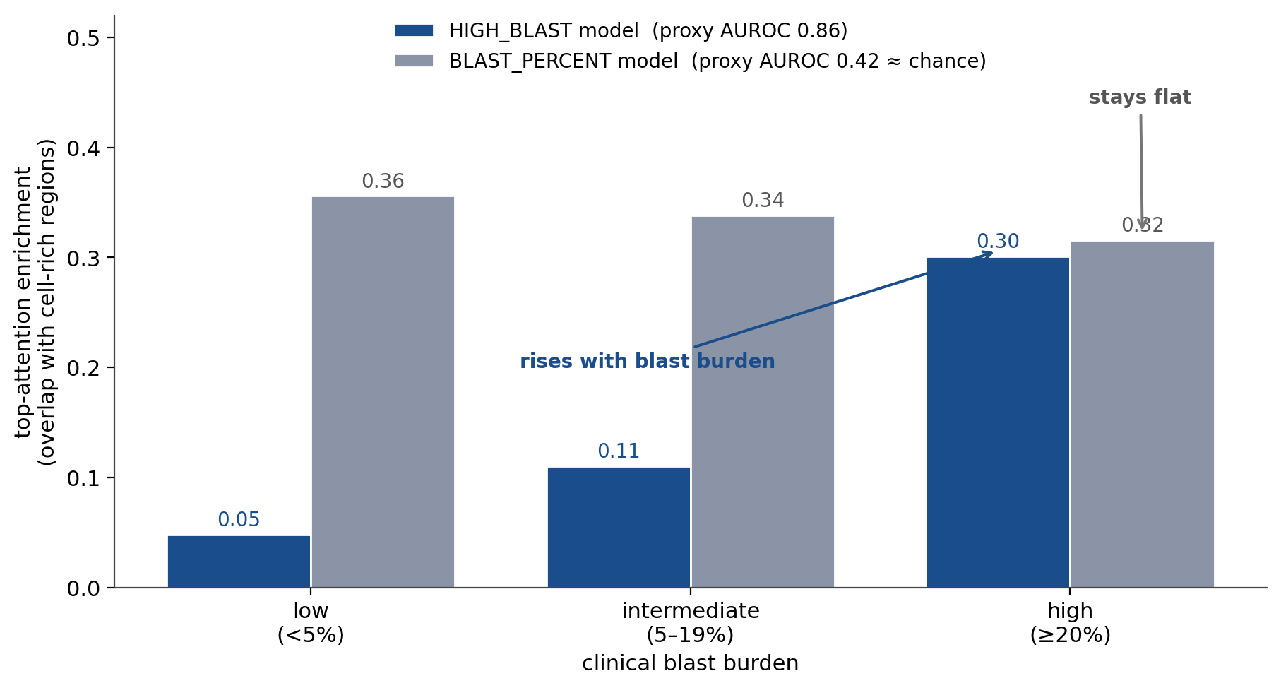
Experiment 5 — Does attention localise real blasts?
HIGH_BLAST maps track clinical blasts (proxy AUROC 0.86); regression maps do not (0.42).
Overlap of top-attended regions with cell-rich tissue by clinical blast band, over ~490 samples. HIGH_BLAST attention rises with blast burden; BLAST_PERCENT attention does not.
SFB 1709 · B01 · STAMP
Notes:
Experiment five asks whether the attention is trustworthy, across all samples. For the HIGH_BLAST model, the overlap of top-attended regions with cell-rich tissue rises with blast burden — proxy AUROC 0.86. For the regression model it is flat, no better than chance. So we use the HIGH_BLAST maps for visual triage, not the regression maps.

Slide 16
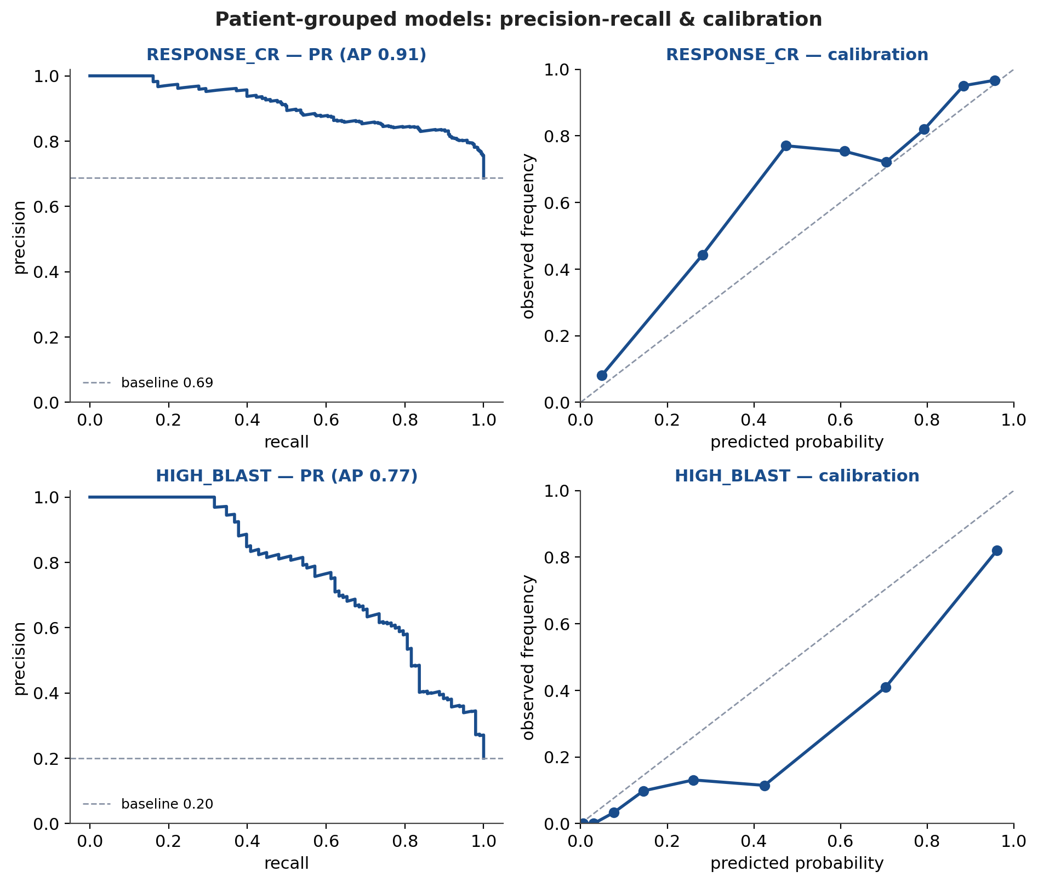
Precision-recall and calibration
Beyond AUROC: performance under imbalance, and probability calibration.
Patient-grouped RESPONSE_CR and HIGH_BLAST. PR curves address the class imbalance; reliability curves show how well probabilities are calibrated.
SFB 1709 · B01 · STAMP
Notes:
Because AUROC can look optimistic under class imbalance, here are precision-recall curves and calibration. HIGH_BLAST holds up well on precision-recall; response is weaker, consistent with the AUROC. The reliability curves show where the probabilities are well-calibrated and where they'd need adjustment before any clinical use.

Slide 17
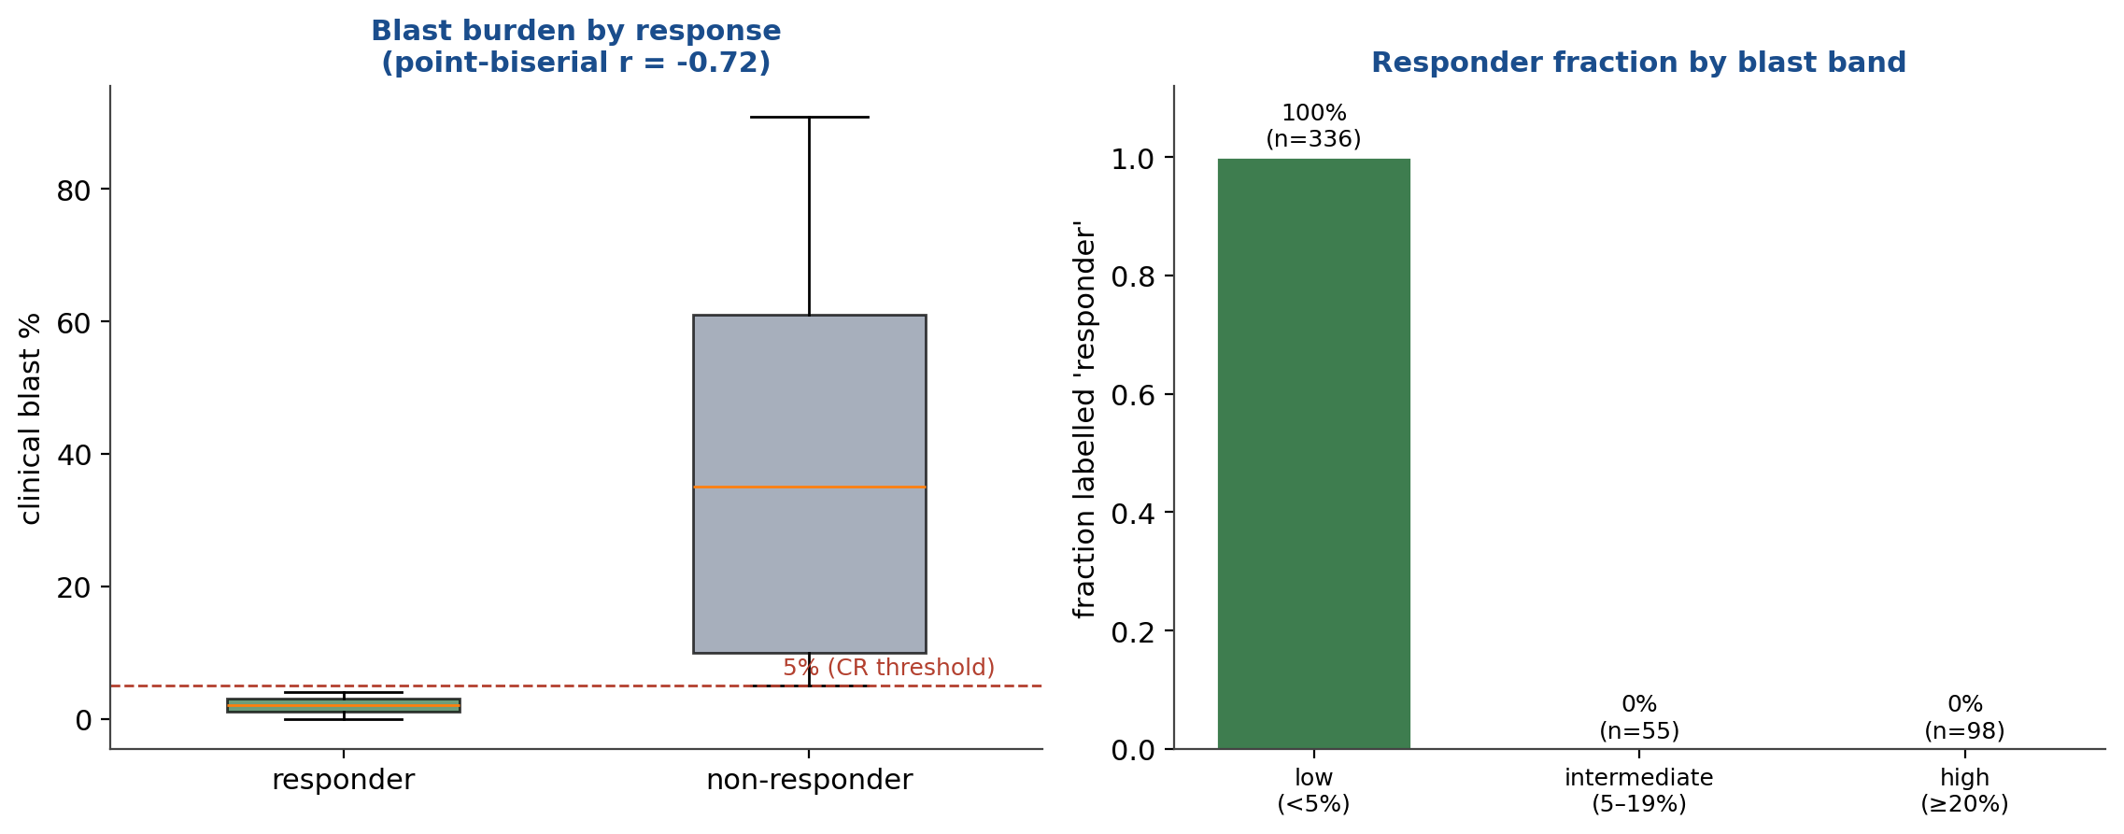
Important caveat: what RESPONSE_CR actually measures
RESPONSE_CR ≡ blast < 5% here, so the 'response' model is re-reading blast burden, not an independent treatment outcome.
In this table, every <5%-blast sample is labelled 'responder' and every ≥5% sample 'non-responder' — RESPONSE_CR is exactly the <5%-blast (morphologic-CR) criterion.
SFB 1709 · B01 · STAMP
Notes:
This is the most important caveat, and I want to be upfront about it. When I split the response labels by blast burden, the separation is perfect: every sample under 5% blasts is labelled responder, and every sample at or above 5% is non-responder. In other words, RESPONSE_CR as provided is exactly the morphologic complete-remission criterion — marrow blasts under 5%. So the 0.83 'response' number is the model re-reading blast burden on the same slide, not predicting an independent treatment outcome. A genuine response-prediction task needs the outcome decoupled from the same-slide blast count — for example predicting later response from the diagnostic smear. I flag this clearly and it's my first question for the clinical team.

Slide 18
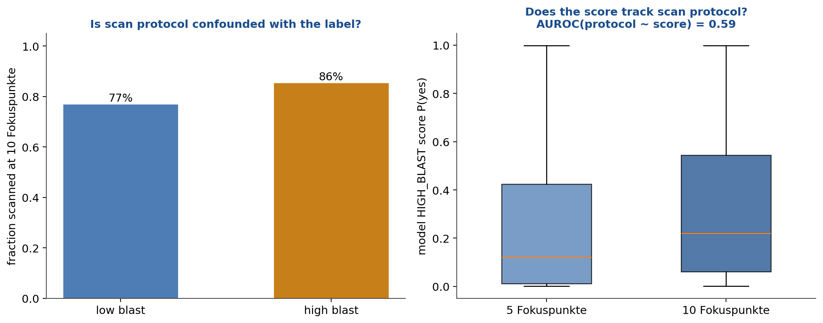
Batch-effect check: scan protocol
Score-predicts-protocol AUROC = 0.59 (0.5 = no batch signal).
Left: is the scan protocol (5 vs 10 focus points) associated with the label? Right: can the model's score predict the protocol? A high AUROC here would be a red flag.
SFB 1709 · B01 · STAMP
Notes:
Kather will ask about batch effects, so I checked directly. On the left, whether the scan protocol is associated with the label; on the right, whether the model's score can predict the protocol — that AUROC is 0.59. The closer to 0.5, the less the model is keying on scanner batch rather than biology. I'll also add stain normalization as a safeguard.

Slide 19
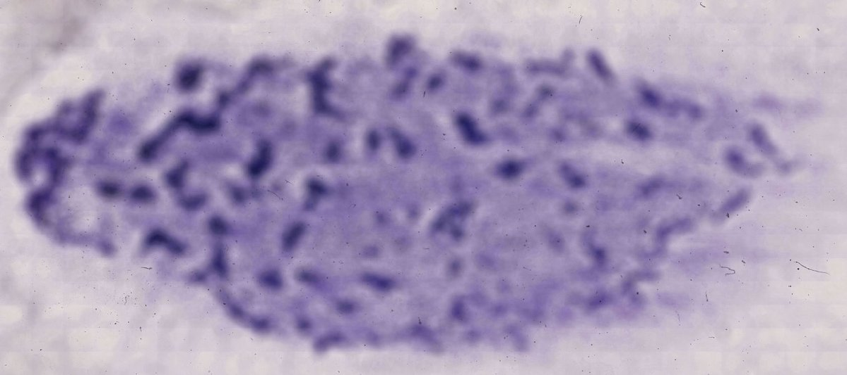
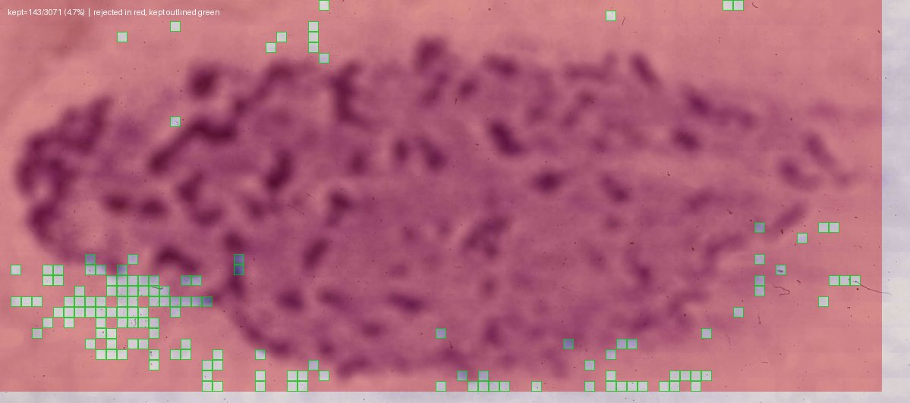
Experiment 6 — Preprocessing quality investigation
Cause: out-of-focus tiles fail the focus filter — the 5- vs 10-Fokuspunkte scan setting. Fix: re-scan.
Before — raw smear (sample 127 26 C); tissue is present.
After — only 4.7% of tiles retained (green kept, red dropped).
SFB 1709 · B01 · STAMP
Notes:
Experiment six: some slides lose almost all tiles in preprocessing — this one kept under 5%. The tissue is present; the tiles fail the focus filter, not the background filter, and it tracks the scan setting. The pipeline is behaving correctly; the fix is upstream — re-scan those slides at higher focus.

Slide 20
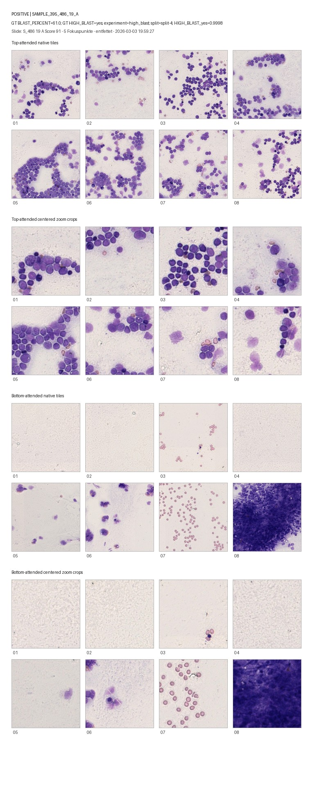
Experiment 7 — Cell-resolution feasibility pilot
• Can individual cells be resolved in the tiles the model selects?
• A prerequisite check before any cell-level (DeepHeme-style) model.
• 12-slide deck: 5 regression failures, 4 high-blast, 3 low-blast.
– Uses existing native-resolution tiles; no new training.
– Status: assembled; awaiting pathologist read-out.
Model-selected tiles + centred zooms for one high-blast case; assembled for hematopathologist review.
SFB 1709 · B01 · STAMP
Notes:
The last experiment is forward-looking. Before investing in a cell-level method like DeepHeme, we need to know whether a human can resolve individual cells in the tiles our model selects. So I assembled a twelve-slide review deck from the native-resolution tiles the pipeline already exports. It's ready for a hematopathologist to score, which is where I'd value the team's help.

Slide 21
Summary of findings
Robust, interpretable blast-burden reading; the 'response' label needs decoupling from blast count.
• The models reliably read blast burden from morphology: HIGH_BLAST AUROC 0.90, robust to the leakage fix.
• Caveat: RESPONSE_CR ≡ blast <5% here, so it is not yet an independent treatment outcome.
• Attention is interpretable: HIGH_BLAST maps localise blast-rich tissue.
• Blast-% regression ranks but is not calibrated — use ordering only.
• No strong scanner-batch confound (protocol-from-score AUROC 0.59); focus is a fixable bottleneck.
SFB 1709 · B01 · STAMP
Notes:
Pulling it together: the strong, honest result is that the model reliably reads blast burden from morphology, and that holds up under patient-grouped evaluation. The key caveat is that the response label, as provided, is the blast-count criterion, so we can't yet call it treatment-response prediction. The models are interpretable, the regression ranks but isn't calibrated, there's no strong scanner-batch confound, and focus quality is fixable.

Slide 22
Limitations
• RESPONSE_CR label ≡ blast <5% — reflects the CR criterion, not an independent outcome.
• Labels are slide-level; no cell-level ground truth yet.
• Blast-% regression is mis-calibrated on high-blast samples.
• Some confident errors may be label noise — need pathologist adjudication.
• Single-center cohort; external validation pending.
SFB 1709 · B01 · STAMP
Notes:
Limitations. Labels are slide-level. The percentage regression is mis-calibrated. The subgroup analyses are limited by small numbers. Some confident errors may be label noise. And this is a single center — external validation is still ahead.

Slide 23
Proposed next steps
Immediate priority: pin down the response label, then pathologist review + re-scan.
• Immediate: confirm RESPONSE_CR definition; obtain an outcome decoupled from same-slide blast count.
• Short term: hematopathologist review of the 12-slide pilot and the confident-error list.
• Short term: re-scan low-focus slides at full focus and re-run those samples.
• Medium: recalibrate/reframe blast-% (ordinal); annotate the intermediate band; add stain normalization.
• Long term: integrate morphology with single-cell RNA-seq for biomarkers; external validation.
SFB 1709 · B01 · STAMP
Notes:
Proposed next steps, and where I'd like your input. Short term: a pathologist review of the pilot and the confident-error list, and re-scanning the low-focus slides. Medium term: recalibrate the blast-percentage task, annotate the intermediate band, add stain normalization, and build a small cell-level annotation set. Long term: integrate with the single-cell data for biomarkers and validate externally. My immediate ask is the pathologist review and the re-scan.

Slide 24
Summary
Thank you — I welcome your feedback and questions.
• Honest, patient-grouped: morphology reads blast burden well (HIGH_BLAST 0.90).
• Key caveat surfaced: RESPONSE_CR ≡ blast <5% — decouple the outcome before claiming response prediction.
• Interpretable, auditable predictions; no strong scanner-batch confound.
• Clear next actions: confirm labels, pathologist review, re-scan, recalibrate, annotate.
• Next horizon: morphology + single-cell transcriptomics for VEN/AZA biomarkers.
SFB 1709 · B01 · STAMP
Notes:
In summary: the honest, robust result is that morphology reads blast burden well and it holds under patient-grouped evaluation. The most important thing I surfaced is that the response label here is the blast-count criterion, so decoupling the outcome is the first priority. The models are interpretable, I've checked the confounds, and the exciting direction is integrating with the single-cell data. Thank you — I welcome your feedback and questions.

Slide 25
Appendix — backup slides
Reference material for discussion.
• Patient- vs sample-level leakage detail
• Full metrics table (sample vs patient, all tasks)
• RESPONSE_CR definition checklist
• Anticipated questions
SFB 1709 · B01 · STAMP
Notes:
These are backup slides for the discussion.

Slide 26
Appendix — why sample-split leaks
• 69 patients but 489 samples: mean 7.1, max 24 smears per patient.
• RESPONSE_CR is one outcome per patient, copied to every smear of that patient.
• Sample-split CV puts a patient's other smears in training → memorisation, not generalisation.
• Result: AUROC inflated by +0.05 (RESPONSE_CR), +0.03 (HIGH_BLAST).
• Patient-grouped StratifiedGroupKFold removes it; every sample still predicted once.
SFB 1709 · B01 · STAMP
Notes:
Detail on the leakage and the fix.

Slide 27
Appendix — full metrics (sample vs patient)
Task | Sample-split | Patient-grouped
RESPONSE_CR | AUROC 0.88 (95% CI 0.84–0.91) | AUROC 0.83 (95% CI 0.79–0.87)
HIGH_BLAST | AUROC 0.93 (95% CI 0.90–0.96) | AUROC 0.90 (95% CI 0.86–0.93)
BLAST_SEVERITY (macro) | AUROC 0.85 | AUROC 0.79
BLAST_PERCENT | r 0.65, R² 0.02 | r 0.65, R² 0.04
SFB 1709 · B01 · STAMP
Notes:
Full comparison table for reference.

Slide 28
Appendix — RESPONSE_CR definition (to confirm)
• Confirm: complete-remission criteria (ELN 2022?) and assessment timepoint.
• Confirm: which smear (diagnosis vs relapse) each label attaches to.
• Confirm: handling of patients with multiple timepoints in the outcome.
• These affect interpretation and are needed before any clinical claim.
SFB 1709 · B01 · STAMP
Notes:
Checklist of label-definition questions to resolve with the clinical team.

Slide 29
Appendix — anticipated questions (1/2)
• Leakage: addressed — all numbers are patient-grouped.
• Imbalance: see PR/calibration slide; AUROC + AUPRC both reported.
• Is 'response' just blast burden? Yes here — RESPONSE_CR ≡ blast <5% (CR criterion); needs decoupling.
• Batch effects: protocol-from-score AUROC 0.59 (mild); stain-normalization planned.
SFB 1709 · B01 · STAMP
Notes:
Q&A crib — methodology.

Slide 30
Appendix — anticipated questions (2/2)
• Why UNI2 / this model? Default; foundation-model & aggregator ablations planned.
• Clinical utility? Proof of concept; needs calibration + external validation.
• Why smears vs flow? Cheap, routine, preserves single-cell morphology (orthogonal signal).
• scRNA-seq integration: correlate attention regions / image features with cell states & response.
SFB 1709 · B01 · STAMP
Notes:
Q&A crib — clinical & next steps.

