Slide 1

Story Telling with Data
GameCo – Case Study
By:
Katherine Lecce

Slide 2
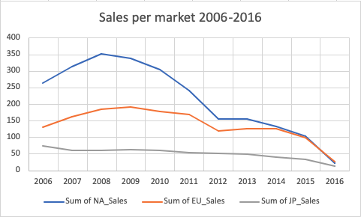
Global Sales Insights
Global Sales Chart:
Demonstrates 10 - year sales in Following Global Marketing:
North America (NA_Sales)
Europe (EU_Sales)
Japan (JP_Sales)
2012 - 2016
Last 4 years:
North America and Japan shows a steady Decline in Sales
Historically high sales in the first 5 years.
Opportunity for sales growth in 2017
Scatter Plot Analysis: Visually depicts the rapid decline in North American sales, represented by the blue data points.
2017 Marketing Strategy: Emphasizes targeting the gaming demographics within North America to revitalize sales and engagement in the region.
Global Scatter Plot Takeaways

Slide 3
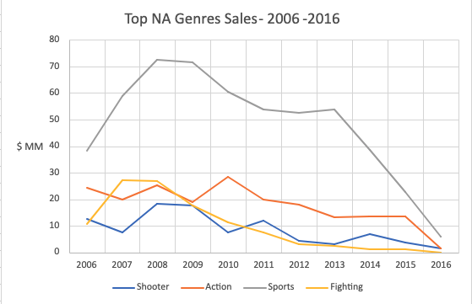
North America Performance Per Genre 2006-2016
Gaming Genres performance – Last 10 years
2006-2014 - Sports genre highest Sales within the NA market
2015-2016 – 2nd highest earning Genre
3rd Overall Earnings in the past ten years (2006-2016)
Graph Takeaways
Major Decline 2015: Highlighted in grey, the sports genre experienced a significant downturn in 2015.
Biggest Potential for Recovery: Despite this decline, it presents the largest opportunity to recover missed sales in recent years.
Factors Driving Potential: Advancements in technology, shifting consumer preferences, and innovative marketing strategies might be major opportunities for GameCo to further research for the 2017 year for sports-related games.
Notes:
Looking at the Macro-econmics of the sales per Genre in the North American market will help us determine where the marketing team's money should go according the past success each genre has had year over year.
Looking at the last decade of the data set we see that shooting games has the highest historical sales.
However, the marketing team might want to invest most of their time and money increasing the Sport Genre of sales in NA since there has been historical sales up til the 2014. As we learned previously in earlier Section in 1.? we should invest

Slide 4
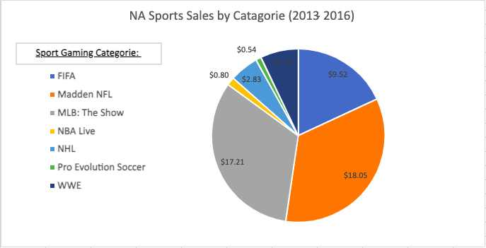
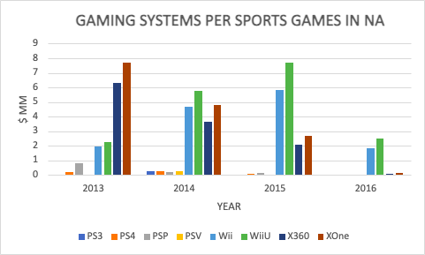
Sports Gaming Performance in North America (2013-2016)
NA Market Biggest Growth Opportunity Sports Genre 2017
Gaming Systems -Sports Genre
Line Graph Analysis: Offers a visual representation of the most popular gaming consults for sports games within the North American Market.
Prime Opportunity: Wii Systems Identified as the best way to create new sales and cultivate sales and generate for cultivating sales and generating excitement around new sports games in the North American market for 2017.
Secondary Opportunity: PlayStation Consults: Represents another significant opportunity for developing marketing strategies tailored for the 2017 fiscal year.
Sub-Genre of Sporting Games
Top Performer: Madden NFL Games: Achieved the highest grossing sporting franchise title in North America, raking in an impressive $18.05 million.
Runner-Up: MLB: The Show: Secured the second-highest spot with earnings totaling $17.21 million in the past three years.
Third Place: FIFA Franchise: Garnered significant success, grossing $9.52 million and claiming the third position in sales within the North American market.

Slide 5

GameCo Sales Insights
Data Insights Summary:
Global sales have fallen short of expectations in recent years, with a consistent decrease observed in North America and Japan.
Over the past decade, sales trends have not followed a linear pattern, indicating a change in conducting sales growth in the past few years.
Despite the overall decline, there is a significant opportunity for sales growth in North America in 2017 – focusing on fostering sales in the Game Genre.
GameCo should prioritize developing targeted strategies to capitalize on this opportunity and revitalize sales in the North American market.
Next Steps:
Logistics and Distribution:
Increased competition and supply chain inefficiencies.
Target is where the limited retail presence is, and there is inadequate online distribution.
Target Insufficient partnerships with distributors.
Marketing:
Ineffective campaigns and low brand awareness.
Find opportunity to market to avid NFL, NBA, FIFA, and MBL fans during peak sporting seasons through TV, social digital channels, and brand deals with professional players in North America
Economic Factors:
Target where consumer spending shifted in the past few years per state
Focus on Promotional advertising during holiday season.

Slide 6

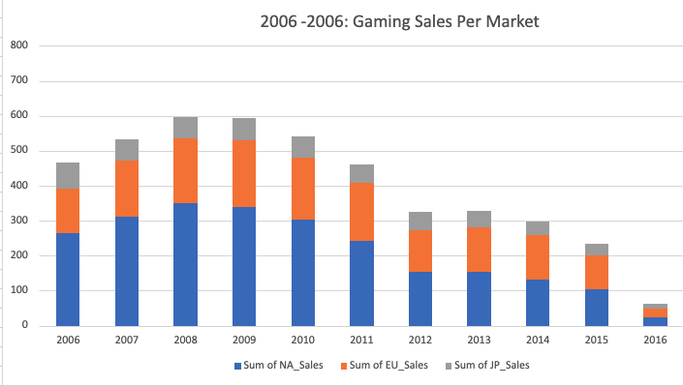
2017 Sales Opportunities for North America
Industry Struggles Over Past Decade: The gaming industry has faced challenges over the past 10 years, with our largest market experiencing the most significant setbacks among all three markets.
Opportunity for GameCo: This situation presents GameCo with a prime opportunity to capitalize on new sporting games within popular franchises, potentially boosting sales for 2017.
Left Bar Chart Analysis: Illustrates that over the past 6 years, the United States has encountered difficulties in maintaining profitable sales momentum within the gaming category.
Marketing Strategy Opportunity: The GameCo marketing team can seize this opportunity by reallocating more funds to this segment, aiming to enhance sales performance in North America.

Slide 7

Thank you!
2017 Marketing Focuses:
NA Marketing
Sports Genre Growth
Gaming Systems – Wii and PlayStation
Next Steps – Work with Marketing Team to create customer focus ad campaigns and sponsorships through North America
Questions

