Slide 1
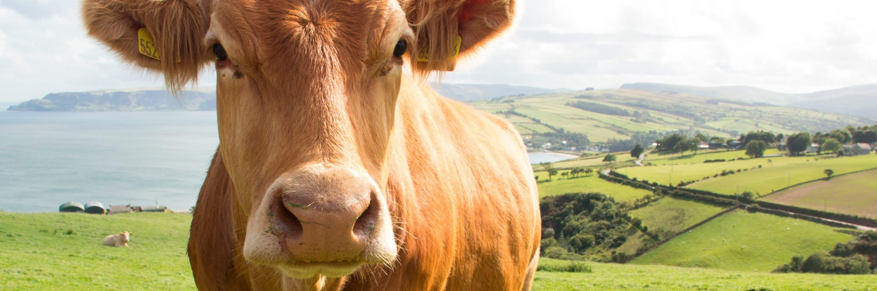

Compression algorithms and their functionality for animal health

Slide 2

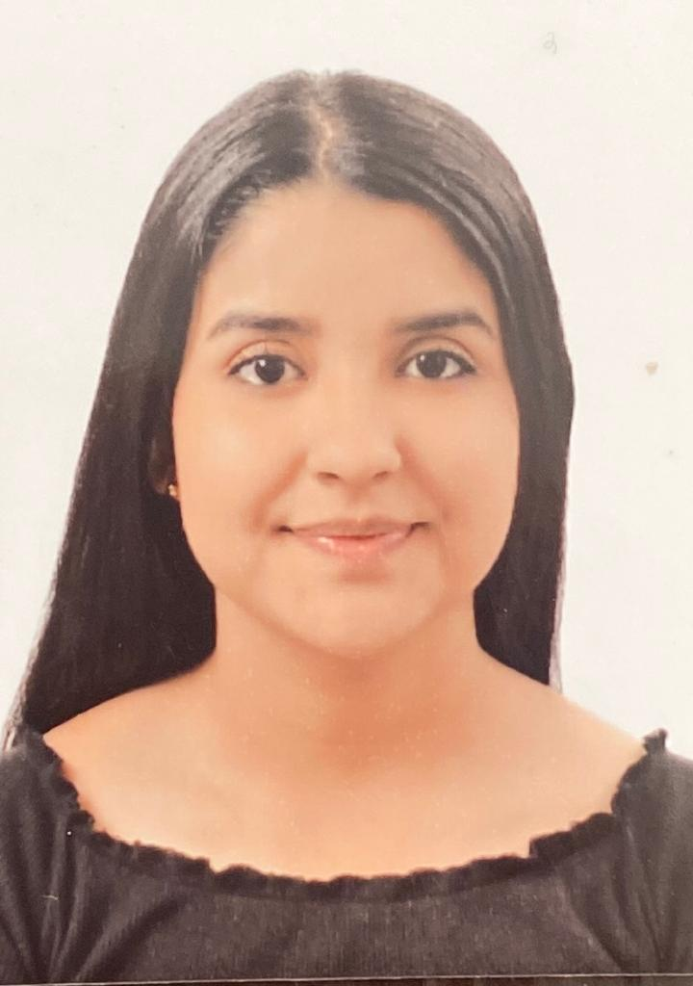

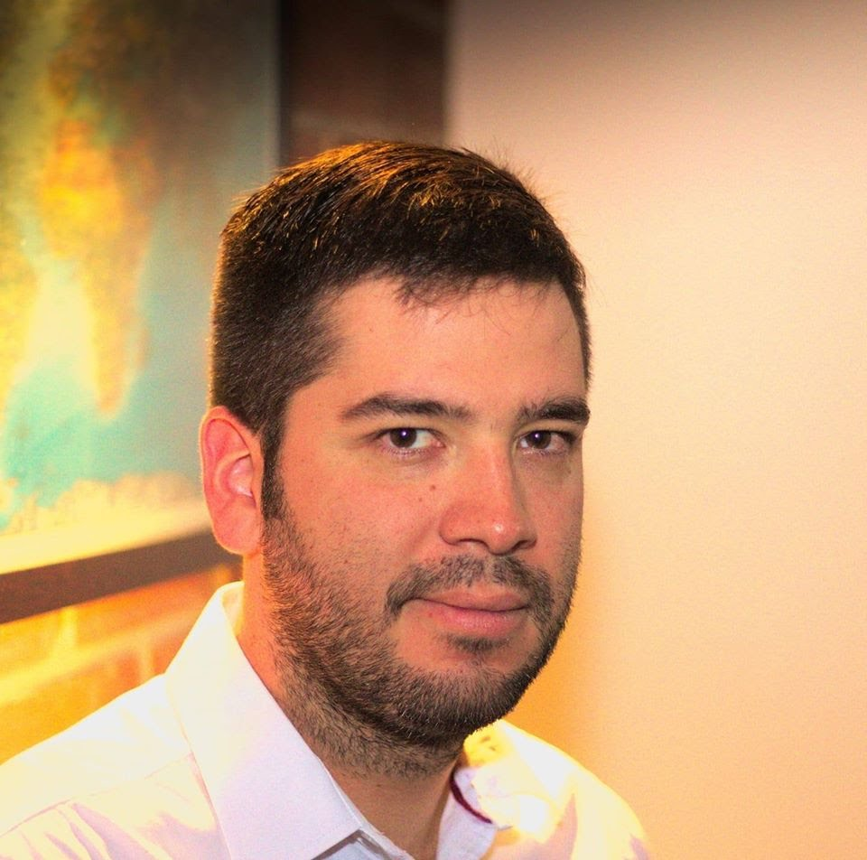
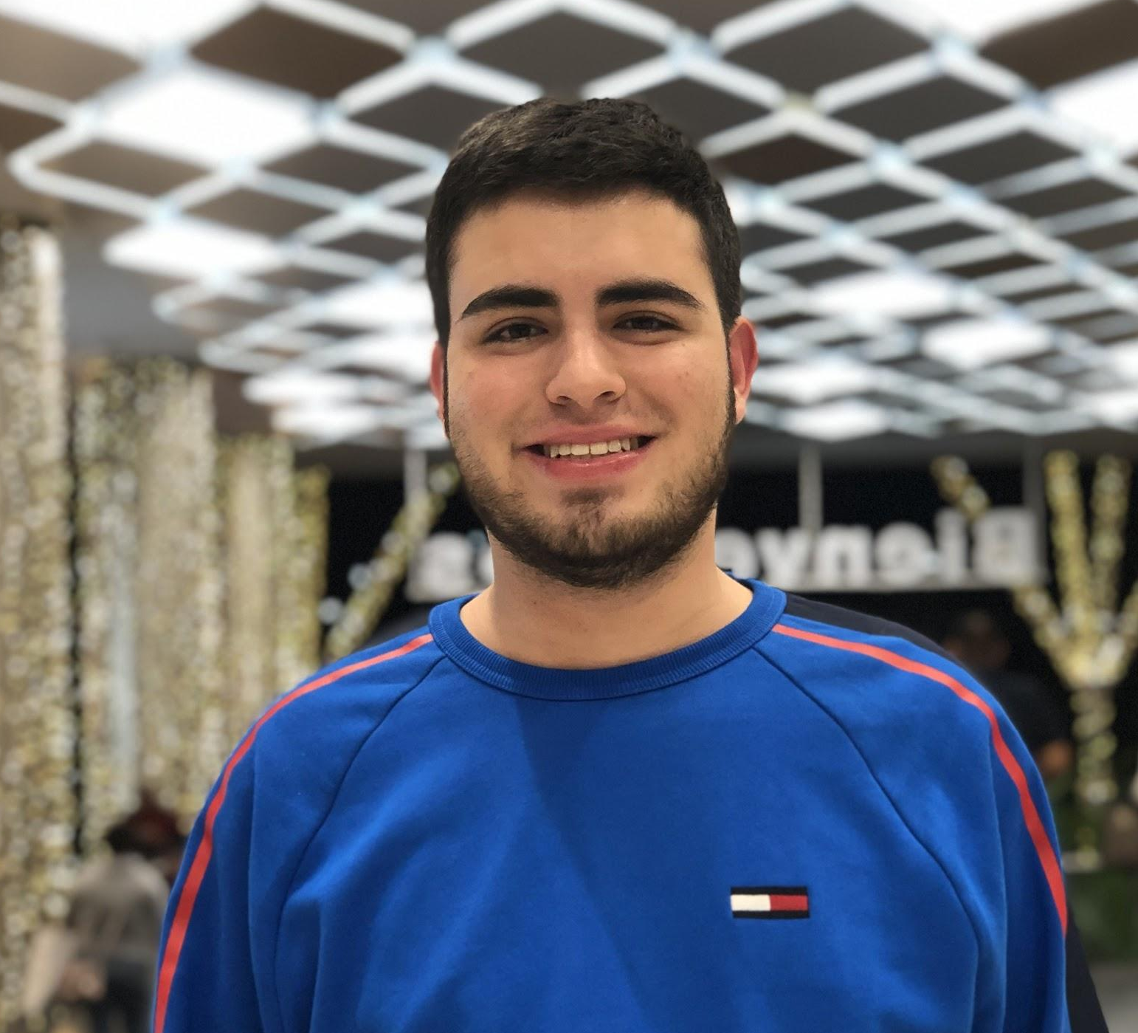

Team Presentation
Katherine Benjumea
Valentina Ochoa
Simón Marín
Mauricio
Toro
https://github.com/Katherine-Ortiz/ST0245-001

Slide 3
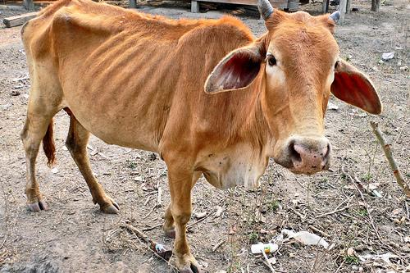
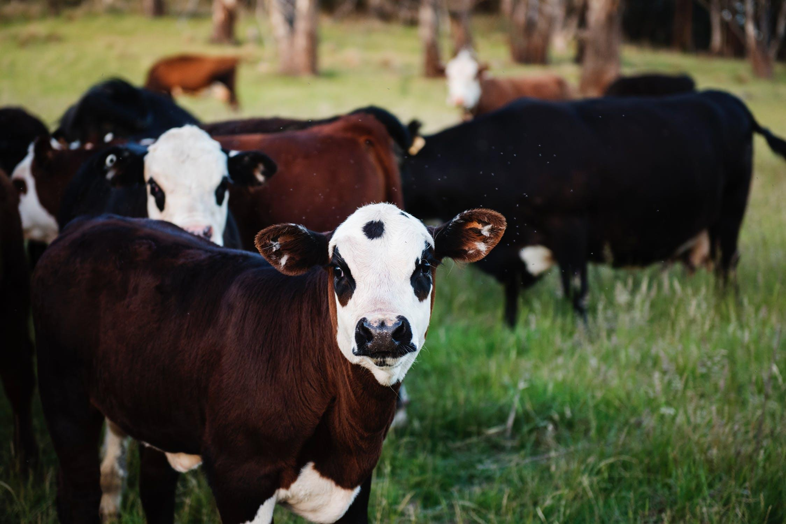
Training Process
Convolutional Neural Network
Sick-Cattle Images
Classification Algorithm
Classification Model
Healthy-Cattle Images

Slide 4
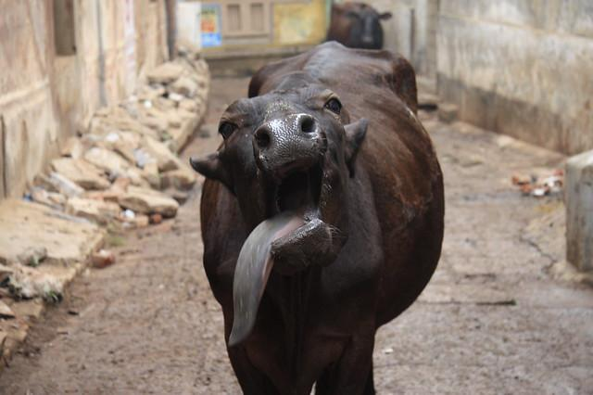
Testing Process
???
Is sick
Cattle Image
Image scaling
Classification Model
Output

Slide 5
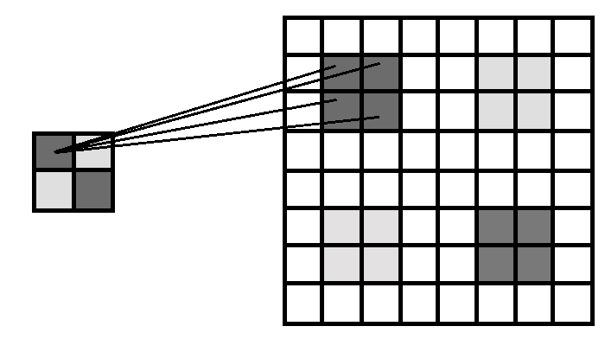
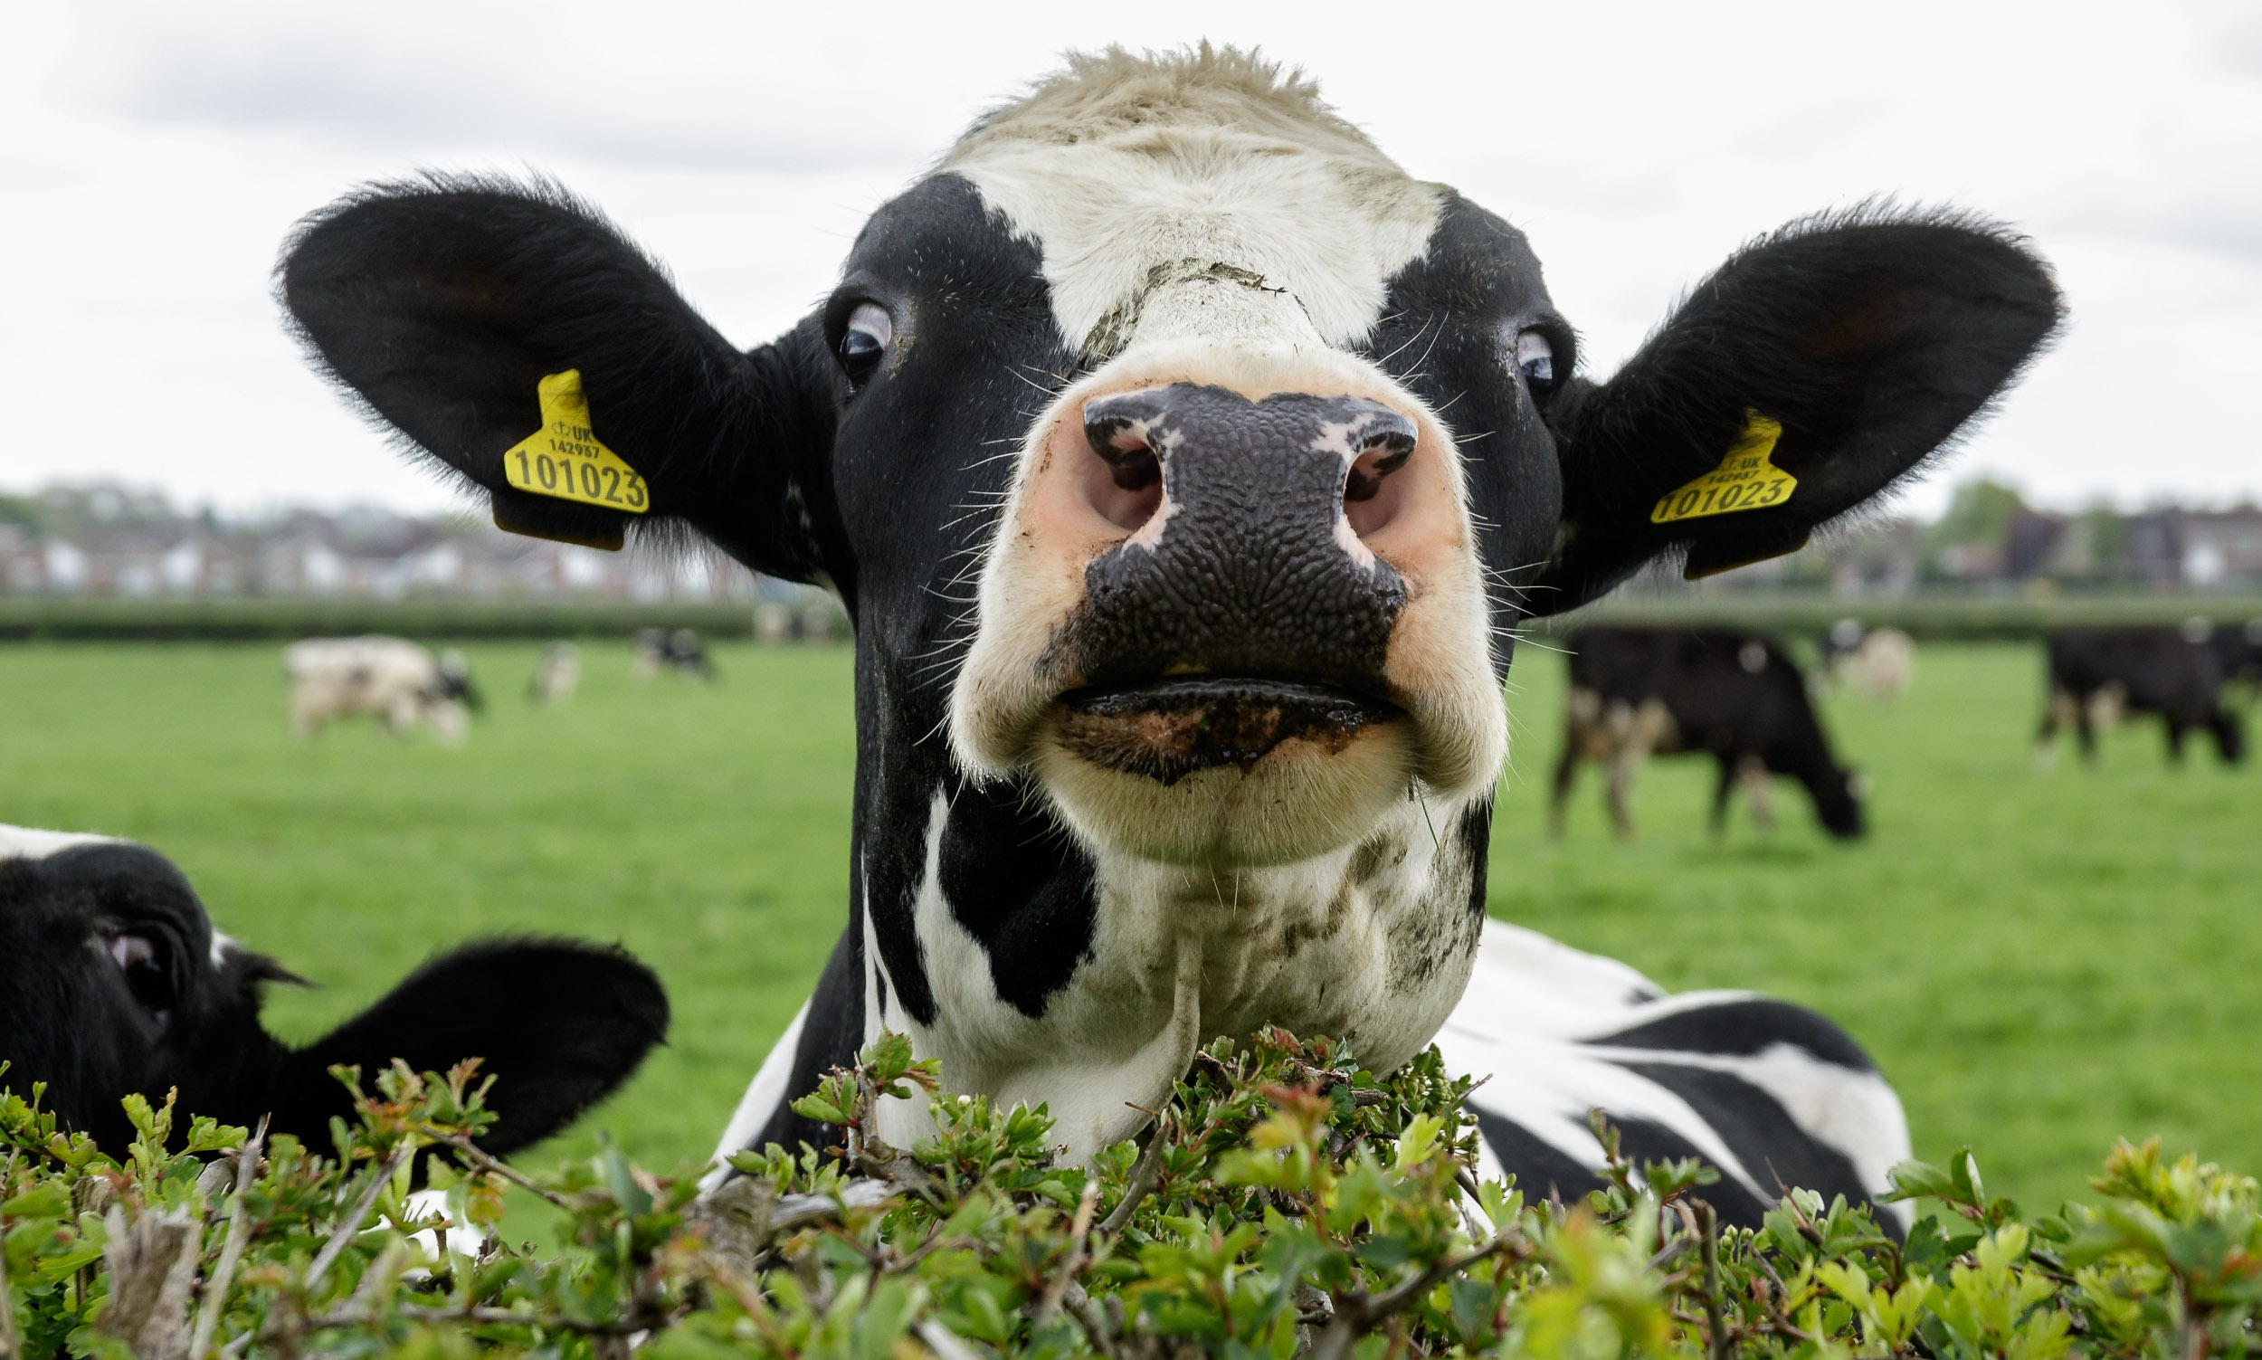
Compression Algorithm Design
Fig. Image scaling by nearest neighbor
After the process of changing from csv data to images, these images are compressed using the nearest neighbor image scaling method.

Slide 6
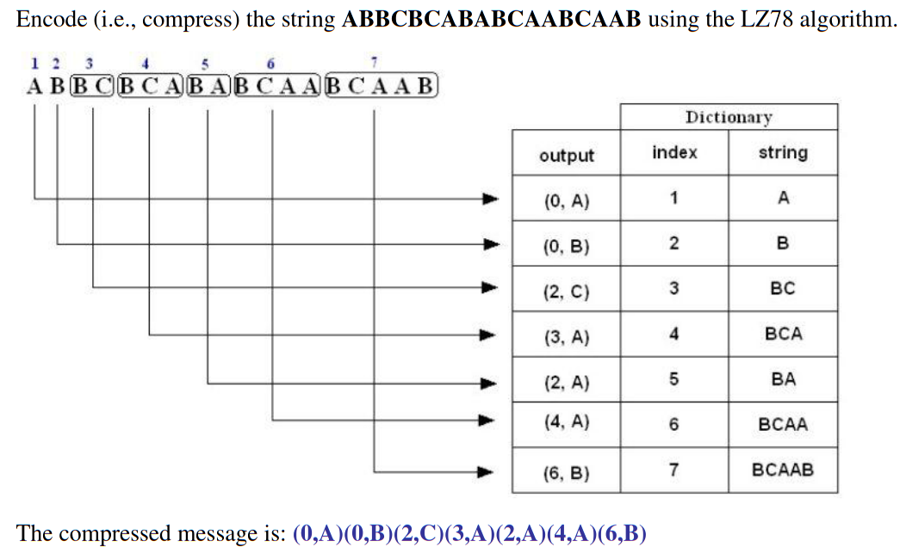
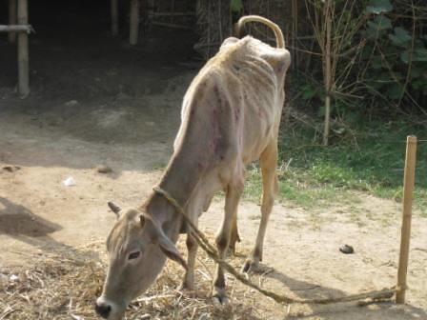
Compression Algorithm Design
Use vectorized figures to
explain the algorithm you designed, so
They are not pixelated like mine
Use these
Colors for
Your figures
Explain the figures in your
own words

Slide 7
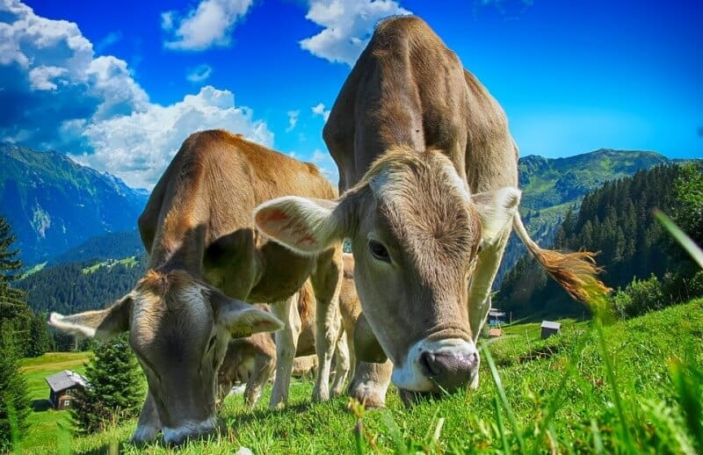
Keep this title
Complete this slide
For the third deliverable
Compression Algorithm Complexity
DO NOT use red color in the slides
Create the table in Powerpoint. Do not copy pixelated screenshots from the technical report please!
 | Time Complexity | Memory Complexity
Image compression | O(N²*M*2^{M}) | O(N*M*2^{M})
Image decompression | O(N*M) | O(1)
Time and memory complexity of the (In this semester, one could be LZS, LZ77, LZ78, Huffman… please choose) algorithm. Please explain what do N and M mean in this problem. PLEASE DO IT!
Explain the tables in your
own words
Include a HD picture related to the problem of animal health in precision livestock farming
Use superindices to represent the exponents. DO NOT use the ^ symbol

Slide 8
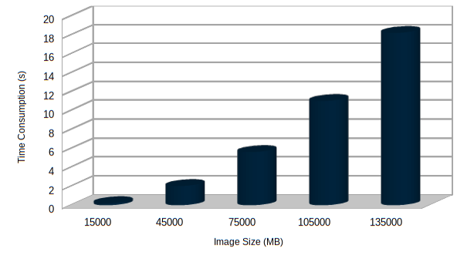
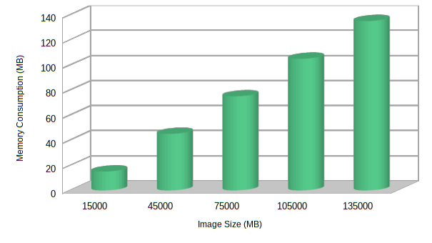


Complete this slide
For the third deliverable
Time and Memory Consumption
Keep this title
DO NOT use red color in the slides
Create the plots in Excel. Do not copy pixelated screenshots from the technical report please!
Time Consumption
Memory Consumption
Please, include measurement units in both X axis and Y axis, for instance, MB, s, KB, minutes...

Slide 9
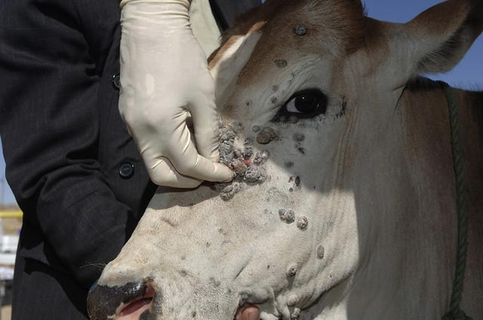
Keep this title
Complete this slide
For the third deliverable
Average Compression Ratio
DO NOT use red color in the slides
Create the table in Powerpoint. Do not copy pixelated screenshots from the technical report please!
 | Compression Ratio
Healthy Cattle | 100 : 1
Sick Cattle | 98 : 1
Average compression ratio for Healthy Cattle and Sick Cattle.
Explain the tables in your
own words
Include a HD picture related to the problem of animal health in precision livestock farming

Slide 10
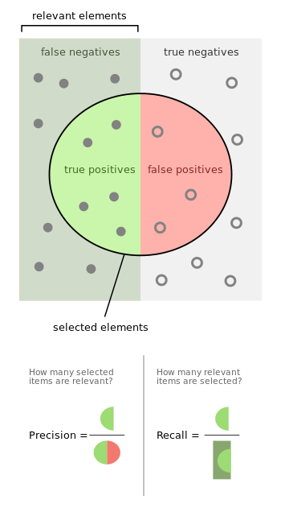
Keep this title
Complete this slide
For the third deliverable
Classification Evaluation Metrics
DO NOT use red color in the slides
Use vectorized figures to
explain the algorithm the evaluation metrics, so they are not pixelated like mines
Use these
Colors for
Your figures
Explain Accuracy too…
Create a graphical representation using the notation proposed in this slide
If possible, avoid equations for simple concepts that can be
explained through diagrams

Slide 11
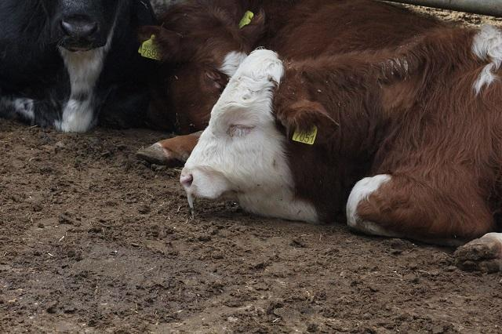
Keep this title
Complete this slide
For the third deliverable
Classification Evaluation Metrics
DO NOT use red color in the slides
Create the table in Powerpoint. Do not copy pixelated screenshots from the technical report please!
 | Testing data set (original images) | Testing data set (compressed images)
Accuracy | 0.3 | 0.2
Precision | 0.25 | 0.21
Recall | 0.12 | 0.11
Evaluation metrics using a testing dataset of ?? healthy cattle and ?? sick cattle images. Compressed images were obtained with ??? algorithm (Please, complete with your algorithm)
Include a HD picture related to the problem of animal health in precision livestock farming
Explain the tables in your
own words

Slide 12
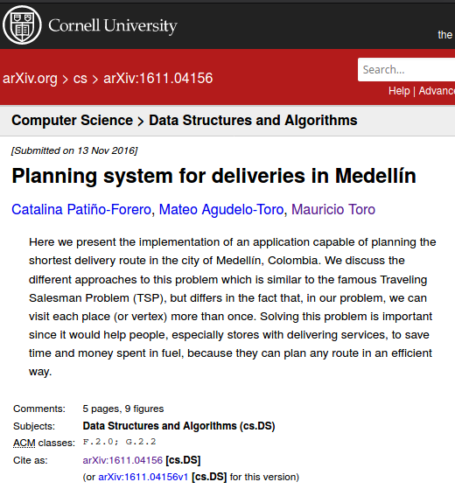
Complete this slide
For the third deliverable
Report Accepted on arXiv
Keep this title
DO NOT use red color in the slides
Include the citation of the report in arXiv and link. Alternatively, use OSF
C. Patiño-Forero, M. Agudelo-Toro, and M. Toro. Planning system for deliveries in Medellín. ArXiv e-prints, Nov. 2016. Available at: https://arxiv.org/abs/1611.04156
Include a screenshot
Include the teaching assistant and professor, please

Slide 13
THANK YOU!.
DO NOT use red color in the slides
Please do not forget the acknowledgements to your scholarship (if you have one)
Supported by
The first two authors are supported by a Sapiencia grant financed by Medellín municipality. All the authors would like to thank the "Vicerrectoría de Descubrimiento y Creación", of Universidad EAFIT, for their support on this research

