Slide 1

PROCESS IMPROVEMENT PROPOSAL
DRIVING OPERATIONAL EXCELLENCE
Transforming our workflows to unlock efficiency, reduce costs, and deliver exceptional results in today's competitive landscape.

Slide 2

ANALYSIS
MAPPING OUR CURRENT WORKFLOW
A thorough understanding of our existing workflow is the critical first step toward meaningful improvement.
Key Data Insights: Cycle Times & Error Rates
35%
REQUEST INTAKE
APPROVAL GATES
Over the past year, average cycle times have increased by 35%, and error rates at key stages remain persistently high. Manual processes dominate critical path activities, leading to human error and hindering scalable growth. Addressing these outdated steps presents a significant opportunity for transformative improvement.
MANUAL ROUTING
VERIFICATION & DELIVERY
Our current process is characterized by numerous handoffs, manual approval stages, and redundant verification steps.

Slide 3






BENEFITS
WHAT SUCCESS LOOKS LIKE
The transformation of our processes will deliver measurable improvements across multiple dimensions. Based on industry benchmarks and pilot results, we project significant gains in efficiency, cost management, and customer satisfaction that will position us as industry leaders.
HAPPIER CUSTOMERS
LOWER COSTS
Consistent, reliable service delivery builds trust and loyalty. Improved first-contact resolution rates mean customers spend less time seeking solutions.
ENHANCED SPEED
Reduced manual labor, fewer errors requiring rework, and optimized resource allocation translate directly to bottom-line savings and improved margins.
Automated routing and streamlined approvals dramatically reduce wait times. Customers receive faster responses, and projects move through the pipeline more efficiently.
BETTER COMPLIANCE
SCALABLE GROWTH
Standardized workflows with built-in controls ensure consistent adherence to policies and regulations, reducing risk and audit exposure.
EMPOWERED EMPLOYEES
Automated processes handle volume increases without proportional staff growth. The organization gains flexibility to adapt quickly to market changes.
Eliminating tedious manual tasks allows staff to focus on meaningful work that leverages their skills. Clear processes reduce frustration and improve morale.

Slide 4

CURRENT STATE
WHY CHANGE? THE COST OF INEFFICIENT PROCESSES
1
OUTDATED SYSTEMS
Organizations worldwide are grappling with the burden of outdated systems and inefficient workflows. Nearly 90% of decision-makers report that legacy systems actively hold back innovation and growth, creating a significant competitive disadvantage.
2
PROCESS INEFFICIENCIES
The consequences extend far beyond technology constraints. Process inefficiencies cascade through organizations, causing project delays, escalating operational costs, and ultimately leading to customer dissatisfaction. When workflows are bogged down by bottlenecks and manual interventions.
3
FINANCIAL IMPACT
The financial impact is staggering: delayed processes directly correlate with revenue loss and increased customer churn rates, making process improvement not just a nice-to-have.

Slide 5
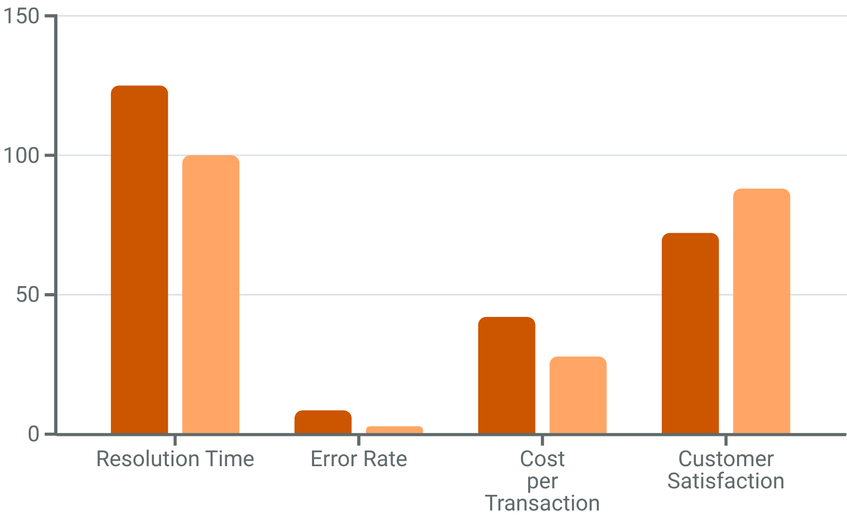

IDENTIFYING KEY PAIN POINTS
CURRENT PERFORMANCE
OUTDATED TECHNOLOGY INFRASTRUCTURE
Legacy systems lack integration capabilities, forcing staff to manually transfer data between platforms. This not only wastes time but introduces errors at each transition point, compounding downstream problems.
Our Performance
Industry Benchmark
The gap between our current performance and industry standards reveals significant opportunity. Our resolution times lag by 25%, while our error rates exceed benchmarks by nearly 3x. These metrics directly impact our bottom line and customer perception.

Slide 6

BENEFITS
ANTICIPATED BENEFITS
The transformation of our processes will deliver measurable improvements across multiple dimensions. Based on industry benchmarks and pilot results, we project significant gains in efficiency, cost management, and customer satisfaction that will position us as industry leaders.
30%
20%
CYCLE TIME REDUCTION
COST SAVINGS
Faster delivery through streamlined workflows and automation
Lower operational expenses from efficiency gains
15%
60%
CUSTOMER SATISFACTION
MANUAL WORK ELIMINATED
Higher CSAT scores from improved service quality
More time for high-value strategic activities

Slide 7




CASE STUDY
REAL-WORLD SUCCESS STORY:
FAST CASUAL OPERATING SYSTEM
STANDARDIZATION
CONTINUOUS IMPROVEMENT
INNOVATION INTEGRATION
Every process documented and optimized. From food preparation to customer service, this fast casual restaurant created repeatable excellence that ensures consistency.
Regular evaluation and refinement of procedures. This fast casual restaurant doesn't rest on success—they constantly test, measure, and enhance their operations based on data and feedback.
From self-service kiosks to mobile ordering and delivery platforms, this fast casual restaurant embraced technology while maintaining their core operational discipline.
"The fast casual operating system story proves that operational excellence isn't about perfection on day one—it's about building systems that get better every day. Their commitment to process improvement created sustainable competitive advantage that transcends individual products."
The results speak for themselves: sustained market leadership across decades, customer loyalty that spans generations, and operational margins that set industry standards. This fast casual restaurant's success demonstrates that process improvement isn't a project; it's a philosophy that becomes embedded in organizational DNA.

Slide 8

IMPLEMENTATION STRATEGY: ROADMAP TO SUCCESS
PILOT PROGRAM
1
Months 1-3
Select pilot department
Deploy automation tools
Gather initial feedback
Refine processes
2
TRAINING & PREPARATION
Months 4-5
Comprehensive staff training
Documentation updates
Change management activities
Technical infrastructure setup
ORGANIZATIONAL ROLLOUT
3
Months 6-9
Phased deployment across teams
Live support and troubleshooting
Process monitoring
Quick-win identification
4
OPTIMIZATION
Months 10-12
Performance review
Fine-tuning and adjustments
Best practice documentation
Celebration of success

