Slide 1

QUANT FINANCE
FACTOR ZOO
A research map for asset-pricing models, anomalies and investable tests.

Slide 2

FACTORS
Factor vs Alpha
Term | Definition | Example
Characteristic 特征 | A firm-level observable at time t (accounting ratio, price statistic, sentiment score) 公司层面在时刻 t 可观察到的量（会计比率、价格统计量、情绪评分） | Book-to-market ratio B/M_(i,t) 账面市值比 B/M_(i,t)
Factor 因子 | A return series (usually long-short) built by sorting stocks on a characteristic, or a statistical factor from PCA/regression 依据某特征对股票排序构建出的收益率序列（通常为多空组合），或由 PCA/回归得到的统计因子 | HML: high B/M minus low B/M portfolio return HML：高 B/M 减低 B/M 组合收益

Slide 3






ANOMALY
Anomaly Is Relative
Term | Definition | Example
Signal / Alpha 信号/阿尔法 | A cross-sectional score used to rank stocks for portfolio construction, may or may not correspond to a known academic factor 用于给股票排序以构建组合的横截面评分，可能对应也可能不对应某个已知的学术因子 | A proprietary blend of 40 characteristics, output as a single number per stock per day 由 40 个特征专有混合而成，每只股票每天输出一个数值
Anomaly 异象 | An empirical pattern in average returns that a benchmark asset pricing model (usually CAPM or FF3) fails to explain — i.e., a factor is "anomalous" relative to *some* model, not in absolute terms 某个基准资产定价模型（通常是 CAPM 或 FF3）无法解释的平均收益率经验模式——即因子相对于*某个*模型而言是"异常"的，而非绝对意义上的异常 | Momentum was an anomaly relative to CAPM/FF3; it is not anomalous relative to Carhart's own 4-factor model (by construction) 动量相对于 CAPM/FF3 是异象；但相对于 Carhart 自己的四因子模型（按构造）就不是异象
Alpha (α) 阿尔法 | The intercept in a factor-model regression — return unexplained by the chosen factors 因子模型回归中的截距项——所选因子无法解释的收益部分 | α_i in r_i - r_f = α_i + β_i^T f + ε_i

Slide 4

CAPM
CAPM Prices Beta
1
Pricing rule
CAPM makes expected excess return proportional to market beta times the market risk premium; its Security Market Line is linear under the model assumptions.
2
Beta
Beta is covariance with the market divided by market-return variance; only systematic risk is priced. Two-fund separation gives all investors the same risky mix; market clearing makes it the market portfolio.
3
Equilibrium
w_mkt ∝ Σ⁻¹(μ − r_f1); μ − r_f1 ∝ Σw_mkt.

Slide 5

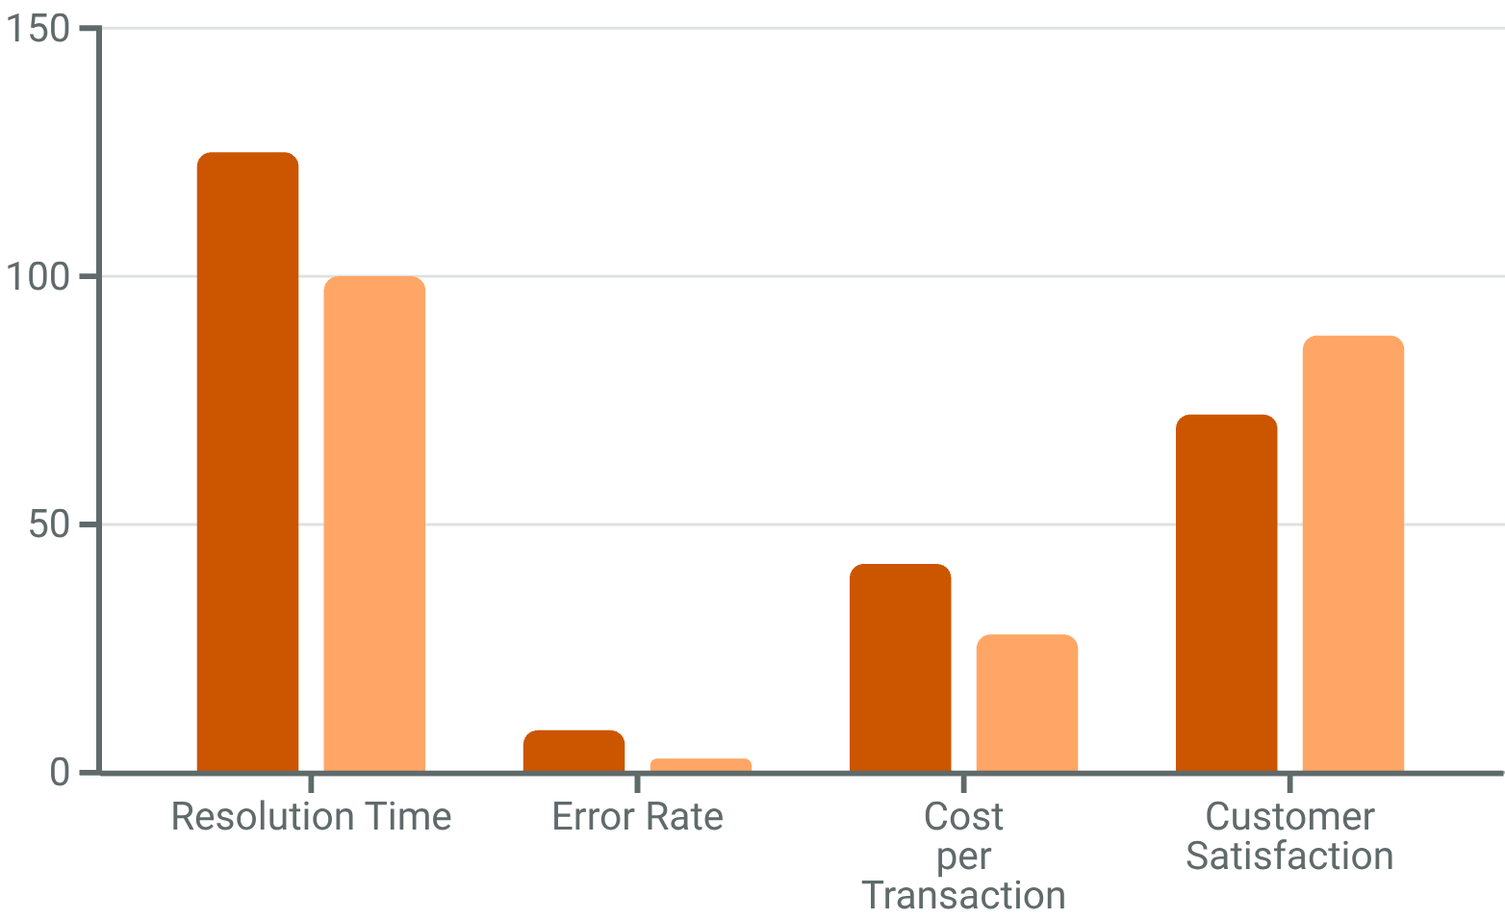
CAPM Limits
Flat SML
ROLL (1977)
The true market spans unobservable bonds, real estate and human capital; equity-only CAPM tests are limited. This shifted research toward multifactor models.
LOW BETA
SIZE / VALUE
The empirical SML was flatter than CAPM predicts; BAB formalizes the low-beta pattern. Size and value returns exceeded beta-only predictions. These failures did not kill factor-based asset pricing; research shifted to multifactor models.

Slide 6
MODELS
Model Lineage
Model | Factors | What it adds | Main limitation
CAPM | Market | One systematic risk source | Cannot explain size, value, momentum
APT | Multiple unspecified factors | Allows several priced risks | Does not identify factors
FF3 | Market, size, value | Empirical cross-section fit | Misses momentum and profitability/investment
Carhart4 | FF3 + momentum | Captures UMD anomaly | Momentum crash risk remains
FF5 | Market, size, value, profitability, investment | Links to q-theory intuition | HML becomes partly redundant in some samples
HXZ q/q5 | Market, size, investment, ROE, expected growth | Investment-based economics | More complex and still sample-dependent
SY mispricing | Management, performance composites | Behavioral anomaly clustering | Requires careful multiple-testing control

Slide 7
FF3
Fama–French 3
Annual 2×3
Three spreads; six portfolios
SORT
MKT
HML
Each June, split size at the NYSE median and book-to-market at the 30th/70th percentiles. The independent sorts form six value-weighted portfolios; SMB contrasts small with big, while HML contrasts high with low book-to-market.
SMB
2×3
Independent sorts separate size and value exposures.

Slide 8

MOMENTUM
Carhart MOM
Monthly rebalanced, value-weighted UMD adds winners-minus-losers to FF3; fund attribution links apparent manager skill to momentum. Rank t−12 to t−2 returns, skip the latest month, and form within-size 2×3 long-short 30%/decile spreads. Rebounds can crash momentum. r_i-r_f = α_i+β_iMKT+s_iSMB+h_iHML+m_iUMD+ε_i.
UMD
RANK
LONG WINNER LEG
t−12/t−2
Top minus bottom 30% or decile; within-size 2×3.
Skip the most recent month.
RISK
ATTR
MOMENTUM CRASHES
Fund attribution
Rebounds can cause crashes.
Skill reduces to passive tilt

Slide 9




FF5
FF5 Adds RMW + CMA
RMW + CMA
RMW
CMA
HML
Robust-minus-weak profitability adds operating profitability to the market, size and value factors; it captures differences in firms’ operating strength.
Conservative-minus-aggressive investment adds an investment dimension, motivated by dividend-discount logic and firms’ investment behavior.
HML can be partly redundant in some samples; its marginal role depends on the test assets and remains debated.
FF5 adds profitability (RMW) and investment (CMA). Broader fit is not a universal verdict; HML may be partly redundant in some samples.
Dividend-discount rationale; sample-dependent HML

Slide 10
q and q5 Models
Production
GRS test
GRS jointly tests zero alphas; the test assets and residual covariance shape the verdict.
I/A + ROE
q5 + EG
The q model uses market, investment-to-assets (I/A) and return on equity (ROE), linking expected returns to investment and profitability. q5 adds expected growth (EG); independent size, investment and profitability sorts form 27 portfolios.

Slide 11

SY MODEL
Model Foundations
Model 模型 | Year 年份 | Factors 因子 | # | Theoretical grounding 理论基础
CAPM | 1964 | MKT | 1 | Mean-variance equilibrium 均值-方差均衡
APT | 1976 | Unspecified f_1,…,f_K 未指定 f_1,…,f_K | K | No-arbitrage, linear factor structure 无套利、线性因子结构
Fama-French 3 | 1993 | MKT, SMB, HML | 3 | Empirical + risk-based rationalization 实证 + 基于风险的理论化
Carhart 4 | 1997 | MKT, SMB, HML, UMD | 4 | Empirical (momentum add-on) 实证（附加动量）
1
2
3
The factor zoo is both a library and a warning. It gives researchers a vocabulary for systematic return patterns, but it also shows how easily finite noisy data can produce beautiful false discoveries. Good factor research therefore combines theory, data discipline, conservative testing, cost realism, and humility about regimes.

Slide 12
TESTS
Testing Models
Model 模型 | Year 年份 | Factors 因子 | # | Theoretical grounding 理论基础
Fama-French 5 | 2015 | MKT, SMB, HML, RMW, CMA | 5 | Dividend-discount-model decomposition 股利折现模型分解
q-factor (HXZ) | 2015 | MKT, ME, I/A, ROE | 4 | Investment-based (q-theory) 基于投资（q 理论）
q5 | 2021 | + EG | 5 | q-theory + forward-looking expected growth q 理论 + 前瞻性预期增长
Stambaugh-Yuan | 2017 | MKT, SMB, MGMT, PERF | 4 | Behavioral mispricing clusters 行为金融错误定价簇
因子动物园既是资料库，也是警告。它为系统性收益模式提供语言，但也说明有限噪声数据多么容易产生漂亮的虚假发现。因此，好的因子研究必须结合理论、数据纪律、保守检验、成本现实，以及对市场状态的谦逊。

Slide 13
PREMIA
Premia Stories
Risk compensation, behavioral mispricing and limits to arbitrage compete; a factor may mix them. Risk pays for bad-state exposure. Behavioral errors include overreaction, underreaction and extrapolation. Trading frictions delay correction, while value, momentum, low-volatility and size each have failure stories.
RISK
BEHV
BAD-STATE LOSSES
Behavior
Pays for losses in adverse states.
Overreaction, underreaction and extrapolation move prices.
FRIC
MIX
SHORTING LIMITS
Stories overlap
Shorting limits slow correction.
Competing stories can overlap

Slide 14
ZOO
Multiple Testing
Trials raise false-discovery risk
ALIASES
ABSORBED
SELECTION
Several labels may reflect one latent exposure rather than distinct sources of return; correlated definitions can repackage a signal.
A broader benchmark can explain an anomaly that appeared under CAPM or FF3, changing the residual claim.
Many trials make a t-stat above 2 weak evidence; require a rationale, point-in-time data, robustness and independent confirmation.
Trading costs may erase the premium. Test incremental value against known factors, model realistic implementation and record the full search process.
Net costs can erase a premium

Slide 15
SCORE
Factor Scorecard
Factor | Risk story | Mispricing story | Data-mining concern
Value | Distress and duration risk | Extrapolation and overreaction | Many metric choices
Momentum | Crash exposure and optionality | Underreaction and slow diffusion | Parameter grids
Quality | Defensive cash flows | Underappreciated persistence | Definition proliferation
Investment | q-theory investment risk | Overinvestment and empire building | Accounting variants
Low volatility | Leverage constraints | Lottery demand for high beta | Hidden sector exposure
Size | Illiquidity/funding risk | Neglected firms | Microcap and cost bias
Liquidity | Compensation for trading frictions | Attention and segmentation | Measured spread quality

Slide 16
FAMILIES
Factor Families
Family | Representative signals | Typical controls
Value | B/P, E/P, EBIT/EV, CFO/P | Industry, profitability, leverage
Momentum | 12-1 return, residual momentum, earnings momentum | Reversal, volatility, crash risk
Quality | GP/A, ROE, accruals, F-score, QMJ | Sector, leverage, size
Investment | asset growth, capex growth, net issuance | Profitability and financing
Low risk | beta, idiosyncratic vol, downside vol | Sector and leverage
Liquidity | Amihud, turnover, spread, ADV | Size and price
Sentiment | analyst revisions, short interest, news tone | Coverage and attention
Alternative data | web traffic, app usage, supply chain, text | Coverage bias and timestamping

Slide 17
PORTFOLIO
Portfolio Forms
1
Long-short
Decile or rank-weighted dollar-neutral portfolios test the premium; a long-only benchmark tilt tests constrained stock selection.
2
Optimizer
Residualized signals fit constrained optimizers; factor-mimicking portfolios serve risk models. Report weighting, rebalancing frequency, breakpoint universe, sector and beta neutrality, leverage, and cost assumptions.
3
Report design
必须报告构建选择：加权方式、调仓频率、断点股票池、行业中性、贝塔中性、杠杆和成本假设。

Slide 18
Timing & Crowding
Timing
Monitor
Track flows, common holdings, short interest, borrow, turnover and manager correlation.
Spreads
Crowding
Valuation spreads, recent factor returns, macro regimes and volatility may inform timing, but they add another layer of multiple testing. Crowded factors can persist until liquidity disappears, then unwind sharply.

Slide 19
A-SHR
U.S. vs A-Shares
Market transfer
Re-test, do not transplant
CHECK
MOM
QUALITY
US momentum is canonical; A-share momentum is more horizon- and limit-event-dependent. Quality screens must watch subsidies, related parties and earnings management. 美股动量是经典稳健因子，而 A 股动量更依赖期限和涨跌停事件；A 股规模因子受壳价值和量化拥挤塑造；A 股质量筛选必须更关注补贴、关联方活动和盈余管理动机。
SIZE
STRUCT.
Shell value and quant crowding have shaped A-share size behavior.

Slide 20
SORT
The 2×3 Sort
Independent sorts
SIZE
INTERSECT
HML
Split the universe into small and big by market capitalization; independently sort the chosen characteristic into low, middle and high buckets.
Cross the two rankings to form six portfolios; compare high with low within each size group.
HML averages the high-characteristic portfolios and subtracts the low-characteristic average across size buckets.
Independent sorting keeps the characteristic spread from merely proxying for firm size; the same template applies to profitability or investment.
HML = ½(SmallHigh + BigHigh) − ½(SmallLow + BigLow). Higher characteristic returns minus lower, averaged across size.；A Fama-French-style 2×3 sort works as follows: split the universe into small/big by market cap, split the characteristic into low/mid/high by breakpoints, then form six portfolios.

Slide 21
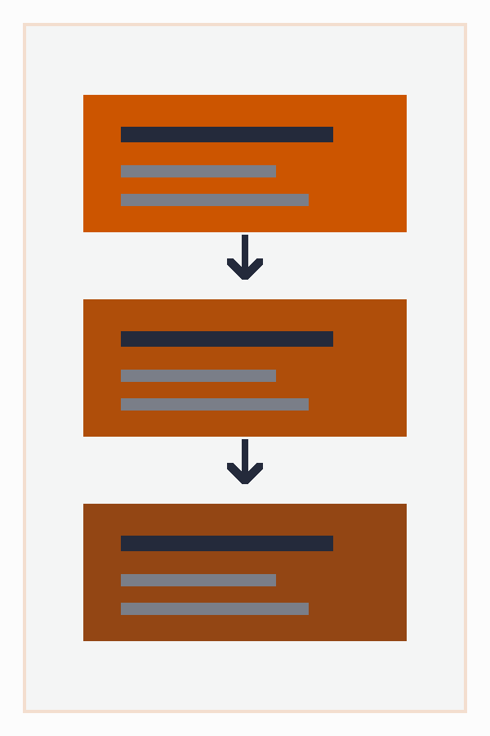
STRAT
Strategy Path
1. The workflow is: economic rationale
2. clean signal
3. single-factor test
4. incrementality test
5. backtest
6. red team
7. constrained portfolio
8. paper trade
9. small live allocation.
1. 流程应为：经济逻辑
2. 干净信号
3. 单因子检验
4. 增量性检验
5. 回测
6. 红队检验
7. 约束组合
8. 模拟盘
9. 小规模实盘。

Slide 22

Research Checklist
1
• It is known at the time it is used.
• It has a reason to exist before seeing the backtest.
• It survives neutralization to obvious exposures.
• Its IC, portfolio sorts, and regression tests agree directionally.
• It works across reasonable horizons and universes.
• It is not just a renamed existing factor.
• It survives costs and turnover.
• It has a failure story and monitoring plan.
• 使用时确实已知。
• 在看到回测前就有存在理由。
• 对明显暴露中性化后仍存在。
• IC、组合分层和回归检验方向一致。
• 在合理期限和股票池中稳健。
• 不是已有因子的改名。
• 能扛住成本和换手。
• 有失效故事和监控方案。
2
3
4

