Slide 1

QUANT FINANCE
FACTOR ZOO
A research map for asset-pricing models, anomalies and investable tests.

Slide 2

FACTORS
Factor vs Alpha
Trait → sort → return
From firm attribute to model residual
FACTOR
TRAIT
SIGNAL
A characteristic is an observable trait. Sorting creates factor returns such as HML; a signal ranks stocks. Alpha is the regression intercept left after the chosen model, which also determines whether a return pattern is anomalous.
HML
ALPHA
Models can absorb yesterday’s anomaly; what survives depends on the benchmark.

Slide 3






ANOMALY
Anomaly Is Relative
An anomaly is benchmark-dependent: specify the model before calling a return pattern unexplained. Tests against broader model sets ask whether the premium survives controls.
Signal
Factor return
A cross-sectional score ranks stocks for portfolio construction.
Characteristic
A return series formed by sorting stocks on a characteristic, such as HML.
An observable firm trait, such as book-to-market.
Model-relative
Alpha
Expanded benchmarks can absorb yesterday’s anomaly exposures.
Unexplained
The regression intercept left unexplained by chosen factors.
A pattern the selected benchmark model fails to explain.

Slide 4

CAPM
CAPM Prices Beta
1
Pricing rule
CAPM makes expected excess return proportional to market beta times the market risk premium; its Security Market Line is linear under the model assumptions.
2
Beta
Beta is covariance with the market divided by market-return variance; only systematic risk is priced. Two-fund separation gives all investors the same risky mix; market clearing makes it the market portfolio.
3
Equilibrium
w_mkt ∝ Σ⁻¹(μ − r_f1); μ − r_f1 ∝ Σw_mkt.

Slide 5

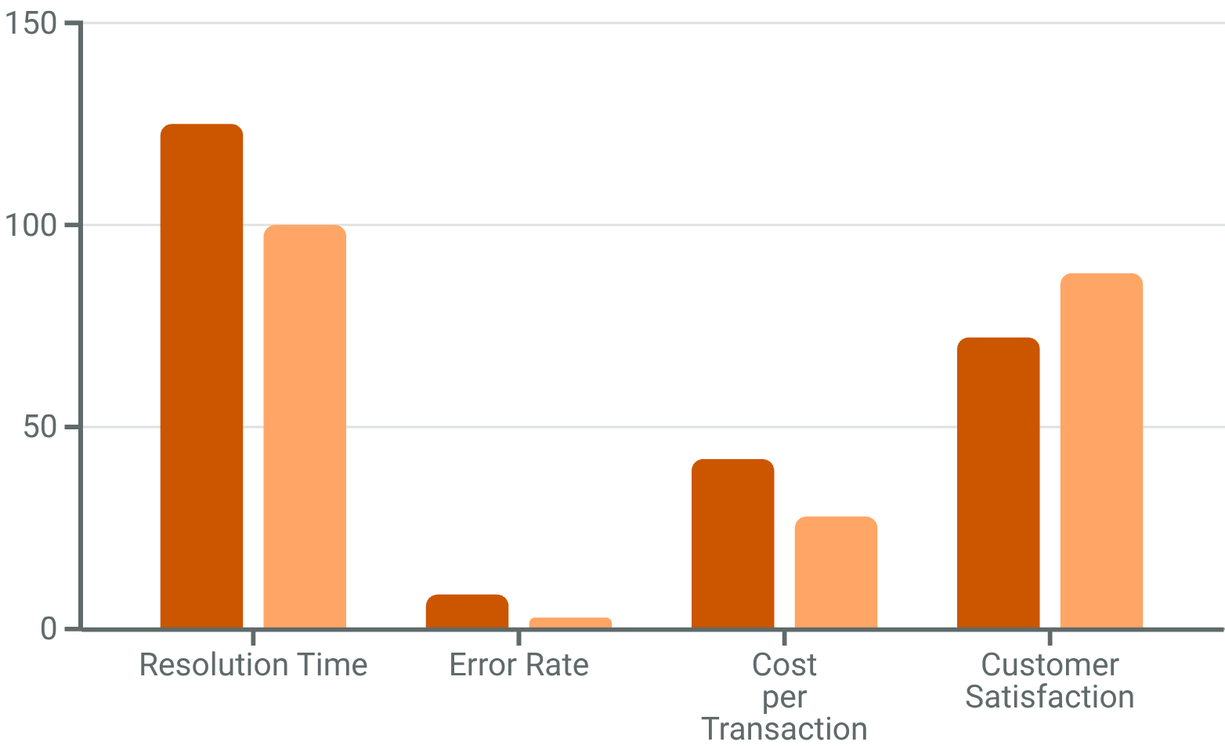
CAPM Limits
Flat SML
ROLL (1977)
The true market spans unobservable bonds, real estate and human capital; equity-only CAPM tests are limited. This shifted research toward multifactor models.
LOW BETA
SIZE / VALUE
The empirical SML was flatter than CAPM predicts; BAB formalizes the low-beta pattern. Size and value returns exceeded beta-only predictions. These failures did not kill factor-based asset pricing; research shifted to multifactor models.

Slide 6
MODELS
Model Lineage
Models broaden the benchmark from market risk to characteristic-based returns, investment, profitability and mispricing. Each extension absorbs patterns, but fit depends on factor construction, assumptions and model selection.
FF3
APT
Adds size (SMB) and value (HML) to market beta after CAPM leaves those return patterns unexplained.
CAPM
APT assumes a linear factor structure and no-arbitrage, without specifying the factors’ economic identities.
CAPM links expected excess returns to market beta under a mean-variance efficient market portfolio and homogeneous expectations.
SY / q5
FF5 / q
Mispricing clusters and expected growth broaden fit; selection still matters.
Carhart
FF5 adds profitability and investment; q uses investment-to-assets and return on equity.
Adds a winner-minus-loser momentum return because momentum-sorted portfolios retain alpha against FF3.

Slide 7
FF3
Fama–French 3
Annual 2×3
Three spreads; six portfolios
SORT
MKT
HML
Each June, split size at the NYSE median and book-to-market at the 30th/70th percentiles. The independent sorts form six value-weighted portfolios; SMB contrasts small with big, while HML contrasts high with low book-to-market.
SMB
2×3
Independent sorts separate size and value exposures.

Slide 8

MOMENTUM
Carhart MOM
Monthly rebalanced, value-weighted UMD adds winners-minus-losers to FF3; fund attribution links apparent manager skill to momentum. Rank t−12 to t−2 returns, skip the latest month, and form within-size 2×3 long-short 30%/decile spreads. Rebounds can crash momentum. r_i-r_f = α_i+β_iMKT+s_iSMB+h_iHML+m_iUMD+ε_i.
UMD
RANK
LONG WINNER LEG
t−12/t−2
Top minus bottom 30% or decile; within-size 2×3.
Skip the most recent month.
RISK
ATTR
MOMENTUM CRASHES
Fund attribution
Rebounds can cause crashes.
Skill reduces to passive tilt

Slide 9




FF5
FF5 Adds RMW + CMA
RMW + CMA
RMW
CMA
HML
Robust-minus-weak profitability adds operating profitability to the market, size and value factors; it captures differences in firms’ operating strength.
Conservative-minus-aggressive investment adds an investment dimension, motivated by dividend-discount logic and firms’ investment behavior.
HML can be partly redundant in some samples; its marginal role depends on the test assets and remains debated.
FF5 adds profitability (RMW) and investment (CMA). Broader fit is not a universal verdict; HML may be partly redundant in some samples.
Dividend-discount rationale; sample-dependent HML

Slide 10
q and q5 Models
Production
Trade-off
Greater structure still leaves results dependent on sample and construction choices.
I/A + ROE
q5 + EG
The q model uses market, investment-to-assets (I/A) and return on equity (ROE), linking expected returns to investment and profitability. q5 adds expected growth (EG); independent size, investment and profitability sorts form 27 portfolios.

Slide 11

SY MODEL
MGMT + PERF
1
MGMT
MGMT clusters investment and accrual anomalies into a composite mispricing factor; its design summarizes related characteristics rather than treating each signal as independent.
2
PERF
PERF groups profitability and momentum patterns. Together, MGMT and PERF summarize 11 known anomaly characteristics in the Stambaugh–Yuan framework.
3
Post-hoc caveat
Its horse-race advantage needs caution because construction is post hoc.

Slide 12
TESTS
Testing Models
Different tests answer different pricing questions; the test assets and covariance estimates shape the verdict. Regression fit alone does not settle the economic explanation.
GRS
Cross section
Jointly test whether test-portfolio alphas equal zero.
Time series
Ask whether betas or traits explain average-return differences.
Regress portfolio returns on factor returns; inspect the intercept.
Inference
Covariance
No single regression settles the economic explanation.
Test assets
GRS depends on estimated residual covariance across portfolios.
Changing the portfolios can change the model comparison.

Slide 13
PREMIA
Premia Stories
Risk compensation, behavioral mispricing and limits to arbitrage compete; a factor may mix them. Risk pays for bad-state exposure. Behavioral errors include overreaction, underreaction and extrapolation. Trading frictions delay correction, while value, momentum, low-volatility and size each have failure stories.
RISK
BEHV
BAD-STATE LOSSES
Behavior
Pays for losses in adverse states.
Overreaction, underreaction and extrapolation move prices.
FRIC
MIX
SHORTING LIMITS
Stories overlap
Shorting limits slow correction.
Competing stories can overlap

Slide 14
ZOO
Multiple Testing
Trials raise false-discovery risk
ALIASES
ABSORBED
SELECTION
Several labels may reflect one latent exposure rather than distinct sources of return; correlated definitions can repackage a signal.
A broader benchmark can explain an anomaly that appeared under CAPM or FF3, changing the residual claim.
Many trials make a t-stat above 2 weak evidence; require a rationale, point-in-time data, robustness and independent confirmation.
Trading costs may erase the premium. Test incremental value against known factors, model realistic implementation and record the full search process.
Net costs can erase a premium

Slide 15
SCORE
Factor Scorecard
No factor story is a verdict; each one needs a failure test.
Risk, mispricing and mining
TEST
VALUE
QUALITY
Value mixes distress/duration risk and extrapolation; metric choice creates a mining risk. Momentum carries crash exposure, underreaction stories and parameter-search risk. Quality and investment pair cash-flow or q-theory stories with definition choices.
MOMENTUM
LOW RISK
Low volatility, size and liquidity face leverage, funding, sector and trading-friction confounds.

Slide 16
FAMILIES
Factor Families
Each factor family needs controls suited to its signal, data source and likely confounds. Families can overlap, but their measurement risks differ.
Quality
Momentum
GP/A, ROE and accruals; control sector, leverage and size.
Value
12–1, residual and earnings signals; test reversal and crash exposure.
B/P, E/P and EBIT/EV; control industry, profitability and leverage.
Sentiment / alt.
Risk / liq.
Revisions, short interest, news and web data require coverage and timestamp controls.
Investment
Beta, volatility and spreads/turnover; control sector, leverage, size and price.
Asset growth, capex growth and net issuance; check profitability.

Slide 17
PORTFOLIO
Portfolio Forms
1
Long-short
Decile or rank-weighted dollar-neutral portfolios test the premium; a long-only benchmark tilt tests constrained stock selection.
2
Optimizer
Residualized signals fit constrained optimizers; factor-mimicking portfolios serve risk models. Report weighting, rebalancing frequency, breakpoint universe, sector and beta neutrality, leverage, and cost assumptions.
3
Report design
必须报告构建选择：加权方式、调仓频率、断点股票池、行业中性、贝塔中性、杠杆和成本假设。

Slide 18
Timing & Crowding
Timing
Monitor
Track flows, common holdings, short interest, borrow, turnover and manager correlation.
Spreads
Crowding
Valuation spreads, recent factor returns, macro regimes and volatility may inform timing, but they add another layer of multiple testing. Crowded factors can persist until liquidity disappears, then unwind sharply.

Slide 19
A-SHR
U.S. vs A-Shares
Market transfer
Re-test, do not transplant
CHECK
MOM
QUALITY
US momentum is canonical; A-share momentum is more horizon- and limit-event-dependent. Quality screens must watch subsidies, related parties and earnings management. 美股动量是经典稳健因子，而 A 股动量更依赖期限和涨跌停事件；A 股规模因子受壳价值和量化拥挤塑造；A 股质量筛选必须更关注补贴、关联方活动和盈余管理动机。
SIZE
STRUCT.
Shell value and quant crowding have shaped A-share size behavior.

Slide 20
SORT
The 2×3 Sort
Independent sorts
SIZE
INTERSECT
HML
Split the universe into small and big by market capitalization; independently sort the chosen characteristic into low, middle and high buckets.
Cross the two rankings to form six portfolios; compare high with low within each size group.
HML averages the high-characteristic portfolios and subtracts the low-characteristic average across size buckets.
Independent sorting keeps the characteristic spread from merely proxying for firm size; the same template applies to profitability or investment.
HML = ½(SmallHigh + BigHigh) − ½(SmallLow + BigLow). Higher characteristic returns minus lower, averaged across size.；A Fama-French-style 2×3 sort works as follows: split the universe into small/big by market cap, split the characteristic into low/mid/high by breakpoints, then form six portfolios.

Slide 21
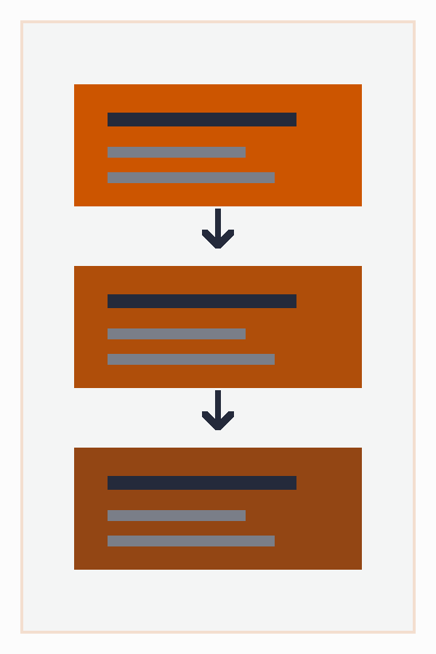
STRAT
Strategy Path
A factor is not yet a strategy: define the universe, forecast, portfolio, execution, risk limits, capacity, monitoring and governance. Test rationale and incremental value, include costs, red-team the result, paper-trade, then consider a small live allocation.
PLAN
TEST
INVESTABLE UNIV
Robust
Define investable names and forecasts.
Check incrementality, costs and capacity.
RISK
LIVE
SET RISK LIMITS
PAPER-TRADE FIRST
Set limits and monitor drawdowns.
before live allocation

Slide 22

Factor Checklist
TIMESTAMP
1
Evidence & rationale
THEORY：A priori case
DATA：Point-in-time
NEUTRAL：Control exposures
UNIQUE：Incremental value
2
NO-LEAK
Robustness
METHOD：Conservative tests
IC：Sorts agree
HORIZON：Reasonable range
UNIVERSE：Broader samples
NET COST
3
Tradability
COSTS：Cost realism
TURNOVER：Realistic rates
BORROW：Available names
CAPACITY：Enough liquidity
4
GOVERN
Library & warning
FAILURE：False discoveries
MONITOR：Track live risk
OWNER：Assign review
REGIME：Stay humble

