Slide 1
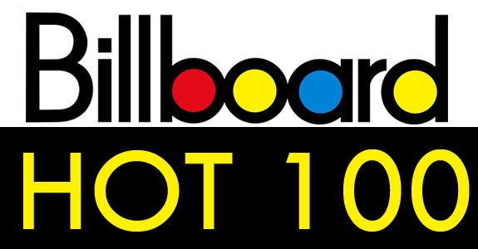

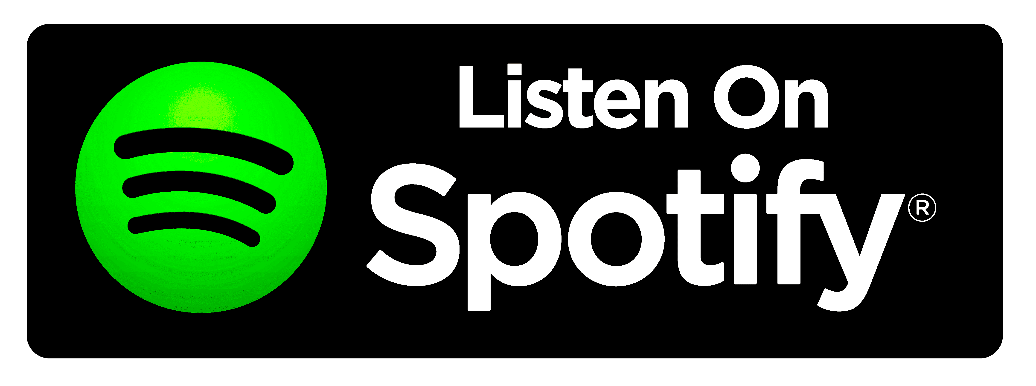
Kickin’ It Old School
Identifying Popular Musicians:
Old School and New School Rankings

Slide 2
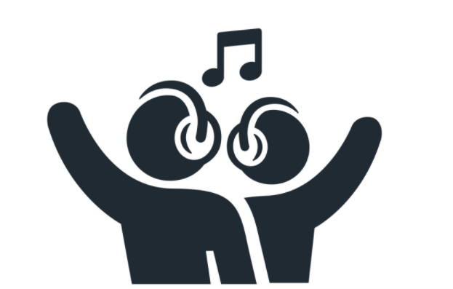
Project Team 7 Members
Alejandra Herbas
Sam Smith
Katherine Kane
Tsegaye Mirach
Valerie Dandar

Slide 3
WHY the Spotify API?
Word on the street… Spotify has a cool API!
Spotify, like other music streaming services, is driven by users’ interests in specific artists and their music (Est. 2008)
The Billboard Charts set the music industry standards for ranking the popularity of artists and their songs (Est. 1940)
MUSIC ACCESS & CONSUMPTION IS CHANGING!
How do artists’ rankings on the Billboard Charts compare with the popularity of artists in Spotify?
Notes:
The Billboard charts tabulate the relative weekly popularity of songs and albums in the United States and elsewhere. The results are published in Billboard magazine. Billboard biz, the online extension of the Billboard charts, provides additional weekly charts,^{[1]} as well as year-end charts.^{[2]} The charts may be dedicated to a specific genre such as R&B, country, or rock, or they may cover all genres. The charts can be ranked according to sales, streams, or airplay, and for main song charts such as the Hot 100 song chart, all three data are used to compile the charts.^{[3]} For the Billboard 200 album chart, streams and track sales are included in addition to album sales.^{[4]}

Slide 4
Defining RESEARCH QUESTIONS
DATA SOURCES & VARIABLES:
2019 Top 100 Artists Charts from Billboard Charts (pulled .csv data source)
Artist name and rank on Billboard Charts
Spotify API (pulled API data source)
Artist name, popularity ranking, number of followers, defined genres
RESEARCH QUESTIONS:
How do Billboard rankings compare with popularity rankings in Spotify? Followers?
Among the top 100 artists, what are the average popularity rankings and followers as measured through Spotify?
What are the most popular musical genres among the top 100 Billboard artists?

Slide 5
Defining Key Variables
Billboard Charts Top Artists = Radio Airplay + Sales Data + Streaming Data
Artists receive a ranking of 1 through 100, with 1 as the highest value
Spotify Popularity = The artist’s popularity is calculated from the popularity of all the artist’s tracks. Artists receive a value will be between 0 and 100, with 100 being the most popular.
Spotify Followers = Number of listeners who hit follow or ❤ on your artist profile.

Slide 6
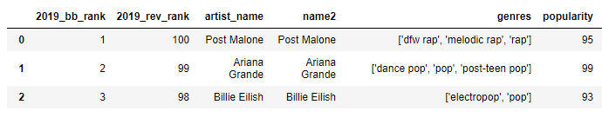
Data Cleaning & Development Process
Reading the documentation! What variables would address our question?
Data was joined between CSV file and Spotify API
Developers also created a Spotify Library via Python
Data cleaning involved converting variables to integers, recodes of rankings, and converting genres string to be counted
Used Group By Function and Plotting & Statistics functions
Most challenging analysis involved understanding the genres variable – AST Library (Abstract Syntax Trees) to parse string text (THANKS, DART!)

Slide 7
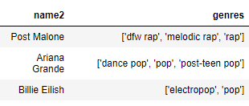
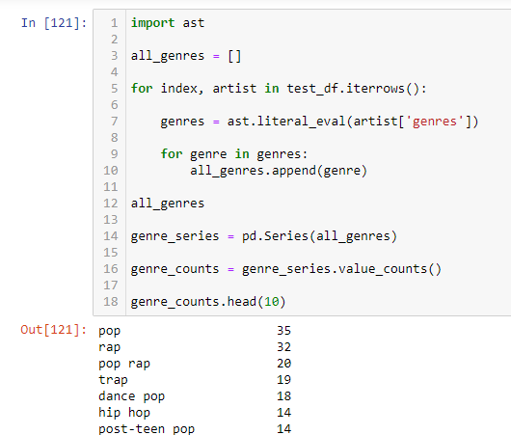
Using AST Library

Slide 8
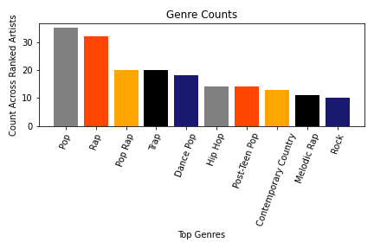
Most popular Genres Among Top 100 Artists
Spotify has so many genres ! (e.g. Atlanta Rap, Dallas Rap, Teen Pop)
91 unique combinations of tags amongst 100 artists
These are the most popular amongst artists!
With more time, we could have recoded and refined these a bit further.

Slide 9
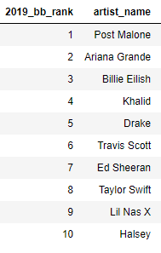
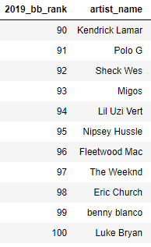
Top & BOTTOM TEN Artists of 2019
Mean Spotify follower count across 100 artists =11,254,196 (Range 161,775 -71,783,101)
Mean Spotify popularity ranking across 100 artists = 86.6 (Range 71-100)
TOP TEN ARTISTS:
Mean Popularity=93.5 (79-100)
Mean Followers=31,505,637
BOTTOM TEN ARTISTS:
Mean Popularity=84.5 (71-96)
Mean Followers=7,471,609
Notes:
Drake is the MOST popular via Spotify with 100; Ed Sheeran has the most followers at 71,783,101
Yet, The Weeknd ranked 97 on Billboard charts, is in the top 10 for popularity on Spotify with a rank of 96. Similarly, Justin Bieber with a BB rank of 75 has a popularity of 96 and in the top ten Spotify. The Beebs is also in the top 10 follower count at #4 with 39,214,943 followers

Slide 10
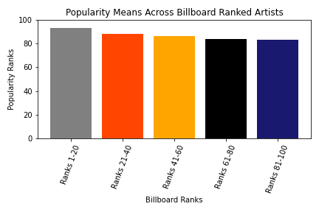
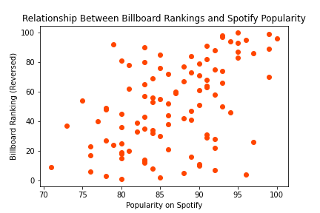
Billboard Rank Vs. Spotify Popularity
Grouped by Billboard ranks, can see that higher ranked artists have slightly increased popularity
Easier to view with reversed Billboard ranks to explore if increased rank towards top arts has a relationship with increased popularity rank via Spotify
Some relationship, although not as strong as you might have predicted
Correlation is 0.47; When explored with regression model r2 was 0.22

Slide 11
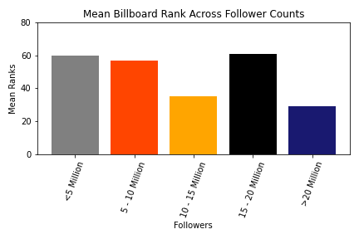
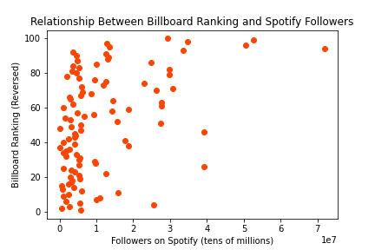
Billboard Rank Vs. Spotify Followers
Grouped by followers, it is clear there is variation in the amount of followers among Billboard ranked artists
While the data is largely skewed to the left with hundreds of thousands to 2 million followers, there are some outliers– Ed Sheeran and the Beibs!
Correlation is 0.43

Slide 12
Key Takeaways
We expected to see that the artists at the top of the Billboard charts would also be the most highly ranked amongst Spotify Popularity ratings.
Our graphs showed that there is a positive correlation between popularity on Spotify with Billboard rankings, but it is not a strong correlation. For example, Drake scored 100 on Spotify {Popularity and was 5th on the Billboards.
Billboard Ranks and Spotify Follower numbers have greater variation than trends in Spotify Popularity
For example, we found that Ed Sheeran had the most followers on Spotify with 71,783,101 followers and only ranked 7th on the Billboards. Also, Justin Bieber had 39,214,943 followers (within the top 10 artists ranked by followers), but was 75 on the Billboard charts.
Among the top 100 Billboard Artists of 2019, pop and rap artists are highly represented.
Music, like other things in popular culture, has unique sub-genres or types as shown in the Spotify genres typology.

Slide 13
Lessons Learned & FURTHER RESERACH
As mentioned, the genres parsing was the most difficult task
DO YOUR RESEARCH! , but know when to ask for HELP!
Recognizing reversed scales
Little details matter when presenting final tables and graphs
Look through documentation for ways to pretty up charts!
Future research could include:
Further analysis of the genre data by artist
Billboard has additional rankings of artists that could be included for deeper analysis
Could pull in additional Billboard chart information about the songs each artist had within 2019 to compare with Spotify data about that particular song
SO many other variables to describe songs:
Danceability, Energy, Speechiness!

Slide 14
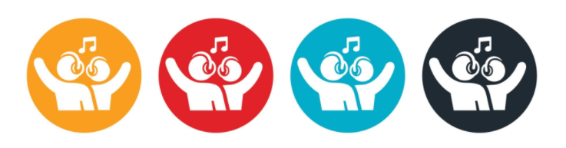
Q & A? Thank You!

