Slide 1
STOCK MOVEMENT PREDICTION
January 9th 2019
By Katherine Tittle

Slide 2
Agenda
Problem Overview
Choose Data Source and data acquisition
Feature Engineering
Feature Selection
Split data into train and test sets
Choose data science models
Model Evaluation
Tuning parameters
Tuning features and choose the best set for each model
Select the best models based on scoring
Model comparison

Slide 3
Problem Overview
Goal: predict individual stock movement in the very near future
  Up if close higher, down if close lower
Independent variables:
  Stock technical analysis indicators, rsi, sma, adx, candlestick ...
Response variables:
  class_1, next day's movement
  class_2, the day after next's movement
  class_3, 2 days after next's movement
Binary classification problem:
  Decision Tree
  Random forest
  Knn
  Logistic regression

Slide 4
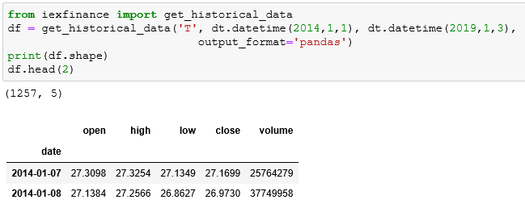
Data acquisition
Data source
  pandas_datareader.get_data_yahoo(): not all adjusted
  Quandl: database has not been updated since March 2018
  iexfinance: only 5 years data
    1257 rows with 5 columns (open, high, low, close, volume)

Slide 5
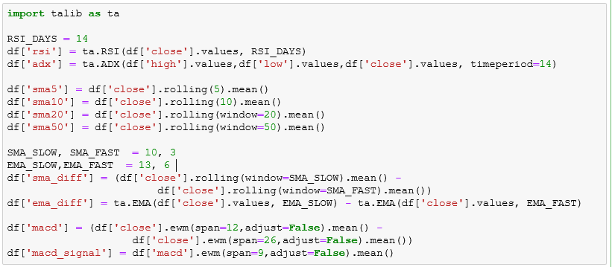
Feature Engineering
Add technical analysis indicators: rsi, adx, macd, moving averages:

Slide 6
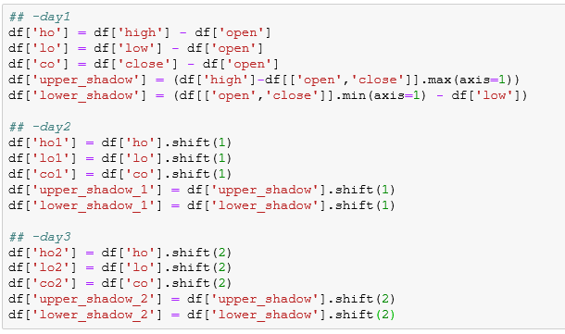
Feature Engineering (cont.)
Add candlesticks of past 3 days:

Slide 7
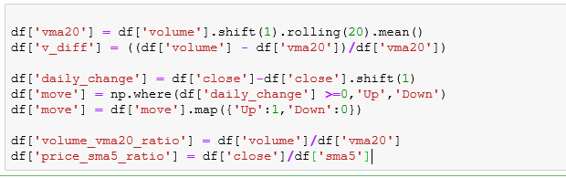
Feature Engineering (cont.)
Add more variables:

Slide 8

Feature Engineering
Add response variables:
  class_1 – next day's close price movement
    1 indicates close up, 0 close down
  class_2 – one day after next day's close price movement
  class_3 – two days after next day's close price movement

Slide 9
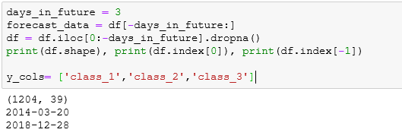
Feature Engineering
Drop Nan value
1204 rows and 39 variables in data set

Slide 10
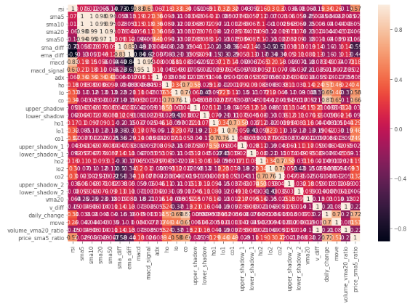
Data analysis
Correlation between features:

Slide 11
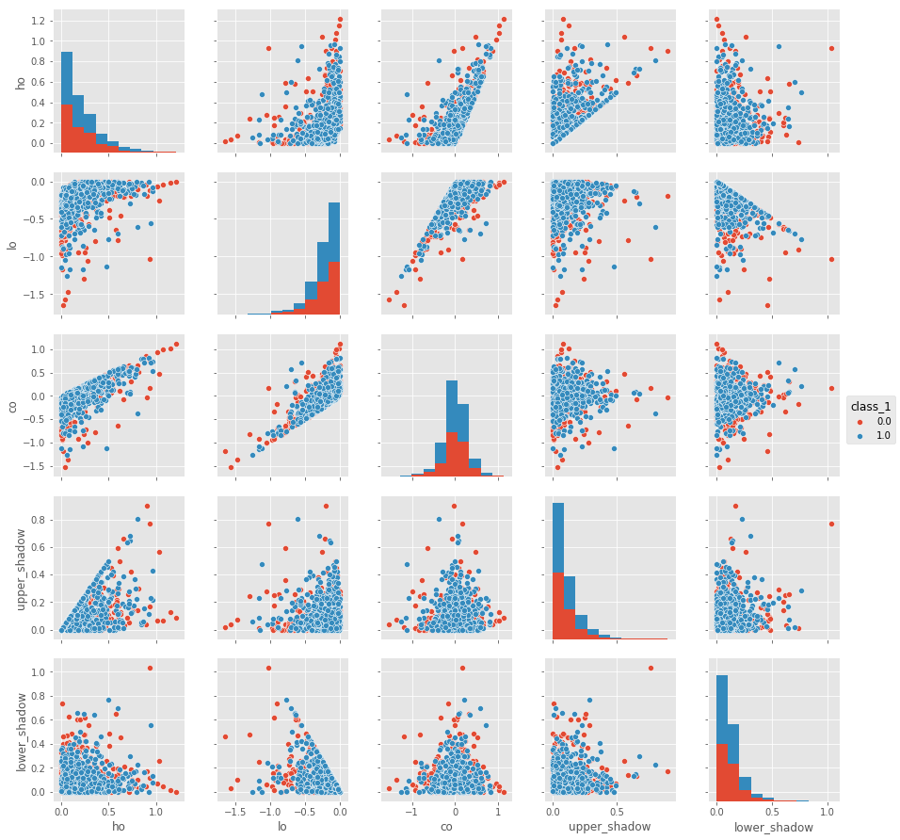
Data analysis (cont.)
Candelstick pairplot (hue='class_1'):

Slide 12
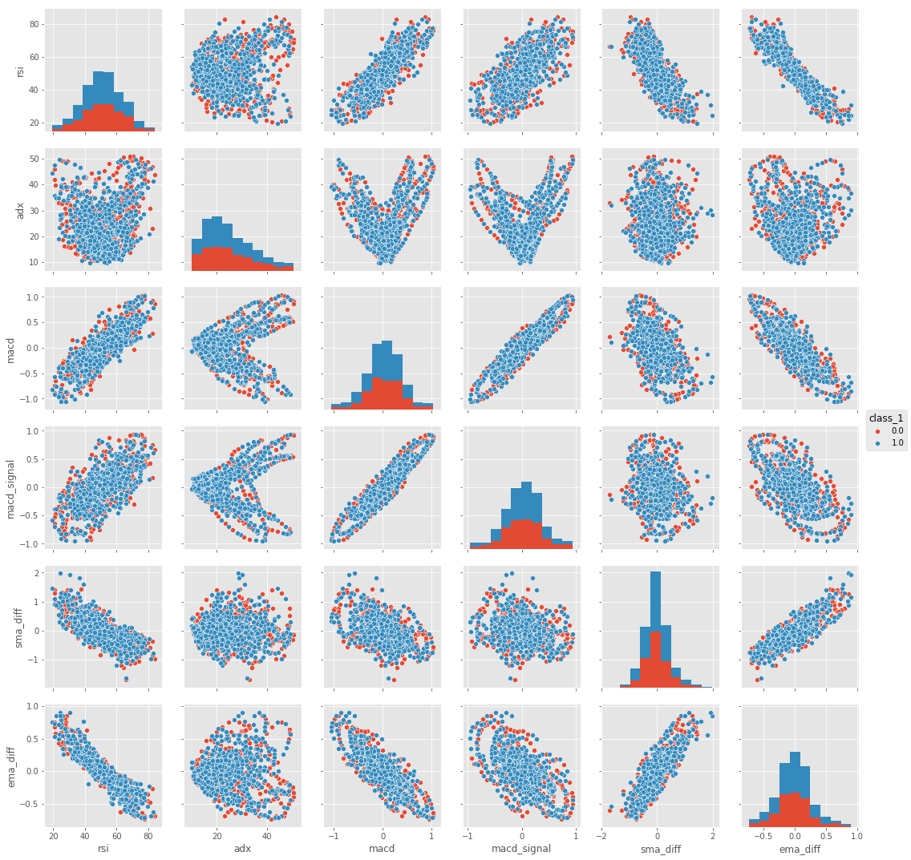
Data analysis (cont.)
indicators pairplot (hue='class_1'):

Slide 13
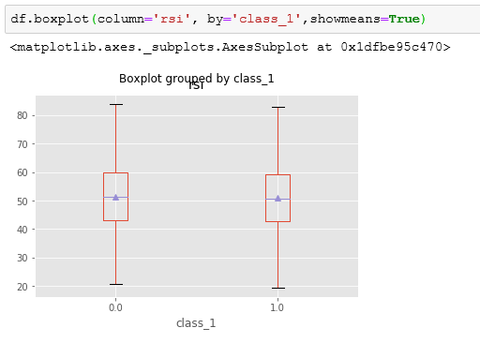
Data analysis (cont.)

Slide 14
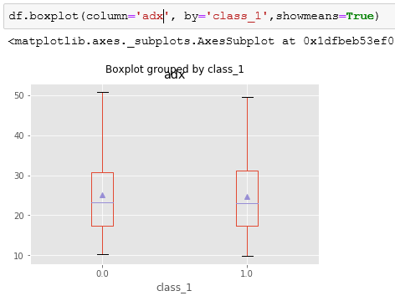
Data analysis (cont.)

Slide 15
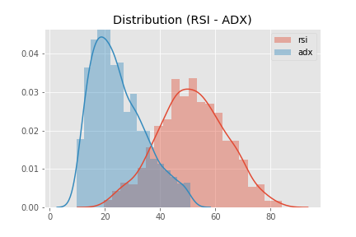
Data analysis (cont.)
Distribution of RSI, ADX:

Slide 16
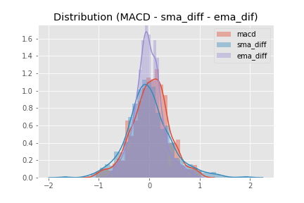
Data analysis (cont.)
Distribution of MACD, sma_diff, ema_diff:

Slide 17
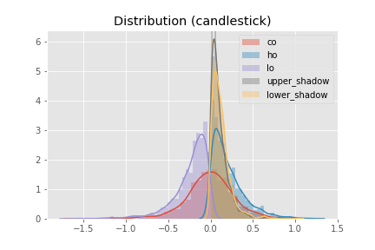
Data analysis (cont.)
Distribution of candlestick (day1):

Slide 18
Feature Selection
Recursive feature eliminating
  Feature evaluator
    DecisionTree
    max_depth range of (1-20)
  Space of feature sets – 14 features groups
  Algorithm:
    1. start with first feature group as a subset
    2. evaluate the subset and rank each feature variable using importance
    3. eliminate the one with lowest rank, get new subset of features
    4. repeat step 2 & 3 until the subset contains only 2 variables
    5. return top 2 feature sets of the highest scores for each target variable
    6. repeat 1 to 5 for the rest of feature groups

Slide 19
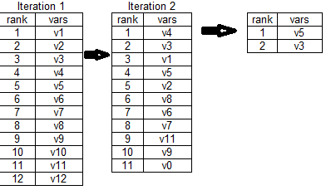
Feature Selection (Cont.)

Slide 20
Feature Selection (Cont.)
Implemented with functions:
  model_eval
    Find the best max_depth and evaluate DecisionTree
  Ranking
    Ranking each feature
  model_validation
    Return score of each feature subset
  feature_evaluation
    Create new subset by eliminating lowest rank feature

Slide 21
Feature Selection (Cont.)
Loop through all 14 features groups
Create the auto_sets dictionary contains total 84 feature_cols:
  Will be used for model evaluation later
  auto_sets[class_key][feature_key] = feature_cols

Slide 22
Choose data science models
Binary classification problem
  Each response variable has only 2 values (1,0)
  Models:
    Decision Tree
    Random Forest
    Knn
    Logistic regression
  .

Slide 23
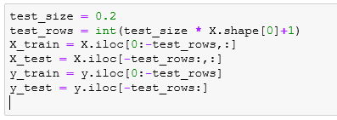
Model Evaluation
Split dataframe into train and test sets
  test_size = 0.2

Slide 24
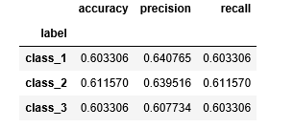
Model Evaluation – Decision Tree
Decision Tree:
  Evaluate model with each feature_set in the auto_sets created in feature_selection
  Find the best max_depth

Slide 25
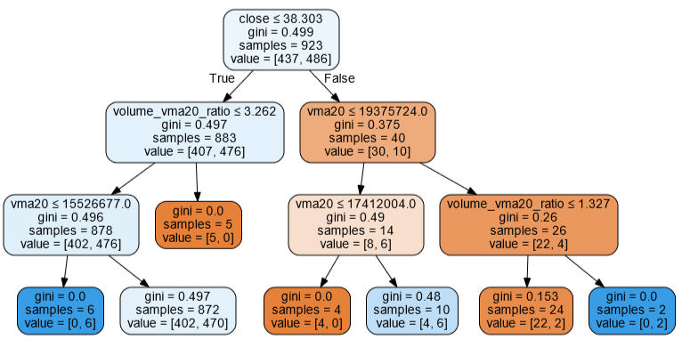
Model Evaluation – Decision Tree(cont.)
Visualizing tree model with highest precision
  plotting depth=3

Slide 26
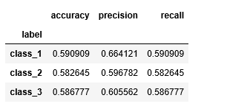
Mode Evaluation – Random Forest

Slide 27

Mode Evaluation – Knn
Feature normalized – StandardScaler & make_pipe

Slide 28

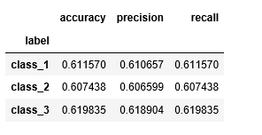
Mode Evaluation – Knn (Cont.)

Slide 29

Mode Evaluation – LogisticRegression
LogisticRegression:
  Evaluate model using auto_sets
  Normalized features & make_pipe

Slide 30

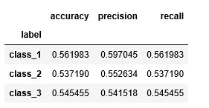
Mode Evaluation – LogisticReg (cont.)

Slide 31
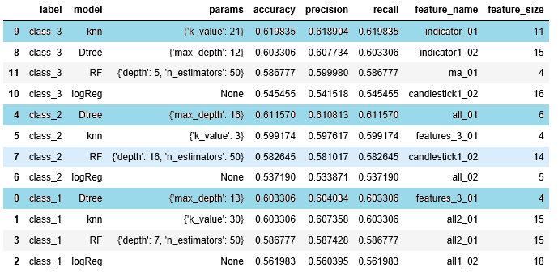
Model comparison
Sorted by accuracy

Slide 32
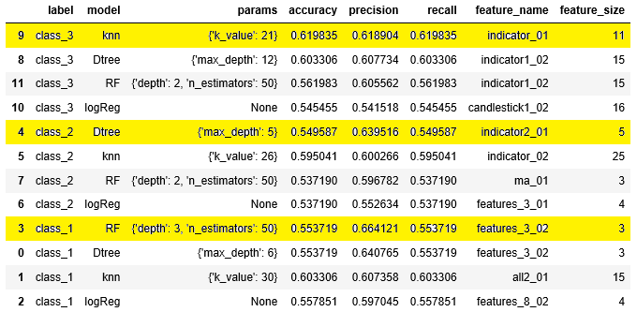
Model comparison (cont.)
Sorted by precision

Slide 33
Conclusion
The accuracy and precision of the best models for each target are between 61% and 66%
It could be improved by improving feature engineering and feature select algorithms.
Feature selection algorithm creates the feature set of the highest scores. However it replies on feature engineering and the feature group space that is searched by the algorithm.

Slide 34
Next Step
Feature engineering
  Evaluate other indicators
Feature selection
  Better algorithm
Tuning parameters
Deep learning

Slide 35
Q&A
Q & A

