Slide 1
RFE Project and Mobile Application
by Ram Kotta and Katherine Thayer

Slide 2
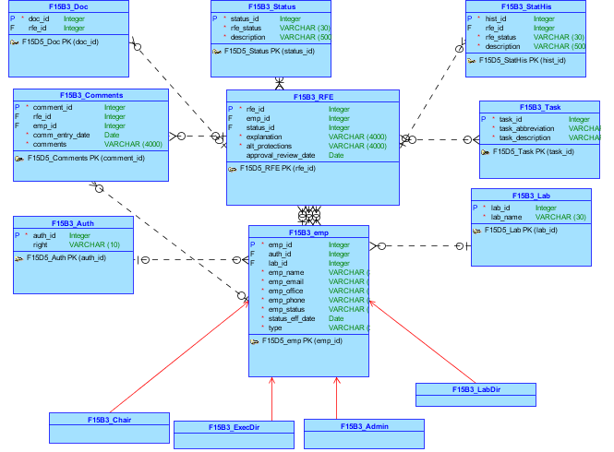
Conceptual Model

Slide 3
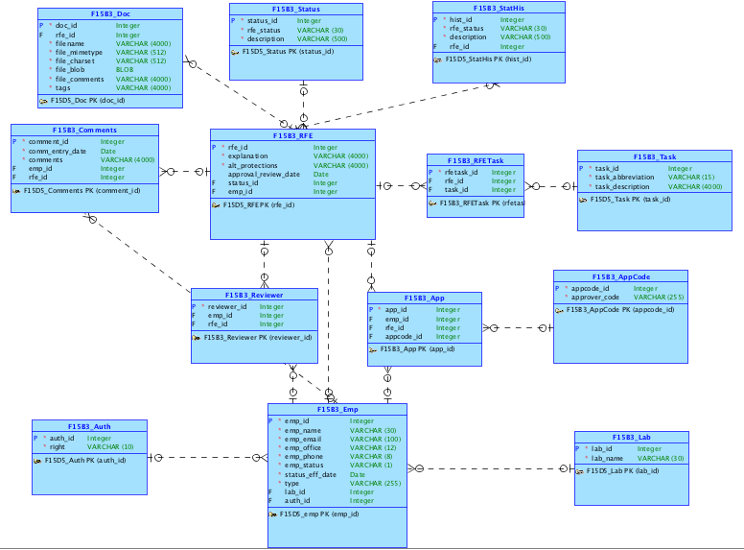
Logical Model

Slide 4
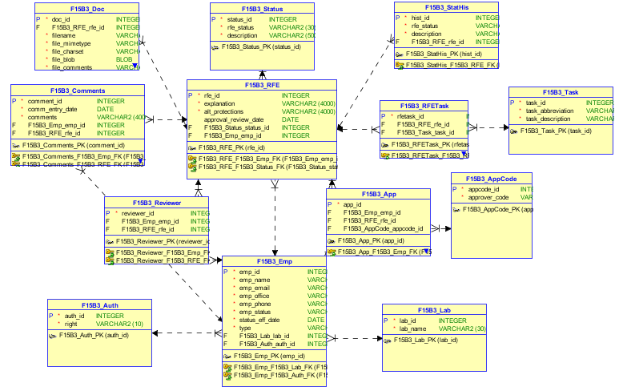
Relational Model

Slide 5
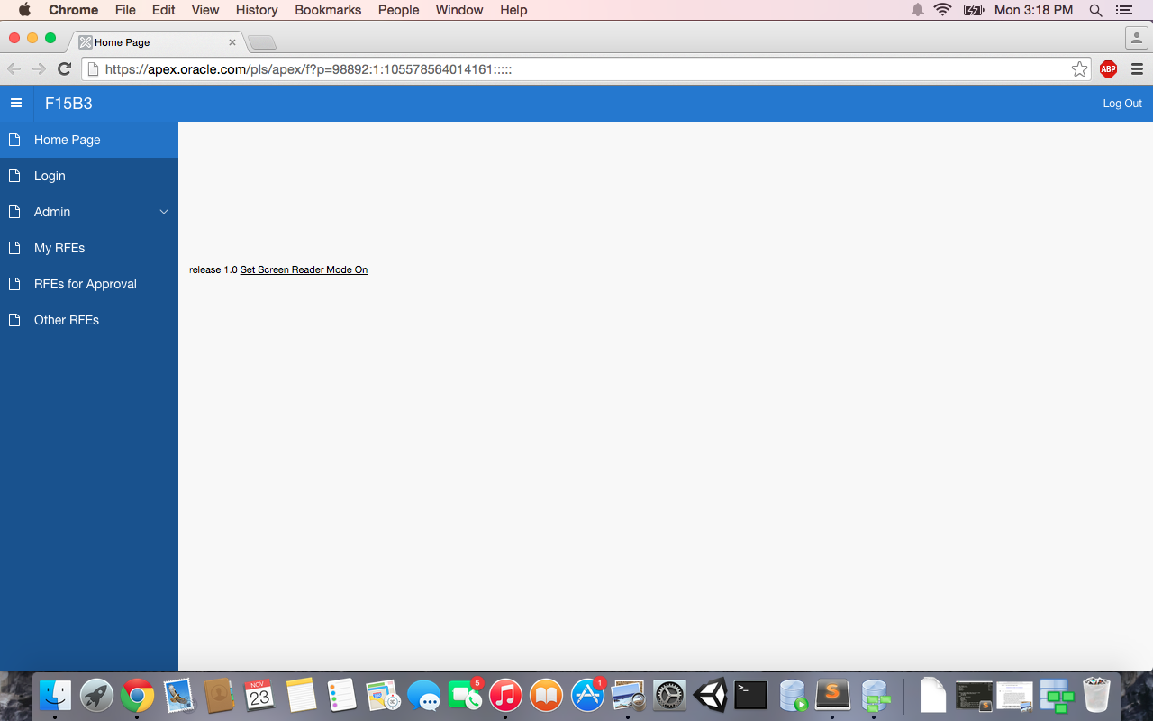
Apex Application

Slide 6
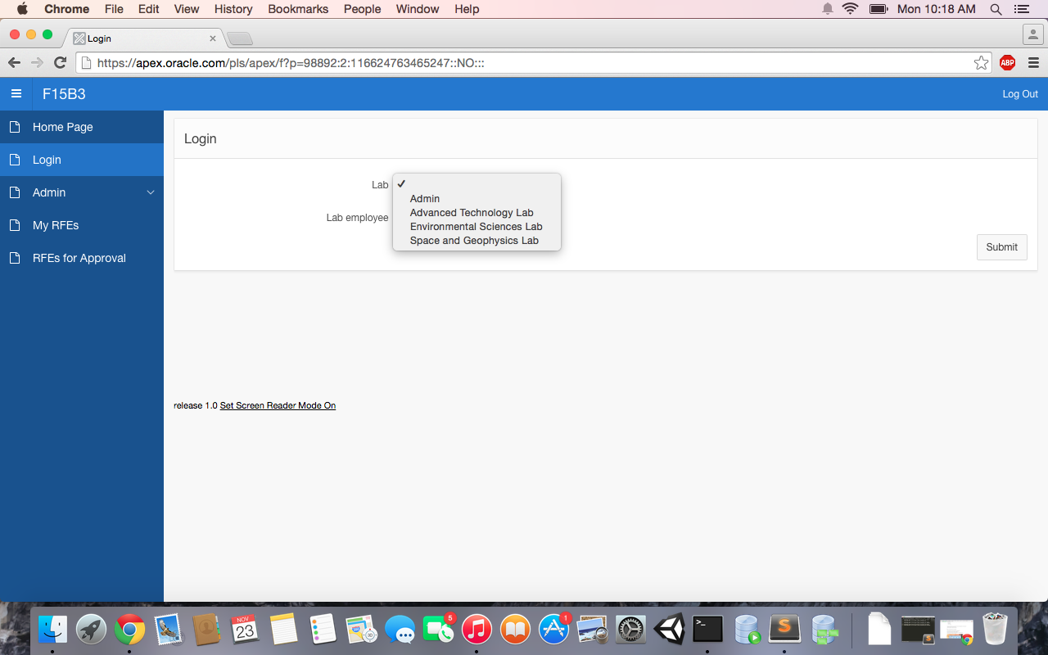
Apex Application (continued)

Slide 7
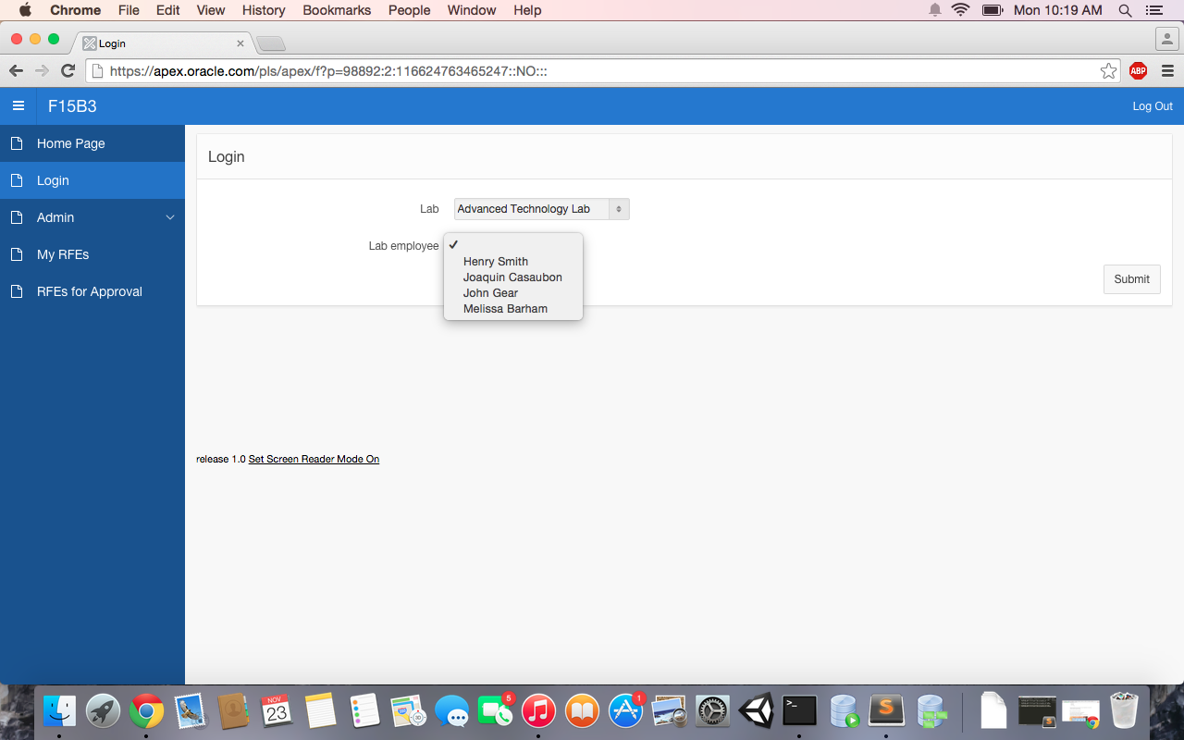
Apex Application (continued)

Slide 8
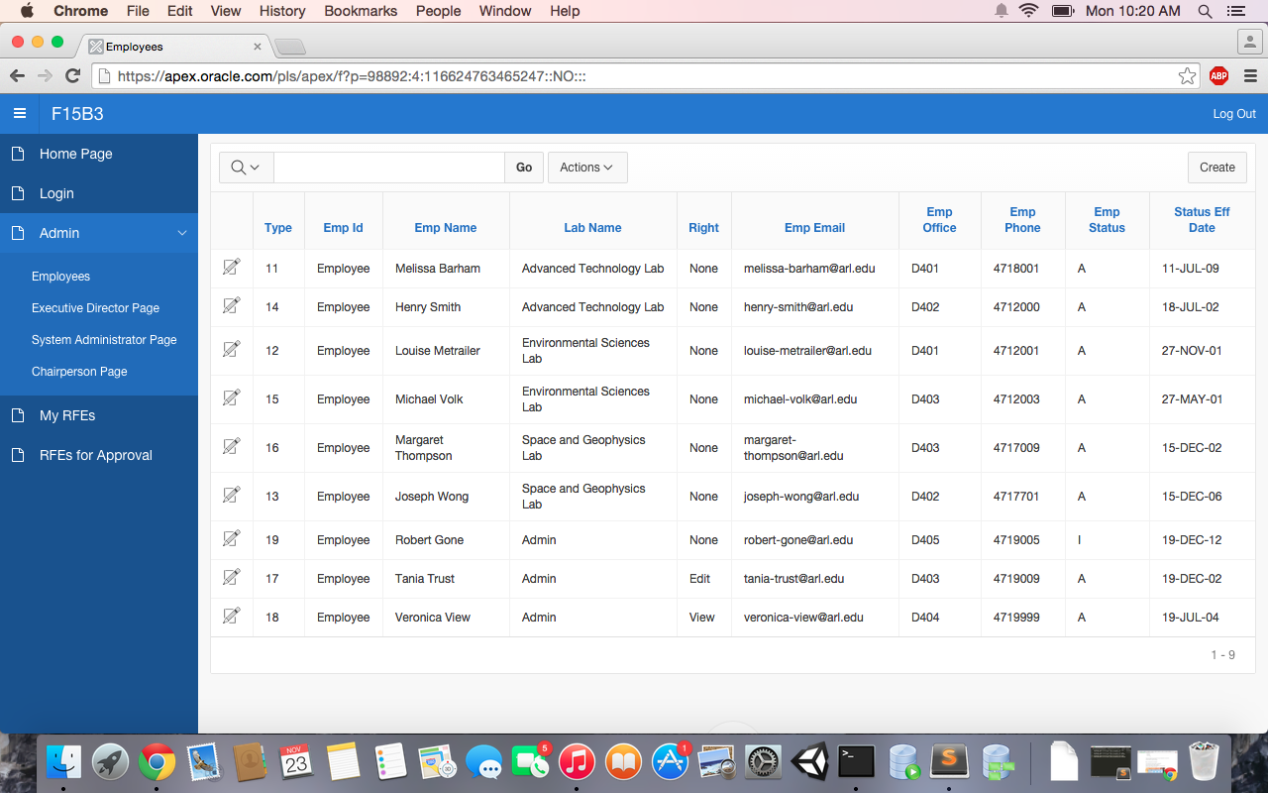
Apex Application (continued)

Slide 9
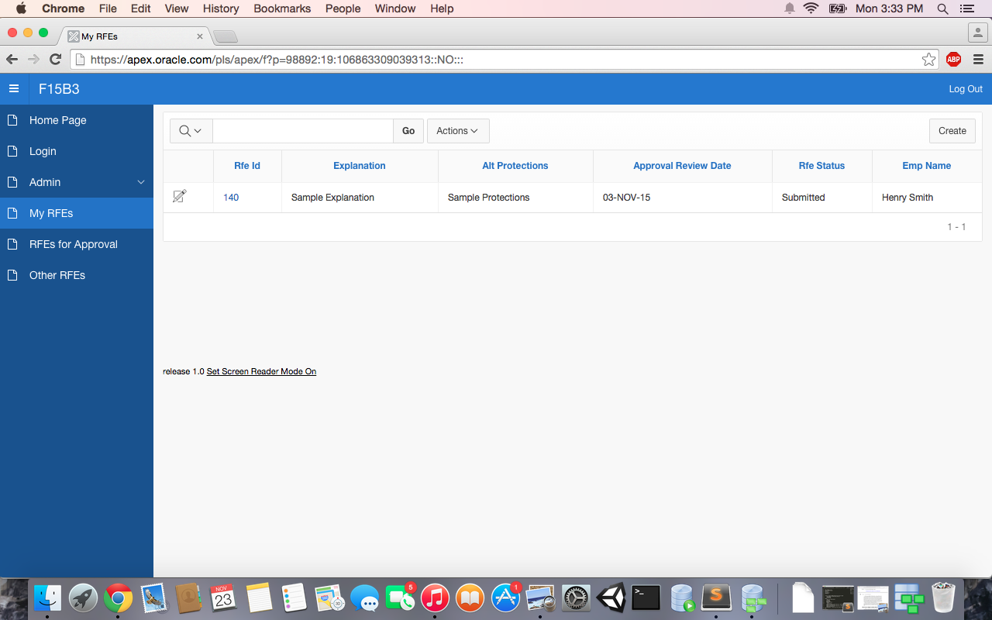
Apex Application (continued)

Slide 10

Apex Application (continued)

Slide 11
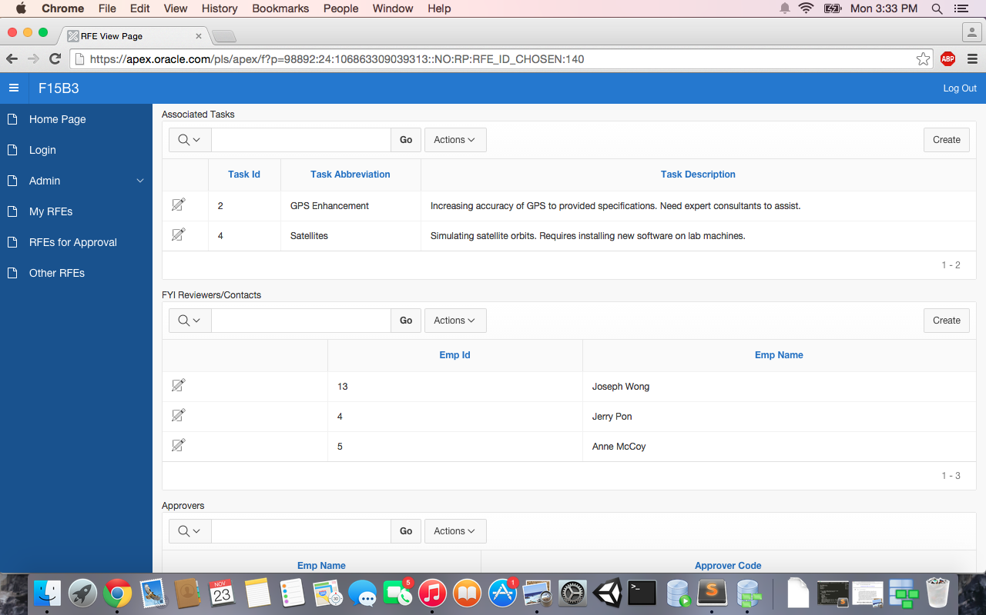
Apex Application (continued)

Slide 12
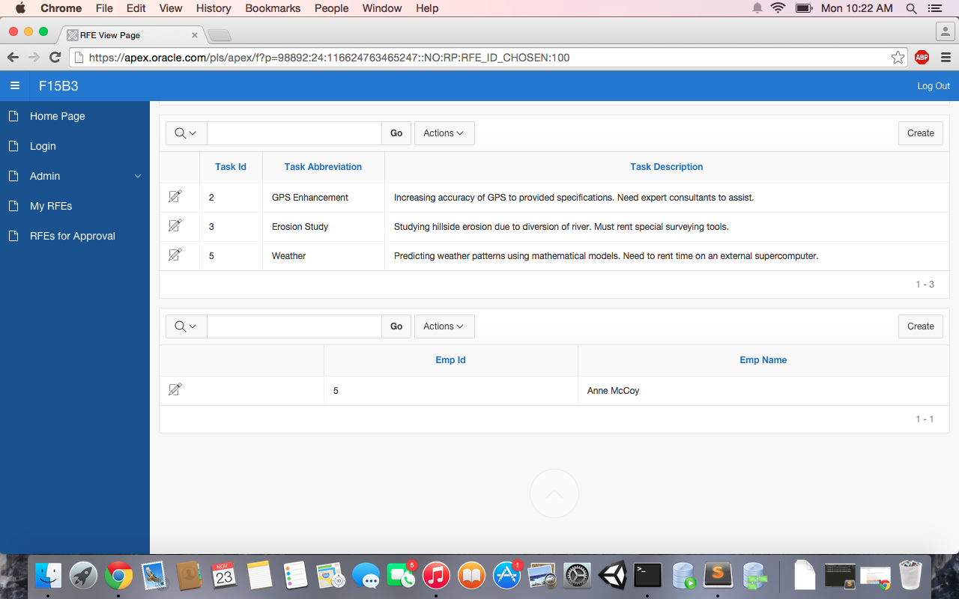
Apex Application (continued)

Slide 13
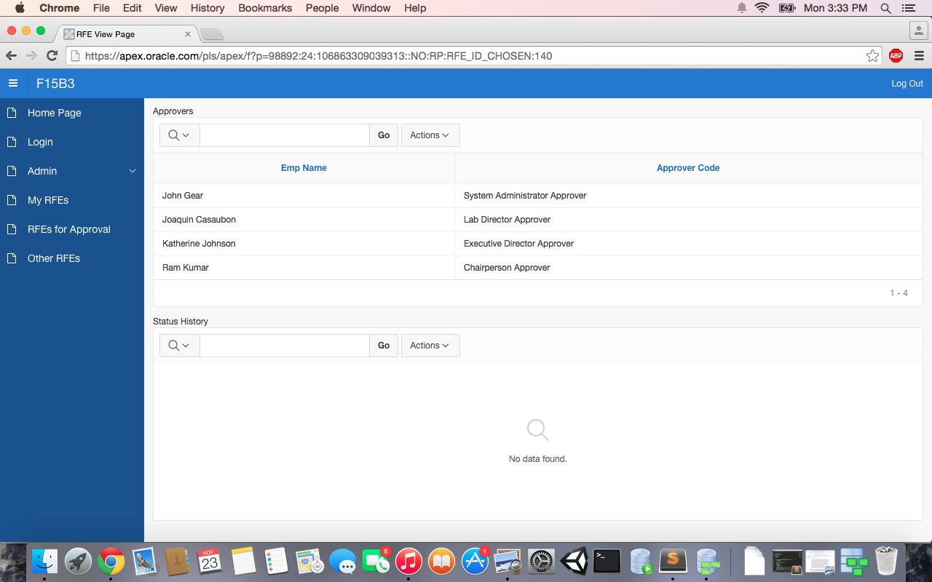
Apex Application (continued)

Slide 14
Github Repository Link
https://github.com/KatherineThayer/F15B3_ARL
(Will be made public after presentations are complete.)

Slide 15
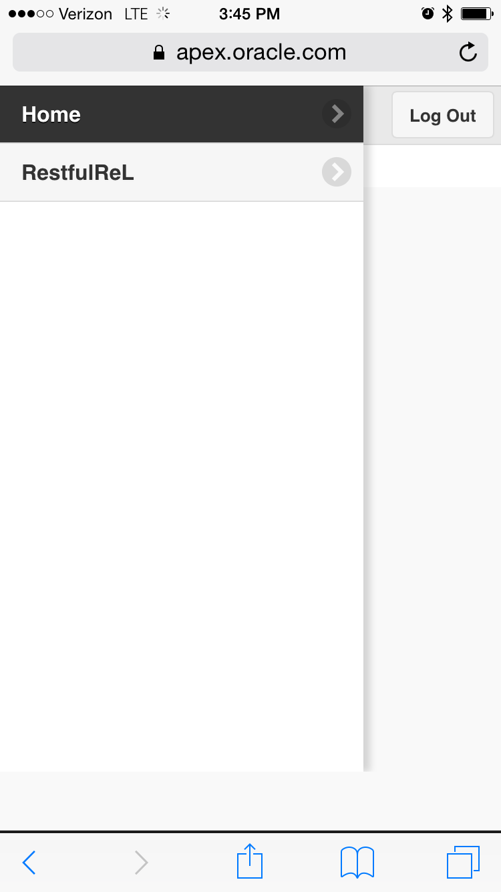
Apex Mobile

Slide 16
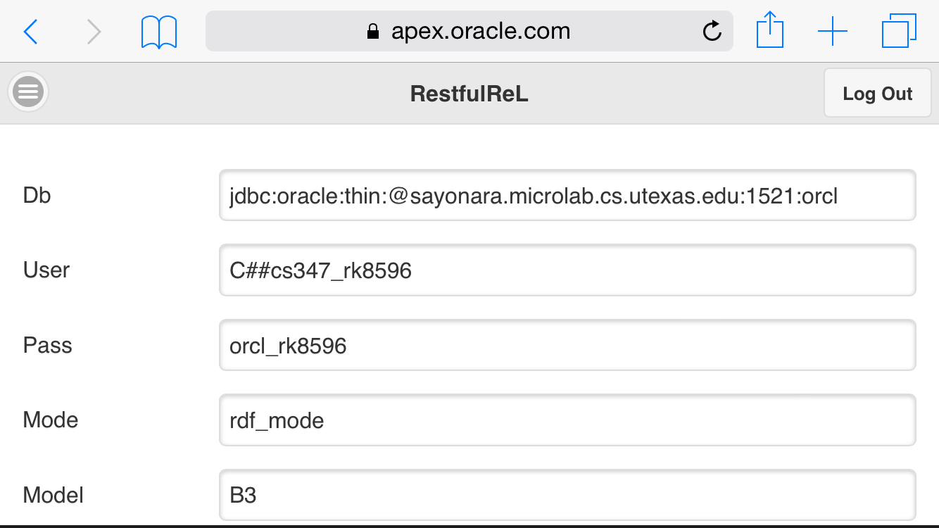
Apex Mobile

Slide 17
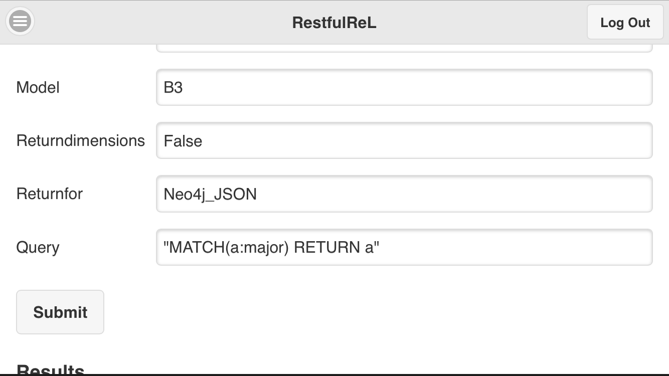
Apex Mobile

Slide 18
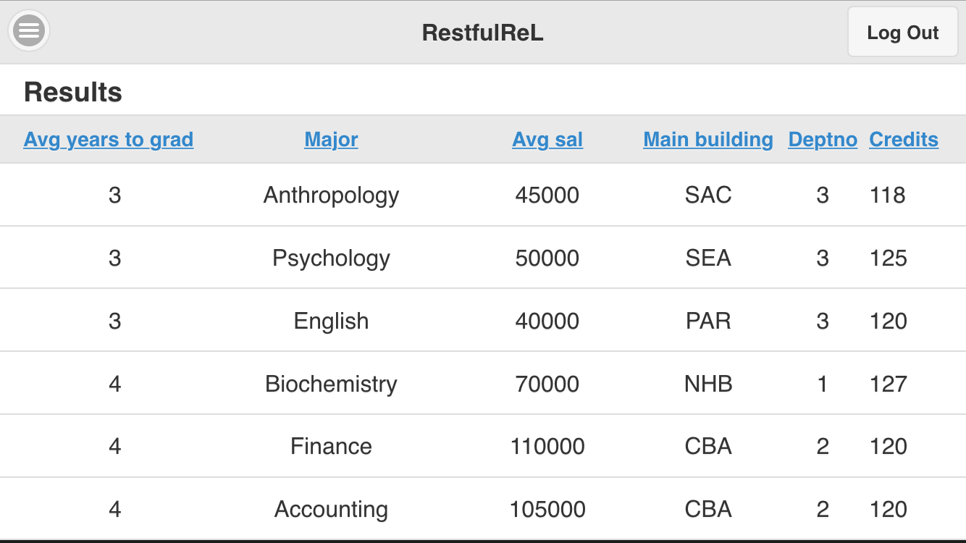
Apex Mobile

Slide 19
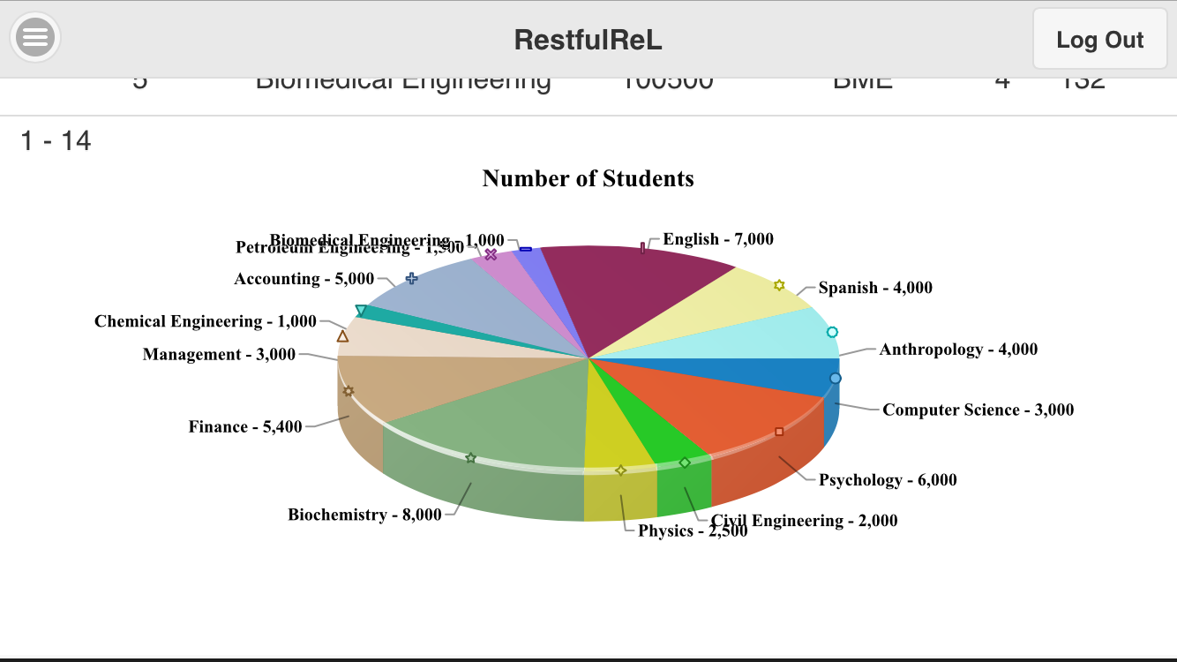
Apex Mobile

