Slide 1
Citi Bike Analysis & Insights
Ruchak Vira
Karthik Ramanathan
Pranav Sheth

Slide 2
Project Overview
Citi Bike - Bike sharing program run in New York City(NYC), Jersey city, & Hoboken
Create an ecosystem where commuters and riders are able to save time and money to get around the town with convenience and ease
Focus on analysing & identifying actionable insights for Citi Bike Business team that would indicate growth opportunities, streamline operations and eventually have a positive impact on the revenue for the Citi Bike business.

Slide 3
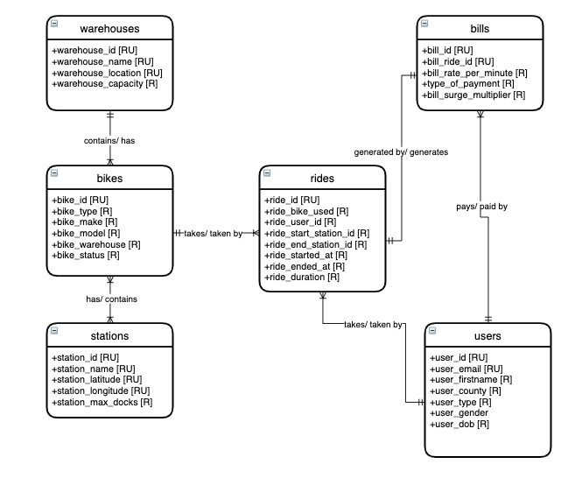
Conceptual Model Diagram

Slide 4
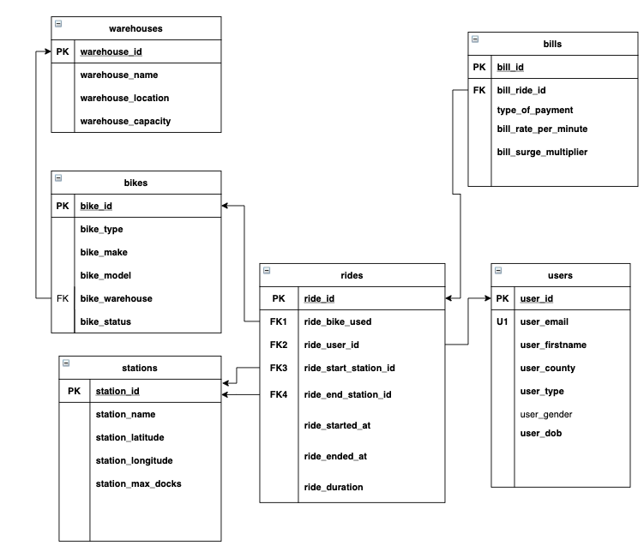
Logical Data Model Diagram

Slide 5
Technologies Used
Draw.io
SQL Server
SQL Server Import Wizard
Azure Data Studio
MS PowerApps
MS PowerBI

Slide 6
Answering Data Questions for Insights

Slide 7


Average Duration of Each Ride & Average Age of Riders

Slide 8
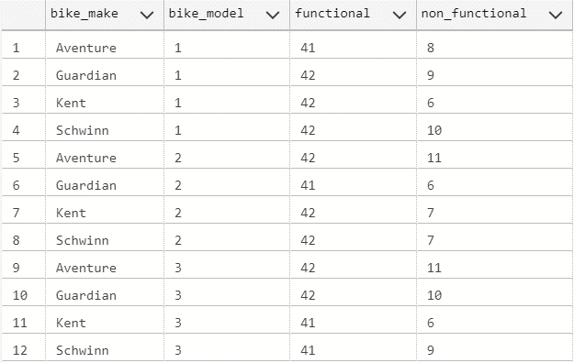
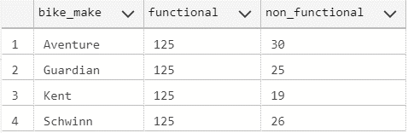
Current Bike Inventory Categorization

Slide 9
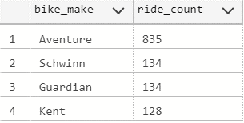
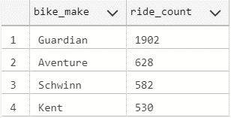
Bike Categorization Basis Trip Duration
>15 mins (long duration)
<15 mins (short duration)

Slide 10
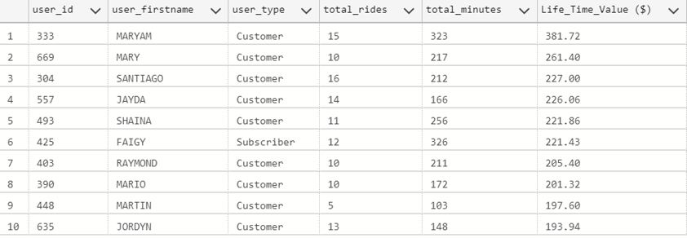
Customer Lifetime Value(LTV)

Slide 11
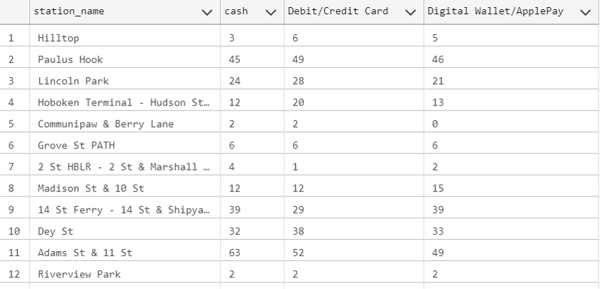
Payment Method Analysis

Slide 12
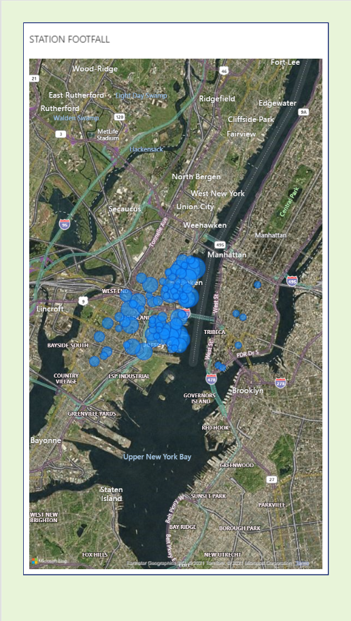
Ride Analysis at Each Station
https://app.powerbi.com/groups/me/reports/0517f884-790d-4602-9ae0-6f82bff5883e/ReportSection

Slide 13
Interface Implementation - Power Apps

Slide 14
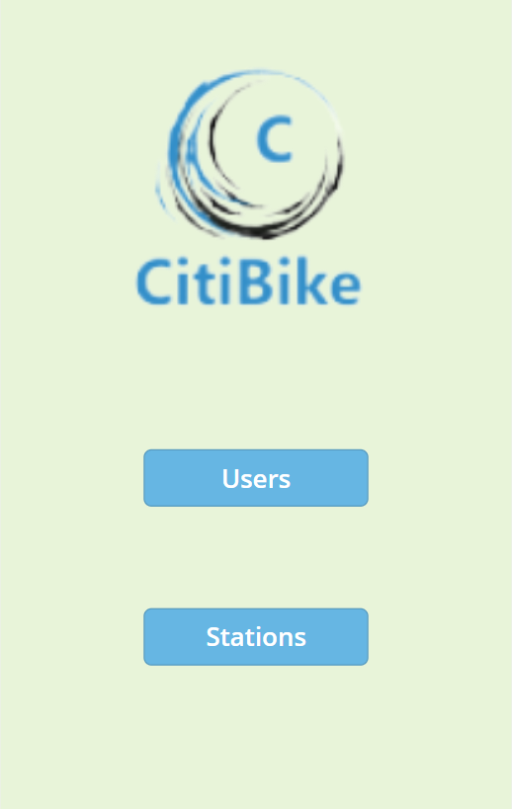
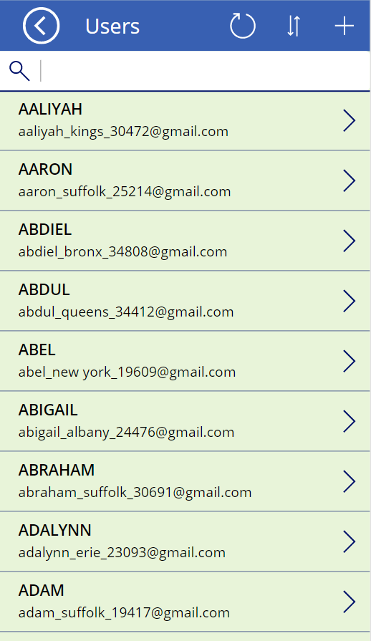
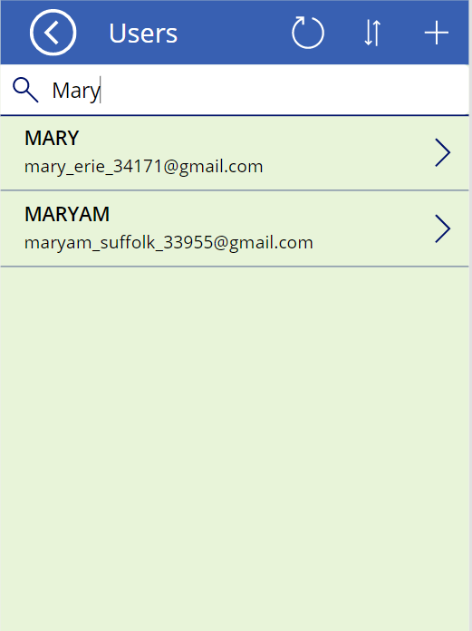

Slide 15
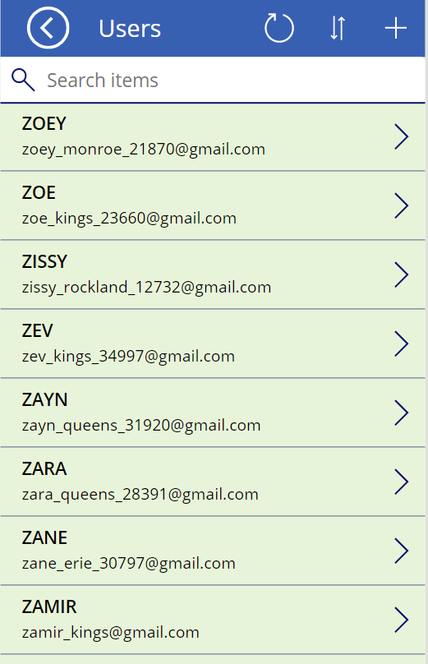
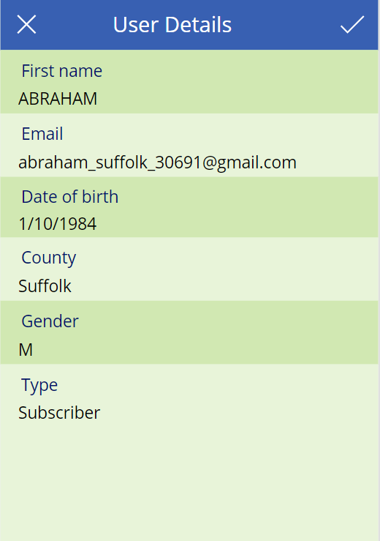

Slide 16
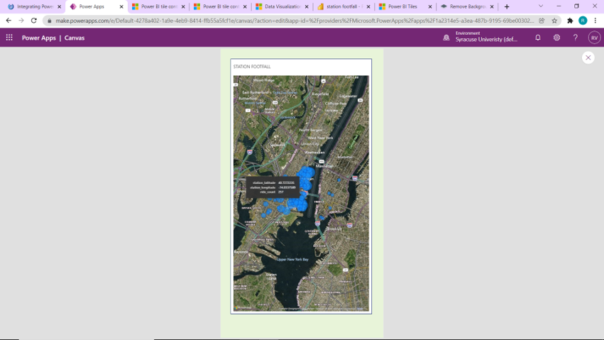
PowerBI Dashboard - link

Slide 17
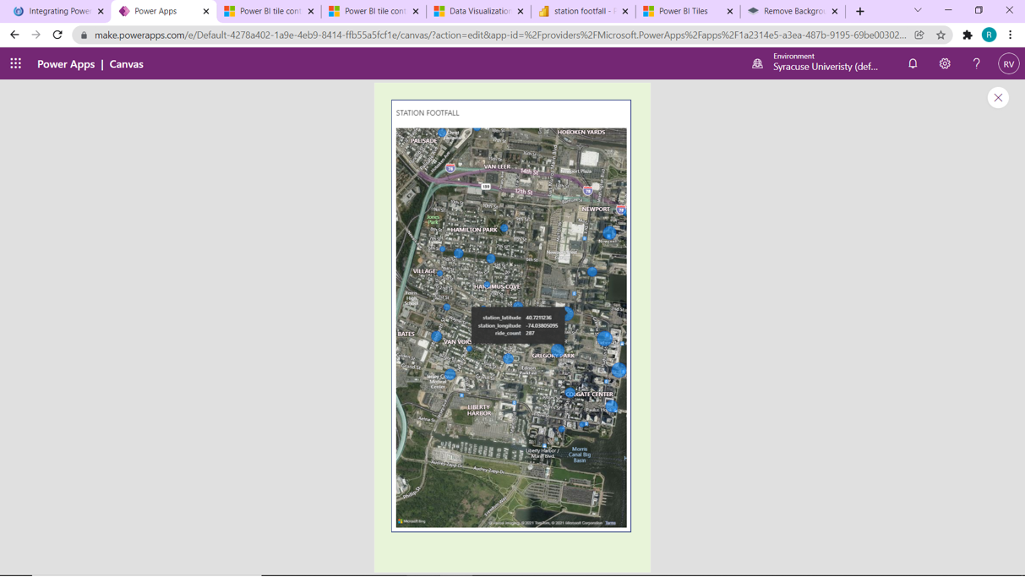

Slide 18
Reflections

Slide 19
Thank You!

