Slide 1
AI-Based Railway Track Defect Detection in India
False Negatives, Safety Assurance and Human Accountability
Responsible AI Case Study
By Team: 4
2023103032 | Jivetesh
2023103546 | Kathir Kalidass B
2023103570 | Dhinesh Babu C M
2023103714 | Paril T
CEG, Anna University | Responsible AI 2026

Slide 2
Agenda
1. Domain Context -- Indian Railway Safety Challenges
2. Why AI? -- Opportunities, Limitations & Critical Distinctions
3. Technical Approach -- CNN Architecture for Defect Detection
4. Results -- Performance, False Negative Rate & Robustness
5. Explainability -- Grad-CAM Visualizations
6. Framework -- Human-in-the-Loop Pipeline
7. Responsible AI Principles -- Safety, Accountability, Governance
8. Recommendations & Conclusion
CEG, Anna University | Responsible AI 2026

Slide 3
Indian Railways -- A Safety-Critical Domain
68,000+ km of track | 23M+ daily passengers | Safety cannot be compromised
Network Scale:
• 68,000+ route-kilometres across diverse geography
• 13,000+ passenger trains, 9,000+ freight trains daily
• 23+ million passengers daily
Inspection Challenges:
• TRCs, patrolling -- effective but infrequent
• Human fatigue & visibility affect quality
• Continuous monitoring impossible at this scale
AI Opportunity:
• High-frequency surface defect monitoring
• Flag sections for priority human inspection
Critical Distinction:
SURFACE defects (detectable by AI):
- Transverse cracks, head checks, squats
- Shelling, surface corrosion, wear
INTERNAL flaws (require NDT):
- Hydrogen cracks, gauge corner cracking
- Weld defects, internal fractures
RDSO T-53 (2020): Ultrasonic testing
remains mandatory for compliance
AI visual inspection = DECISION-SUPPORT
tool, not a replacement for NDT
CEG, Anna University | Responsible AI 2026

Slide 4
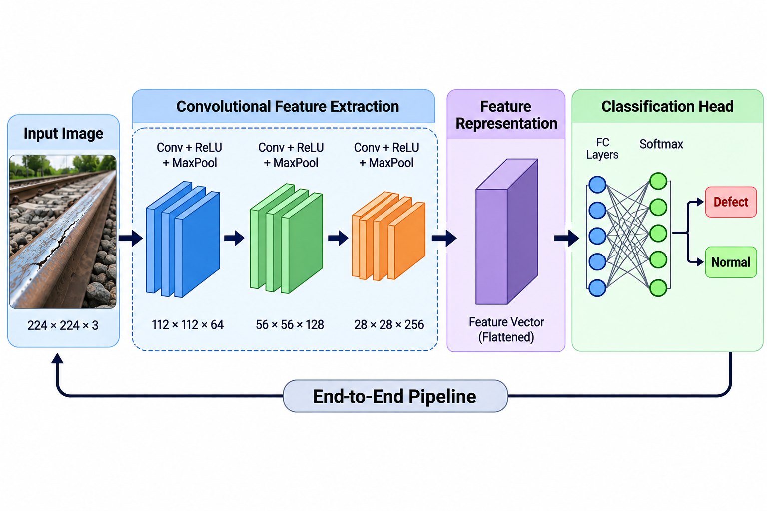
Technical Approach -- CNN Architecture
Binary classification: Defective vs Normal rail surface
Model: Convolutional Neural Network (CNN)
• 4 Conv blocks: 32 -> 64 -> 128 -> 256 filters
• Global Average Pooling + FC(512) + Dropout(0.5)
• Binary output (Sigmoid)
Input: 200x200 RGB rail surface images
Training:
• Adam optimiser, LR = 0.001, 50 epochs
• Augmentation: rotation, flip, brightness
• Early stopping on validation loss
Explainability: Grad-CAM attention heatmaps
Key Innovation: Weighted loss (w_FN=10, w_FP=1)
penalises missed defects 10x more than false alarms
CEG, Anna University | Responsible AI 2026

Slide 5
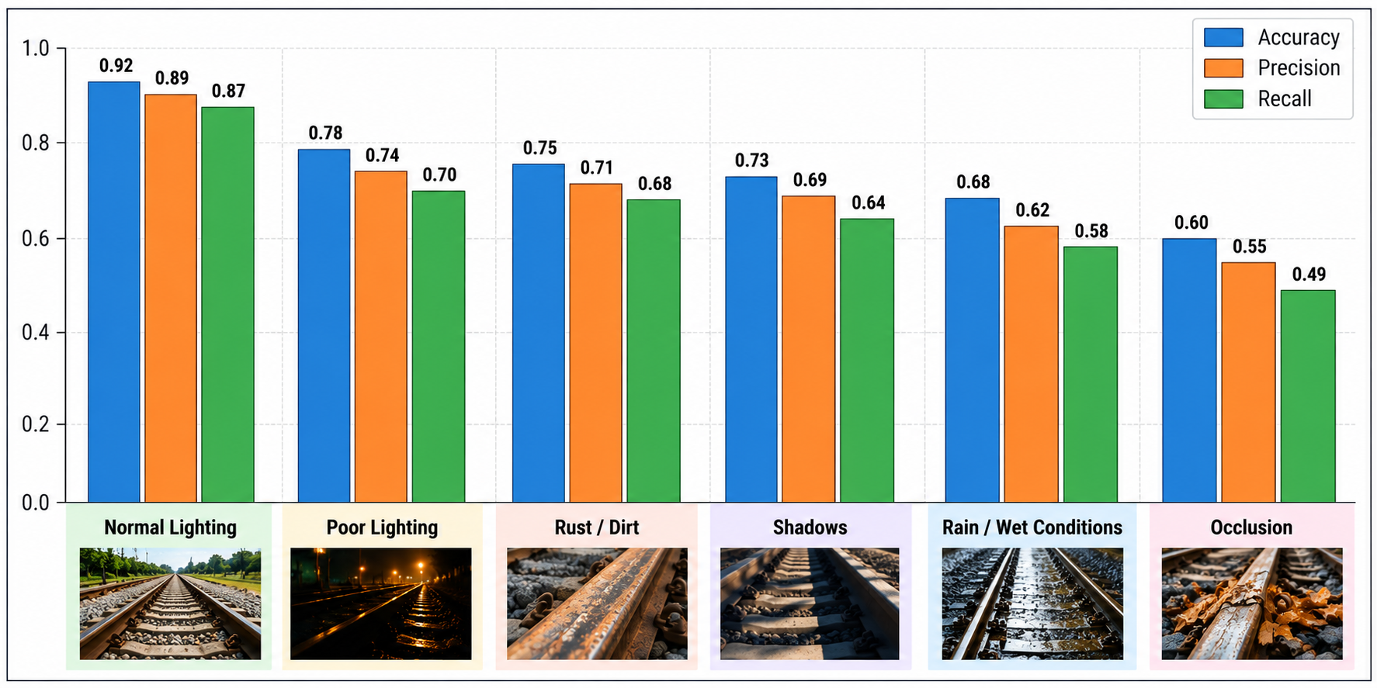
Key Results -- Performance & Robustness
Performance (Ideal Conditions):
Accuracy: 93.2%
Precision: 94.1%
Recall: 91.5%
F1-Score: 92.8%
FNR: 8.5% ⚠
Robustness Findings:
• FNR increases 2.7x under adverse conditions
• Shadow occlusion causes largest FNR jump
• Accuracy alone is an unsafe metric
⚠ 1 in 12 defects missed in ideal conditions
⚠ 1 in 4 defects missed in worst-case field conditions
CEG, Anna University | Responsible AI 2026

Slide 6
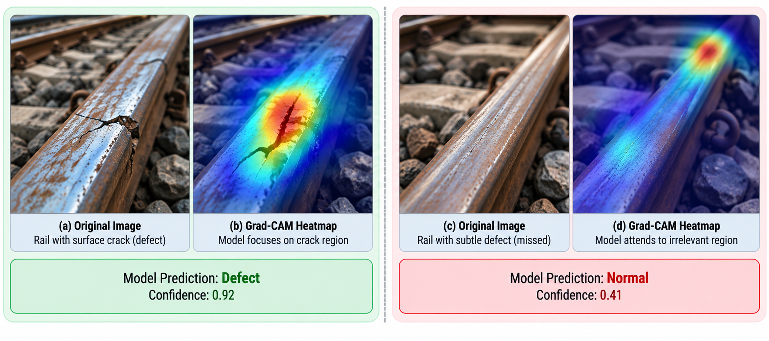
Explainability -- Grad-CAM Visualizations
Understanding why the model makes its decisions
Grad-CAM highlights regions
the model attended to:
(a) Correct Detection:
Heatmap on crack region
→ Model learned correctly
(b) Missed Detection:
Heatmap on ballast (wrong!)
→ Spurious correlation learned
(c) False Positive:
Heatmap on shadow pattern
→ Texture confusion
Inspectors use heatmaps to
verify or override AI decisions
CEG, Anna University | Responsible AI 2026

Slide 7
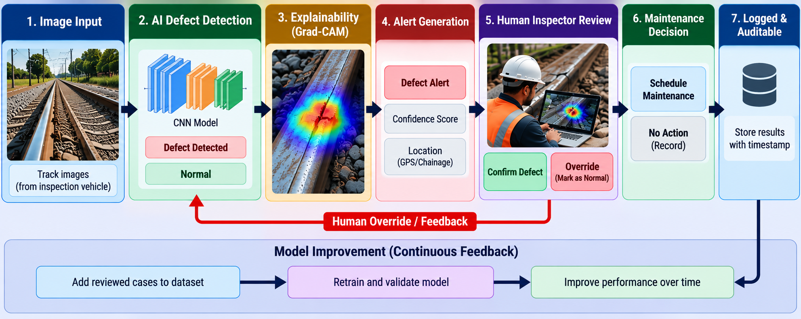
Proposed Human-in-the-Loop Framework
AI supports inspectors -- never replaces them
Seven-stage pipeline: Image Capture -> AI Detection -> Grad-CAM -> Confidence Routing -> Inspector Review -> Maintenance -> Audit Log
Low-confidence classifications trigger mandatory manual inspection. Inspectors always retain override authority.
CEG, Anna University | Responsible AI 2026

Slide 8
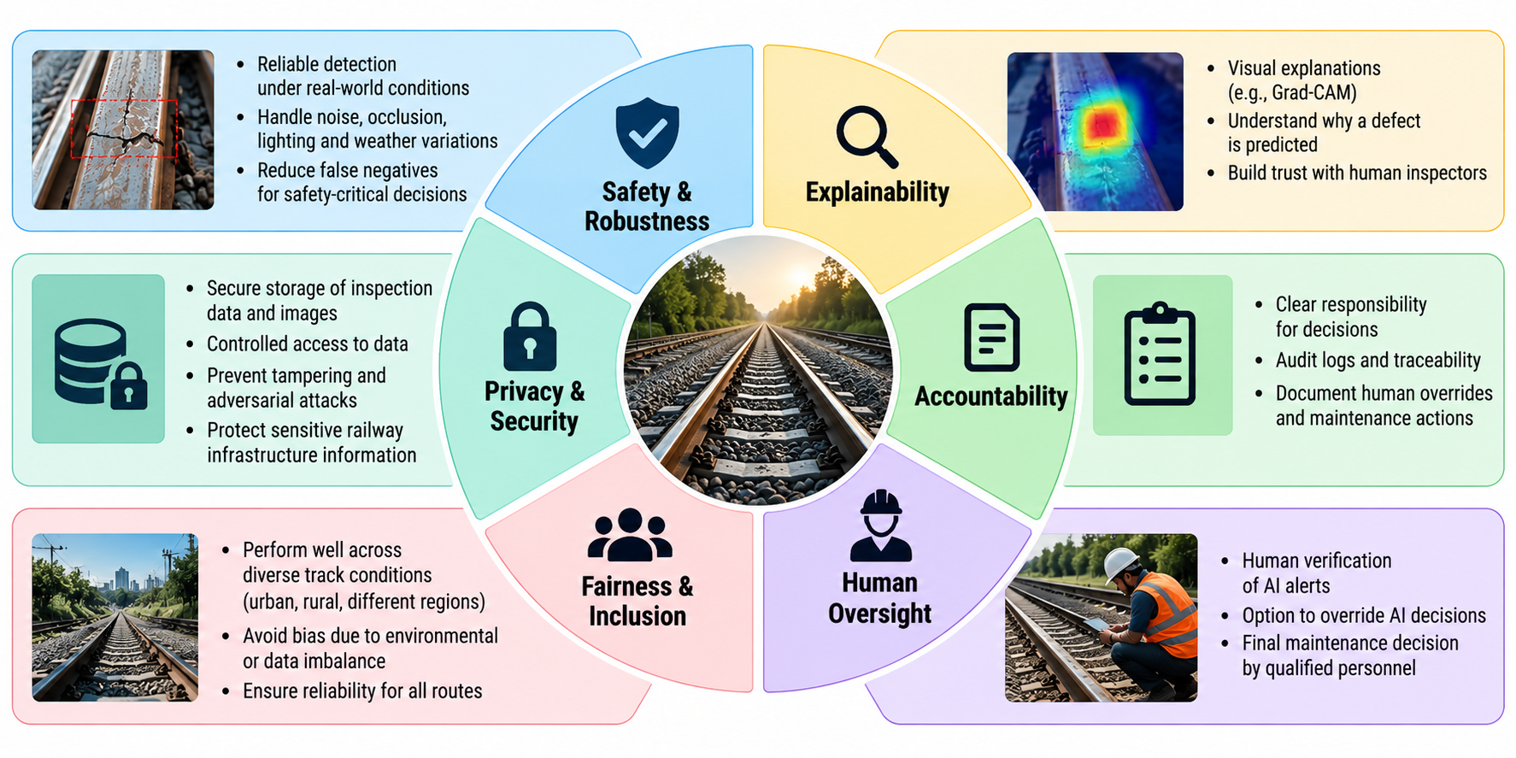
Responsible AI Principles for Railway Inspection
Six Core Principles:
1. Safety & Robustness
FNR < 5%, field testing
2. Explainability
Grad-CAM for trust & debugging
3. Accountability
Clear roles, RDSO alignment
4. Human Oversight
Mandatory review, override right
5. Fairness & Inclusion
Cross-region, defect-type testing
6. Privacy & Security
Access control, audit trail
CEG, Anna University | Responsible AI 2026

Slide 9
Key Recommendations for Responsible Deployment
Do NOT deploy standalone
-- operate within existing governance
Report FALSE NEGATIVE RATE
-- not just overall accuracy
Maintain ultrasonic testing
-- AI cannot replace NDT
Confidence-based escalation
-- low confidence = mandatory review
Explicit accountability chains
-- who reviews, authorises, is responsible
Environmental robustness testing
-- validate per railway division
Explainability from design phase
-- not retrofitted for compliance
The goal: AI that augments inspector
capability while maintaining the safety
assurance passengers depend upon.
CEG, Anna University | Responsible AI 2026

Slide 10
Thank You
Questions & Discussion
CEG, Anna University | Responsible AI 2026

