Slide 1













WALMART SPARKATHON
Team Spartans

Slide 2



What is the problem?
Irrelevant Reviews: Some reviews focus on unrelated topics like personal stories or comments about the retailer rather than the product itself.
Misleading Information: These off-topic reviews can mislead buyers, distorting the true feedback about the product.
Impact on Decisions: This can negatively and positively affect purchase decisions and skew the overall perception of the product.

Slide 3

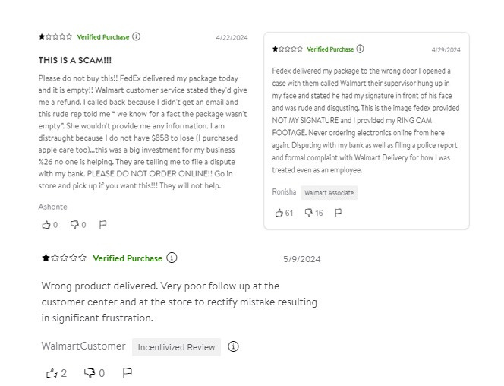


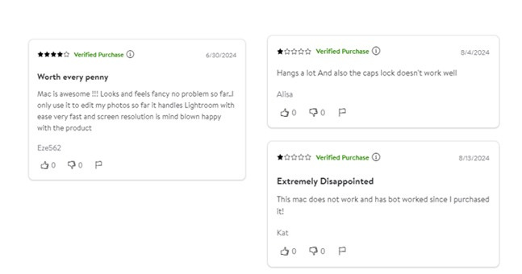
Your paragraph text
Proof: These Reviews Properly impact on the buyers
Proof: These Reviews has improper feedback which may mislead the buyer

Slide 4


The solution:
Our Review Filtering and Summarization System transforms the way user feedback is analyzed.
Shows out the reviews most relavent to the product that can inform the user about the overall quality of the product.
Further we classify the reviews into positive & negative categories using advanced NLP techniques. This classification helps in quickly understanding the overall sentiment of the reviews.
Additionally, the system provides concise summaries of each review, highlighting the key points without requiring extensive manual review
This dual functionality streamlines feedback management,
enabling businesses and consumers to make informed
decisions more efficiently.

Slide 5




TECH STACK
Python
Excel
01
02
Used for designing class and fuctionality
Used as an intermediary for data storage and access
03
NLP
04
LLM - Gemini pro
USed NLP for formatting the text for further use in the LLM
Used LLM for generating the review that the user wants

Slide 6

Thank You
Team Members:
Kathiravan M
S Jegannath
Lankesh M
Sughan S

