Slide 1
Final Review – B.TECH PROJECT
Graph-MoE: A Topology-Aware Mixture-of-Experts Framework for Drift Adaptive Weather Forecasting
Student Details:
1. Pranesh L - CB.AI.U4AID23133
2. Kathirvelan M - CB.AI.U4AID23118
3. Sasikumar P - CB.AI.U4AID23146
4. Jeiesh J S - CB.AI.U4AID23116
Team Number: AB 13
Supervisor: Dr. Vinith
Notes:
Updated final-review deck. All results are taken from the project's current result files (after the September audit fix).

Slide 2
Problem statement and motivation
Weather and climate regimes shift over time (El Niño vs. normal years): a model trained once quietly goes stale as conditions change.
Retraining the entire model, from scratch or on a fixed schedule, is wasteful: a shift is usually confined to particular regions or relationships.
Most forecasters choose which regions to trust by correlation or geography, so they cannot tell "this region's physics changed" from "a coincidental correlation broke".
As systems grow from regional to global scale, the number of regions that can drift grows too, and full retraining becomes even more costly.
Our approach: validate real causal drivers first, then adapt only the regions that actually drifted.

Slide 3
Phase 1 objectives
1
Causal graph: discover which regions' past conditions carry information about another region's future OLR (PCMCI over 50 regions x 6 variables).
2
Stress tests: check every link against fake decoy variables, physical travel speeds, trimming to the strongest links, and redrawing the regions at double resolution.
3
Graph as guidance: feed the validated graph to the causal splitter three ways: narrow its candidates, nudge its scores, or penalise selections outside the graph.
4
Unseen years: compare the graph-guided splitter with an unguided one on held-out 2013–2022.
5
Drift-adaptive experts: detect drift per region, then retrain, spawn, or reactivate only that region's expert.

Slide 4
Phase 2 objectives
1
India forecasting backbone: shared graph neural network on hourly surface data, with region-specific experts conditioned on Phase 1 validated causal drivers.
2
72-hour forecasts: autoregressive roll-out to 72 h, with a station-level component checked against real observations.
3
Benchmark: compare with GraphCast and WeatherNext on the same data, horizons and evaluation protocol.
4
Global scale: extend the validated regional architecture to larger meshes, more regimes and a larger expert pool.

Slide 5
03 | Consolidated Literature Review & Research Gap
Paper | Key idea / method | Limitation
Wu et al., "Discovering invariant rationales for graph neural networks", ICLR 2022 | Splits a graph into causal rationale and non-causal part; swaps the non-causal part across instances; stable prediction = invariant causal information. | Built for graph classification; no spatiotemporal forecasting; no dynamic expert adaptation.
Ghaffari et al., "Graph-conditioned mixture of GNN experts for traffic forecasting", arXiv 2026 | A small router blends frozen, pre-trained experts per node using topology and recent input. | Experts frozen forever: no retraining, no spawning, no answer to drift.
Cao et al., "Geometric mixture-of-experts with curvature-guided adaptive routing", arXiv 2026 | Routes each node to expert sub-networks by Ollivier–Ricci curvature across Riemannian spaces. | Routes by topology/curvature alone: no notion of drift or causality.
Wu et al., "GraphMETRO: mitigating complex graph distribution shifts via mixture of aligned experts", NeurIPS 2024 | Each expert is invariant to one hand-constructed shift type; blended by a learned gate. | Shift components hand-constructed and static; no shift structure learned from data.
RESEARCH GAP
Existing studies address causal rationale discovery, graph distribution shifts, dynamic expert learning and graph-based weather forecasting separately. None combines causal structure discovery with drift-triggered expert adaptation for spatiotemporal weather forecasting.

Slide 6
06 | Dataset
Source: BSISO monitoring data; the Boreal Summer Intraseasonal Oscillation is a slow-moving pattern of tropical convection related to the MJO.
Grid: 2.5° tropical belt, 30°S–30°N, all longitudes (25 x 144 = 3,600 cells, about 275 km each).
Time: daily, 1979-01-01 to 2022-12-31; 16,071 days, none missing.
Fields: SST, h850, u200, PW, u850, OLR, as anomalies normalised per grid cell.
Target: OLR, a proxy for convection (low OLR = active rain) and the least persistent field.
Regions: 3,600 cells -> 50 regions by k-means on OLR -> 50 x 6 = 300 nodes; the adjacency mesh defines candidate pools.
Split: 1979–2012 for graph discovery and training; 2013–2022 held out for testing only.
Season: Phase 1 scores BSISO-active target days only (208 days/yr on average); source history is kept in full.

Slide 7
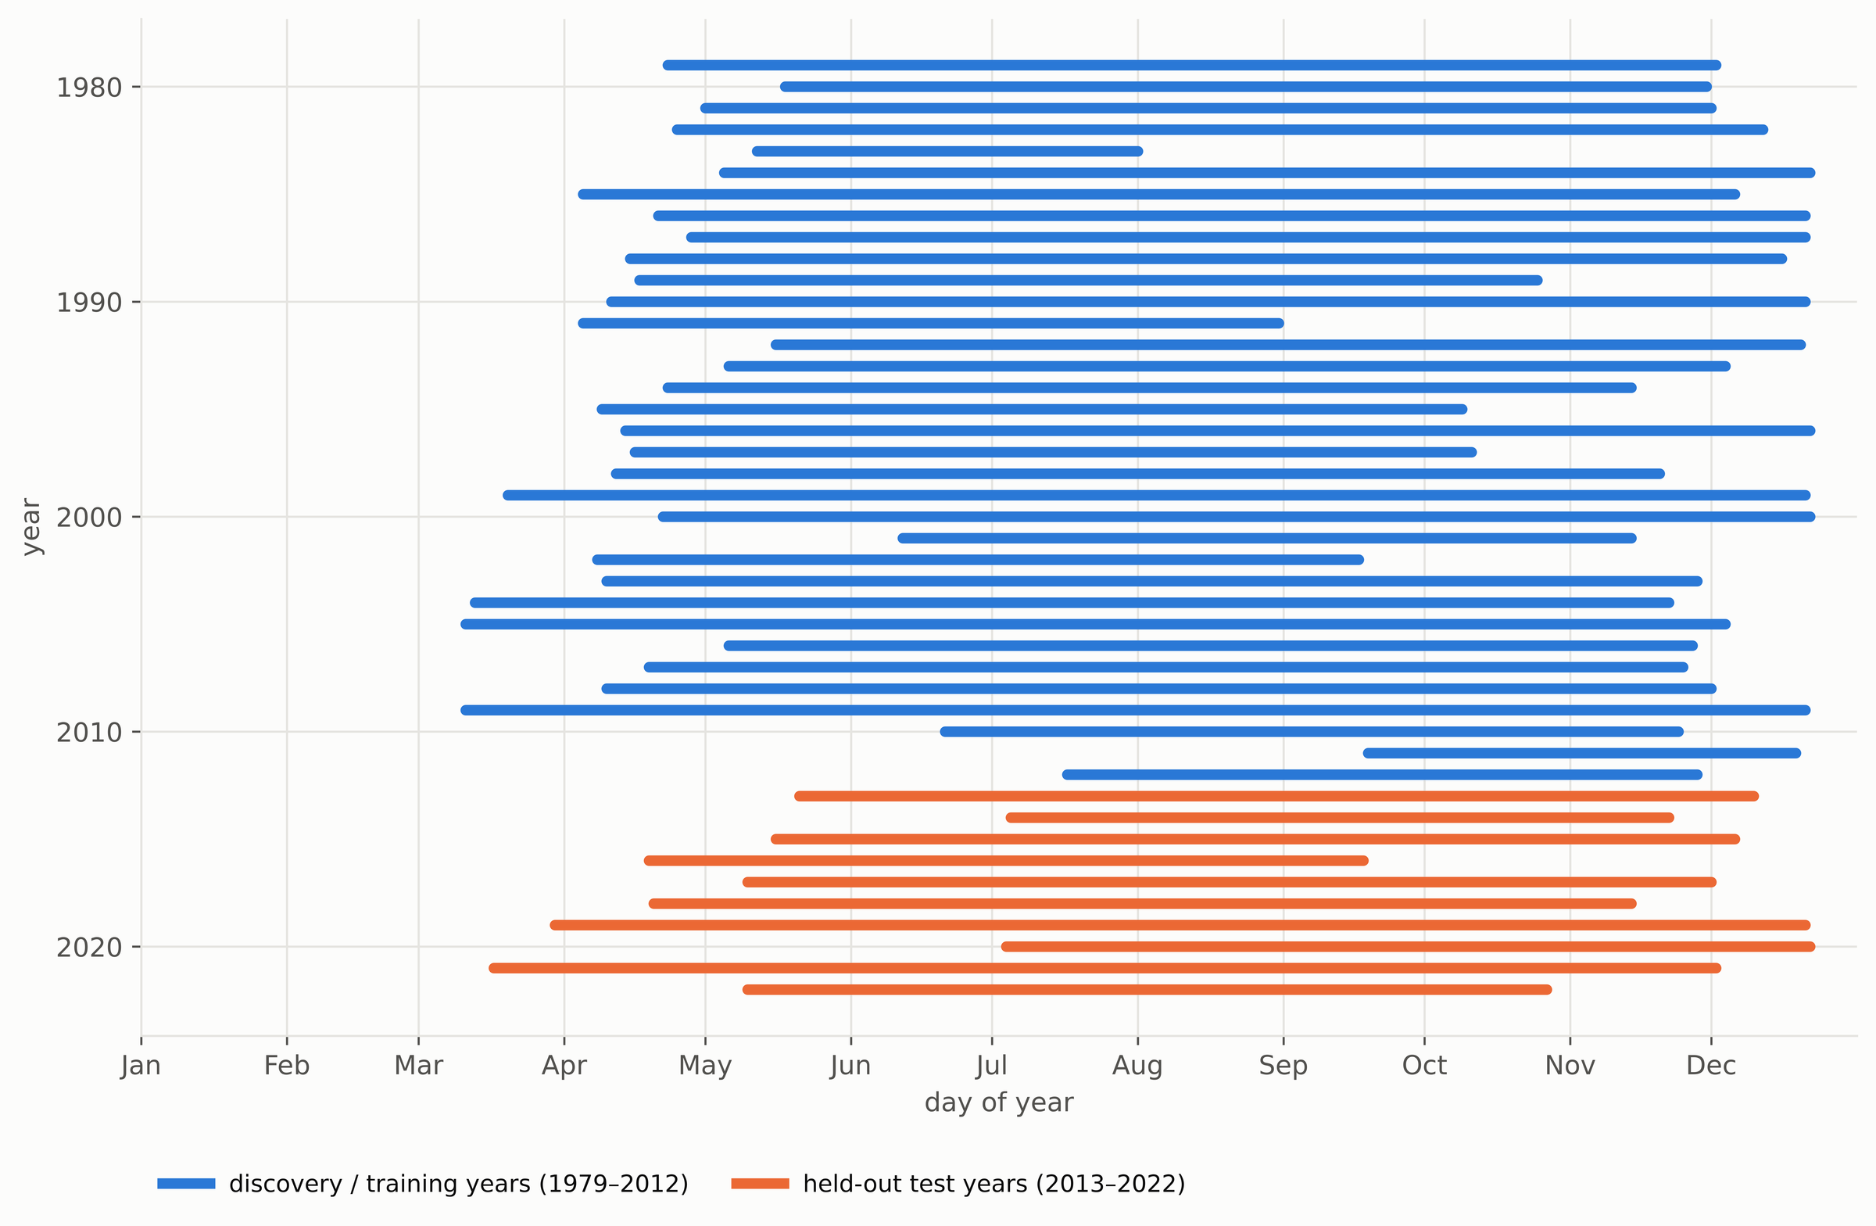
06 | Dataset: active BSISO season
BSISO index rebuilt from our own OLR + u850 (combined EOF, May–Oct, 1979–2012 only).
EOF variance 11.2% / 7.7% vs. about 10% / 7% published by Lee et al. (2013).
Season = 31-day mean amplitude > 1 for 20+ days, padded by 21 days.
208 days/yr on average (82–286); onset April–July.
Active season per year: blue = discovery/training years, orange = held-out test years.
Notes:
A fixed May-October window would include inactive weeks in some years and miss active weeks in others, so the season is defined by the oscillation's own amplitude. Only target days are restricted; a lag-45 source for a 1 June target reads mid-April.

Slide 8
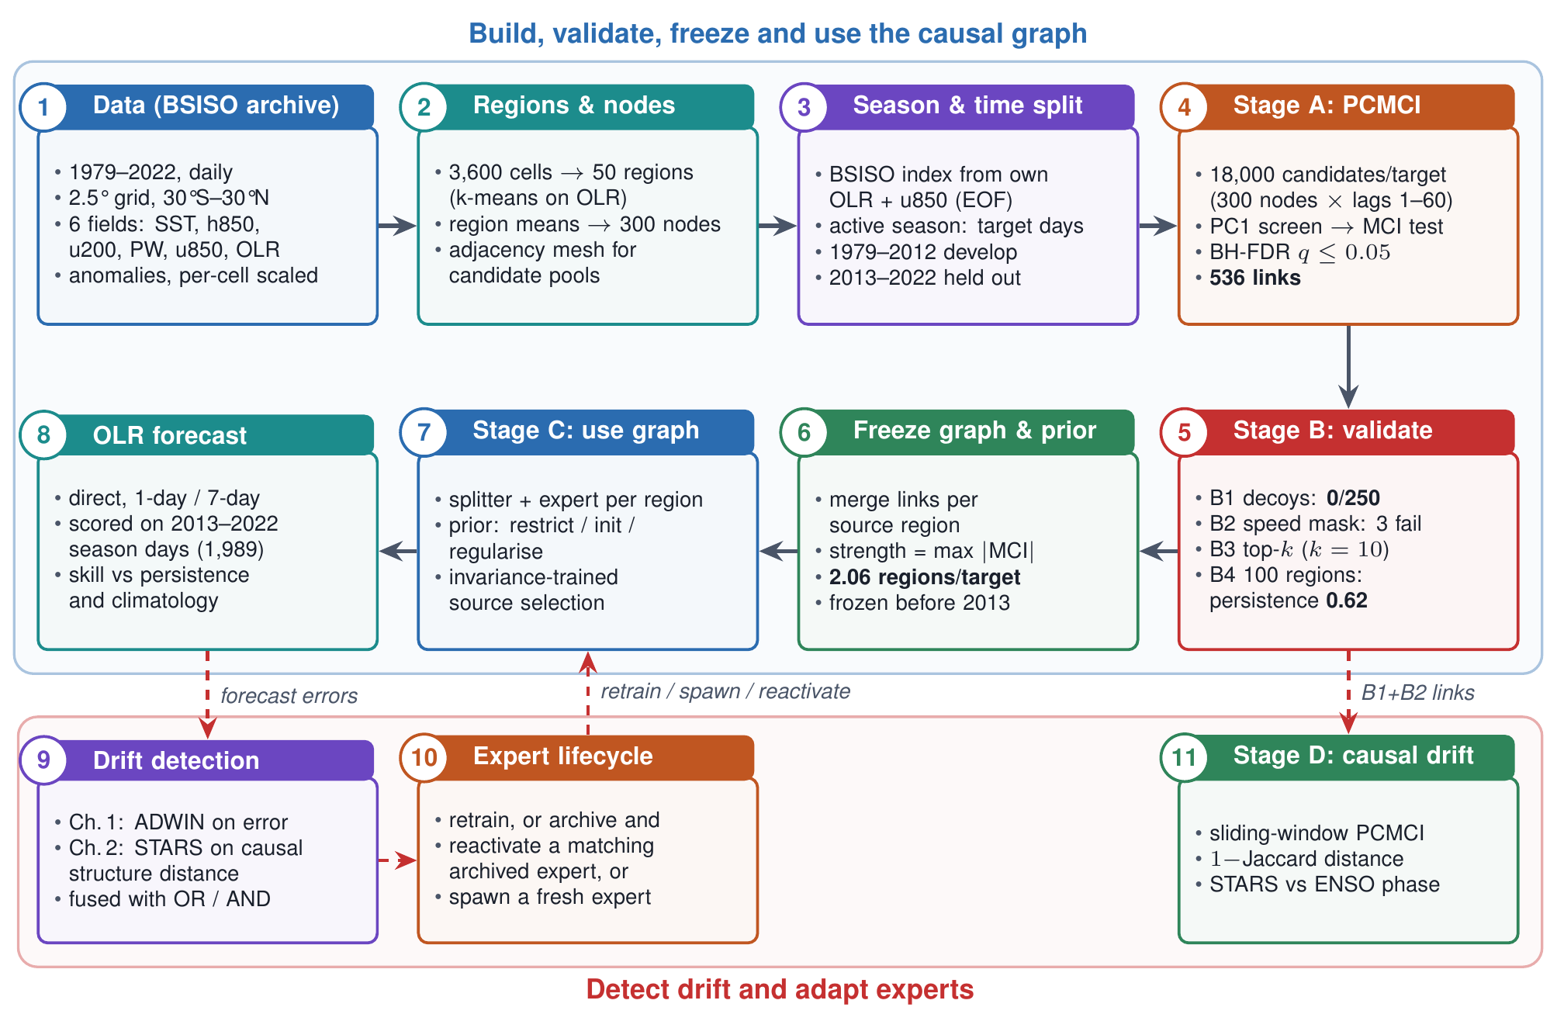
System architecture
Notes:
Steps 1-8 build, validate, freeze and use the causal graph; steps 9-11 detect drift and adapt the regional experts. Bold numbers are measured results.

Slide 9
How PCMCI works?
1
Build candidates: For each OLR target, every node (region x field) at every lag 1–60 days: 18,000 candidates per target.
2
PC1 screening: Test each candidate against the target while controlling for the strongest candidates found so far; weak candidates drop out early.
3
MCI final test: Retest each survivor while controlling for the target's other parents AND the source's own past; a link survives only if it still adds information.
4
FDR correction: Benjamini–Hochberg across all 18,000 tests per target keeps only reliable links (q ≤ 0.05).
Lag 0 is excluded, so direction comes from time order. Our vectorised implementation matches the Tigramite reference (identical PC1 parent sets, MCI values within 0.002) and runs 50 targets x 18,000 candidates in about 23 minutes.

Slide 10
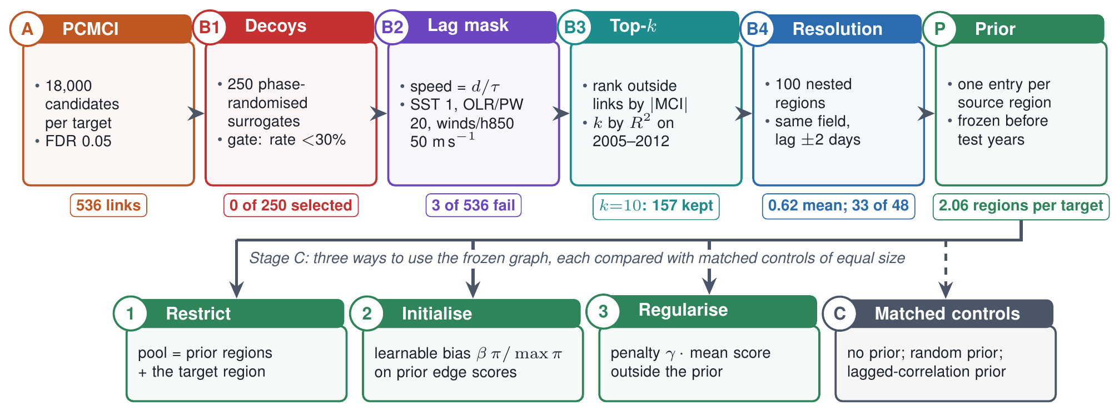
Graph validation: four independent checks
B1 Decoys: phase-randomised copies keep each series' memory but no real link; does PCMCI pick them?
B2 Lag mask: implied speed = distance / lag must be physically possible for the source field.
B3 Top-k: keep the k strongest outside links per target, k chosen on 2005–2012.
B4 Resolution: do links reappear when every region is split in two?

Slide 11
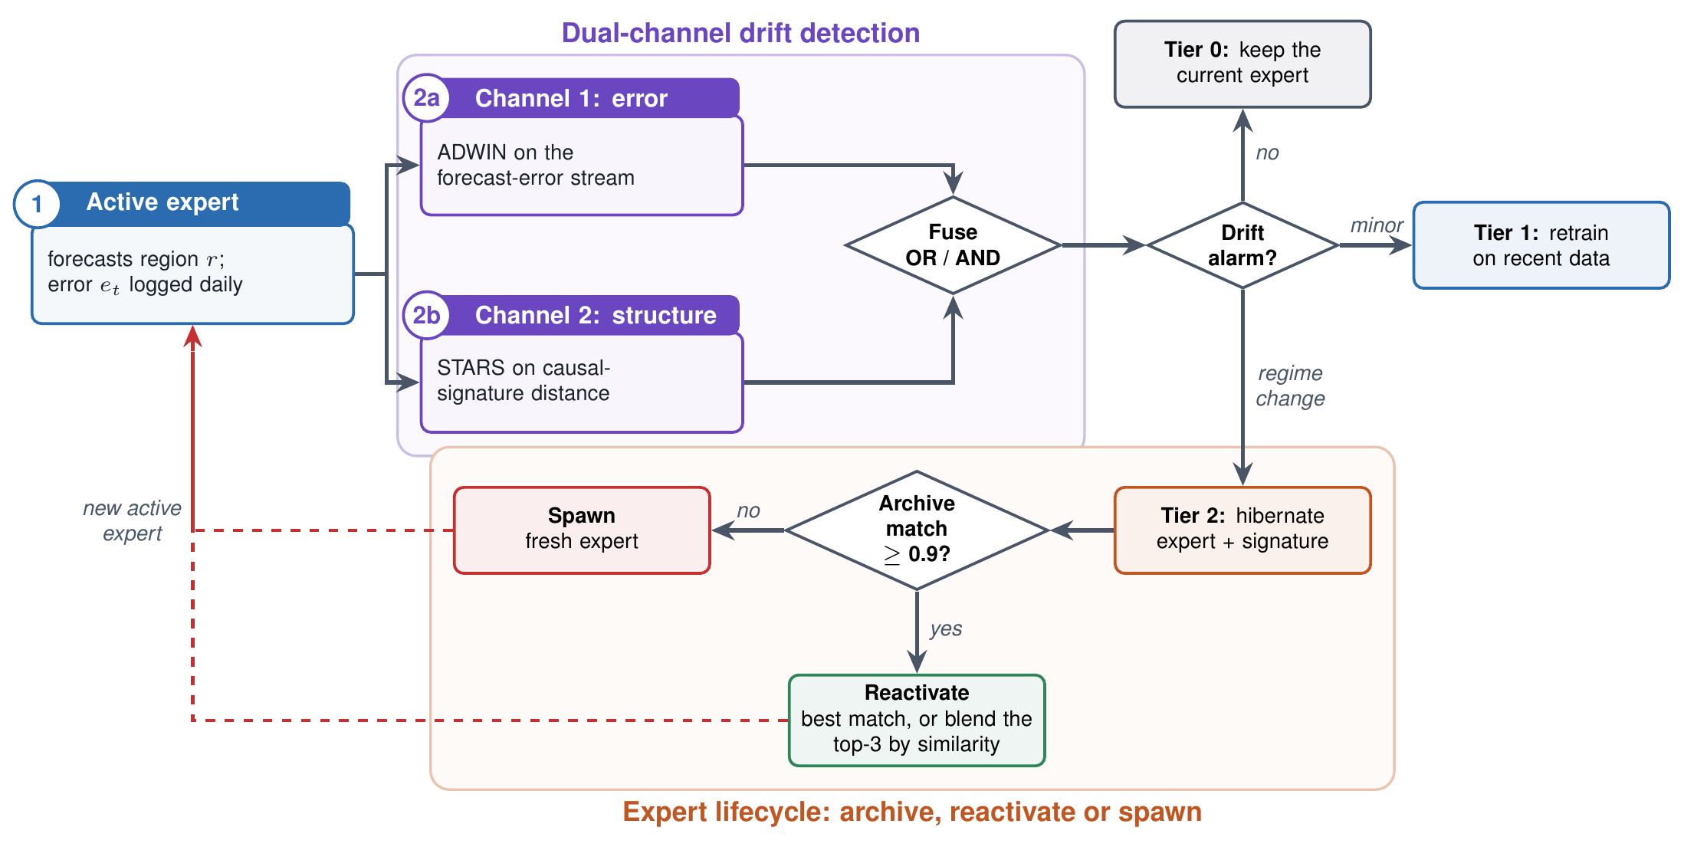
How the drift detectors and expert lifecycle work
Channel 1, ADWIN: raises an alarm when recent forecast errors differ significantly from older ones.
Channel 2, STARS: tests the causal-signature distance for a confirmed regime shift; it can react before errors rise.
Lifecycle: retrain, or archive and reactivate a matching expert (cosine similarity ≥ 0.9), else spawn a new one.

Slide 12
Model, configuration and parameters
Hyperparameter (splitter + expert) | Value
Epochs / training samples | 5 / 4,000 contiguous
Optimiser, learning rate, batch | Adam, 1e-3, 16
Hidden width / generator window | 16 / 10 days
Interventions; variance weight | 6 swaps; 0 -> 1 after 30% warm-up
Causal graph (PCMCI) | Value
Nodes | 300 (50 regions x 6 fields)
Candidates per target | 18,000
Lags tested | 1–60 days
PC alpha / FDR alpha | 0.05 / 0.05
Discovery days | 7,153 season days, 1979–2012
50 independent splitter + expert pairs: one per region, trained from scratch, no weight sharing.
Splitter (DIR-style): rationale generator scores each candidate source from 10-day windows; top fraction = causal set; non-causal sources swapped with other days; loss = mean + variance of risk across swaps.
Expert: weighted mean of the selected sources' features (weights from the splitter) -> MLP -> OLR forecast.

Slide 13
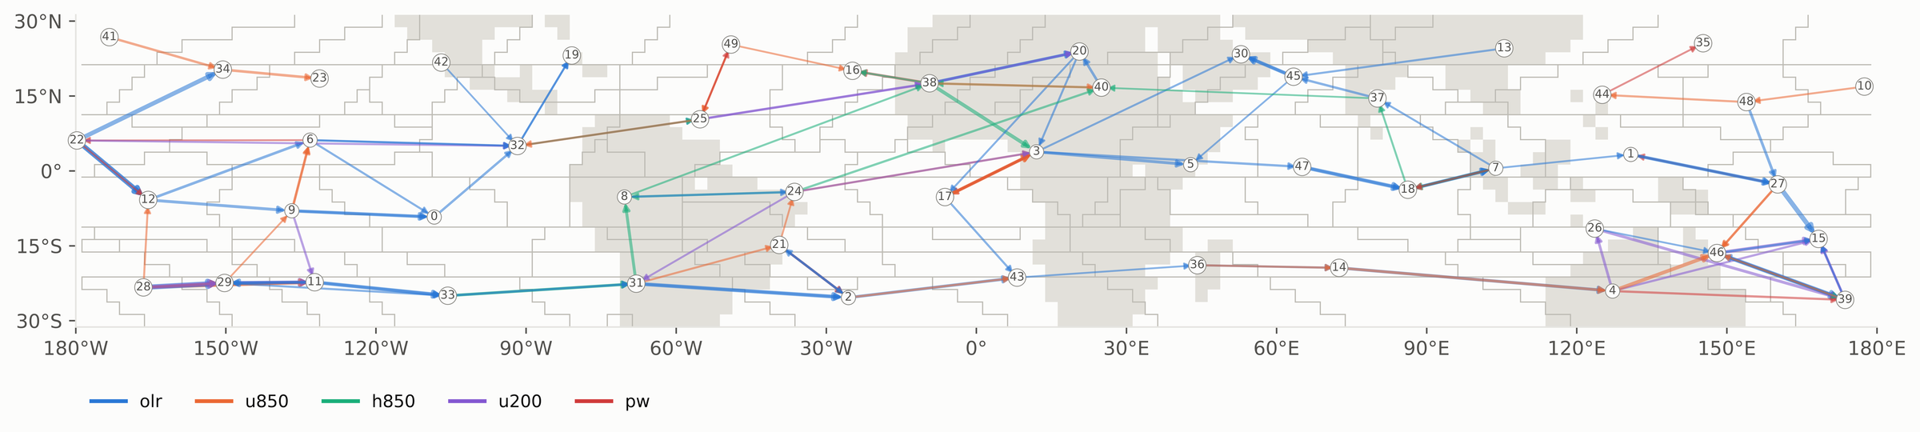
Phase 1 results: the discovered causal graph
536
160
1 day
2.06
significant links (FDR 0.05)
links from other regions
median lag of outside links
source regions per target
Outside drivers by field: OLR 72, u850 37, u200 22, h850 18, PW 11, SST 0; mostly neighbouring regions.
A few long links (wind and height) cross thousands of km in 1–2 days, at equatorial-wave speeds.
Region 22: the graph picks regions 27 and 6; the unguided splitter independently picks 6, 12 and 27. Two different methods agree.

Slide 14
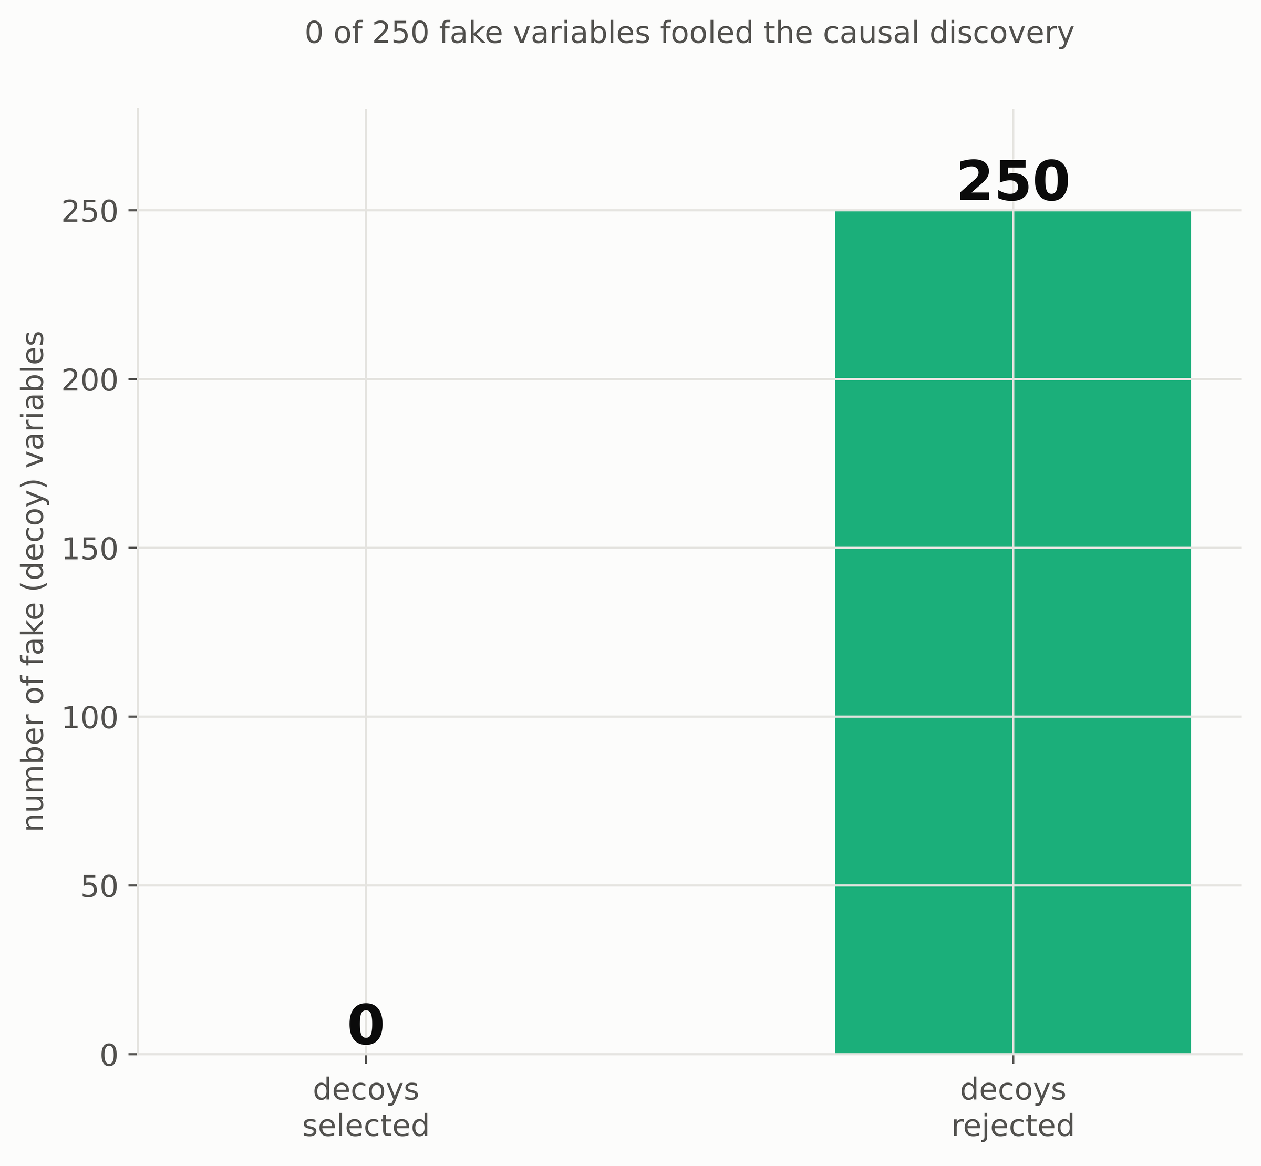
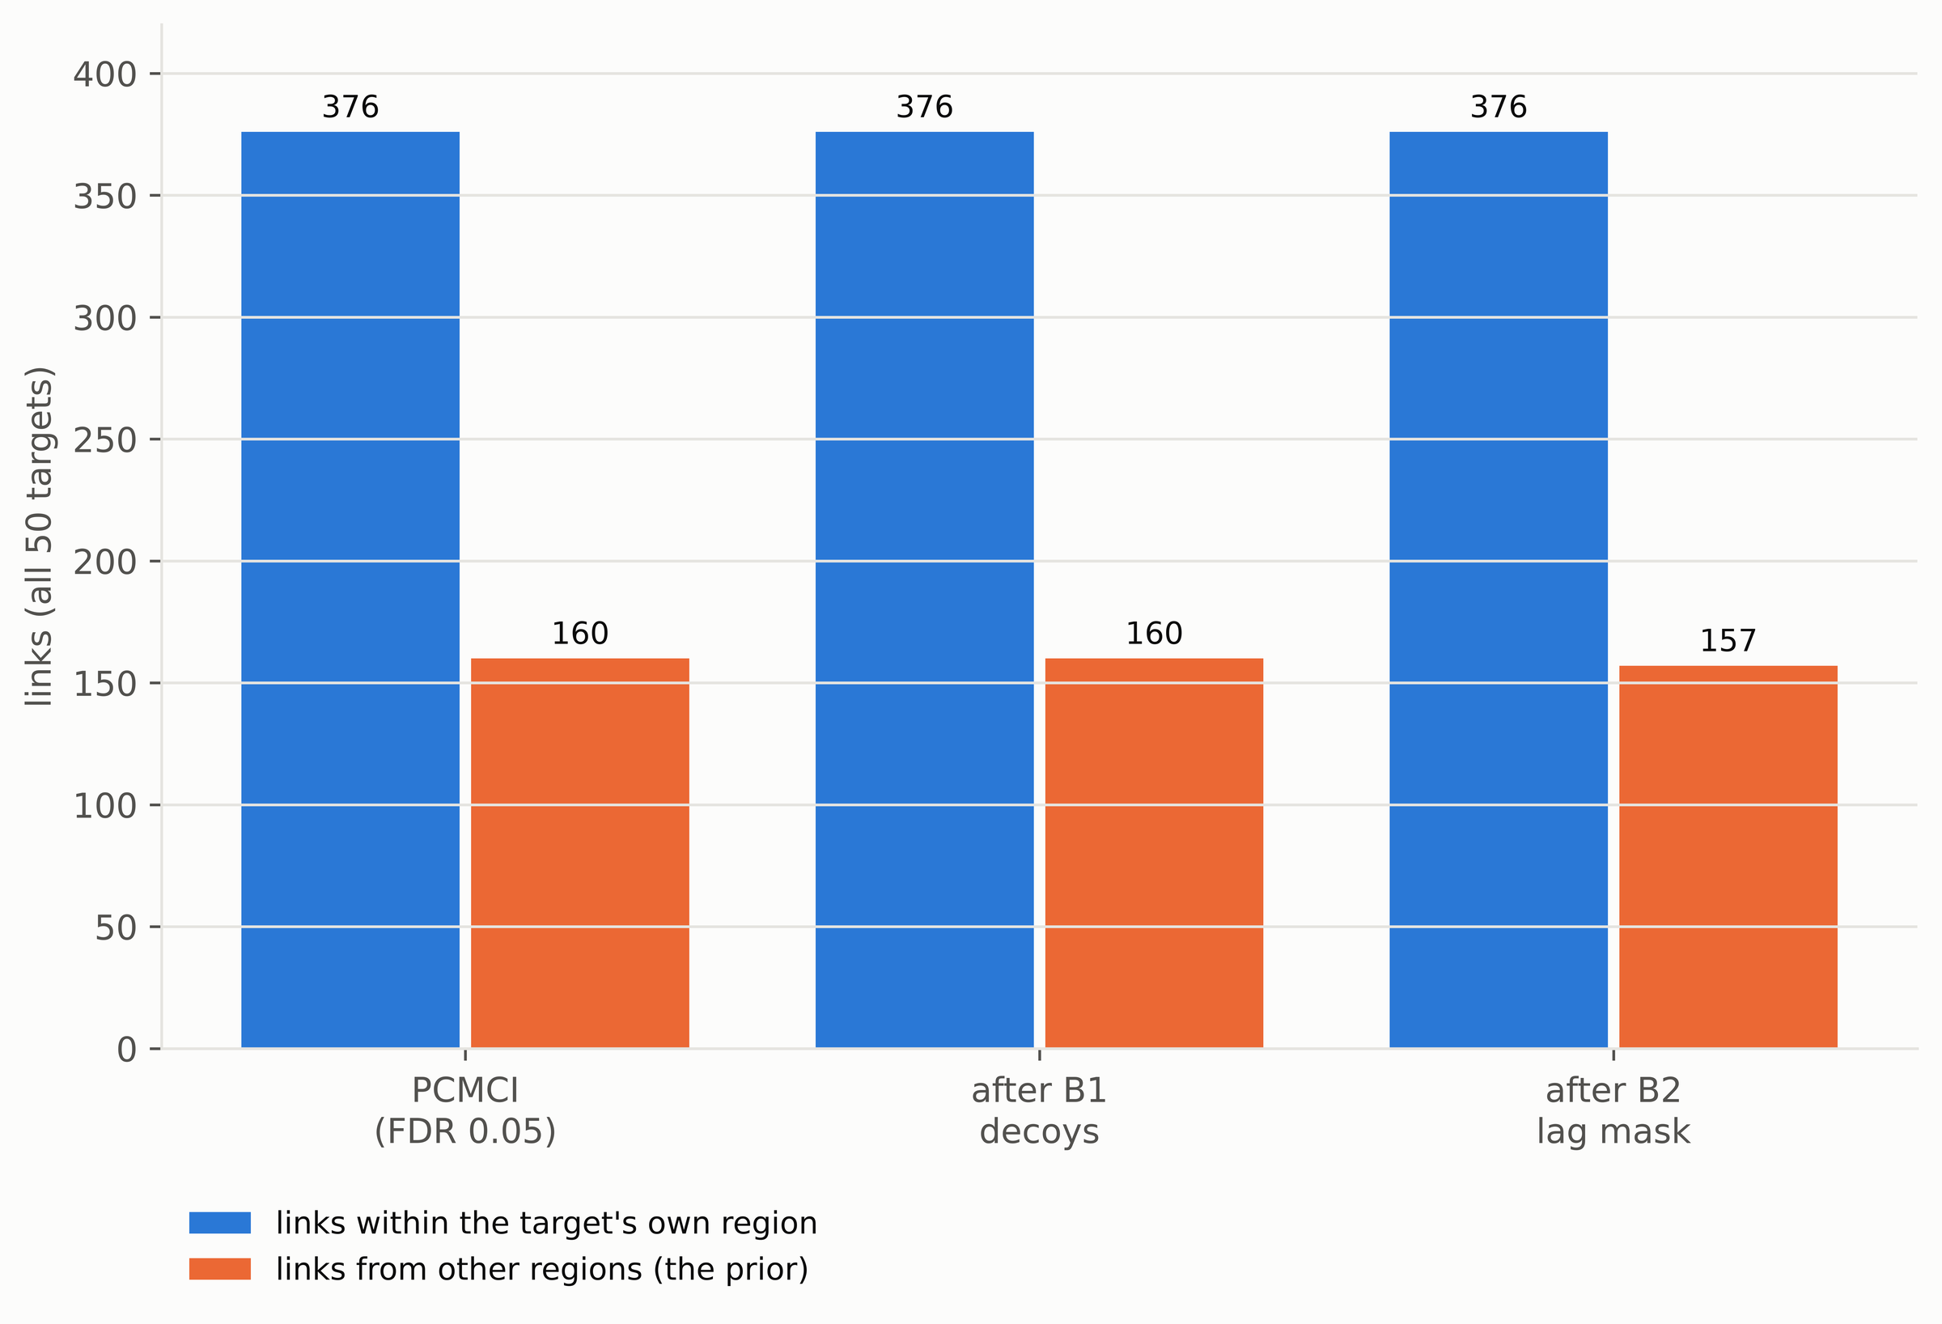
Phase 1 results: B1 decoy test
0 of 250 fake variables fooled the causal discovery
Own-region (blue) and outside (orange) links after each check
Decoys share the real series' memory and 30–60-day rhythm but have no real link. None was selected (gate: below 30%), and the real graph barely changed (517 vs. 536 links), so PCMCI is not fooled by autocorrelation.

Slide 15
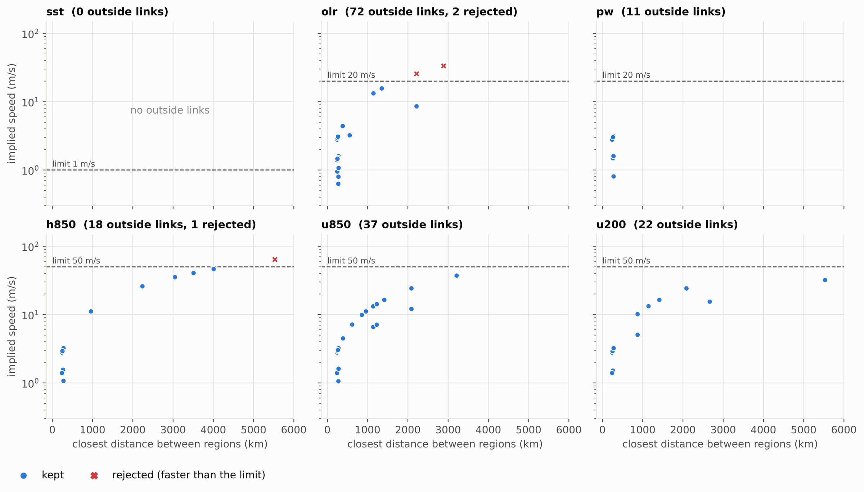
Phase 1 results: B2 physical lag mask
Only 3 of 536 links need an impossible speed (64, 33 and 26 m/s at lag 1); they are dropped from the prior.
Limits: SST 1 m/s; OLR and PW 20 m/s (coupled Kelvin waves); winds and height 50 m/s.
28 kept outside links span 500–5,500 km at up to 46 m/s, all carried by wind and height fields.

Slide 16
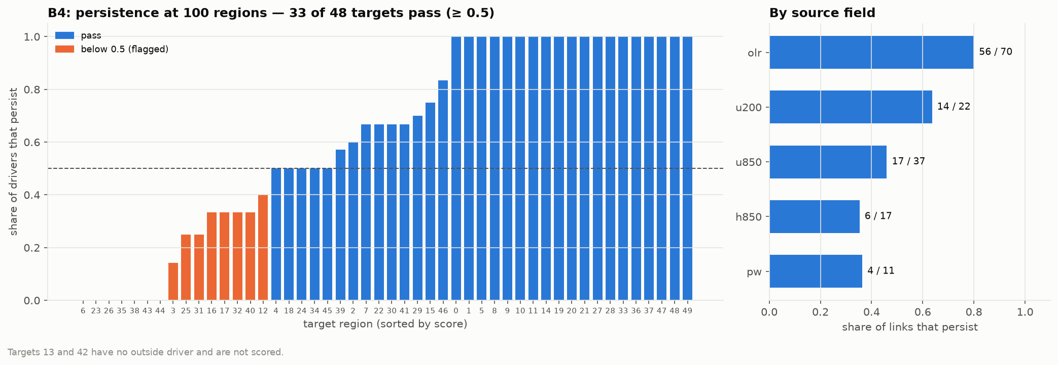
Phase 1 results: B3 top-k and B4 resolution
0.62
33 / 48
k = 10
mean persistence at 100 regions
targets with persistence ≥ 0.5
B3 keeps all 157 outside links
OLR links persist best (56/70); moisture and low-level height links, being more local, least. PCMCI + FDR is already sparse, so B3 keeps every outside link.

Slide 17
Phase 1 results: causal graph as the splitter's guide
Lead | Prior | Informative splitters | Beat persistence | Mean skill vs pers. | Mean R² vs clim.
7 days | none | 0/50 | 50/50 | +0.415 | -0.015
7 days | PCMCI | 24/50 | 50/50 | +0.416 | -0.015
1 day | none | 0/50 | 0/50 | -1.527 | +0.720
1 day | PCMCI | 36/50 | 3/50 | -1.327 | +0.745
Full 50-region pool: without guidance the splitter's scores are uninformative everywhere; with the graph (restrict mode) 24 regions at 7 days and 36 at 1 day become informative.
1-day skill improves in 32 of 50 regions (median +0.40 skill vs persistence, about 17% lower MSE; Wilcoxon p = 0.049).
7-day skill unchanged: the validated links act within 1–2 days, so they help short leads; week-ahead guidance needs a graph built with lags of 7+ days.
Held-out 2013–2022 season days (1,989); skill = 1 − MSE / MSE(reference).

Slide 18
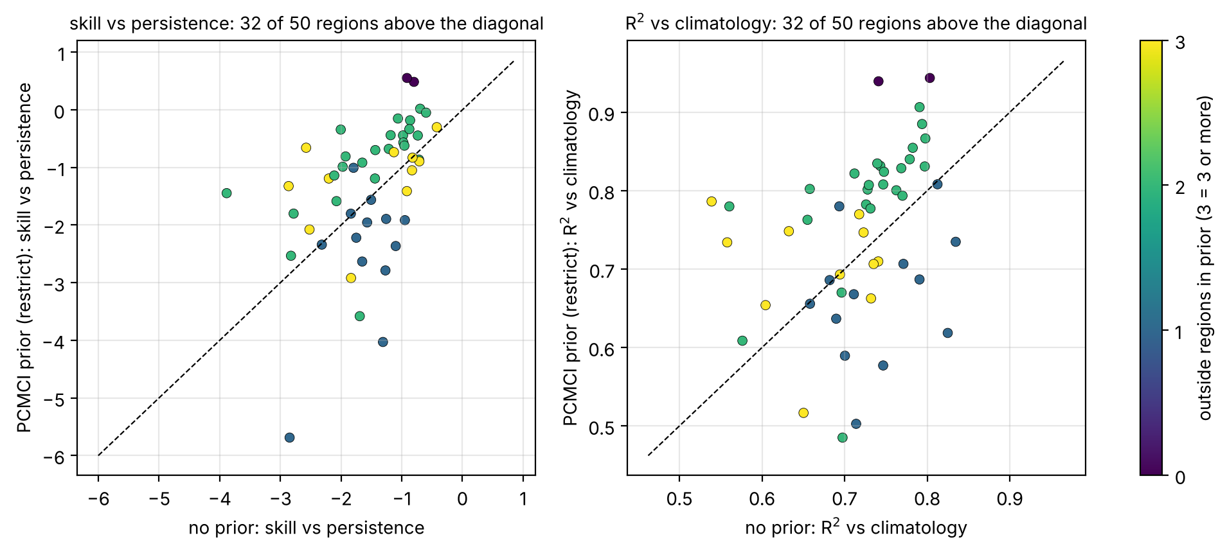
Phase 1 results: 1-day gain, region by region
Each dot is a region; dots above the diagonal improve with the causal prior.
Region 22: skill vs persistence -0.60 -> -0.05.
Regions with 2+ causal drivers improve on average; regions with a single driver are the hardest case (the splitter must choose between own history and one driver).

Slide 19
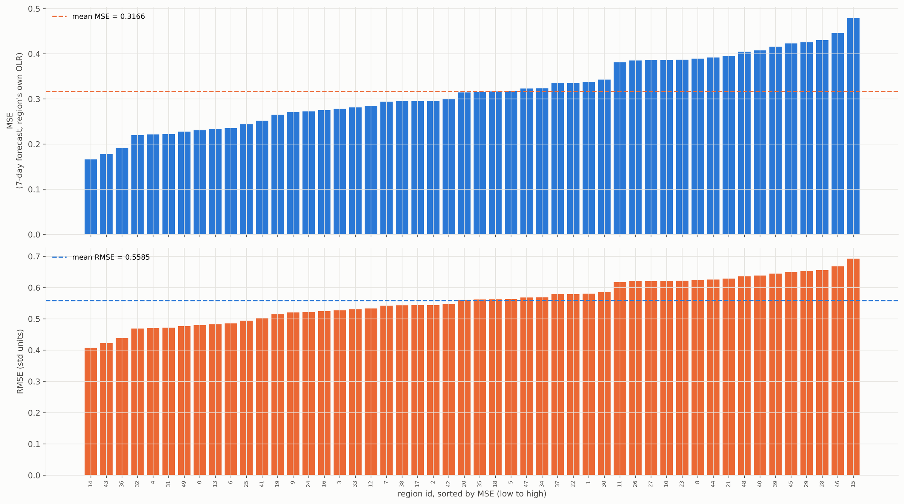
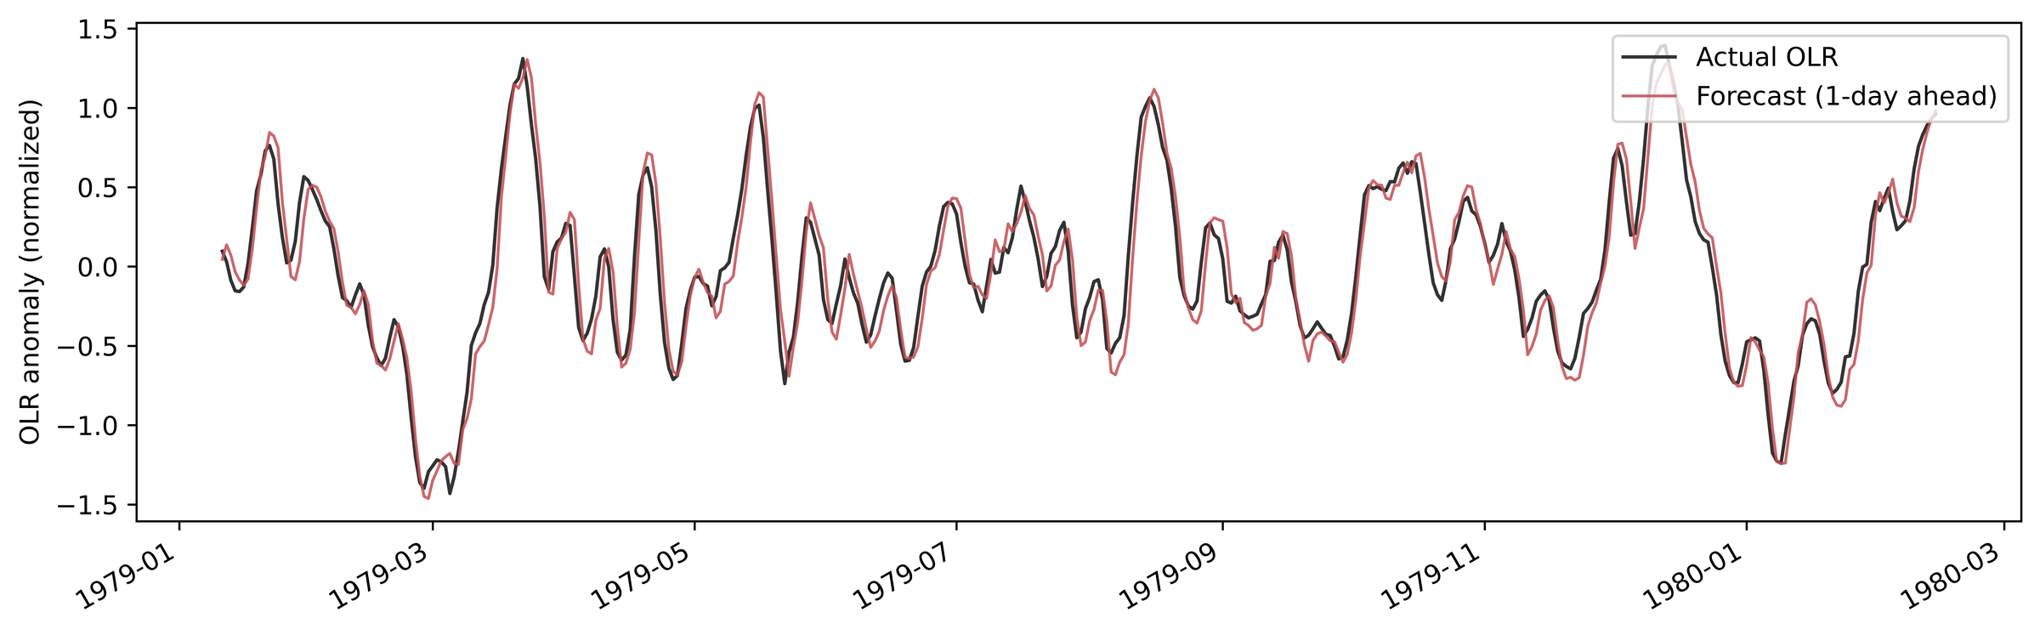
Phase 1 results: forecast accuracy
7-day forecast error per region (mean MSE 0.317, RMSE 0.559 std)
Region 22: 1-day forecast vs observed OLR (illustrative 1979–80 window)
Beats persistence in all 50 regions at 7 days in every candidate pool (mean skill about +0.40, i.e. about 40% lower error than "no change").
The expert tracks OLR swings one day ahead, including sharp convective transitions.
At 7 days OLR keeps little memory, so climatology becomes the harder reference (mean R² vs climatology about -0.015).

Slide 20
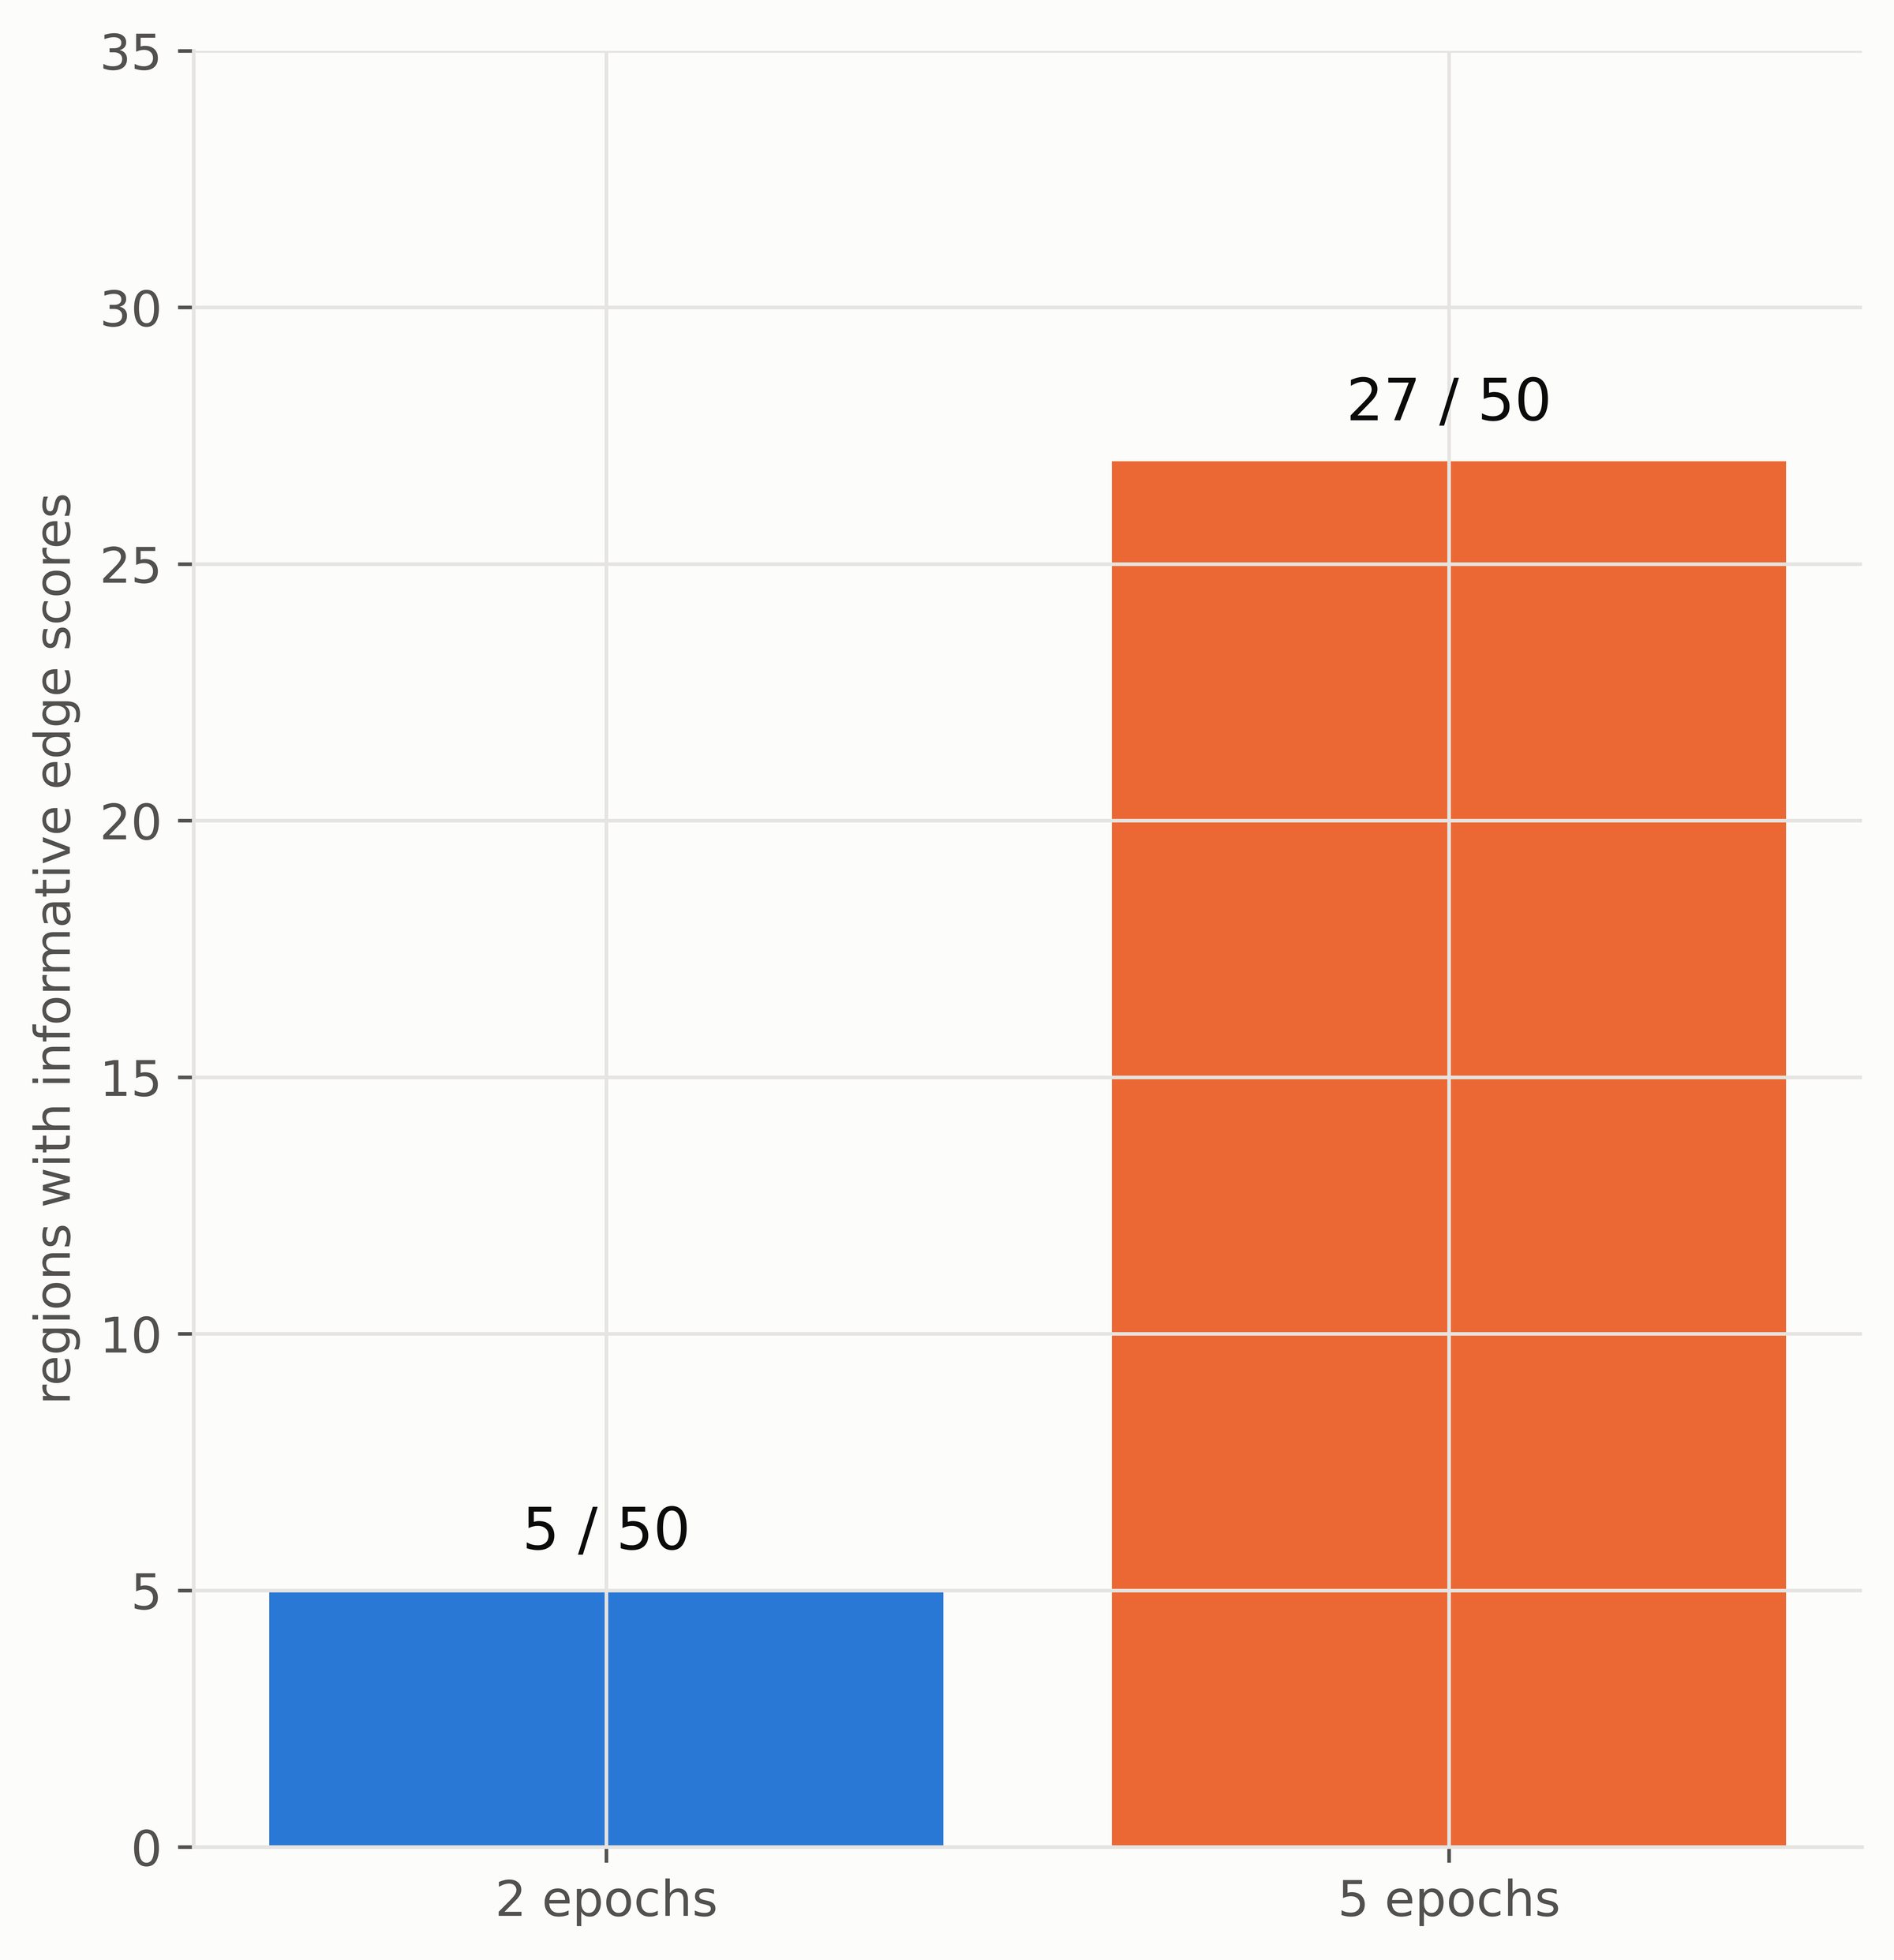
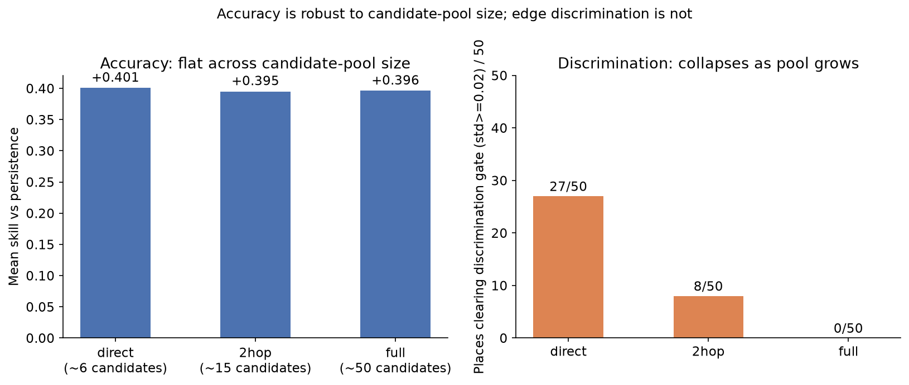
Phase 1 results: what makes source selection work
Training budget: 5/50 -> 27/50 informative
Pool size: accuracy flat, discrimination falls
Training: 5 epochs instead of 2 raises informative splitters from 5 to 27 of 50 at equal accuracy.
Pool size: informative splitters fall from 27 (neighbours) to 8 (2-hop) to 0 (all 50 regions). This is exactly the gap the validated graph closes (0 -> 24 / 36).

Slide 21
Phase 1 results: drift detection
Region | Shift | Ch.1 error (ADWIN) | Ch.2 causal (STARS) | Fused OR | Fused AND
22 | Abrupt El Niño 97–98 | 159 d | 35 d | 35 d | missed
22 | Gradual 2013–22 | 966 d | 181 d | 181 d | 966 d
29 | Abrupt El Niño 97–98 | 223 d | 92 d | 92 d | 235 d
29 | Gradual 2013–22 | 1,158 d | 117 d | 117 d | 1,195 d
12 | Abrupt El Niño 97–98 | 95 d | 123 d | 95 d | 123 d
12 | Gradual 2013–22 | 70 d | 100 d | 70 d | 100 d
False alarms / yr | 22 / 29 / 12 | 0.17 / 0.34 / 1.04 | 1.62 / 2.25 / 2.19 | 1.78 / 2.59 / 3.23 | 0.17 / 0.34 / 0.94
The causal channel sees shifts first: at regions 22 and 29 it detects the El Niño 2.4–4.5x sooner and the gradual drift 5.3–9.9x sooner than the error channel.
Fused OR catches every shift at every region; AND is slower but raises far fewer false alarms: a real, measured trade-off.
Latency = days from the start of the shift window to the first alarm in it.

Slide 22
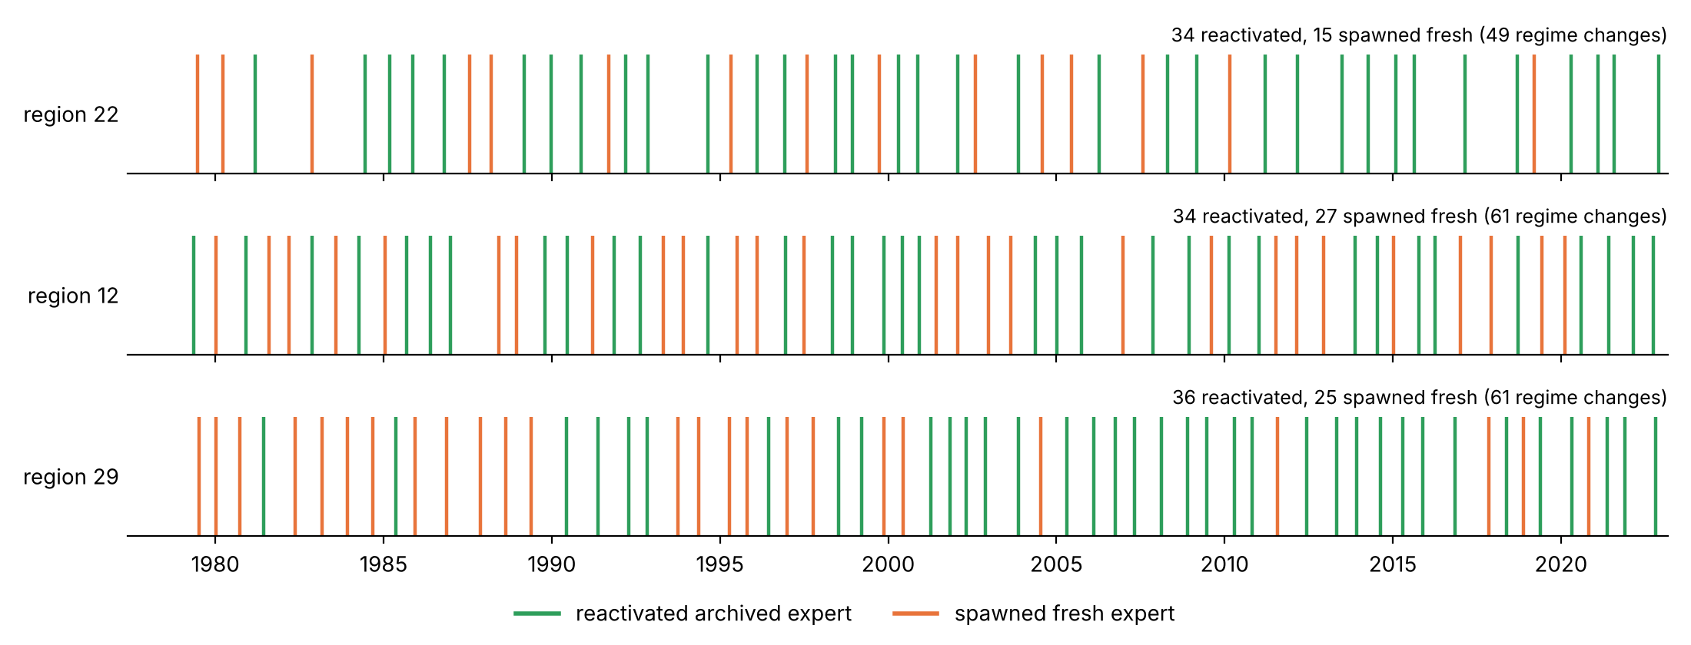
Phase 1 results: expert lifecycle
Reactivation strategy | Region 22 | Region 12 | Region 29
Top-3 blend beats single best | 30/49 | 42/61 | 41/61
Mean MSE: single -> blend | 0.368 -> 0.352 | 0.422 -> 0.402 | 0.384 -> 0.376
Forgetting: single -> blend | -0.010 -> -0.013 | 0.183 -> 0.170 | 0.092 -> 0.086
104 of 171 regime changes reactivated an archived expert instead of training from scratch: regimes recur and the archive pays off. Blending the 3 closest archived experts lowers both error and forgetting at every region.

Slide 23
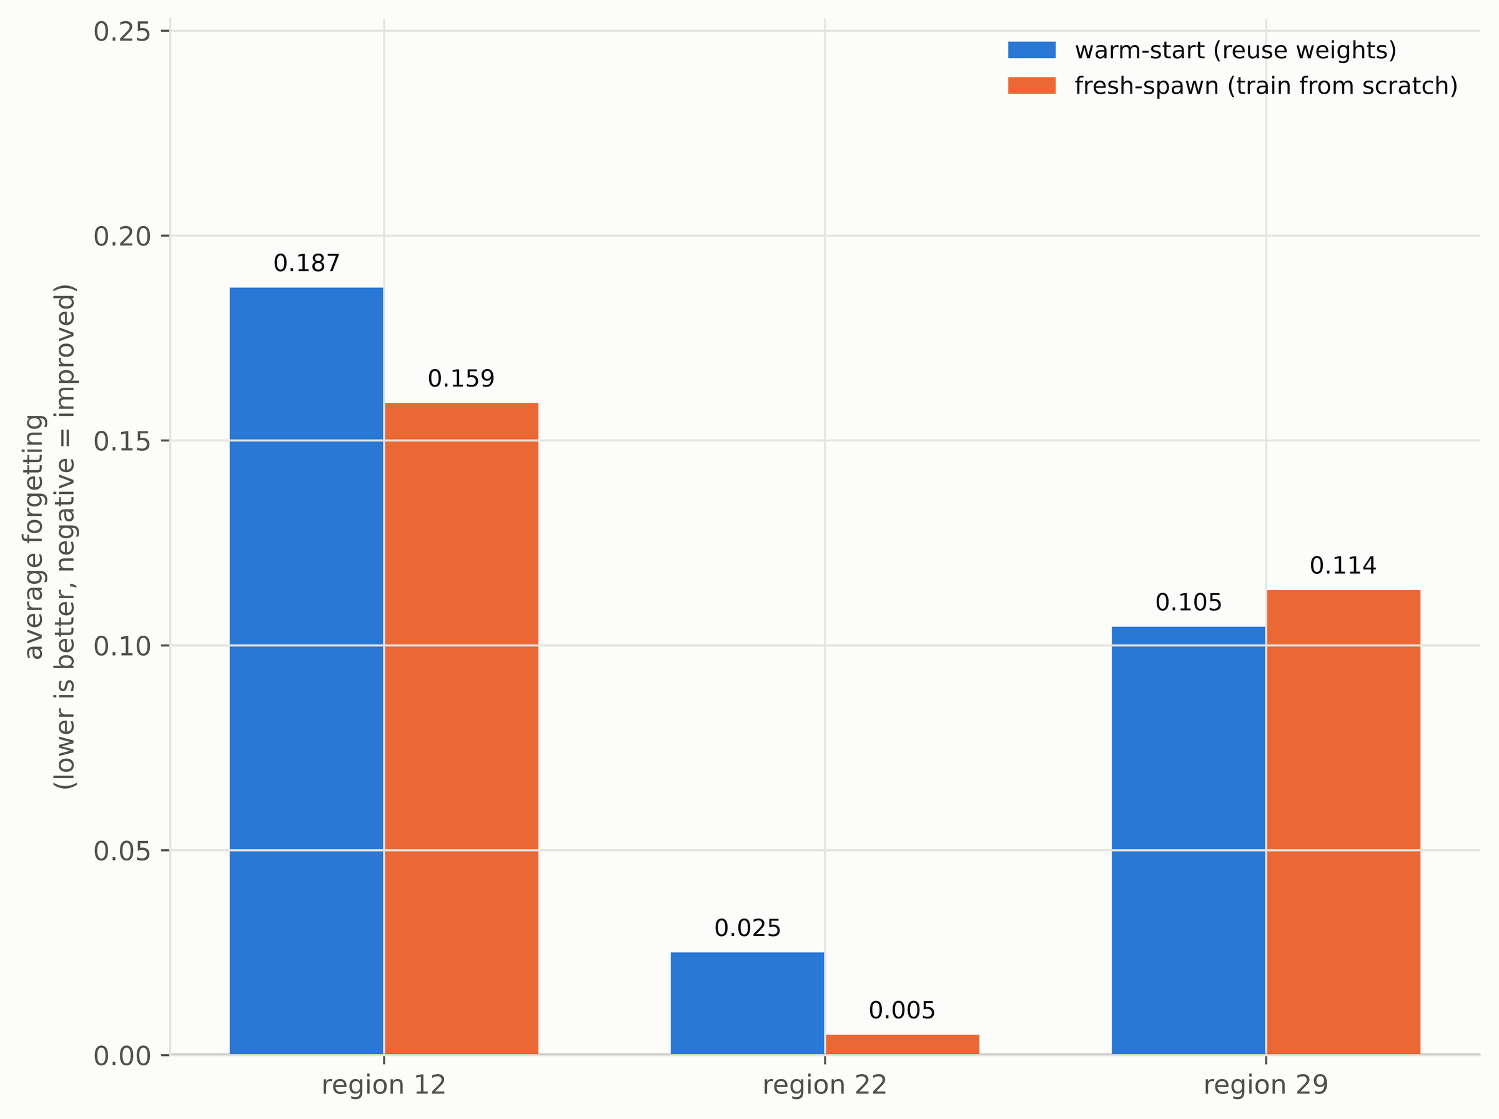
Phase 1 results: warm start vs fresh spawn
Forgetting = increase in error on a regime seen before, after adapting (lower is better).
Warm start (reuse archived weights) gives lower forecast error in 28/34 events at region 22 and 24/36 at region 29.
On forgetting it wins only at region 29, so the choice is region-dependent.
Default: reactivate by pooled top-3 blend, the most consistent winner.

Slide 24
Key findings
0 / 250
3 / 536
62%
decoys selected
physically impossible links
links persist at 2x resolution
32 / 50
up to 9.9x
104 / 171
regions: better 1-day skill
faster drift detection (causal channel)
regime changes reuse an archived expert
The causal graph is trustworthy by every check that can reject it.
It makes source selection meaningful and helps at the lead its links match (1 day).
Watching causal structure reveals drift early; recurring regimes make archived experts valuable.

Slide 25
Current limitations
No independently verified ground truth exists for real climate causal links: every claim rests on indirect checks (decoys, physical plausibility, resolution persistence).
The validated graph is short-lag (mostly 1–2 days) while the main forecaster runs at 7 days: a time-scale mismatch that limits the prior there. A graph with lags of 7+ days is the fix.
Forecast comparisons use one training seed and are made against the unguided splitter; random- and correlation-prior controls of equal size are the next runs.
Drift and lifecycle results cover three regions so far.

Slide 26
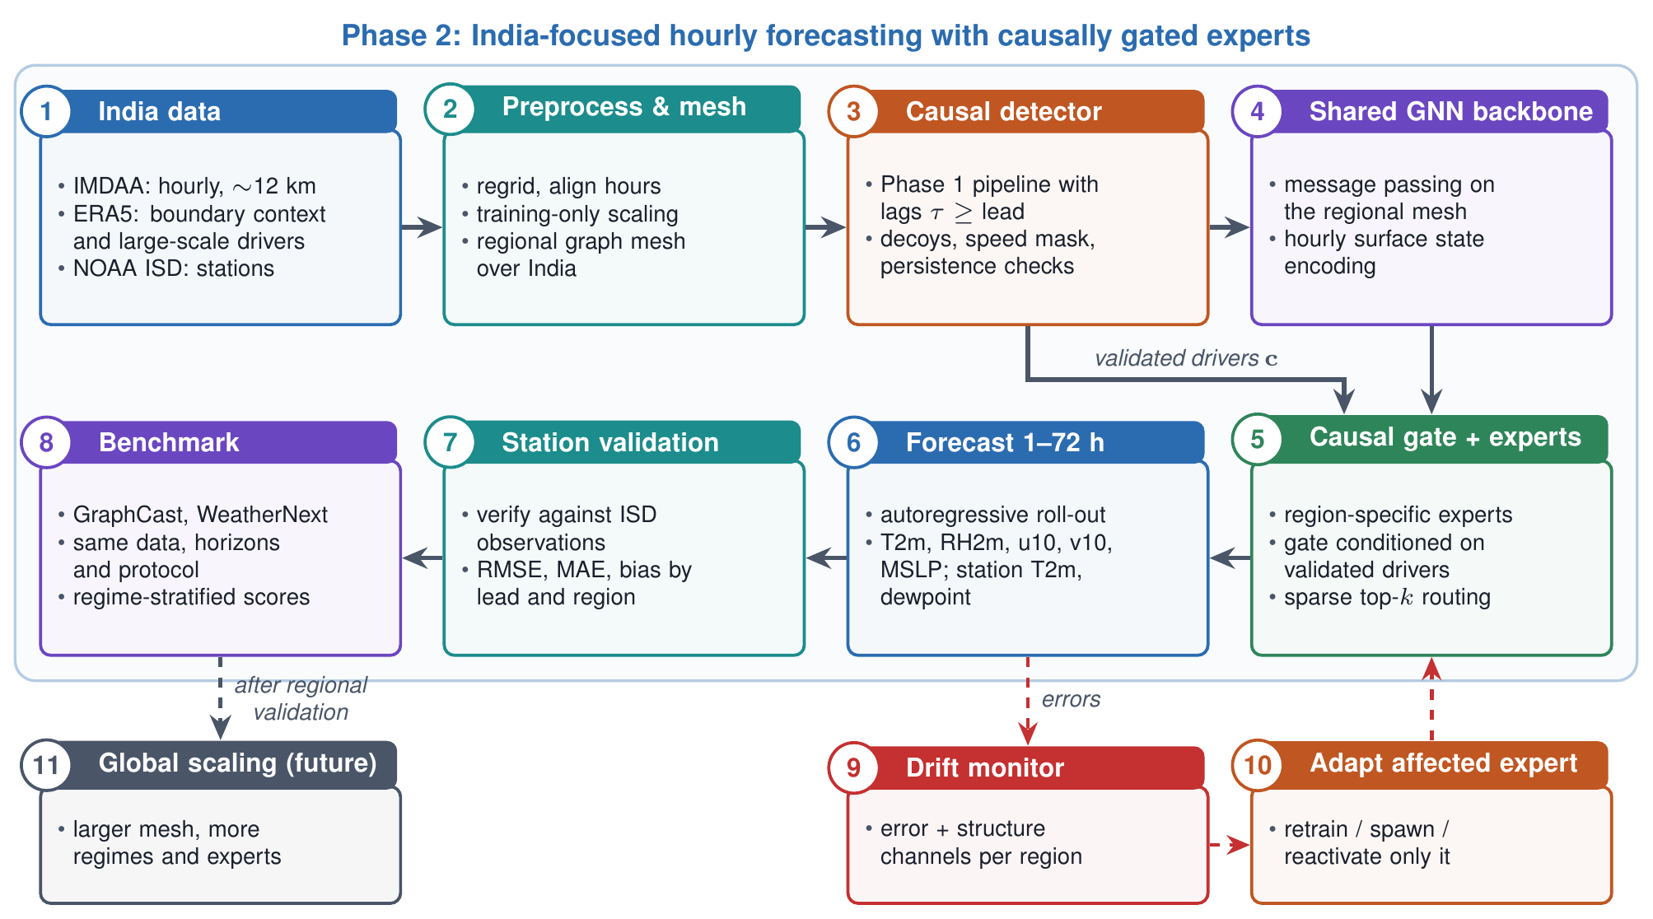
Phase 2 plan

Slide 27
Phase 2 plan
India hourly system: shared GNN backbone over IMDAA (~12 km, hourly) with ERA5 boundary context; region-specific experts gated by Phase 1-validated causal drivers.
Lead-matched causal drivers: PCMCI tested only at lags ≥ forecast lead, with decoy, speed and persistence checks.
72-hour forecasts: autoregressive roll-out of 2 m temperature, humidity, 10 m wind and MSLP, validated against ISD station observations.
Selective adaptation: per-region drift detection; retrain, spawn or reactivate only the affected expert.
Benchmark: GraphCast and WeatherNext on the same data, horizons and protocol.
Global scaling: larger meshes, more regimes and long-range teleconnections once India is competitive.

Slide 28
14 | References
[1] Y.-X. Wu et al., "Discovering invariant rationales for graph neural networks," Proc. ICLR, 2022.
[2] A. Ghaffari, S. Sheikhi and E. Gilman, "Graph-conditioned mixture of graph neural network experts for traffic forecasting," arXiv:2605.30486, 2026.
[3] H. Cao et al., "Geometric mixture-of-experts with curvature-guided adaptive routing for graph representation learning," arXiv:2603.22317, 2026.
[4] S. Wu et al., "GraphMETRO: Mitigating complex graph distribution shifts via mixture of aligned experts," NeurIPS 37, pp. 9358–9387, 2024.
[5] L. Kong et al., "Dynamic mixture-of-experts for incremental graph learning," arXiv:2508.09974, 2025.
[6] H. Li et al., "Out-of-distribution generalization on graphs: A survey," arXiv:2202.07987, 2022.
[7] R. Lam et al., "Learning skillful medium-range global weather forecasting," Science 382, pp. 1416–1421, 2023.
[8] J. Runge et al., "Detecting and quantifying causal associations in large nonlinear time series datasets," Science Advances 5, eaau4996, 2019.
[9] J.-Y. Lee et al., "Real-time multivariate indices for the boreal summer intraseasonal oscillation," Climate Dynamics 40, pp. 493–509, 2013.
[10] S. N. Rodionov, "A sequential algorithm for testing climate regime shifts," GRL 31, L09204, 2004.
[11] A. Bifet and R. Gavaldà, "Learning from time-changing data with adaptive windowing," SIAM SDM, 2007.

