Slide 1

Pradeeban Kathiravelu, Ph.D. Assistant Professor of Computer Science, Department of Computer Science and Engineering, University of Alaska Anchorage. July 27th – 31st, 2026. Day 2
Text-Based Coding: Python
https://tinyurl.com/sea2025python

Slide 2
Recap from yesterday
Overall agenda, timeline, and goals.
Coding:
1) Applications with GUI:
TicTacToe game with Tkinter GUI Toolkit for Python.
2) Data Mining:
Classification with synthetic data, with pandas, numpy, and scikit-learn.
Classification with the breast cancer dataset from scikit-learn with matplotlib.
Overall Intro:
Programming and Python.
Data Mining.
Data Mining in Healthcare.

Slide 3
Python Anywhere
https://www.pythonanywhere.com
“Headless” environment.
Server only.
No GUI.
Matplotlib, Tkinter, … GUI Apps (tictactoe.py, health2.py, …) won’t work.
Good place to test commandline interface (CLI) applications.

Slide 4
Python Tutorial
https://python.land/python-tutorial

Slide 5
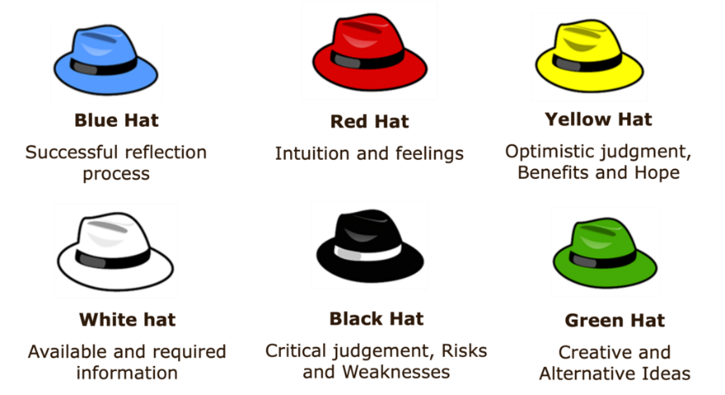
Six thinking hats Book by Edward de Bono

Slide 6
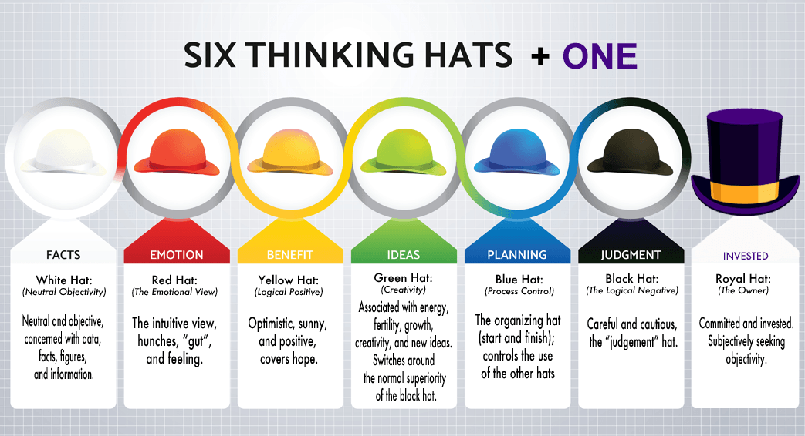
6+

Slide 7
How to make good tech/research presentations?

Slide 8
Why do people make bad presentations? (1 of 2)
1) Lack of preparation.
Not enough time, interest, or practice.
2) “Creativity.”
Creativity is good. But if there is a standard, there could be a reason.
3) Language barriers.
Needs more time/effort to prepare (and attempting to memorize).
4) Not knowing the subject/topic well.
I present my (especially first-author or last-author) papers better than when I present someone else’s.
5) Not timing it correctly.
Class presentations have the luxury to carry it forward to the next class.

Slide 9
Why do people make bad presentations? (2 of 2)
Timezone difference.
for conference presentations.
Tiredness, Lack of sleep, and other external/social factors.
Not knowing the audience.
Boring talk/topic and uninterested audience.
Shy/nervousness.
Fear of judgment/audience.

Slide 10
Some Pointers
Practice (repeatedly, if you can!).
How important is this presentation for you?
A small class assignment vs. conference presentation vs. career-defining
Feel free to drop the complex matters out of the presentation.
But don’t drop everything. Then, your presentation lacks merit.
Localize the content to fit the audience and place.
Update the content to fit the time (if the topic/presentation is old!).

Slide 11
How To Present a Paper (book chapter)
Šarūnas Girdzijauskas, KTH

Slide 12
Your Presentations
This presentation assumes you to have 30 – 35 minutes of presentation and totally 45 minutes in total, including Q&A.
45 min in total (target 30-35 min for your presentation)
Student presentations are evaluated on:
Slides;
Quality of Presentation;
Paper understanding;
Question Answering.

Slide 13
What to Present?
You do not need to retell each and every part of the paper (book chapter)!!!
Motivation
The Ideas/Main Concepts
Results
Unveil both positive and negative sides of the paper
negative sides are usually well hidden
Can be a bit different for a book chapter

Slide 14
How to Present?
Know Your Audience!!!
While referring to a concept check if…
…it is a “common knowledge” or needs a special introduction
maybe not included in the paper (your book chapter) itself!
…it has been introduced in the presentation before

Slide 15
Never proceed if you think some concept might not be clear for your audience!

Slide 16
How to Present? (cont.)
If you think you won’t fit into 30-35 min with all your concepts…
…order them by importance
…throw the least important away
…iterate until you fit into 30-35 min ;-)
1 slide ~ 2 min, so do not have too many slides!
Make few Hidden Slides for Q&A

Slide 17
Slides
In summary the primary contributions of our work are the following:
We introduce the architecture of a scalable RDF database system that leverages best-of-breed single node RDF-stores and parallelizes execution across them using the Hadoop framework.
We describe date partitioning and placement techniques that can dramatically reduce the amount of network communication at query time.
We provide an algorithm for automatically decomposing queries into parallelizable chunks. We experimentally evaluate our system to understand the effect of various system parameters and compare against other currently available RDF stores.
Many of our techniques are applicable to general graph data management applications, especially those for which subgraph matching is an important task.
Furthermore, while our system is primarily designed for the largest RDF data sets, we will also show that even for smaller data sets, the techniques introduced in this paper are highly relevant.

Slide 18
Slides (alternative)
Contributions:
Scalable RDF database on Hadoop
Data Partitioning & Query Decomposition
General Applicability; Small & Big Data Sets

Slide 19
Slides (alternative)
Contributions:
Scalable RDF database on Hadoop
Data Partitioning & Query Decomposition
General Applicability; Small & Big Data Sets

Slide 20
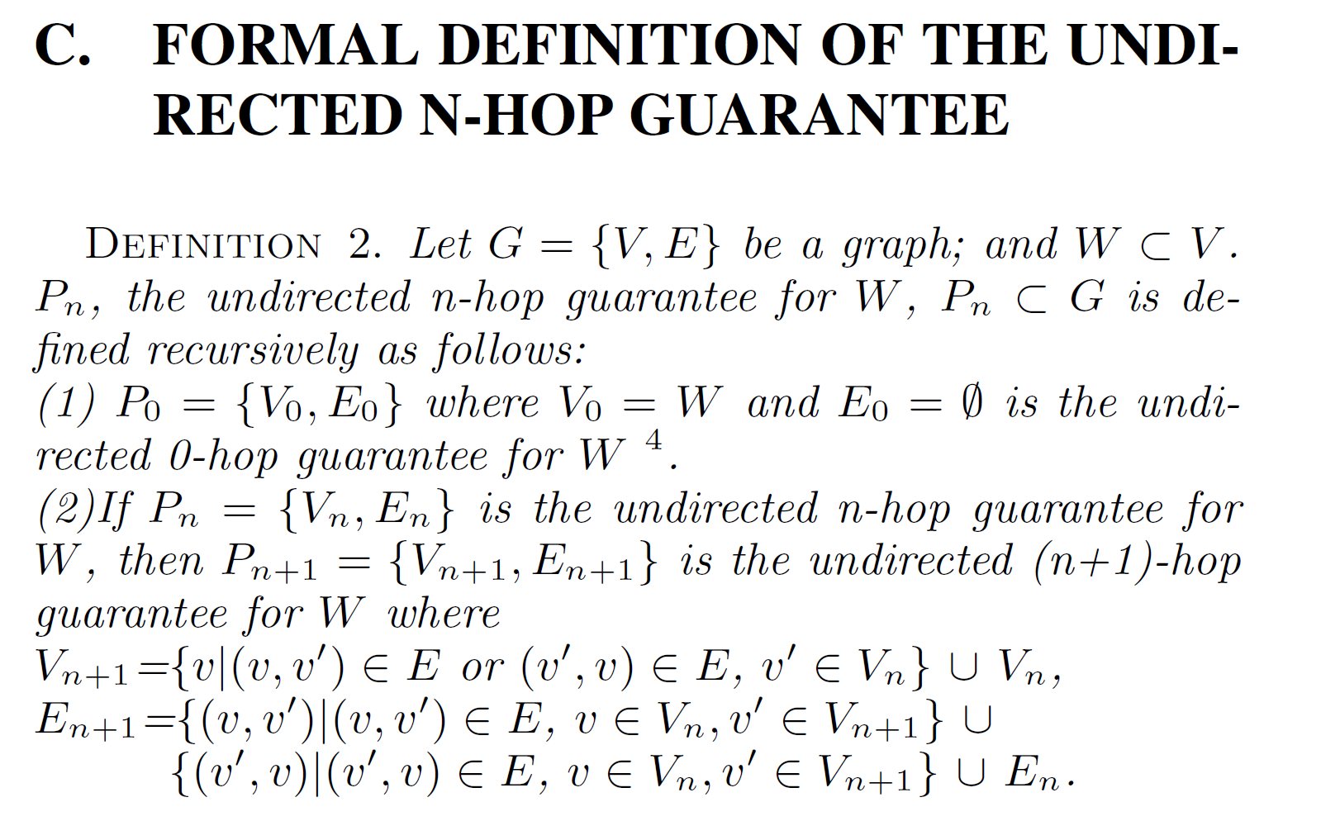
Another (Bad) Example

Slide 21
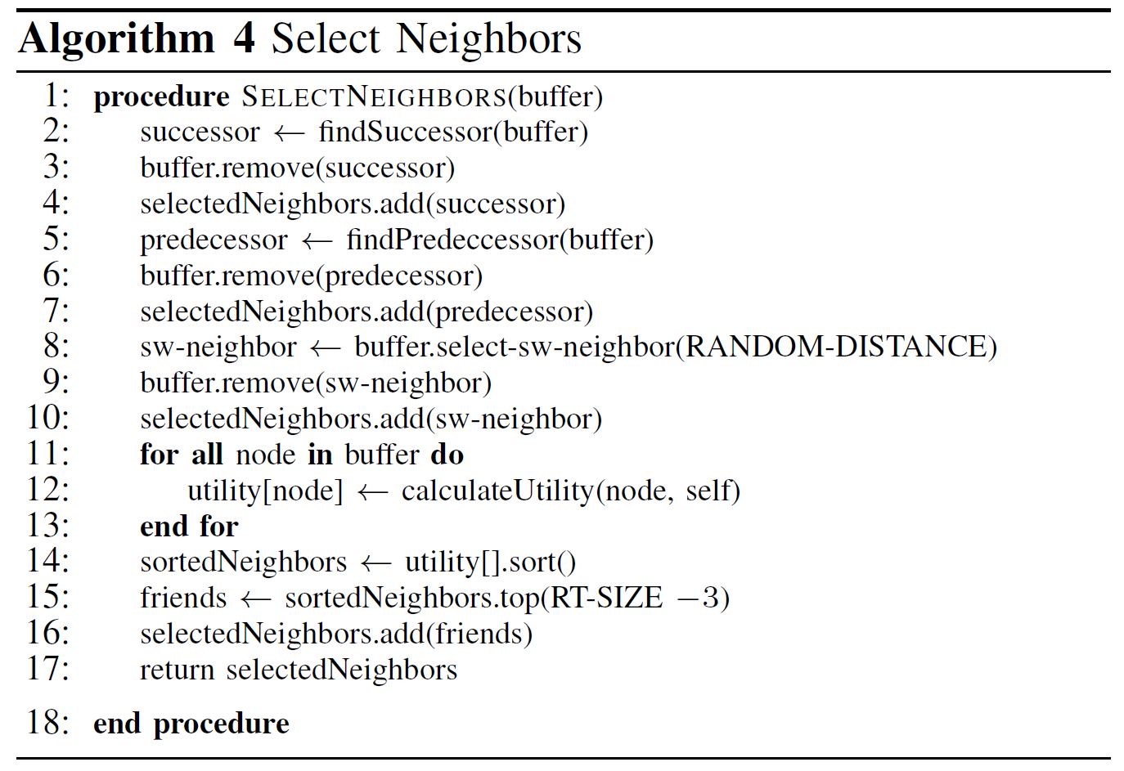
Pseudocodes

Slide 22
Slides (cont)
Animations as an alternative to text, pseudocodes and formulas
Publisher node for topic Tgreen
Topic Tgreen
Topic | Access Point
T1 | P3
T2 | P12
T3 | P5
P4
Topic | Access Point
Tgreen | P4
T1 | P3
T3 | P22
Topic | Access Point
T2 | P4
T3 | P11
T4 | P3

Slide 23
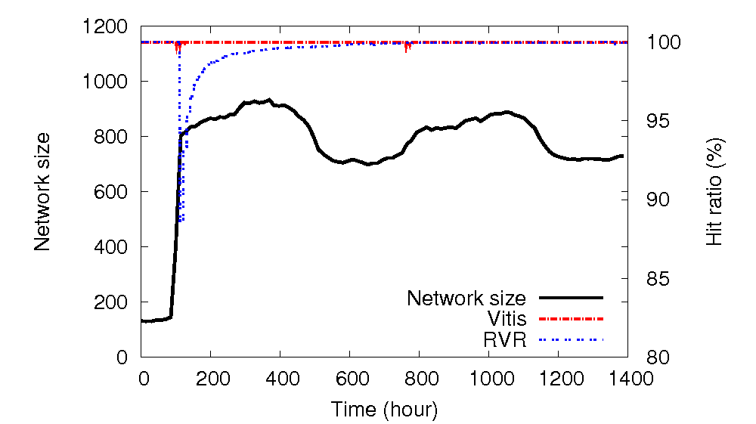
Figures
Always introduce X and Y axes as well as general settings before explaining!

Slide 24
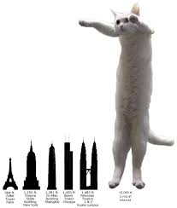
Title Slide
Presented by: Your name
The title of the paper/project you are presenting.
Event: CSCE A490 Class Activity.
Date: DATE.

Slide 25
Agenda
!SKIP!

Slide 26
Introduction
The global state of matters.
UberEats.
The world is still hungry.
There are clouds everywhere. Still, we have high latency!

Slide 27
State of the art
Other people must be doing something about this issue. Right?

Slide 28
Motivation
Do you think you have a better approach?

Slide 29
Solution
UE2!
Or L4S, …., cloud-to-edge continuum, community cloud, … whatever the paper is proposing.

Slide 30
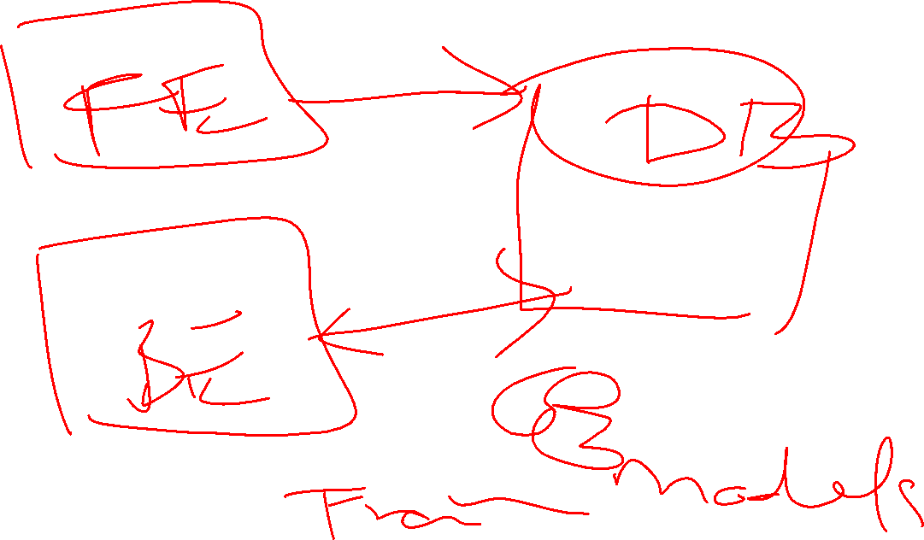
UE2
Add the deployment diagram. Explain.

Slide 31
UE2
Add the major algorithm/brain. Explain.

Slide 32
UE2
Add the use cases

Slide 33
UE2
Add the architecture diagram and explain the implementation.

Slide 34
UE2
Prototype Implementation and Evaluation. Add the plots.

Slide 35
UE2
Discussion. Why your solution is better (or justify why it is not better and still deserve publication).

Slide 36
UE2
Conclusion and future work

Slide 37
UE2
Your own reflections, if this is someone else’s published work.

Slide 38
How about some example bad presentations?

Slide 39
Chicken Chicken Chicken: Chicken Chicken
Doug Zongker
University of Washington

Slide 40
Chicken
Chicken
Chicken chicken
Chicken
Chicken chicken chicken

Slide 41
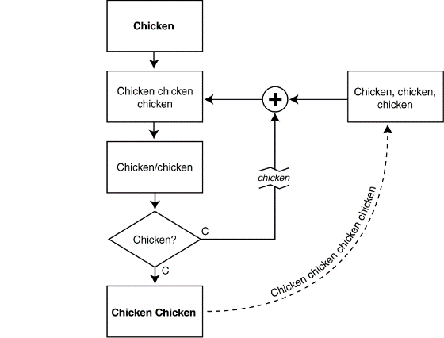
Chicken chicken

Slide 42
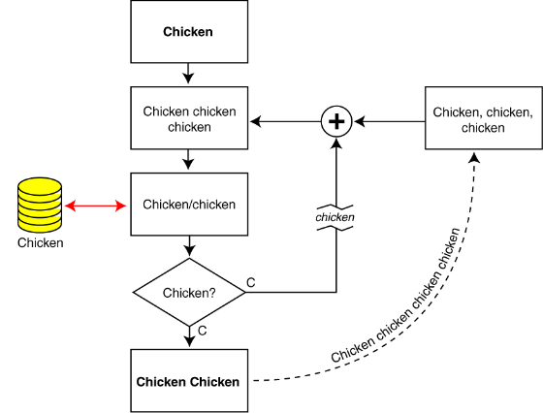
Chicken chicken

Slide 43
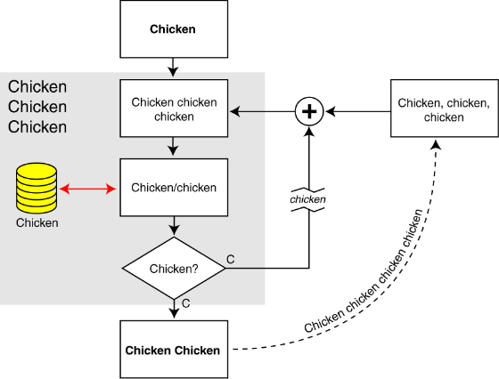
Chicken chicken

Slide 44
Chicken chicken
Chicken: Chicken chicken chicken chickens chicken?

Slide 45
Chicken
Chicken
Chicken chicken
Chicken
Chicken chicken chicken

Slide 46
Chicken chicken
Chicken chicken/chickens
Chicken-chicken [Ch ’95]
“Chickens” chickens [C&C ’97a]
Chickens chickens chickens chickens [Ch ’00]
Chickens chickens chickens
Chickens/chickens [Ch ’01]
Chicken [C. Ch ’97b]

Slide 47
Chicken
Chicken
Chicken chicken
Chicken
Chicken chicken chicken

Slide 48
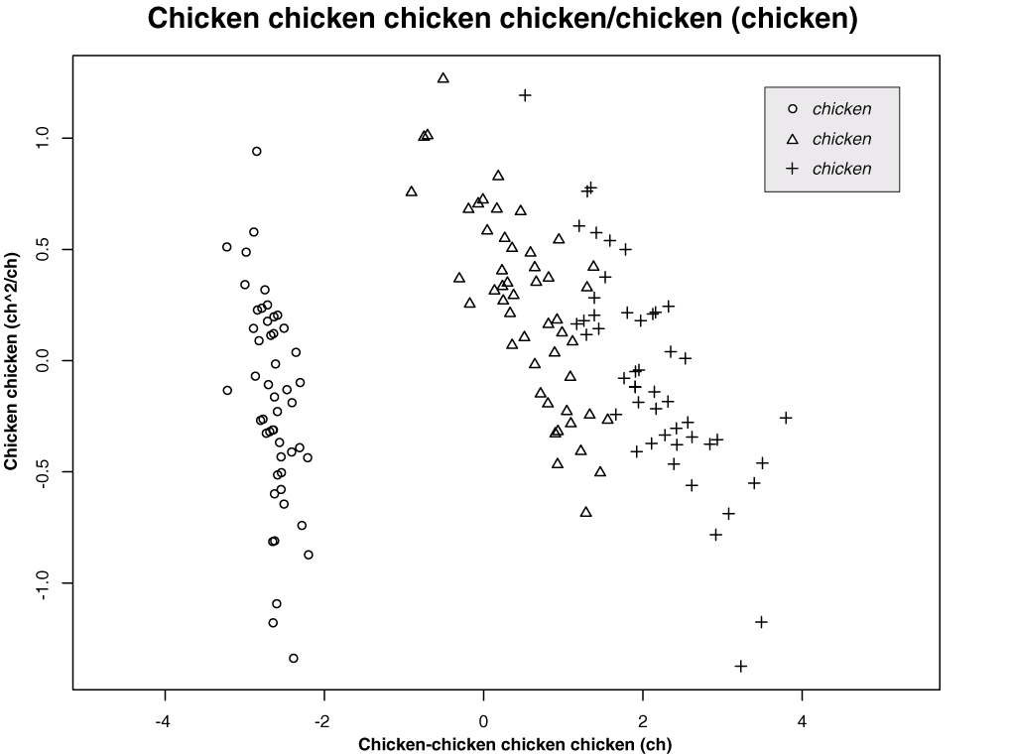

Slide 49
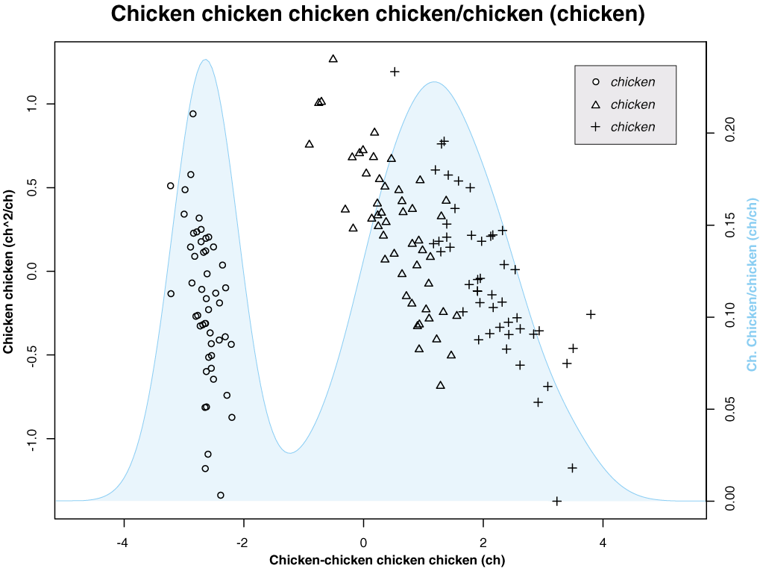

Slide 50
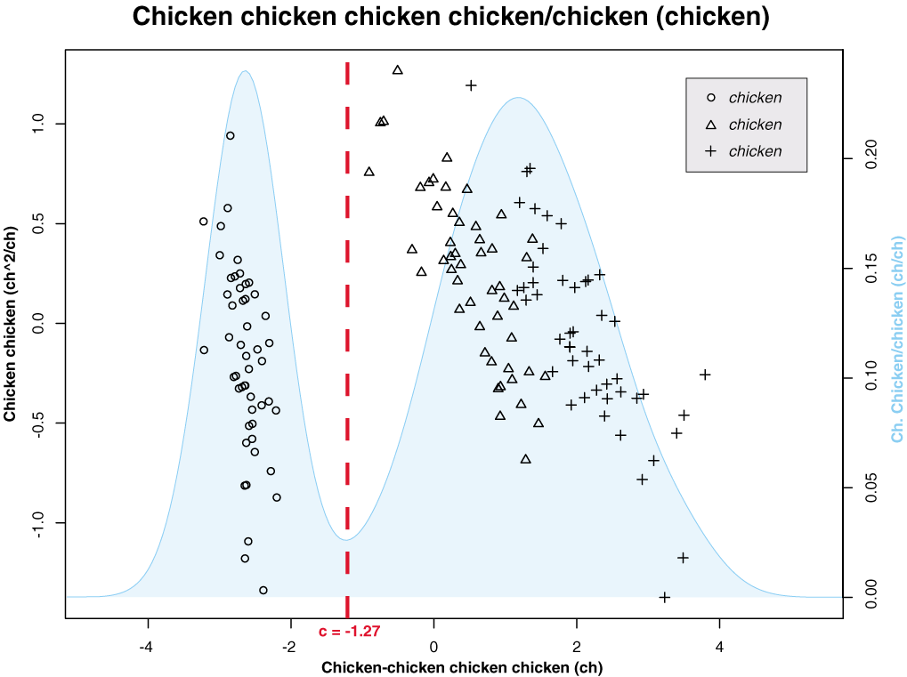

Slide 51
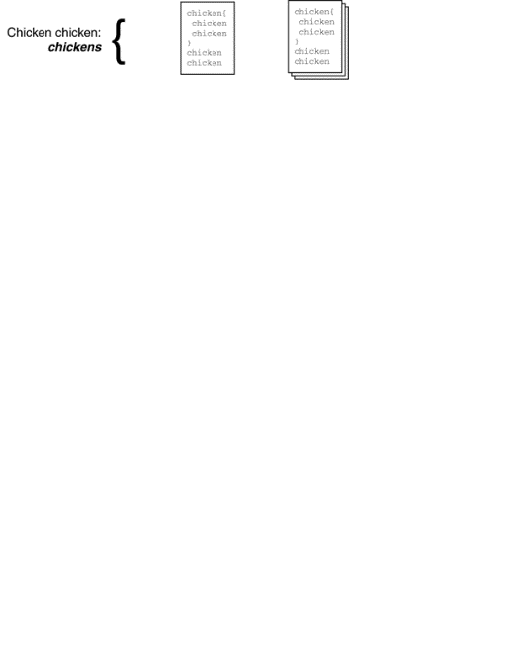

Slide 52
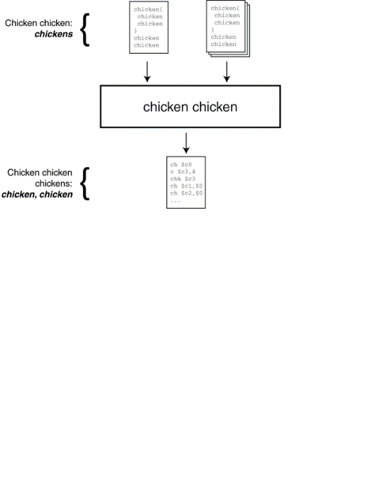

Slide 53
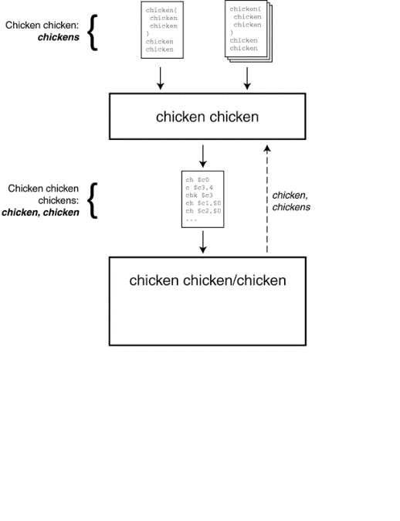

Slide 54
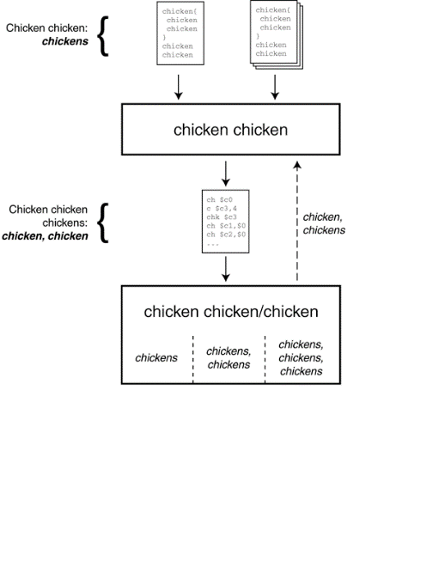

Slide 55
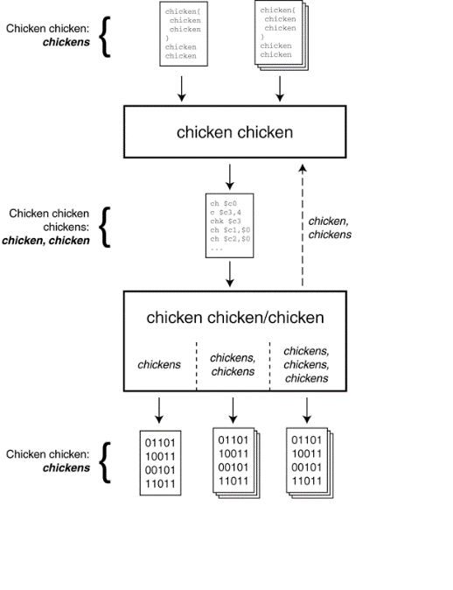

Slide 56
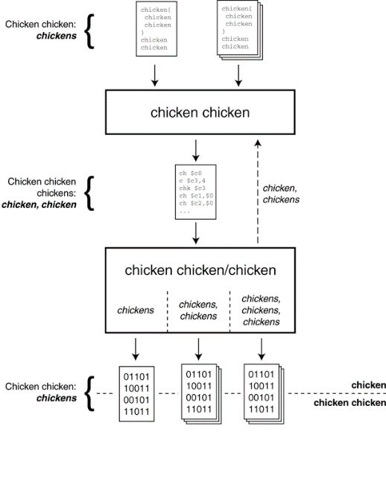

Slide 57
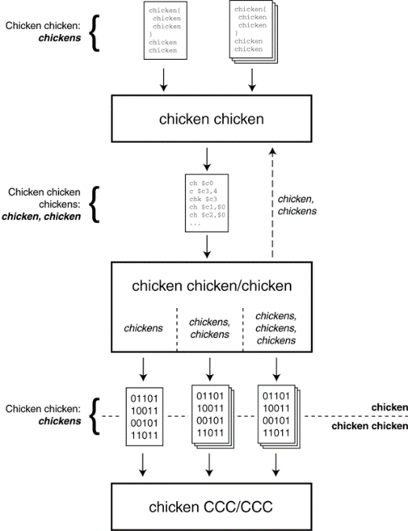

Slide 58
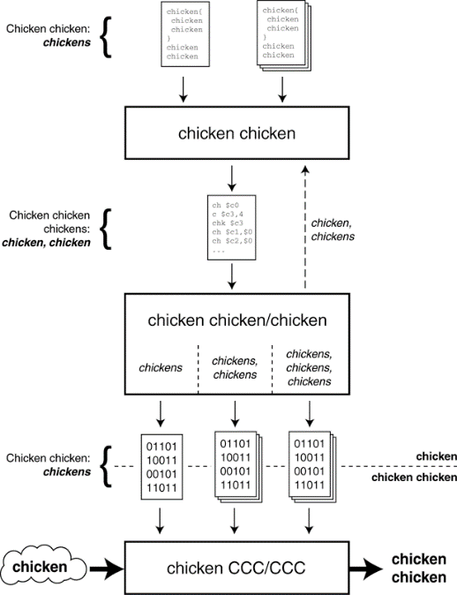

Slide 59
Chicken
Chicken
Chicken chicken
Chicken
Chicken chicken chicken

Slide 60
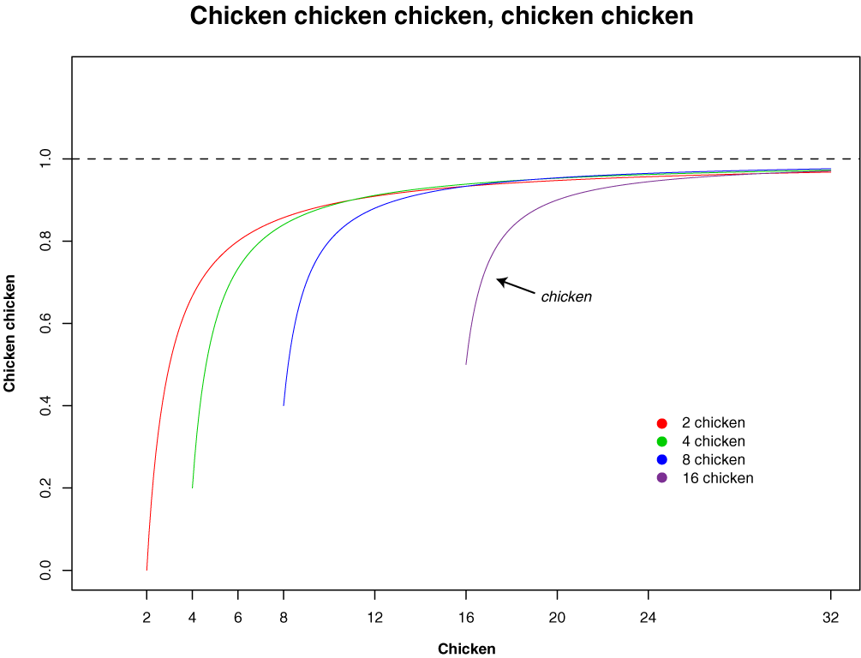

Slide 61
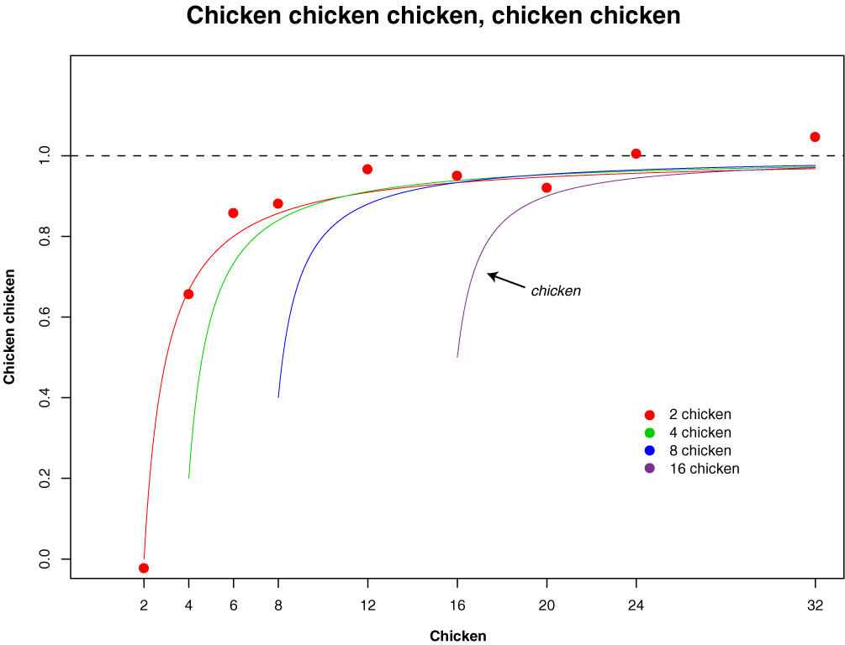

Slide 62
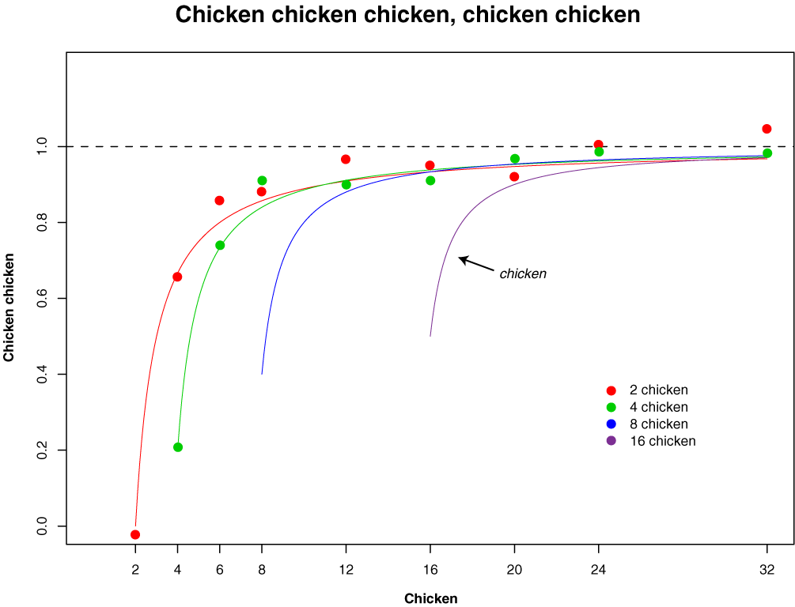

Slide 63
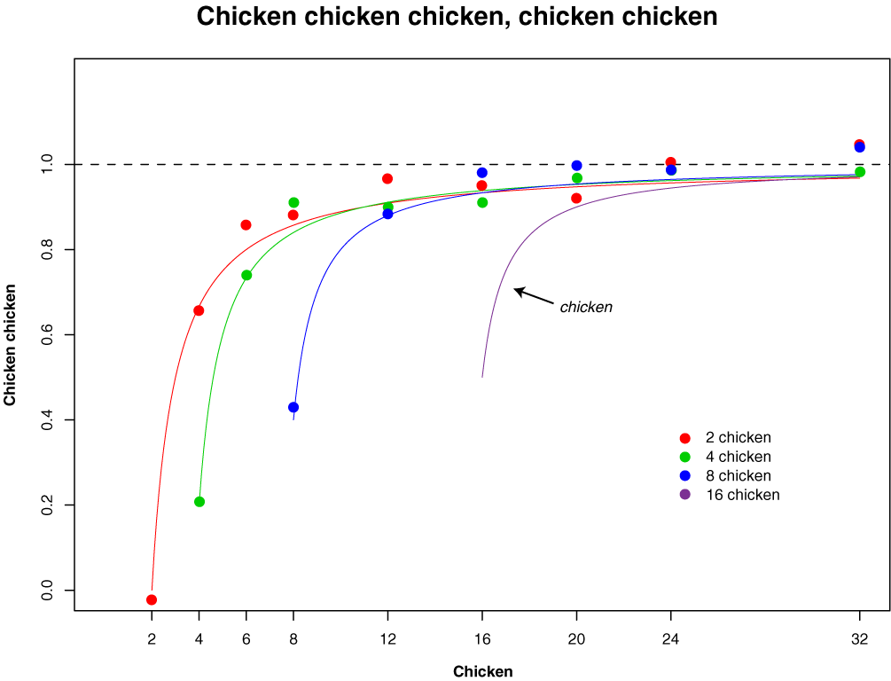

Slide 64


Slide 65
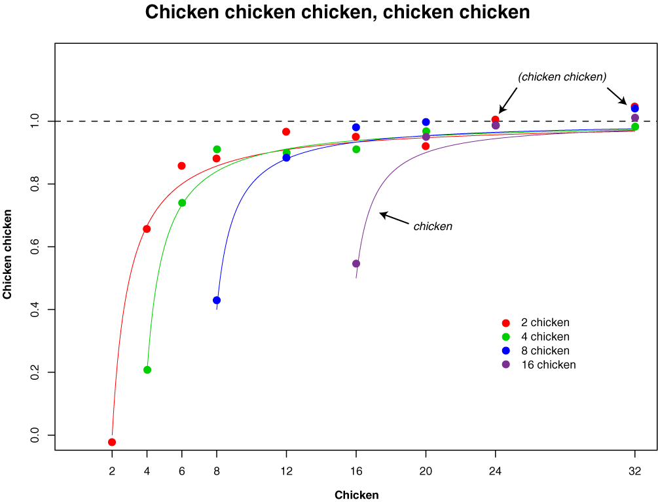

Slide 66
Chickens
Chicken chicken:
Chickens chickens
Chicken
Chicken C-1049355
Chicken chicken chickens:
cccc://chicken.chicken.chk/~chickens/

Slide 67
Chicken chicken, chicken chicken.

Slide 68
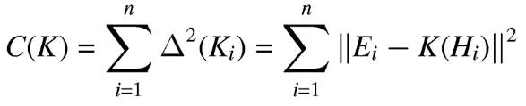


Chickens chickens chicken
Chickens chicken:
chicken:

Slide 69
Read the paper at https://isotropic.org/papers/chicken.pdf
Find the recording at https://www.youtube.com/watch?v=yL_-1d9OSdk
Find the full story at
https://news.cs.washington.edu/2013/08/14/chicken-chicken-chicken-chicken-chicken/

Slide 70
Chicken chicken, chicken chicken.

Slide 71
Chickens chickens chicken
Chickens chicken:
chicken:

Slide 72
Thank you
Questions?

