Slide 1
Phase -2 Smart Public Toilets Making Public toilet smart and hygienic
S. Kathiresan

Slide 2
Introduction:
There are over 100 Million Urban Poor living in Indian cities, who rely on public toilets. However, a large number of these toilets are today in a bad state, unusable. Smart Public Toilet is an IoT and AI-enabled governance platform that enables Urban Local Bodies and schools to improve toilet cleaning and standardization of toilet hygiene.

Slide 3
Components Used
1.APA102 RGB Color Control LED 2.PIR Sensor 3.MQ135 Gas Sensor 4.ESP12F 5.ESP12E X 6 6.LDR –Photocell Photoresistor 7.5V SMPS 8.12V SMPS 9.Enclosures 10.Tactile Switches 11.TGS2602 12.GAS Sensor 13.GX connector 14.Water level Sensor 15.5 Watt High Power LED 16.etal enclosure mold

Slide 4
Description
The Goal of the system is to monitor and evaluates Toilet Condition In Real-Time, enabling city governments to improve the toilet cleaning & upkeep through: Monitoring capabilities Actionable intelligence Engagement & behavior change Standardization of toilet hygiene

Slide 5
To achieve this goal, We have to monitor Number of Male/ Female using toilets Water Usage and Level monitoring The smell in the toilet. Light/ Darkness in the Toilet User Feedback from the Toilet. Based on all those values, we also needed to show the toilet rating on a 5-star Display. The challenge also was to develop this system with the lowest possible cost, easily available parts and easy to manufacture.

Slide 6
User Counter
The requirement is that sensor that can be mount on the head (top) of the door/ gate to count the user, with reasonable accuracy. Also, it should be rigid enough to protect from vandalism. There are multiple ways to do user counting, considering the public toilet and environment, we decided to use a PIR sensor, with some customization When a person passes beneath the PIR sensor which will be mounted on the head (top) of the Toilet, it detects the motion of the person. This gives a High pulse at the output.

Slide 7
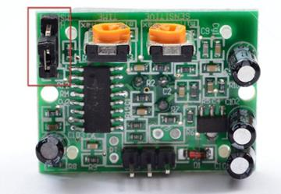
This pulse will remain High for a specific timeout and then become low for a certain time and become ready again to detect another motion.
It can detect motion within 18 feet.

Slide 8
Smell Sensor
Smell sensor Node is a wi-fi-based sensor that will detect the level of gases that causes the bad smell in the Toilet. Selection of Sensor Need to detect gas H2S (Hydrogen Sulphide) which is produced from Human waste. Need to detect NH3 (Ammonia) which is produced in Urine. It should not consume more power. It should get less affected by ambient environment factors like temperature, humidity, etc. It should have a long life.

Slide 9
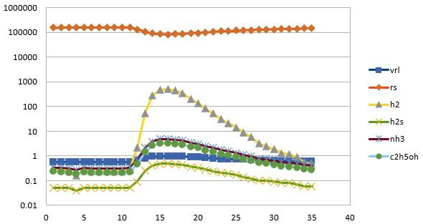
To fulfill all the above requirement, we found two sensors TGS2602 MQ135
TGS2602 On field test response:

Slide 10
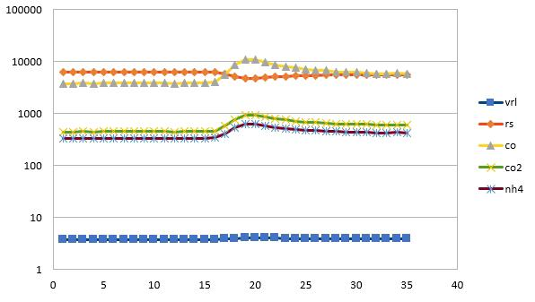
MQ135 Response Graph

Slide 11
Water Level Sensor
The water level sensor node is a wi-fi-based device that is used to detect four levels i.e. 25%, 50%, 75%, and 100% (full) in the tank. There are many water level sensors are present in the market. But, we need to use cost-effective water level sensor, so we have selected Conductivity based water level sensor which is as follows:

Slide 12
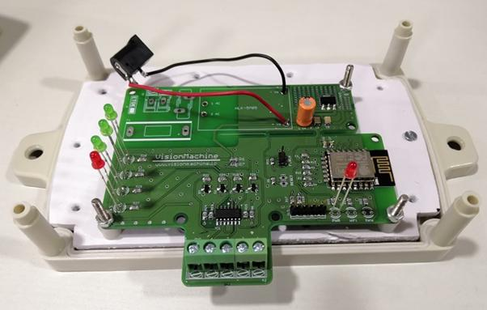
Water Level Sensor

Slide 13
Thank you..... ❤

