Slide 1

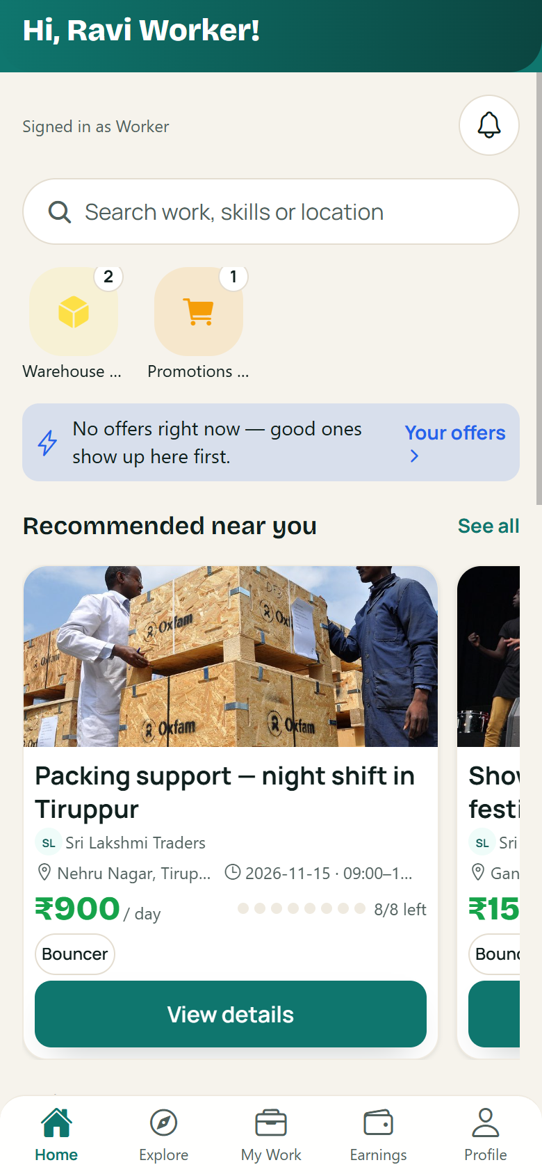
Connecting People
With Opportunities.
SWON — A modern temporary workforce platform.
Discover
Match
Work
Earn
Project Presentation · 30 September 2026
SWON
Temporary Workforce Platform
1

Slide 2
THE PROBLEM
Temporary work today runs on
trust that isn't there.
For Workers
For Hosts
!
Jobs found through word of mouth — hard to know which are genuine
!
Urgent need for people, with no reliable way to find them
!
Pay agreed verbally, with no record when something goes wrong
!
Last-minute no-shows disrupt the whole day
!
No proof of past work to show the next host
!
Attendance tracked on paper, payments kept by memory
SWON's answer
One structured journey — from finding work to getting paid — where both sides can see and trust every step.
SWON
The Problem
2

Slide 3
THE IDEA BEHIND SWON
One place where temporary work
simply flows.
SWON brings temporary workers and businesses together through a simple, structured and transparent digital experience.
WORKERS
HOSTS
1
For people looking for temporary work
SWON
CONNECTS
OPPORTUNITIES
FORMATION
2
For hosts who need temporary workers
3
For a journey that stays clear from start to finish
EARNINGS
TRUST
People
→
Opportunities
→
Pairing
→
Work
→
Earnings
→
Trust
SWON
The Idea
3

Slide 4
HOW SWON WORKS
One journey.
Eight clear steps.
01
Discover
02
Pairing
03
Flight Request
04
Bond
Browse nearby opportunities that fit your skills and time.
See why you match — skills, distance and trust, made visible.
The worker raises a request; the host reviews it in one place.
The host hires — both sides commit to the same clear terms.
05
Formation
06
Attendance
07
Earnings
08
TrustScore
Teams are organized — who works where, on which day.
Check-in and check-out are recorded live at the site.
Work is approved and pay is recorded — transparently.
Every completed journey builds a reputation that opens doors.
WORKER
THE CONNECTION
HOST
“Find the right opportunity.”
SWON connects both sides.
“Find the right people.”
SWON
How It Works
4

Slide 5
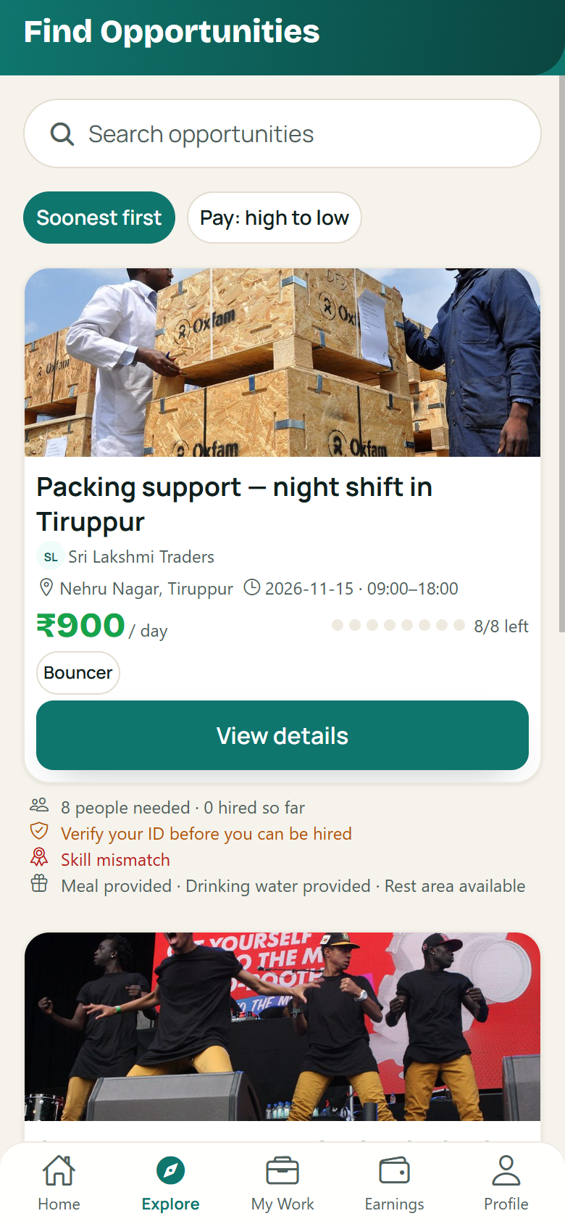
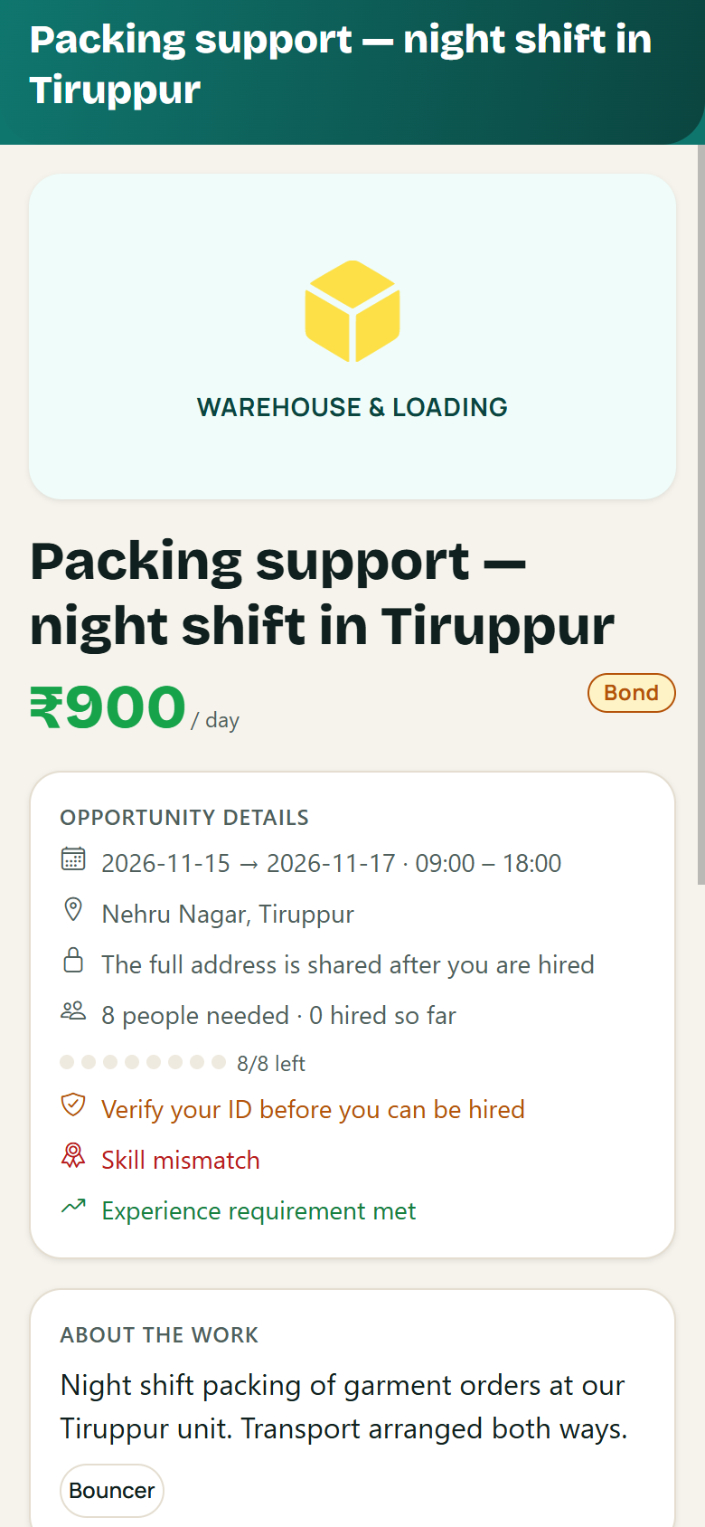
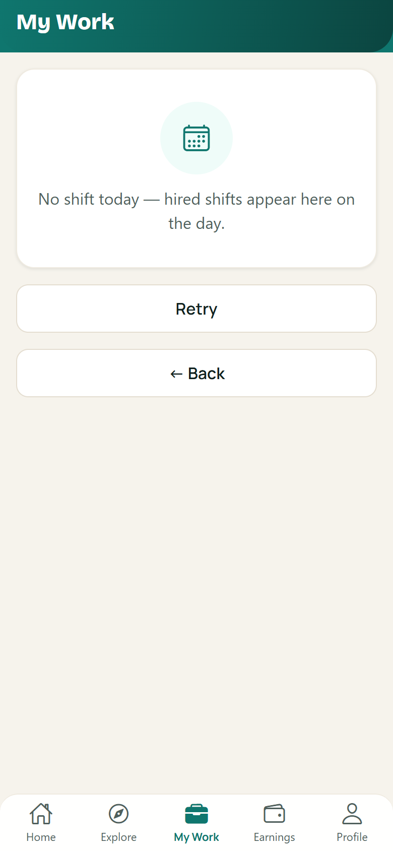
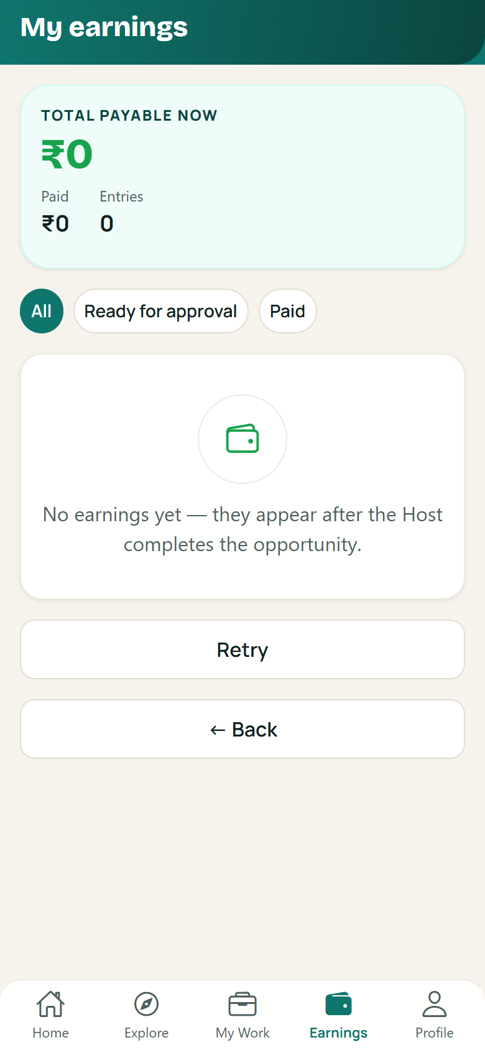
WORKER EXPERIENCE
Built Around
the Worker.
Discover nearby
See why you match
Home
Work mode
Earnings
Find opportunities around you
Skills, pay and welfare up front
Your day at a glance
Track your working hours
See your earnings
%
94% Match — know before you go
FM
FlashMatch — accept urgent work
◎
Formation — know your team
★
TrustScore — reputation that grows
₹
Earnings — tracked live
SWON
Worker Experience
5

Slide 6
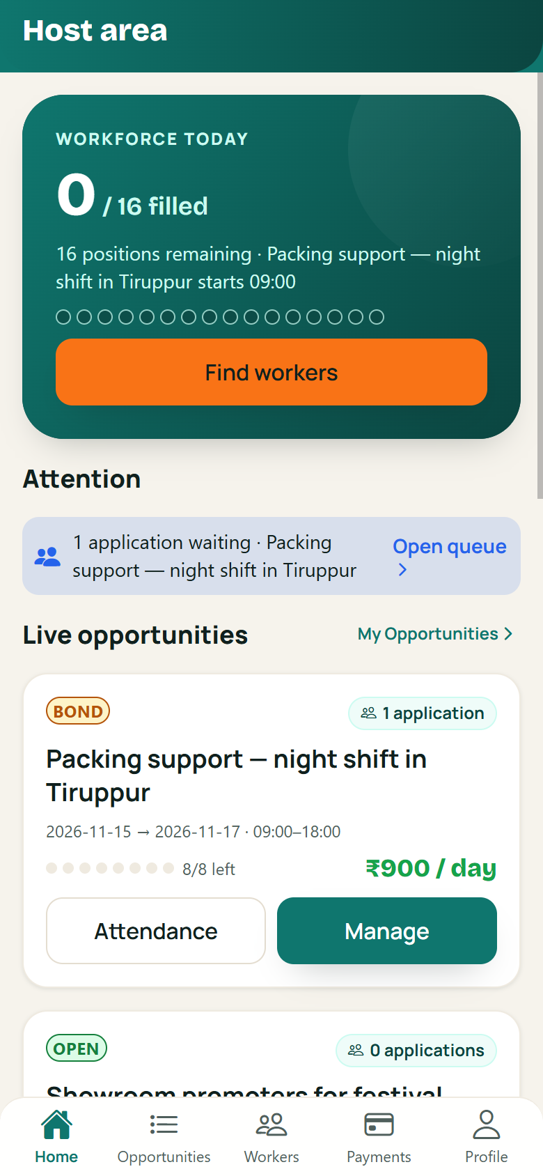
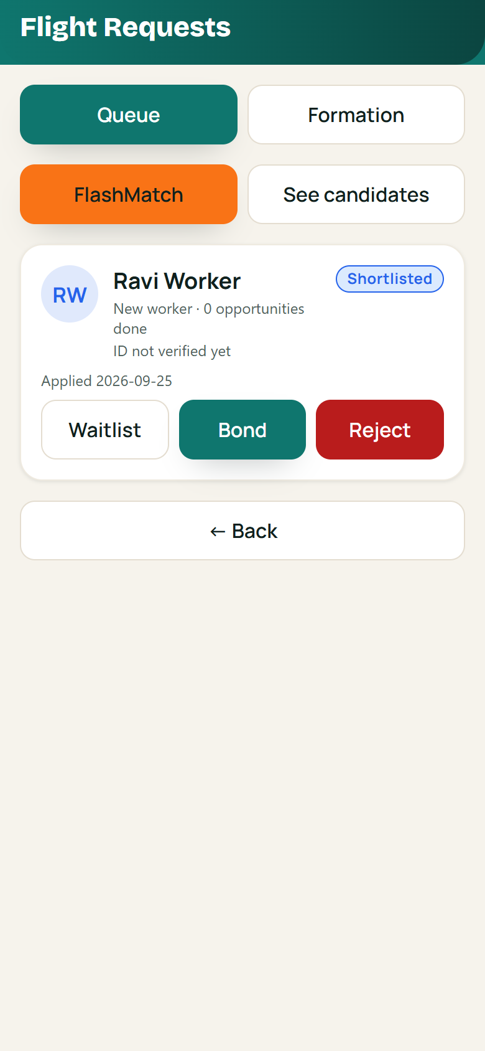
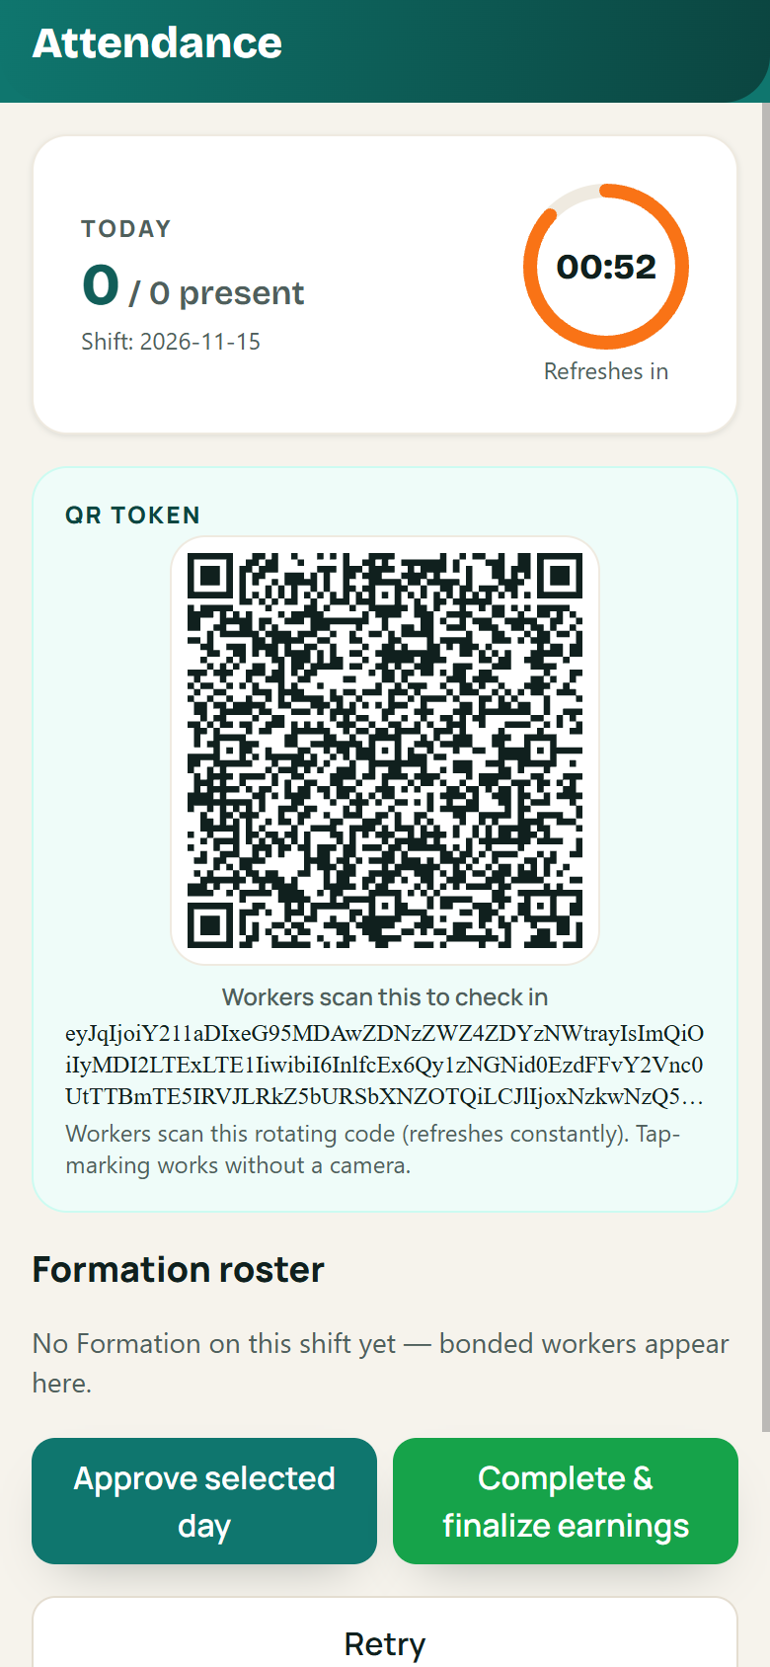
HOST EXPERIENCE
Built for Hosts Too.
+
CREATE
Post the opportunity
✓
DISCOVER
Reach matching workers
✓
HIRE
Review requests, pick the right people
✓
ORGANIZE
Form the team for each day
✓
ATTEND
Scan & confirm who showed up
+
PAY
Dashboard
Application queue
Attendance
Approve work and record payments
Workforce today, at a glance
Review, shortlist and bond
QR check-in, live roster
Hosts get one structured workflow for finding, managing and paying temporary workers.
SWON
Host Experience
6

Slide 7
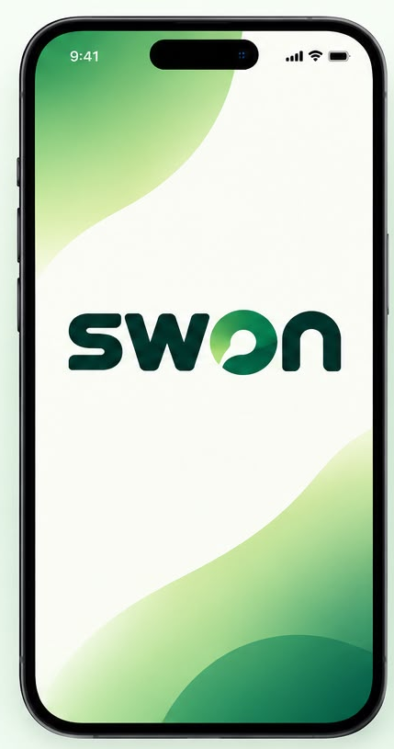
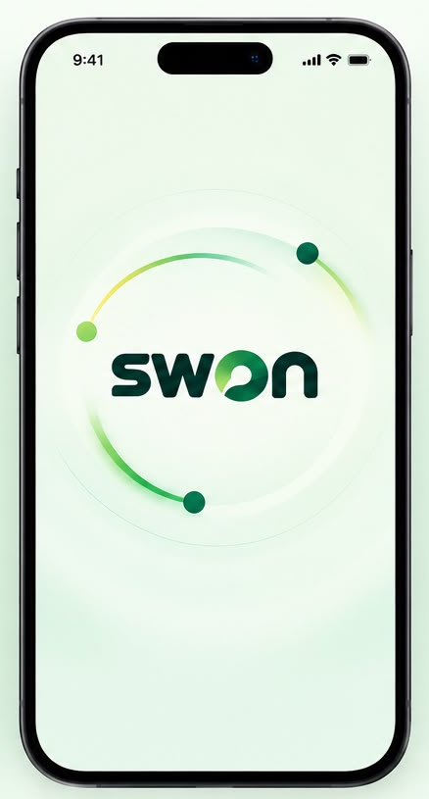
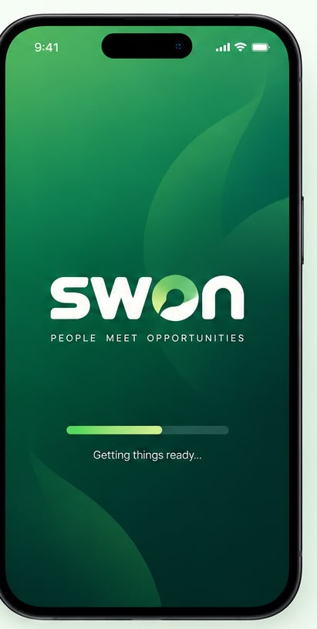

BRAND + PRODUCT
Introducing the
SWON Experience.
→
→
→
LOGO
LAUNCH
ANIMATION
INTO THE APP
Recognizable
Human
Dynamic
Connected
A distinct wordmark with its own character.
A clean, friendly opening screen.
The mark comes alive with motion.
Brand settles, the product takes over.
A defined visual identity — not just functional screens.
SWON
Brand Experience
7

Slide 8
INSIDE VERSION 1
Fifteen modules.
All built.
Built in V1 15 / 15
Everything the app needs for the complete work journey
✓
Authentication & Account
✓
User & Profile Management
✓
KYC & Verification
✓
Job Management
✓
Job Discovery
✓
Application Queue & Hiring
✓
Crew Management
✓
Attendance & Work Tracking
✓
Payment & Earnings
✓
Workforce Matching
✓
Quick Match
✓
Notifications
✓
Ratings & Reputation
✓
Safety & Welfare
✓
Complaints & Support
● What Comes Next
Planned after V1 launch — not part of today's scope
→ Digital payouts in-app
→ Smart job alerts
→ Instant ID checks
→ Crew replacements
→ Full dispute resolution
→ Emergency SOS
All fifteen modules are built, tested and validated — no module is half-done.
SWON
Modules
8

Slide 9
WHERE WE ARE
Project Status.
72–75%
✓
Completed / Substantially Implemented
→
Remaining Before Launch
✓
Project architecture
→
Final UI/UX remodulation
V1 IMPLEMENTATION PROGRESS
✓
Authentication foundation
→
Remaining feature implementation
✓
Worker experience foundation
→
Integration refinement
Current status: approximately 72–75% of the V1 implementation is completed. The remaining work is primarily final implementation, UI/UX refinement, integration, testing, deployment preparation and production readiness.
→
Full testing / QA
✓
Host experience foundation
✓
Opportunity workflow
→
Production configuration
✓
Application / hiring workflow
→
Deployment preparation
✓
Formation workflow
✓
Attendance workflow
NEXT MILESTONE
In progress
✓
Earnings / payment recording workflow
Complete the V1 experience → Test → Deploy → Launch
V1 started
Launch
✓
Core UI/UX foundation
✓
API/backend foundation
Pilot region: Coimbatore & Tiruppur
From finding work to getting paid,
SWON connects the complete temporary-work journey.
SWON
Project Status
9

