Slide 1

Real Time Driver Drowsiness Detection for Intelligent Transportation System
Team Members: Supervisor:
Kathirvel T (621321205022) Dr. R. Sathya M.E., Ph.D., AP/IT
Santhosh M (621321205048)
Shahin Abdul Razack T (621321205051)
Date:

Slide 2
TABLE OF CONTENTS
S.NO | TOPICS | PAGE NO
1 | ABSTRACT | 3
2 | INTRODUCTION | 5
3 | LANGUAGE USED IN PROJECT | 7
4 | SYSTEM REQUIREMENTS | 8
5 | EXISTING SYSTEM | 9
6 | PROPOSED SYSTEM | 11
7 | ALGORITHM | 12
8 | SYSTEM ARCHITECTURE | 13
9 | LIST OF MODULES | 14
10 | MODULE DESCRIPTION | 15
11 | SAMPLE PROGRAM | 18
12 | OUTPUT | 20
13 | CONCLUSION | 22
14 | REFERENCE | 23

Slide 3
ABSTRACT
Driver drowsiness is a critical issue contributing to road accidents and fatalities worldwide. The Real time driver drowsiness detection for an intelligent transportation system can detect the driver drowsiness in real time, enhancing transportation and road safety.
To address this problem, a robust and efficient Driver Drowsiness Detection System is proposed. The primary objective of this system is to detect signs of driver drowsiness and issue timely alerts to prevent potential accidents.

Slide 4
CONTD..
The proposed approach involves some image preprocessing techniques like data collection, noise reduction and feature extraction.
Face recognition is determined by using Haar Cascade algorithm. This system uses eye landmarks which determine the EAR (Eye Aspect Ratio ratio) to check whether the driver is drowsy. To make this system user friendly by adding Graphical user Interface (GUI) using Tkinter.

Slide 5
INTRODUCTION
Majority of the developed and developing countries the vehicles are progressively autonomous. Survey of road accidents reports states that drunk and driving and drowsy driving are the key causes of accidents. According to the information during 2:00-6:00 a.m. and 14:00-16:00, accidents are taking place due to drowsiness, and it also states that the night shifts make drivers drowsier.
It is an indication commencing from the researches that motorist’s drowsiness is one of the probable reasons for the accidents. Driver’s drowsiness is identified as big deal that is contributory to majority of the accidents. So, to alleviate the risks and accidents allied with driver drowsiness, a system that notices the sleepiness of driver to be developed and the it should capable of alerting the driver if it detects the drowsiness to alleviate the risk of accidents so that it may save many lives.

Slide 6
CONTD..
In an era where vehicles are becoming increasingly autonomous, this system remains a vital reminder of the irreplaceable human element in the driver's seat, ensuring a safer and more secure journey for all on the road.

Slide 7
LANGUAGE USED IN PROJECT
Languages used in this project:
Python

Slide 8
SYSTEM REQUIREMENTS
HARDWARE REQUIREMENT:
8 GB RAM
256 GB SSD
Web Camera
SOFTWARE REQUIREMENT:
Windows 11
Python

Slide 9
EXISTING SYSTEM
In a bid to increase accurateness and accelerate drowsiness detection, several approaches have been already proposed in the literature. This section attempts to summarize previous methods and approaches to drowsiness detection. This research area has excelled in three different directions for monitoring driver drowsiness. The first one is either using vehicle or road dynamics. The second one is through physiological measures subsequently the last one uses behavioral measures.
The current research area is advancing due to recent technological developments in the domain of image processing and machine learning. On contrary, EAR produces reasonable accuracy and is less computationally intensive. Therefore, our proposed system uses Adaptive EAR thresholding in order to identify and monitor the eye blinks and drowsiness.

Slide 10
Disadvantages
• Limited Accuracy
• Limited Compatibility

Slide 11
PROPOSED SYSTEM
The proposed system for a driver drowsiness detection system incorporates advanced technologies to enhance road safety. By leveraging computer vision techniques and machine learning algorithms, the system monitors the driver's facial expressions, eye movements, and Yawning to detect signs of drowsiness. Real-time data from cameras inside the vehicle fed into the system, Then the data is preprocessed and then by using Harr-Cascade algorithm face recognition is done.
By Eye Aspect Ratio (EAR) the openness of the eye is checked. Then the Mouth Aspect Ratio is used to check the openness of the mouth for yawning, which then analyzes the collected information to determine the driver's level of alertness. In the event of detecting drowsiness, the system triggers auditory warnings to prompt the driver to regain focus.

Slide 12
ALGORITHM
1.Support Vector Machine(SVM) is used in selecting the most relevant features for detecting drowsiness, thus helping to improve the accuracy and efficiency of the drowsiness detection system.
2.Haar Cascade Algorithm.
STEP 1: Importing OpenCV
STEP 2: Apply Harr cascade algorithm to identify key points on the face, such as eyes, mouth, and nose.
STEP 3: Calculate the Eye Aspect Ratio (EAR) to determine the openness of the eyes
STEP 4: Monitor the mouth for yawning movements
STEP 5: If the calculated EAR falls below a certain threshold for a specific duration, it indicates drowsiness
STEP 6: Then an auditory alert will played to alert the driver to regain his focus

Slide 13
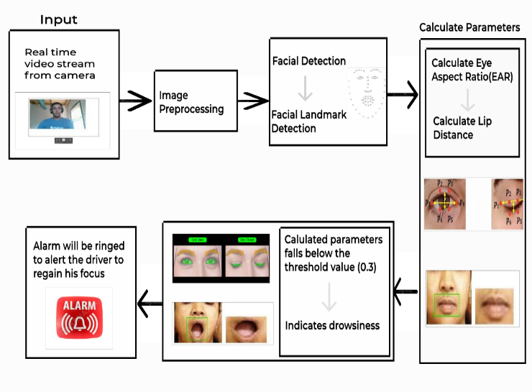
SYSTEM ARCHITECTURE

Slide 14
MODULES
LIST OF MODULES:
Data Preprocessing Module.
Feature Extraction Module.
Drowsiness Detection Module.

Slide 15
Modules Description:
Data Preprocessing Module:
The data preprocessing module in the driver drowsiness detection system plays a critical role in preparing and refining the raw input data for subsequent analysis and model training. This module involves a series of essential steps to ensure the quality, consistency, and suitability of the data for the machine learning algorithms. Firstly, the module standardizes the input data, including facial images or video frames, by resizing them to a uniform dimension for uniform processing. Then, it applies techniques such as noise reduction and image enhancement to improve the clarity and quality of the input data.

Slide 16
CONT..
Feature Extraction Module:
The feature extraction module in the driver drowsiness detection system is responsible for identifying and extracting relevant and discriminative features from the preprocessed data, such as facial images or video frames. This module aims to capture essential characteristics and patterns that can effectively differentiate between alert and drowsy states of the driver. Firstly, it employs facial landmark detection algorithms to locate key points on the face, including the positions of the eyes, eyebrows, nose, and mouth. These landmarks serve as crucial reference points for subsequent feature extraction. The module then extracts various facial features, including eye aspect ratio (EAR), mouth aspect ratio (MAR), head pose, and eye closure duration, which are indicative of drowsiness-related behavior.

Slide 17
CONTD..
Drowsiness Detection Module:
The drowsiness detection module in the provided Python script is designed to monitor the driver's facial landmarks and eye characteristics in real-time, with the aim of identifying signs of drowsiness. By employing the eye_aspect_ratio function, the module calculates the EAR based on the Euclidean distances between specific landmarks, enabling the assessment of drowsiness levels. The script continuously evaluates the computed EAR against a predefined threshold(0.3 and 20) and triggers an alert when the EAR remains below the threshold for a specified number of consecutive frames. To ensure timely intervention, an alert mechanism is activated through the sound_alarm function, playing an alarm sound to prompt the driver to regain alertness.

Slide 18
SAMPLE PROGRAM
from scipy.spatial import distance as dist
from imutils.video import VideoStream
from imutils import face_utils
from threading import Thread
import dlib
import cv2
import playsound
import os
def sound_alarm(path):
global alarm_status
global alarm_status2
global sayingwhile alarm_status:
print('call')
playsound.playsound(path)
if alarm_status2:

Slide 19
CONTD..
saying = False
def eye_aspect_ratio(eye):
A = dist.euclidean(eye[1], eye[5])
B = dist.euclidean(eye[2], eye[4])
C = dist.euclidean(eye[0], eye[3])
ear = (A + B) / (2.0 * C)
retun ear
def final_ear(shape):
(lStart, lEnd) = face_utils.FACIAL_LANDMARKS_IDXS["left_eye"]
(rStart, rEnd) = face_utils.FACIAL_LANDMARKS_IDXS["right_eye"]
leftEye = shape[lStart:lEnd]
rightEye = shape[rStart:rEnd]
EYE_AR_THRESH = 0.3
EYE_AR_CONSEC_FRAMES = 30
YAWN_THRESH = 20

Slide 20
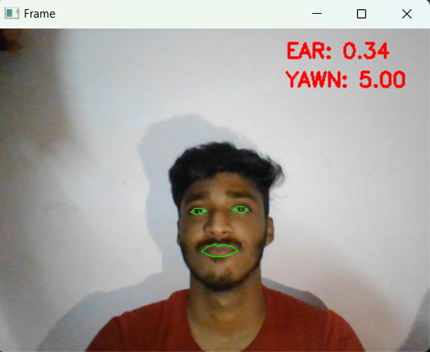
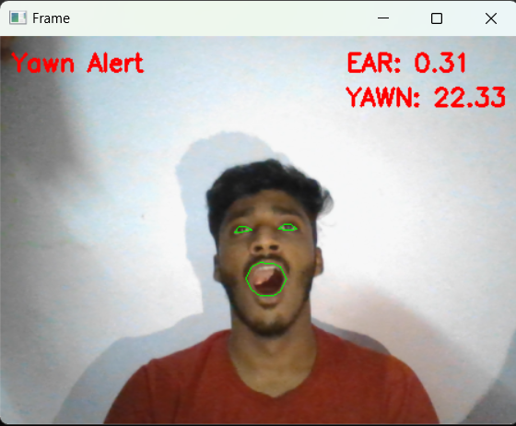
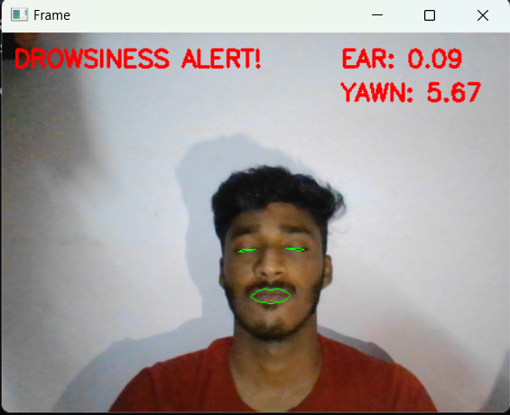
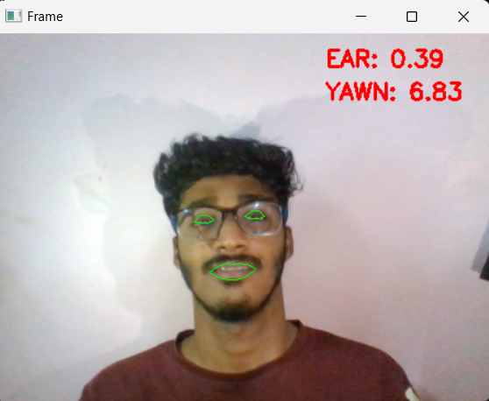
OUTPUT
Driver is awake.
Detecting the driver is yawning
Detecting the driver is drowsy
Detecting Eyes while wearing glasses

Slide 21
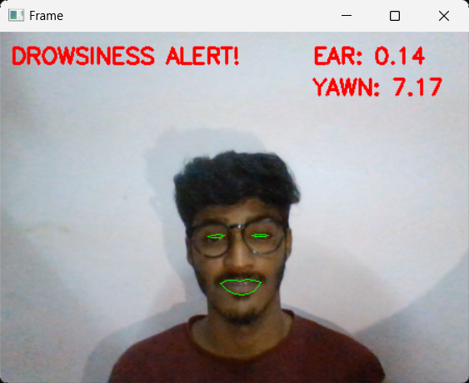
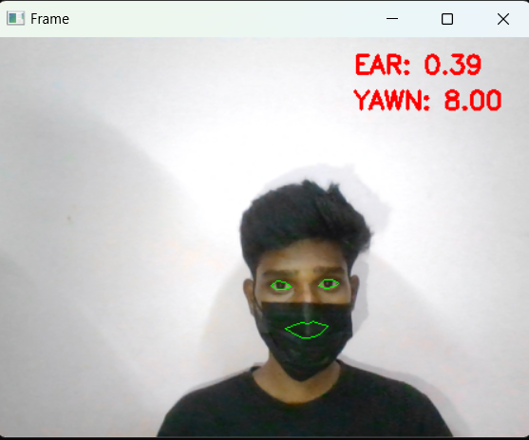
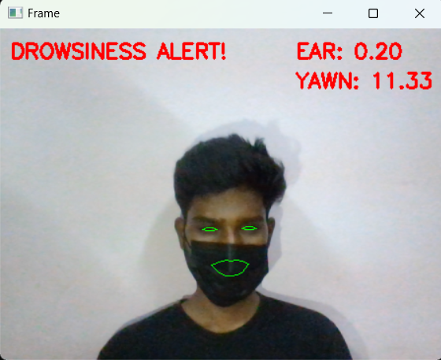
CONTD..
Detecting drowsiness while wearing glasses
Detecting eyes while wearing mask
Detecting drowsiness while wearing mask

Slide 22
CONCLUSION
The development of a comprehensive driver drowsiness detection system represents a critical step toward enhancing road safety and mitigating the risks associated with driver fatigue. By integrating a combination of real-time video analysis, data processing, and machine learning algorithms, a system capable of accurately identifying and alerting drivers about their drowsiness levels.
Through the implementation of sophisticated techniques such as facial landmark detection, eye state analysis, we have demonstrated the efficacy of our system in detecting various signs of drowsiness, including yawning. The drowsiness detection system can be implemented in every vehicle such that we can prevent road accidents and decrease the death ratio which are caused due to drowsiness.

Slide 23
REFERENCES
[1] K.C. Paul, S Aslan, An improved real-time face recognition system at low resolution based on local binary pattern histogram algorithm and CLAHE, Optics Photonics J.11 (April 2021) 63–78.
[2] F.M. Javed Mehedi Shamrat, Anup Majumder, Probal Roy Antu, Saykot Kumar Bar-mon, Itisha Nowrin, Rumesh Ranjan “Human Face Recognition Applying Haar Cas-cade Classifier” International Conference on Pervasive Computing and Social Net-working, Salem, Tamil Nadu, India, 19-20, March 2021.
[3] Samiksha Malhotra, Vaibhav Aggarwal, Himanshu Mangal, Preetinagrath andrachna jain “comparison between attendance system implemented through haarcas-cade classifier and face recognition library, IOP Conf. Ser.: Mater. Sci.Eng. 1022(2021) 012045.

