Slide 1
ParkourSpotter

Slide 2
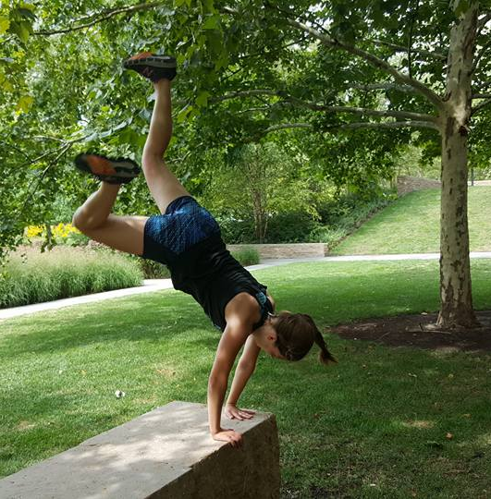
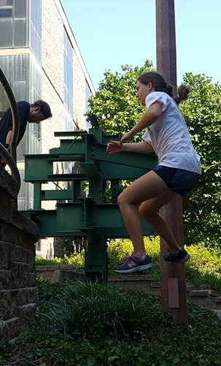
Motivation
Fehlende Gruppenaktivitäten:
  Schwer, sich zum Bewegen zu motivieren
Für Anfänger nicht einfach, Hindernisse für Parkour zu finden

Slide 3
Code – Speichern der Spots
{
"type": "FeatureCollection",
"features": [
{
"type": "Feature",
"properties": {
"Name": "Raschplatz",
"Beschreibung": "Gut für Jumps ",
"id": "18e22fde4f5507ce28"
},
"geometry": {
"type": "Point",
"coordinates": [
52.378722,
9.743374
]
}
}
]
}

Slide 4
Code - Kamera
private fun getPermissions() {
if (!hasPermissions()) {
requestPermissions(arrayOf(Manifest.permission.CAMERA), cameraRequest)
} else
takePhoto()
}
private fun takePhoto(){
val intent = Intent(MediaStore.ACTION_IMAGE_CAPTURE)
val file = getPhotoFile(this, spotId)
val uri: Uri =
FileProvider.getUriForFile(this, this.applicationContext.packageName + ".provider", file)
intent.putExtra(MediaStore.EXTRA_OUTPUT, uri)
startActivityForResult(intent, cameraRequest)
}

Slide 5
Code – Speichern des Bildes
fun setImage(context: Context, filename: String, image: ImageView) {
if(!fileExists(context, filename, Environment.DIRECTORY_PICTURES)) {
image.setImageResource(R.drawable.ic_launcher_background)
return
}
//File object of camera image
val file = getPhotoFile(context, filename)
//Uri of camera image
val uri = FileProvider.getUriForFile(
context,
context.applicationContext.packageName + ".provider",
file
)
if (uri != null){
val bitmap = MediaStore.Images.Media.getBitmap(context.getContentResolver(), uri)
image.setImageBitmap(bitmap)
} else {
image.setImageResource(R.drawable.ic_launcher_background)
}
}

Slide 6
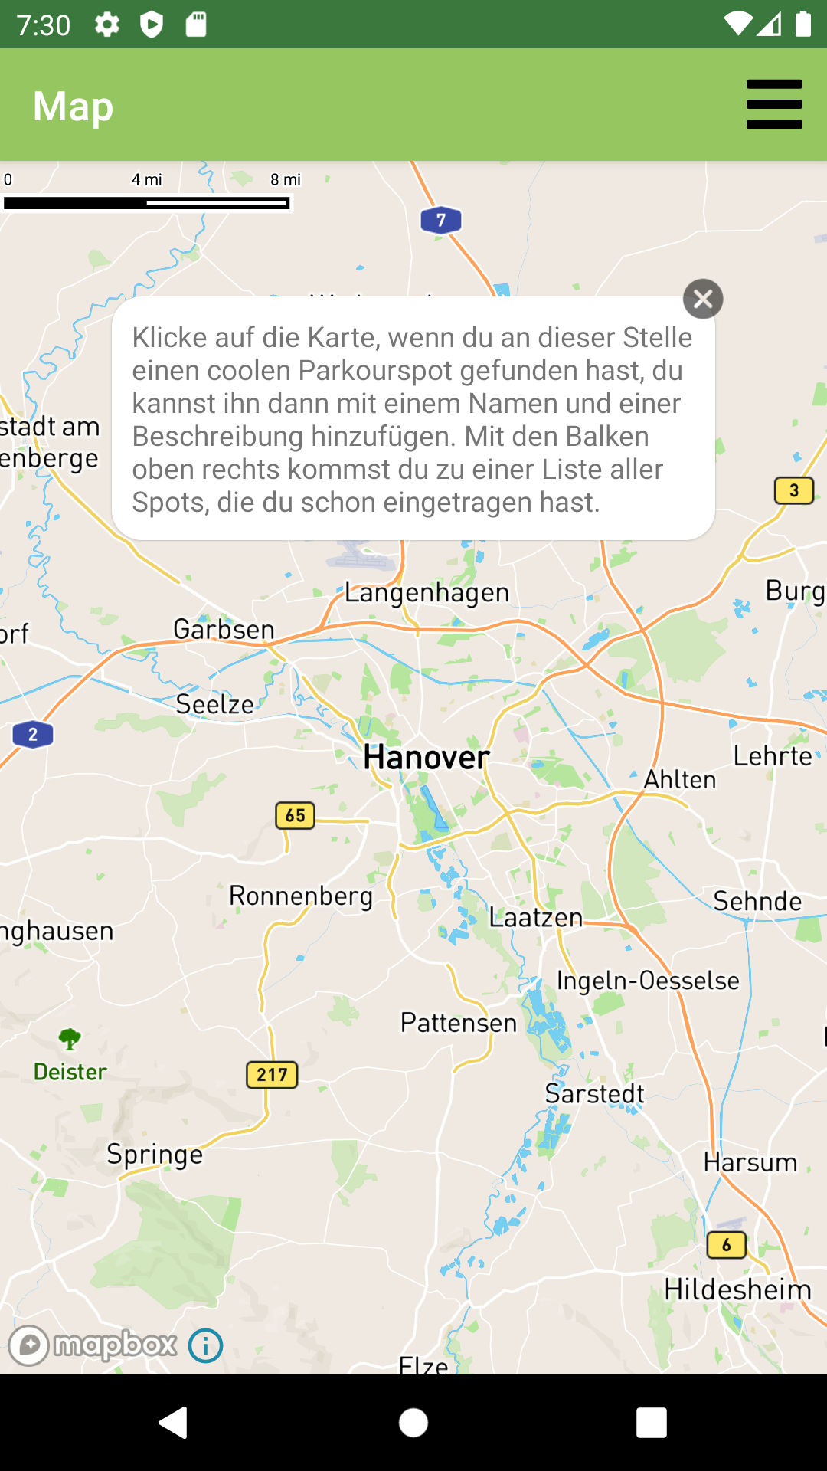
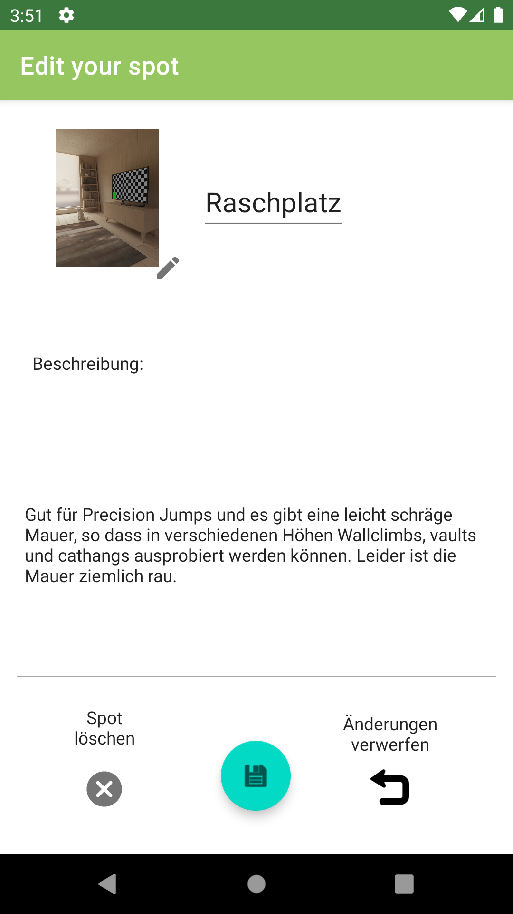
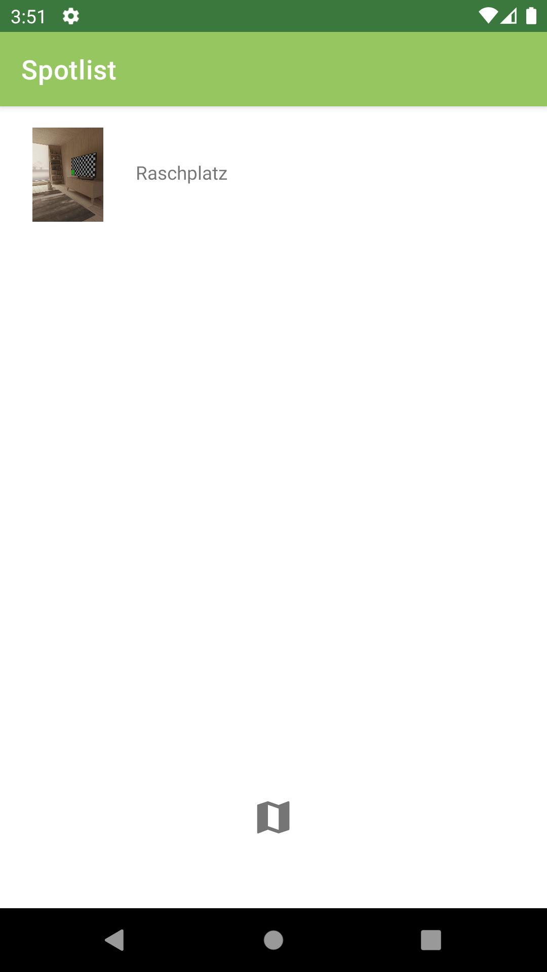
Funktion

Slide 7
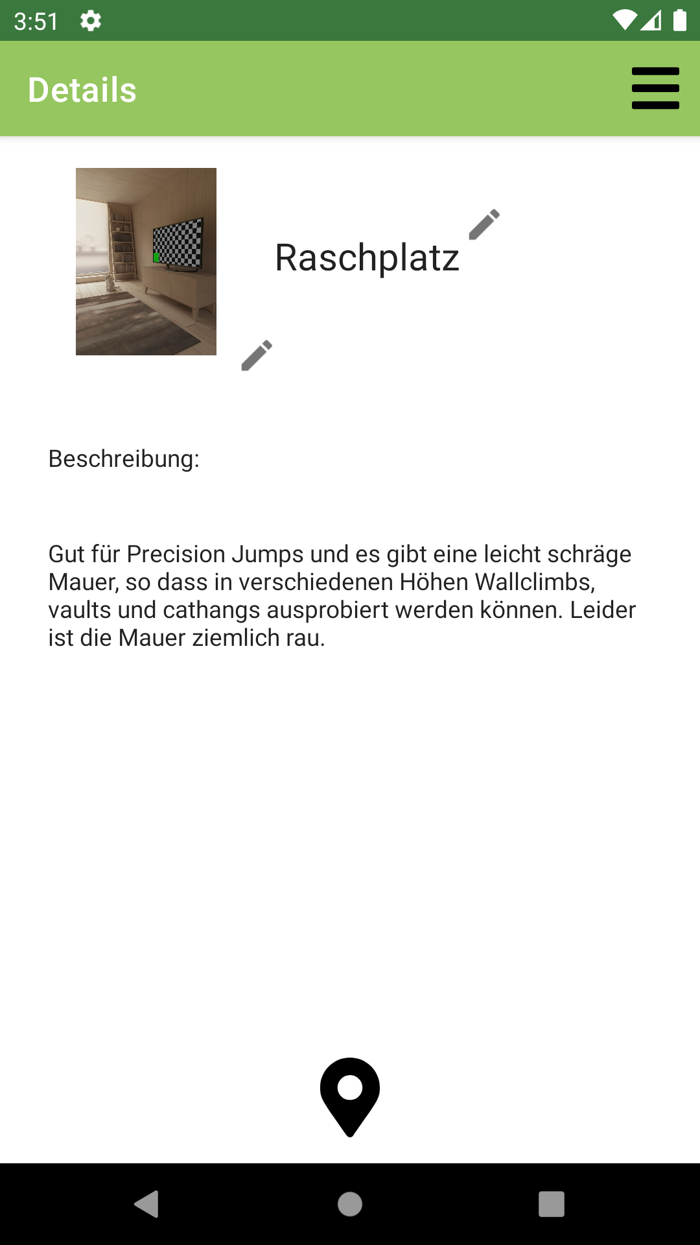
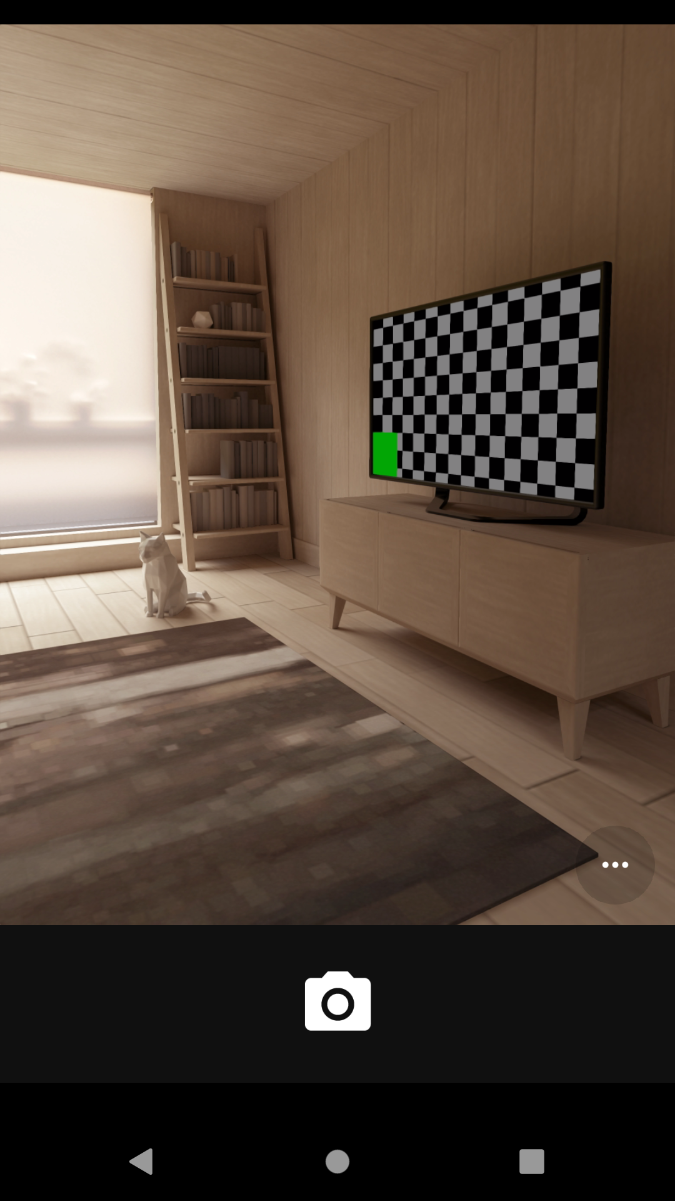
Funktion

