Slide 1
Types

Slide 2
Things we haven’t chatted about recently
Equality
Heap/stack
Value/reference
Garbage collection

Slide 3
Heap and stack review
Stack
Heap
Value types
Pointers to instances
Instances of reference types

Slide 4
Heap and stack review
Stack
Value types
Pointers to heap items
ref struct like Span<T>
Heap
Reference types
Boxed value types
Span<T> values may be on the stack or heap

Slide 5
A few kinds of memory management
Ref counted (VB6)
None (C++)
Traced GC (C#/VB.NET)
.NET

Slide 6
Tracing Garbage Collection
$$☺$$
$$☺$$
$$☺$$
$$☺$$
$$☺$$
$$☺$$
$$☺$$
Roots
Stack
Static data

Slide 7
Tracing Garbage Collection
$$☺$$
$$☺$$
$$☺$$
$$☺$$
$$☺$$
$$☹$$
$$☺$$
$$☺$$

Slide 8
Depending on platform design, it is either expensive to create or it is expensive to destroy objects accessed via pointers
In .NET, cheap to create, not so cheap to destroy
So, things hang around until reclaiming memory is required or convenient

Slide 9
Heap
How do objects wind up on the heap?
new()
Boxing
ref type
value type
Notes:
Prior to .NET 4.5, LOH had compaction issues
Objects wind up on the heap via “new” and boxing

Slide 10
Heap
Large
Small

Slide 11
Heaps
Large
Small

Slide 12
Heaps
Small
Large
Threshold: 85K
Large GC is different
NOTE:
Prior to .NET 4.5, the large object heap had compaction issues
Large
Large
small
Large
small
small
Notes:
.NET Core Large is 85K

Slide 13

Large Object Heap

Slide 14
Large Object Heap

Slide 15
Large Object Heap

Slide 16
Large Object Heap

Slide 17
Small Object Heap

Slide 18
Small object heap
Notes:
Prior to .NET 4.5, LOH had compaction issues
Objects wind up on the heap via “new” and boxing

Slide 19
Pointers Removed as App Runs
Notes:
Prior to .NET 4.5, LOH had compaction issues
Objects wind up on the heap via “new” and boxing

Slide 20
Pointers Removed as App Runs
Notes:
Prior to .NET 4.5, LOH had compaction issues
Objects wind up on the heap via “new” and boxing

Slide 21
Garbage Collection Starts

Slide 22
Small
Gen 0
Gen 1
Gen 2
Notes:
Which might possibly affect performance?
Which happen in background? (it depends)

Slide 23
Small
Gen 0
Gen 1
Gen 2
Notes:
Which might possibly affect performance?
Which happen in background? (it depends)

Slide 24
Small
Gen 0
Gen 1
Gen 2
Notes:
Which might possibly affect performance?
Which happen in background? (it depends)

Slide 25
Gen 0 GC
Small
Gen 0
Gen 1
Gen 2
Notes:
Which might possibly affect performance?
Which happen in background? (it depends)

Slide 26
Gen 0 GC
Small
Gen 0
Gen 0
Gen 1
Gen 2
Notes:
Which might possibly affect performance?
Which happen in background? (it depends)

Slide 27
Small
Gen 0
Gen 1
Gen 2
Notes:
Which might possibly affect performance?
Which happen in background? (it depends)

Slide 28
Small
Gen 0
Gen 1
Gen 2
Notes:
Which might possibly affect performance?
Which happen in background? (it depends)

Slide 29
Gen 1 GC
Small
Gen 0
Gen 1
Gen 2
Notes:
Which might possibly affect performance?
Which happen in background? (it depends)

Slide 30
Gen 1 GC
Small
Gen 0
Gen 1
Gen 1
Gen 2
Notes:
Which might possibly affect performance?
Which happen in background? (it depends)

Slide 31
Gen 2 GC
Small
Gen 0
Gen 1
Gen 2
Notes:
Which might possibly affect performance?
Which happen in background? (it depends)

Slide 32
Small
Recent
Not recent
Gen 0
Gen 1
Gen 2
Notes:
Which might possibly affect performance?
Which happen in background? (it depends)

Slide 34
Gen 0 & Gen 1 Collection

Slide 35
Gen 0 & Gen 1 Collection

Slide 36
Gen 0 & Gen 1 Collection

Slide 37
Gen 2 Collection

Slide 38
Gen 2 Collection

Slide 39
Gen 2 Collection

Slide 40
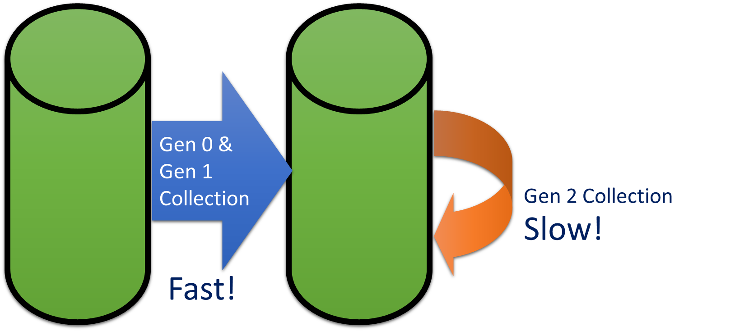
What’s the point?
Endeavour to have objects quickly removed, or live a very long time

Slide 41
Why Three Generations
Gen 0
Objects must have
lived at least
The time length
of Gen 1
Gen 0
Gen 1
Gen 2
Gen 2

Slide 42


Ways You Effect GC
Allocations
Well, this is sort of the point of memory ☺
You don’t have a GC problem, you might have an allocation problem
Design objects to live forever (if they are needed) or be discarded quickly
Avoid boxing
GC settings
Explicitly calling Collect

Slide 43
ref struct and other direct memory access

Slide 44

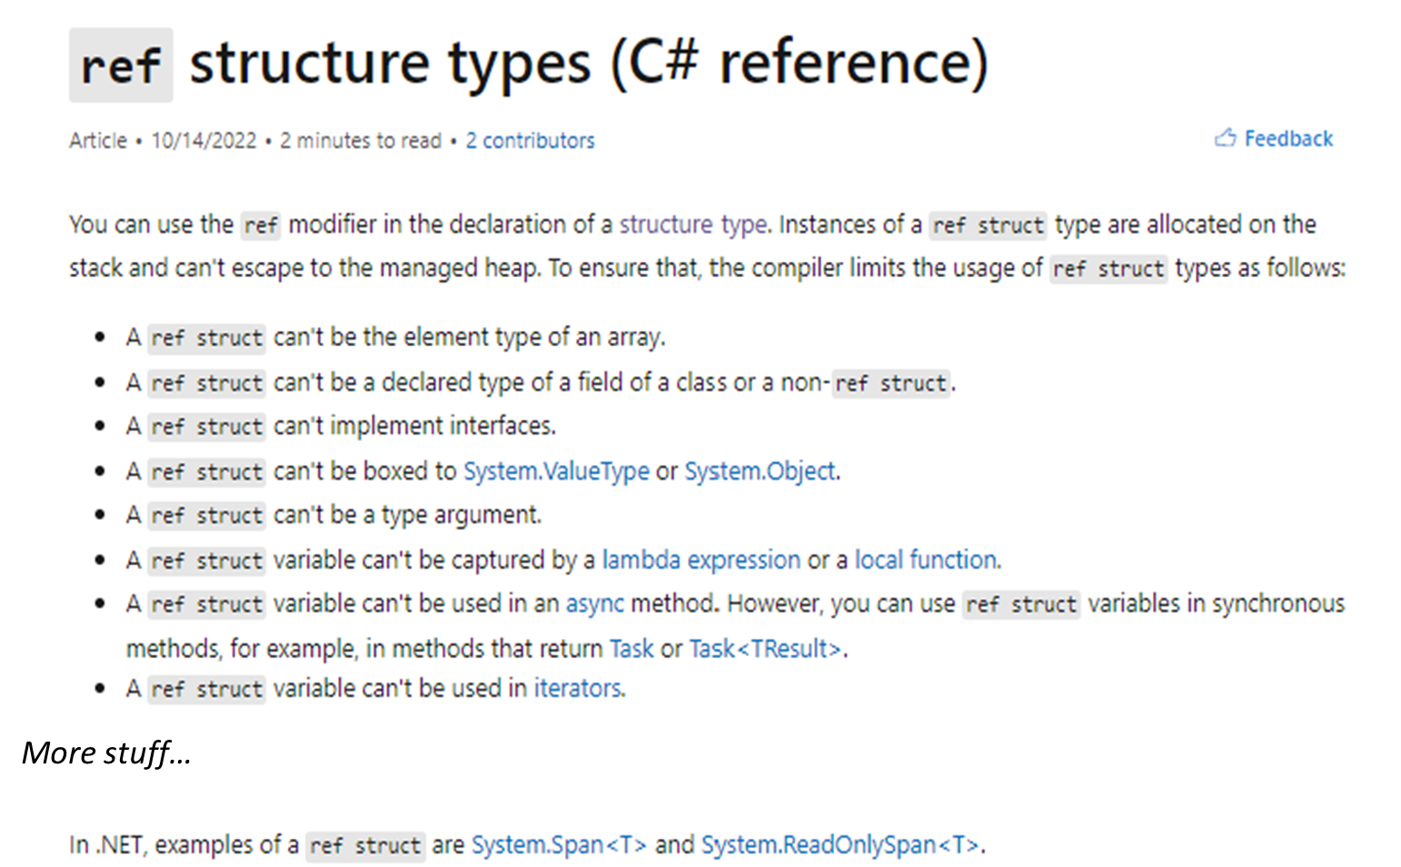
Take time to learn about ref struct and other unsafe guardrails if you plan to use it
- ref struct types - C# reference | Microsoft Learn

Slide 45
Classes, structs and records
Demo first

Slide 46
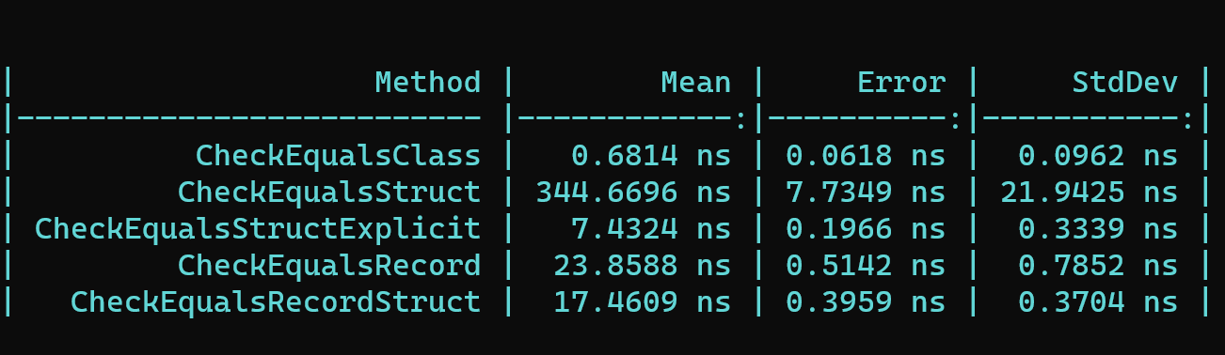
Classes, Records, Structs, oh my!
This is a casual benchmark to show the big differences – orders of magnitude
This is not evidence for difference differences in the value equality.

Slide 47
References
More on heap and stack details (not ref struct): Understanding the Stack and Heap in C# | endjin - Azure Data Analytics Consultancy UK

