Slide 1

Debugging and Light Profiling
Kathleen Dollard
Principal Project Manager, Microsoft
@KatheenDollard

Slide 2


Slide 3
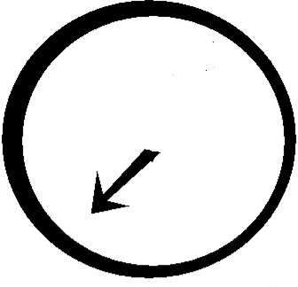


Notes:
Once upon a programmer was looking forward to the weekend

Slide 4
Notes:
He had big plans and all the applications he was responsible for were running smoothly

Slide 5
Notes:
Then the phone rang

Slide 6
Notes:
And all his great plans, were blown away

Slide 7
Notes:
He was very sad

Slide 8
Notes:
It didn’t matter whether he had been part of the initial design, but statistically he wasn’t

Slide 9
Notes:
He was frustrated

Slide 10
Notes:
And confused

Slide 11
Notes:
He was even rather angry

Slide 12
Notes:
And I’m sorry to say he used bad words

Slide 13
Notes:
And wondered why he thought programming was a good career choice

Slide 14
Notes:
He did consider… running away, but he actually liked his job

Slide 16
Game of strategy with rules set by by the computer, your debugger, and requirements or user expectations
You may enter the contest expecting a trivial opponent, only to find it like Hydra with two new problems sprouting for each one you solve
It’s a critical game because we fix bugs from the time we first check in code, and the cost of each bug tends to increase across the project lifecycle

Slide 17
Introduction
Debugging Strategy
Scientific method
Light Profiling
Demos will be in Visual Studio 2022
There is a typo in the abstract
Debugging part is the same, profiling is different

Slide 18
Don’t Make Bugs
Use decimal not floating points
Talk Tursday at 12:00
Know where conversions happen
Recognize O(n) algorithms
Caution with integer division
Use system methods for date time calcs
Caution with overloads/ override rules
Cry over timezones

Slide 19
Bug?
Something you have to fix in existing code

Slide 20
You begin fixing bugs during development and continue throughout the
Feature A

Slide 21

You begin fixing bugs during development and continue throughout the
Feature A

Slide 22
You begin fixing bugs during development and continue throughout the
Feature A
Kill bug

Slide 23
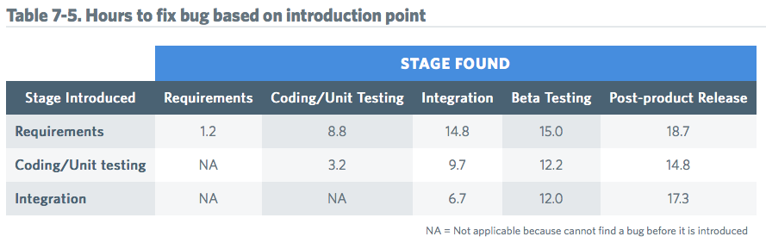
3 to 5 times more expensive
Source: http://www.nist.gov/director/planning/upload/report02-3.pdf via http://blog.fullstory.com/2016/04/code-reviews-arent-just-for-catching-bugs

Slide 24
Test Driven Debugging
A bug in the wild is always an indication of two bugs
The bug itself
The bug in testing that allowed it to get into the wild
Fix the second bug first
Write a failing test to reproduce the problem
Fix the bug, prove it with a test

Slide 25
Code is hard to debug when you can’t read the code
Code is hard to debug when the symptom is distant from the problem in time or space
Code is hard to debug when the context causing the bug is transitory or inconsistent
Code is hard to debug when someone gave you
Incorrect or misleading information
Bugs due to threading and other special cases

Slide 26

What’s the most important debugging tool you have?

Slide 27

?
What’s the most important debugging tool you have?

Slide 28

What’s the most important debugging tool you have?

Slide 29
Strategy

Slide 30
Debugging Strategies
Divide & Conquer
Scientific Method.
A good debugging strategy is any strategy you can articulate and repeat

Slide 31
Debugging Strategies
Scientific Method.
Divide & Conquer
A good debugging strategy is any strategy you can articulate and repeat

Slide 32
Scientific Method Debugging
Repro, think, write test
Something Happens
Create several hypotheses
Can you repro?
Select one to disprove
Yes
Run experiment
Outside production?
Evaluate

Slide 33
Scientific Method Walkthrough
Web front end using Razor
WebAPI back end getting data from a SQL database
User reports that the zip code is missing when they retrieve data

Slide 34
Collaborative Debugging Game
One person imagines a bug. Be VERY specific. Know exactly the broken code and exactly what would happen and write it down
Helps if it’s a bug you’ve stumbled with
Everyone else works together to solve the bug by asking what would happen if they ran certain VERY specific tests
The person imagining the bug may well make mistakes. Be patient. You’ll also make mistakes and go down rabbit holes in the real world.
Take turns imagining the bug

Slide 35
Scientific Method Debugging
Repro, think, write test
Something Happens
Create several hypotheses
Can you repro?
Select one to disprove
Yes
Run experiment
Outside production?
Evaluate

Slide 36
Scientific Method Debugging
Something Happens
Repro, think, write test
Can you repro?
Create several hypotheses
No
Yes
Select one to disprove
Outside production?
Run experiment
Evaluate

Slide 37
Logging
is not optional
Semantic logging greatly preferred

Slide 38

Profiling (light)

Slide 39
Profiling
Do you use a profiling tool?
Do you know how to use one?
Do you believe you will never have a performance problem?
Are you planning on hiring an expert?
Notes:
App with performance issue
Use Diagnostic tools for a quick and dirty view of issues
Check for a lot of GC or memory or CPU problems
Since that didn’t help us…
Open Debug/Performance Profiler
Select CPU
Open the session
In this case, we don’t need details to start finding the problem, but check them anyway
The number is the number of samples that where in that callstack. Percent is most interesting
Call tree gives details on execution paths
Total includes called functions and gives idea of expensive paths
Self is within functions and indicates what is expensive
Functions helps you find expensive functions called from lots of places
Total includes called functions and gives idea of expensive paths
Self is within functions and indicates what is expensive
Caller/Callee let’s you jump around
Flame graph is visual
Note there was an inline optimization

Slide 40
Demo

Slide 41
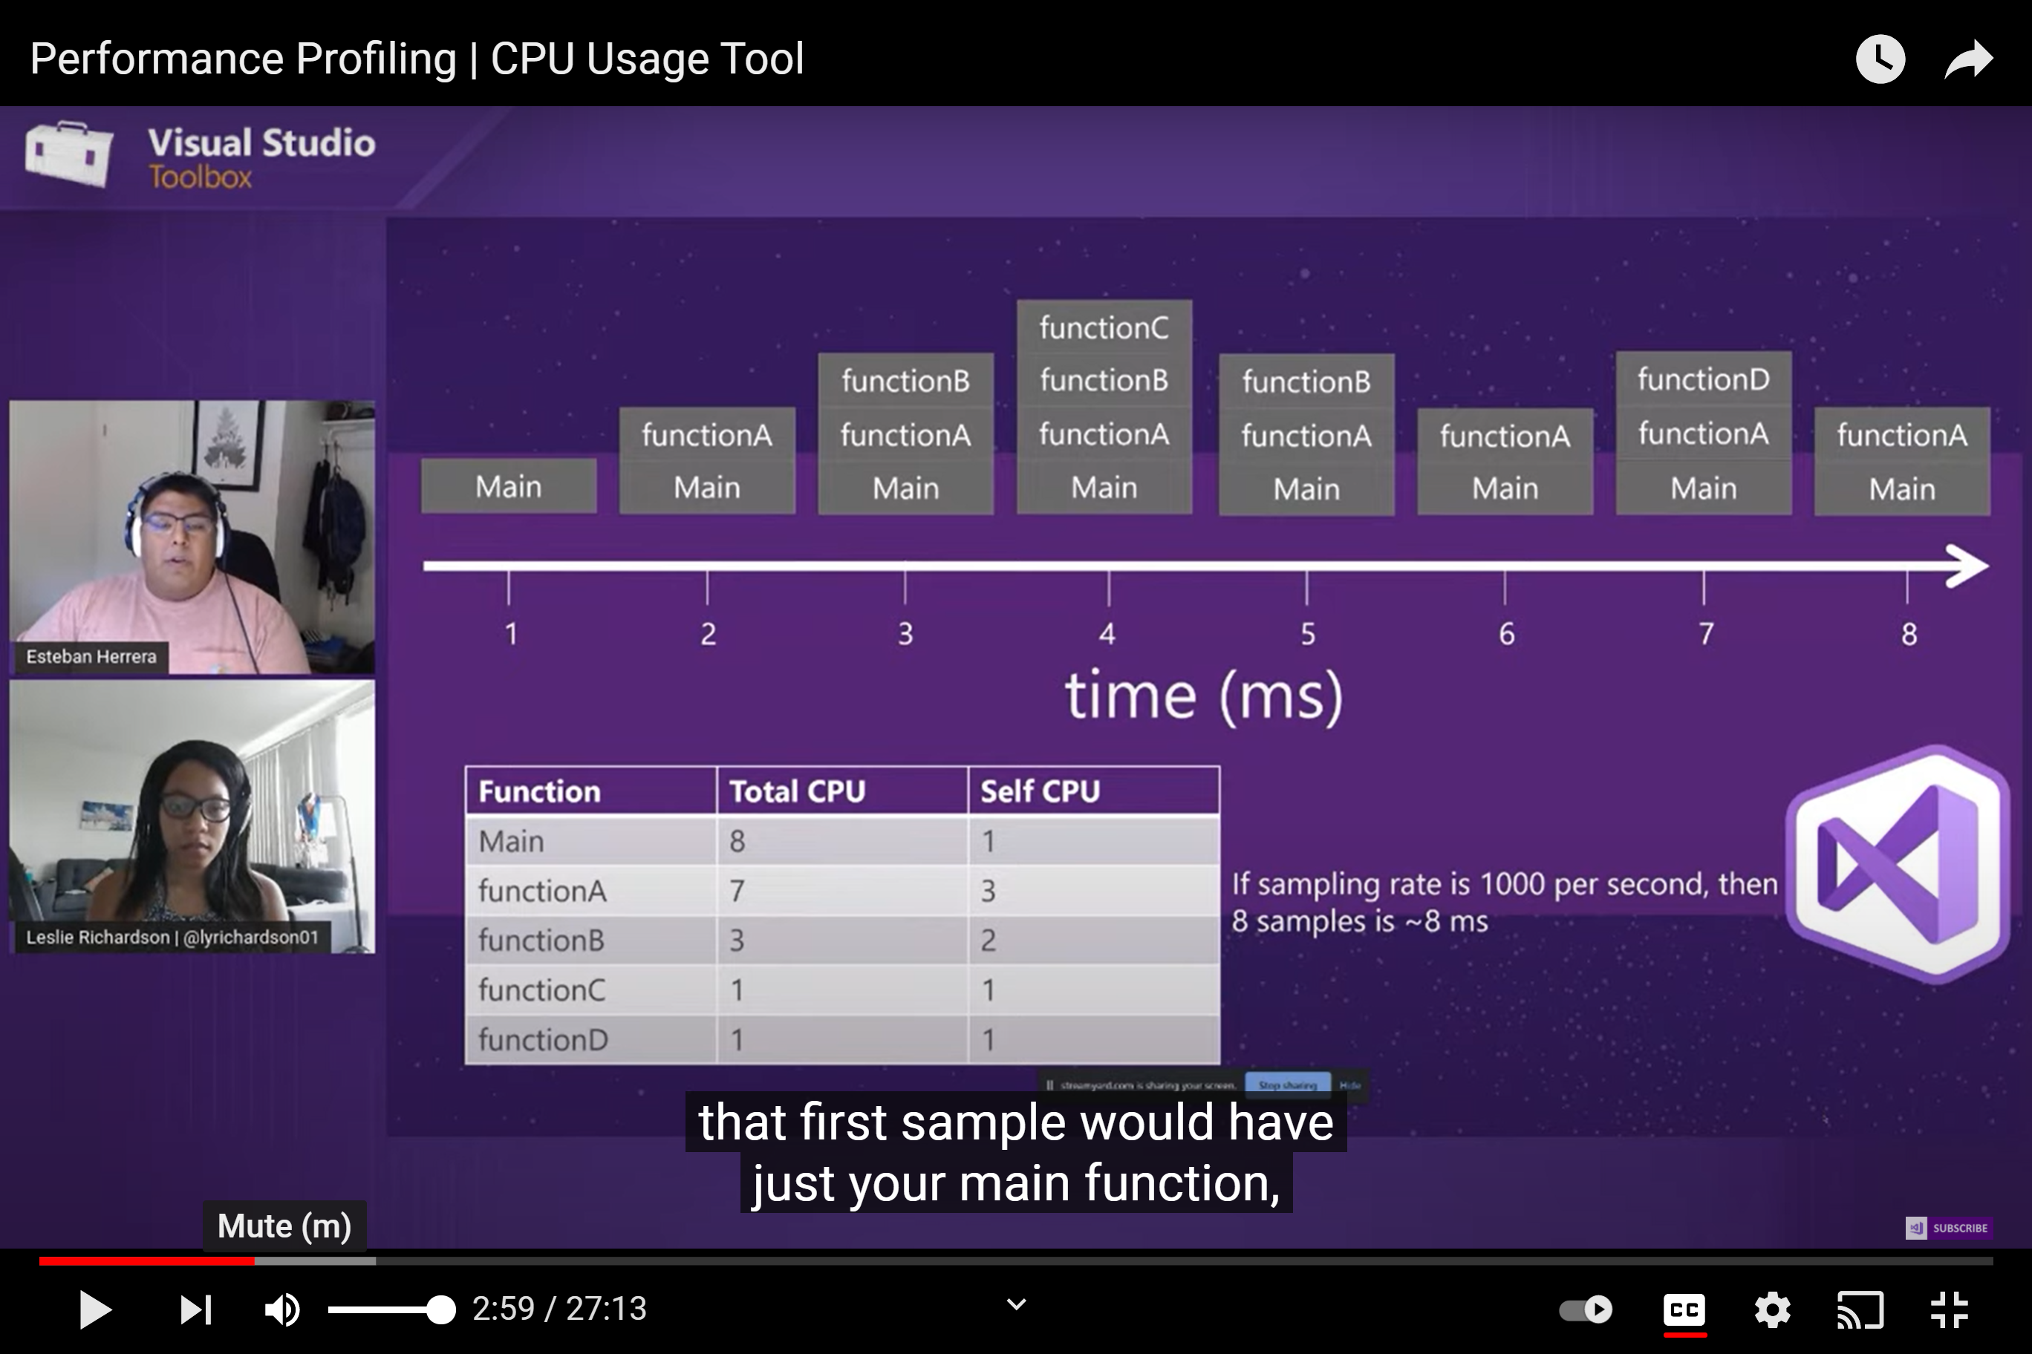
Performance Profiling | Part 1 An Introduction – YouTube
.NET Toolbox with Leslie Richardson

Slide 42
When to profile with Show Diagnostic Tools?
During debugging – quick and dirty
Default set of tools
Can limit to section between breakpoints
When to profile with Performance Profiler?
More accurate (no debugging overhead)
Pick your tools, more tools

Slide 43
Review
Debugging
The most important debugging tool is you and your team’s brains
Have a strategy and use it – move fast and be smart
Profiling
The tools are incredibly easy to get started with

Slide 44
Thank you!
@KatheenDollard
Don’t forget to complete an online evaluation
Debugging and Light Profiling
Your evaluation helps organizers build better conferences and helps speakers improve their sessions.

