Slide 1
C# 13 and Beyond
This talk is about
Tomorrow’s talk is how to effectively use C# today (C# 12 and below)
Kathleen Dollard
.NET Languages, Microsoft

Slide 2
Changes in communicating new features
Push to docs over blogs for how to use new features
Docs pushes how to use new features to permanent location
What’s new is a reference to new features
Blogs advertise new features
Feature status is a more reliable source of truth
Similar changes happening for communicating new .NET features

Slide 3
C# 13 features
Escape character
Method group natural type improvements
Lock object
Implicit indexer access in object initializers
Params-collections
Ref/unsafe in iterators/async
allows ref struct constraint
Overload Resolution Priority (for library authors and advanced scenarios)
Partial properties
Ref Struct Interfaces

Slide 4
ref struct
You are very happy the .NET Libraries (BCL) use them
Your app probably does not need them
They require an investment in understanding, and a commitment to resolving warnings
Mistakes can crash your app/make it unstable
But it’s awesome if you are using it to replace unsafe code
Span<T> is often a safer/better choice
We keep investing in it because this and similar work has contributed significantly to our ongoing performance improvements

Slide 5
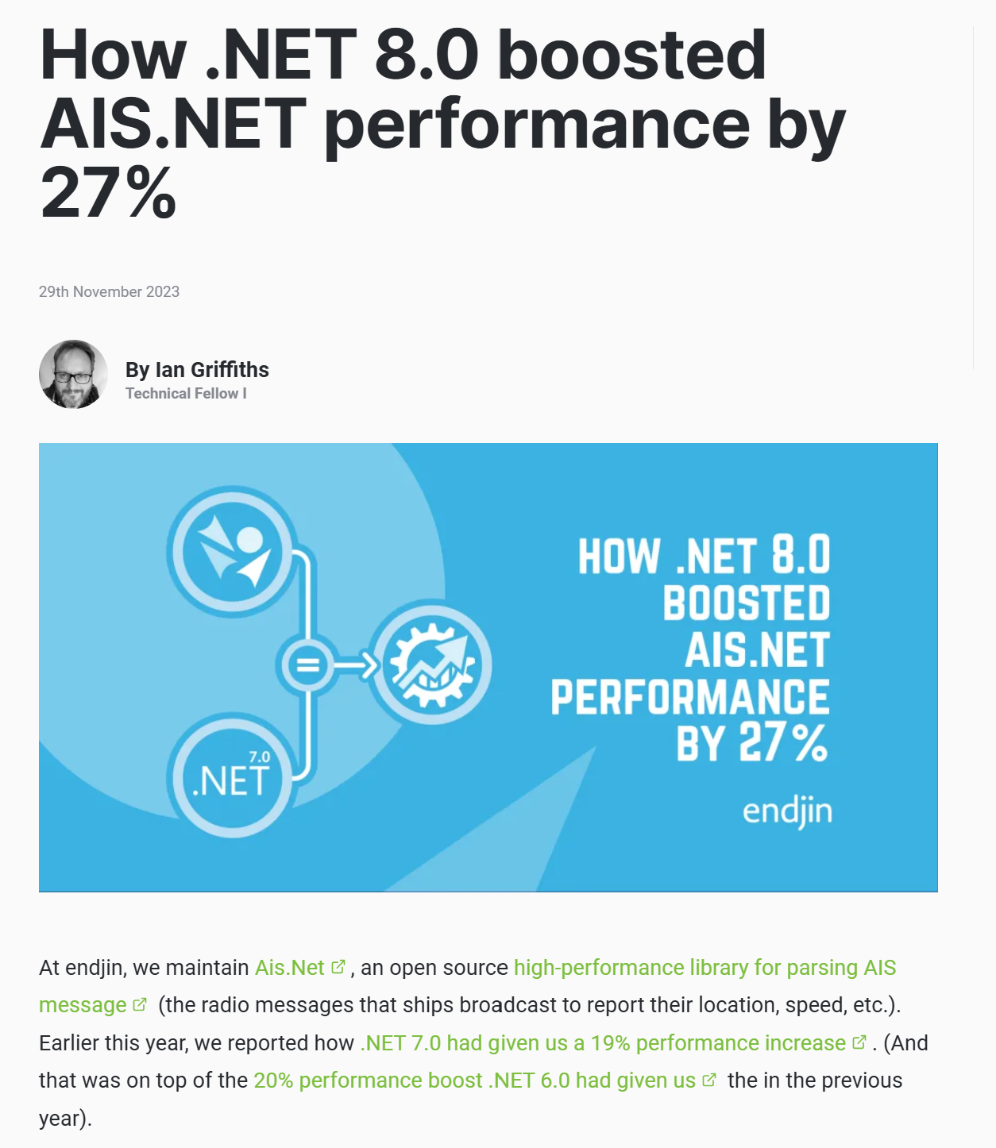


Just about doubling perf!
- https://endjin.com/blog/2023/11/how-dotnet-8-boosted-ais-dotnet-performance-by-27-percent-for-free

Slide 6
C# 13 action items (current list, may be updated)
Search for field (case sensitive, whole word)
Consider renaming
Search for lock
Replace any lock on object with locks on the System.Threading.Lock
Search for .ToArray() being used to support params
Consider updating your API
Search for \x001b (with varying numbers of 0)
Replace with \e
Explore replacing unsafe blocks with safer alternatives

Slide 7
And beyond…

Slide 8
Field access in properties
What we are currently planning for C# 14, possibly C# 13 (note that plans can change)
public string Name { get; set => field = value.Trim(); }
You can access the backing field of an auto-property
Can be multi-line
Useful for DI
Breaking change (next slide)
We anticipate releasing field access as a preview feature available within C# 13/.NET 8
Delay is to get the breaking change strategy correct
public string Xyz
{
get;
set
{
if (field == value) return;
field = value;
OnXyzChanged();
}
}
Proposal: `field` keyword in properties · Issue #140 · dotnet/csharplang (github.com)

Slide 9
Field access is a breaking change
What we are currently planning for C# 14, possibly C# 13 (note that plans can change)
Breaking change because within the code of a property, field means the backing field, even if there is another field in scope
Access the class field with this. or @
We will introduce a breaking change system along with this feature
We anticipate you will get extra warning when you upgrade your SDK if you use field
The breaking change mechanism is to let you silence those warnings

Slide 10
Dictionary expressions Like type expressions, but for dictionaries
What we are currently hoping to include in C# 14 (note that plans can change)
public void Example()
{
var folks Dictionary<string, int> _nameToAge =
[
"Kathleen": 21,
"Dustin": 22,
"Mads": 23,
];
Console.WriteLine(string.Join(Environment.NewLine,
_nameToAge
.Select(x => $"{x.Key} is {x.Value}")));
}
[Proposal]: Dictionary expressions · Issue #7822 · dotnet/csharplang (github.com)

Slide 11
Extensions types Like extension methods, they enhance the API
What we are thinking about, and might add to C# in the future
Implicit extension types
Do more with extensions, like extension methods, but more
Properties, static methods, and static properties
Perhaps, indexers and operators
Maybe, interfaces and inheritance for extension reuse
Explicit extension types – aka Roles
Disambiguation (resolve naming collisions)
Roles – only when requested to include the extensions
Key point of the demo is that not all options are ComparableSymbols, but if they are declared to be, they get extra methods and properties
[Proposal]: Extensions · Issue #5497 · dotnet/csharplang (github.com)

Slide 12
Discriminated Unions Yes, we are working on designs, but it will take a while
What we are thinking about, and might add to C# in the future
Four types
Standard or class union (F# like)
Special or struct union
Ad hoc or anonymous (TypeScript like)
Custom unions
Requirements
It has to feel like C# (not feel bolted on)
We want it to be performant with good memory usage
Anonymous unions are challenging
csharplang/proposals/field-keyword.md at main · dotnet/csharplang (github.com)

Slide 13
Standard or class union
What we are thinking about, and might add to C# in the future
Declaration
union U
{
A(int x, string y);
B(int z);
C;
}
Construction
U u = new A(10, "ten");
Deconstruction
if (u is A a) { ... }
if (u is A(var x, var y))
{ ... }
if (u is A { y: var y })
{ ... }

Slide 14
Special or struct union
What we are thinking about, and might add to C# in the future
Declared and used much like a class union
Declaration would include struct
Memory footprint may be sum of members
Type test use special features
Boxing creates a boxed union, which must be unboxed
ref unions may be allowed

Slide 15
Ad hoc or anonymous unions
What we are thinking about, and might add to C# in the future
Deconstruction
if (u is A a) {...}
// Or may look just like standard
if (u is A(var x, var y)) { ... }
Equivalence
(A or B) x = new A(10, "ten");
(B or A) y = x;
And possibly, assignability
(A or B) x = new A(10, "ten");
(A or B or C) y = x;
Declaration
(A or B or C)
global using U = (A or B or C);
Construction
record A(int x, string y);
record B(int z);
record C() {
public static C Singleton =
new C(); };
(A or B or C) u = new A(10, "ten");

Slide 16
Custom unions
What we are thinking about, and may or may not implement
Declaration (note these are not nested, they could probably be records)
[Closed]
public class U { ... }
public class A(int x, string y) : U { ... }
public class B(int z) : U { ... }
What scope would you want: file or assembly?

Slide 17
Questions on Discriminated Unions Email me, or even better discuss at https://github.com/dotnet/csharplang/
What are your scenarios?
Feel free to send many or explain how they align with the four types
Do allocations matter more than usability in unions?
Does memory footprint matter more than usability in unions?
Does the deconstruction in TollCalculator make sense?
If you add a new member to your union, do you expect using code to break?
Example: Uncommenting DeliveryTruck would break TollCalculator if exhaustiveness was enforced
Are there other things – maybe enums – that you wish were exhaustive?

Slide 18
Thank you!
kdollard@microsoft.com
https://github.com/KathleenDollard/devintersection-2024-csharp13
Docs:
https://learn.microsoft.com/dotnet/csharp/whats-new/csharp-13
Docs philosophy is to add new features in permanent location
C# design:
https://github.com/dotnet/csharplang
Implementation:
https://aka.ms/csharp-feature-status
.NET blog
https://devblogs.microsoft.com/dotnet

