Slide 1
Debugging
Kathleen Dollard
Principal Program Manager, Microsoft
kathleen.dollard@microsoft.com

Slide 2



Notes:
Once upon a programmer was looking forward to the weekend

Slide 3
Notes:
He had big plans and all the applications he was responsible for were running smoothly

Slide 4
Notes:
Then the phone rang

Slide 5
Notes:
And all his great plans, were blown away

Slide 6
Notes:
He was very sad

Slide 7
Notes:
It didn’t matter whether he had been part of the initial design, but statistically he wasn’t

Slide 8
Notes:
He was frustrated

Slide 9
Notes:
And confused

Slide 10
Notes:
He was even rather angry

Slide 11
Notes:
And I’m sorry to say he used bad words

Slide 12
Notes:
And wondered why he thought programming was a good career choice

Slide 13
Notes:
But mostly he didn’t know what to do because he could not reproduce the bug in Visual Studio

Slide 14
Notes:
He did consider… running away, but he actually liked his job

Slide 15
Bug?
Something you have to fix in existing code

Slide 16
Code is hard to debug when you can’t read the code
Code is hard to debug when the symptom (issue) is distant from the problem (bug) in time or space
Code is hard to debug when the context causing the bug is transitory
Code is hard to debug when someone gave you incorrect or misleading information

Slide 17
Debugging Strategies
Divide and Conquer
Scientific Method
A good debugging strategy is any strategy you can articulate and repeat

Slide 18
A Debugging Strategy Scientific Method
Repro, think, write test
Something Happens
Can you repro in Visual Studio?
Create several hypotheses
Yes
Select one to disprove
Run experiment
Evaluate

Slide 19
Scientific Method Walkthrough

Slide 20
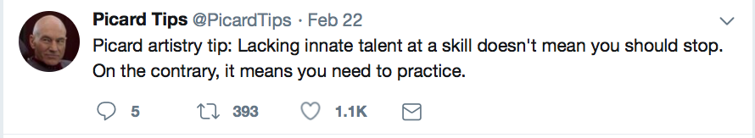

Slide 21
Collaborative Debugging Game
One person imagines a bug. Be VERY specific. Know exactly the broken code and exactly what would happen
Helps if it’s a bug you’ve stumbled with
Everyone else works together to solve the bug by asking what would happen if they ran certain VERY specific tests
The person imagining the bug may well make mistakes. Be patient. You’ll also make mistakes and go down rabbit holes in the real world.
Take turns imagining the bug

Slide 22
A Debugging Strategy Scientific Method
Same thing?
Repro, think, write test
Something Happens
but harder
Can you repro in Visual Studio?
Create several hypotheses
No
Yes
Select one to disprove
Run experiment
Evaluate

Slide 23
Your skill keeps bug in correct quadrant
OMG!
High Value
Typo in company name
Privacy or Data Loss
Easy
Hard
$
Many performance issues
Ordinary Typo
Low Value
Oh well

Slide 24
Get help with high value bugs!
That was why you practiced!
Concentrate on hypotheses and work in parallel groups
If you’re stuck expand the circle
John Robbins consults

Slide 25
Light Profiling

Slide 26
Before you use Visual Studio Debugging/Profiling, download symbols
Ctl Q and type “Symbol”
Set cache, hit load, and get some tea

Slide 27
Before using VS to debug a project, set Debugging Information to full
Project Properties/Build/Advanced

Slide 28
Profiling Experiment

Slide 29
Profiling Visual Studio 2019
Debug/Performance Profiler
For performance, generally CPU
Check startup, then Start
Explore the different outputs
Consider Details/Tree to search for hot paths

Slide 30

Thank you! https://github.com/KathleenDollard/talks-debugging @KathleenDollard
Debugging is a game of strategy.
The rules are set by the computer, your debugger, and requirements or user expectations.
You may enter the contest expecting a trivial opponent, only to find it like Hydra with two new problems sprouting for each one you solve.
It’s a critical game because we fix bugs from the time we first check in code, and the cost of each bug tends to increase across the project lifecycle.
Practice profiling, it’s FUN!

