Slide 1
Async
Become a better C# programmer 2019 Edition
Kathleen.Dollard@Microsoft.com

Slide 2
An Async Restaurant
Notes:
As a concept, we’ll use the tasks that are part of making a breakfast to illustrate the difference between sync, async, and parallel programming.
Some of the code in the simulation is stubbed out, but it still illustrates the concepts.

Slide 3






Dining room tasks for staff
Greet customers and put them on table wait list
Seat customers at their tables with menus
Take and deliver orders ( , , , ,and )
Deliver food & drinks
Deliver check
Get payment
Clean and prep table
Notes:
This lists the tasks necessary to make the breakfast.
Key concept: Some of these tasks require work of a person.
Some are started by a person, and then complete (toasting the bread, cooking the eggs)
Some have steps (bacon needs to be flipped occasionally)

Slide 4


Synchronous
Asynchronous
Parallel
One waiter performs each task in sequence.
Six waiters, each serving one table
One waiter starts a task. Begins next while awaiting.
Notes:
This is a key concept for the talk. Take time. Walk through each of the three scenarios. Imagine a person represents a CPU.
Synchronous: One person does each task in order. That person waits (synchronously blocking) for each task to finish. Breakfast takes longer to make, and when everything is done, some of the first items are cold. You get breakfast later, and it’s not what you wanted. We can do better.
Parallel: You can get a hot breakfast by making these tasks run in parallel. One person does each breakfast item (bacon, eggs, toast, coffee & oj). But, that is expensive. Use that analogy for cloud services, and your cloud based program needs many more resources (CPUs) to scale than it should. Too many CPUs are blocked, waiting for the next task. The point is not that parallel programming is bad. Rather, programming and async are not the same: parallel programming is for CPU bound tasks.
Asynchronous: One person makes breakfast. Work does not stop waiting for tasks to complete. Rather, the cook is notified when an action is required.

Slide 5
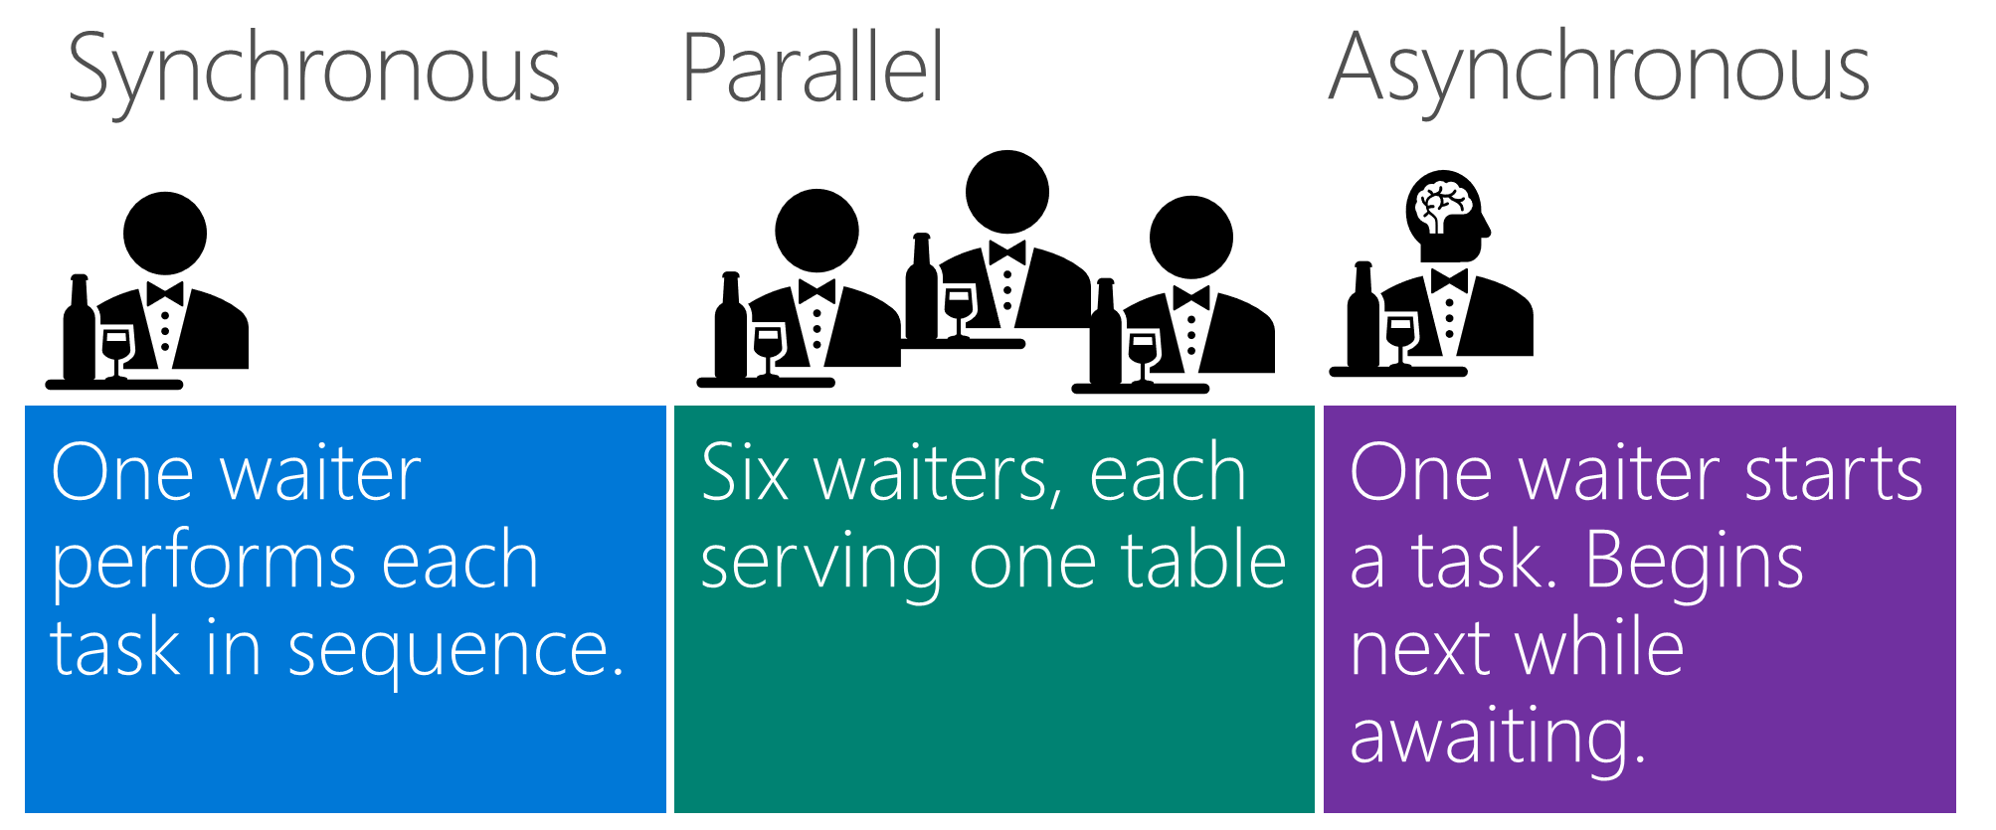
Which is fastest for first customer?
Second through sixth customer?
Which scales?
What happens when a rude table monopolizes waiter?

Slide 6
An Async Kitchen Concurrent Async
Notes:
As a concept, we’ll use the tasks that are part of making a breakfast to illustrate the difference between sync, async, and parallel programming.
Some of the code in the simulation is stubbed out, but it still illustrates the concepts.

Slide 7
Breakfast means many tasks
Pour a cup of coffee
Fry two eggs
Fry three slices of bacon
Toast two pieces of bread
Add butter and jam to toast
Pour orange juice
Notes:
This lists the tasks necessary to make the breakfast.
Key concept: Some of these tasks require work of a person.
Some are started by a person, and then complete (toasting the bread, cooking the eggs)
Some have steps (bacon needs to be flipped occasionally)

Slide 8
Synchronous, Parallel, Asynchronous
One cook performs each task in sequence. The next begins when previous completes.
Six cooks work on breakfast. Each performs one task.
One cook starts a task. Starts next while awaiting the previous.
Notes:
This is a key concept for the talk. Take time. Walk through each of the three scenarios. Imagine a person represents a CPU.
Synchronous: One person does each task in order. That person waits (synchronously blocking) for each task to finish. Breakfast takes longer to make, and when everything is done, some of the first items are cold. You get breakfast later, and it’s not what you wanted. We can do better.
Parallel: You can get a hot breakfast by making these tasks run in parallel. One person does each breakfast item (bacon, eggs, toast, coffee & oj). But, that is expensive. Use that analogy for cloud services, and your cloud based program needs many more resources (CPUs) to scale than it should. Too many CPUs are blocked, waiting for the next task. The point is not that parallel programming is bad. Rather, programming and async are not the same: parallel programming is for CPU bound tasks.
Asynchronous: One person makes breakfast. Work does not stop waiting for tasks to complete. Rather, the cook is notified when an action is required.

Slide 9
Demo

Slide 10
Cook Breakfast Synchronously
static void Main(string[] args)
{
Coffee cup = PourCoffee();
Egg eggs = FryEggs(2);
Bacon bacon = FryBacon(3);
Toast toast = ToastBread(2);
ApplyButter(toast);
ApplyJam(toast);
Juice oj = PourOJ();
Console.WriteLine("Breakfast is ready!");
}
Notes:
This is the intro to the demo. This is one representation of the code would look like.

Slide 11
Make Breakfast Asynchronously
Notes:
See demo1.md

Slide 12
Cook Breakfast Asynchronously
static async Task Main(string[] args)
{
Coffee cup = PourCoffee();
var eggsTask = FryEggsAsync(2);
var baconTask = FryBaconAsync(3);
var toastTask = makeToastWithButterAndJamAsync(2);
var eggs = await eggsTask;
var bacon = await baconTask;
var toast = await toastTask;
Juice oj = PourOJ();
async Task<Toast> makeToastWithButterAndJamAsync(int number)
{
var plainToast = await ToastBreadAsync(number);
ApplyButter(plainToast);
ApplyJam(plainToast);
return plainToast;
}
}
Notes:
Conclusion of the first demo: The *structure* of the code looks very similar. Squint and ignore the awaits, and it looks like synchronous code. The *execution* path is very different though.
Now, your breakfast is hot, and it is ready sooner.

Slide 13
Barista (new scenario)
Constantly working on coffee till its done
Any value to async?
Gets orders from online or human queue
Any value to async?
Waiter taking coffee orders at tables
Any value to async?
Queue is similar to ASP.NET/web world
Waiter is similar to desktop
Respond even if no one gets their coffee faster

Slide 14
Waiter! (as in server)
Takes order
Gives it to the kitchen
Kitchen does what we discussed
Picks up order and carries it to the table
Should the server wait or awat?
This is why async is “viral” – async everywhere

Slide 15
Different environments
Desktop
Responsive
Free up the single UI thread
Resume on UI thread
Rarely, if ever, Task.Result
USE THREADS for simultaneously CPU intensive operations
Server
Throughput
Don’t have bored threads
Resume wherever
Rarely, if ever, Task.Result
DO NOT USE THREADS unless you have two simultaneously CPU intensive operations

Slide 16
Best practices for async (Stephen Cleary, see references)
Name | Description | Exceptions
Avoid async void | Prefer async Task methods over async void methods | Event handlers
Async all the way | Don’t mix blocking and async code | Console main method
Configure context | Use ConfigureAwait(false) when you can | Methods that require con­text

Slide 17
Best practices for async (Stephen Cleary, see references)
To Do This … | Instead of This … | Use This
Retrieve the result of a background task | Task.Wait or Task.Result | await
Wait for any task to complete | Task.WaitAny | await Task.WhenAny
Retrieve the results of multiple tasks | Task.WaitAll | await Task.WhenAll
Wait a period of time | Thread.Sleep | await Task.Delay

Slide 18
References
Task asynchronous programming model
https://docs.microsoft.com/dotnet/csharp/programming-guide/concepts/async/task-asynchronous-programming-model
Control flow in async programs (C#)
https://docs.microsoft.com/dotnet/csharp/programming-guide/concepts/async/control-flow-in-async-programs
Async/Await - Best Practices in Asynchronous Programming
Stephen Cleary, MSDN Magazine, March 2013
https://msdn.microsoft.com/en-us/magazine/jj991977.aspx?f=255&MSPPError=-2147217396
Psychic debugging: Stephen Toub
https://devblogs.microsoft.com/pfxteam/psychic-debugging-of-async-methods/

