Slide 1
Become a Better C# Developer Techorama 2019, Netherlands
Kathleen Dollard
Microsoft
Kathleen.dollard@Microsoft.com
https://github.com/kathleendollard `

Slide 2
Abstract
You’re an intermediate to advanced C# programmer excited about attending a conference filled with cutting edge talks from amazing speakers. It’s important to stay up to date, but you keep wondering if you’re effectively using new features and fundamental aspects of C# and .NET. You’ll learn more about the type system. Along with its garbage collector it remains the foundation of all variations of .NET. You’ll also see how delegates have evolved while remaining one of the most important building blocks. You’ll see a sampling of ways that C# and the .NET can surprise you, in possibly unpleasant ways. You’ll look back at effectively using generics, how to use new generic constraints, type hierarchies, and the complex signatures that can result from tuples and functional techniques. You’ll get a guided tour through the async and await wilderness. You'll start with basic uses where async and await work like magic. From there, you'll learn common practices and how async tasks compose. You'll dive into enough of the implementation details to understand how to apply async practices. After working through these different practices, you'll emerge from the wilderness understanding how to write clear, correct and safe async code. You’ll explore how features in recent versions of C# work together to significantly simplify code. You’ll learn how to use pattern matching to apply algorithms to multiple and diverse objects, how string interpolation makes formatting strings much easier and clearer, how to create compound assignments and comparisons using Tuples and Deconstruction and how to simplify iterators and async error handling using local functions Throughout the day the focus is on how you can use these features and techniques to make the code you write better – more reliable, easier to comprehend, and better performing.

Slide 3
DEMO
Review
Code
Code under review

Slide 4


Slide 5

Intermediate to Advanced
We all know more about some things and less about others
We always wonder what we’re missing
New learning “sticks” better in the context of fundamentals
I hope this workshop will be a great opening to the conference
But you’ll forget a lot by Monday
Link to materials at end of day
This Photo by Unknown Author is licensed under CC BY-SA

Slide 6

Agenda
Future of .NET
How C# can surprise you
Async
Recent features
This Photo by Unknown Author is licensed under CC BY

Slide 7
.NET Schedule
Dec 2018
.NET Core 2.2
Sept 2019
.NET Core 3.0
.NET Core 3.0 released September 23

Slide 8
Get more info at

Slide 9

Announcing .NET Conf 2019
Watch the videos!!
Save the date!
Beth TODO

Slide 10
Schedule and determining version right for you

Slide 11
.NET Schedule
Dec 2018
.NET Core 2.2
Sept 2019
.NET Core 3.0
Nov 2019
.NET Core 3.1
LTS
Nov 2020
.NET 5.0
Nov 2021
.NET 6.0
LTS
Nov 2022
.NET 7.0
Nov 2023
.NET 8.0
LTS
.NET Core 3.0 released September 23
.NET Core 3.1 - Long term support (LTS)
.NET 5.0 release planned for November 2020
Major releases every year, LTS for even numbered releases
Predictable schedule, minor releases if needed

Slide 12
LTS Support - 3 years from release
Dec 2018
.NET Core 2.2
Sept 2019
.NET Core 3.0
Nov 2019
.NET Core 3.1
LTS
Nov 2020
.NET 5.0
Nov 2021
.NET 6.0
LTS
Nov 2022
.NET 7.0
Nov 2023
.NET 8.0
LTS
.NET Core 2.2 (until Dec 23, 2019)
.NET Core 2.1 (3 years from LTS declaration 8/21/2018)
.NET Core 3.0 (3 months after 3.1)
.NET Core 3.1 (3 years from release)
.NET Core 5.0 (3 months after next, including point releases)
.NET Core 6.0 (3 years from release)
Commitment is at
https://dotnet.microsoft.com/platform/support/policy/dotnet-core

Slide 13
LTS for Runtime
Dec 2018
.NET Core 2.2
Sept 2019
.NET Core 3.0
Nov 2019
.NET Core 3.1
LTS
Nov 2020
.NET 5.0
Nov 2021
.NET 6.0
LTS
Nov 2022
.NET 7.0
Nov 2023
.NET 8.0
LTS

Slide 14
Schedule and determining version right for you
Current is a good place to be
LTS is for where/when you need it

Slide 15
Roadmap - .NET 5.0

Slide 16
The .NET Roadmap
Many
.NETs
2014
.NET FRAMEWORK
.NET CORE
XAMARIN / MONO
Runtime
Runtime
Runtime
Base class library
Core library
Mono class library

Slide 17
The .NET Roadmap
Many
.NETs
.NET
standard
2014
2016
.NET FRAMEWORK
.NET CORE
XAMARIN / MONO
Runtime
Runtime
Runtime
Base class library
Core library
Mono class library
.NET STANDARD

Slide 18
Introducing .NET 5
The .NET Roadmap
Many
.NETs
.NET
standard
.NET
2014
2016
Next
.NET FRAMEWORK
.NET CORE
.NET
XAMARIN / MONO
Runtime
Runtime
Runtime (JIT & native)
Runtime
Core library
Base class library
One base class library
Mono class library
.NET STANDARD

Slide 19
Introducing .NET 5
The .NET Roadmap
Many
.NETs
.NET
standard
.NET
2014
2016
Next
.NET FRAMEWORK
.NET CORE
.NET
XAMARIN / MONO
Runtime
Runtime
Runtime (JIT & native)
Runtime
Core library
Base class library
One base class library
Mono class library
.NET STANDARD
.NET STANDARD

Slide 20
LTS Support - 3 years from release https://dotnet.microsoft.com/platform/support/policy/dotnet-core
Dec 2018
.NET Core 2.2
Sept 2019
.NET Core 3.0
Nov 2019
.NET Core 3.1
LTS
Nov 2020
.NET 5.0
Nov 2021
.NET 6.0
LTS
Nov 2022
.NET 7.0
Nov 2023
.NET 8.0
LTS
.NET Core 2.2 (until Dec 23, 2019)
.NET Core 2.1 (3 years from LTS declaration 8/21/2018)
.NET Core 3.0 (3 months after 3.1)
.NET Core 3.1 (3 years from release)
.NET Core 5.0 (3 months after next, including point releases)
.NET Core 6.0 (3 years from release)
.NET Framework 4.8 (Windows support policy)

Slide 21
.NET 5
Evolution of .NET Core, adding the best of Mono into one platform
One BCL implementation, still adheres to .NET Standard
One toolchain (SDK style projects)
Both Just-in-Time (JIT) and native models supported
Interop with Java and Swift

Slide 22
Most things are in .NET Core and Framework
Adding .NET Framework features to .NET Core is done
.NET Core features will grow

Slide 23
What is not in .NET Core?
Web forms, WCF server and Windows workflow remain on .NET Framework 4.8 only. There are no plans to port these.
Recommendations
ASP.NET Blazor for ASP.NET Web forms
gRPC for WCF server and remoting
And watch the Open Source project in .NET Foundation
Open source core workflow for Windows workflow (WF): https://github.com/UiPath/corewf

Slide 24











.NET—A unified platform
TOOLS
DESKTOP
WEB
CLOUD
MOBILE
GAMING
IoT
AI
WPF
Windows forms
UWP
ASP.NET
Azure
Xamarin
Unity
ARM32
ARM64
ML.NET
.NET for Apache Spark
VISUAL STUDIO
.NET STANDARD
VISUAL STUDIO FOR MAC
.NET 5
VISUAL STUDIO CODE
INFRASTRUCTURE
RUNTIME COMPONENTS
COMPILERS
LANGUAGES
COMMAND LINE INTERFACE

Slide 25
37.19 in Episode 1 of Lord Byron BBC

Slide 26
.NET Core benefits
Deployment
Side-by-side installation
Self-contained applications
Not updated via Windows update
Faster (significantly with ASP.NET Core)
Cross platform
Open Source
Will have future features

Slide 27
Benefits of .NET Framework
Your working app keeps working without effort
And that will continue for a very long time
Things will be very stable
You can move libraries gradually with .NET Standard 2.0
Some things will only be on .NET Framework
.NET 4.8 has new features
https://devblogs.microsoft.com/dotnet/announcing-the-net-framework-4-8/

Slide 28
.NET Core is the Future of .NET https://devblogs.microsoft.com/dotnet/net-core-is-the-future-of-net/
With the .NET Core 3.0 release in September 2019 we think that all *new* .NET applications should be based on .NET Core. The primary application types from .NET Framework are supported, and where we did not port something over there is a recommended modern replacement. All future investment in .NET will be in .NET Core. This includes: Runtime, JIT, AOT, GC, BCL (Base Class Library), C#, VB.NET, F#, ASP.NET, Entity Framework, ML.NET, WinForms, WPF and Xamarin.
.NET Framework 4.8 will be the last major version of .NET Framework. If you have existing .NET Framework applications that you are maintaining, there is no need to move these applications to .NET Core. We will continue to both service and support .NET Framework, which includes bug–, reliability– and security fixes. It will continue to ship with Windows (much of Windows depends on .NET Framework) and we will continue to improve the tooling support for .NET in Visual Studio (Visual Studio is written on .NET Framework).

Slide 29
C# 8.0 will not be supported on .NET Core 4.8 https://devblogs.microsoft.com/dotnet/building-c-8-0/
Many of the C# 8.0 language features have platform dependencies. Async streams, indexers and ranges all rely on new framework types that will be part of .NET Standard 2.1. As Immo describes in his post Announcing .NET Standard 2.1, .NET Core 3.0 as well as Xamarin, Unity and Mono will all implement .NET Standard 2.1, but .NET Framework 4.8 will not. This means that the types required to use these features won’t be available on .NET Framework 4.8. Likewise, default interface member implementations rely on new runtime enhancements, and we will not make those in the .NET Runtime 4.8 either.
For this reason, using C# 8.0 is only supported on platforms that implement .NET Standard 2.1. The need to keep the runtime stable has prevented us from implementing new language features in it for more than a decade. With the side-by-side and open-source nature of the modern runtimes, we feel that we can responsibly evolve them again, and do language design with that in mind. Scott explained in his Update on .NET Core 3.0 and .NET Framework 4.8 that .NET Framework is going to see less innovation in the future, instead focusing on stability and reliability. Given that, we think it is better for it to miss out on some language features than for nobody to get them.

Slide 30
Announcing .NET Conf 2019
Tips for moving to .NET Core 3.0:
Rich Lander and I
Save the date!
Beth TODO

Slide 31
.NET Core Tools

Slide 32
.NET Core SDK and CLI
Oh, that’s not confusing?!?
SDK is a bucket: Roslyn, F#, NuGet, MSBuild, CLI, templates, etc.
CLI is the command line interface
.NET Framework apps generally built in Visual Studio
.NET Core CLI can build apps that target .NET Framework
.NET Core apps can be built with Visual Studio or CLI
Since Visual Studio is a Framework app, tools are delivered for both
CLI can build apps targeting lower versions

Slide 33
.NET Core Versions
Runtime
SDK
major
minor/ feature
patch
highest target runtime
feature
patch
3.0.0
3.0.100
Roughly follows semantic versioning
No symmetry between runtime patch and SDK feature band
Does not follow semantic versioning
Is not linear in time
Ex: 2.1.803 newer than 2.2.100
We’re working to fix

Slide 34

SDK Selection How is an SDK selected when you type a CLI command (simplified)
Native
Cross Platform
CLI
dotnet.exe
NuGet
.NET Core Tools
Roslyn
MSBuild
This Photo by Unknown Author is licensed under CC BY
One copy on machine
Side by side SDKs versions on machine

Slide 35
.NET Core SDK Selection
No `global.json`
With `global.json`
For most people, most of the time the best choice
Best performance and features
Generally aligns with VS
Use latest SDK on the machine
Builds apps targeting earlier frameworks
{ "sdk": {
"version": "2.1.501"
}
}
Leaves you in control
Use if you need legally reproducible builds
Best when specified SDK is on machine
Non-linear version numbers are a problem here

Slide 36
global.json
Prior to .NET Core 3.0 being installed
After .NET Core 3.0 installed
{ "sdk": {
"version":"[versionNumber]
}
}
{ "sdk": {
"version":"[versionNumber]",
"allowPrerelease":true|false,
"rollForward":"patch"|"feature"|"minor"|"major"|"latestPatch"|"latestFeature"| "latestMinor"|"latestMajor"|"disable"
}
}

Slide 37
global.json scenarios
Use the latest, but don’t use any previews:
Use the best available above 2.2.800:
{ "sdk": {
"allowPrerelease":true
}
}
{ "sdk": {
"version":"2.2.800",
"rollForward":"latestMajor"
}
}

Slide 38
Runtime

Slide 39


Supported Operating Systems (https://docs.microsoft.com/dotnet/core/windows-prerequisites)
Windows | Version | Architectures
Windows Client | 7 SP1+, 8.1 | x64, x86
Windows 10 Client | Version 1607+ | x64, x86
Nano Server | Version 1803+ | x64, ARM32
Windows Server | 2012 R2 SP1+ | x64, x86
Mac | Version | Architectures
Mac OS X | 10.13+ | x64
See Apple Support Sitemap and Apple Security Updates
Linux | Version | Architectures | Notes
Red Hat Enterprise Linux | 6 | x64 | Microsoft support policy
Red Hat Enterprise Linux CentOS Oracle Linux | 7 | x64 | Red Hat support policy CentOS lifecycle Oracle Linux lifecycle
Fedora | 28+ | x64 | Fedora lifecycle
Debian | 9+ | x64, ARM32, ARM64 | Debian lifecycle
Ubuntu | 16.04+ | x64, ARM32, ARM64 | Ubuntu lifecycle
Linux Mint | 18+ | x64 | Linux Mint end of life announcements
openSUSE | 42.3+ | x64 | OpenSUSE lifecycle
SUSE Enterprise Linux (SLES) | 12 SP2+ | x64 | SUSE lifecycle
Alpine Linux | 3.8+ | x64, ARM64 | Alpine lifecycle

Slide 40
Target a Framework
Runtime machine could have Core 3.0 or 3.1
<Project Sdk="Microsoft.NET.Sdk">
<PropertyGroup>
<OutputType>Exe</OutputType>
<TargetFramework>netcoreapp3.0</TargetFramework>
</PropertyGroup>
</Project>
Multi-target (note that frameworks is plural here)
...
<TargetFrameworks>netcoreapp3.0;netcoreapp2.0;net47</TargetFrameworks>
...
Runtime machine could have Framework 4.7, Core 2.0, 2.1, 3.0, 3.1

Slide 41
If the OS supports the framework, and the framework is installed, your app will run
If a feature is not supported, you will get a runtime PlatformNotSupportedException

Slide 42
If the OS supports the framework, and the framework is installed, your app will run
If a feature is not supported, you will get a runtime PlatformNotSupportedException

Slide 43
.NET Core 3.0 publish options
“Publish” in CLI means creating artifacts
“Publish” in Visual Studio means creating and delivering artifacts

Slide 44
.NET Core 3.0 publish options
Native
Cross-platform
App DLLs
dotnet EXE
.NET Runtime
Shim EXE
In some cases, a shim does the job of starting things up

Slide 45
.NET Core 3.0 publish options
Machine global
Your app Folder

Slide 46
.NET Core 3.0 publish options
Machine global
Your app Folder
Framework
Dependent x-plat
App DLLs
dotnet EXE
.NET Runtime
Your app Folder
Framework
Dependent EXE
.NET Runtime
Shim EXE
App DLLs
Your app Folder
Self contained
Shim EXE
App DLLs
.NET Runtime

Slide 47
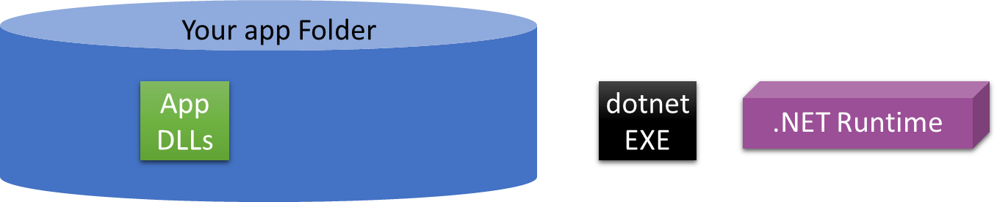
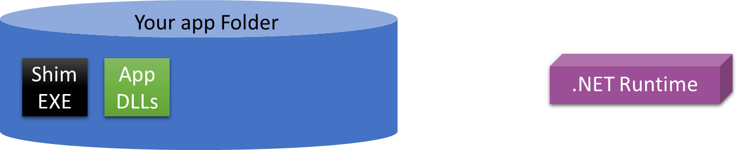
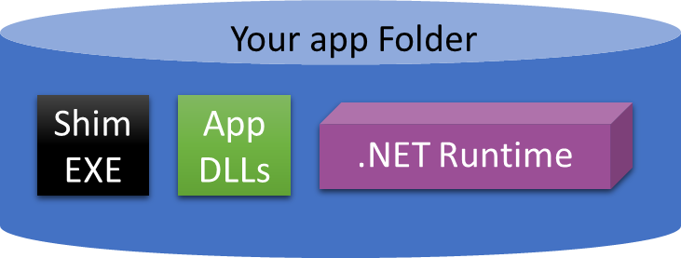

Slide 48
Publish options (https://docs.microsoft.com/dotnet/core/deploying/)
Framework dependent x-plat
Framework dependent EXE
Self-contained EXE
Cross platform (**)
Launched via `dotnet`
Requires Runtime install
Machine updated for runtime servicing (*)
DLL size small and based on app complexity
OS/chip specific
Launched directly(double click)
Requires Runtime install
Machine updated for runtime servicing (*)
EXE size small and based on app complexity
OS/chip specific
Launched directly(double click)
Carries Runtime
EXE itself updated for runtime servicing
EXE always large
(*) By default the latest patch on the machine is used, although you can override this to specify a patch
(**) “Cross-platform” doesn’t guarantee it will run as there may be dependencies like WinForms. True for all options

Slide 49
Deployed size: How big is big? HelloWorld console, release mode, .NET Core 3.0 CLI publish
Framework dependent x-plat
Framework dependent EXE
Self-contained EXE
8Kb
164Kb
66.3 Mb
Smaller host planned for .NET 5.0
Linker will reduce
.NET Core 3.0 has linking and single EXE for self-contained in preview

Slide 50
.NET Core 3.0 publish options
Framework
Dependent x-plat
Target
2.x | dotnet publish -c Release
2.2 | dotnet publish -c Release -r <RID> --self-contained false
3.0 | dotnet publish -c Release -r <RID> --self-contained false
3.0* | dotnet publish -c Release
Framework
Dependent EXE
2.1 | dotnet publish -c Release -r <RID> --self-contained true
2.2 | dotnet publish -c Release -r <RID> --self-contained true
3.0 | dotnet publish -c Release -r <RID> [--self-contained true]
Self contained

Slide 51
Demo
Create Console App, run, succeed
Publish into separate directories for
Framework Dependent cross platform
Framework Dependent executable
Self-contained

Slide 52
Runtime Selection https://github.com/dotnet/designs/blob/master/accepted/runtime-binding.md
<exeName>.runtimeconfig.json file created during build
3 part version number, defaults to zero for the patch
Highest patch, greater than that specified, in this major/minor will be used
If not found, the highest patch of the nearest higher minor version is used
If no minor in this major band is found: Error occurs
You can alter this file on target/production machine
Manually edit <exeName>.runtimeconfig.json
You can alter build behavior
.csproj or <appName>.runtimeconfig.template.json

Slide 53
Demo
Create Console App, run, succeed
Modify .csproj to target 2.2, show machine is missing 2.2, run, fail
Save <appName>.runtimeconfig.json
Modify .csproj to <RollForward>Major…, Build, Publish, run succeed
Compare <appName>.runtimeconfig.json

Slide 54
Scenario: Create a 2.1 FD app for 2.1 runtime
It just works

Slide 55
Scenario: Use a 2.1 FD app without 2.1 runtime
Reach out to the author to determine their plans
Determine whether you trust that the app will work, or you test it
Edit the <appName>.runtimeconfig.json file on the target machine
Anticipate doing this on every update targeting 2.1
This will happen frequently in .NET Core 3.0 and .NET (Global) Tools

Slide 56
Scenario: Create app not to fail on major version change
Determine if the nature of your app makes this OK
How problematic will a runtime failure be?
Trades simplicity for an untested environment
Edit .csproj to include <RollForward>Major</RollForward>
This is a good solution for some .NET (Global) Tools

Slide 57
Scenario: Author app for 2.1 -> 3.0
Test on the specific frameworks you are targeting
Edit .csproj
Replace <TargetFramework>.. with
<TargetFrameworks>[frameworks]</ TargetFrameworks>
Explicitly list each framework you support
This is a good solution for some .NET (Global) Tools

Slide 58

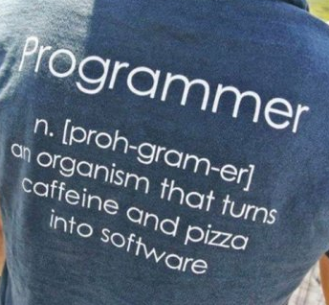

Extra photos
This Photo by Unknown Author is licensed under CC BY-ND
This Photo by Unknown Author is licensed under CC BY-NC-ND
This Photo by Unknown Author is licensed under CC BY-NC-ND

