Slide 1



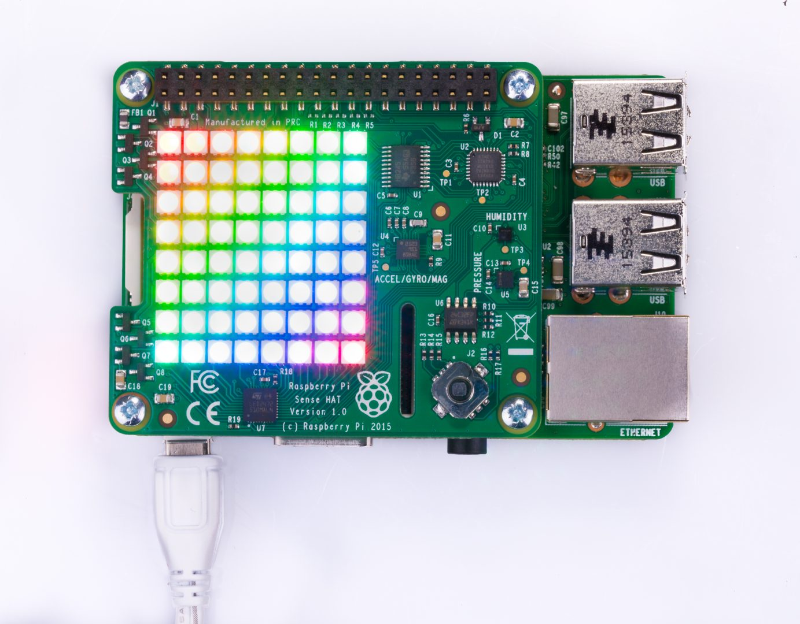



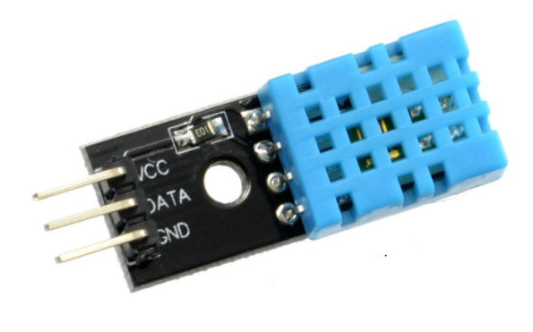

Weather Depends IoT
Weather API
Blynk Server
Raspberry Pi with Sense Hat
Blynk Mobile App
Rain Sensor and DHT11 Humidity and Temperature Sensor connected to the Raspberry Pi via GPIO
connected to home Wifi (802.11 protocol):
Home to python code that does the following:
Requests using HTTP local hourly weather forecast from public Weather API
Determines whether hourly weather meets criteria as per programme
Pushes findings to be displayed on Blynk mobile phone app
Using physical sensors determines actual conditions and writes to the Blynk app
Takes input of drying in progress button and phone GPS data from Blynk app
Takes input from sense hat joystick to signal change in drying progress
Decides push notifications and email based on the above
Sense hat simple LED display based on the above
Sends actual conditions and drying status to ThingSpeak channel
Via Blynk Server:
Reads from and writes to the Raspberry Pi Python script.
Webpage button for full weather forecast
Webpage button for ThingSpeak channel
Displays temperature, humidity, rain status and drying status.
Using ThingTweet sends tweet if Rain and Drying in Progress.

