Slide 1
Weather Depends
Internet of Things support of Depending on the Weather
Kathleen McCarthy Kelleher
Student #: 20042361

Slide 2
Potential Logic for Drying Weather Window:
Yes
Get current conditions from sensors
Send Current Conditions for display on Blynk App
Display information on Blynk App
Is Drying in Progress?
Continue?
Start
Does Weather Opportunity Exist?
No
No
End
Get weather forecast from Web API
Check data for Weather Opportunity
No
Yes
Yes
Send expected window information for display on Blynk App
Monitor current conditions , send rain/other information for notification on Blynk App

Slide 3




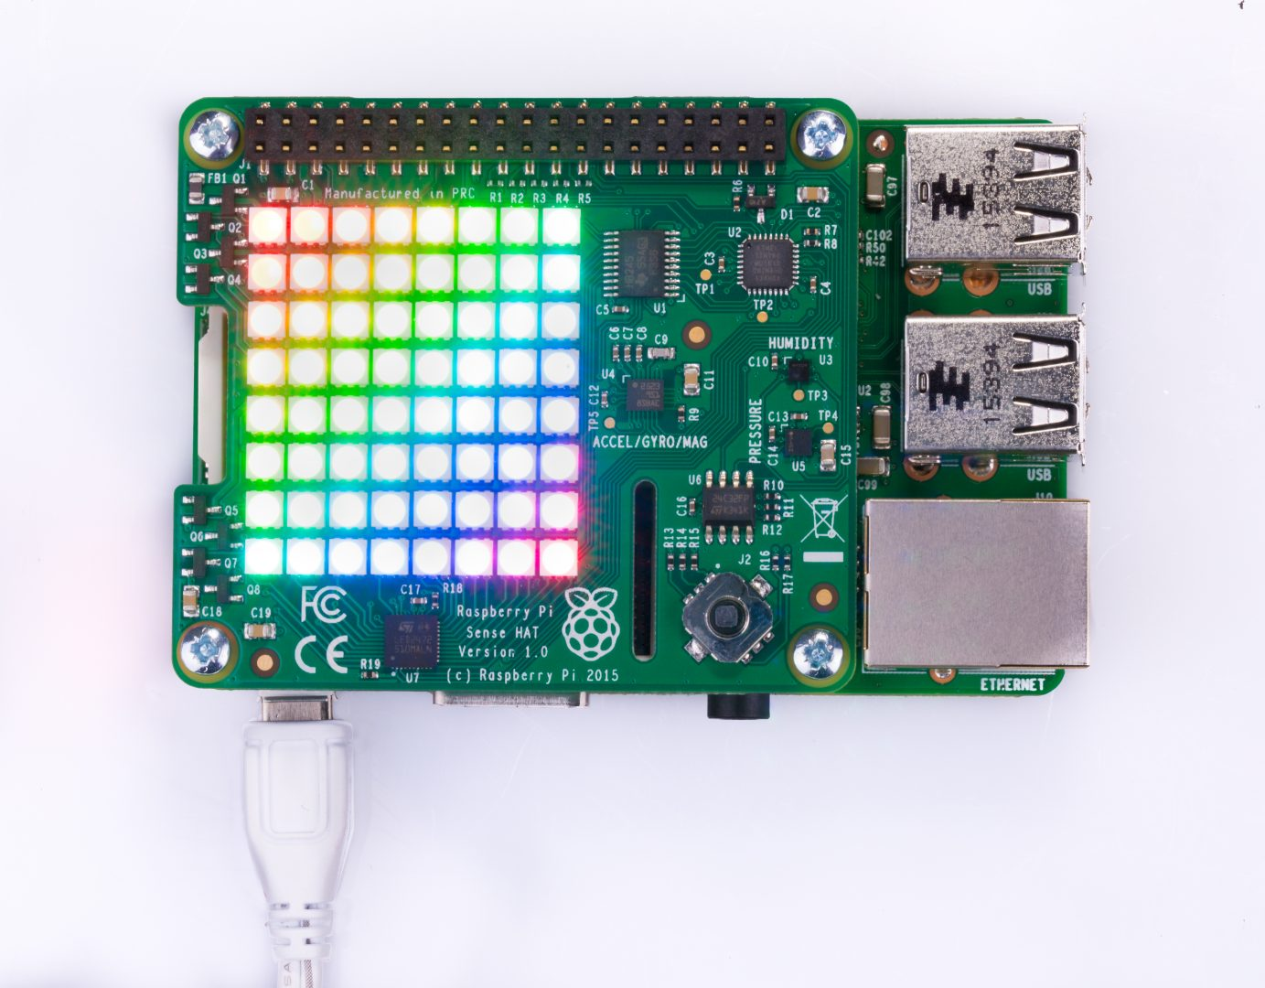

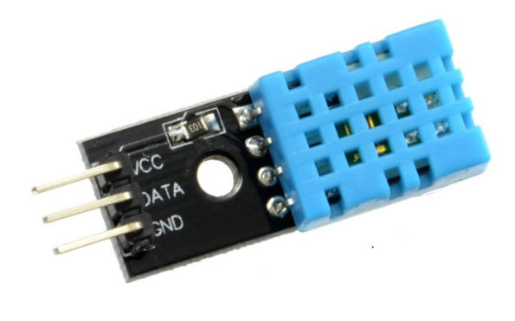

Weather Depends IoT
Weather API
Blynk Server
Raspberry Pi with Sense Hat
Blynk Mobile App
Rain Sensor and DHT11 Humidity and Temperature Sensor connected to the Raspberry Pi via GPIO
connected to home Wifi (802.11 protocol):
Home to python code that does the following:
Requests using HTTP local hourly weather forecast from public Weather API
Determines whether hourly weather meets criteria as per programme
Pushes findings to be displayed on Blynk mobile phone app
Using physical sensors determines actual conditions and writes to the Blynk app
Takes input of drying in progress button and phone GPS data from Blynk app
Takes input from sense hat joystick to signal change in drying progress
Decides push notifications and email based on the above
Sense hat simple LED display based on the above
Via Blynk Server:
Reads from and writes to the Raspberry Pi Python script.
Using Blynk Webhook writes Drying in Progress status to ThingSpeak Drying Channel.

