Slide 1

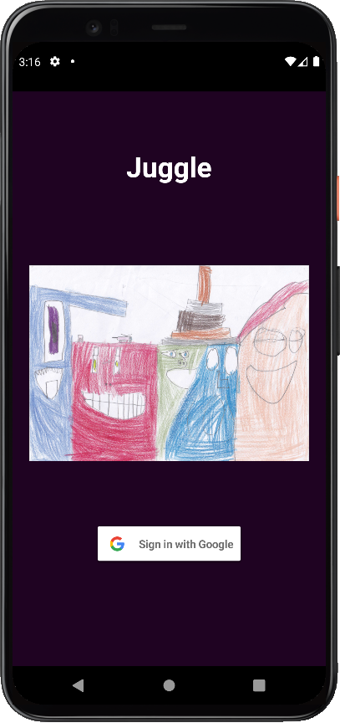
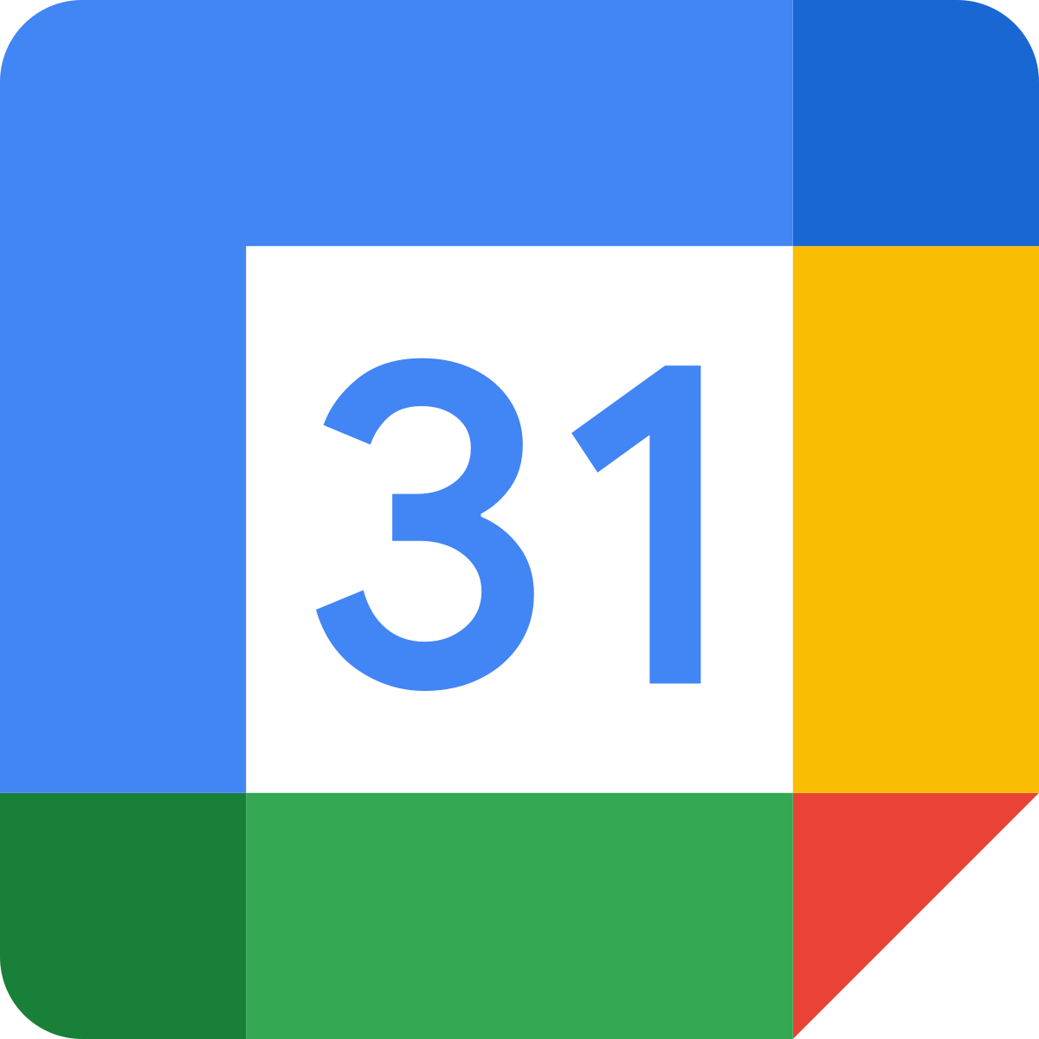
GET calendars and GET/POST events via Google Calendar API
Save and retrieve User details and calendar roles using Realtime Database
Native Android App

Slide 2
Save and retrieve User details and calendar roles using Realtime Database
GET calendars and GET/POST events via Google Calendar API
Native Android App

Slide 3
Save and retrieve User details and calendar roles using Realtime Database
GET calendars and GET/POST events via Google Calendar API
Native Android App

