Slide 1
Impact of public libraries one the literacy skills of school-age children

Slide 2
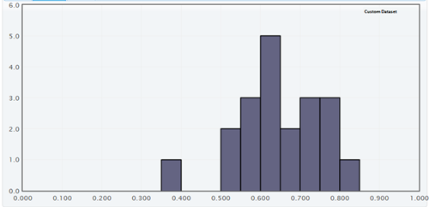
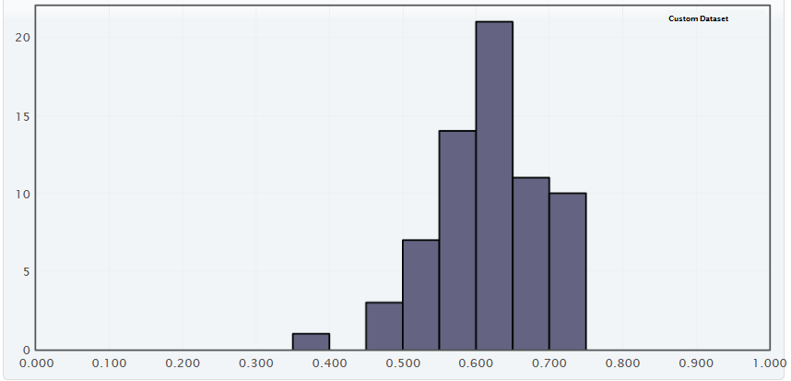
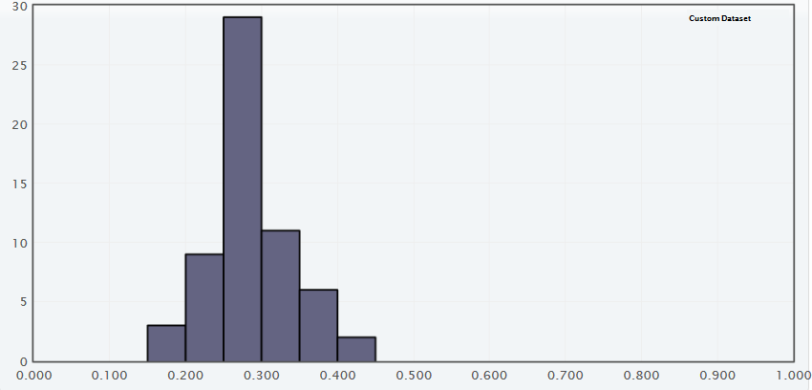
NJ (2014)
www.nj.gov
mean: 0.65
std dev: 0.10
% of students
(grades 3-8) scoring proficient or above in
NJ, PA, NY
counties
PA (2016)
www.education.pa.gov
mean: 0.62
std dev: 0.07
NY (2015)
www.schools.nyc.gov
mean: 0.28
std dev: 0.05

