Slide 1

PUBLIC AGENDA MONITOR
Public agenda research misses what matters
A two-week editorial agenda from public sources, reviewed by people
THE PROBLEM
Editorial teams search fragmented public sources manually. Important appointments, court developments, meetings, panels and reports can be missed. Raw results add noise without a trusted hand-off.
FOR WHOM
Documentary researchers
need to review plausible upcoming events quickly and retain editorial control.
Editors and journalists
need a compact, trustworthy agenda for coverage planning.
Our focus: one accountable chain from public source to a verified editorial agenda.
01
Notes:
Source: Product Brief, sections Executive Summary, Problem, Product and User Experience, Users; PRD, sections 1 and 2.

Slide 2
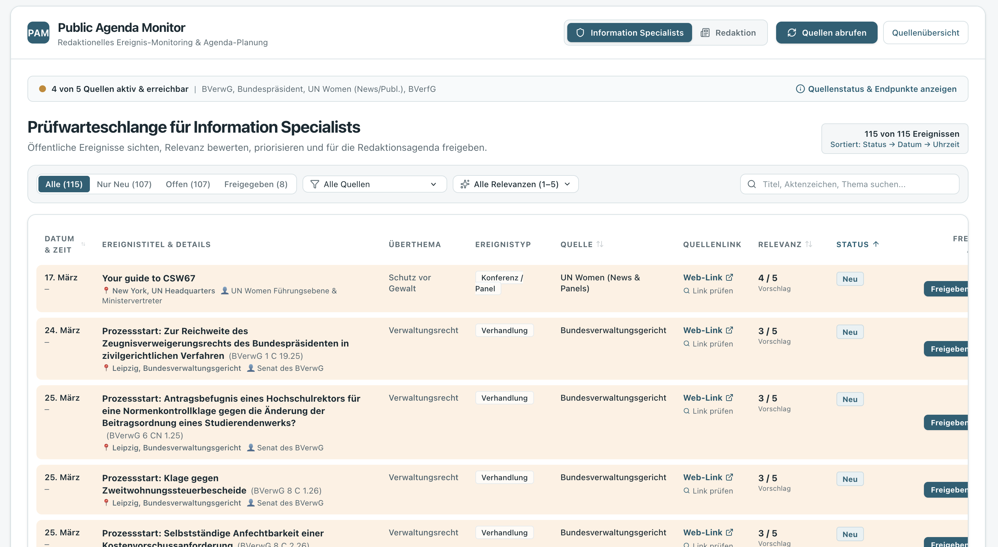
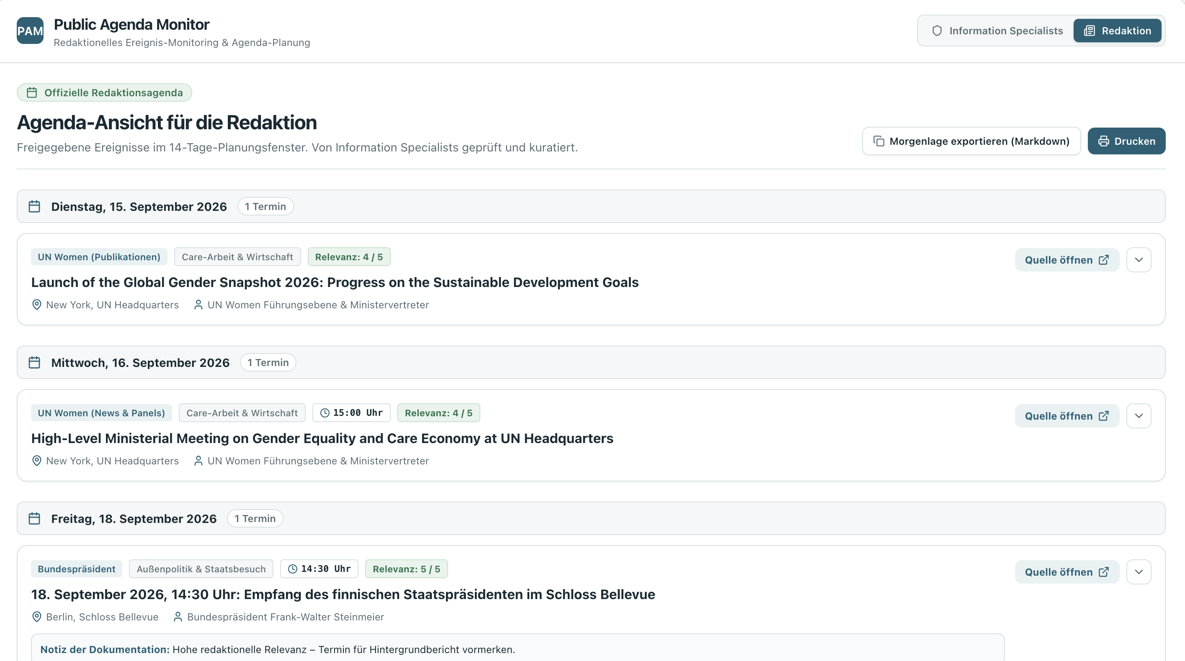
PUBLIC AGENDA MONITOR
Execution & Product
A working human-in-the-loop workflow from source retrieval to agenda planning
CORE FEATURE
WORKING NOW
MVP BOUNDARIES
Researchers turn candidate events from official sources into an approved editorial agenda.
Manual retrieval, review queue, editable score and comments, plus approval into the Redaktionsagenda.
Source adapters are still prototype-grade. Authentication, scheduled retrieval and a trained scoring model remain outside this MVP.
REVIEW QUEUE
EDITOR AGENDA
02
Notes:
Source: Product Brief, sections Product and User Experience, MVP Scope, Success Criteria; PRD, sections 4.1–4.4 and 8. Screenshots supplied by the project team.

Slide 3
PUBLIC AGENDA MONITOR
How we built the prototype
Codex and the BMad method turned an idea into an implementation-ready plan
01
02
03
04
Ideation
Architecture
Requirements
Implementation
Codex + BMad
Explore the problem, users and product brief.
Draft the solution architecture and define the product boundaries.
Create requirements, epics and user stories for the MVP.
Move
epics-and-user-
stories.md into
Google AI Studio to
implement the app.
Hand-off artifact: epics-and-user-stories.md
The structured plan gave Google AI Studio a clear implementation starting point.
03
Notes:
Project team account of the build process: Codex combined with the BMad method for ideation, architecture, requirements, epics and user stories; Google AI Studio for implementation using epics-and-user-stories.md.

Slide 4
PUBLIC AGENDA MONITOR
What makes it yours
Add the project’s distinctive angle or solution
YOUR ORIGINALITY
What should make a judge look twice?
Add one
memorable
example
Use this space for the unexpected part of your approach, a smart workaround, or the perspective that makes Public Agenda Monitor different.
04
Notes:
Placeholder slide based on the AI.WOMEN Hackathon deck: Slide 4 – What makes it yours.

Slide 5
PUBLIC AGENDA MONITOR
The team
Introduce who worked on the project and how the work came together
Add team members and responsibilities
Use names, roles and a short contribution for each person. Keep the focus on the collaboration that shaped the prototype.
Name / role
Name / role
Name / role
Contribution
Contribution
Contribution
05
Notes:
Placeholder slide based on the AI.WOMEN Hackathon deck: Slide 5 – The team.

