Slide 1
Summary of data discrepancies between our internal LVWS data and what is pulled from NWIS
Bella Oleksy, Adeline Kelly

Slide 2
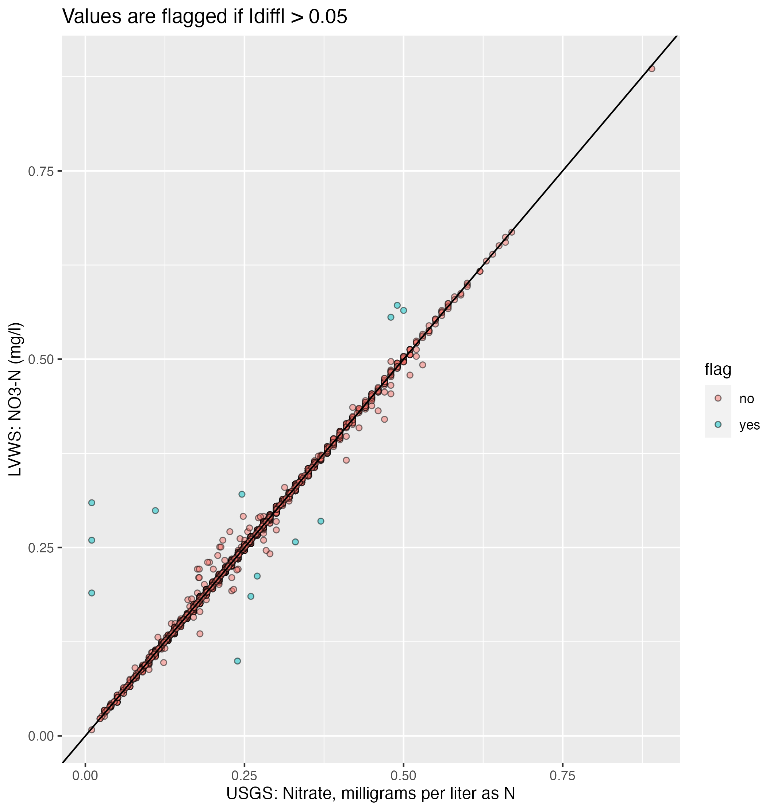
This plot shows the LVWS (Excel) data compared to the USGS (NWIS) data for nitrate. I flagged a point if the absolute value of the difference between the two values was greater than 0.05 (the practical quantification limit).
There is still some scatter around the 1:1 line but we no longer have those super low LVWS values on the x-axis (those were BLANKs that didn’t get filtered out). Some of the scatter may conceivably be rounding error (so they are not flagged), but there are still quite a few non-matches

Slide 3
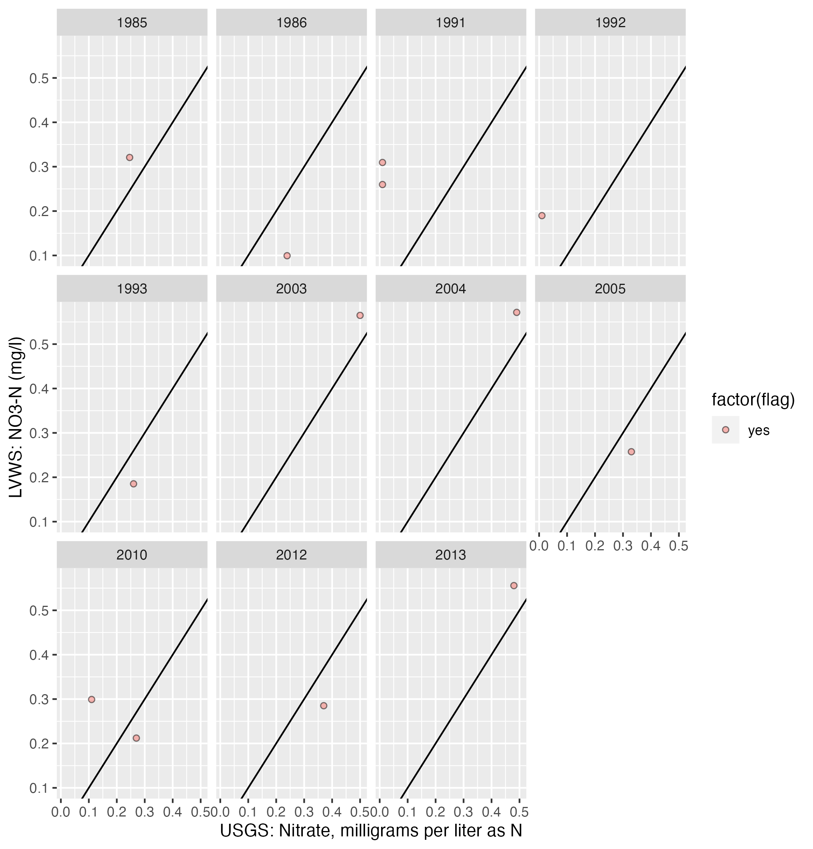
This plot shows the same data as the previous slide, with a separate plot for every year in the dataset, only including years with flags.
The discrepancies are peppered throughout the record, but don’t happen in every year,

Slide 4
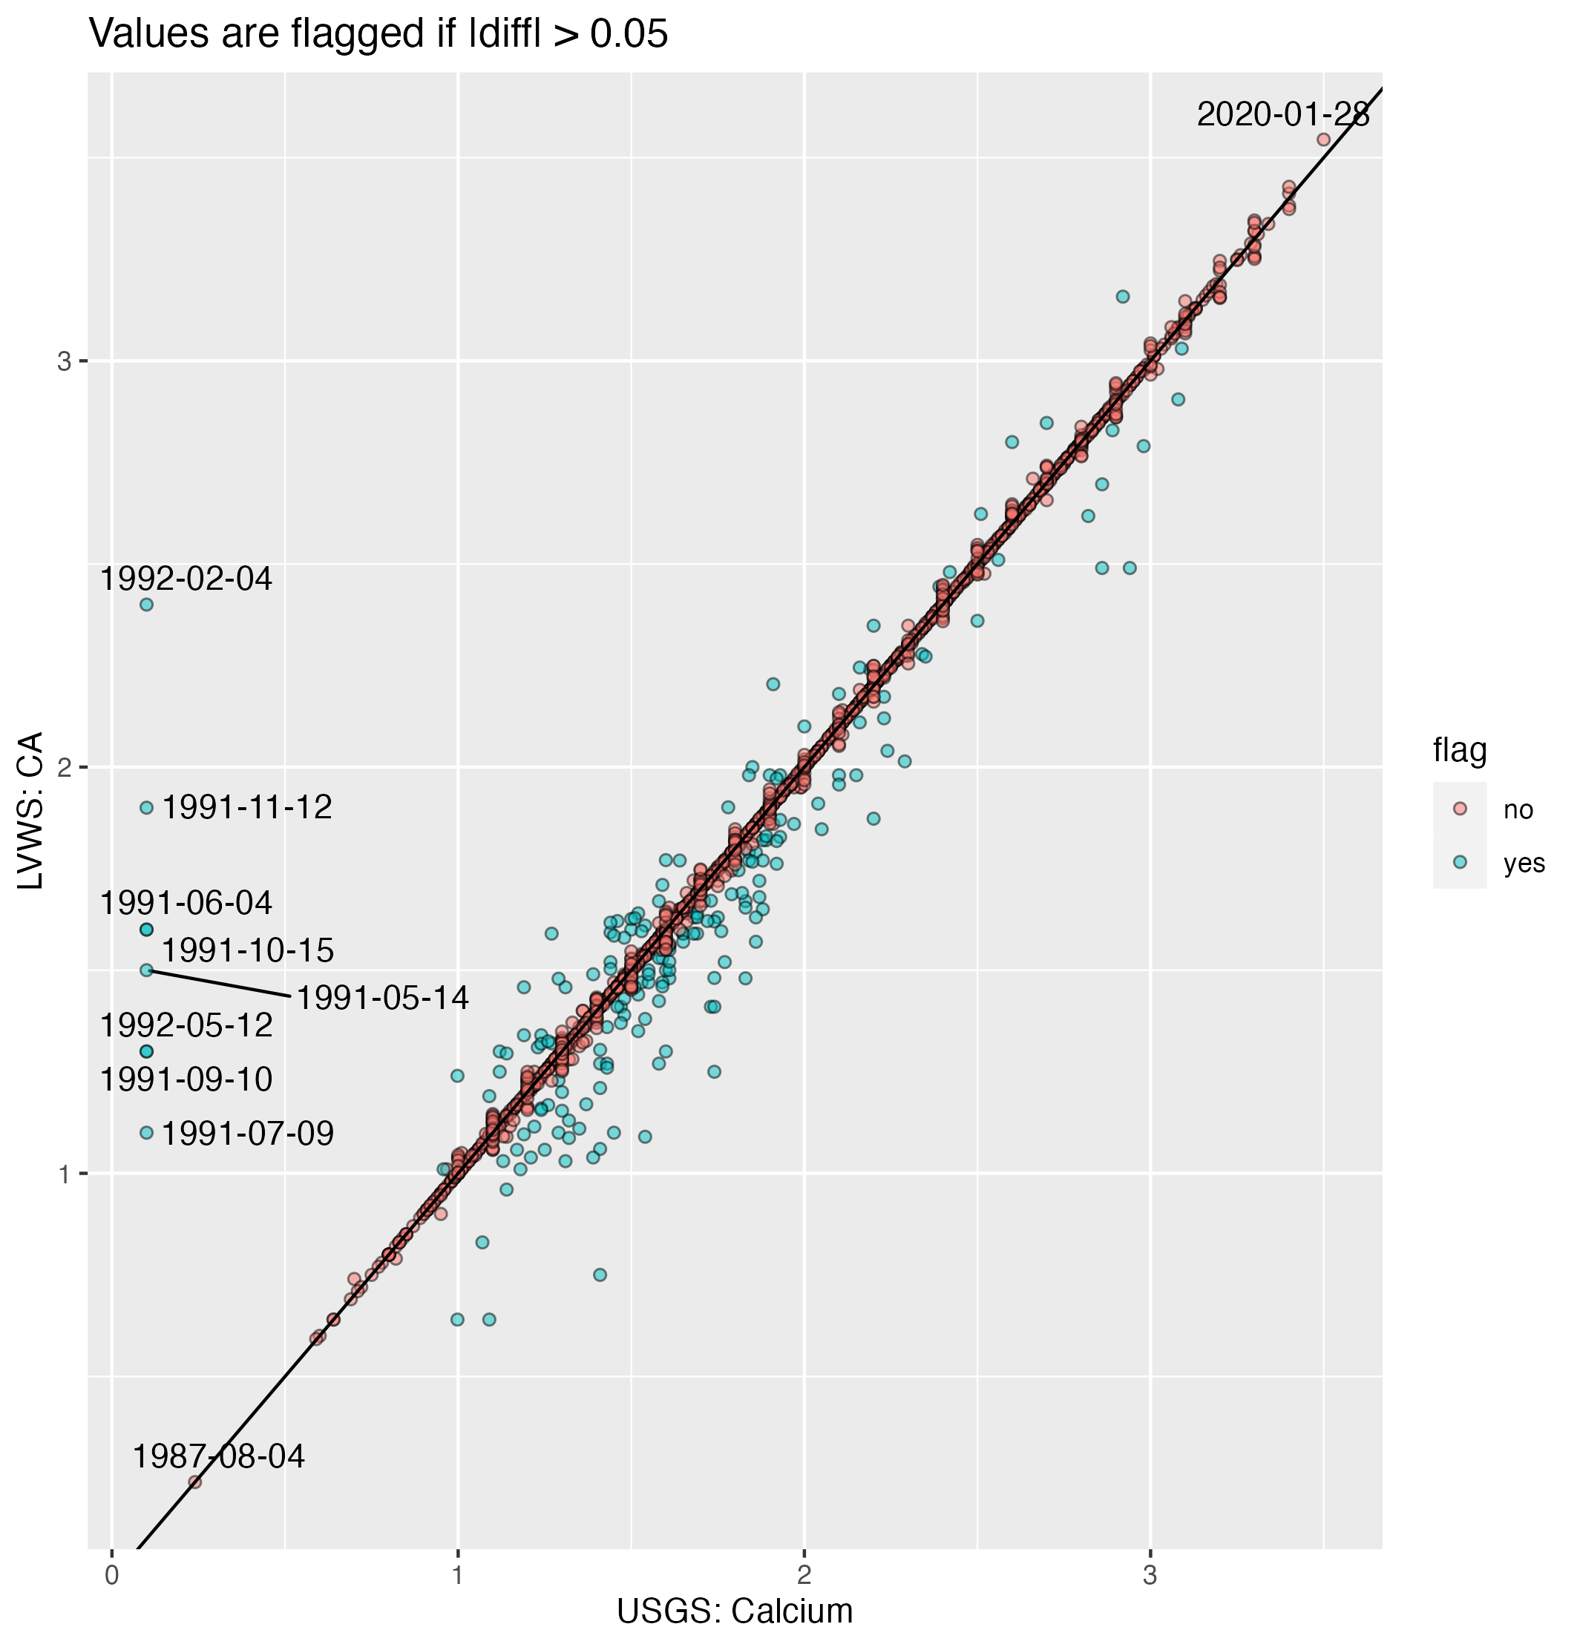
This plot shows the LVWS (Excel) data compared to the USGS (NWIS) data for calcium. I flagged a point if the absolute value of the difference between the two values was greater than 0.05 (the practical quantification limit).
Notably, however, there are a bunch of values from 1991-1992 that are >1 mg/L in our data, but nearly zero in the USGS NWIS database.

Slide 5
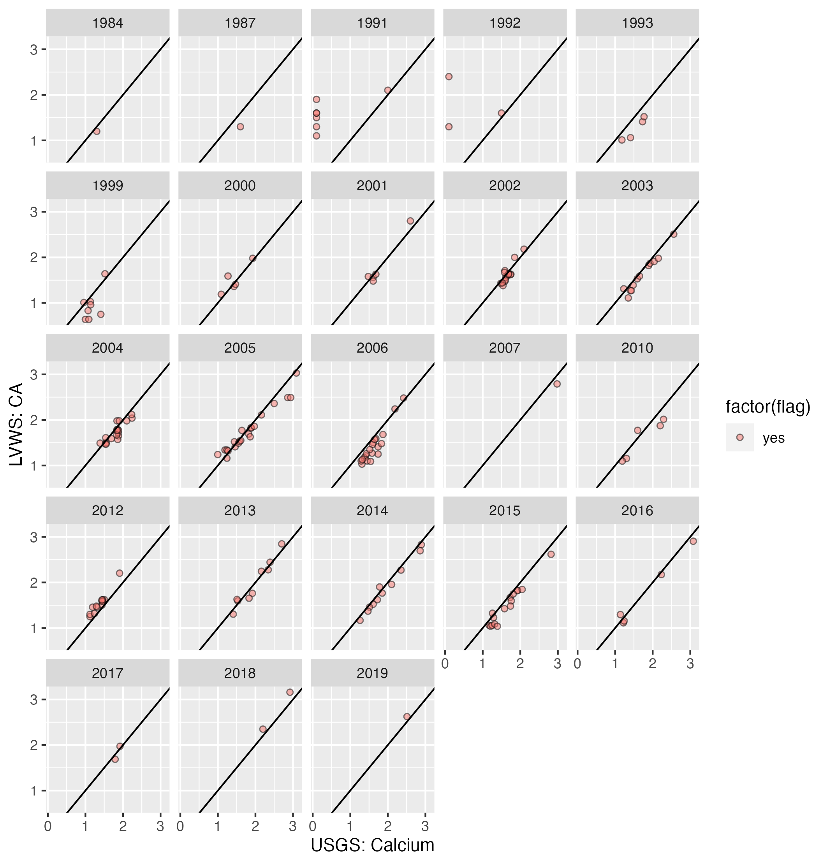
This plot shows the same data as the previous slide, with a separate plot for every year in the dataset. As you can see, these deviations are apparent in nearly every year of the record.

Slide 6
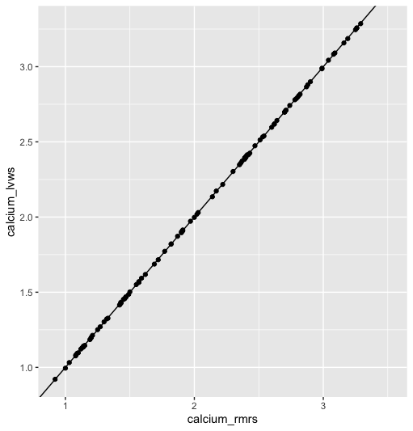
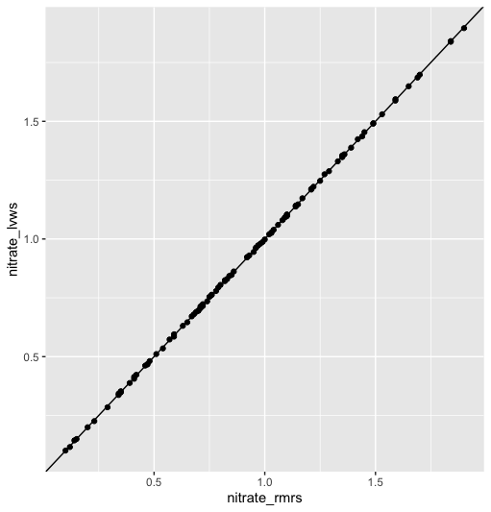
Between the LVWS spreadsheet & RMRS spreadsheets, data are a 1:1 match for 2017-18. Good!!

Slide 7
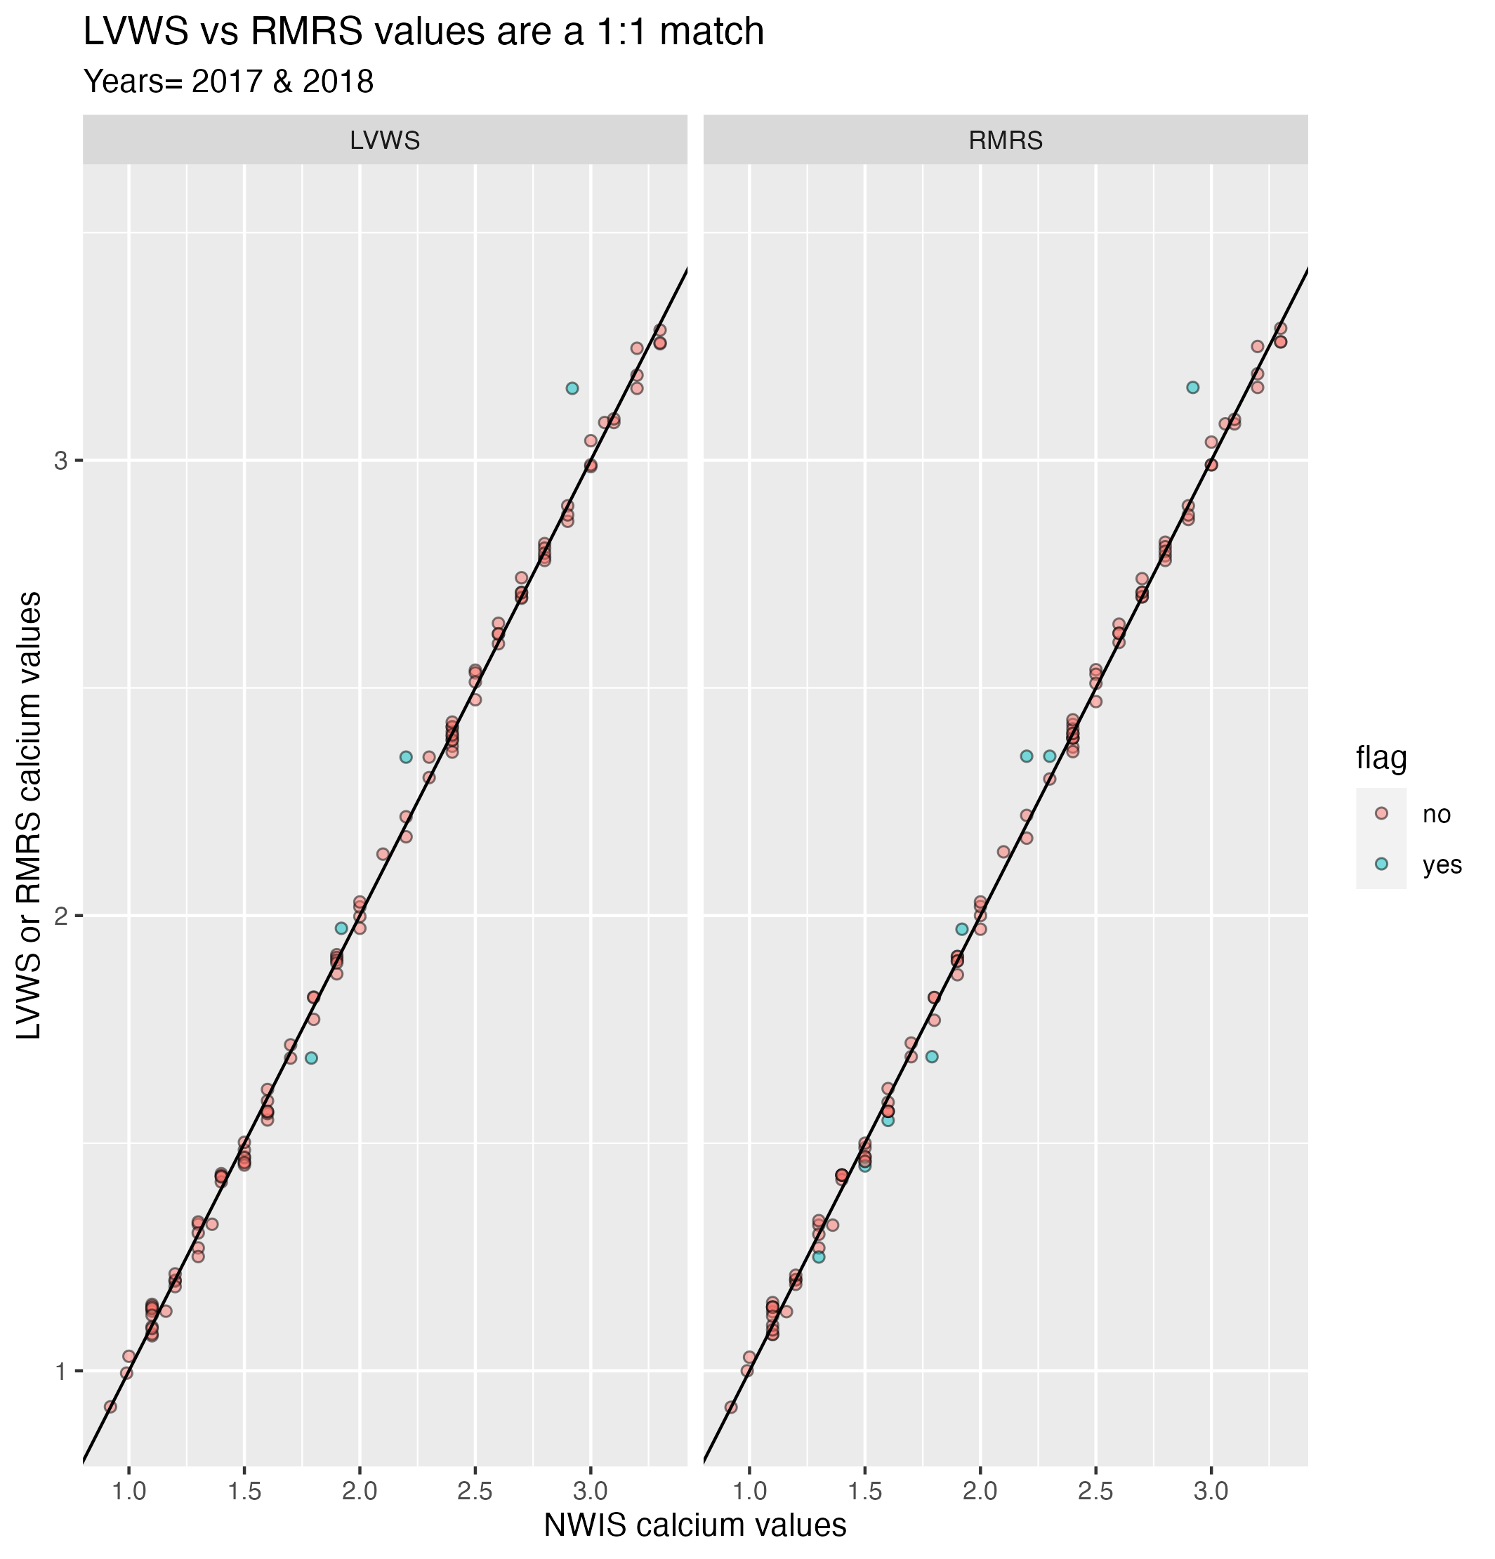
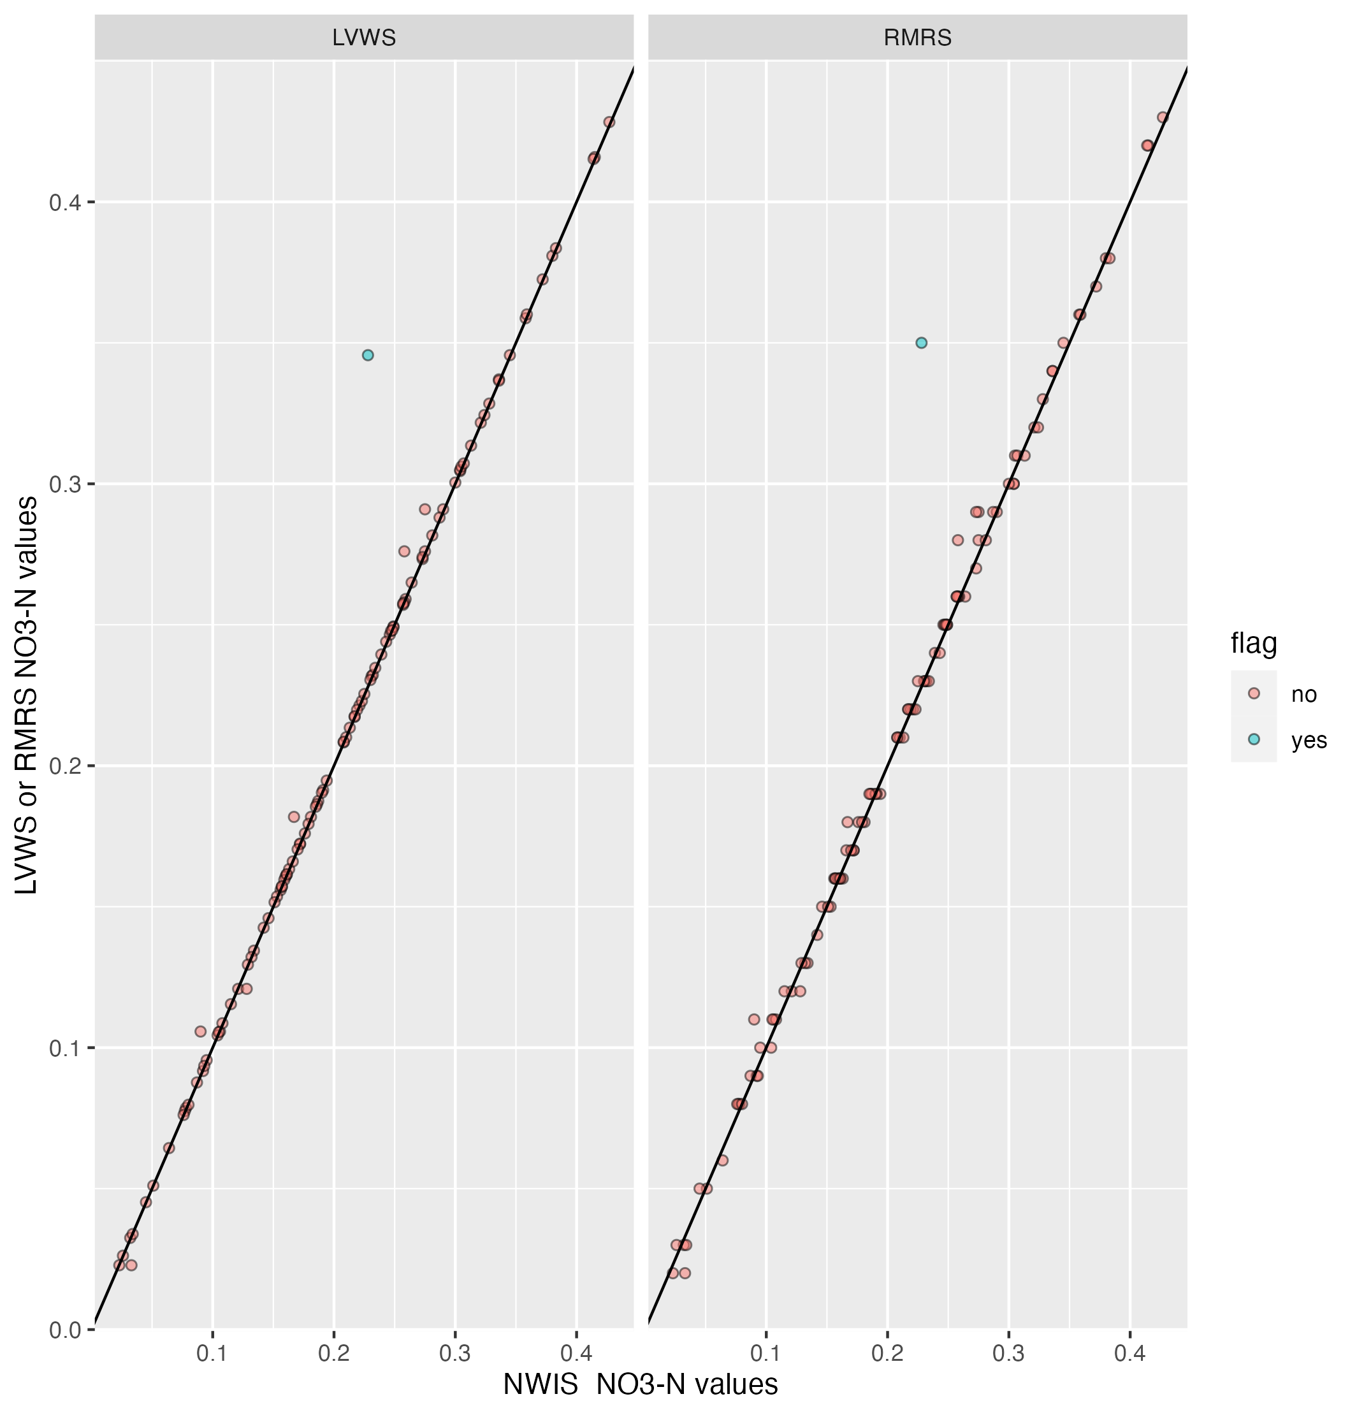
RMRS vs. NWIS comparison (with LVWS excel data for reference)
Notes:
2018-04-10 is one of the calcium flags
That one nitrate flag is what date?? 2017-06-13…

Slide 8
Other strange issues with NWIS
Many instances where there is a reported sample on Mon right before a Tues sample, and the values don’t match *see slide 8-9*
Some instances where there are multiple samples in one date (so same date, but different timestamp) and the values are not the same. Not explicitly labeled as a DUPE in NWIS. Sometimes this duplicate gets flagged. Is it real?
Between 2017-2018 there is one value in the RMRS dataset that doesn’t appear in LVWS or NWIS:
DATE calcium_rmrs nitrate_rmrs
2018-12-26 3.52 1.38

Slide 9
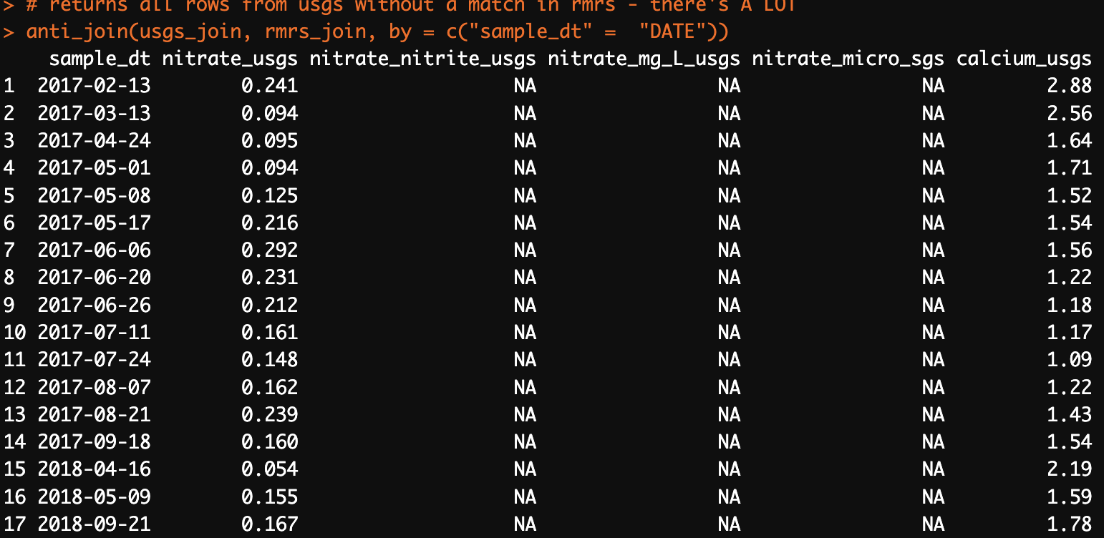
This screenshot shows all of sample from NWIS/USGS without a match in RMRS or LVWS (2017-2018). These are all MONDAYS immediately preceding a normal Tuesday sample too (where we also have data). See next slide for more.

Slide 10
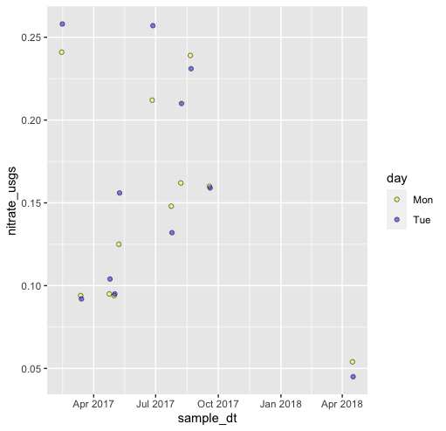
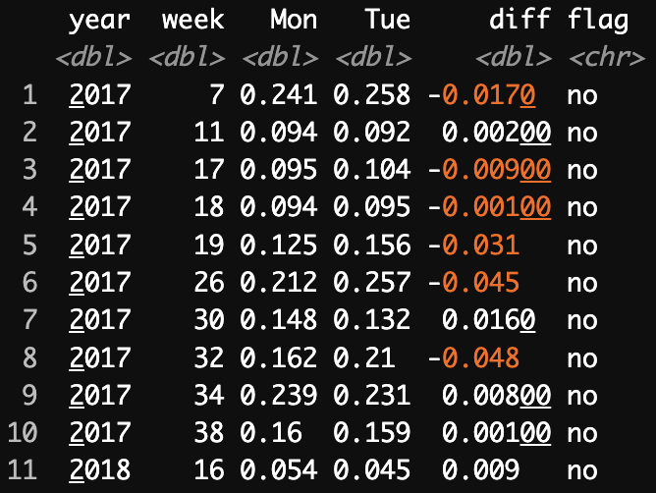
Continued from slide 8
The values are *close* and don’t exceed the 0.05 difference “threshold” for the flag but it is still weird. These Monday samples don’t exist in the RMRS data. How are these introduced into NWIS? It is possible this happens before 2017, but for now this issue only became apparent when matching the RMRS raw data with the NWIS/USGS data.

