Slide 1
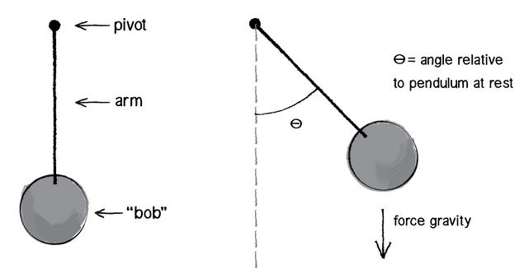

Slide 2
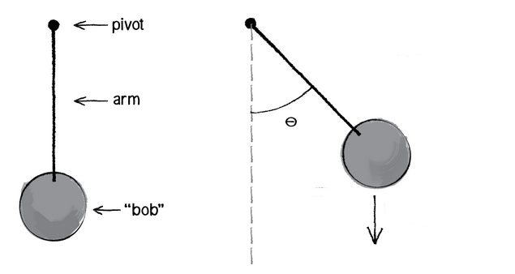

pivot
θ
L
Dampening force
arm
m
“bob”
Resulting force
Gravitational force

Slide 3
L
θ
Dampening force
m
Resulting force
Gravitational force

