Slide 1
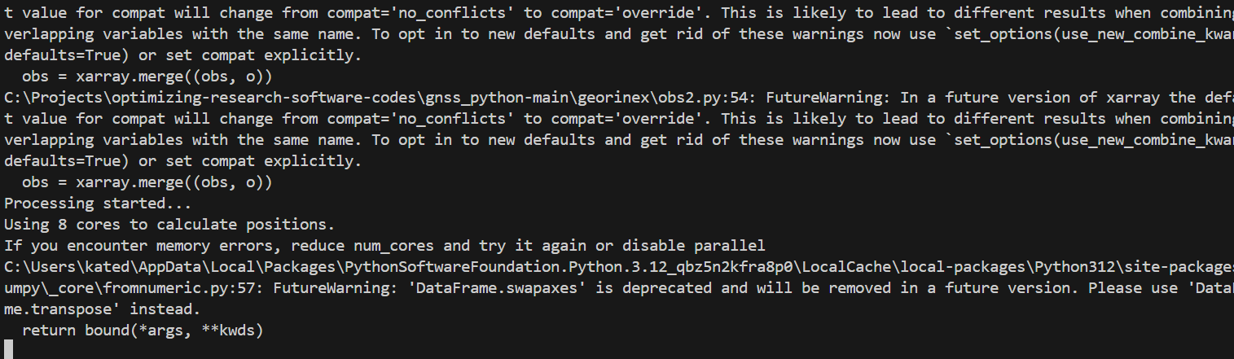
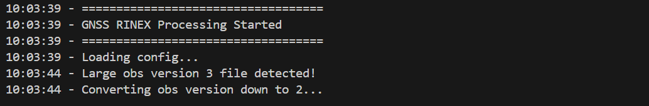
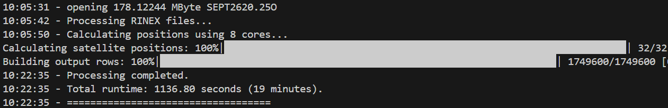

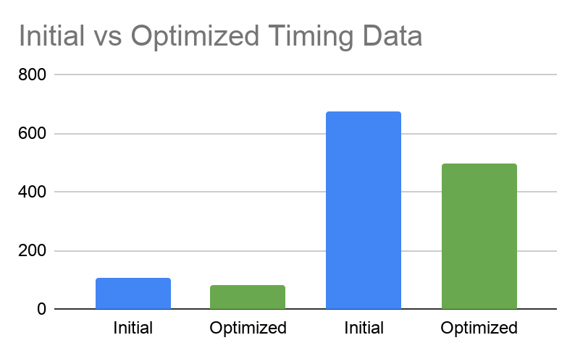

CS.028
Optimizing Research
Software Codes
WHAT IS GNSS?
ACKNOWLEDGEMENTS
GNSS stands for Global Navigation Satellite System. It’s like GPS, but global! This system includes the USA’s GPS, China’s BeiDou, Russia’s GLONASS, and the European Union’s Galileo.
But why use GNSS over GPS? Using multiple systems simultaneously significantly improves positioning performance. Adding GLONASS, Galileo, and BeiDou to GPS can reduce convergence time by nearly 70% and improve positioning accuracy by about 25%.
Contributors
Kathryn Butler butlekat@oregonstate.edu
Joseph Schaab schaabj@oregonstate.edu
Project Partner
Dr. Jihye Park, Associate Professor Civil & Construction Engineering jihye.park@oregonstate.edu
Improving GNSS Satellite Observation and Navigation Parsing Software
The codebase we inherited ran the calculations at a very slow pace, almost half an hour for large datasets!
It also had no user interface, and sent all the non-critical warnings to the console. This is confusing for users because they receive no feedback of the program’s progress until it's done.
DATA PARSING TAKES FOREVER
Figure 1. Initial Program Output
The current RINEX2DB software processes GNSS data to generate receiver position information. However, its runtime can take up to 30 minutes for 1-second data, which limits its usability. Our goal was to reduce computation time while maintaining accuracy.
Our primary users are research scientists and engineers using RINEX2DB for GNSS analysis. They mainly run the RINEX2DB program on standard workstations or university servers to process large volumes of satellite data.
Our secondary users are student researchers and developers maintaining or extending the code. They will use our software as a building-point for integration with new data-processing tools, and will likely have more powerful systems.
Even though our current program’s far from perfect, we’ve made some great progress. Now users can see when the process has started, and they also can see the progress bar for key tasks.
This alone has greatly improved user experience because now users can see the estimated time that it will take for the program to complete and are reassured that the program is indeed doing what it’s supposed to.
Figure 2. Optimized Program Output
Kathryn is a fourth-year Computer Science student with a focus in Data Science. She is also a Senior in the MECOP program. Connect with her on LinkedIn! linkedin.com/in/kathryn-j-butler
KEY OUTCOMES
Body. Duismolessi utem ex et, sumsan utat amet dolorero commy nulla feugait, sit alisci bla core doleniat, consectem volobore core eu facil irit dip et wis nim nostincin henim quamconsed tat veliscin ulputem vel ut Ovit eum facernatiunt harum as voloremquis ea si des alit, ant repuda ipietur rae apeditas maionserum vendaest.
We were able to successfully reduce the processing time by about 30%. We also maintained the reproducibility of the code, and ensured that the final product was as accurate as the initial program. The attached graph demonstrates the runtime improvements that we have achieved so far.
We are continuing improvements through the end of the year, and will likely see an even larger improvement as we finalize our refactoring.
While this project could use many more improvements, current optimizations have made data parsing more consistent and made using the software easier.
Joseph is a Computer Science Systems Major with a focus in Theoretical Computer Science and Operating Systems. Connect through LinkedIn. linkedin.com/in/joseph-schaab
500000 Entries
900000 Entries
Figure 3. Output Performance Comparison

