Slide 1
OBJECT ORIENTED PROGRAMMING
B.TECH II YR II SEMESTER(TERM 08-09)
UNIT 1 PPT SLIDES
TEXT BOOKS:
1. Java: the complete reference, 7th editon, Herbert schildt, TMH.Understanding
2. OOP with Java, updated edition, T. Budd, pearson eduction.
No. of slides: 24

Slide 2
INDEX
UNIT 1 PPT SLIDES
S.NO. TOPIC LECTURE NO. PPTSLIDES
Need for oop paradigm, L1 L1.1TO L1.4
A way of viewing world – Agents
Responsibility, Messages, Methods L2 L2.1 TO L2.3
classes and instances, L3 L3.1 TO L3.6
class hierarchies, Inheritance
method binding L 4 L4.1 TO L4.5
overriding and exceptions
summary of oop concepts,
coping with complexity, L5 L5.1 TO 5.4
abstraction mechanisms

Slide 3
Need for OOP Paradigm
OOP is an approach to program organization and development, which attempts to eliminate some of the drawbacks of conventional programming methods by incorporating the best of structured programming features with several new concepts.
OOP allows us to decompose a problem into number of entities called objects and then build data and methods (functions) around these entities.
The data of an object can be accessed only by the methods associated with the object.

Slide 4
Some of the Object-Oriented Paradigm are:
Emphasis is on data rather than procedure.
Programs are divided into objects.
Data Structures are designed such that they
Characterize the objects.
Methods that operate on the data of an object are tied together in the data structure.
Data is hidden and can not be accessed by external functions.
Objects may communicate with each other through methods.

Slide 5
A way of viewing world – Agents
OOP uses an approach of treating a real world agent as an object.
Object-oriented programming organizes a program around its data (that is, objects) and a set of well-defined interfaces to that data.
An object-oriented program can be characterized as data controlling access to code by switching the controlling entity to data.

Slide 6
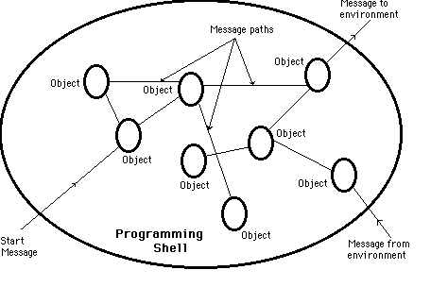

Slide 7
Responsibility
primary motivation is the need for a platform-independent (that is, architecture- neutral) language that could be used to create software to be embedded in various consumer electronic devices, such as microwave ovens and remote controls.
Objects with clear responsibilities
Each class should have a clear responsibility.
If you can't state the purpose of a class in a single, clear sentence, then perhaps your class structure needs some thought.

Slide 8
Messages
We all like to use programs that let us know what's going on. Programs that keep us informed often do so by displaying status and error messages.
These messages need to be translated so they can be understood by end users around the world.
The Section discusses translatable text messages. Usually, you're done after you move a message String into a ResourceBundle.
If you've embedded variable data in a message, you'll have to take some extra steps to prepare it for translation.

Slide 9
Methods
A method is a group of instructions that is given a name and can be called up at any point in a program simply by quoting that name.
Drawing a Triangle require draw of three straight lines. This instruction three times to draw a simple triangle.
We can define a method to call this instruction three times and draw the triangle(i.e. create a method drawLine() to draw lines and this method is called repeatedly to achieve the needed task)
The idea of methods appears in all programming languages, although sometimes it goes under the name functions and sometimes under the name procedures.
The name methods is a throw-back to the language C++, from which Java was developed.
In C++, there is an object called a class which can contain methods. However, everything in Java is enclosed within a class .so the functions within it are called methods

Slide 10
CLASSES
Class is blue print or an idea of an Object
From One class any number of Instances can be created
It is an encapsulation of attributes and methods
class
FIGURE
Ob1
Ob3
CIRCLE
Ob2
SQUARE
RECTANGLE

Slide 11
syntax of CLASS
class <ClassName>
{
attributes/variables;
Constructors();
methods();
}

Slide 12
INSTANCE
Instance is an Object of a class which is an entity with its own attribute values and methods.
Creating an Instance
ClassName refVariable;
refVariable = new Constructor();
or
ClassName refVariable = new Constructor();

Slide 13
Java Class Hierarchy
In Java, class “Object” is the base class to all other classes
  If we do not explicitly say extends in a new class definition, it implicitly extends Object
  The tree of classes that extend from Object and all of its subclasses are is called the class hierarchy
  All classes eventually lead back up to Object
  This will enable consistent access of objects of different classes.

Slide 14
Inheritance
Methods allows to reuse a sequence of statements
Inheritance allows to reuse classes by deriving a new class from an existing one
The existing class is called the parent class, or superclass, or base class
The derived class is called the child class or subclass.
The child class inherits characteristics of the parent class(i.e the child class inherits the methods and data defined for the parent class

Slide 15
Inheritance
Inheritance relationships are often shown graphically in a class diagram, with the arrow pointing to the parent class
Animal
weight : int
+ getWeight() : int
Bird
+ fly() : void

Slide 16
Method Binding
Objects are used to call methods.
MethodBinding is an object that can be used to call an arbitrary public method, on an instance that is acquired by evaluatng the leading portion of a method binding expression via a value binding.
It is legal for a class to have two or more methods with the same name.
Java has to be able to uniquely associate the invocation of a method with its definition relying on the number and types of arguments.
Therefore the same-named methods must be distinguished:
        1) by the number of arguments, or
        2) by the types of arguments
Overloading and inheritance are two ways to implement polymorphism.

Slide 17
Method Overriding.
There may be some occasions when we want an object to respond to the same method but have different behaviour when that method is called.
That means, we should override the method defined in the superclass. This is possible by defining a method in a sub class that has the same name, same arguments and same return type as a method in the superclass.
Then when that method is called, the method defined in the sub class is invoked and executed instead of the one in the superclass. This is known as overriding.

Slide 18
Exceptions in Java
Exception is an abnormal condition that arises in the code sequence.
Exceptions occur during compile time or run time.
“throwable” is the super class in exception hierarchy.
Compile time errors occurs due to incorrect syntax.
Run-time errors happen when
  User enters incorrect input
  Resource is not available (ex. file)
  Logic error (bug) that was not fixed

Slide 19
Exception classes
In Java, exceptions are objects. When you throw an exception, you throw an object. You can't throw just any object as an exception, however -- only those objects whose classes descend from Throwable.
Throwable serves as the base class for an entire family of classes, declared in java.lang, that your program can instantiate and throw.
Throwable has two direct subclasses, Exception and Error.
Exceptions are thrown to signal abnormal conditions that can often be handled by some catcher, though it's possible they may not be caught and therefore could result in a dead thread.
Errors are usually thrown for more serious problems, such as OutOfMemoryError, that may not be so easy to handle. In general, code you write should throw only exceptions, not errors.
Errors are usually thrown by the methods of the Java API, or by the Java virtual machine itself.

Slide 20
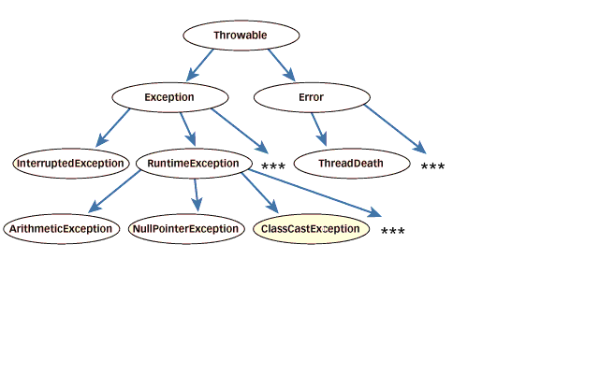

Slide 21
Summary of OOPS
The following are the basic oops concepts: They are as follows:
Objects.
Classes.
Data Abstraction.
Data Encapsulation.
Inheritance.
Polymorphism.
Dynamic Binding.
Message Passing.

Slide 22
Abstraction in Object-Oriented Programming
Procedural Abstraction
Procedural Abstractions organize instructions.
Function Power
Give me two numbers (base & exponent)
I’ll return base^{exponent}
Implementation

Slide 23
Data Abstraction
Data Abstractions organize data.
StudentType
Name (string)
Marks (num)
Grade (char)
Student Number (num)

Slide 24
Behavioral Abstraction
Behavioral Abstractions combine procedural and data abstractions.
Queue Object
Enqueue
Is Full
Data State
Is Empty
Dequeue
Initialize

