Slide 1
OBJECT ORIENTED PROGRAMMING
B.TECH II YR II SEMESTER(TERM 08-09)
UNIT 7 PPT SLIDES
TEXT BOOKS:
1. Java: the complete reference, 7th editon, Herbert schildt, TMH.Understanding
2. OOP with Java, updated edition, T. Budd, pearson eduction.
No. of slides:45

Slide 2
INDEX
UNIT 7 PPT SLIDES
S.NO. TOPIC LECTURE NO. PPTSLIDES
Concepts of Applets, L1 L1.1TO L1.5 differences between applets and applications
Life cycle of an applet, types of applets L2 L2.1 TO L2.4
Creating applets, passing parameters to applets. L3 L3.1 TO L3.4
4 Introduction to swings, limitations of AWT L 4 L4.1 TO L4.5
MVC architecture, components, containers L 5 L5.1 TO L5.10
Exploring swing- JApplet, JFrame and JComponent, L 6 L6.1 TO L6.3
Icons and Labels, text fields, buttons L 7 L7.1 TO L7.4
8 Check boxes, Combo boxes,RadioButton,JButton L 8 L8.1 TO L8.4
9 Tabbed Panes, Scroll Panes, Trees, and Tables L 9 L9.1 TO L9.4

Slide 3
Concepts of Applets
Applets are small applications that are accessed on an Internet server, transported over the Internet, automatically installed, and run as part of a Web document.
After an applet arrives on the client, it has limited access to resources, so that it can produce an arbitrary multimedia user interface and run complex computations without introducing the risk of viruses or breaching data integrity.

Slide 4
applets – Java program that runs within a Java-enabled browser, invoked through a “applet” reference on a web page, dynamically downloaded to the client computer
    import java.awt.*;
    import java.applet.*;
    public class SimpleApplet extends Applet {
    public void paint(Graphics g) {
    g.drawString("A Simple Applet", 20, 20);
    }
    }

Slide 5
There are two ways to run an applet:
Executing the applet within a Java-compatible
Web browser, such as NetscapeNavigator.
2. Using an applet viewer, such as the standard JDK tool, appletviewer.
An appletviewer executes your applet in a window. This is generally the fastest and easiest way to test an applet.
To execute an applet in a Web browser, you need to write a short HTML text file that contains the appropriate APPLET tag.
<applet code="SimpleApplet" width=200 height=60>
</applet>

Slide 6
Differences between applets and applications
Java can be used to create two types of programs: applications and applets.
An application is a program that runs on your computer, under the operating system of that Computer(i.e an application created by Java is more or less like one created using C or C++).
When used to create applications, Java is not much different from any other computer language.
An applet is an application designed to be transmitted over the Internet and executed by a Java-compatible Web browser.
An applet is actually a tiny Java program, dynamically downloaded across the network, just like an image, sound file, or video clip.

Slide 7
The important difference is that an applet is an intelligent program, not just an animation or media file(i.e an applet is a program that can react to user input and dynamically change—not just run the same animation or sound over and over.
Applications require main method to execute.
Applets do not require main method.
Java's console input is quite limited
Applets are graphical and window-based.

Slide 8
Life cycle of an applet
Applets life cycle includes the following methods
      init( )
      start( )
      paint( )
      stop( )
      destroy( )
When an applet begins, the AWT calls the following methods, in this sequence:
      init( )
      start( )
      paint( )
When an applet is terminated, the following sequence of method calls takes place:
      stop( )
      destroy( )

Slide 9
init( ): The init( ) method is the first method to be called. This is where you should initialize variables. This method is called only once during the run time of your applet.
start( ): The start( ) method is called after init( ). It is also called to restart an applet after it has been stopped. Whereas init( ) is called once—the first time an applet is loaded—start( ) is called each time an applet's HTML document is displayed onscreen. So, if a user leaves a web page and comes back, the applet resumes execution at start( ).
paint( ): The paint( ) method is called each time applet's output must be redrawn. paint( ) is also called when the applet begins execution. Whatever the cause, whenever the applet must redraw its output, paint( ) is called. The paint( ) method has one parameter of type Graphics. This parameter will contain the graphics context, which describes the graphics environment in which the applet is running. This context is used whenever output to the applet is required.

Slide 10
stop( ): The stop( ) method is called when a web browser leaves the HTML document containing the applet—when it goes to another page, for example. When stop( ) is called, the applet is probably running. Applet uses stop( ) to suspend threads that don't need to run when the applet is not visible. To restart start( ) is called if the user returns to the page.
destroy( ): The destroy( ) method is called when the environment determines that your applet needs to be removed completely from memory. The stop( ) method is always called before destroy( ).

Slide 11
Types of applets
Applets are two types
    1.Simple applets
    2.JApplets
Simple applets can be created by extending Applet class
JApplets can be created by extending JApplet class of javax.swing.JApplet package

Slide 12
Creating applets
Applets are created by extending the Applet class.
  import java.awt.*;
  import java.applet.*;
  /*<applet code="AppletSkel" width=300 height=100></applet> */
  public class AppletSkel extends Applet {
  public void init() {
  // initialization
  }
  public void start() {
  // start or resume execution
  }
  public void stop() {
  // suspends execution
  }
  public void destroy() {
  // perform shutdown activities
  }
  public void paint(Graphics g) {
  // redisplay contents of window
  }
}

Slide 13
passing parameters to applets
APPLET tag in HTML allows you to pass parameters to applet.
To retrieve a parameter, use the getParameter( ) method. It returns the value of the specified parameter in the form of a String object.
  // Use Parameters
  import java.awt.*;
  import java.applet.*;
  /*
  <applet code="ParamDemo" width=300 height=80>
  <param name=fontName value=Courier>
  <param name=fontSize value=14>
  <param name=leading value=2>
  <param name=accountEnabled value=true>
  </applet>
  */

Slide 14
public class ParamDemo extends Applet{
String fontName;
int fontSize;
float leading;
boolean active;
// Initialize the string to be displayed.
public void start() {
String param;
fontName = getParameter("fontName");
if(fontName == null)
fontName = "Not Found";
param = getParameter("fontSize");
try {
if(param != null) // if not found
fontSize = Integer.parseInt(param);
else
fontSize = 0;
} catch(NumberFormatException e) {
fontSize = -1;
}
param = getParameter("leading");

Slide 15
try {
if(param != null) // if not found
leading = Float.valueOf(param).floatValue();
else
leading = 0;
} catch(NumberFormatException e) {
leading = -1;
}
param = getParameter("accountEnabled");
if(param != null)
active = Boolean.valueOf(param).booleanValue();
}
// Display parameters.
public void paint(Graphics g) {
g.drawString("Font name: " + fontName, 0, 10);
g.drawString("Font size: " + fontSize, 0, 26);
g.drawString("Leading: " + leading, 0, 42);
g.drawString("Account Active: " + active, 0, 58);
}
}

Slide 16
Introduction to swings
Swing is a set of classes that provides more powerful and flexible components than are possible with the AWT.
In addition to the familiar components, such as buttons, check boxes, and labels, Swing supplies several exciting additions, including tabbed panes, scroll panes, trees, and tables.
Even familiar components such as buttons have more capabilities in Swing.
For example, a button may have both an image and a text string associated with it. Also, the image can be changed as the state of the button changes.
Unlike AWT components, Swing components are not implemented by platform-specific code.
Instead, they are written entirely in Java and, therefore, are platform-independent.
The term lightweight is used to describe such elements.

Slide 17
The Swing component are defined in javax.swing
  AbstractButton: Abstract superclass for Swing buttons.
  ButtonGroup: Encapsulates a mutually exclusive set of buttons.
  ImageIcon: Encapsulates an icon.
  JApplet: The Swing version of Applet.
  JButton: The Swing push button class.
  JCheckBox: The Swing check box class.
  JComboBox : Encapsulates a combo box (an combination of a drop-down list and text field).
  JLabel: The Swing version of a label.
  JRadioButton: The Swing version of a radio button.
  JScrollPane: Encapsulates a scrollable window.
  JTabbedPane: Encapsulates a tabbed window.
  JTable: Encapsulates a table-based control.
  JTextField: The Swing version of a text field.
  JTree: Encapsulates a tree-based control.

Slide 18
Limitations of AWT
AWT supports limited number of GUI components.
AWT components are heavy weight components.
AWT components are developed by using platform specific code.
AWT components behaves differently in different operating systems.
AWT component is converted by the native code of the operating system.

Slide 19
Lowest Common Denominator
  If not available natively on one Java platform, not available on any Java platform
Simple Component Set
Components Peer-Based
  Platform controls component appearance
  Inconsistencies in implementations
    Interfacing to native platform error-prone

Slide 20
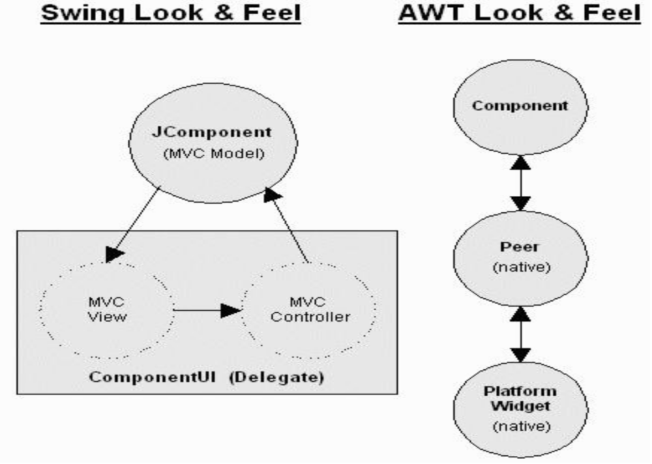

Slide 21
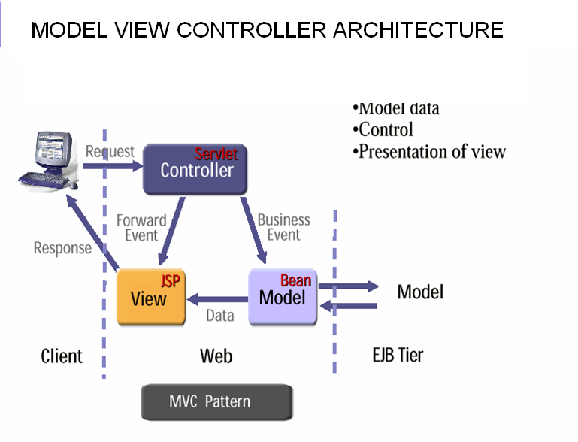

Slide 22
Model
Model consists of data and the functions that operate on data
Java bean that we use to store data is a model component
EJB can also be used as a model component

Slide 23
view
View is the front end that user interact.
View can be a
HTML
JSP
Struts ActionForm

Slide 24
Controller
Controller component responsibilities
  Receive request from client
  Map request to specific business operation
  Determine the view to display based on the result of the business operation

Slide 25
components
Container
  JComponent
    AbstractButton
      JButton
      JMenuItem
        JCheckBoxMenuItem
        JMenu
        JRadioButtonMenuItem
      JToggleButton
        JCheckBox
        JRadioButton

Slide 26
Components (contd…)
JComponent
  JComboBox
  JLabel
  JList
  JMenuBar
  JPanel
  JPopupMenu
  JScrollBar
  JScrollPane

Slide 27
Components (contd…)
JComponent
  JTextComponent
    JTextArea
    JTextField
      JPasswordField
    JTextPane
      JHTMLPane

Slide 28
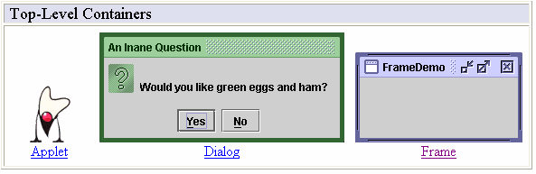
Containers
Top-Level Containers
The components at the top of any Swing containment hierarchy

Slide 29
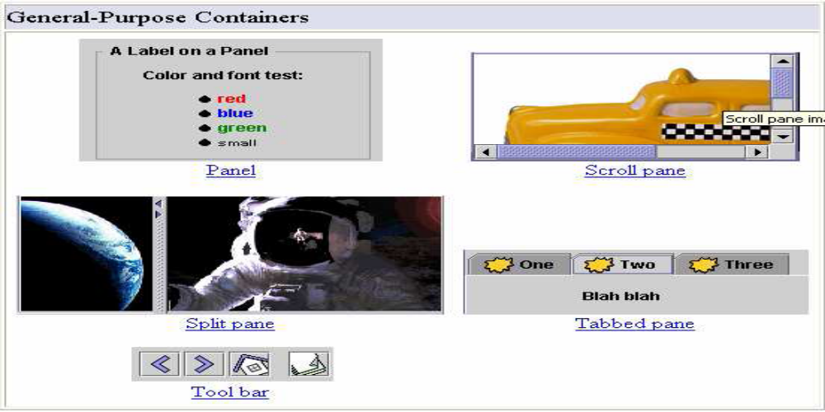
General Purpose Containers
Intermediate containers that can be used under many different circumstances.

Slide 30
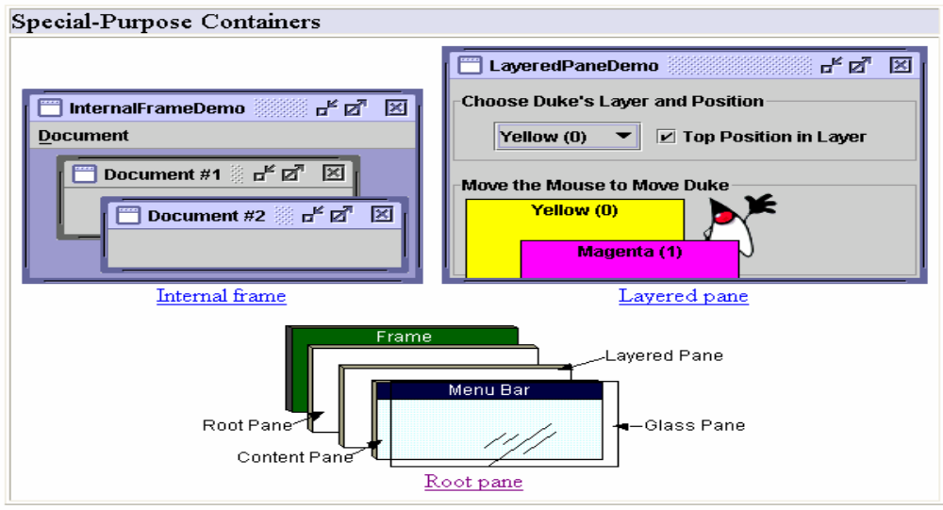
Special Purpose Container
Intermediate containers that play specific roles in the UI.

Slide 31
Exploring swing- JApplet,
If using Swing components in an applet, subclass JApplet, not Applet
  JApplet is a subclass of Applet
  Sets up special internal component event handling, among other things
  Can have a JMenuBar
  Default LayoutManager is BorderLayout

Slide 32
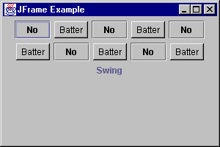
JFrame
public class FrameTest {
public static void main (String args[]) {
JFrame f = new JFrame ("JFrame Example");
Container c = f.getContentPane();
c.setLayout (new FlowLayout());
for (int i = 0; i < 5; i++) {
c.add (new JButton ("No"));
c.add (new Button ("Batter"));
}
c.add (new JLabel ("Swing"));
f.setSize (300, 200);
f.show();
}
}

Slide 33
JComponent
JComponent supports the following components.
JComponent
  JComboBox
  JLabel
  JList
  JMenuBar
  JPanel
  JPopupMenu
  JScrollBar
  JScrollPane
  JTextComponent
    JTextArea
    JTextField
      JPasswordField
    JTextPane
      JHTMLPane

Slide 34
Icons and Labels
In Swing, icons are encapsulated by the ImageIcon class, which paints an icon from an image.
constructors are:
ImageIcon(String filename)
ImageIcon(URL url)
The ImageIcon class implements the Icon interface that declares the methods
    int getIconHeight( )
    int getIconWidth( )
    void paintIcon(Component comp,Graphics g,int x, int y)

Slide 35
Swing labels are instances of the JLabel class, which extends JComponent.
It can display text and/or an icon.
Constructors are:
    JLabel(Icon i)
    Label(String s)
    JLabel(String s, Icon i, int align)
Here, s and i are the text and icon used for the label. The align argument is either LEFT, RIGHT, or CENTER. These constants are defined in the SwingConstants interface,
Methods are:
    Icon getIcon( )
    String getText( )
    void setIcon(Icon i)
    void setText(String s)
Here, i and s are the icon and text, respectively.

Slide 36
Text fields
The Swing text field is encapsulated by the JTextComponent class, which extendsJComponent.
It provides functionality that is common to Swing text components.
One of its subclasses is JTextField, which allows you to edit one line of text.
Constructors are:
    JTextField( )
    JTextField(int cols)
    JTextField(String s, int cols)
    JTextField(String s)
Here, s is the string to be presented, and cols is the number of columns in the text field.

Slide 37
Buttons
Swing buttons provide features that are not found in the Button class defined by the AWT.
Swing buttons are subclasses of the AbstractButton class, which extends JComponent.
AbstractButton contains many methods that allow you to control the behavior of buttons, check boxes, and radio buttons.
Methods are:
    void setDisabledIcon(Icon di)
    void setPressedIcon(Icon pi)
    void setSelectedIcon(Icon si)
    void setRolloverIcon(Icon ri)
Here, di, pi, si, and ri are the icons to be used for these different conditions.
The text associated with a button can be read and written via the following methods:
    String getText( )
    void setText(String s)
Here, s is the text to be associated with the button.

Slide 38
JButton
The JButton class provides the functionality of a push button.
JButton allows an icon, a string, or both to be associated with the push button.
Some of its constructors are :
    JButton(Icon i)
    JButton(String s)
    JButton(String s, Icon i)
Here, s and i are the string and icon used for the button.

Slide 39
Check boxes
The JCheckBox class, which provides the functionality of a check box, is a concrete implementation of AbstractButton.
Some of its constructors are shown here:
    JCheckBox(Icon i)
    JCheckBox(Icon i, boolean state)
    JCheckBox(String s)
    JCheckBox(String s, boolean state)
    JCheckBox(String s, Icon i)
    JCheckBox(String s, Icon i, boolean state)
Here, i is the icon for the button. The text is specified by s. If state is true, the check box is initially selected. Otherwise, it is not.
The state of the check box can be changed via the following method:
void setSelected(boolean state)
Here, state is true if the check box should be checked.

Slide 40
Combo boxes
Swing provides a combo box (a combination of a text field and a drop-down list) through the JComboBox class, which extends JComponent.
A combo box normally displays one entry. However, it can also display a drop-down list that allows a user to select a different entry. You can also type your selection into the text field.
Two of JComboBox's constructors are :
    JComboBox( )
    JComboBox(Vector v)
Here, v is a vector that initializes the combo box.
Items are added to the list of choices via the addItem( ) method, whose signature is:
void addItem(Object obj)
Here, obj is the object to be added to the combo box.

Slide 41
Radio Buttons
Radio buttons are supported by the JRadioButton class, which is a concrete implementation of AbstractButton.
Some of its constructors are :
JRadioButton(Icon i)
JRadioButton(Icon i, boolean state)
JRadioButton(String s)
JRadioButton(String s, boolean state)
JRadioButton(String s, Icon i)
JRadioButton(String s, Icon i, boolean state)
Here, i is the icon for the button. The text is specified by s. If state is true, the button is initially selected. Otherwise, it is not.
Elements are then added to the button group via the following method:
void add(AbstractButton ab)
Here, ab is a reference to the button to be added to the group.

Slide 42
Tabbed Panes
A tabbed pane is a component that appears as a group of folders in a file cabinet.
Each folder has a title. When a user selects a folder, its contents become visible. Only one of the folders may be selected at a time.
Tabbed panes are commonly used for setting configuration options.
Tabbed panes are encapsulated by the JTabbedPane class, which extends JComponent. We will use its default constructor. Tabs are defined via the following method:
void addTab(String str, Component comp)
Here, str is the title for the tab, and comp is the component that should be added to the tab. Typically, a JPanel or a subclass of it is added.
The general procedure to use a tabbed pane in an applet is outlined here:
1. Create a JTabbedPane object.
2. Call addTab( ) to add a tab to the pane. (The arguments to this method define the
title of the tab and the component it contains.)
3. Repeat step 2 for each tab.
4. Add the tabbed pane to the content pane of the applet.

Slide 43
Scroll Panes
A scroll pane is a component that presents a rectangular area in which a component may be viewed. Horizontal and/or vertical scroll bars may be provided if necessary.
Scroll panes are implemented in Swing by the JScrollPane class, which extends JComponent. Some of its constructors are :
JScrollPane(Component comp)
JScrollPane(int vsb, int hsb)
JScrollPane(Component comp, int vsb, int hsb)
Here, comp is the component to be added to the scroll pane. vsb and hsb are int constants that define when vertical and horizontal scroll bars for this scroll pane areshown.
These constants are defined by the ScrollPaneConstants interface.
    HORIZONTAL_SCROLLBAR_ALWAYS
    HORIZONTAL_SCROLLBAR_AS_NEEDED
    VERTICAL_SCROLLBAR_ALWAYS
    VERTICAL_SCROLLBAR_AS_NEEDED
Here are the steps to follow to use a scroll pane in an applet:
    1. Create a JComponent object.
    2. Create a JScrollPane object. (The arguments to the constructor specify thecomponent and the policies for vertical and horizontal scroll bars.)
    3. Add the scroll pane to the content pane of the applet.

Slide 44
Trees
Data Model - TreeModel
  default: DefaultTreeModel
  getChild, getChildCount, getIndexOfChild, getRoot, isLeaf
Selection Model - TreeSelectionModel
View - TreeCellRenderer
  getTreeCellRendererComponent
Node - DefaultMutableTreeNode

Slide 45
Tables
A table is a component that displays rows and columns of data. You can drag the cursor on column boundaries to resize columns. You can also drag a column to a new position.
Tables are implemented by the JTable class, which extends JComponent.
One of its constructors is :
JTable(Object data[ ][ ], Object colHeads[ ])
Here, data is a two-dimensional array of the information to be presented, and colHeads is a one-dimensional array with the column headings.
Here are the steps for using a table in an applet:
    1. Create a JTable object.
    2. Create a JScrollPane object. (The arguments to the constructor specify the table and
    the policies for vertical and horizontal scroll bars.)
    3. Add the table to the scroll pane.
    4. Add the scroll pane to the content pane of the applet.

