Slide 1

School of Computer Science and
Engineering (CSE)
COMP9900 Information Technology Project COMP3900 Computer Science Project
Dr. Basem Suleiman

Slide 2

Outline
Course Introduction
Assessment Tasks Overview
Project Clients Coordination
User Stories and Acceptance Criteria
Jira Software
Working in Group
Week 1 Lab Tasks
Q & A

Slide 3
Course Introduction

Slide 4
Course Introduction
Moodle Course Website
Edstem forum – Discussion
Lectures: Monday 18:00 - 20:00 Location: Hybrid on-campus and Online Weeks 1-5 (Lectures), 7-10 (Consultations)
Labs : 2 hours per week Location: F2F or Online (MS Teams) - check timetable / moodle Weeks 1-5, 7-10 (Week 6 if Flex Week)
Workshops: 2 sessions per week (1 hour each) - Wed & Thurs Location: Online (MS Teams) Weeks 2-5, 7-9 (Week 6 is Flex Week)

Slide 5
Course Introduction
• Moodle Course Website
https://moodle.telt.unsw.edu.au/course/view.php?id=91927
• Edstem forum: - Discussion
https://edstem.org/au/courses/24654/discussion/2724829
• Lectures: Monday 18:00 - 20:00
Location: Hybrid on-campus (K-J14-G5) and Online
Weeks 1, 3-5 (Lectures), 7-10 (Consultations)
• Labs : 2 hours per week
Location: In-person or Online (Echo360)
Check timetable/moodle
Weeks 1-5, 7-10 (Week 6 is Flex Week)
4

Slide 6
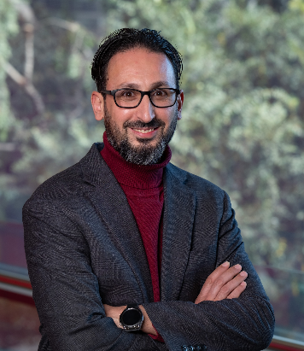
COMP[39]900 Teaching Team
Lecturer in charge (LiC) / Course Convenor
Capstone Industry Liaison Officer
Academic profile
Research profile & projects
Email: b.suleiman@unsw.edu.au

Slide 7
COMP[39]900 Course Contact
Course Administrators (Chitra & Arthur) can be contacted via course emails.
Course Emails
COMP3900: cs3900@cse.unsw.edu.au
COMP9900: cs9900@cse.unsw.edu.au
For ELS / ELP, please reach out to staff via the respective course email + CC Iromie Samarasekara

Slide 8
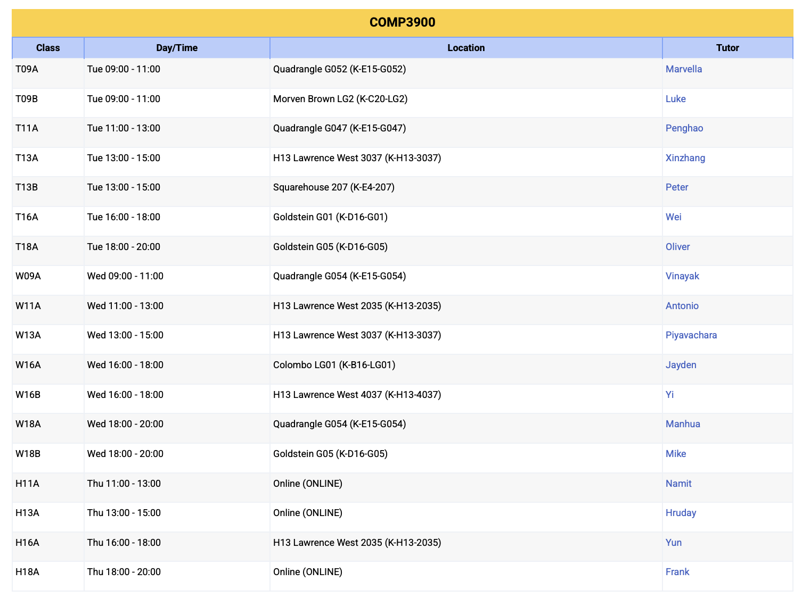
COMP3900 Lab Schedule
*COMP[39]9900 Moodle > Lab Schedule

Slide 9
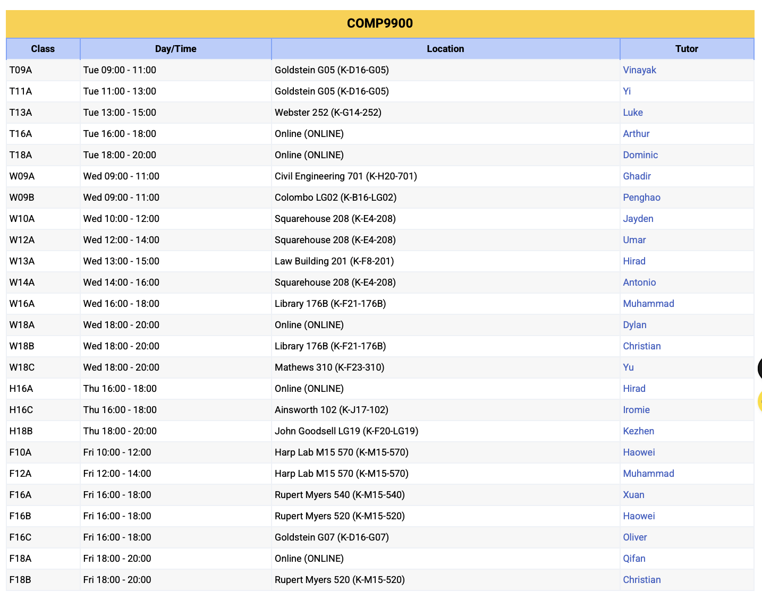
COMP9900 Lab Schedule
*COMP[39]9900 Moodle > Lab Schedule

Slide 10
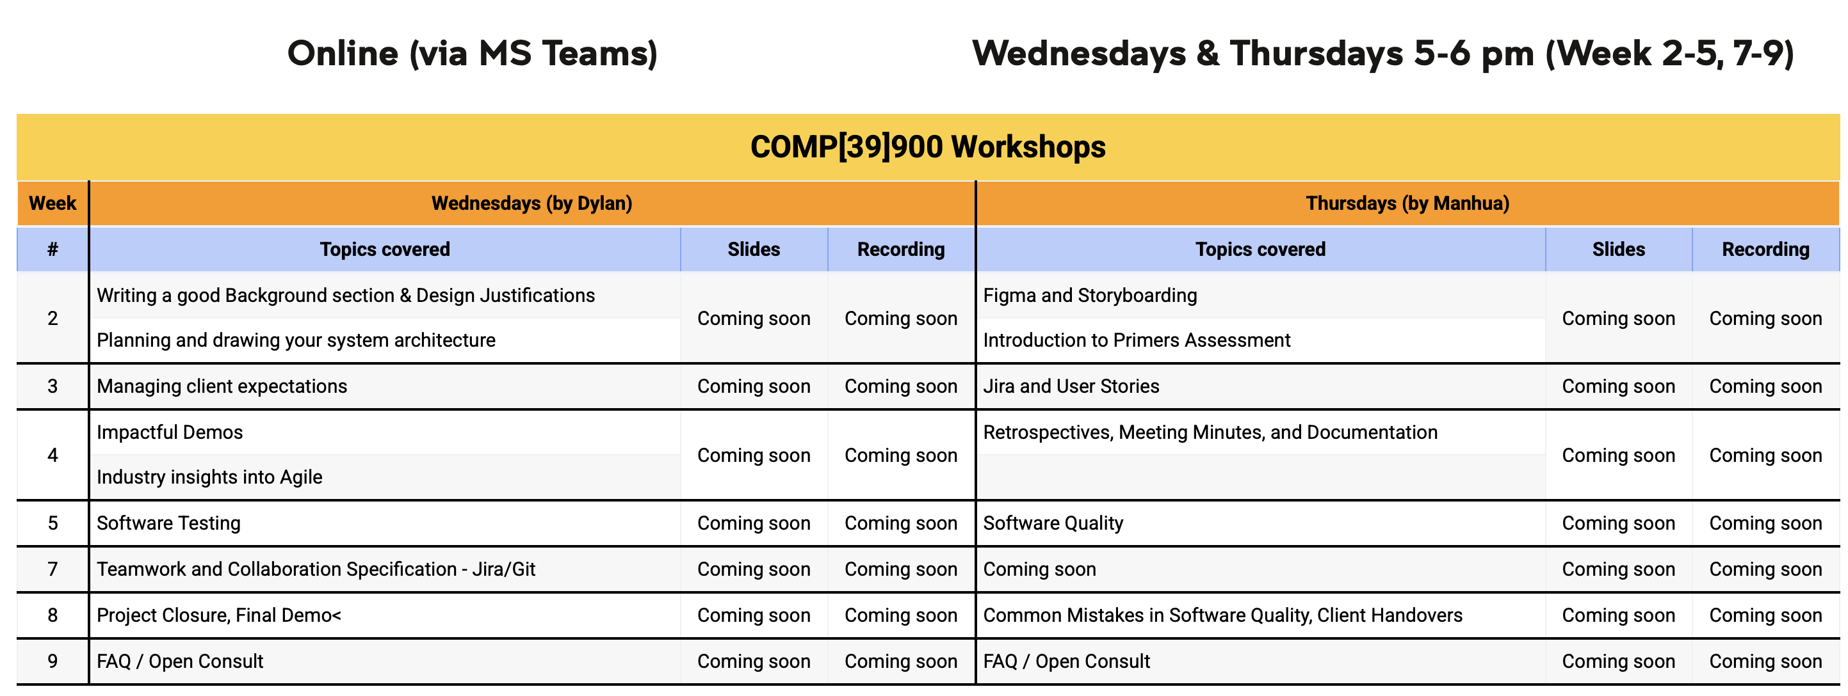
COMP[39]900 Workshop Schedule
*COMP[39]9900 Moodle > Workshop Schedule

Slide 11
Course Summary
A software project capstone course
Students work in teams to define, implement and evaluate
a real-world software system or research
All of the work in this course is team-based project work
There are some introductory lectures on software project management techniques and teamwork strategies

Slide 12
Course Summary (cont’d)
Project teams meet weekly with project mentors to report on the progress of the project
Assessment is based on a project proposal, progressive demonstrations and retrospectives, a final project demonstration and report, and on the quality of the software system itself
Students are also required to reflect on their work and to provide peer assessment of their teammates' contributions to the project

Slide 13
Labs (or Mentoring Sessions)
Weekly project progress meeting with tutor (mentor) - weekly check points individually / group
Attendance to labs is mandatory and will be recorded – report individual and group progress to tutors (mentors)
Individual and group assessments
Two progressive demos to mentor in Weeks 5 and 8 and
final demo in Week 10
Two retrospectives right after progressive demos (due Weeks 5 & 8)
Regular group meetings (more than once per week) among team members

Slide 14
Readings / Resources
No textbook
Lectures slides cover core knowledge and skills (links to additional resources/readings)
Online resources including Fundamentals Primers, lectures, industry lectures, dedicated help sessions and tutor/mentor support
For Project Management part of the course, the following text is recommended (for traditional project management)
Kathy Schwalbe. Information Technology Project Management. 9th Edition. Cengage. 2018

Slide 15
Assumed Knowledge
Before commencing this course, students should be able to:
produce correct software programs in Python, Java or C/C++, i.e., compilation, running, testing, debugging, etc.
produce readable code with clear documentation
have basic knowledge of database programming, Web programming and/or script programming (such as Python, PHP, and JavaScript)

Slide 16
Assumed Knowledge (cont’d)
For COMP3900, students must:
Have successfully completed COMP1531 and
COMP2521 (or the old equivalent COMP1927)
Be enrolled in a BSc Computer Science major
Have completed at least 102 UOC

Slide 17
Assumed Knowledge (cont’d)
For COMP9900, students must:
Be in their final term of study, and
Have completed at least 66 UOC towards MIT program 8543

Slide 18
Learning Outcomes
Work from a set of requirements, elaborate them, and produce a
specification
Design and build a correct, efficient and robust software system from
specification
Use software development and software project management tools
Validate the correctness and robustness of software
Work effectively in a project team, and lead when required
Manage their time effectively, and make reasoned trade-offs over
competing demands
Communicate technical information clearly, both verbally and in writing

Slide 19
COMP[39]900 – Projects
A brief description of real-world projects to choose from this term is provided under Project Topics section in Moodle
As a team, decide on the project that best matches the team’s areas of specialization, knowledge and skills by end of Week 1

Slide 20
Course Improvements - MyExperience
Larger number and varieties of real-world projects
Refined and streamlined assessments guidelines and markings
Group-focused mentoring – weekly consultation and check points
Additional resources – e.g., primers, guide for essential skills
Additional help/consultation sessions and support
Client feedback and assessment throughout the term
A greater emphasis on design in the development process
Industry lectures – related to project work
Many more – teaching team weekly feedback discussion

Slide 21
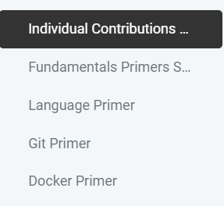
Course Improvements - Primers
Fundamentals Primers: 3 short individual exercises
Language Primer: software development in Python or Javascript
Git Primer: version control and collaborative development and
Docker Primer: automated code deployment
Notes:
Fundamentals Primers (5% due Week 3 Lab Time)
You are required to complete three short individual exercises to ensure every student has a few essential skills for groupwork.
The Language Primer requires you to demonstrate sufficient skill in either Python or Javascript to ensure that every student can confidently contribute to their group.
Access the Language Primer here
The Git Primer ensures you know how to clone a repository, commit changes and submit a pull request.
Access the Git Primer here
The Docker Primer ensures that you are comfortable working with Docker, Dockerfiles, and Docker compose files.
Access the Docker Primer here
You will need to show your tutor that you have completed all of the above during your Week 3 Lab Time.
No submission is necessary. Your tutor will assess your work during the lab.

Slide 22
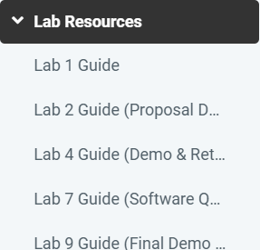
Course Improvements - Lab Resources
Guides on key lab activities and assessments
Group formation and project selection
Project proposal
Sprint demos. and retrospectives
Final report, demo, code quality

Slide 23
Assessment Tasks Overview

Slide 24
Assessment Overview
No final exam
A team-based project
Each team has six (6) members (4 groups per lab)

Slide 25
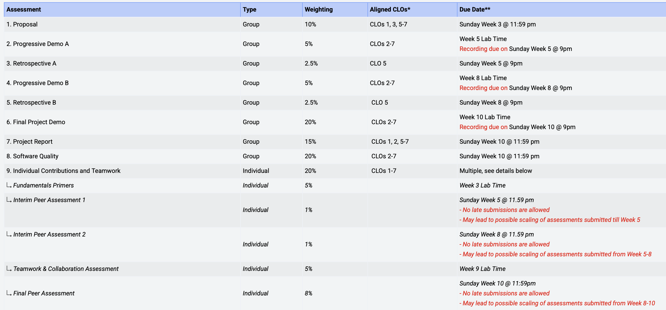
Assessment Overview (cont’d)

Slide 26
Assessment – Individual Contributions and Peer Assessment
Fundamentals Primers (5%): Week 3 Lab Time (individual)
Interim Peer Assessment - 1 (1%): Week 5 Sunday (individual)
Interim Peer Assessment - 2 (1%): Week 8 Sunday (individual)
Teamwork and Collaboration Assessment (5%): Week 9 Lab Time (individual)
Final Peer Assessment (8%): Week 10 Sunday (individual)
Notes:
Basics
Due Dates and Weightings:
Fundamentals Primers: Week 3 Lab Time
Interim Peer Assessment- Part 1: Week 5 Sunday @ 11:59 pm
Interim Peer Assessment- Part 2: Week 8 Sunday @ 11:59 pm
Teamwork and Collaboration Assessment: Week 9 Lab Time
Final Peer Assessment: Week 10 Sunday @ 11:59 pm
Weighting:
Fundamentals Primers: 5%
Interim Peer Assessment: 2% (1% for each week 5 & 8)
Teamwork and Collaboration Assessment: 5%
Final Peer Assessment: 10% with possible scaling of all other assessments
This assessment item aims to:
Assess how you work collaboratively as a team
Ensure you have the prerequisite skills to clearly articulate technical information in both written and spoken mediums
Assess individual contributions through a peer assessment
You will need to show your tutor that you have completed all of the above during your Week 3 Lab Time.
No submission is necessary. Your tutor will assess your work during the lab.
If you need any clarifications on the above, please ask your tutor or make a forum post.
Each of the above will be marked individually. It is essential that each person in the group has completed their individual tasks and attend their Week 3 Lab to get it marked off.
Alternative arrangements will be made if Special Consideration is approved.

Slide 27
Assessment – Final Peer Assessment
Detailed Assessment Description
Note: this assessment will take into consideration individual contributions through weekly informal oral presentation.
Each group member will need to briefly discuss their technical contributions (e.g., design & development activities) to their mentor/tutor who will record these during the lab consultation time and consider when assessing peer assessments besides other sources (e.g., Github contributions, jira sprints).
Notes:
Basics
Due Dates and Weightings:
Fundamentals Primers: Week 3 Lab Time
Interim Peer Assessment: Week 7 Lab Time
Teamwork and Collaboration Assessment: Week 9 Lab Time
Final Peer Assessment: Week 10 Sunday (17 November 2024) @ 11:59 pm
Weighting:
Fundamentals Primers: 5%
Interim Peer Assessment: 0%
Teamwork and Collaboration Assessment: 5%
Final Peer Assessment: 10% with possible scaling of all other assessments
This assessment item aims to:
Assess how you work collaboratively as a team
Ensure you have the prerequisite skills to clearly articulate technical information in both written and spoken mediums
Assess individual contributions through a peer assessment
You will need to show your tutor that you have completed all of the above during your Week 3 Lab Time.
No submission is necessary. Your tutor will assess your work during the lab.
If you need any clarifications on the above, please ask your tutor or make a forum post.
Each of the above will be marked individually. It is essential that each person in the group has completed their individual tasks and attend their Week 3 Lab to get it marked off.
Alternative arrangements will be made if Special Consideration is approved.

Slide 28
Assessment – Project Proposal
Project Proposal (10%)
Proposal report inc. problem, scope, requirements, initial designs and architecture, development plan
Group report due week 3 - submit via Moodle
Discuss and review with client/product owner
Notes:
Basics
· Due Date: Week 3 Sunday (29 September 2024) @ 9:00pm. Late submission attracts a penalty of 5% per day (i.e. 0.5 marks will be deducted per day).
· Weighting: 10%
· Submission: Submission is via Turnitin on Moodle. Please follow the instructions laid out on Moodle.
· The project proposal should be self-contained. i.e. no content should be outside of the report and simply linked to.
Purpose
· The main purpose of your proposal is to
1. Identify and research the problem you are solving.
2. Propose a solution based on the research you perform and justify how your solution is unique and overcomes problems you identify in existing systems.3. Set out the project management that you will use for the duration of the project (user stories, sprint milestones, project objectives).

Slide 29
Assessment – Progressive Check points
Sprint Demonstrations
Demonstrate working version of the implemented software
Demo A (5%): live demo during week 5 lab and client demo.
Demo B (5%): live demo during week 8 lab and client demo.
Group work submit through Moodle (recording)
Sprint Retrospectives
Retro A (2.5%): team review of group processes due by week 5
Retro B (2.5%): team review of group processes due by week 8
Group work, submit reports via Moodle
Notes:
Progressive Demo A (during Week 5 Lab Time) (worth 2.5%)
The demo should be between 10-12 minutes
You may be penalised if your presentation is too short and does not go into enough depth
You will be cut off at 12 minutes (hard-limit)
Make sure you are ready to demo your project during your lab and that any necessary preparations are conducted before the lab
You must submit a recording of your demo by Sunday Week 5 (30 June) @ 9pm
This will not be marked so please make minimal edits to the recording
The easiest way to record the demo is to setup a zoom meeting when presenting and record that with screensharing on
You must have multiple members of the team speaking. Every person does not have to speak, however, at least 2-3 people should have relatively equal speaking time
You must be present during the demo even if you are not speaking otherwise you will receive a mark of 0.
The main purpose of your demo is to
Showcase the work you have done in Sprint 1 to your tutor and peers
Receive feedback on progress that you must implement in future sprints
Justify that not only is your project well-made but is also an effective solution to the given problem

Slide 30
Assessment – Progressive Check points
Detailed Assessment Description
Each group should demo the completed work by these checkpoints to their stakeholder (client) and collect and document feedback for future changes/improvements.
The client feedback (e.g., request for changes or improvements) should be addressed in by the group in the subsequent Sprints and documented and communicated with your client and tutor.
Notes:
Progressive Demo A (during Week 5 Lab Time) (worth 2.5%)
The demo should be between 10-12 minutes
You may be penalised if your presentation is too short and does not go into enough depth
You will be cut off at 12 minutes (hard-limit)
Make sure you are ready to demo your project during your lab and that any necessary preparations are conducted before the lab
You must submit a recording of your demo by Sunday Week 5 (30 June) @ 9pm
This will not be marked so please make minimal edits to the recording
The easiest way to record the demo is to setup a zoom meeting when presenting and record that with screensharing on
You must have multiple members of the team speaking. Every person does not have to speak, however, at least 2-3 people should have relatively equal speaking time
You must be present during the demo even if you are not speaking otherwise you will receive a mark of 0.
The main purpose of your demo is to
Showcase the work you have done in Sprint 1 to your tutor and peers
Receive feedback on progress that you must implement in future sprints
Justify that not only is your project well-made but is also an effective solution to the given problem

Slide 31
Assessment – Final Assessments
Final Report (15%)
Project report documentation (inc. requirements, design, implementation, deployment)
Group work due by week 10 – submit via Moodle
Software Quality Specifications (20%)
Quality of the system to be delivered (inc. completeness, system robustness, code quality practices, user interface design, and system deployment)
Group work report and code due by week 10 – submit via Moodle
Final Demo (20%): live demo and client demo during week 10 lab
Group work all must attend and present, submit recording via Moodle
Notes:
Due Date: Sunday Week 10 (4 August) @ 9.00pm
Weighting: 20%
Assessment Criteria: This assessment assesses the quality of the system you have delivered, including
the system’s level of completeness, considered against
your own proposal objectives,
the original project specification, and
any client requirements (such as changes from the weekly meetings or sprint reviews/demos),
the system’s robustness,
whether the system has high technical quality, in the sense that it
shows well-considered design,
demonstrates acceptable technical quality in terms of functional and non-functional requirements (e.g., performance, scalability, security) as stated in the requirements, raised by the client or applicable to the nature of the project
shows technical skill, such as through the implementation of non-trivial algorithms or similar,
whether the codebase has good style and testing in that
it is well-structured, readable, and well-documented,
there is evidence of robust testing, and
the system’s user interface.
Requirement to use Docker: Generally, the final system must run in a Docker container:
Instructions on how to build your image and run the container must be provided in your Project Report under the relevant section.
If your project or part of your project cannot reasonably be containerised in Docker (e.g. it is a mobile app that must run in an emulator or mobile device) you must make arrangements with your tutor on how to test your project before the end of Week 8.
Your tutor may waive the requirement to use Docker and use other testing arrangements at their discretion.
Generally, the system should, to the maximum extent possible, be containerised in Docker. For example, while the mobile app itself may not be able to be containerised, the system’s backend may be containerised in Docker.

Slide 32
Assessment – Final Assessments
1. Final presentation/demo
each student should be presenting the main technical work (user stories) they were responsible for. Each team should also demo their final software/application to their client. The clients will provide feedback on the software/application which will be taken into consideration by the tutor in the final demo/presentation assessment.
2. Project report:
all team members should contribute and revise the document to ensure faire contributions and transparency among team members.
3. Source code quality:
each student should be responsible for implementing set of functionalities (user stories) during the project. This should be documented in Jira (throughout the Sprints) and in the code with inline comments with information including user story (or issue), name of the team member who implement, team member who reviewed the code if needed, and any useful information.
Notes:
Due Date: Sunday Week 10 (4 August) @ 9.00pm
Weighting: 20%
Assessment Criteria: This assessment assesses the quality of the system you have delivered, including
the system’s level of completeness, considered against
your own proposal objectives,
the original project specification, and
any client requirements (such as changes from the weekly meetings or sprint reviews/demos),
the system’s robustness,
whether the system has high technical quality, in the sense that it
shows well-considered design,
demonstrates acceptable technical quality in terms of functional and non-functional requirements (e.g., performance, scalability, security) as stated in the requirements, raised by the client or applicable to the nature of the project
shows technical skill, such as through the implementation of non-trivial algorithms or similar,
whether the codebase has good style and testing in that
it is well-structured, readable, and well-documented,
there is evidence of robust testing, and
the system’s user interface.
Requirement to use Docker: Generally, the final system must run in a Docker container:
Instructions on how to build your image and run the container must be provided in your Project Report under the relevant section.
If your project or part of your project cannot reasonably be containerised in Docker (e.g. it is a mobile app that must run in an emulator or mobile device) you must make arrangements with your tutor on how to test your project before the end of Week 8.
Your tutor may waive the requirement to use Docker and use other testing arrangements at their discretion.
Generally, the system should, to the maximum extent possible, be containerised in Docker. For example, while the mobile app itself may not be able to be containerised, the system’s backend may be containerised in Docker.

Slide 33
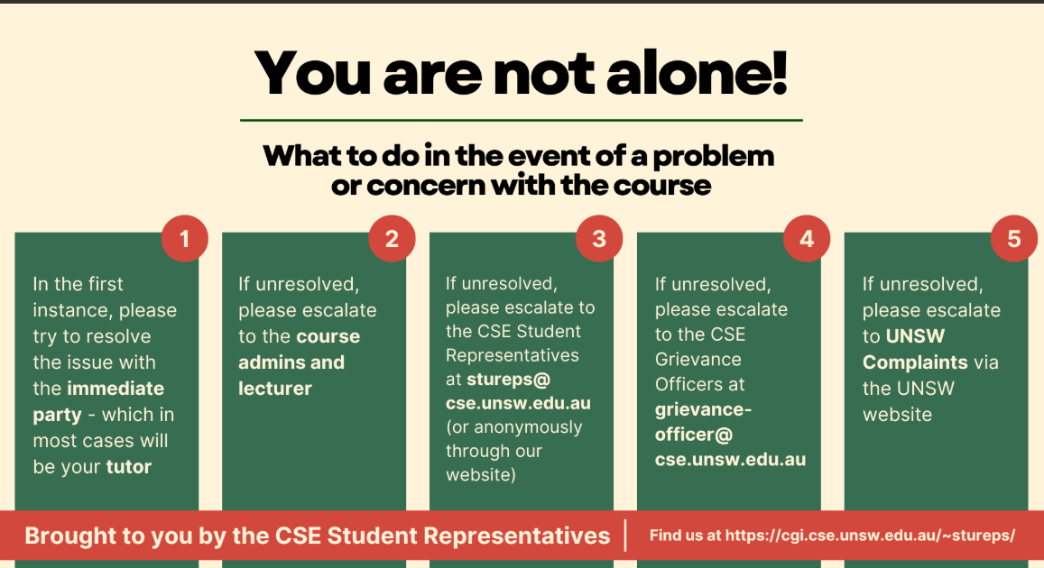
Complaints / Grievance Process
Notes:
Due Date: Sunday Week 10 (4 August) @ 9.00pm
Weighting: 20%
Assessment Criteria: This assessment assesses the quality of the system you have delivered, including
the system’s level of completeness, considered against
your own proposal objectives,
the original project specification, and
any client requirements (such as changes from the weekly meetings or sprint reviews/demos),
the system’s robustness,
whether the system has high technical quality, in the sense that it
shows well-considered design,
demonstrates acceptable technical quality in terms of functional and non-functional requirements (e.g., performance, scalability, security) as stated in the requirements, raised by the client or applicable to the nature of the project
shows technical skill, such as through the implementation of non-trivial algorithms or similar,
whether the codebase has good style and testing in that
it is well-structured, readable, and well-documented,
there is evidence of robust testing, and
the system’s user interface.
Requirement to use Docker: Generally, the final system must run in a Docker container:
Instructions on how to build your image and run the container must be provided in your Project Report under the relevant section.
If your project or part of your project cannot reasonably be containerised in Docker (e.g. it is a mobile app that must run in an emulator or mobile device) you must make arrangements with your tutor on how to test your project before the end of Week 8.
Your tutor may waive the requirement to use Docker and use other testing arrangements at their discretion.
Generally, the system should, to the maximum extent possible, be containerised in Docker. For example, while the mobile app itself may not be able to be containerised, the system’s backend may be containerised in Docker.

Slide 34
Assessment – GenAI Level
Simple Editing Assistance
You are permitted to use standard editing and referencing functions in the software you use to complete your assessment. You must not use any functions that generate or paraphrase passages of text or other media, whether based on your own work or not.
If your Convenor has concerns that your submission contains passages of AI-generated text or media, you may be asked to account for your work. If you are unable to satisfactorily demonstrate your understanding of your submission you may be referred to UNSW Conduct & Integrity Office for investigation for academic misconduct and possible penalties.
For more information on Generative AI and permitted use, please see here
Notes:
Simple Editing Assistance
In completing this assessment, you are permitted to use standard editing and referencing functions in the software you use to complete your assessment. These functions are described below. You must not use any functions that generate or paraphrase passages of text or other media, whether based on your own work or not. If your Convenor has concerns that your submission contains passages of AI-generated text or media, you may be asked to account for your work. If you are unable to satisfactorily demonstrate your understanding of your submission you may be referred to UNSW Conduct & Integrity Office for investigation for academic misconduct and possible penalties. For more information on Generative AI and permitted use please see here, opens in a new window.

Slide 35
Project Clients Coordination

Slide 36
How to select a project
Read project details and discuss as team (more projects will be added by Thursday)
As a team, decide on 7 project preferences (knowledge, skills, goals)
Complete Project Questionnaire (with justification). One submission per group. Complete end of week 1
Discuss with your tutor - more information during week 1 (students guide).
Project allocation based on knowledge, skills, client's capacity
Notification of project allocation from week 2
Contact client, discuss the scope and clarify requirements

Slide 37
Project Clients Coordination
Roadmap for capstone projects – accreditation by ACS, Engineers Australia
Projects proposed by clients (project owners) – real-life project experience
Group’s Product Owner – communicate with client and understand their needs
Project description
Client, project specialization, background, requirements and scope, required knowledge and skills, expected outcomes
Projects focus – development work and discipline-specific
Traditional software/system development and interdisciplinary
Web/software/mobile application, AI-based development, cybersecurity, computer vision
Teams to select project based on knowledge and skills – important!

Slide 38
Project Clients Coordination
Teams to work with project client
Project stakeholders – (e.g., industry partners, research assistants)
Requirements elicitation and scope – by Week 3
Sprint demos, deliverables/outcomes, handover/documentation
Bi-weekly/milestone meetings (e.g., demos) and communication – efficient and effective
Early feedback and changes (Sprints reviews)
Product owner (team lead) – act on the client’s behalf
Scrum master – ensure following scrum roles, events, artefacts
Be creative – suggest/lead novel ideas
Projects coordinator (Basem Suleiman) to facilitate with clients
Teams to manage with Product Owner
Product owner act as client to their best knowledge or best practice (Scrum method)
Team to experience working with product owner
Product owners and Scum Masters will also members of the development team

Slide 39
Project Clients Coordination
• Why we need to keep client in the loop
As part of gaining real-world experience that mirrors what you’ll encounter in the industry.
Their involvement is crucial to ensuring the solution you develop meets real needs and expectations.
For final assessment (Final demo, report and software quality, 55% in total), client feedback is a really important factor which affect how we assess your project completeness.
Before finishing the final handover to client, your final result will not be finalized.
Our tutor will check the client communication on weekly basis.
36

Slide 40
Project Clients Coordination
• When things go wrong, e.g., Client is unresponsive
• Send polite email asking whether you can meet up - sometime clients get busy with other commisions.
If still no response, reflect the situation to Tutor via email or during the lab
Your tutor will reflect this issue to admin team to solve it asap.
• Client gives too easy or too hard requirements
• Please note: your final deliverable will be assessed against the academic standards of this course.
Too easy: Even if you fulfill the requirements, you may not gain high marks. Try to think proactively how to make it better and communicate your thoughts with client.
Too hard: Communicate with your client to explain why you believe the requirement is difficult to implement within the development timeframe of this course.
Main tip: Product owner should always balance between the client and team.
37

Slide 41
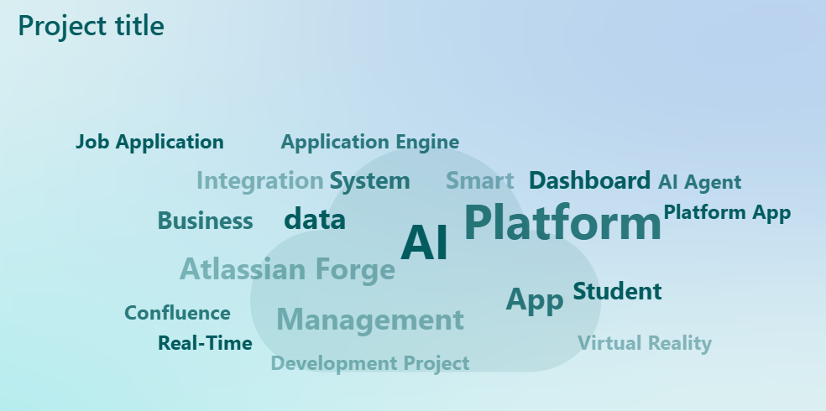
Projects Summary

Slide 42
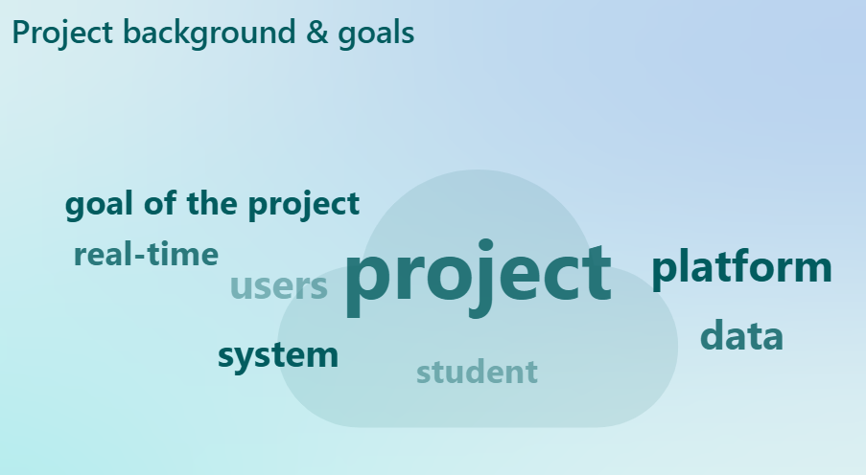
Projects Summary

Slide 43
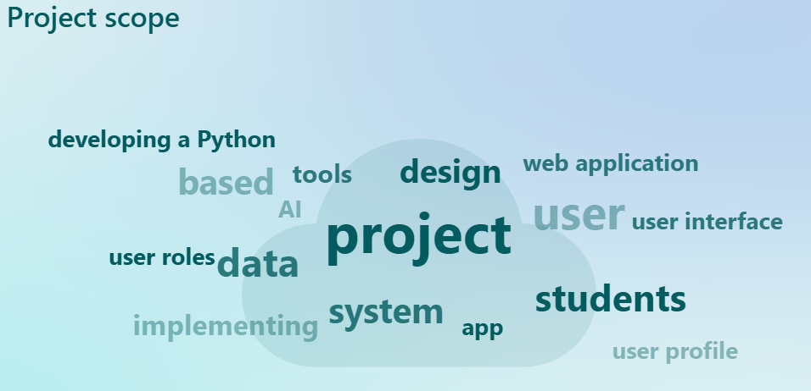
Projects Summary

Slide 44
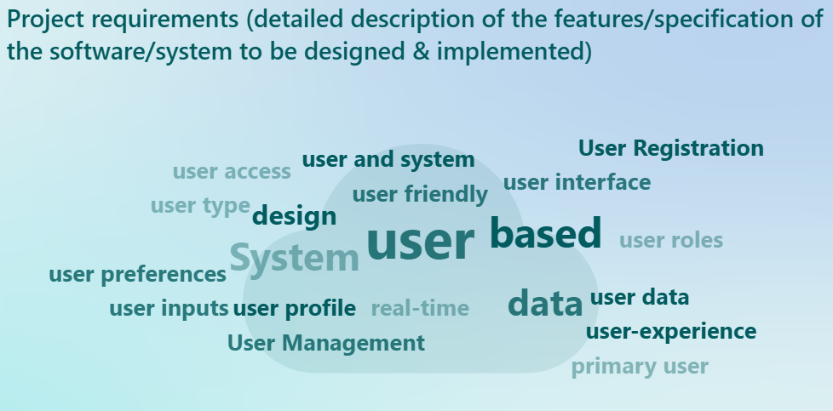
Projects Summary

Slide 45
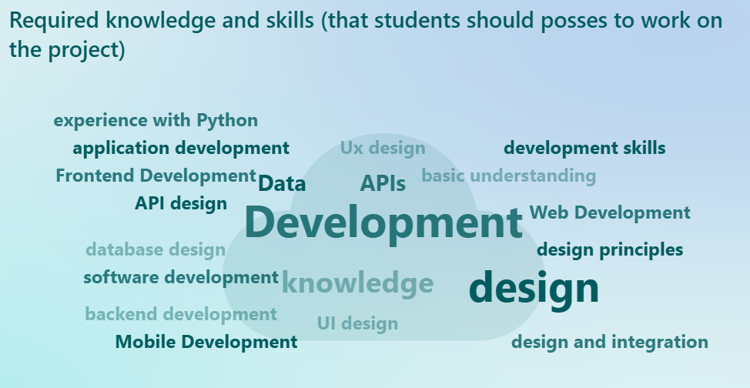
Projects Summary

Slide 46
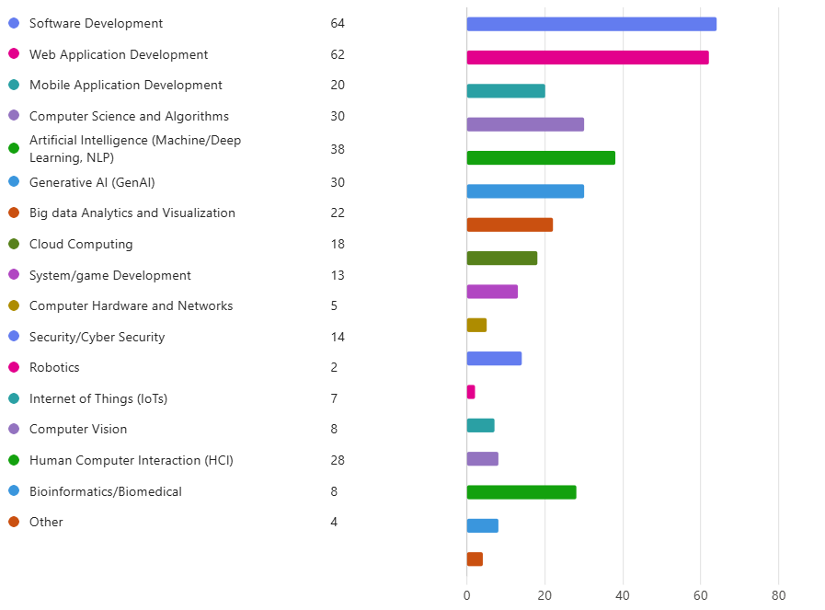
Projects Summary

Slide 47
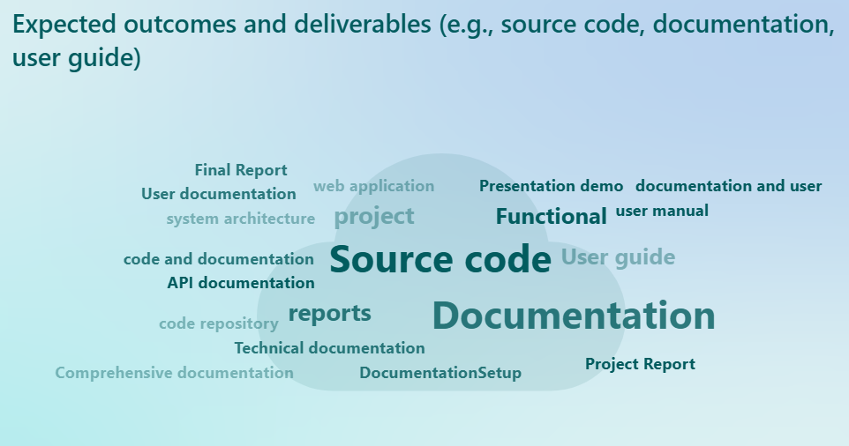
Projects Summary

Slide 48
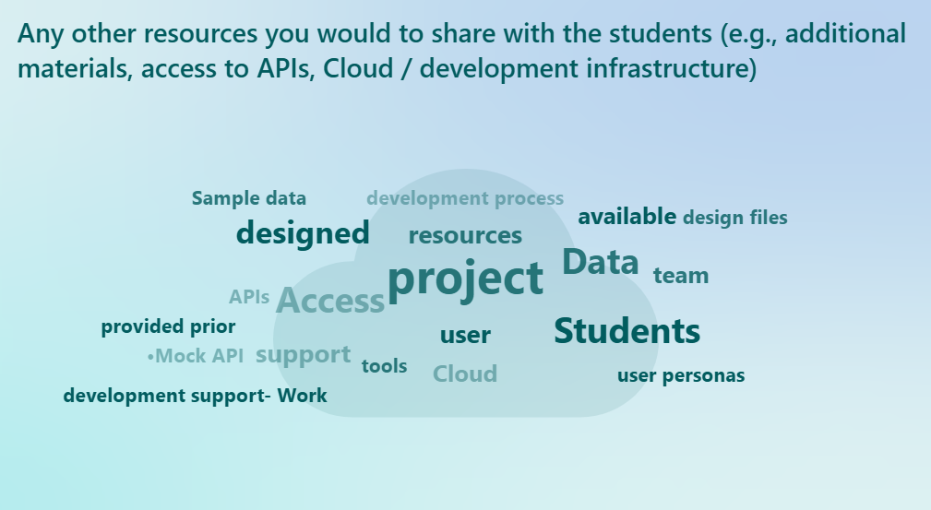
Projects Summary

Slide 49
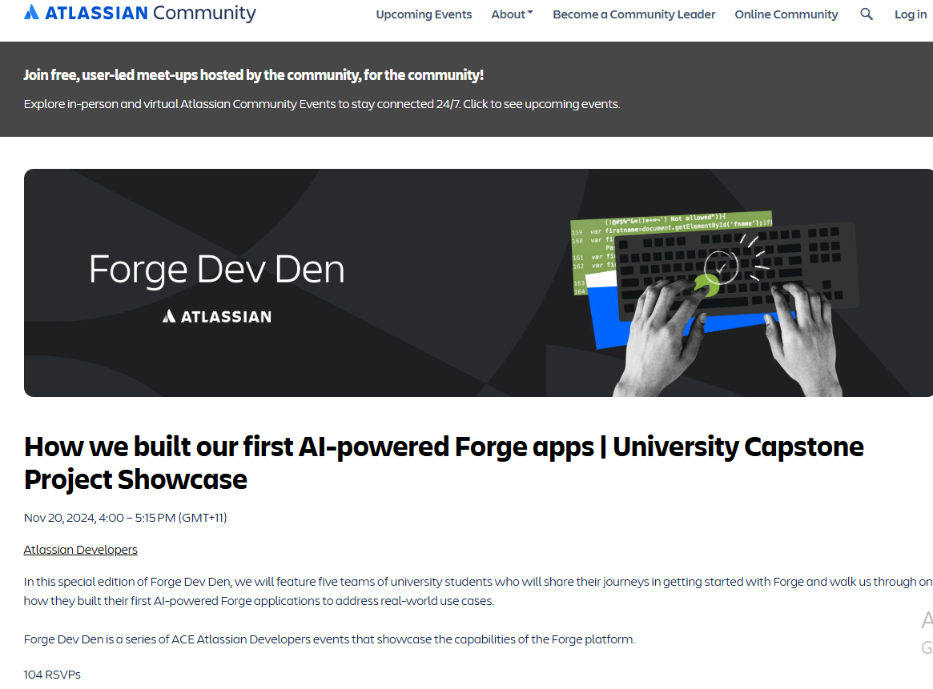
Industry Projects – Success Stories
COMP[39]900 capstone project teams invited to present at Atlassian Forge Dev Den (community channel)!
Impressed of the team's achievements on the new Atlassian AI-powered Forge Apps.

Slide 50


Industry Projects – Success Stories
COMP[39]900 capstone project team worked with NSW health stakeholders and Managers!
The Royal Hospital for Women Newborn Care Center Neonatal Milk Checker App.
Students offered project employment to continue working on the project

Slide 51
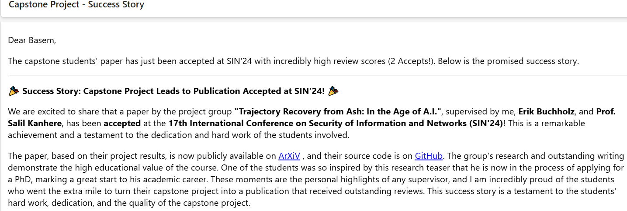
Industry Projects – Success Stories

Slide 52
Project Timeline and Milestones
Week 1: team formation and project selection
Week 2-3: meet/communicate with your client (lead/product owner)
Week 3: proposal due (clear requirements and scope, project plan)
Week 4-10: development work and major milestones/demos to communicate with client (meeting, communication channels)
Week 5: Sprint 1 demo and retrospective
Week 8: Sprint 2 demo and retrospective
Week 10: Sprint 3 (final) demo, project document
Week 11: Project handover

Slide 53
User Stories and Acceptance Criteria

Slide 54
User Stories
A user story helps agile software development teams capture a simplified and high-level description of a requirement from an end user perspective
A user story often follows Connextra format/template:
As a [who] I want to [what] so that [why]
Example:
As an online shopper, I want to add an item to my cart, so that I can purchase it

Slide 55
User Stories (cont’d)
As a <type of user> – this is the WHO
Who are we building this for? Who is the user?
I want <some feature> – this is the WHAT
What are we building? What is the intention?
So that <some reason> – this is the WHY
Why are we building this? What is the value for the customer?

Slide 56
User Stories (cont’d)
User Stories Checklist
Keep them short
Keep them simple
Write them from the user perspective
Make the value/benefit of the story clear
Describe only one piece of functionality
Write stories as a team
Use acceptance criteria to show a Minimum Viable
Product (MVP), a working and usable product

Slide 57
Acceptance Criteria
Acceptance criteria, also called satisfaction conditions, provide a detailed scope of end users requirements
Help the development team understand the value of the user story and set expectations as to when a team should consider something done
Acceptance Criteria Goals
clarify what the team should build before they start
ensure everyone has a common understanding of the functionality
help the team members know when the story is complete
help verify the story via automated tests

Slide 58
Acceptance Criteria (cont’d)
Example:
As an online banking customer, I want a strong password, so that my credit card information is secure
Acceptance Criteria:
The password must be at least eight (8) characters
The password must contain at least one character from
each of the following groups:
lower case alphabet
upper case alphabet
digit
special characters (!, @, #, $, %, ^, &, *)

Slide 59
Acceptance Criteria (cont’d)
Acceptance criteria should include:
Negative scenarios of the functionality
Functional and non-functional use cases
Performance concerns and guidelines
What the system/feature intends to do
User experience aspects

Slide 60
Jira Software

Slide 61
Jira Software
Jira Software is an agile project management tool
Jira Software supports any agile project management methodology such as Scrum and Kanban
From agile boards to reports, you can plan, track, and manage all your agile software development projects from a single tool
See https://www.atlassian.com/software/jira/agile for more details

Slide 62
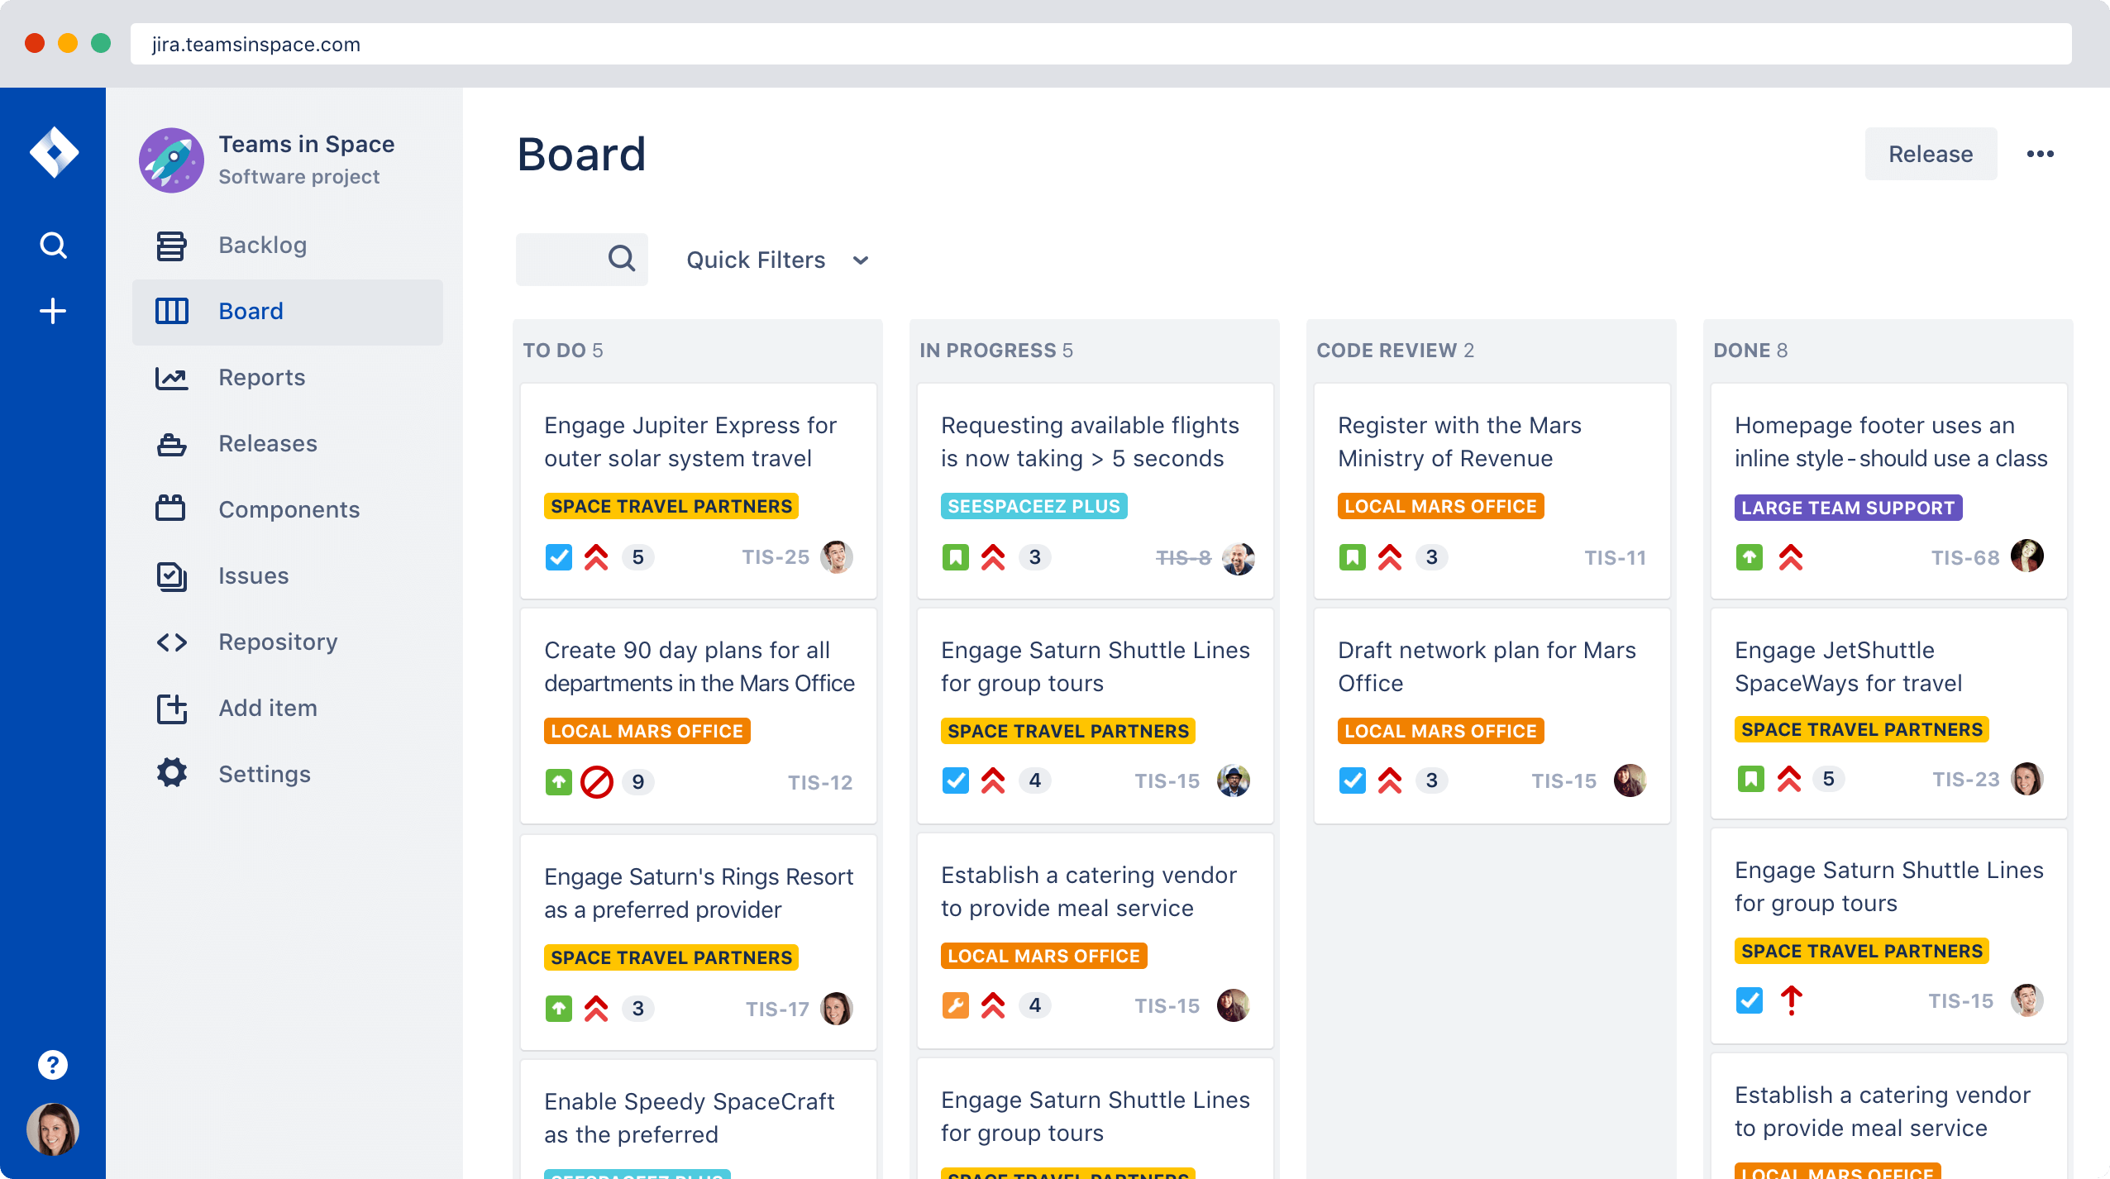
Jira Software (cont’d)

Slide 63
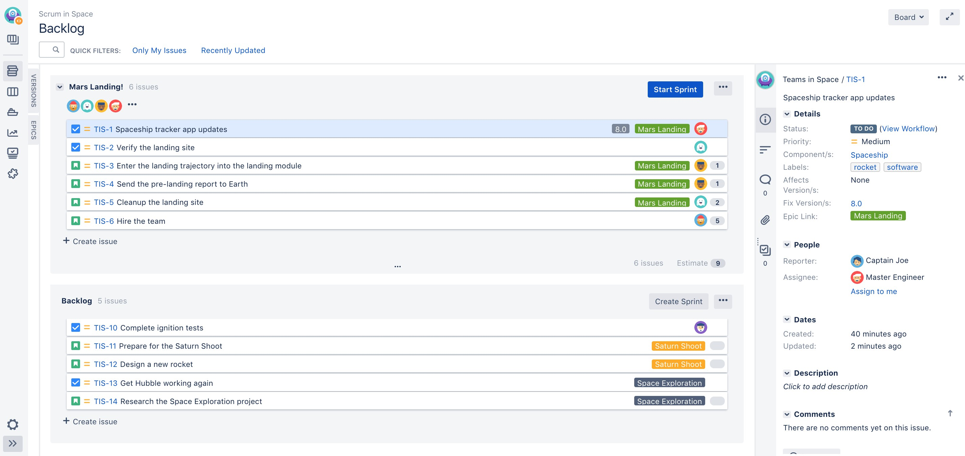
Jira Software (cont’d)
Product Backlog – Software Requirements

Slide 64
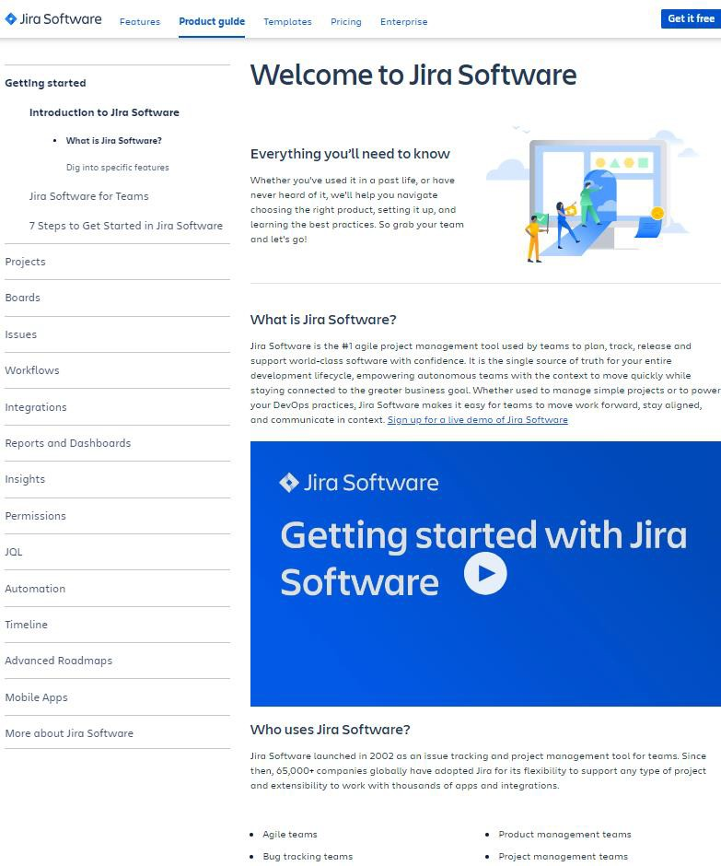
Jira Software (cont’d)
How to use Jira Software
Jira Software Guides and Tutorials https://www.atlassian.com/software/jira/guides

Slide 65
Working in Groups

Slide 66
Group-based Projects
Most software development is a team (group) activity
The development schedule for most non-trivial software projects is
such that they cannot be completed by one person working alone
A good team is cohesive and has a team spirit
The people involved are motivated by the success of the team as
well as by their own personal goals
Team interaction is a key determinant of team performance
Flexibility in team composition is limited
Managers must do the best they can with available people

Slide 67
Team Cohesiveness
In a cohesive team, members consider the team to be more important than any individual
The advantages of a cohesive team are:
Team quality standards can be developed by the team members
Team members learn from each other and get to know each other’s work.
Knowledge is shared. Continuity can be maintained if a team member leaves
Refactoring and continual improvement is encouraged. Team members work collectively to deliver high quality results and fix problems, irrespective of the individuals who originally created the design or program

Slide 68
Team Effectiveness
The people in the team
You need a mix of people in a project team as software development involves diverse activities such as negotiating with clients, programming, testing and documentation
The team organization
A team should be organized so that individuals can contribute to the best of their abilities and tasks can be completed as expected
Technical and managerial communications
Good communications between team members, and between the software engineering team and other project stakeholders, is essential

Slide 69
Selecting Team Members
A manager or team leader’s job is to create a cohesive team and organize their team so that they can work together effectively
This involves creating a team with the right balance of technical skills and personalities, and organizing that team so that the members work together effectively

Slide 70
Forming a Team
May not be possible to appoint the ideal people to work on a project
Project budget may not allow for the use of highly-paid staff
Staff with the appropriate experience may not be available
An organisation may wish to develop employee skills on a
software project
Team leaders must work within these constraints especially when there are lack of trained technical staff

Slide 71
Team Composition
Team composed of members who share the same motivation can be problematic
Task-oriented – everyone wants to do their own tasks
Self-oriented – everyone wants to be the boss
Interaction-oriented – too much chatting, not enough work
An effective team has a balance of all types
This can be difficult to achieve as software engineers are often
task-oriented
Interaction-oriented people are very important as they can detect and defuse tensions that arise

Slide 72
Team Composition Scenario
In creating a team for assistive technology development, Alice is aware of the importance of selecting members with complementary personalities.
When interviewing potential team members, she tried to assess whether they were task-oriented, self-oriented, or interaction-oriented. She felt that she was primarily a self-oriented type because she considered the project to be a way of getting noticed by senior management and possibly
promoted. She therefore looked for one or perhaps two interaction-oriented personalities, with task-oriented individuals to complete the team
The final assessment that she arrived at was:
Alice – self-oriented Brian – task-oriented Bob – task-oriented
Carol – interaction-oriented
Dorothy – self-oriented Ed – interaction-oriented Fred – task-oriented

Slide 73
Team Organization
The way that a team is organized affects the decisions that are made by that team, the ways that information is exchanged and the interactions between the development team and external project stakeholders
Key aspects include:
Should the project manager be the technical leader of the team?
Who will be involved in making critical technical decisions, and how will these be made?
How will interactions with external stakeholders and senior company management be handled?
How can teams integrate people who are not co-located? How can knowledge be shared across the team?

Slide 74
Team Organization
Small software engineering teams are usually organised informally without a rigid structure
For large projects, there may be a hierarchical structure where different
teams are responsible for different sub-projects
Agile development is always based around an informal team on the
principle that formal structure inhibits information exchange

Slide 75
Agile Teams
The team acts as a whole and comes to a consensus on decisions affecting the system
The team leader serves as the external interface of the team but does not allocate specific work items
Rather, work is discussed by the team as a whole and tasks are allocated according to ability and experience
This approach is successful for teams where all members are experienced and competent

Slide 76
Team Communications
Good communications are essential for effective team working
Information must be exchanged on the status of work, design decisions, and changes to previous decisions
Good communications also strengthens team cohesion as it promotes understanding

Slide 77
Team Communications
Team size
The larger the group, the harder it is for people to communicate with other group members
Team structure
Communication is better in informally structured groups than in hierarchically structured groups
Team composition
Communication is better when there are different personality types
The physical work environment
Good workplace organisation can help encourage communications

Slide 78
Team Conflicts
Conflict is a form of relating or interacting where we find ourselves (either as individual or groups) under some sort of perceived threat to our persona or collective goals (Condliffe)
According to Davidson et al. conflict manifests itself in a variety of ways:
people compete with one another
people glare at one another
people shout or withdraw

Slide 79
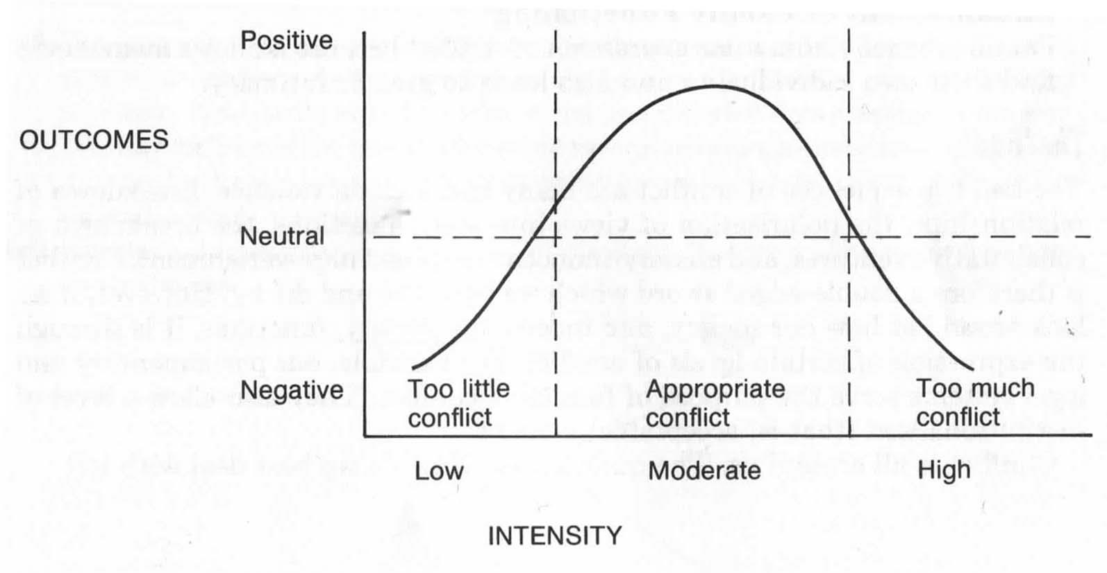
Conflict Intensity

Slide 80
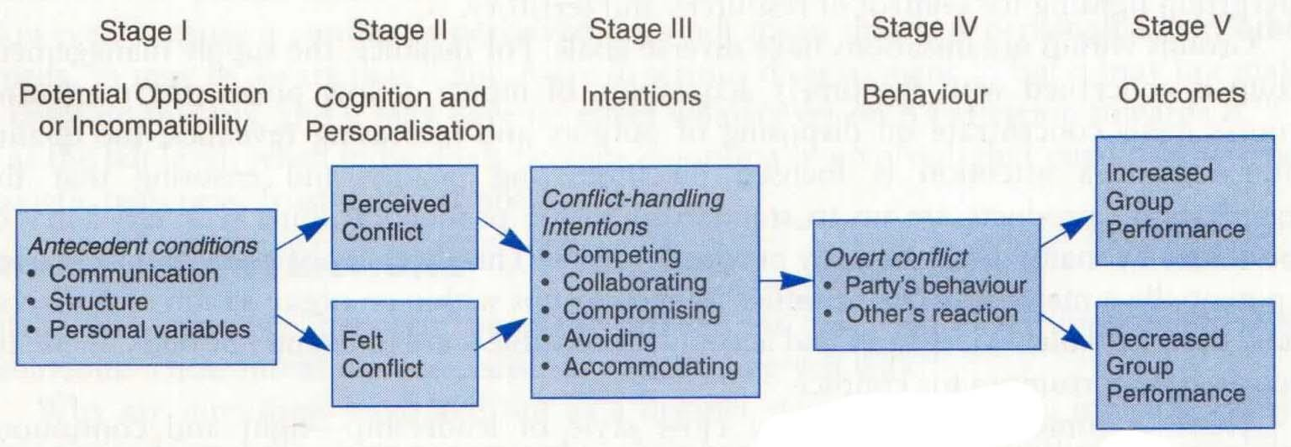
Process of Conflict
Notes:
Overt – done openly

Slide 81
Types of Conflict
Pinto (2010) suggests three categories of conflicts:
Goal-oriented conflict: this is associated with disagreements regarding results, project scope outcomes, performance specifications and criteria, and project priorities and objectives
Administrative conflict: this arises through management hierarchy, organisational structure, or company philosophy
Interpersonal conflict: this occurs with personality differences between project team members and important project stakeholders

Slide 82
Sources of Conflict
There are numerous potential sources of conflict in projects.
Common sources of organisational conflict include reward systems
scarce resources
uncertainty and differentiation
Common causes of interpersonal conflict include:
faulty attributions (i.e., misconceptions around the reasons behind another’s behaviour)
poor communication
holding personal grudges (Pinto, 2010)

Slide 83
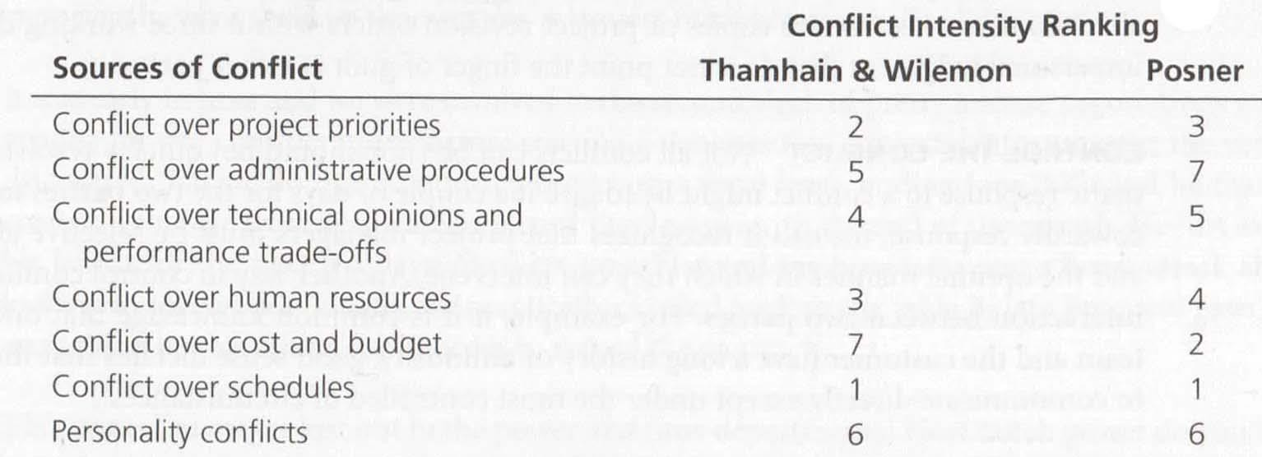
Sources of Conflict

Slide 84
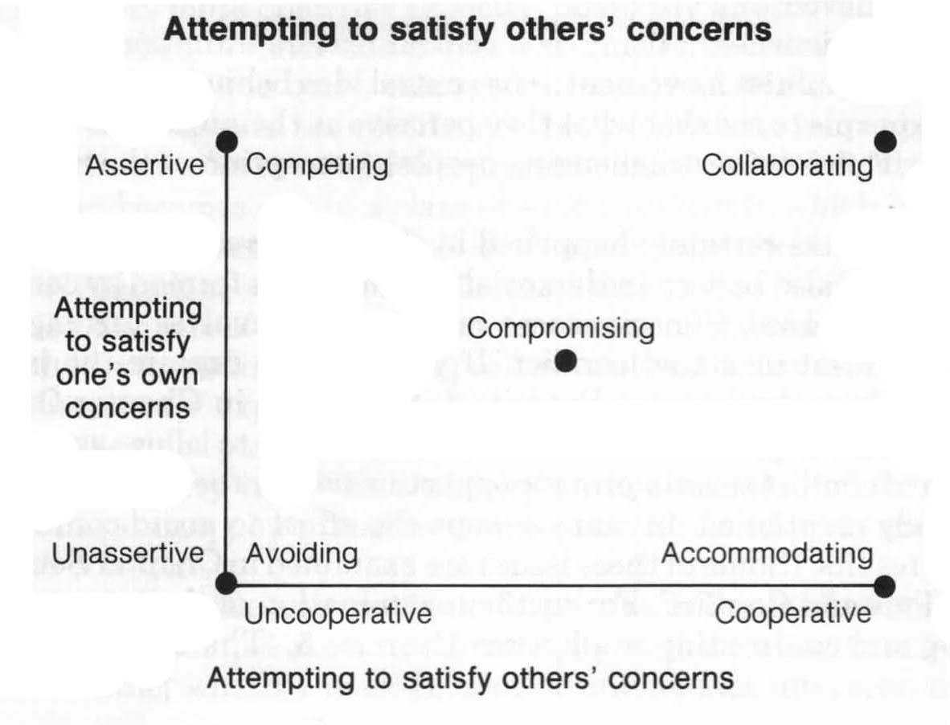
Resolving Conflict
Methods for resolving group conflict is at the project leader’s priorities – should consider several issues before deciding on an approach, e.g., is the conflict professional or personal in nature?
Conflict handling model (Blake and Mouton):​

Slide 85
Resolving Conflict
willingness of one party in a conflict to place the opponent’s interests above their own (smoothing)
desire to withdraw from, or suppress, a conflict (withdrawal)
3. situation where the parties to a conflict each desire to satisfy fully the concerns of all parties (confrontation or problem-solving)
4. desire to satisfy one’s interests, regardless of the impact on the other parties to the conflict (forcing)
5. situation in which each party to a conflict is willing to give up something of value

Slide 86
Resolving Conflict
Conflict handling model (Blake and Mouton):
Accommodating (smoothing): the willingness of one party in a conflict to place the opponent’s interests above their own
Avoiding (withdrawal): the desire to withdraw from, or suppress, a conflict
Collaborating (confrontation or problem-solving): a situation where the parties to a conflict each desire to satisfy fully the concerns of all parties
Competing (forcing): a desire to satisfy one’s interests, regardless of the impact on the other parties to the conflict
Compromising: a situation in which each party to a conflict is willing to give up something of value

Slide 87

Agile Development – Week 2
Public holiday – update on Ed (e.g., recording)
Agile values and principles
Scrum method; team structure, roles, interaction
Scrum method; sprints, events and product backlog
Scrum method; planning and estimation, monitoring progress
Agile management with Jira –
Atlassian Industry Lecture & demons

Slide 88
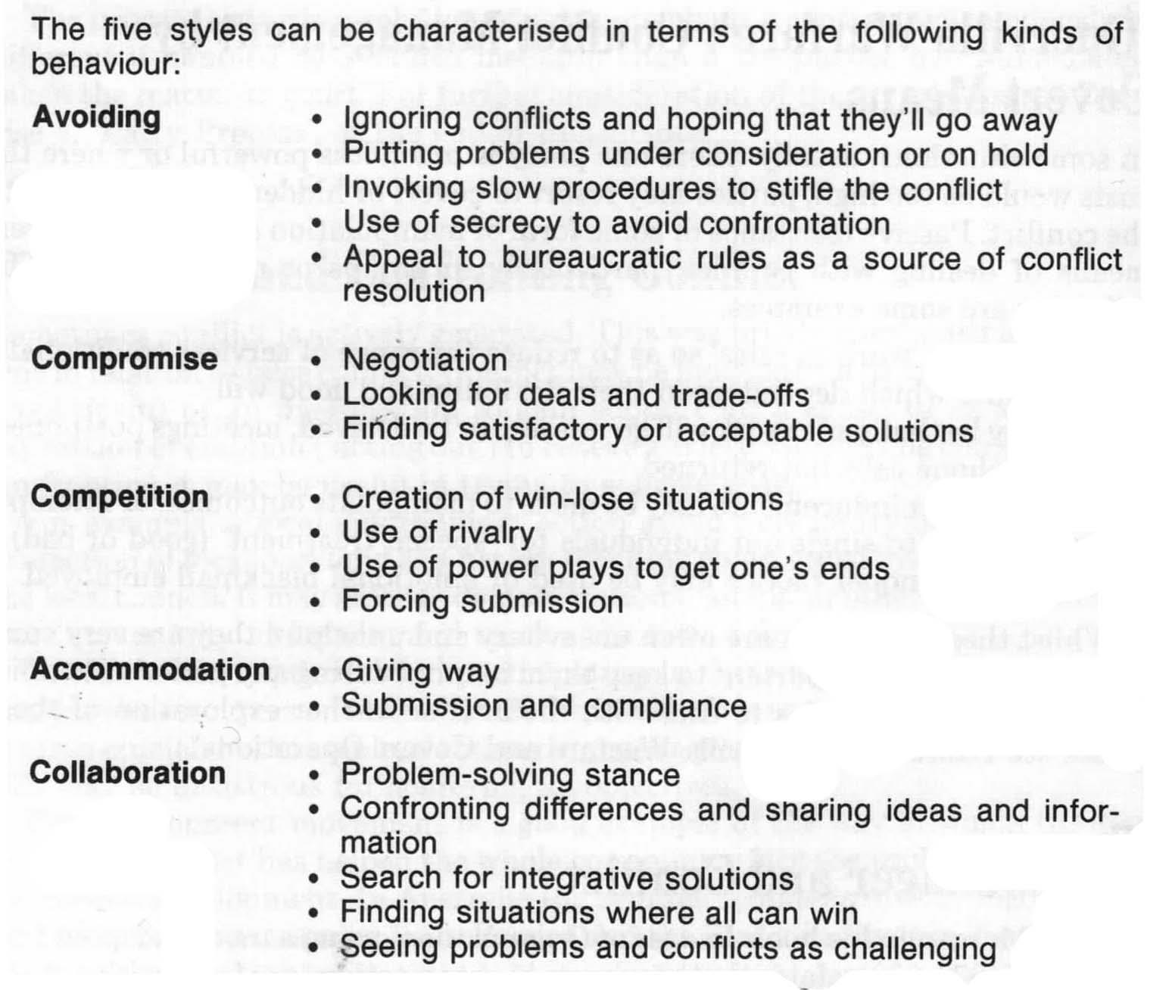


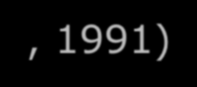
Resolving Conflict
(Condliffe, 1991)
88

Slide 89
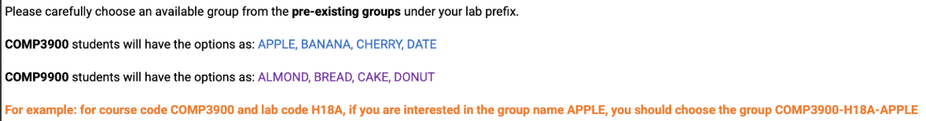
Week 1 Lab Tasks
Form a team of 6 members within your lab
Decide on who will be the Scrum Master and Product Owner
Decide on a team name
Register your team in Moodle using Group Selection activity under "Setting Up" section

Slide 90
Team Formation
Consider the Team Formation guidelines
Try to diverse the skillset for well-rounded background.
If you want to swap lab to join a group, you need to email course admin first to put you on waiting list. However, the transfer is not guaranteed.
If you cannot form a group by end of week 1, we will help you by assign you to a group randomly.

Slide 91
Week 1 Lab Tasks (cont’d)
Register for Jira. Use the exact team’s name for the Jira site name. Add all team members and mentor as site-admin (see Jira guide in Moodle under Jira section)
Decide on the project you will work on and submit the project selection questionnaire by end of Week 1 (keep an eye for new projects)
Start completing course Primers in Python, GitHub, and Docker by the week 3 lab.

Slide 92
Important Highlights & Actions – Ed / Moodle
Make yourself familiar with COMP[39]9900 Moodle site
Read course outlines (COMP 3900 Course Outline and 9900 Course Outline)
Read Team Formation and Project Preferences Selection guidelines
Check Projects List
Check the 3 Primers on Coding Primer, Docker Primer, and Git Primer
Check group self-selection activity under Teams Formation
Join your Lab Schedule
Check lab resources
Keep an eye on the Workshops schedule
Check Ed and Moodle for more details:
https://edstem.org/au/courses/24654/discussion/2724829
https://moodle.telt.unsw.edu.au/course/view.php?id=91927

Slide 93
Thank you!

Slide 94
References
Blake, R., & Mouton, J. (1964). The managerial grid. Gulf.
Condliffe, P. (1991). Conflict management: A practical guide. RMIT TAFE.
Davidson, P., Simon, A., Gottschalk, L., Hunt, J., Wood, G., & Griffin, R. (2006). Management
- Core concepts and skills. John Wiley.
Pinto, J. (2010). Project management - Achieving competitive advantage. Pearson.
Posner, B. (1986). What's all the fighting about? Conflicts in project management. IEEE Transactions on Engineering Management, 33, 207-211.
Robbins, S. P., Millett, B., Cacioppe, R., & Waters-Marsh, T. (1998). Organisational
behaviour - Leading and managing in Australia and New Zealand (2nd ed.). Prentice Hall.
Saeed, T., Almas, S., Anis-ul-Haq, M., & Niazi, G. (2014). Leadership styles: Relationship with conflict. International Journal of Conflict Management, 25(3), 214 - 225.
Thamhain, H., & Wilemon, D. (1975). Conflict management in project life cycles. Sloan
Management Review, 16(3), 31-50.

