Slide 1



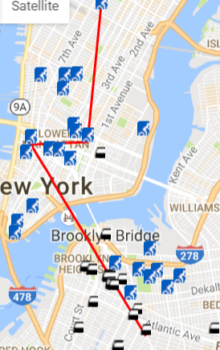
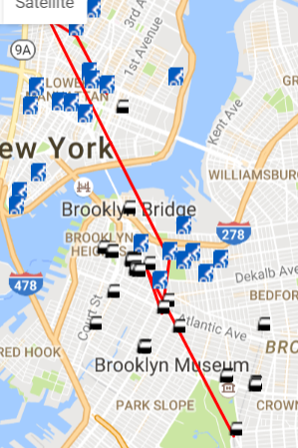
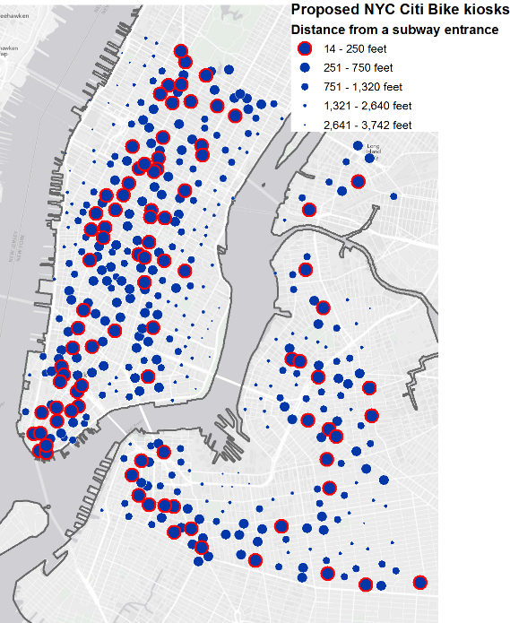
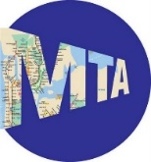
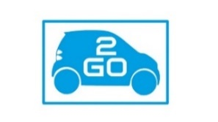

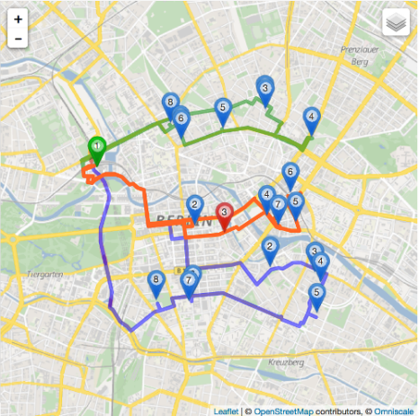
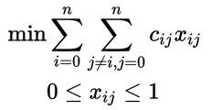
Multi-Route Sharing
Kathy Lau (Stuyvesant HS)
Mentor: Susan Jia Xu
Professor Chow
ABSTRACT
METHODLOGY
RESULTS
CONCLUSION
With increasing urbanization, megaregion growth, and emergence of privately operated transport services, there is increasing need for strategic planning and collaboration between multiple operators and agencies. However, hampered by a lack of tools to make system operating data easily available to decision-makers across the table, a new GIS visualization tool will be studied to explore the potential for sharing route information.
The maps below reflect simulations of successful plotting of Car2Go, MTA, and Cit Bike as nodes onto one network, connected by polylines generated by the Google Maps JavaScript API.
Considerations of time, cost, and exercise were taken by survey.
 | Adult | Teen | Elder
Time Preference | 82 | 82 | 49
Cost Preference | 76 | 76 | 88
Exercise Preference | 34 | 84 | 90
The maps below reflect simulations of successful plotting of Car2Go, MTA, and Cit Bike as nodes onto one network, connected by polylines generated by the Google Maps JavaScript API.
By exploring route combinations, it is shown that there is little time difference with a significant increase in daily exercise. The greatest challenge is the price of Citi Bike by day. However, Citi Bike would actually cost little if bought on a weekly, or even annual, rate. It would be an effective route to take for those who are willing to follow through this path.
The datasets of MTA subway entrances, Citi Bike stations, Car2Go stations, etc. are scattered among different open source or API pages. Since all provide lat/lon coordinates in json format, they can be downloaded separately and easily read by python using the same command.
INTRODUCTION
In 2012, the NYC DoT asked for crowdsourced opinions of possible Citi Bike stations. Although it was designed for the first and last mile of local commutes, Google Maps has yet to merge routes between bike and subway lanes.
Enter location of destination
ACKNOWLEDGEMENTS
Select preference(s)
Connect nodes in region
Both maps show a tendency to include Citi Bike as a mode of travel across the Bklyn Bridge after subway through downtown Bklyn.
New York University Tandon School of Engineering (NYU)
Center of K-12 Education – ARISE
The Pinkerton Foundation
Dr. Joseph Chow, PhD Professor, NYU
Susan Jia Xu, PhD Candidate, NYU
Calculate
Generate routes with no more than 3 intersections
Time
Costs
Walking / biking amount
OBJECTIVE
To combine different modes of transportation onto one neural network and generate routes across all modes while paying attention to consumer needs.
Algorithm to choose routes while taking cost into consideration poses a special case of the travelling purchaser and vehicle routing problem.

