Slide 1
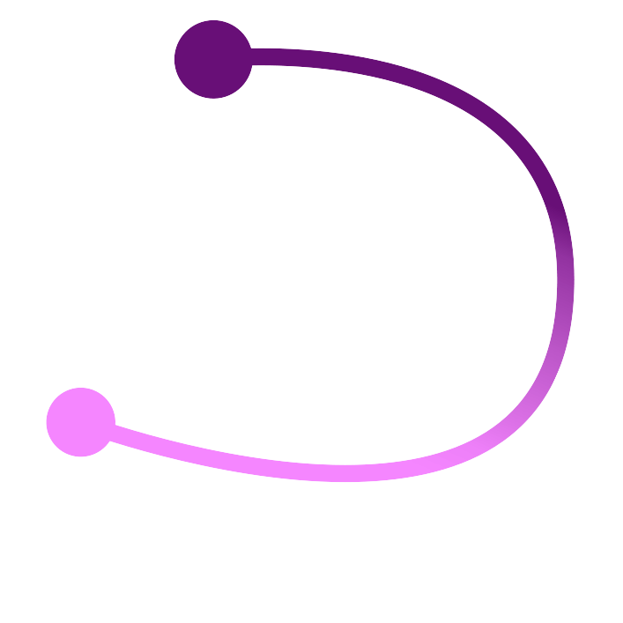

Good, better, breast: An open source sensing mastectomy prosthetic
KATHY REID
Masters of Applied Cybernetics
Student at 3A Institute
Australian National University
@KathyReid | @SenseBreast
Notes:
Thanks so much for the lovely introduction $VOLUNTEER_NAME. Before I start the talk proper, there are three things I'd like to do first.
Acknowledgement of country
Firstly, I’d like to acknowledge that we meet today on the traditional lands of the Yugambeh people, the traditional custodians of this area. I pay my respects to their elders past and present, and to their leaders emerging, and I warmly welcome any Indigenous and First Nations people with us today.
Acknowledgement of volunteers
Linux.conf.au is an entirely voluntary run conference, and I’d like to express my appreciation to VOLUNTEERS for your help. Without you, linux.conf.au doesn’t happen.
With those pieces covered, allow me to introduce myself.
## About me
SLIDE: Introduction
Hi awesome humans! I'm Kathy Reid. I'm currently with the 3A Institute in Canberra, where I'm completing a Masters in Applied Cybernetics. Many of you will know me from the various bits and pieces I've been involved with in the open source scene in Australia over the last decade or so, and it's great to see you all again. I'm @kathyreid on the Twitters, and the GitHub.
Today we're going to cover;
@TODO dot points
## All technique
SLIDE: All technologies have a history
## women of history
women who've had breast cancer previously
Empress Feodora of the Eastern Roman Empire
Rachel Carson - Silent Spring
Maryam Mirzhikhani - Fields Medallist
_choice_ of starting points for a story
---
# SenseBreast
<small><i><a href='http://ecotrust-canada.github.io/markdown-toc/'>Table of contents generated with markdown-toc</a></i></small>
## What is SenseBreast?
**SenseBreast is not a medical device - it is an maker project that some people may find useful and/or interesting to experiment with. It should not be used as the basis for making diagnostic or medical decisions**
SenseBreast is designed to be an _early prototype_ of a mastectomy prosthetic, and explores the concept of a _cyberphysical system_ by having both computing-based components - "the cybers" - and physical components that are placed in close proximity to the body - "the physical".
It can be used to explore:
* Temperature, pressure and humidity measured close to the chest wall
* Movement, acceleration and direction using the Inertial Motion Unit (IMU) of the Sense HAT
* Experiential factors surrounding wearing a prosthetic, and a smart prosthetic
* Notions of privacy, data ownership and quantified self
The sensors currently used in SenseBreast - provided by the [Raspberry Pi Sense HAT](https://projects.raspberrypi.org/en/projects/getting-started-with-the-sense-hat) - are not particularly precise or accurate. They are however useful for experimentation and exploration.
Constructing a breast form to house the electronics used with SenseBreast is a useful exercise in industrial design, and can be used to explore the properties of different materials.
## Why is SenseBreast open source?
Different women have different journeys after breast cancer. For some women, there is a desire to look and feel closer to the way they were prior to diagnosis and possibly, surgery. For others, the ability to reclaim intellectual and cognitive capability is paramount.
SenseBreast is a way for women who are technical, who are Makers, who are experimenters, who are curious - to explore a different approach to the traditional mastectomy prosthetic.
## Further reading
If you'd like more information on prosthetics and proxemics, the following are recommended reading.
> Haber, J., Greening, M., Castellano, L., & Wheaton, P. Proxemic Conversational UI: Moving beyond simple conversation.
http://www.jonathanhaber.com/pub/gi2016.pdf
## What is SenseBreast?
SenseBreast is a Maker Project for CECS8001 - Lab, by Kathy Reid (@kathyreid on the Twitters, GitHub, IRC etc).
SenseBreast is open source under the Apache2 license, inspired by projects like OpenAPS. Because open source is an act of generosity - an act of contributing to the commons - a movement which is more than the sum of its individual contributions.
## How do you build SenseBreast?
These instructions are provided so that SenseBreast has a _reproducible build_.
Where documentation for a step already exists, it is linked rather than being reproduced.
### Requirements
To build SenseBreast you will need:
* Raspberry Pi 3B+
* Sense HAT
* Monitor with a HDMI connection and a HDMI cable
* USB keyboard
* 8GB or more Micro SD card and a way to write to the card (ie Etcher)
* Basic `bash` and `python` knowledge
* A source of battery power - I recommand a small form factor Li-Ion pack with a Micro-USB cable to go to the Raspberry Pi. _NOTE: Most of the power sources I tested resulted in 'under voltage' warnings on the RPi, but these are generally safely ignored._
* Coffee, patience, and when that fails, your favourite curse words.
### Method
#### Raspberry Pi
##### Flash the Raspbian operating system to the Micro SD card
* Flash the [Raspbian Stretch Lite operating system](https://www.raspberrypi.org/downloads/raspbian/) to your Micro SD card using a program like Etcher
* To prove that you have a working Raspberry Pi with Rasbpian, connect the RPi to the monitor using a HDMI cable, and to the keyboard using the USB cable. Connect the RPi to a power source using the Micro USB cable. On the first boot, the RPi will display "resizing file system, rebooting in 5 seconds...". Once the RPi is powered on, you should see the device boot. Use the username `pi` and password `raspberry` to log in. If you can successfully log in, you are ready for the next steps.
_NOTE: You will not have network access yet, that's the next step._
##### Set the localisation for your preferred keyboard layout
By default, the RPi ships with the `en-GB` keyboard layout, which has several different key settings, like the `@` symbol and `#` symbol aren't where they are on an Australian keyboard. To set localisation options, type `sudo raspi-config` at the command line, then choose `4 - Localisation option`. If you're Australian, choose `en-AU`, then set this as the default `LOCALE`. Then, set the keyboard layout to `English-Australian` by typing `sudo raspi-config`, then choosing `4 - Localisation options` then `I3 Change Keyboard Layout`.
This will make you life easier when manually typing configurations.
##### Connect to a network with internet access
_NOTE: This is the hardest step in hardware setup. Do not underestimate how difficult this step is. Here be dragons._
There are two methods to do this.
* You can use `sudo raspi-config` from the command line, then choose `2 - Network options` and enter the details for your network.
Chances are though that you're on a secure, PEAP-authenticated network, in which case this method won't work and you'll need to manually edit the `wpa_supplicant.conf` file. This is an exercise in pain, misery and the limits of caffeine tolerance, so the repo includes a sample `wpa_supplicant.conf` to protect your sanity. The tutorial [here](https://www.raspberrypi.org/forums/viewtopic.php?t=111100) shows you how to generate a password hash for PEAP authentication.
* `cd /etc/wpa_supplicant`
* `sudo mv wpa_supplicant.conf wpa_supplicant.conf.BAK` # this makes a copy of the existing file in case of borkage
* `sudo nano wpa_supplicant.conf`
Then, edit the wpa_supplicant.conf with the details relevant for your network. Use `Ctrl + X` to save. Type `sudo reboot now` on the command line to reboot.
If you have a working `wpa_supplicant.conf` file then you will be able to proceed and install other components, otherwise you will be blocked until you can get `wpa_supplicant.conf` working.
##### Install `git` and clone this repo
`git` will make setting up the SenseBreast a lot easier, because you can pull down this repo and a lot of the associated files.
`sudo apt-get install git`
Then, we clone this repo:
`git clone https://gitlab.cecs.anu.edu.au/u6933485/sensebreast/`
You will be asked for your ANU CECS GitLab username and password.
_NOTE: If you have 2FA enabled on the CECS GitLab, remember to use your token instead of your raw password._
##### A little `.bashrc` hack for making `ls` much nicer
`sudo vi ~/.bashrc`
Use the `/` key and enter `alias`.
In the block of aliases, add:
`alias ls='ls -las'`
Then use `:wq` to write and quit.
Type `exit` then log in again, and when you use `ls` it will give you verbose information. Very helpful for development purposes.
##### Get `nano` to do proper syntax highlighting
If you're doing any development work on the SenseBreast using the `nano` editor, then you will want to create and edit a `.nanorc` file in the `pi` user's home directory.
An example `.nanorc` is included in the repo, which includes Python and bash syntax highlighting.
```bash
include /usr/share/nano/sh.nanorc
include /usr/share/nano/python.nanorc
```
##### Symlinking the `wpa_supplicant.conf` file
Once you have the repo down, you can symlink `wpa_supplicant.conf` to make your life easier.
```
cd /etc/wpa_supplicant
sudo rm wpa_supplicant.conf
sudo ln -s /home/pi/sensebreast/wpa_supplicant.conf wpa_supplicant.conf
```
This means that you can make changes to `wpa_supplicant.conf` in `git` such as adding a new network, and when you update the `sensebreast` repo using `git pull`, you will bring the changes down automagically.
##### Setting up a `crontab` for the `pi` user to run the scripts
Use the `crontab` program to set up scripts to run at the frequency you want. Currently the script will sense for 5 minutes then write to disk, so the [example crontab](pi-user-crontab) is set to run the scripts every 5 minutes.
##### Logging
The `crontab` is set to log to `./log/sensebreast.log`. You may wish to use this if you do any additional sensing.
_NOTE: `rsyslog` has been configured to log `cron.d` events to `/var/log/cron.log`, *however* this file is not writeable by the `pi` user and so commands executed under `crontab` will fail - this is why they are set to log to a different log file.
##### Install the `sense-hat` package for Raspbian
* Install [Sense HAT and the Python libraries for Sense HAT](https://www.raspberrypi.org/documentation/hardware/sense-hat/). The Python libraries are installed by installing the `sense-hat` package - you don't have to install something separate.
#### Using sensors
##### Calibrate the sensors using `octave`
* Follow the [instructions on the Sense HAT website](https://www.raspberrypi.org/forums/viewtopic.php?f=104&t=109064&p=750616#p810193) or [this forum post](https://www.raspberrypi.org/forums/viewtopic.php?f=104&t=109064&p=750616#p810193) to calibrate the sensors.
* The files in the `sensing-scripts` directory use Python to take readings from the Sense HAT.
### Prosthetic form
### Future directions for development
#### Additional sensors
It may be possible to add additional sensors, and use the pins that are not consumed by the Sense HAT.
### Disk image of SenseBreast
A [disk image of SenseBreast 1.0 is available](https://drive.google.com/file/d/1BEew4lalLM3Gj5rReMM677PFe3qEfLil/view?usp=sharing)

Slide 2
CONTENT ADVISORY
This talk contains descriptions of cancer, medical procedures, and the aftermath of cancer surgeries
Images of breast prostheses will be displayed
There is an image of a breast in a plaster cast
No images of scarring, surgery, radiotherapy etc are shown
Notes:
Today I'll be talking frankly about breast cancer, and topics like mastectomies. This talk contains images of a breast with a plaster cast, and you will see images of mastectomy prosthetics.
Some folx may find this content confronting or distressing, and if this isn't the talk for you, then I'd like to provide a gentle opportunity for you to choose to be in another space.

Slide 3
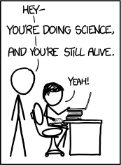
Image: XKCD “Two years”
Randall Munro, CC-BY, https://xkcd.com/1141/
Notes:
I will be using humour in my talk today, there will be lots of puns – only the breast ones - because one of the privileges I have as a cancer survivor is to make fun of the terrible experience that is cancer.
Laughing about cancer jokes can sometimes feel awkward, or inappropriate, somehow taboo.
Life is short, and I’m choosing to spend more of it laughing.

Slide 4
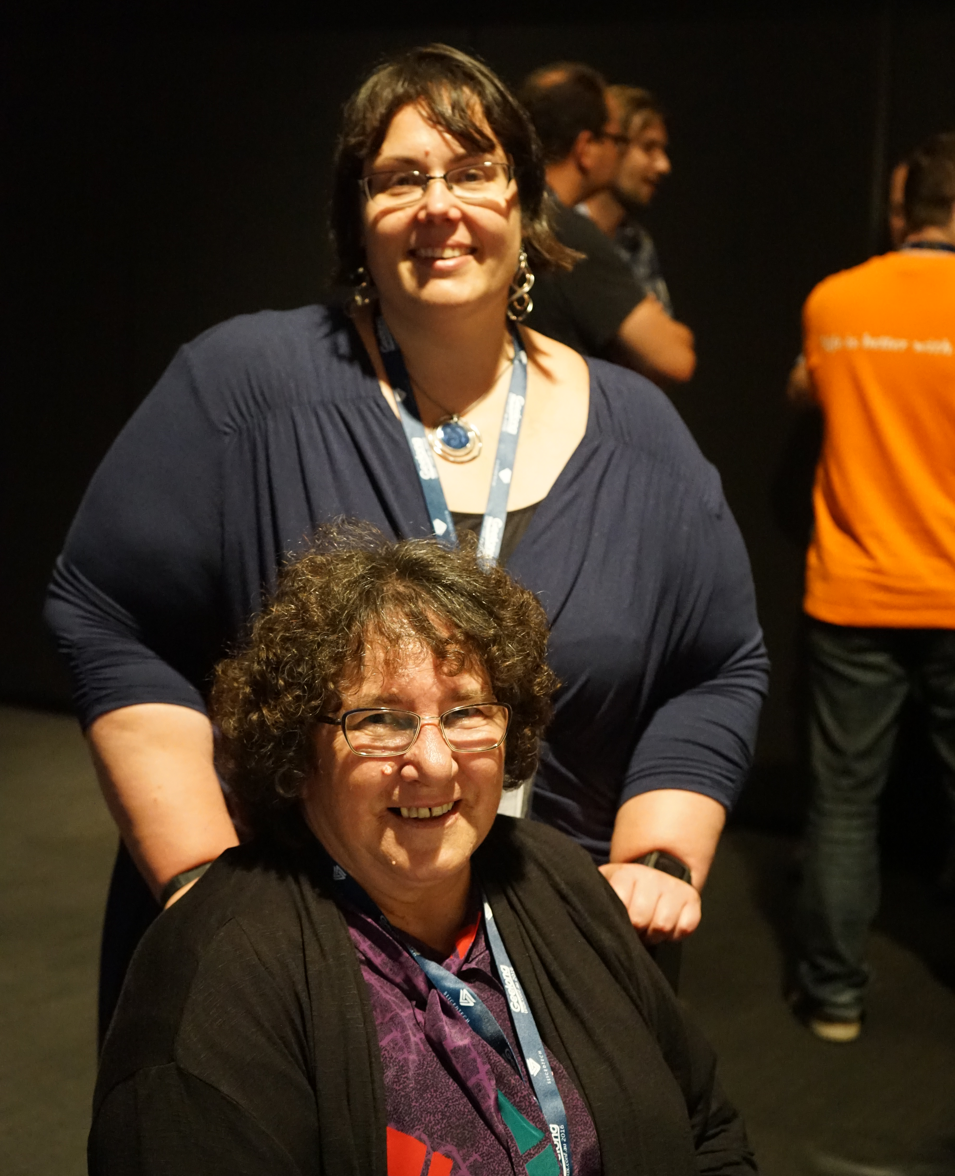
KATHY REID
Masters of Applied Cybernetics
Student at 3A Institute
@KathyReid | @SenseBreast
Photo: Brett James via Flickr
CC-BY-NC-SA
https://flic.kr/p/DMRpeg
Notes:
So now you know one thing about me, let me introduce myself properly and provide you with some CONTEXT.
I’m Kathy Reid, and last year I spent the year on what you could call an adult gap year, one of 16 students from across the world undertaking a Masters of Applied Cybernetics at the 3A Institute in Canberra, run by Distinguished Professor Genevieve Bell – some of you may remember her as one of our keynotes from LCA 2016 in Geelong. During this course we explored a range topics, but they all relate to how cyber-physical systems and AI go safely to scale, and in particular the nexus between humans, technology and the environment.
My talk today is an outcome of that year, and my INTENT today is to share with you part of that journey.

Slide 5
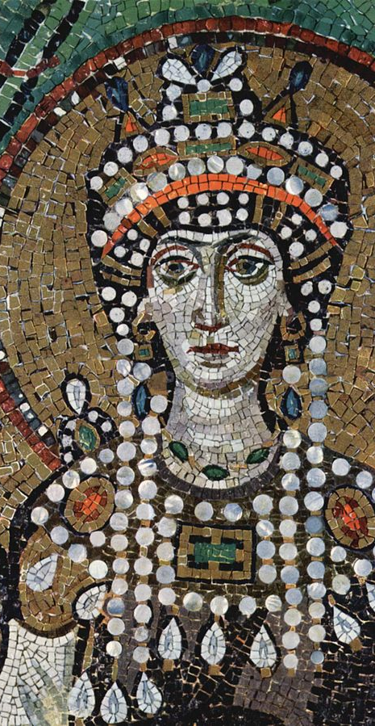
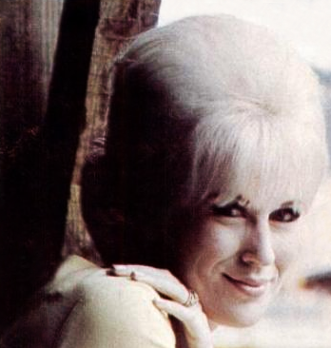
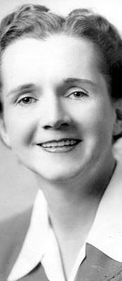
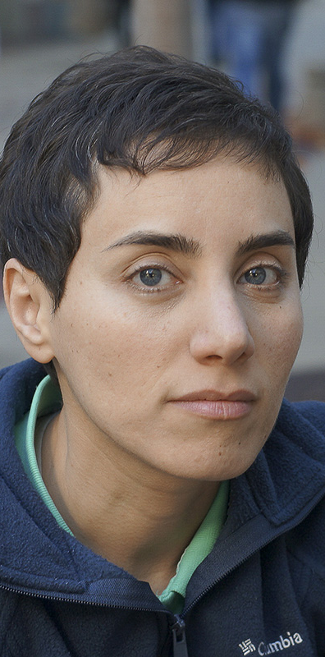
All images courtesy Wikipedia
Notes:
But first, a history lesson, because all technology has a history. Can anyone tell me who these women are?
Empress Theodora – Eastern Roman Empire 500-548 AD CE, wife of Emperor Justinian, Saint day November 14th. Unifying influence in the Orthodox church
Rachel Carson, environmentalist and author of Silent Spring, 1907-1964
Dusty Springfield, 1939-1999, blue-eyed soul singer
Maryam Mirzakhani, 1977-2017, the first woman to be awarded the Fields Medal in Mathematics for her work in hyperbolic geometry. One of the most promising mathematicians of our age.
Now for the follow up.
Can you tell me what unites these women?
That’s right, they all died from breast cancer, well before their time. We’re left with the lingering question – given more years, more time, what other greatness might they have accomplished?

Slide 6
every technology has a history
Notes:
Every technology has a history, a genealogy, a line of antecedents, pioneers and unfortunately, I’m in the best of company.
But this story doesn’t start with Empress Theodora and her unifying influence over the orthodox church. It doesn’t start with Rachel Carson and her enduring legacy of pesticide awareness. It doesn’t start with Dusty Springfield and her incredible, soulful voice. It doesn’t start with Maryam Mirzakhani’s non-Euclidean geometry.
This story starts in 2010.
On November 14th, to be exact, which as it happens is the feast day in the Orthodox Church for which Empress Theodora – Saint Theodora – is celebrated. For nothing is ever a coincidence.
This story starts on the 14th November 2010, with three small words.

Slide 7
you have cancer
Notes:
The next six months are a blur. Major surgery, pathology – it’s fast moving, and aggressive, and it’s already spread to my lymph nodes. Many many rounds of chemo, a life threatening infection - I’m “touch or go”.
But, thanks to science, some incredible practitioners, and the women who’ve previously walked this road, I make it through to the other side. That other side is very different. I’m 31 years old, in instant menopause. My body has been decimated by 200 stitches and a range of poisons.
But I’m still here, too stubborn to die, and it’s time to rebuild.
My surgeon, an empathetic, wise woman, asks me about reconstructive surgery. There are several options. They’re all huge, risky surgeries, with a very minimal outcome. You’re not going to look anything like you did before, but you’ll just look slightly less terrible than you do now.
I asked her a question she wasn’t really expecting.

Slide 8
how many USB ports can you give me?
Notes:
And so begins the story of SenseBreast.
SHOW THE PROSTHETIC
According to figures from the Breast Cancer Network of Australia, only around 12% of women who have a mastectomy will have reconstruction. Instead, so we look “normal” we wear these – silicon based prosthetics.
They do their job adequately. Serviceable, but nothing special. A bit like instant coffee. They degrade over time – like this one has – they get hot and sweaty in summer, and well,
they don’t have any USB ports!
What a great opportunity for open hardware!

Slide 9
sense and breast
= cyber and physical
Notes:
There are two key pieces to Sense Breast – the Cyber and the Physical.
I wanted to explore the two together – could I create something that harmonised, that synchronised these two juxtaposed elements?
I also wanted to break some taboos around the concept of cancer and mastectomy. It’s still a taboo topic – particularly in mixed company, that social element.

Slide 10
approach (the cybers)

Slide 11
Equipment
> Rpi 3B+
> Sense HAT
> Flat Li-Ion battery
> Case (RIP)
>16GB Micro SD card
> Many colourful swear words
Notes:
I deliberately chose the Rpi 3B+ becase I’d worked with it before, and I knew that it had decent networking capabilities, In my experience it was a more robust model than the Pi Zero, which has a much smaller form factor, the Pi 3B+ is a bit gruntier.
Obviously it has a bigger form factor.
And, probably for the first time in my life, I was grateful that I was a larger person, it gave me a bit of space to play with!
It also worked with the senseHAT, so I could get a bunch of sensors “out of the box” without having to solder them because soldering is really fiddly so I wanted to avoid it.
I’d used Rpi before, but I hadn’t used the Sense HAT, so that would be a good challenge for me technically, and it means I’d be using more Python, which I’m not fluent in, so again good experience there.

Slide 12
“the price of liberty is eternal vigilance”
– JOHN PHILPOT CURRAN or
- WENDELL PHILLIPS
Notes:
And so begins the story of SenseBreast.
SHOW THE PROSTHETIC
According to figures from the Breast Cancer Network of Australia, only around 12% of women who have a mastectomy will have reconstruction. Instead, so we look “normal” we wear these – silicon based prosthetics.
They do their job adequately. Serviceable, but nothing special. They degrade over time – like this one has – they get hot and sweaty in summer, and well,
they don’t have any USB ports!

Slide 13
“the price of liberty is eternal vigilance”
– JOHN PHILPOT CURRAN or
- WENDELL PHILLIPS

Slide 14
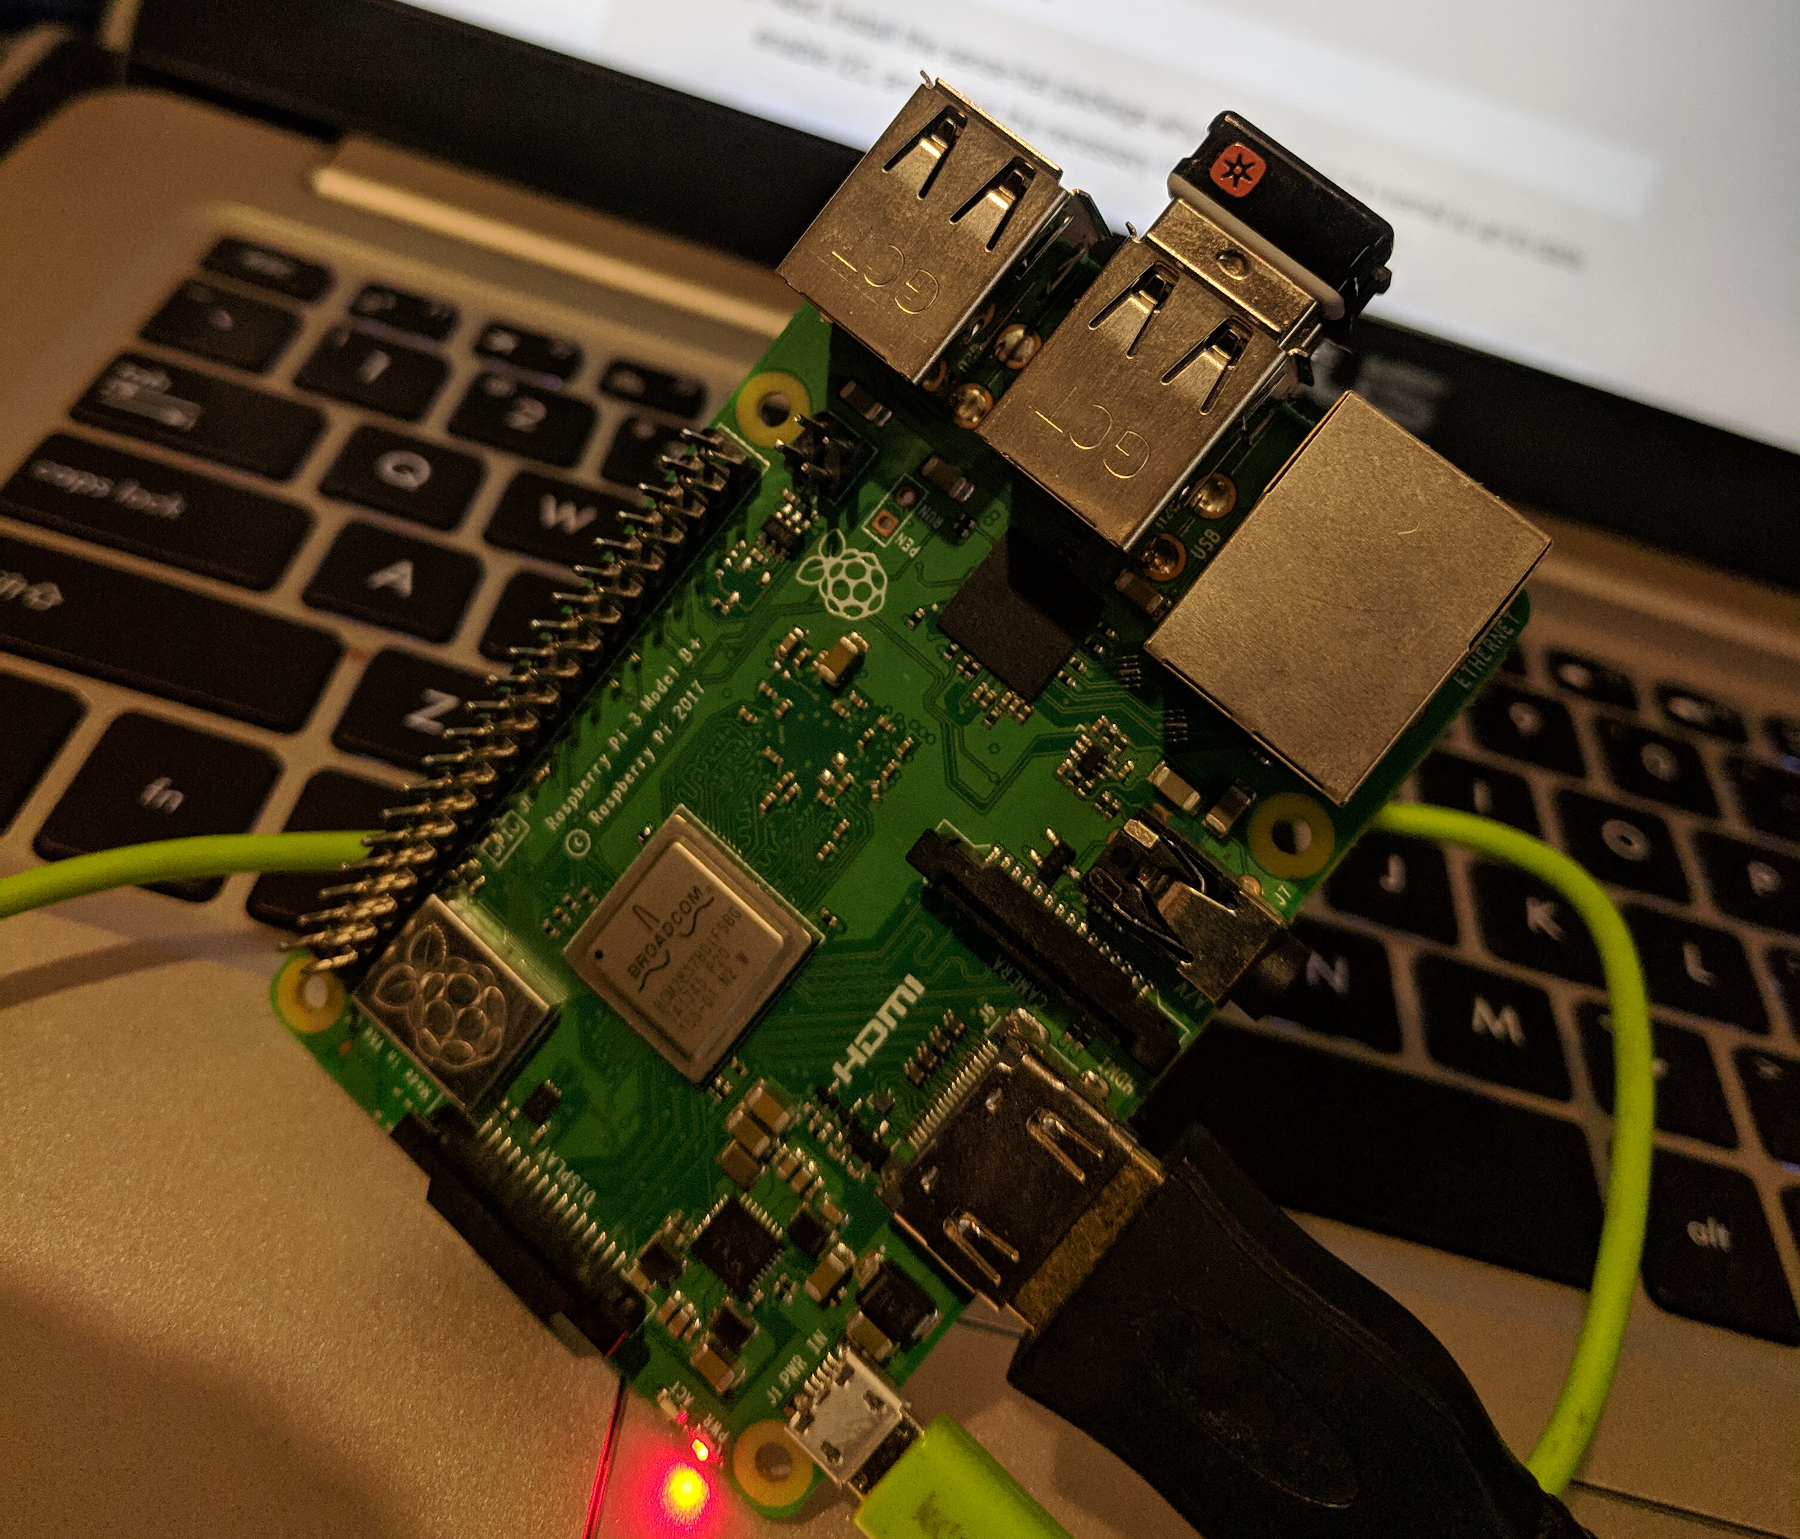
approach: getting connected
Notes:
The first challenge was to get the Raspberry Pi set up and connected to a monitor and keyboard, which was straightforward.
This is where I ran into one of the first hurdles – finding a workspace where I could connect it to develop on without taking up space in the lab. Thanks to Liz, I borrowed a monitor and keyboard, and set up in my dorm room in my nerd cave. Thank you!!!
Next challenge was getting the Pi on the network. This was pretty challenging, but I used some network sniffing tools like ifconfig to figure out the type of network that ANU-Secure was, and I was able to manually edit the network configuration file for the Rpi – wpa-supplicant, and get it on the network. Pretty proud of that.
However, I still couldn’t connect to it remotely, but I gave up on pursuing this because it would have taken too much time. There’s a bigger question there of whether the uni needs a dedicated IoT network – but, well, out of scope for this project.

Slide 15
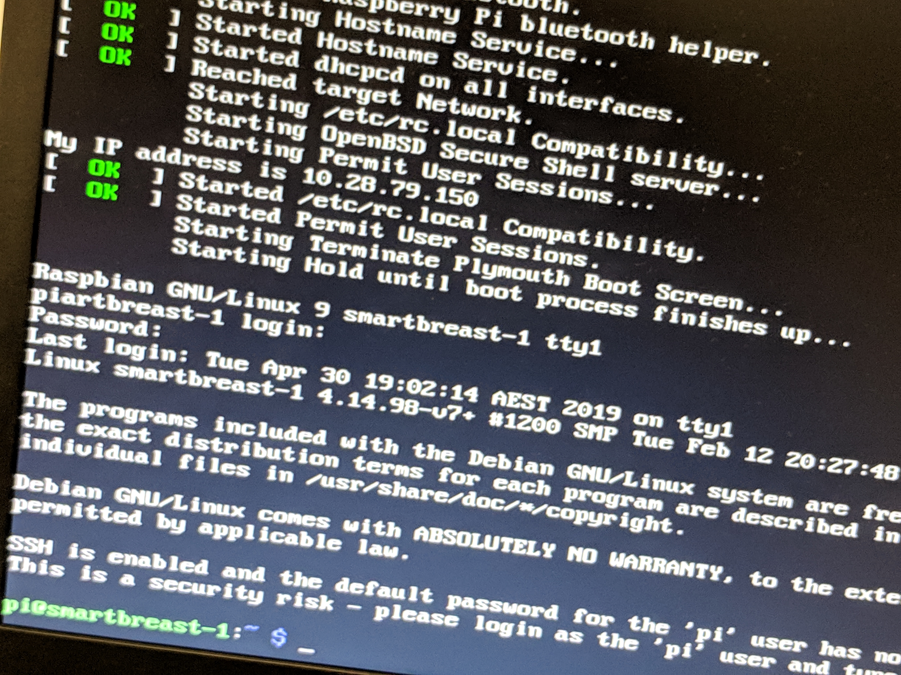
Notes:
So here’s a photo of me getting the Rpi on the wireless network, and here it’s telling me it’s IP address. This was a very happy moment on the project.

Slide 16
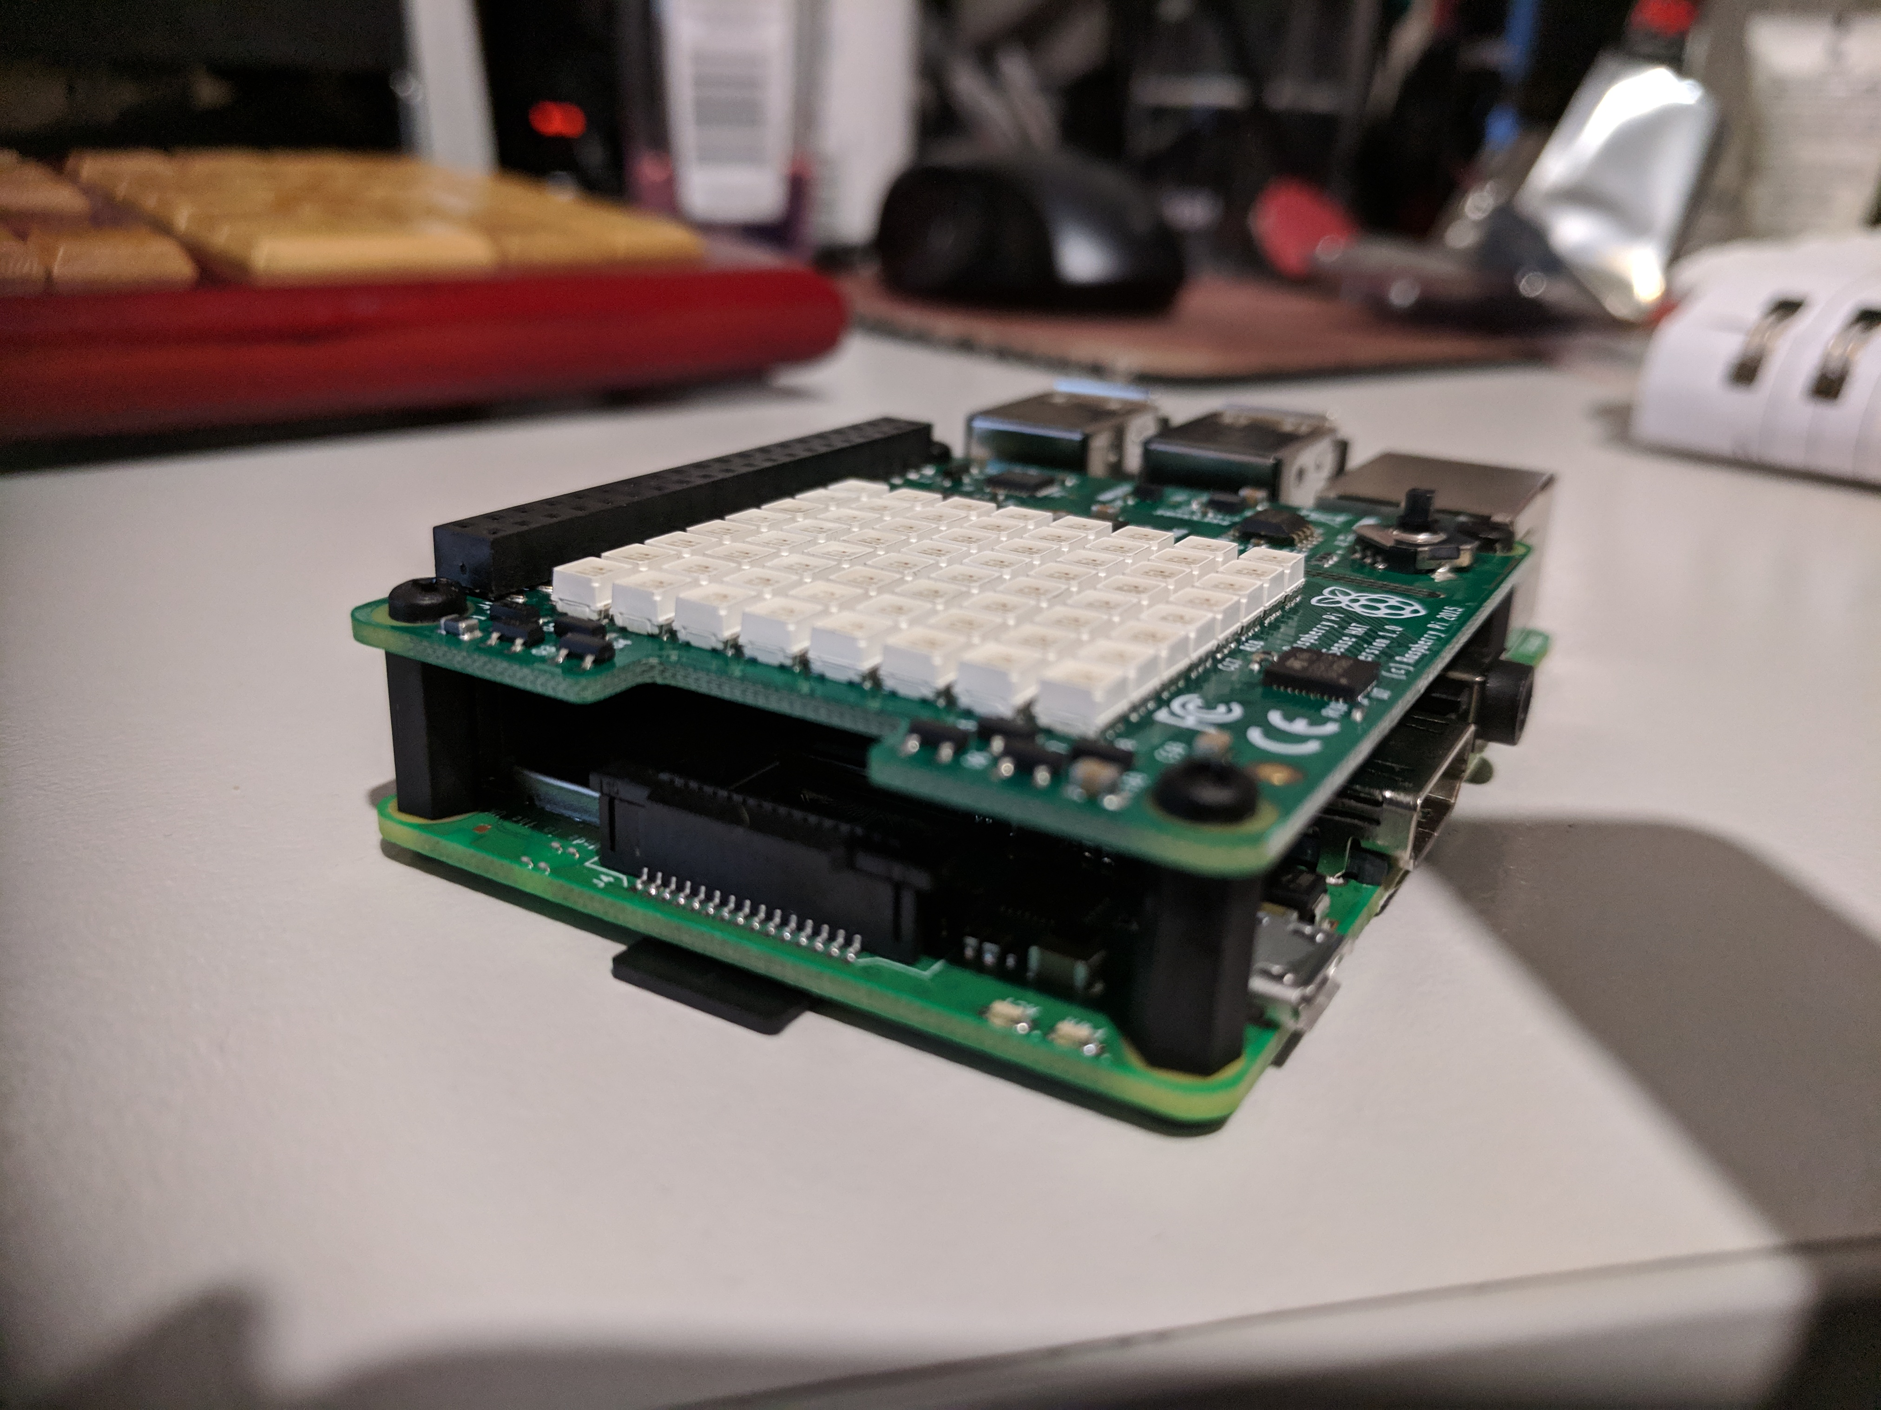
Notes:
Next, I needed to connect the SenseHAT to the Raspberry Pi. This was pretty straightforward, a bit fiddly, but I got there.

Slide 17
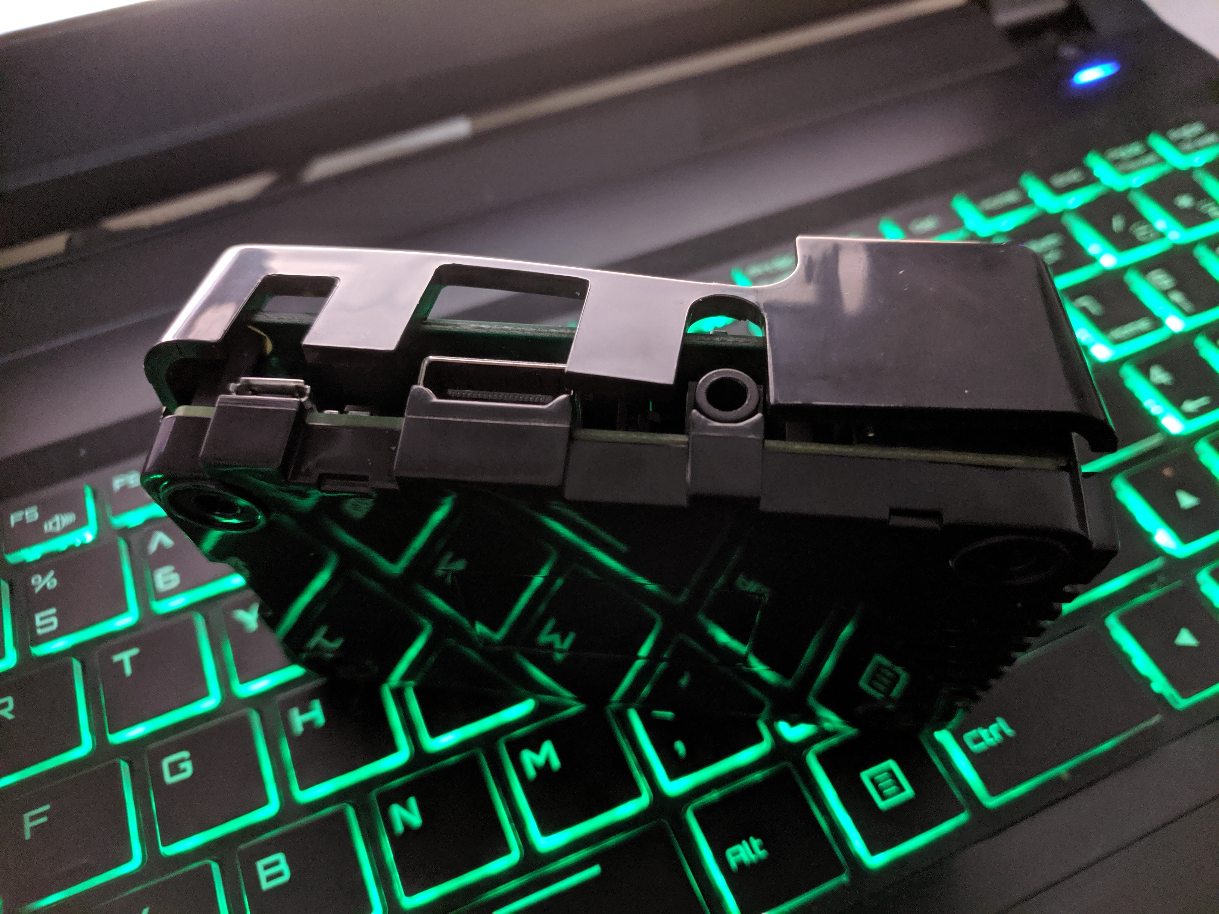
Notes:
I tried to put the SenseHat in the SenseHAT case.
And this didn’t end well. Not only did I break the case,
I also managed to ..

Slide 18
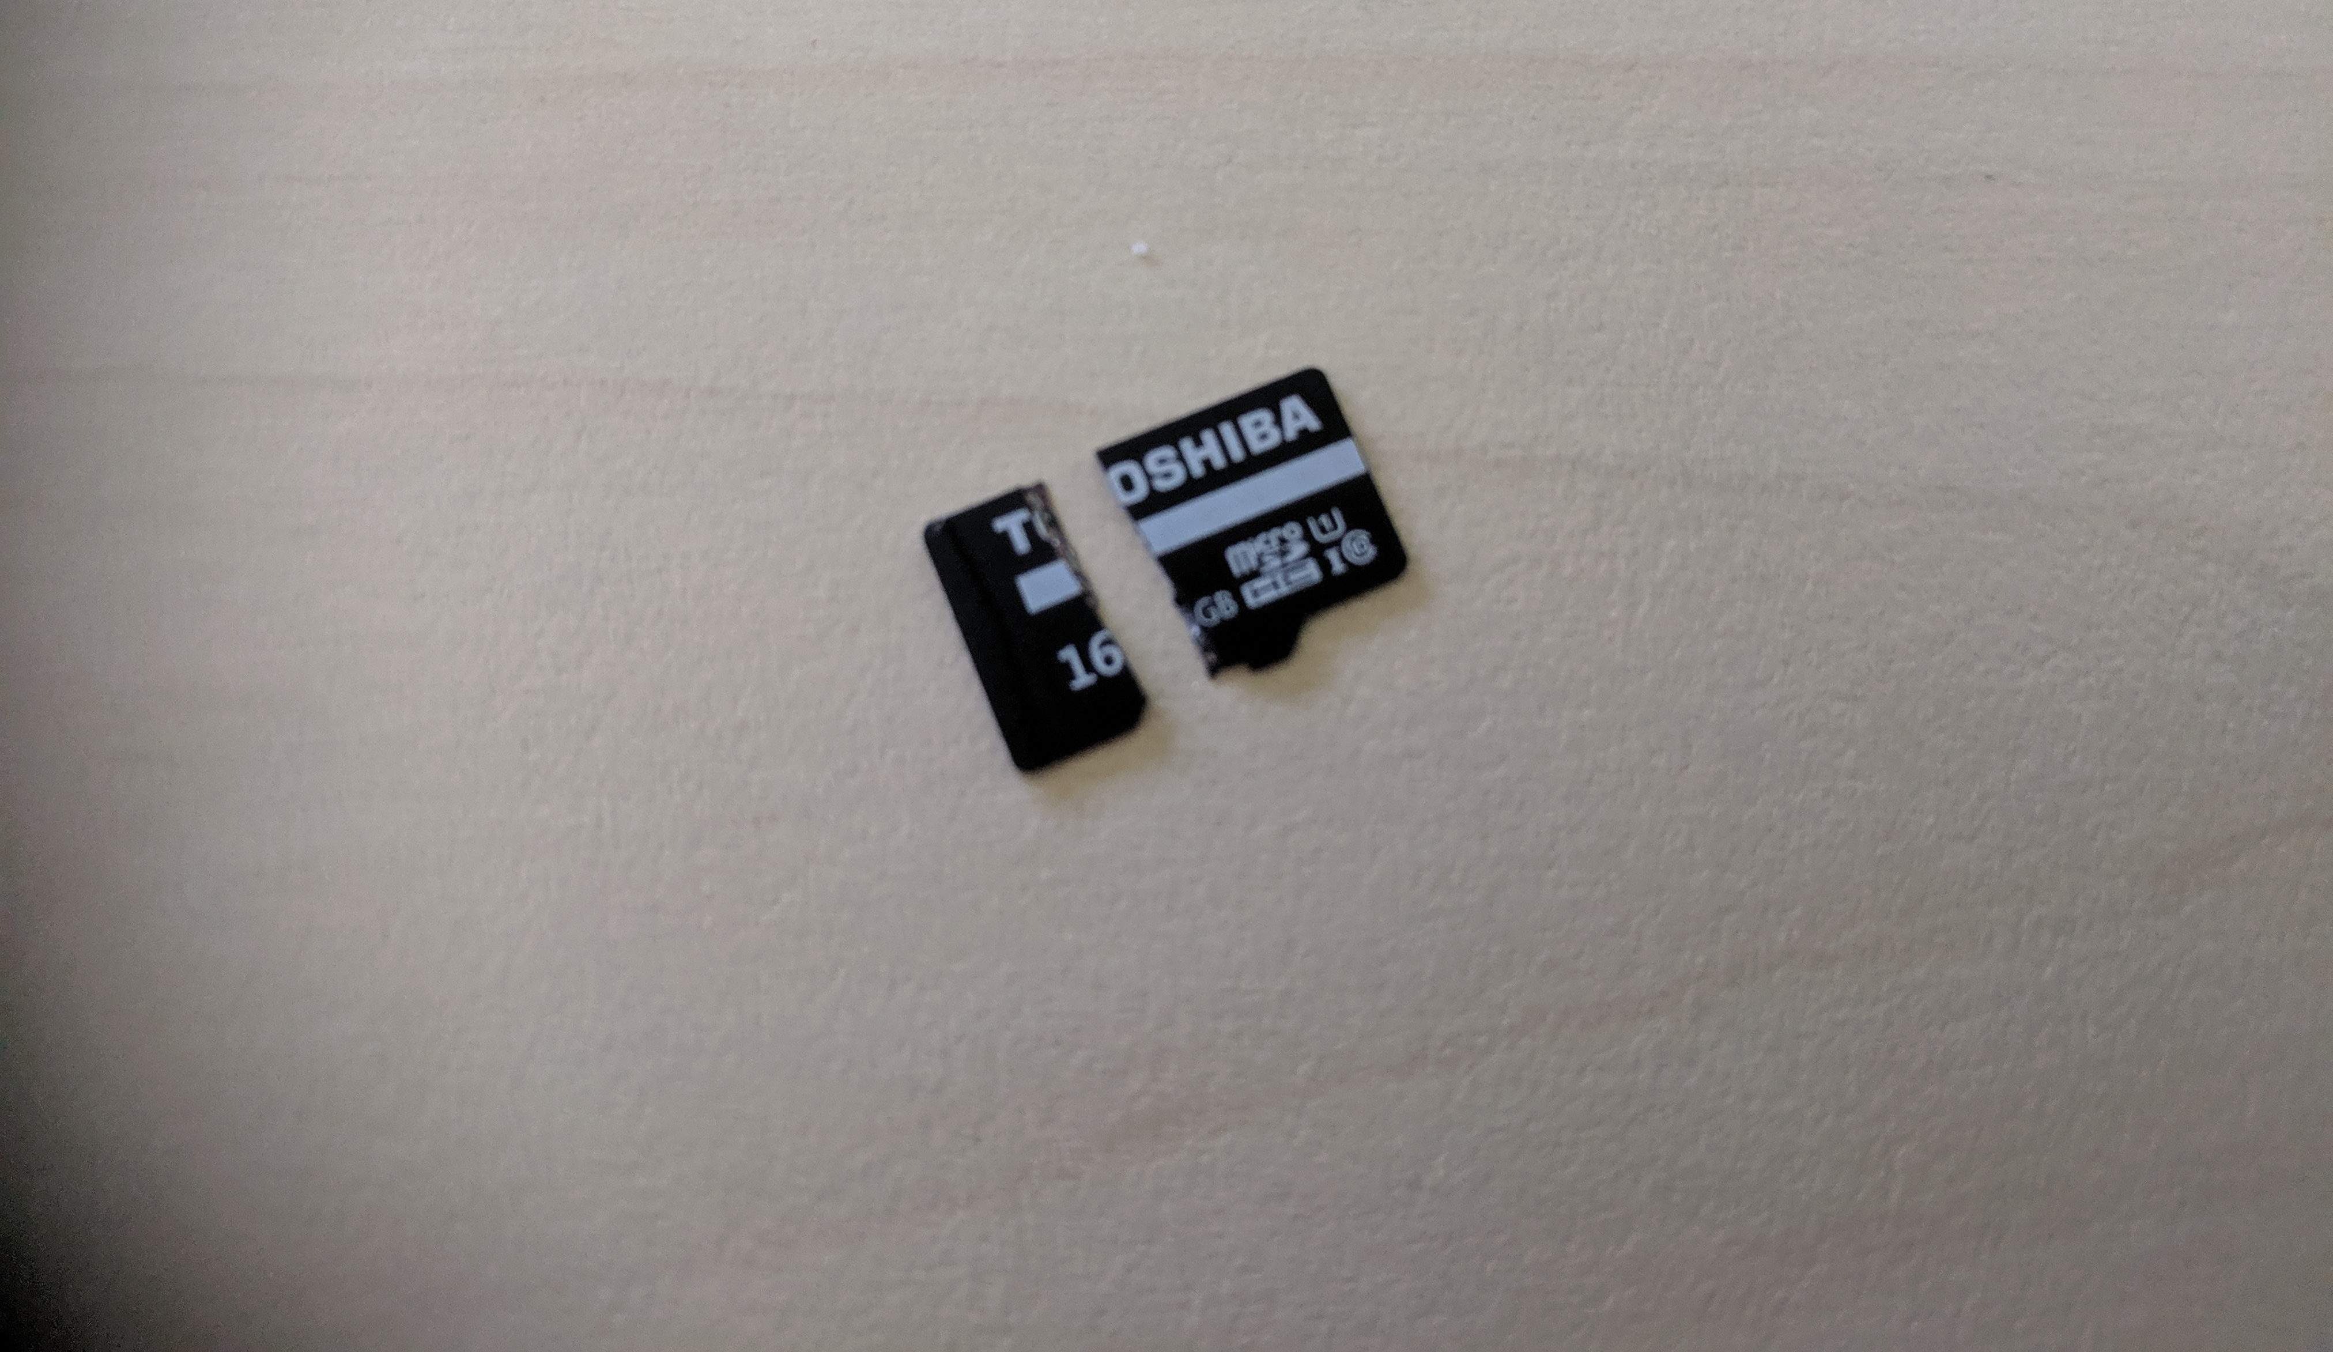
Notes:
Break my SD card in half
And here’s where I learned a key lesson – always git push.
I’d been really good about git committing my code, but I hadn’t git pushed back to GitLab so I lost about two days’ work.
This was OK though, because I’d been fairly good about documenting what I was doing and I was quickly able to redo it.
So again, a key lesson here is to always document what you’re doing comprehensively, in case you need to re-do any of it.

Slide 19
code (SenseHAT IMU) http://bit.ly/sensebreast
Notes:
I’m going to talk about some of the code rather than show it, because we don’t have time, but essentially there’s a python script which uses the IMU – the inertial motion unit within the senseHAT – that has a gyroscope, and accelerometer and a magnetometer, to take readings of movement. The IMU first had to be calibrated, which required installing a bunch of libraries, but I worked through that and got it calibrated oK.
The script runs for 5 minutes, and saves all the sensor data to a JSON file.
Then what I did was set up a cron job – a scheduled job – to run the script every 5 minutes – and what this gave me was essentially an independently operating device – it could boot up and start taking readings independently – which as a wearable device was a key milestone.

Slide 20
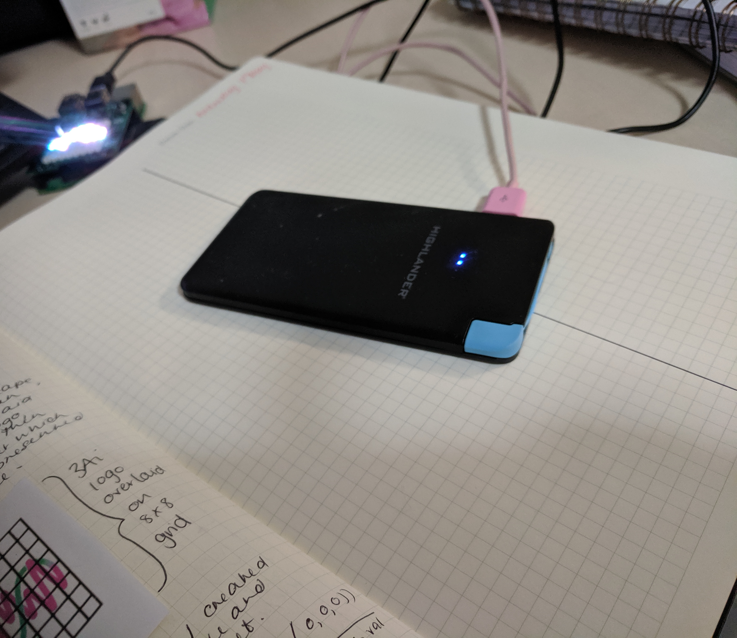
approach: acquiring power*
* not the political kind
Notes:
Getting connected to power turned out to be really simple, there is a tech vending machine in the health co-op building and I just swiped my credit card card and voila a flat form power bank.
I did some testing on this with the Rpi, and found it had about 7-8 hours of battery life, so reasonably fit for purpose for a prototype.

Slide 21
milestone: sensors working, data being gathered by an independently powered unit

Slide 22
approach (the physical)

Slide 23
Equipment
> 100g Pinkysil medical grade silicon
> 400g tub of acrylic texture renderer
> plastic case from a silicon breast form
> 1.5m of linen cloth
> paperclips
> PVA glue
> polystyrene foam
> sharp knife / Stanley knife
> alcohol (for drinking, not using) ;-)
Notes:
The next challenge was to build a breast form and a way to house the Rpi and the SenseHAT.

Slide 24
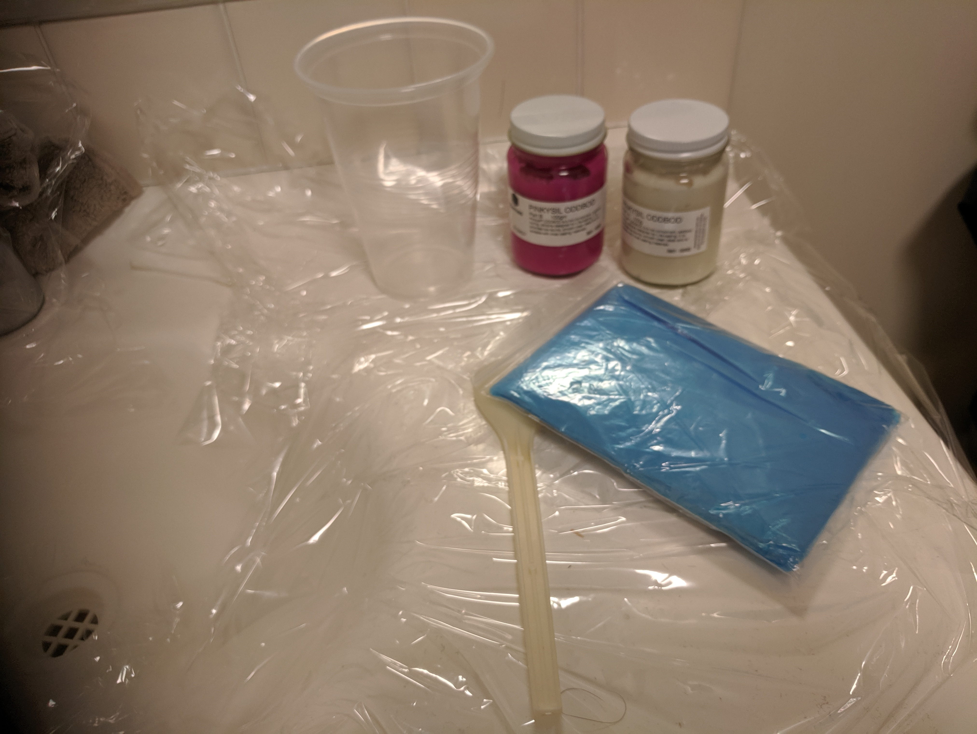
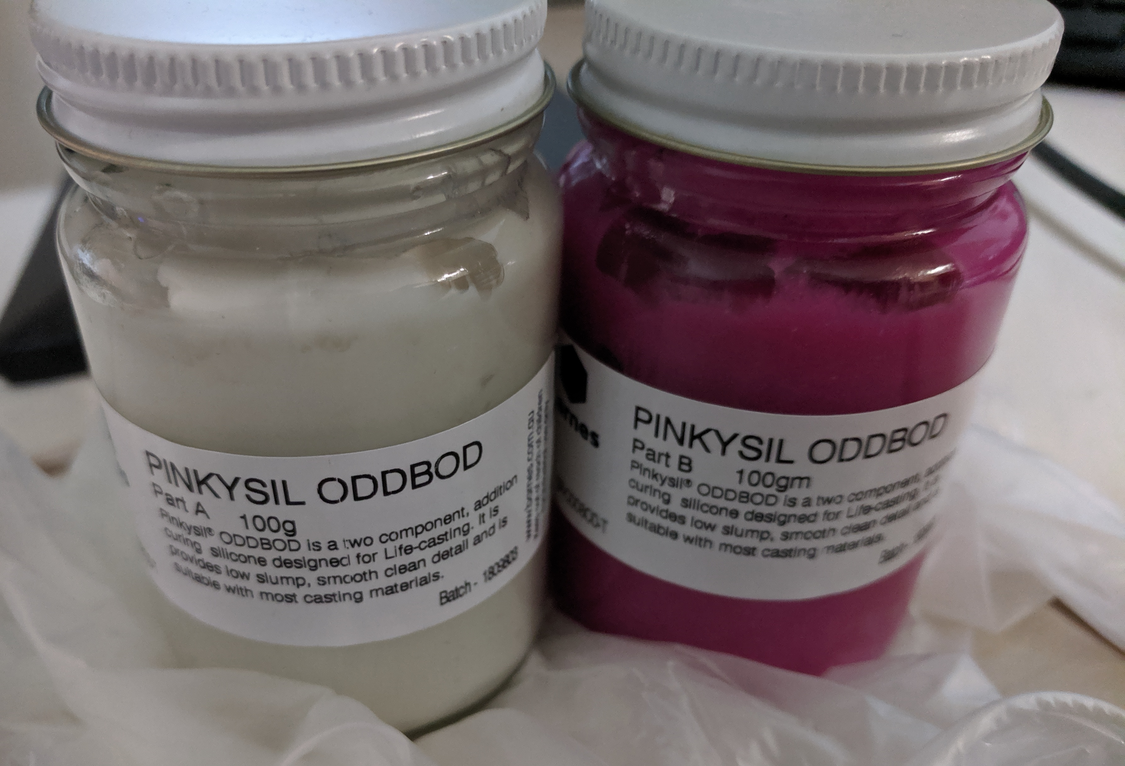
Notes:
My original plan was to take a silicon mould of my remaining breast, and use this to create a breast form to put the electronics into.
I want to give a special shout out to Felicity here who put me on to Pinkysil
I did take a mould, but this was really really tricky, and I didn’t have enough Pinkysil to get a good layer of silicon, so the silicon I did get was quite thin, and couldn’t be used for a mould.

Slide 25
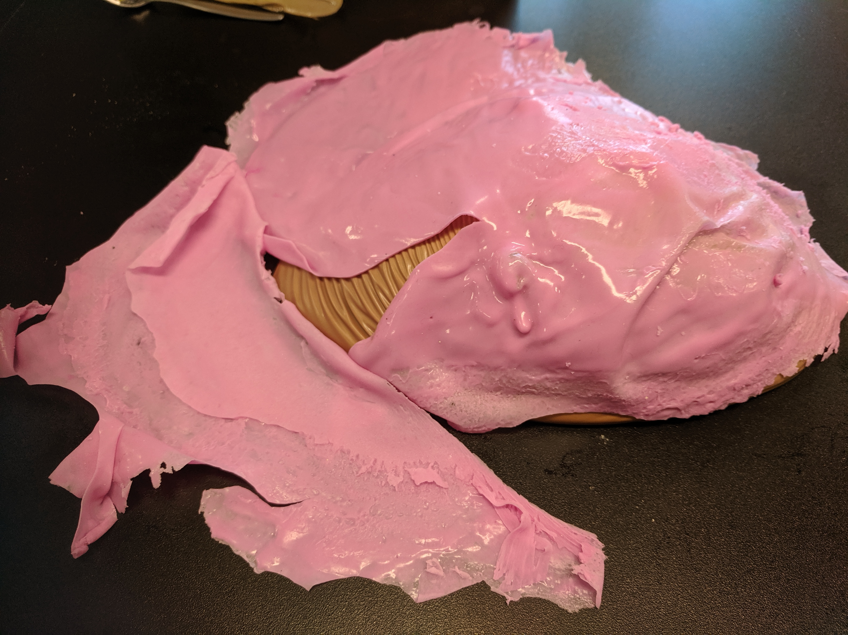

Slide 26
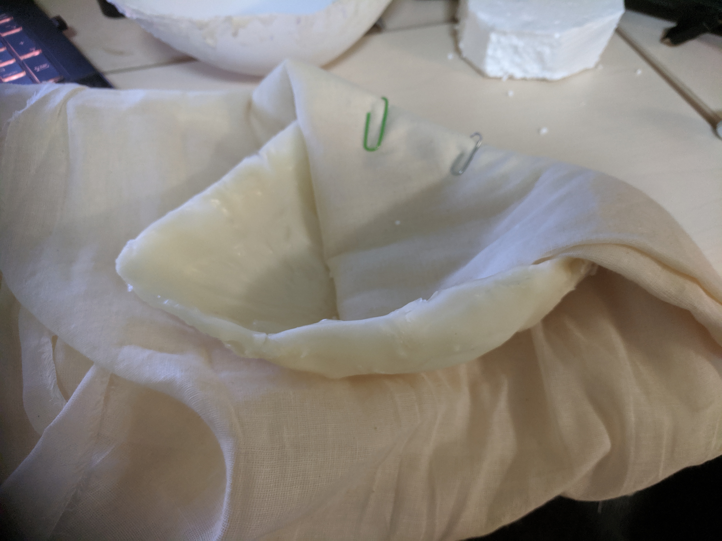
Notes:
So what I did instead was place the silicon sheet over the plastic cover from my breast form, and then layer acrylic texture over it in layers. Each layer took about 2-3 days to dry, so I slowly built it up over time.
It was a bit lumpy and bumpy, so I trimmed it up and then covered it in linen cloth using PVA glue fastened with paperclips, then when the glue dried, I removed the paperclips.
Then, I cut out a block of polystyrene foam in the shape of the Rpi SenseHAT, and popped it in.
The next test was to see if I could fit it in to a mastectomy bra, and as you can see here, it’s a good fit.
I’ve been wearing it for the past couple of days, did anyone notice?

Slide 27
milestone: housing complete for the Rpi 3b+ and SenseHAT

Slide 28
milestone: a minimum viable smart mastectomy prosthetic
(!!!!11!!!111!!!1!1!!!)

Slide 29
approach (the dataviz)

Slide 30
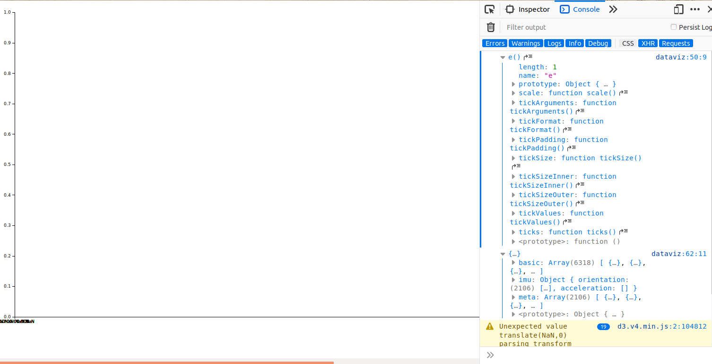

Slide 31
towards embodiment-driven development an evolution
Notes:
We’ve seen an evolution in programming paradigms over the years -
Test-driven development where tests are written to check functionality
Behaviour driven development where the actual behaviour of users is tested,
And I think we’re moving towards a third paradigm where we’re going to be developing systems around how much they’re embodied, how they’re assimilated and adopted physically – and I think the SenseBreast is a part of that – part of that embodiment driven development approach
Merleau-Pontey – phenomenology
Noel Crossley – embodied activities
Marget Locke – social body, body politic, biological body
Nancy Sheper-hughs
What does embodiment mean in a programming context
How is programming different? How is it differentiated from other activities – pharmaceuticals, prosthetics – differences b/w enhancement, augmentation, implantation, relationships, interfaces.

Slide 32
open source because to do otherwise would be acting against every value I hold
Notes:
I really want to make what I’ve done here open source so that others can benefit from the work that I’ve done.

Slide 33
every technology has a history. technologies are not just built, they are born. and reborn.

