Slide 1


Professional layout design with Scribus tutorial
Kathy Reid |@kathyreid
linux.conf.au 2020,
Gold Coast, Australia, January 2020

Slide 2
Some preliminaries
Acknowledgement of Country
Hi! I’m Kathy Reid. She/her. Cybernetics. Corgis.
Questions at any time are warmly welcomed.
All questions welcomed.
Assumed that you already have Scribus installed, and have downloaded the repo that contains all the files to your local machine
git clone URL to go in here

Slide 3

Why learn Scribus?
(and some basic
design principles)

Slide 4

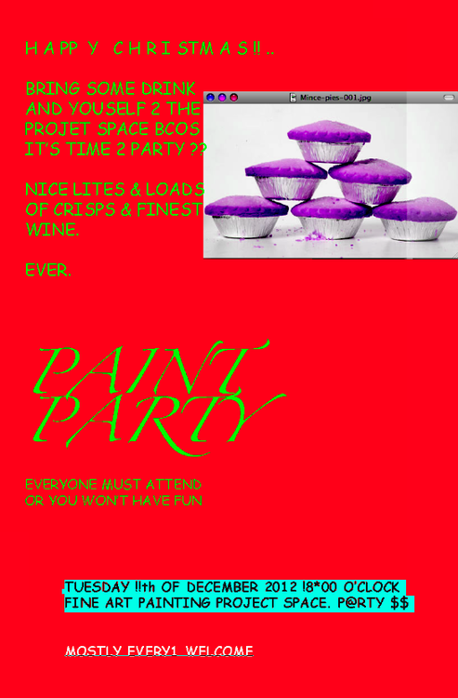

Slide 5
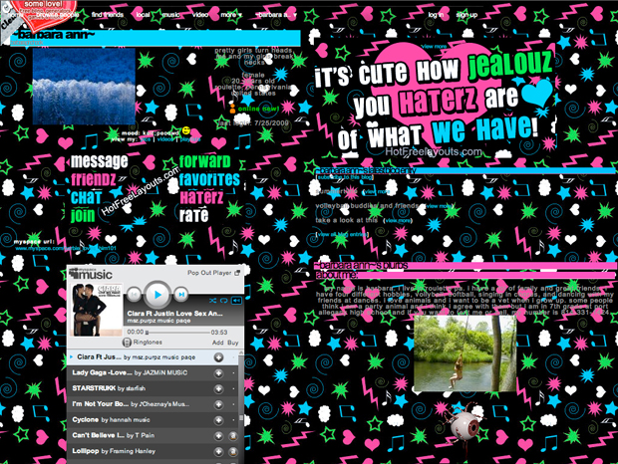

Slide 6


Slide 7
Present your information clearly, on brand
Professional appearance, high impact
Much cheaper than alternatives such as Publisher, InDesign etc
Principles and concepts learned here can be applied, ie. when using other applications
Why learn Scribus?

Slide 8

learning objectives
Learning outcomes

