Slide 1
CS-275 Project
Orders Managing Tool
Qinjianhong Yang & Kexin Han

Slide 2
Project Idea
Develope a set of tools to help manage restaurant orders;
Functions Completed: calculate price for each order, calculate change based on payment input value, display orders according to date input, calculate daily income
Functions in Development: insert order data into database, modify menu items

Slide 3
Current Difficulties
Need PHP knowledge to create scripts which can perform insert action from client side to server side;
Need to learn how to alter and delete a row in the database table using stored procedure;

Slide 4
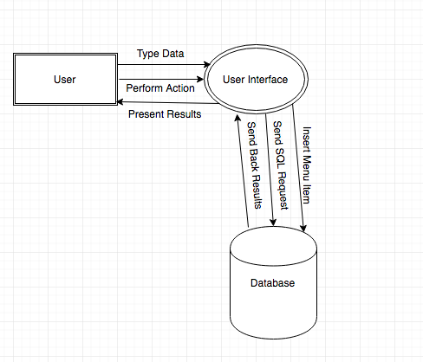
Information Flow Chart

Slide 5
Home Page Functionalities
Has two buttons directed to seperate html pages;
Has an image placed in the center of the page;
Using CSS code to create page style and manage components’ placement
https://www.cs.drexel.edu/~kh579/cs275/webApp1/final_proj.html

Slide 6
Menu Page Functionalities
Display items from a MySQL table named menu on the web page using Node.JS;
Has a dropdown list associated with each item in the table for quantity selection;
Calculate total price based on selected items and their quantity;
Using user typed payment value and total price to calculate the change needed;
https://www.cs.drexel.edu/~kh579/cs275/webApp1/menu.html

Slide 7
Orders Page Functionalities
Display orders’ information using the date value from user input;
Calculate the total income for the date entered by user;
https://www.cs.drexel.edu/~kh579/cs275/webApp1/orders.html

Slide 8
Lesson Learned
Using task tracking tools to keep development process following the planned schedule;
Modify goals and expectations when difficulties met;
Divided tasks based on individual skills and develop at the same time;

Slide 9
Future Enhancements
Generate a pop-up alert if the payment is less than the order amount due;
Adding user login to make sure only admin user can modify menu items;
Adding a home button on each page so that user can return to home page easily;
Using existed templates to make the pages more enjoyable and user friendly;

