Slide 1

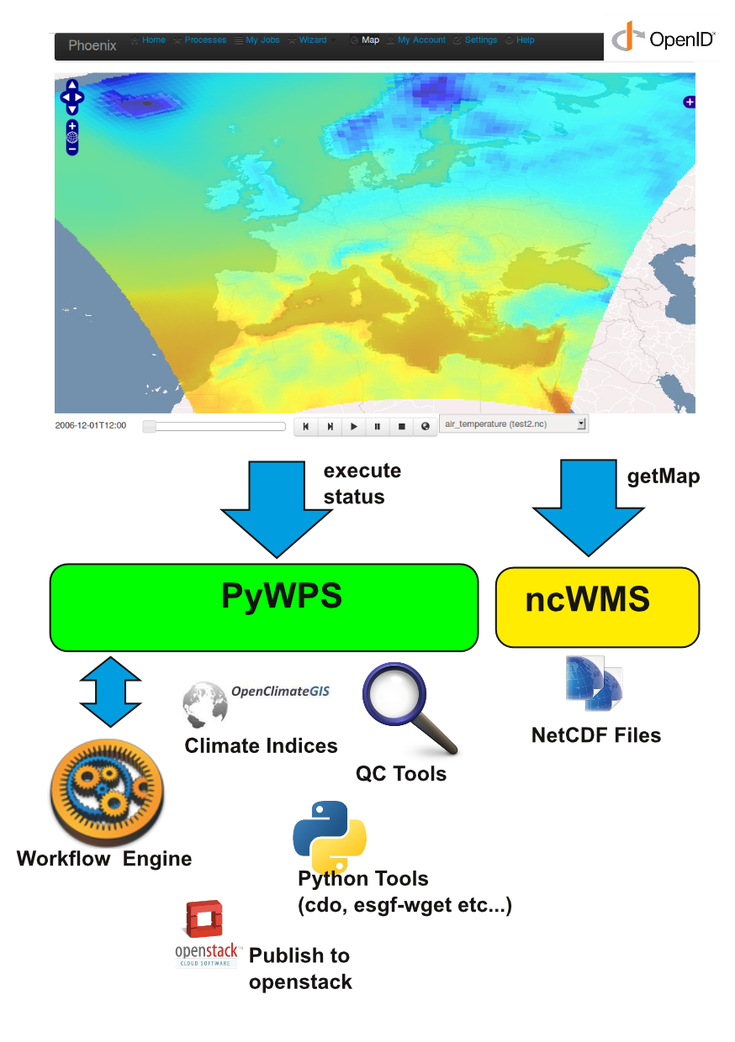

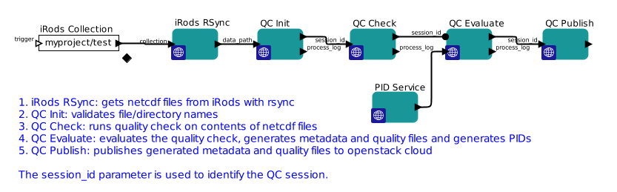
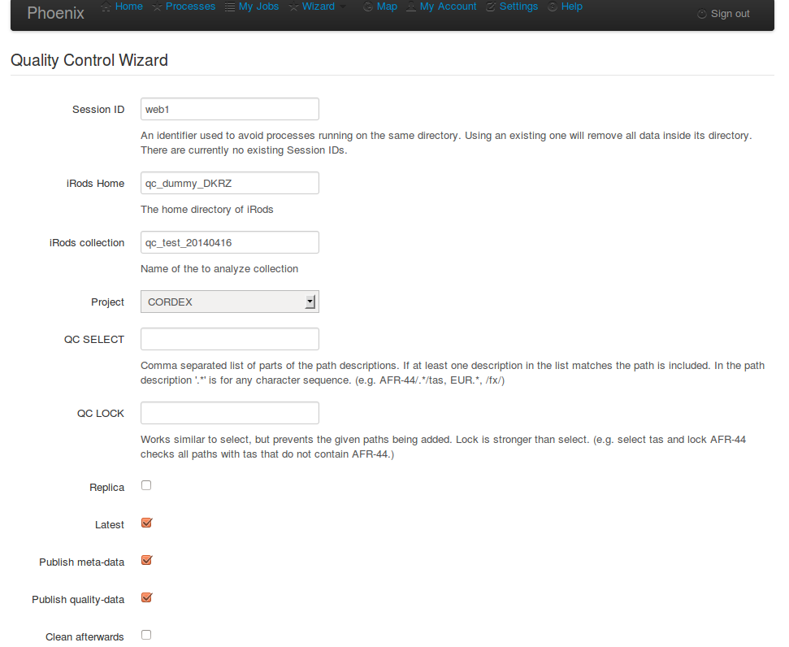
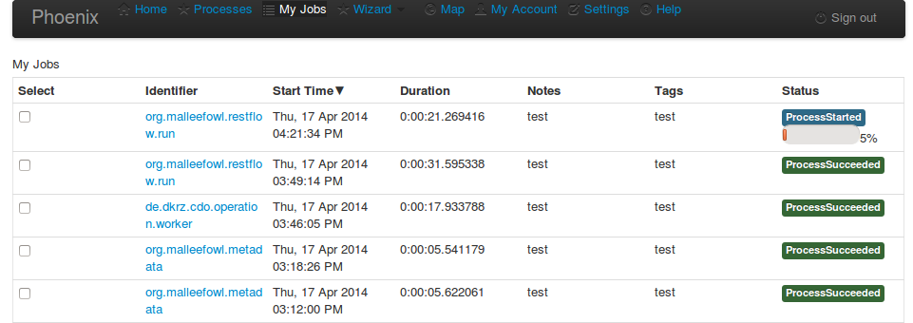
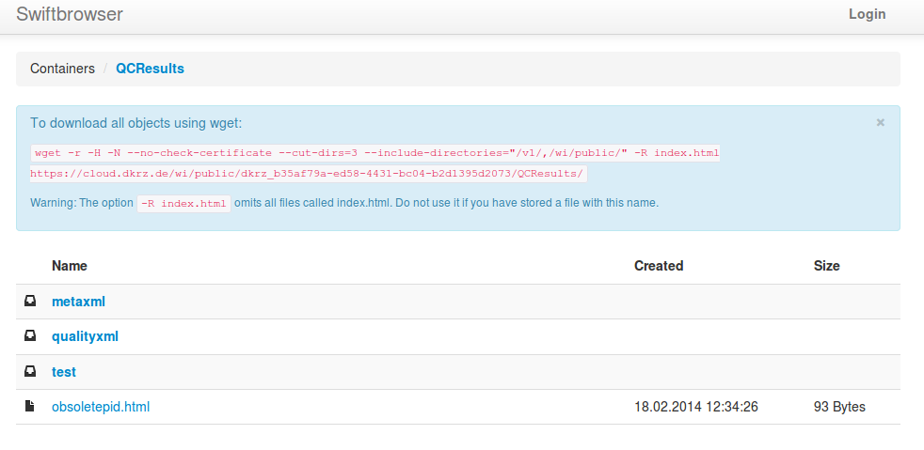
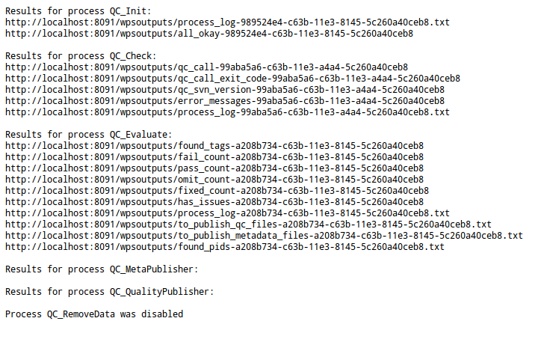
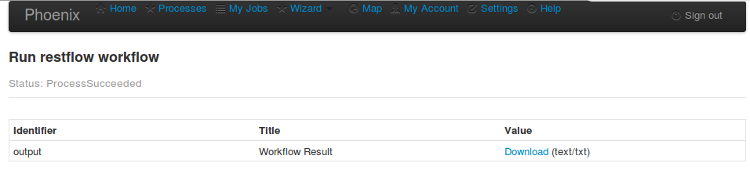
A geospatial data life cycle services framework C. Ehbrecht¹, J. Meyer², S. Kindermann¹, T. Kipp¹ 1) Deutsches Klimarechenzentrum DKRZ, Hamburg 2) Karlsruher Institut für Technologie KIT, Karlsruhe
Background / Motivation:
Support of end users in data life cycle management activities involving multiple distributed data centers
Data management activities are composed of a set of basic operations
Services are accessible to end users via GUIs as well as client tools
Services are discoverable and expose standardized interface descriptions
The Approach:
Basic data life cycle support operations are exposed as services by data centers
Services can be composed to build up complex data management activities (workflows)
A web framework supports users in invoking, composing and executing services / workflows
Services are exposed conforming to the OGC WPS standard.
The data services framework ClimDaPs:
Components of ClimDaPs:
Pyramid WPS WebClient with OpenLayers
PyWPS Web Processing Service
ncWMS Web Mapping Service for NetCDF files
Restflow Workflow Engine
Authentication with OpenID
Workflow Engine called as WPS Process/ Workflow calls other WPS Processes
Prototype available at http://mouflon.dkrz.de
A Concrete Use Case:
Data Generation and Publication for Regional Climate Model Data
Data generation:
Researcher copies initialization data from KIT to DKRZ
Researcher at KIT runs climate model at DKRZ
Researcher collects output at DKRZ storage resources
Data postprocessing:
Data scientist postprocesses data (at DKRZ)
Storage of data in standard format/layout
Quality Control of Data
Data quality check software is run at Data Center
Quality check results are communicated for review
To successfully checked data persistent identifiers (PIDs) are assigned
Data Publication
Data is published to a worldwide data federation portal at DKRZ
Data is visible and accessible via any of the ESGF portals worldwide
Data Archival
Important parts of published data are archived
Close collaboration necessary between Researcher and Data Scientist
(coming from different institutions)
Large variety of services and tools are involved in this collaboration
Services available via ClimDaPs by now:
Low level (meta-)data operations:
ISO 19139 and ESGF solr metadata generation
iRods based data transfer and synchronization
Handle system based persistent identifier assignment
and retrieval for single data products and data aggregations
Publication of results on an OpenStack storage cloud
Higher level operations:
Cordex data quality checking
CDO based climate data processing
Calculation of climate indices
Calculation of species distribution
Complex workflows:
Cordex data quality control and quality result publication
GIF Animations of NetCDF files via ncWMS Mapping Serivce
Next / Open Issues
Security infrastructure
Discovery and semantic service description
…..
Project / Funding context:
Current development and application to concrete use cases is funded within the Helmholtz LSDMA project
Work on a scalable WPS based data quality processing infrastructure is supported by the ExArch G8 project.
Development and consistent deployment of WPS services at European data centers is supported by the IS-ENES2 FP7 project
Early ClimDaps service and framework developments were supported by the German C3-Grid-INAD project.
SM1.3/ESSI2.14/GD8.7/GI1.6/GMPV56/TS1.5

